Slide 1
Disney World

Slide 2
Intro

Slide 3
Business case
Recht naar de resultaten gaan: wat hebben we gevonden?
Storytelling:
Dataset aangevuld met “”, voorspeld op basis van posted waiting timesestimated actuele data
Deze voorspelde data geanalyseerd voor een aantal use cases
Waarom zijn de waiting times bijzonder kort / lang voor bepaalde attracties?
Zit er evolutie in, langere/kortere wachttijd doorheen de tijd?
Zijn er attracties met lange waiting times die nog geen fast pass hebben?
Zijn er attracties die wel en fast pass hebben maar eigenlijk geen lange waiting times?
Suggesties doen om waiting times te verbeteren, vb nieuwe attracties van een heel populaire soort, andere problemen die we gezien hebben oplossen etc.

Slide 4
Meer gedetailleerd ons werk toelichten
Preprocessing
Modelling
Plotten -> meer ingewikkelde plots hier tonen, zoals ROC, AUC

Slide 5
Estimating the waiting times
Ratio actual over posted
Predict ratios with model
Estimate waiting times

Slide 6
Estimating the waiting times
Ratio actual over posted

Slide 7
Calculate actual over posted ratio
attraction | date | minute | SACTMIN | SPOSTMIN | SPOSTMIN_interp | actual_over_posted
7_dwarfs_train | 01/01/2015 | 471 |  | 45.0 | 45.0
7_dwarfs_train | 01/01/2015 | 482 |  | 60.0 | 60.0
7_dwarfs_train | 01/01/2015 | 485 | 54.0 |  | 60.0 | 0.9
7_dwarfs_train | 01/01/2015 | 489 |  | 60.0 | 60.0
7_dwarfs_train | 01/01/2015 | 496 |  | 60.0 | 60.0
7_dwarfs_train | 01/01/2015 | 502 | 55.0 |  | 60.0 | 0.9167
7_dwarfs_train | 01/01/2015 | 503 |  | 60.0 | 60.0
7_dwarfs_train | 01/01/2015 | 509 |  | 60.0 | 60.0
??
Interpolate
??
Interpolate

Slide 8
Calculate actual over posted ratio
attraction | date | minute | SACTMIN | SPOSTMIN | SPOSTMIN_interp | actual_over_posted
7_dwarfs_train | 01/01/2015 | 471 |  | 45.0 | 45.0
7_dwarfs_train | 01/01/2015 | 482 |  | 60.0 | 60.0
7_dwarfs_train | 01/01/2015 | 485 | 54.0 |  | 60.0 | 0.9
7_dwarfs_train | 01/01/2015 | 489 |  | 60.0 | 60.0
7_dwarfs_train | 01/01/2015 | 496 |  | 60.0 | 60.0
7_dwarfs_train | 01/01/2015 | 502 | 55.0 |  | 60.0 | 0.9167
7_dwarfs_train | 01/01/2015 | 503 |  | 60.0 | 60.0
7_dwarfs_train | 01/01/2015 | 509 |  | 60.0 | 60.0
Ratio = 54.0 / 60.0
Ratio = 55.0 / 60.0

Slide 9
Calculate actual over posted ratio
FEATURES
TARGET
attraction | date | minute | SACTMIN | SPOSTMIN | SPOSTMIN_interp | actual_over_posted
7_dwarfs_train | 01/01/2015 | 471 |  | 45.0 | 45.0
7_dwarfs_train | 01/01/2015 | 482 |  | 60.0 | 60.0
7_dwarfs_train | 01/01/2015 | 485 | 54.0 |  | 60.0 | 0.9
7_dwarfs_train | 01/01/2015 | 489 |  | 60.0 | 60.0
7_dwarfs_train | 01/01/2015 | 496 |  | 60.0 | 60.0
7_dwarfs_train | 01/01/2015 | 502 | 55.0 |  | 60.0 | 0.9167
7_dwarfs_train | 01/01/2015 | 503 |  | 60.0 | 60.0
7_dwarfs_train | 01/01/2015 | 509 |  | 60.0 | 60.0

Slide 10
Estimating the waiting times
Ratio actual over posted
Predict ratios with model

Slide 11
Model training
attraction | year | month | day | minute | day_of_week | week_of_year | quarter | day_of_year | is_weekend | actual_over_posted
pirates_of_caribbean | 2017 | 6 | 2 | 458 | 4 | 22 | 2 | 153 | 0 | 1.025
laugh_floor | 2015 | 5 | 31 | 573 | 6 | 22 | 2 | 151 | 1 | 1.8
tom_land_speedway | 2018 | 10 | 10 | 655 | 2 | 41 | 4 | 283 | 0 | 0.72
buzz_lightyear | 2016 | 4 | 23 | 236 | 5 | 16 | 2 | 114 | 1 | 2.0
flight_of_passage | 2020 | 12 | 29 | 896 | 1 | 53 | 4 | 364 | 0 | 0.925

Slide 12
Model training
Linear regression model
MAE : 0.29
RMSE : 0.43

Slide 13
Estimating the waiting times
Ratio actual over posted
Predict ratios with model
Estimate waiting times

Slide 14
Calculate predicted waiting times
attraction | year | month | etc… | minute | SPOSTMIN
it_s_a_small_world | 2018 | 7 | … | 0 | 0.0
buzz_lightyear | 2017 | 6 | … | 1620 | 5.0
under_the_sea | 2016 | 1 | … | 1200 | 10.0
jungle_cruise | 2021 | 10 | … | 1620 | 20.0
toy_story_mania | 2021 | 8 | … | 1140 | 20.0
predicted_ratio
0.65
0.61
0.66
0.73
0.69
predicted_actual_time
0.0
3.03
6.57
14.65
13.85
x
=

Slide 15
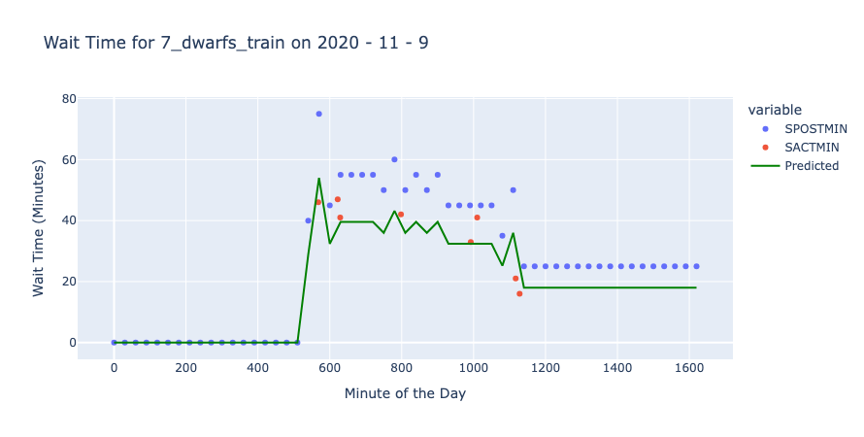

Slide 16
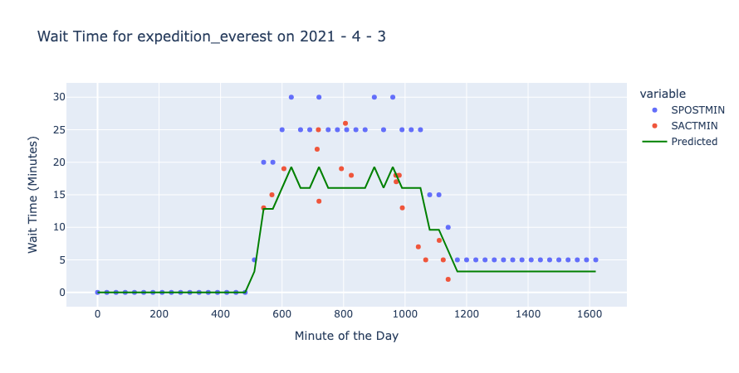

Slide 17
