Slide 1
Unveiling Insights from Amazon US Transactional Data
Zuru
DS Task
Isabel Body

Slide 2
Key Questions
Does the gender and age of a customer affect sales?
Does the time of year affect sales?
Does the category of an item affect sales?

Slide 3
number of units bought
category of the item
age of the customer
month of the purchase
70%
of changes in sales can explained by:

Slide 4
What are we looking at?
Sales: the amount of money spent in a transaction.
A purchase’s
A customer’s
date
category
number of units bought
age
gender
and how they interact together to affect sales.

Slide 5
combined data
each user has made one transaction.

Slide 6
Interpreting Date
Sales Data
Sales data is seasonal.
Let’s look at month to understand how seasons affect our data.

Slide 7
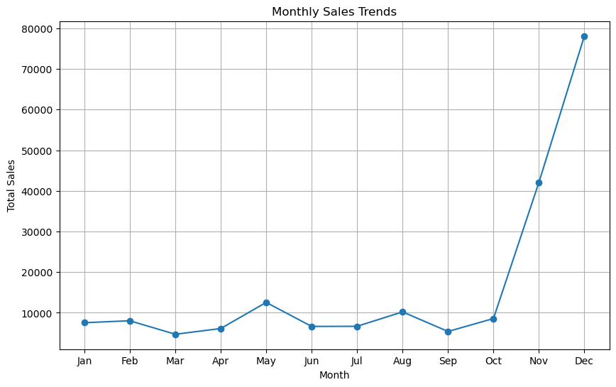
Which months are the most impactful on our sales?
November and December lead to the biggest increases in sales.

Slide 8
November and December’s Affect on Sales
Monthly Analysis
In November, sales are expected to increase by approximately 152.52%, and in December, sales are expected to increase by approximately 150.30% compared to other months.
*we can expect December to be higher than November, with results driven by another factor

Slide 9


Why are November and December effective sales months?
Monthly Analysis
Christmas
Black Friday
Indicates people are sales-driven (Black Friday) or driven to buy for other people (Christmas).

Slide 10
Item categories
Sales Data
restricted to:
beauty
electronic
clothing

Slide 11
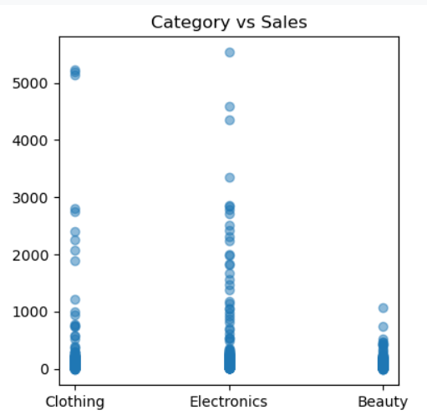
Which categories are the most impactful on our sales?
Electronics has a much wider range of sales prices.
Beauty products sales are generally below $1000.

Slide 12
Electronic item’s effect on sales
Category Analysis
Sales of electronic items are expected to be approximately 68.51% higher than other categories.

Slide 13
Key age groups
Customer Data
Young Adults
Young Professionals
18 - 24 year olds
25 - 34 year olds
Established Professionals
Middle-Aged
Pre-Retirement
35 - 44 year olds
45 - 54 year olds
55+ year olds

Slide 14
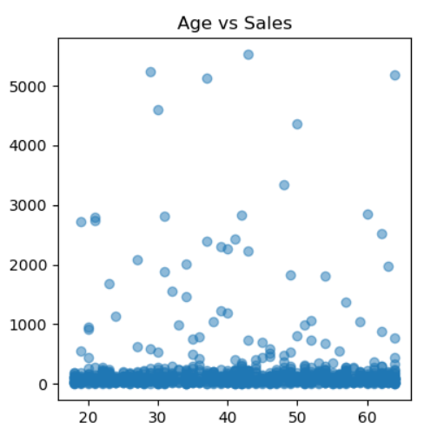
Does age affect sales?
It doesn’t appear that any particular age is very impactful on sales, and no statistical evidence of a relationship was found.
At this stage, your domain understanding of interactive relationships will be of higher value.
*For example, in the beauty industry makeup products may be popular with young girls, and skincare products may be with older women. My modelling is not yet at the standard of representing these complex relationships

Slide 15
note on gender
Customer Data
for the sake of analysis gender will be represented as male or female.

Slide 16
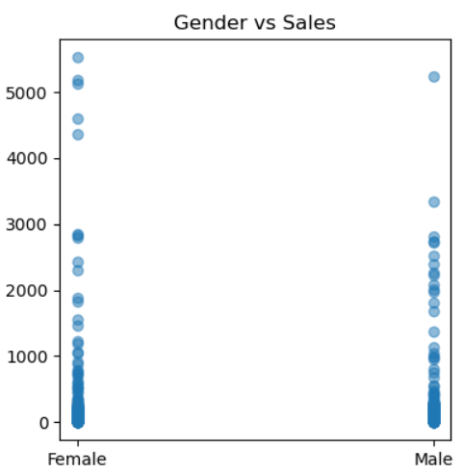
Does gender affect sales?
Gender also does not appear to have a relationship with sales.
At this stage, your domain understanding of interactive relationships will be of higher value.
*For example, in the beauty industry makeup products may be popular with young girls, and skincare products may be with older women. My modelling is not yet at the standard of representing these complex relationships

Slide 17
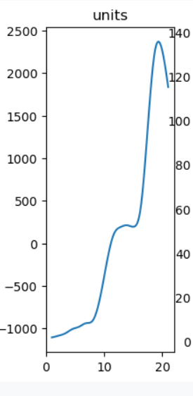
How the number of units bought affect sales:
You know that as units increase, sales will increase.
For every one-unit increase in units sold, we expect sales to increase by approximately 148.83%.

Slide 18
Be Careful: it’s not all about units
For every time you double the number of units sold, the increase in sales is about 32.36%.
Diminishing returns:
While selling more units is great for sales, there comes a point where each additional unit sold doesn't have as big of an impact on increasing sales as it did before. (increasing at a decreasing rate)
Why? Potentially, in very large orders customers are likely to choose cheaper items.

Slide 19
Thank you for listening!
Zuru
DS Task
Isabel Body
Any questions?

