Slide 1
Introduction to TensorFlow
Hackathon 2018
Part 1 – The basics

Slide 2
What is TensorFlow?
Software library for numerical computation
… but wait, why not just use Numpy?
Notes:
So, what is tensorflow?
It is a library for numerical computation. It can be used from python, c++, java and go. We are going to focus on the python API for this hackathon.
So why should we use TensorFlow rather than Numpy to do numerical computations?

Slide 3
TensorFlow vs Numpy
Easier to run on GPUs
Notes:
The first advantage is that it makes it much easier to run the code on GPUs

Slide 4
TensorFlow vs Numpy
Numpy:
Expensive computations are done outside of python
Problem:
Overhead for switching in and out of python for every operation.
TensorFlow:
Sets of interacting operations that can be run all outside of python.
Notes:
The first reason is that numpy does the expensive calculations outside of python using other efficient code. However, there can be considerable overhead in switching in and out of python.
Tensorflow tries to avoid this overhead by constructing a set of interacting operations and then running all of them outside of python. It does this by using data flow graphs.

Slide 5
Data Flow Graphs
Representations of the data dependencies between a number of operations
ADD EXAMPLE PSEUDO CODE
Notes:
Data flow graphs are representations of data dependencies between a number of different operations.
That may sound quite confusing, I was pretty confused the first time I went through it. So here is a small example of what this means.
If we wanted to sum two numbers A and B and then subtract C, the data flow graph would look like this.
So you see that you can only compute the “subtract” operation AFTER you have done the sum.

Slide 6
The Basics
There are 2 main parts to a TensorFlow program:
Building the graph
Running the graph
Notes:
So, in order to do some calculations in Tensorflow, there are two main things that you need to do. The first one is building the data flow graph that we talked about in the previous slide.
You have to construct all the operation dependencies. So, for the example of the previous slide you’d have to say “First I want to do an addition between two numbers and then I want to subtract another number from that sum”.
The second part is to run the graph. This means saying, Number A is 1, number B is 5 and number C is 10. Compute the result.
It is really important to understand that the graph on its own does nothing. It’s like an empty plumbing system. To make something happen you have to add the water which is your data.
Now we are going to go through each part in detail with some examples. So if it is not too clear yet, don’t worry, the next bit should help you.

Slide 7
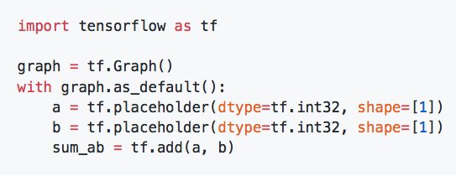
Building the Graph
Give a name to the graph
Notes:
The first step is to give a name to the graph that you are about to construct. If you have only one graph that you want to construct, then you could skip these two lines as everything would just go into the “default graph”. However, just to make you aware that every operation is associated with a particular graph, I thought it would be good to include this here in the example.

Slide 8
Building the Graph
Say what shape and type your data will be
Notes:
Place holders are the parts of your graph that stand where your data is going to come in. You need to specify the type and the shape of the data that will be used.
In this case we have two integer scalars

Slide 9
Building the Graph
Define the operations that you want to have
Notes:
Then, once you have your place holders defining what the data will look like, you can start building all the operations.
In this case we have the sum between two numbers.

Slide 10

Running the Graph
Define a session
Notes:
In order to run the graph, we need to create a session. This is a confusing concept when you first encounter tensorflow. The graph on its own does nothing, it's basically just a route map of where the data needs to go. Things are only computed within the session.
So, here we call our tensorflow session “Sess”
If you don’t specify which graph to run, it will just use the default graph.

Slide 11
Running the Graph
Run the operations
Notes:
To obtain the result, you need to feed some data to the graph. In this case, we can feed the numbers "1" and "2" and obtain their sum as a result.
This is the end of the super basic part of the workshop.

Slide 12
Introduction to TensorFlow
Hackathon 2018
Part 2 – Building on the basics

Slide 13
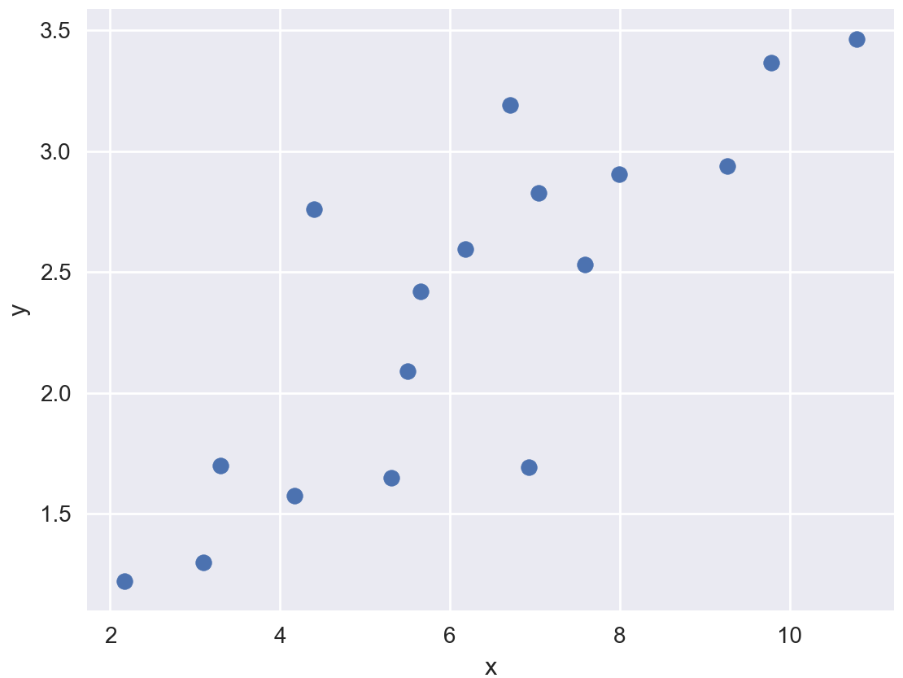

Linear Regression
$$y=mx+c$$
Notes:
Now that we have learnt how to do sums and very basic things, we are going to look at an example that is a bit closer to a neural network.
To bring everyone up to speed, do do linear regression, you have some points and you want to find the line of best fit. The equation for the line is y = mx + c, where m is the slope and c is the intercept.
So, you start with a random value of m and c. You want all these black distances to be as small as possible. How can we express “I want to make all these lines as small as possible” in a mathematical way?

Slide 14
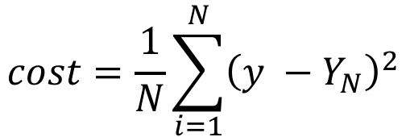
Linear Regression
Cost function:
$$cost=\frac{1}{N}\sum_{i=1}^{N}{{\left(y −Y_{N}\right)}^{2}}$$
Number of data points
Notes:
We define a function which is an average of the length of all the lines, and we call it the cost function. Y is the orange value and YN is the data point value. In this case, I use the square error function, but this could be another function.
Now, we want to choose the slope and the intercept of the orange line in such a way that this cost function is smallest. So we minimise this function with respect to (m, c)

Slide 15
Linear Regression
$$y=mx+c$$
Notes:
So then the values of m and c that give the smallest value of the cost function give this line that fits best the data.
Now we are going to do that with tensorflow. You want to look at the “linear_regression.py” script.

Slide 16
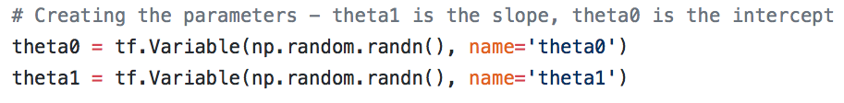
Linear regression
TF variable:
A tensor whose value can be modified by running operations on it.
Notes:
We are going to introduce a few more concepts with the linear regression example.
As you can see, we still have the part where you create the graph and where you create the session and run the operations. This time I didn’t specify in which graph the operations go, so they all go in the default graph.
A new thing that we havent encountered yet are tensorflow variables.
A variable is a tensor whose value can be modified by running operations on it. So in this case, the slope and the intercept of the line are variables because we want to modify them until we find the best value possible.

Slide 17
Linear regression
Gradient Descent Optimiser:
Implements the gradient descent algorithm.
Notes:
The next element that is new is the optimiser.
This is the operation of minimising a particular tensor with respect to the variables it depends on. So we have our cost function that depends on the slope and the intercept. So this operation will modify the two variables so that they have the value that gives the smallest cost function.
Tensorflow gives many different possibilities for the optimiser, here we are using Gradient Descent algorithm, but there are many others that are fanciers.

Slide 18

Linear regression
Needs to be run in the session before any other operation!
Variable initialiser:
Operation that assigns a value to the variables in a session.
Notes:
When one creates a variable, it is added to collection. The default collection is the "GLOBAL_VARIABLES" collection. The function global_variables_initializer() iterates through the variables in this collection and calls their initialiser. The function initialize_all_variables() goes through all the collections and calls the initialiser for all the variables in each collection.
What does initialising the variables mean?
My understanding is that on their own the variables only have the shape that you assign when you build the graph. But outside of the session they don’t have a value. So, before you run operations you have to initialise them with a value.
All the Variables of a graph need to have a value before you can run operations that depend on them. Instead of initialising them like this, you could also restore a value from a stored value.
Now, I will give you 30 min to play with the linear regression example and try to do the same thing for a qudratic fit. So instead of using the y = mx + c you have y = ax2 + bx + c.

Slide 19
Introduction to TensorFlow
Hackathon 2018
Part 3 – Neural Network!

