Slide 1
Introduction to TensorFlow
Hackathon 2018
Part 1 – The basics

Slide 2
What is TensorFlow?
Software library for numerical computation
… but wait, why not just use Numpy?
Notes:
What is tensorflow?
It is a library for numerical computation. It can be used from python, c++, java and go. We are going to focus on the python API for this hackathon.
So why should we use TensorFlow rather than Numpy to do numerical computations?

Slide 3
TensorFlow vs Numpy
Easier to run on GPUs
Notes:
The first advantage is that it makes it much easier to run the code on GPUs

Slide 4
TensorFlow vs Numpy
Numpy:
Expensive computations are done outside of python
Problem:
Overhead for switching in and out of python for every operation.
TensorFlow:
Sets of interacting operations that can be run all outside of python.
Notes:
The other reason is that numpy does the expensive calculations outside of python using other efficient code. However, there can be considerable overhead in switching in and out of python.
Tensorflow tries to avoid this overhead by constructing a set of interacting operations and then running all of them outside of python. It does this by using data flow graphs.

Slide 5
Data Flow Graphs
Representations of the data dependencies between a number of operations
Sum = A + B
Subtract = Sum - C
Notes:
Data flow graphs are representations of data dependencies between a number of different operations.
That may sound quite confusing. So here is a small example of what this means.
If we wanted to sum two numbers A and B and then subtract C, the data flow graph would look like this.
So you see that you can only compute the “subtract” operation AFTER you have done the sum.

Slide 6
The Basics
There are 2 main parts to a TensorFlow program:
Building the graph
Running the graph
Notes:
In order to do some calculations in Tensorflow, there are two main things that you need to do. The first one is building the data flow graph that we talked about in the previous slide.
You have to construct all the operation dependencies. So, for the example on the previous slide you’d have to say “First I want to do an addition between two numbers and then I want to subtract another number from that sum”.
The second part is to run the graph. This means saying, Number A is 1, number B is 5 and number C is 10. Compute the result.
It is really important to understand that the graph on its own does nothing. It’s like an empty plumbing system. To make something happen you have to add the water which is your data.
Now we are going to go through each part in detail with some examples. So if it is not too clear yet, don’t worry, the next bit should help you.

Slide 7
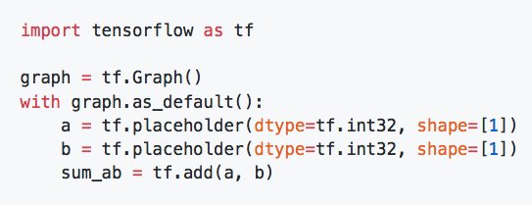
Building the Graph
Give a name to the graph
Notes:
The first step is to give a name to the graph that you are about to construct. If you have only one graph that you want to construct, then you could skip these two lines as everything would just go into the “default graph”. However, just to make you aware that every operation is associated with a particular graph, I thought it would be good to include this here in the example.

Slide 8
Building the Graph
Say what shape and type your data will be
Notes:
Place holders are the parts of your graph that stand where your data is going to come in. You need to specify the type and the shape of the data that will be used.
In this case we have two integer scalars

Slide 9
Building the Graph
Define the operations that you want to have
Notes:
Then, once you have your place holders defining what the data will look like, you can start building all the operations.
In this case we have the sum between two numbers.

Slide 10

Running the Graph
Define a session
Notes:
In order to run the graph, we need to create a session. This is a confusing concept when you first encounter tensorflow. The graph on its own does nothing, it's basically just a route map of where the data needs to go. Things are only computed within the session.
So, here we call our tensorflow session “Sess”
If you don’t specify which graph to run, it will just use the default graph.

Slide 11
Running the Graph
Run the operations
Notes:
To obtain the result, you need to feed some data to the graph. In this case, we can feed the numbers "1" and "2" and obtain their sum as a result.
This is the end of the basic part of the workshop.
Take home message for this section:
In tensorflow you need to
Build a graph
Run the graph in a session

Slide 12
Introduction to TensorFlow
Hackathon 2018
Part 2 – Building on the basics

Slide 13
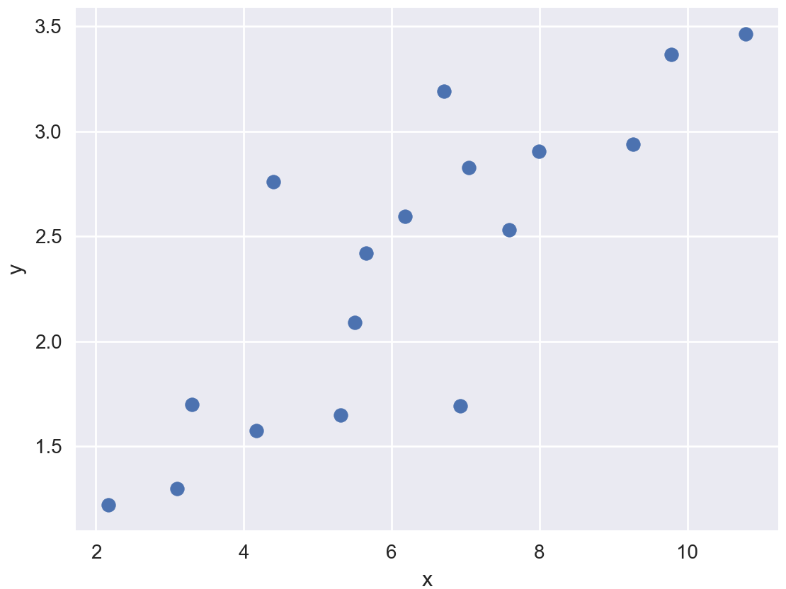

Linear Regression
$$y=mx+c$$
Notes:
Now that we have learnt how to do sums and very basic things, we are going to look at an example that is a bit closer to a neural network.
To bring everyone up to speed, to do linear regression, you have some points and you want to find the line of best fit. The equation for the line is y = mx + c, where m is the slope and c is the intercept.
So, you start with a random value of m and c. You want all these dotted black distances to be as small as possible. How can we express “I want to make all these lines as small as possible” in a mathematical way?

Slide 14
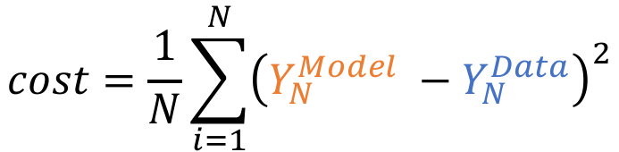
Linear Regression
Cost function:
$$cost=\frac{1}{N}\sum_{i=1}^{N}{{\left(Y_{N}^{Model} −Y_{N}^{Data}\right)}^{2}}$$
Number of data points
Notes:
We define a function which is an average of the length of all the lines, and we call it the cost function. Y is the orange value and YN is the data point value. In this case, I use the square error function, but this could be another function.
Now, we want to choose the slope and the intercept of the orange line in such a way that this cost function is smallest. So we minimise this function with respect to the parameters m and c.

Slide 15
Linear Regression
$$y=mx+c$$
Notes:
Then, the values of m and c that give the smallest value of the cost function give this line that fits best the data.
Now we are going to do that with tensorflow. You want to look at the “linear_regression.py” script.

Slide 16
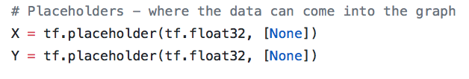
Linear Regression
Can be a variable size
Notes:
A new feature that we haven’t seen yet in the basic part of the tutorial is that the shape of the place holder can be variable. This is because the number of data points that you want to include can vary, and this enables you not to hard code it.

Slide 17
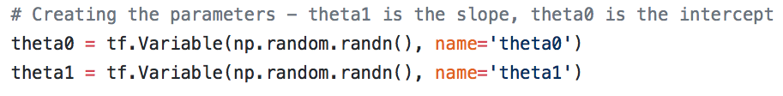
Linear regression
TF variable:
A tensor whose value can be modified by running operations on it.
Notes:
We are going to introduce a few more concepts with the linear regression example.
As you can see, we still have the part where you create the graph and where you create the session and run the operations. This time I didn’t specify in which graph the operations go, so they all go in the default graph.
A new thing that we havent encountered yet are tensorflow variables.
A variable is a tensor whose value can be modified by running operations on it. So in this case, the slope and the intercept of the line are variables because we want to modify them until we find the best value possible.

Slide 18
Linear regression
Gradient Descent Optimiser:
Implements the gradient descent algorithm.
Notes:
The next element that is new is the optimiser.
This is the operation of minimising a particular tensor with respect to the variables it depends on. So we have our cost function that depends on the slope and the intercept. This operation will modify the two variables so that they have the value that gives the smallest cost function.
Tensorflow gives many different possibilities for the optimiser, here we are using Gradient Descent algorithm, but there are many others that are fancier.

Slide 19

Linear regression
Needs to be run in the session before any other operation!
Variable initialiser:
Operation that assigns a value to the variables in a session.
Notes:
When one creates a variable, it is added to a “collection”. The default collection is the "GLOBAL_VARIABLES" collection. The function global_variables_initializer() iterates through the variables in this collection and calls their initialiser.
What does initialising the variables mean?
On their own the variables only have the shape that you assign when you build the graph. But outside of the session they don’t have a value. So, before you run operations you have to initialise them with a value.
All the Variables of a graph need to have a value before you can run operations that depend on them. Instead of initialising them like this, you could also restore a value from a stored value.

Slide 20
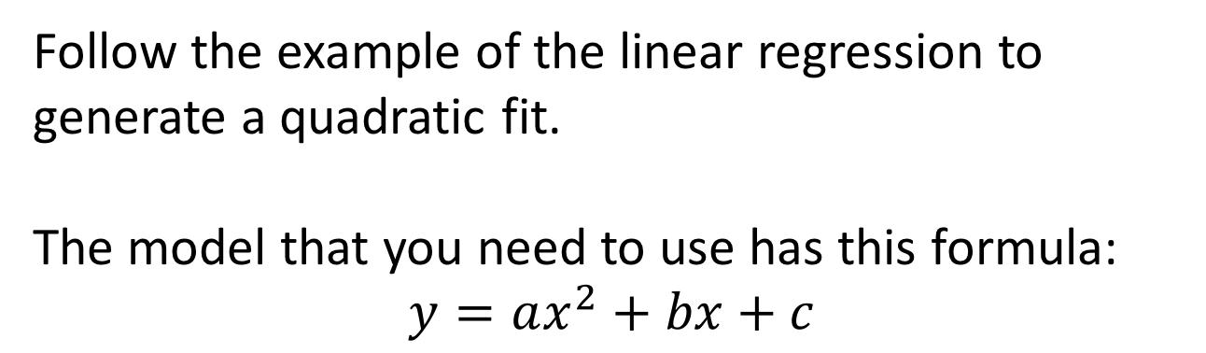
Exercise
Follow the example of the linear regression to generate a quadratic fit.
The model that you need to use has this formula:
$$y=ax^{2}+bx+c$$
Notes:
Now, I will give you 30 min to play with the linear regression example and try to do the same thing for a qudratic fit. So instead of using the y = mx + c you have the equation for a parabola. You can find a skeleton of what you need to do in the git repository and then the solution is in the solution folder.

Slide 21
Introduction to TensorFlow
Hackathon 2018
Part 3 – Neural Network!

Slide 22
Neural networks
Hidden Layer
Neuron
Input Layer
Output Layer
A tiny neural network
Notes:
Neural networks are a way to create complex functions to fit your data. You remember the example of the linear fit? You have a function with some parameters and you want to find the best parameters. However, the linear model can only describe data where there is a linear relationship. For different relationships you need a different model. Neural networks are just that, they are models for the data that have a complex functional form.
They have an architecture like this: There is an input layer, which is where your data comes in. Then there is one or more hidden layers, and finally an output.
First, what does each hidden neuron do?

Slide 23

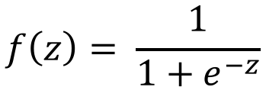
Hidden neuron
Parameters
X₁
$$f\left(w_{1}x_{1}+w_{2}x_{2}+b\right)$$
X₂
For example:
$$f\left(z\right)= \frac{1}{1+e^{−z}}$$
Notes:
Each neuron takes your data as an input and multiplies it by some parameters and adds another parameter.
Here we will go through an example on the board, using the following notation:
W^(l)_ij is the weight connecting unit j in layer l to unit i in layer l+1. First layer starts at 1. (being consistent with Andrew Ng)
The function is also called the activation function.

Slide 24
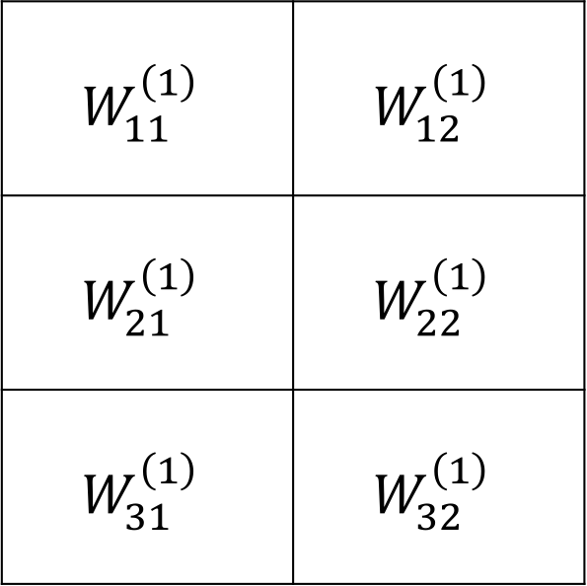
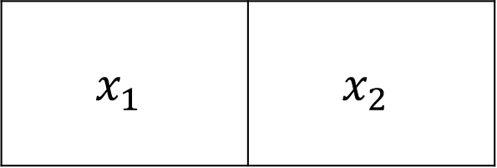
Linear Algebra
To go from the input layer to the output layer:
$$x_{1}$$ | $$x_{2}$$
$$W_{11}^{\left(1\right)}$$ | $$W_{12}^{\left(1\right)}$$
$$W_{21}^{\left(1\right)}$$ | $$W_{22}^{\left(1\right)}$$
$$W_{31}^{\left(1\right)}$$ | $$W_{32}^{\left(1\right)}$$
Notes:
All the weights that one needs in order to go from the input layer to the hidden layer can be placed into a matrix.
Your input data is x_1 and x_2.
Then, you can use matrix multiplication to do the product. This is more efficient because the code in the computer for matrix multiplication is well optimised.

Slide 25

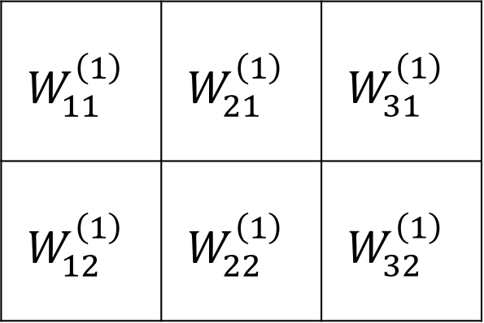
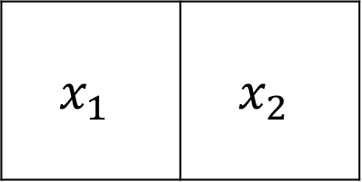
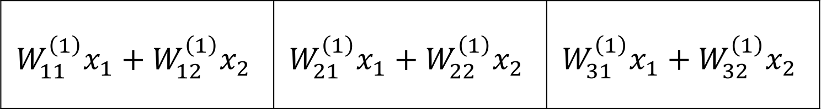
Linear algebra
$$x W^{T}$$
$$x_{1}$$ | $$x_{2}$$
$$W_{11}^{\left(1\right)}$$ | $$W_{21}^{\left(1\right)}$$ | $$W_{31}^{\left(1\right)}$$
$$W_{12}^{\left(1\right)}$$ | $$W_{22}^{\left(1\right)}$$ | $$W_{32}^{\left(1\right)}$$
=
$$W_{11}^{\left(1\right)}x_{1}+W_{12}^{\left(1\right)}x_{2}$$ | $$W_{21}^{\left(1\right)}x_{1}+W_{22}^{\left(1\right)}x_{2}$$ | $$W_{31}^{\left(1\right)}x_{1}+W_{32}^{\left(1\right)}x_{2}$$
Notes:
You can write the product in the previous slide as x times the transpose of the weight matrix.
You obtain the values of the hidden layer nodes before you apply the activation function.

Slide 26
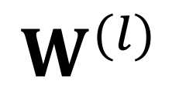
Linear Algebra
$$W^{(l)}$$
Matrix of shape N x M
Number of neurons in layer l+1
Number of neurons in layer l

Slide 27
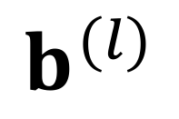
Linear Algebra
$$b^{(l)}$$
Matrix of shape 1 x N
Number of neurons in layer l+1
Notes:
Show on the board what it looks like to add the bias.

Slide 28
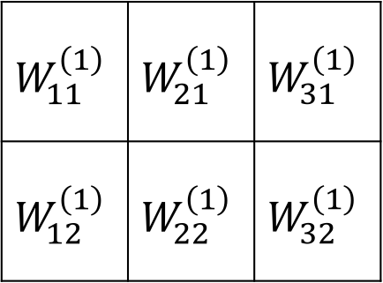
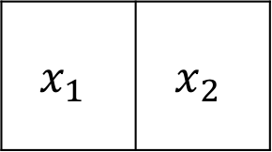
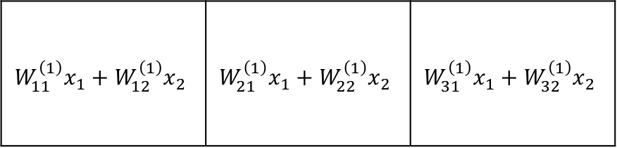
Linear Algebra
$$x W^{T}$$
$$x_{1}$$ | $$x_{2}$$
$$W_{11}^{\left(1\right)}$$ | $$W_{21}^{\left(1\right)}$$ | $$W_{31}^{\left(1\right)}$$
$$W_{12}^{\left(1\right)}$$ | $$W_{22}^{\left(1\right)}$$ | $$W_{32}^{\left(1\right)}$$
$$W_{11}^{\left(1\right)}x_{1}+W_{12}^{\left(1\right)}x_{2}$$ | $$W_{21}^{\left(1\right)}x_{1}+W_{22}^{\left(1\right)}x_{2}$$ | $$W_{31}^{\left(1\right)}x_{1}+W_{32}^{\left(1\right)}x_{2}$$
=
…
…
Notes:
The final point to notice is that this will then work for all your samples in one go, so that you don’t have to do the multiplication for one sample at a time.
Now spend some time observing how this is done in the code.

Slide 29
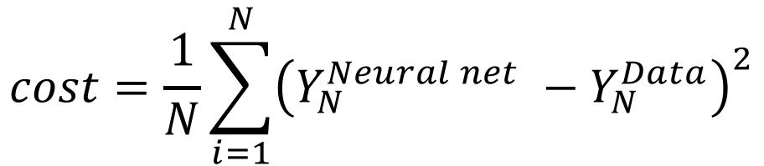
Training the network
Output of the neural network
Cost function:
$$cost=\frac{1}{N}\sum_{i=1}^{N}{{\left(Y_{N}^{Neural net} −Y_{N}^{Data}\right)}^{2}}$$
Data point
Number of data points
Notes:
Then, everything is the same as for the linear regression.
We have a model, y which is what comes out of the network. You have YN which is from the data.
Now, we want to find the parameters that make this function as small as possible. This is exactly the same as for the linear regression!

Slide 30
Exercise
Modify the neural network so that there are 2 hidden layers instead of one.

Slide 31
Introduction to TensorFlow
Hackathon 2018
Part 4 – Extra stuff

Slide 32
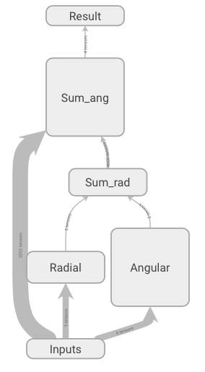
Tensorboard
Web interface for graph visualization and manipulation
Group nodes in “Name scopes”
(Add scalar and histogram summaries to your operations)
Instantiate a SummaryWriter object
In a session, pass the summaries to the SummaryWriter
Notes:
Everything related to visualisation in Tensorflow is done in tensorboard. This is a web interface for graph visualization and manipulation.
Graphs with complex topologies and can be displayed in a clear and organized manner, allowing the user to understand exactly how data flows through it.
Name scopes: nodes may be grouped into one visual block. Then they can be expanded to inspect in more details
Also enables to track scalar values through time in your graph. You can also check the amount of memory and the compute time of each node.

Slide 33
Tensorboard
After training, a directory is created containing:
events.out.tfevents.1524151475.Silvias-MacBook-Pro.local
On command line, travel to that directory
Type:
tensorboard –-logdir=.
Copy the address that comes out into a browser:
http://Silvias-MBP:6006

Slide 34
Dataset
tf.data
API that lets you build complex input pipelines
tf.data.Dataset
tf.data.Iterator
Notes:
The tf.data class lets one build complex input pipelines. There are two main parts: the dataset and the iterator

Slide 35
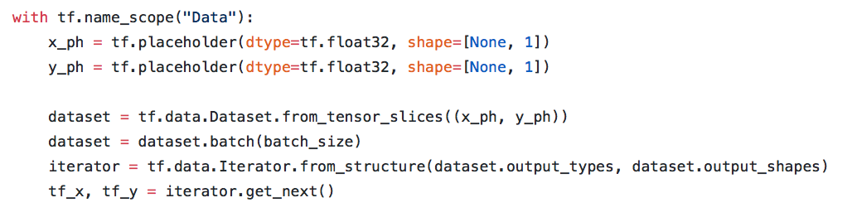
Dataset
Create dataset from tensors or from TFRecord files
Notes:
The tf.data.Dataset which contain the input data. There are different ways of putting your data into this class. If your data is already in memory you can use “tf.data.from_tensors”, but if the data is on disk you can use things like tf.TFRecordDataset. I have never tried the second option yet, so can’t tell you much about it.
There are methods that let you apply functions to each element of the data set, so this lets you create complex input pipelines.

Slide 36
Dataset
Extract elements from the data set using the iterator
Note: when you run an operation that depends on tf_x and tf_y, it will automatically run the iterator.get_next() operation.
Notes:
The iterator has a method “get_next” that lets you extract the data samples from your dataset. It acts as the interface between the data and the model.
You can access the elements one at a time or in batches.

Slide 37
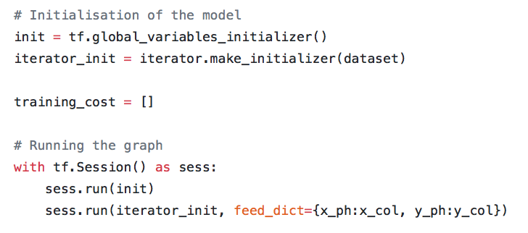
Dataset
Creating an initialisation operation
Running the initialisation operation
Notes:
So now, we not only have to initialise variables, we also have to initialise the iterator. When the iterator is initialised, it will be at the beginning of the data set, and as you call the “get_next” method it will go through the data set. If at some point you want to go back to the beginning you need to re-initialise the iterator.

Slide 38
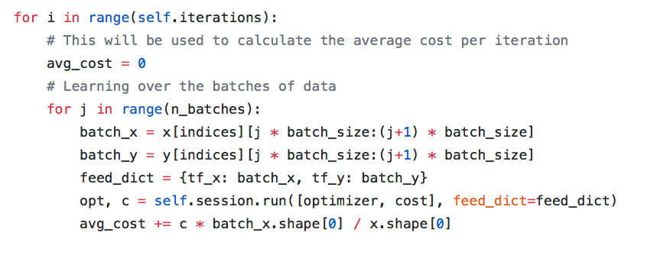
Dataset
Notes:
Nice, because now for training in batches instead of having to do something like this, you can do this:

Slide 39
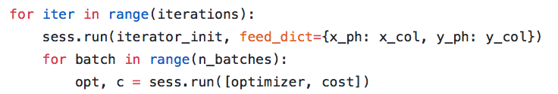
Dataset
Notes:
There are obviously many other advantages in terms of efficiency and things but I haven’t explored these as much yet

