Slide 1
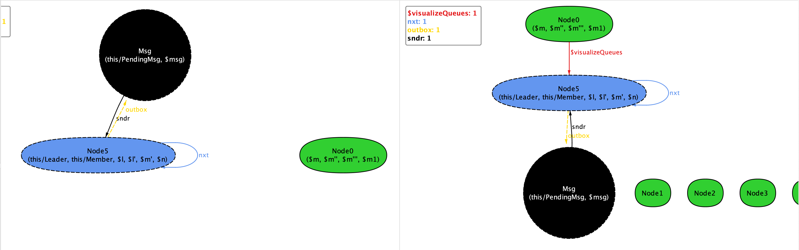
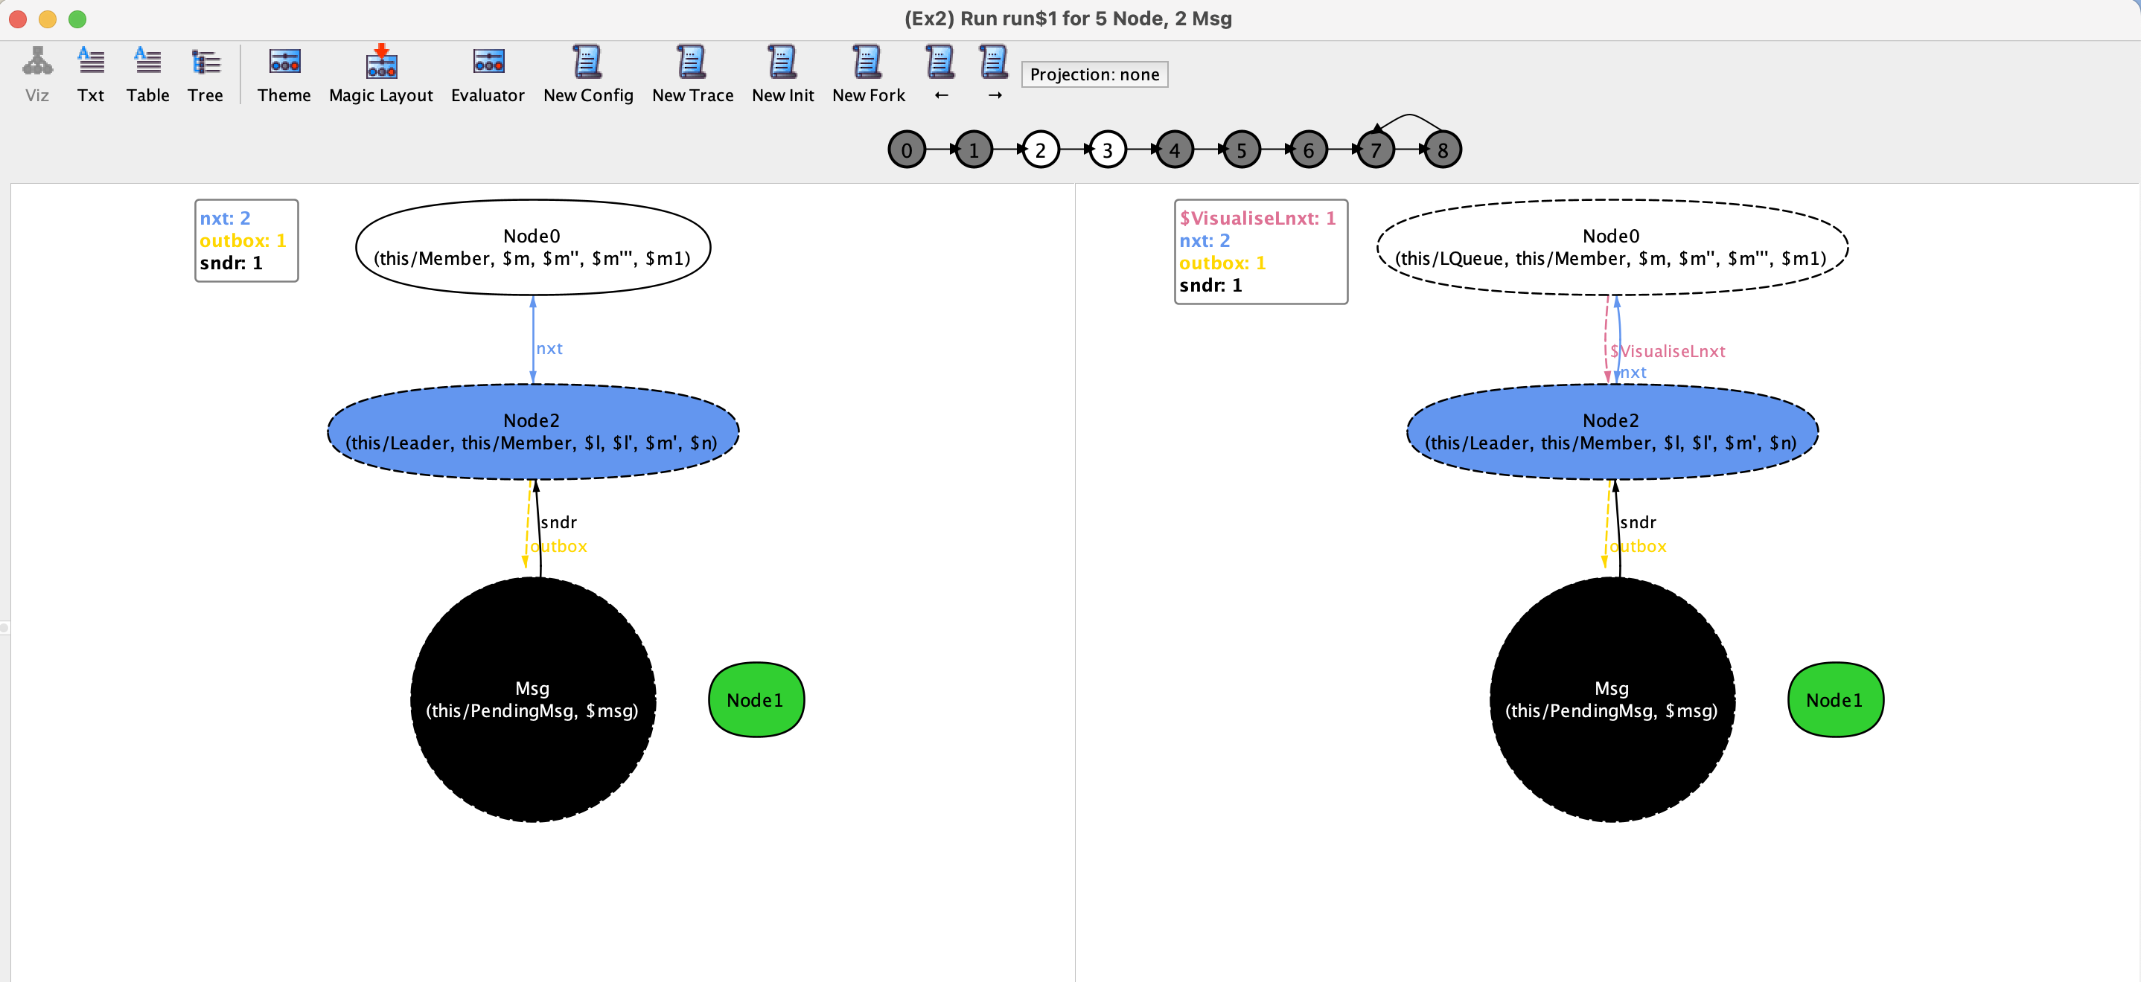
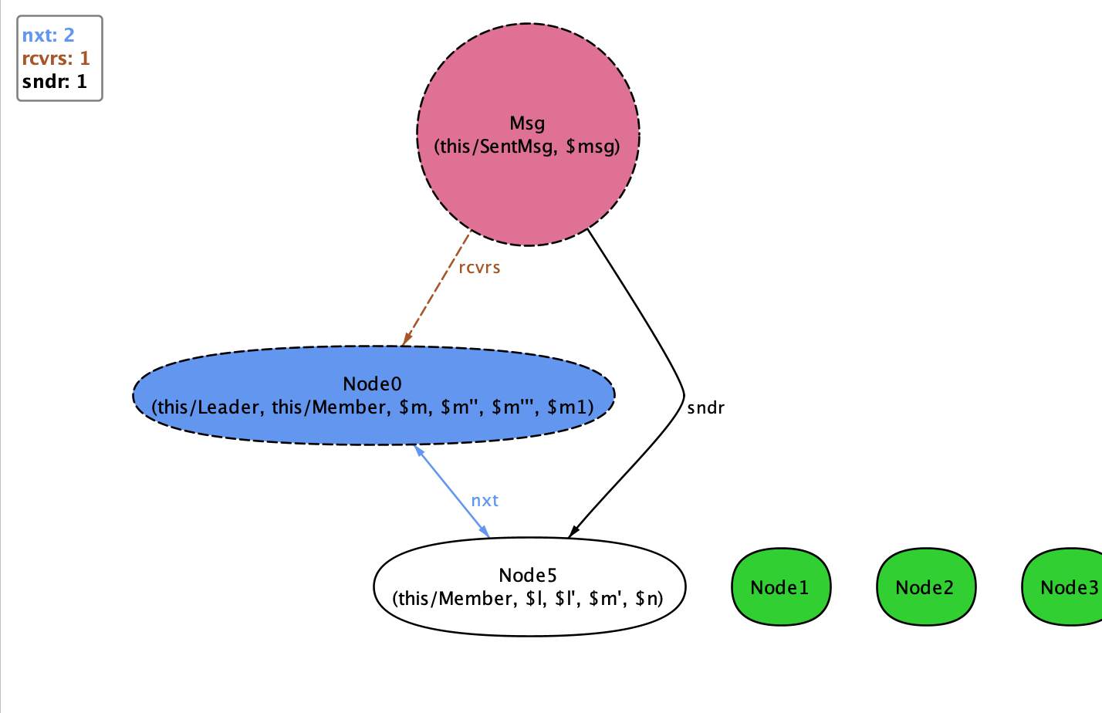
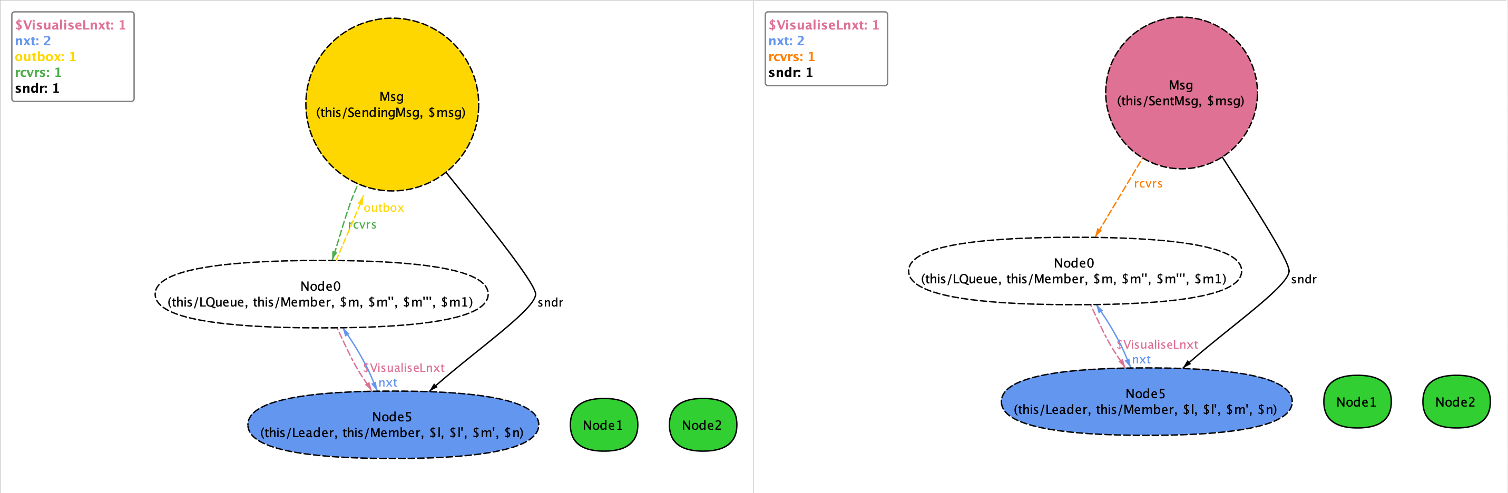
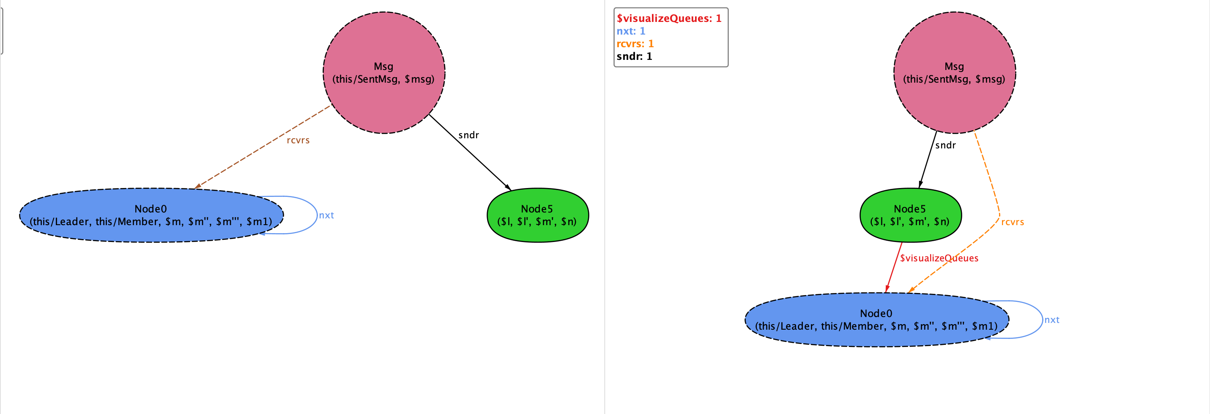
Node 0 is added to Member queue
Node 0 is now a Member
Node 0 is in LQueue
Message bradcast has started. Msg is now in Sending state with sender as leader and Node0 as receiver.
Node0 is now the Leader
Message Broadcast has ended. Node0 in receivers and no outbox. The leader is the sender.
Node 5 is no longer a Member
Node 5 is added to Member queue

Slide 2
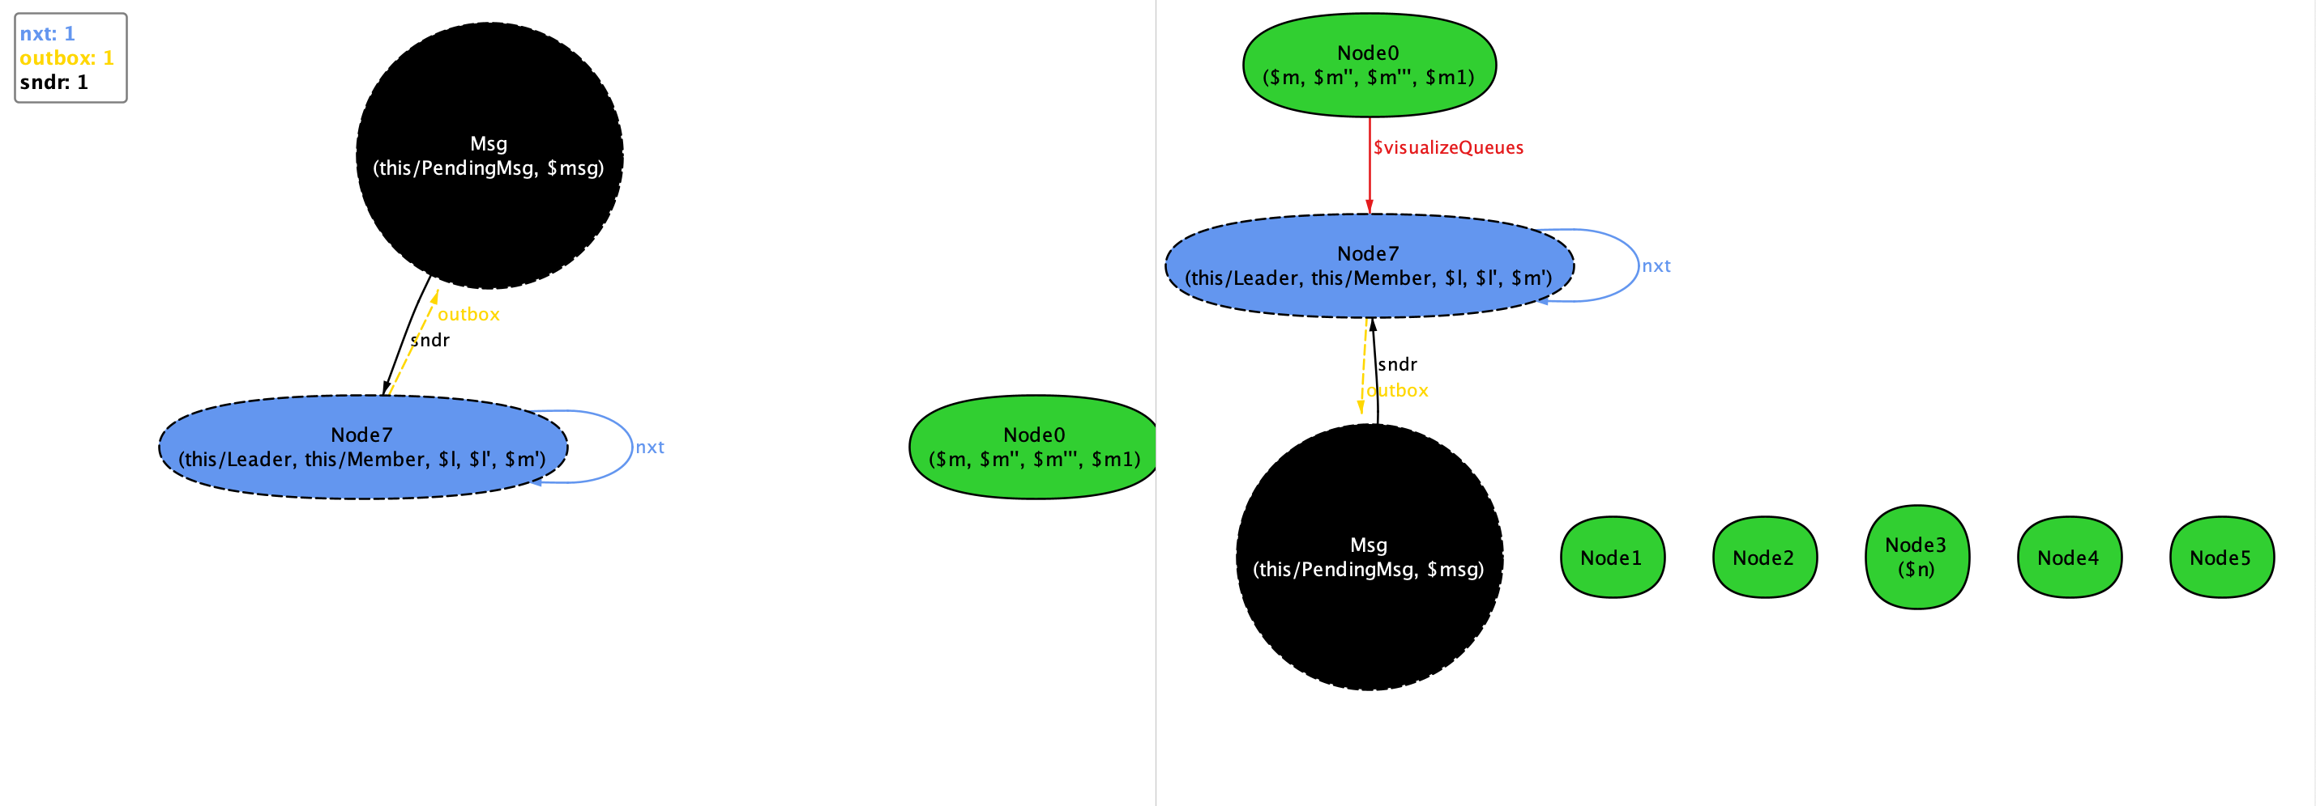
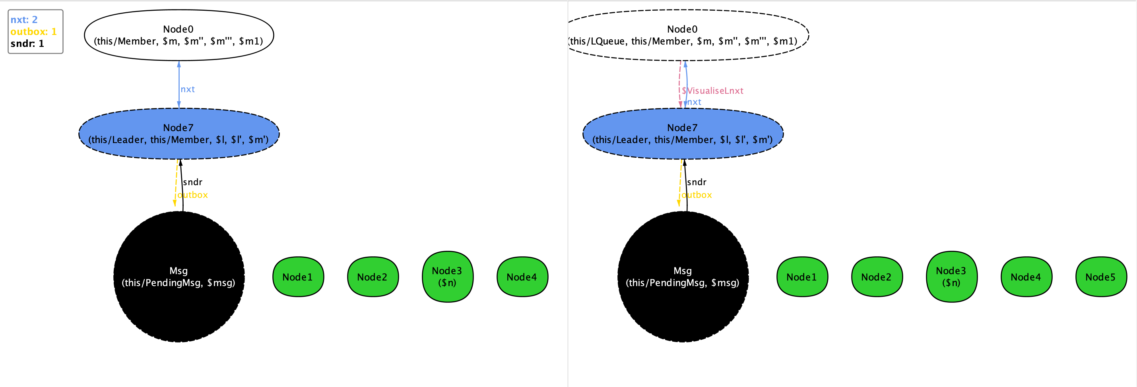
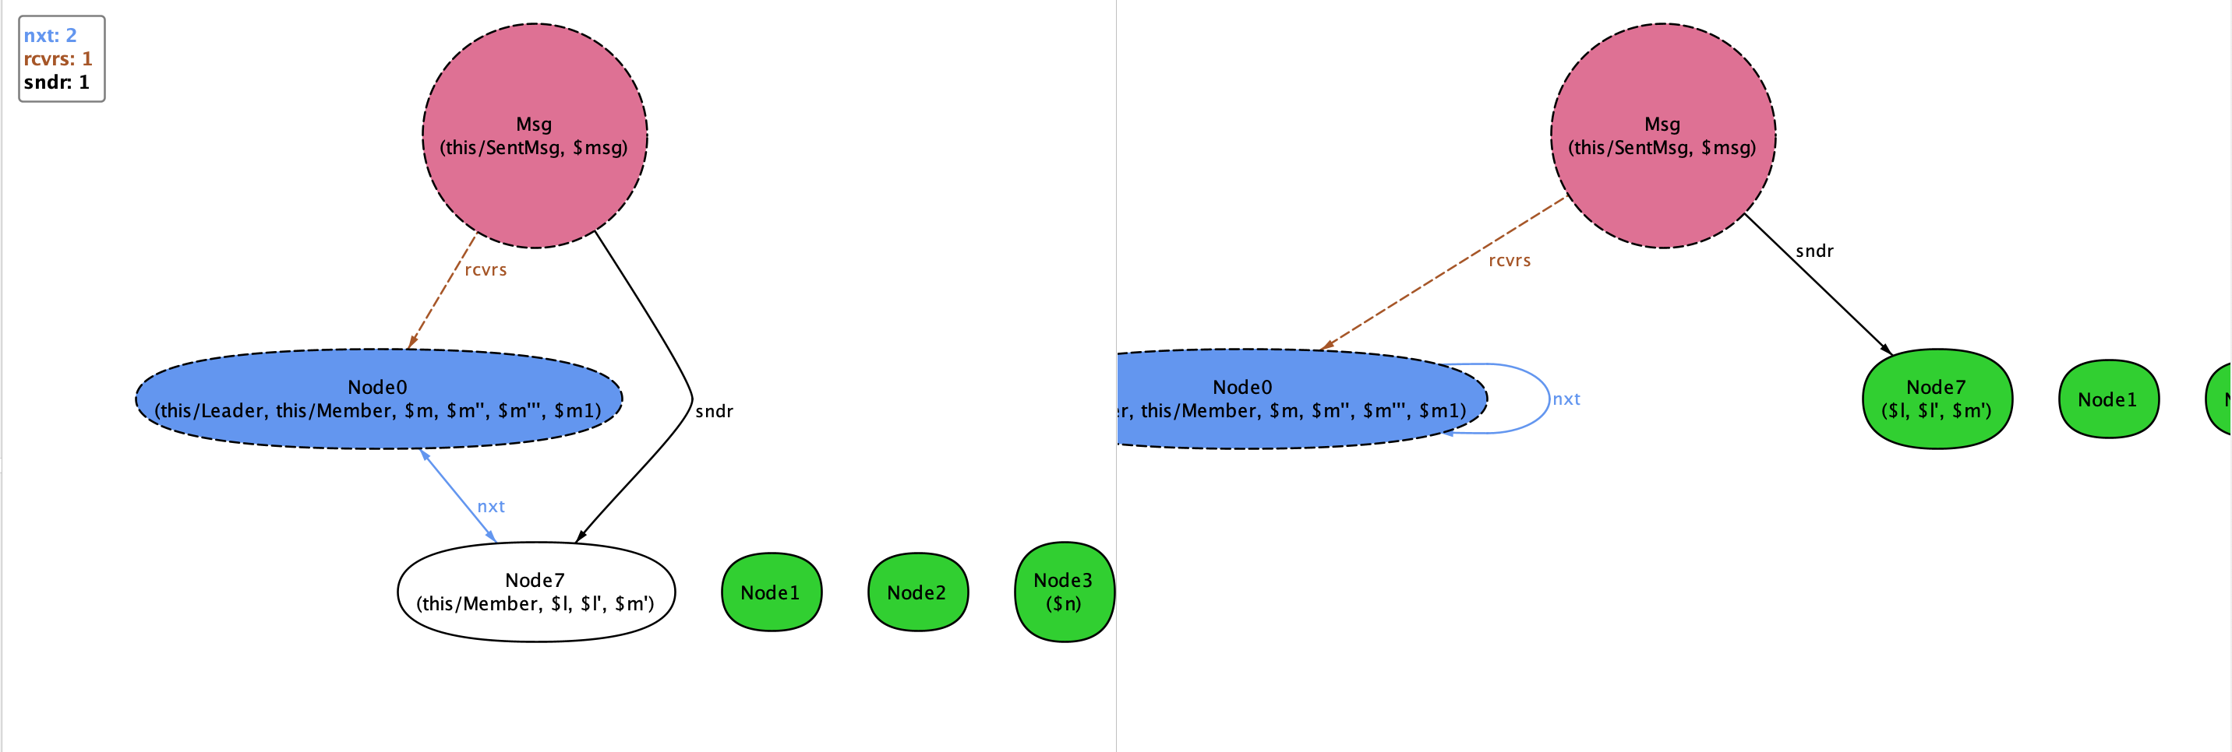
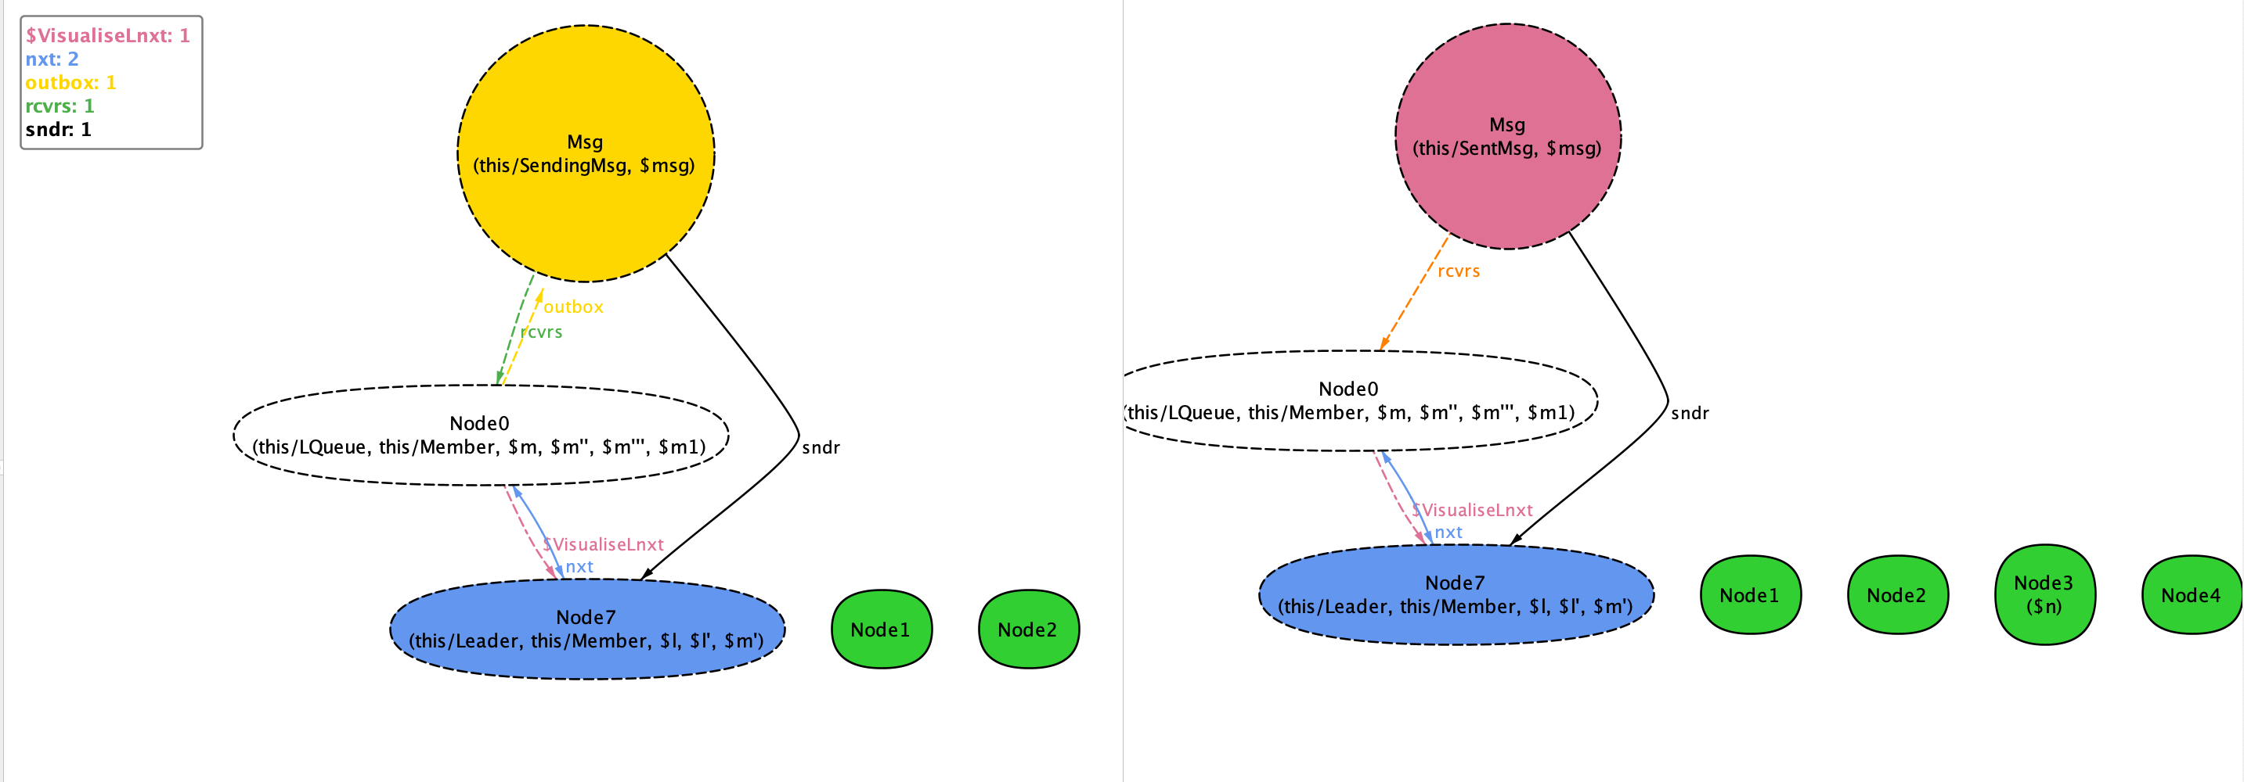
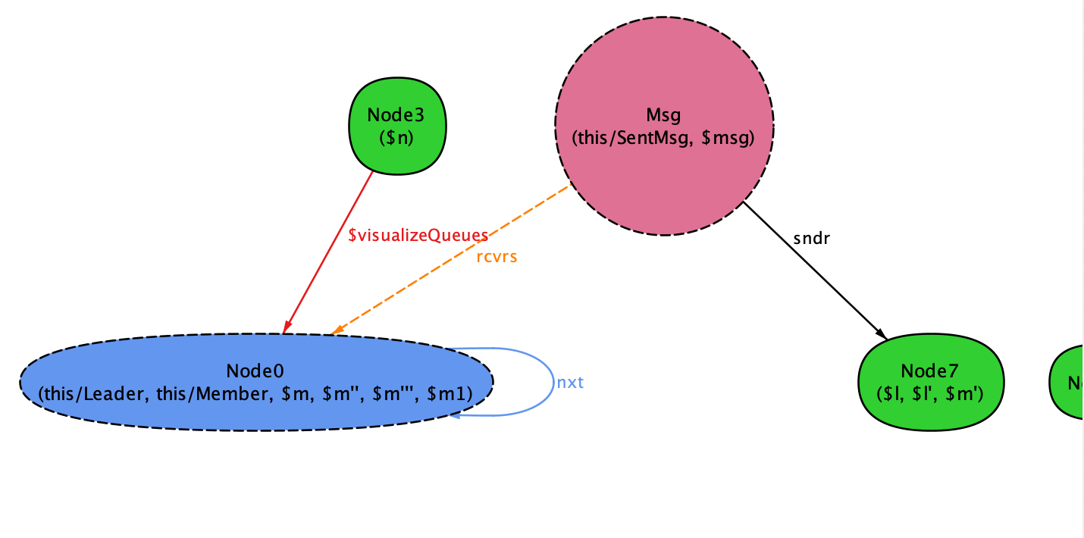
Node0 is added to Member Queue
Node0 is added to LQueue
Node0 is added to Members
Message bradcast has started. Msg is now in Sending state with sender as leader and Node0 as receiver.
Node0 is now the Leader
Message Broadcast has ended. Node0 in receivers and no outbox. The leader is the sender.
Node7 is no longer a Member
Node 3 is added to Member queue

