Slide 1
Your Trusted Partner in Accreditation
Admin Guide for Revamped Website – Add a new post (in NewsRoom)
Sharon
AAD
24th June 2019
www.sac-accreditation.gov.sg

Slide 2
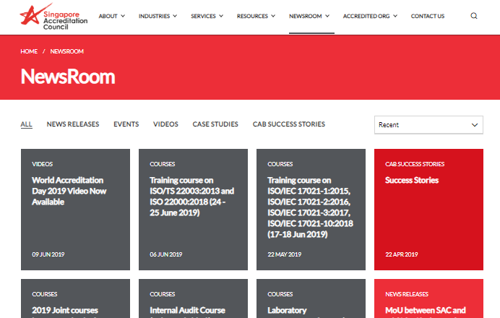
SAC Website NewsRoom
Sub-links for each category inside the NewsRoom
Each ‘card’ or box in the NewsRoom page corresponds to a single ‘post’ template page

Slide 3
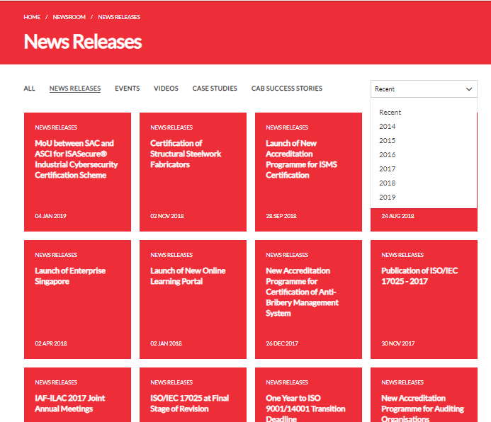
SAC Website NewsRoom – News Releases
Breadcrumb navigation which shows your current website navigation flow (i.e. Home -> NewsRoom -> News Releases)
Clicking on the ‘News Releases’ sub-link will display all the posts under the News Releases section (arranged in descending chronological order)
Dropdown containing timeline selection

Slide 4

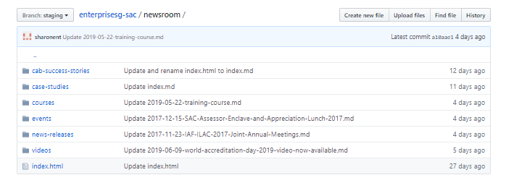
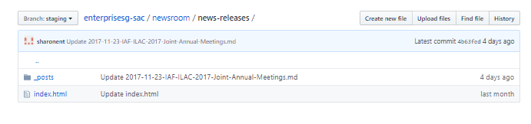
Adding inside Github Repository
1. Click on the newsroom folder inside the Github Repository
2. The newsroom directory contains folders for all the categories inside newsroom.
Click on any of the category folders to access the article posts under that category
3. Inside the category folder, click on ‘_posts’ folder

Slide 5
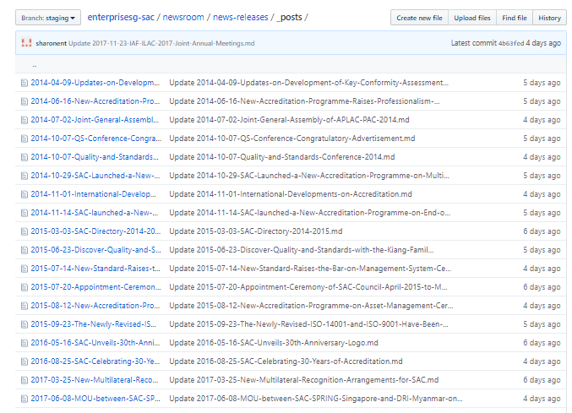
Adding inside Github Repository
List of all the posts made in ‘news-releases’
Category (arranged in chronological order)

Slide 6
Adding inside Github Repository
4. Click on ‘Create new file’ to create a new post
List of all the posts made in ‘news-releases’
Category (arranged in chronological order)

Slide 7
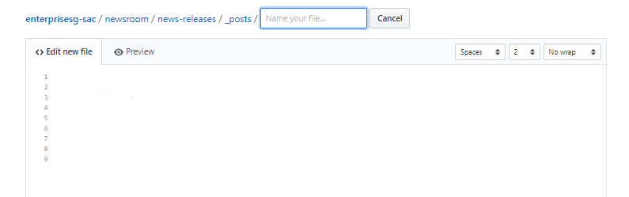
Adding inside Github Repository – Text editor

Slide 8
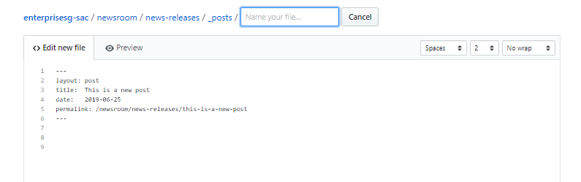
Adding inside Github Repository – Text editor
5. Add the header code snippet into your file
Fill in title of post, date (current date in YYYY-MM-DD format) and permalink (this is the url that will be displayed in the user’s internet browser when the user clicks on the post)

Slide 9
Adding inside Github Repository – Text editor
5. Add the header code snippet into your file
Fill in title of post, date (current date in YYYY-MM-DD format) and permalink (this is the url that will be displayed in the user’s internet browser when the user clicks on the post)
Sample Header Code Snippet for Post (copy and paste into the file or copy from other posts)
Note: Always replace the spaces in the permalink with dashes(-), otherwise the webpage will not be displayed
---
layout: post
title: Fill in your own title description
date: Fill in your own date in YYYY-MM-DD format, example 2018-12-31
permalink: /newsroom/news-releases/fill-in-your-own-title-description/
---

Slide 10
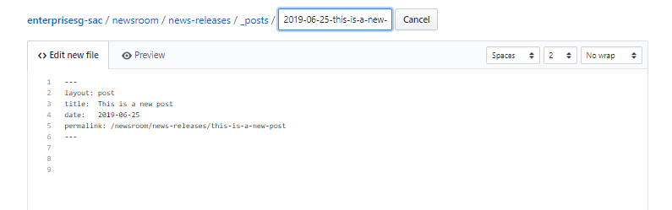
Adding inside Github Repository – Text editor
6. Name the file in the format of YYYY-MM-DD-filename.md
Full filename: ‘2019-06-25-this-is-a-new-post.md’
Note: Do not put spaces in the filename of your .md file. Always replace the spaces with dash (-).
Also remember to add the ‘.md’ extension at the end

Slide 11
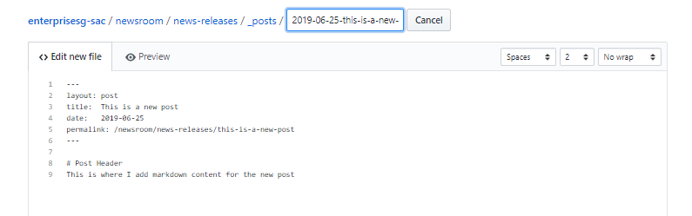
Adding inside Github Repository – Text editor
7. Add in your markdown content of your page.
Add the markdown content below the header code

Slide 12
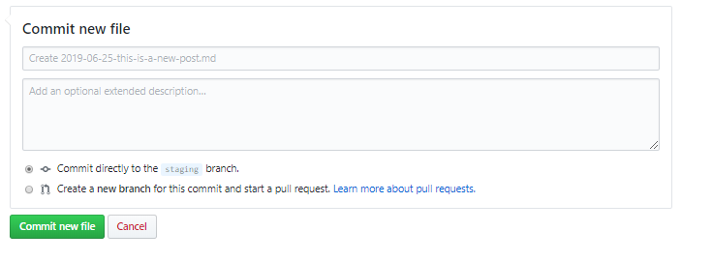
Adding inside Github Repository – Text editor
8. Click on “Commit new file” button at the bottom of the text editor.

Slide 13
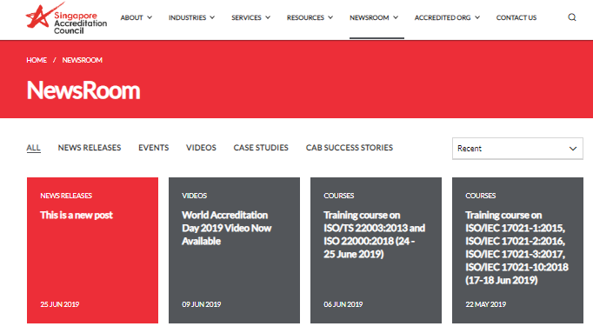
Adding inside Github Repository – Text editor
9. Wait a few minutes and refresh the SAC website to view the new post.

Slide 14
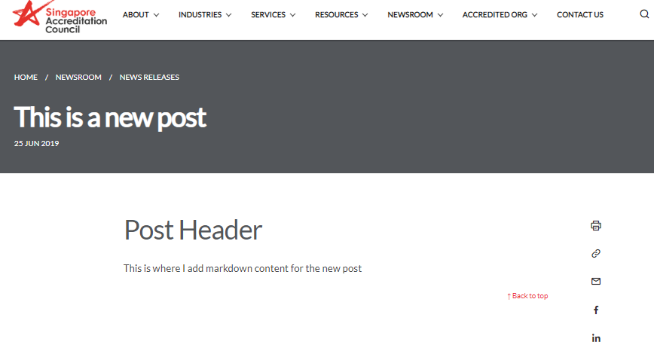
Adding inside Github Repository – Text editor
9. Wait a few minutes and refresh the SAC website to view the new post.
Congratulations! You have created a new post inside NewsRoom!

Slide 15
GovTech Example (Animation)

Slide 16
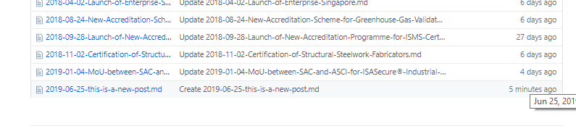
Editing / Deleting a Post
1. Select the file inside the category folder that you wish to edit / delete.

Slide 17
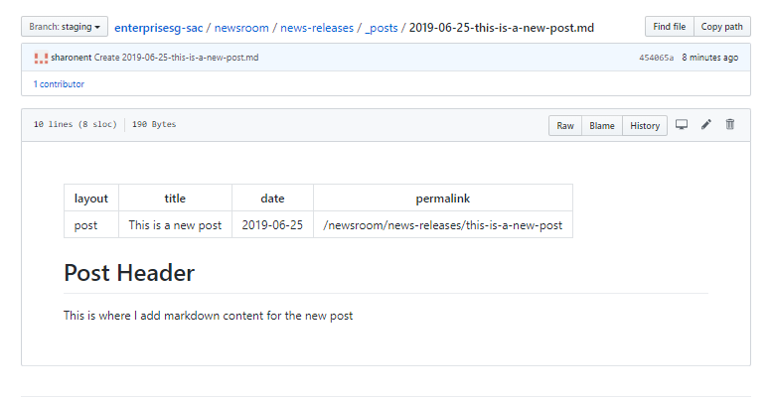
Editing / Deleting a Post
2. Click on the ‘edit’ pencil icon or ‘delete’ trash icon.
Click on ‘edit’ icon to edit the file, and edit the markdown content inside the text editor.
Click on ‘delete’ icon to delete the file.

Slide 18
Editing / Deleting a Post
2. Click on the ‘edit’ pencil icon or ‘delete’ trash icon.
Click on ‘edit’ icon to edit the file, and edit the markdown content inside the text editor.
Click on ‘delete’ icon to delete the file.
3. Click on the ‘Commit changes’ button when you are done.

