Slide 1
Your Trusted Partner in Accreditation
Admin Guide for Revamped Website – Add a new training course
Sharon
AAD
24th June 2019
www.sac-accreditation.gov.sg

Slide 2
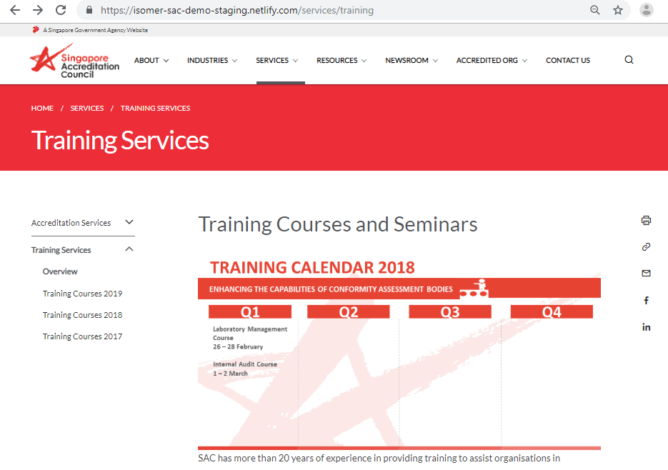
SAC Website Training Courses Page
Services Tab -> Training Services

Slide 3
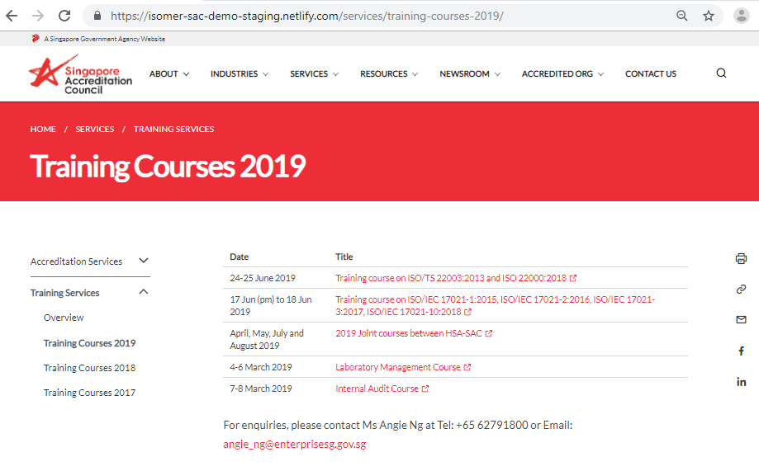
SAC Website Training Courses Page
Services Tab -> Training Services -> Training Courses 2019

Slide 4

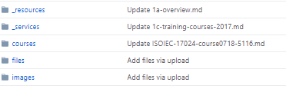
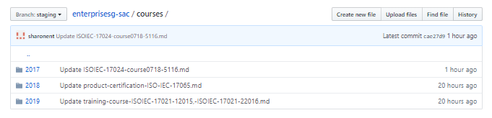
a. Add new training course details page
Make sure you are at the ‘staging’ branch
1. Click on the courses folder inside the Github Repository
2. Click on the course year folder (e.g. “2019” folder contains the course detail pages of all the courses in 2019)

Slide 5
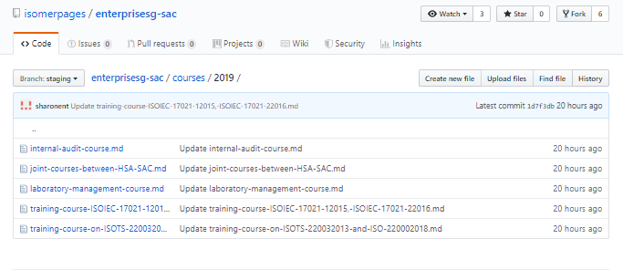
a. Add new training course details page
This shows that you are inside the “2019” course year folder in the “courses” directory of the enterprise-sac Github Repository

Slide 6
a. Add new training course details page
This shows that you are inside the “2019” course year folder in the “courses” directory of the enterprise-sac Github Repository
3. Click on “Create new file” button

Slide 7
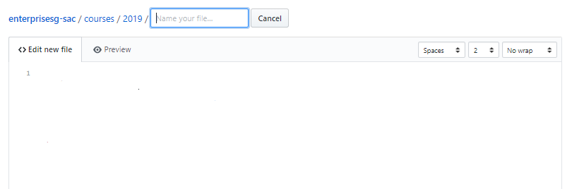
a. Add new training course details page - text editor
Check that you are editing inside the the correct directory

Slide 8
a. Add new training course details page - text editor
2. Copy and paste the header code snippet below (or copy from other files inside the folder) into the top of the Github text editor. Edit the title and permalink.
---
layout: simple-page
title: Fill in your own title description
permalink: /services/training-courses-2019/fill-in-your-own-title-description/
---

Slide 9
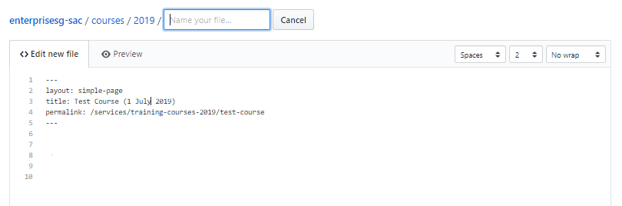
a. Add new training course details page - text editor
2. Copy and paste the header code snippet below (or copy from other files inside the folder) into the top of the Github text editor. Edit the title and permalink.

Slide 10
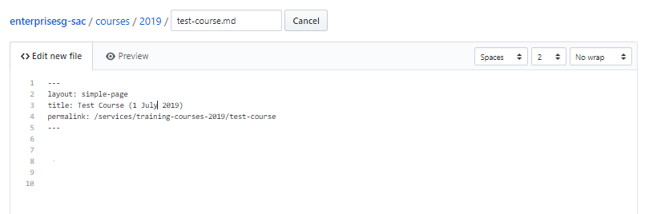
a. Add new training course details page - text editor
3. Name the file in filename.md format.
Note: Do not put spaces in the filename of your .md file. Always replace the spaces with dash (-).
Also remember to add the ‘.md’ extension at the end

Slide 11
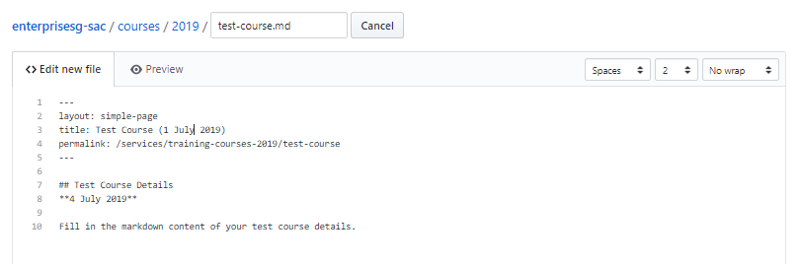
a. Add new training course details page - text editor
4. Add in the markdown content of the course details.
Add the markdown content below the header code

Slide 12
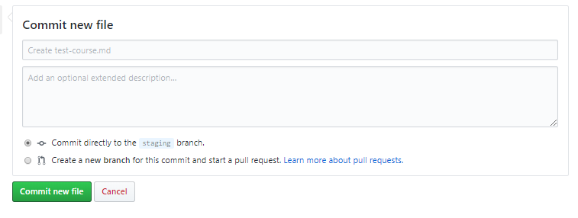
a. Add new training course details page - text editor
5. Click on “Commit new file” button at the bottom of the text editor.

Slide 13
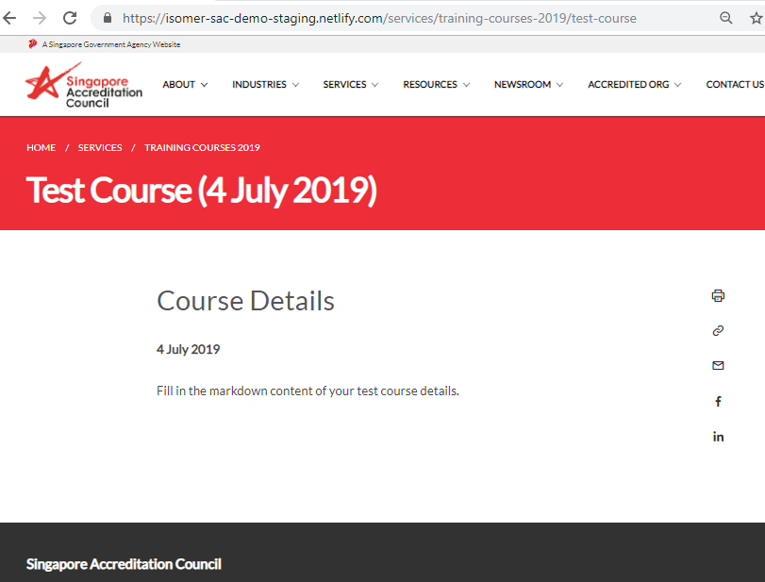
a. Add new training course details page - text editor
6. Wait a few minutes go to the permalink of your new page to view in your Internet web browser.

Slide 14
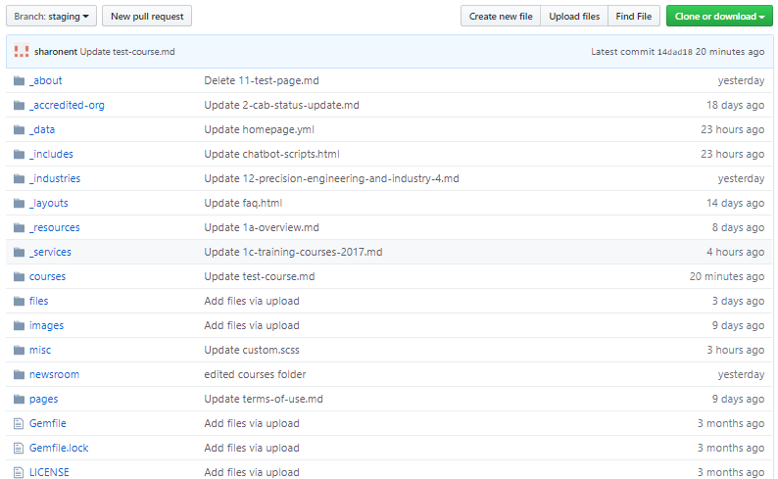
b. Update table in ‘training courses’ page
Make sure you are at the ‘staging’ branch
1. Click on the _services folder inside the Github Repository

Slide 15
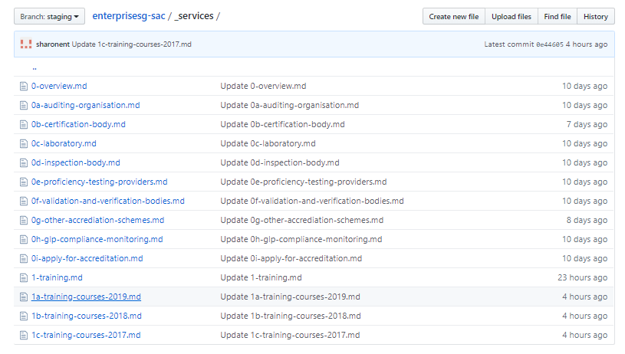
b. Update table in ‘training courses’ page
2. Inside the _services folder, select the markdown file that contains the correct courses table for that year (e.g. If your new course is in 2019, select “1a-training-courses-2019.md”

Slide 16
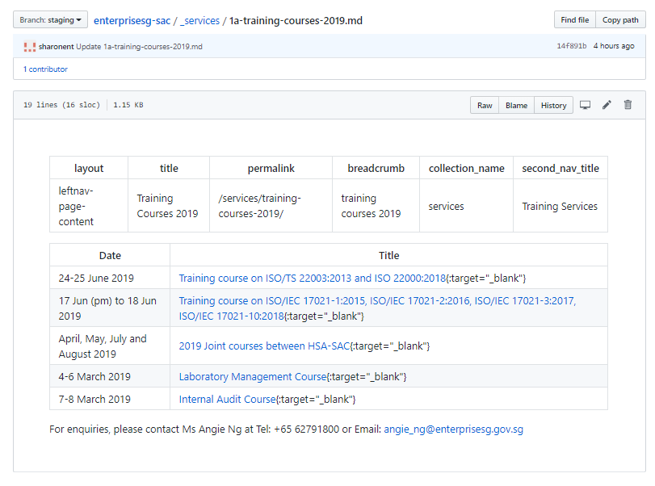
b. Update table in ‘training courses’ page
3. Inside the training courses file, click on ‘Edit’pencil button on the top right hand corner

Slide 17
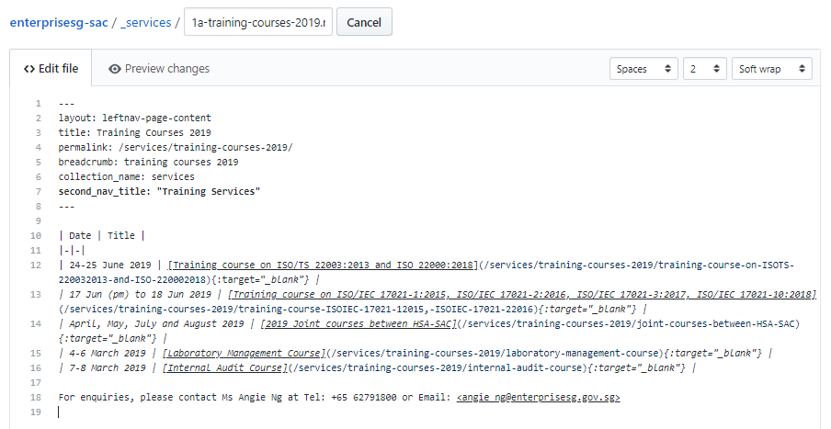
b. Update table in ‘training courses’ page
4. Edit the Markdown table inside the text editor of the selected file.
Markdown table syntax

Slide 18
b. Update table in ‘training courses’ page
4. Edit the Markdown table inside the text editor of the selected file.
Basic Markdown table:
| row 1/column 1 | row 2/column 2 |
| row 2/column 1 | row 2/column 2 |
Basic Markdown table with header:
| header 1/column 1 | header 1/column 2 |
|--
| row 1/column 1 | row 2/column 2 |
| row 2/column 1 | row 2/column 2 |
Basic Markdown table with footer:
| header 1/column 1 | header 1/column 2 |
|--
| row 1/column 1 | row 2/column 2 |
| row 2/column 1 | row 2/column 2 |
|==
| footer-row
|

Slide 19
b. Update table in ‘training courses’ page
5. Copy the table row code snippet below (or copy from the other table rows in the course table). Edit the markdown content in each column.
| date of course | [title of course](permalink-of-course-details-page){:target=“_blank”} |
Full example:
| 4 July 2019 | [Test Course](/services/training-courses-2019/test-course){:target=“_blank”}|
Date of course
Title of course
Permalink
This indicates that the url opens in a new window when the user clicks on it

Slide 20
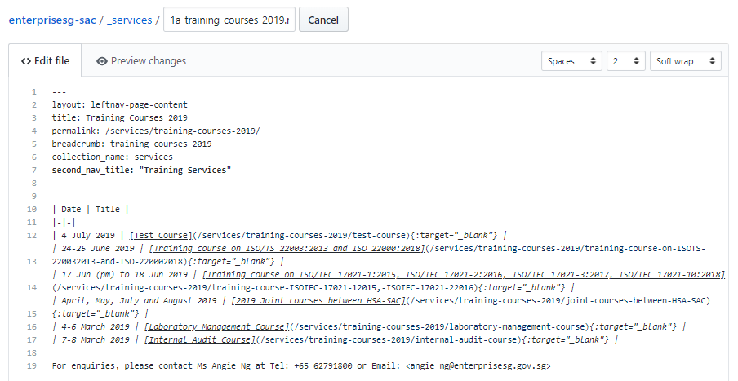
b. Update table in ‘training courses’ page
6. Insert the new table row into the table of the ‘training courses’ page below the table header row.
New table row

Slide 21
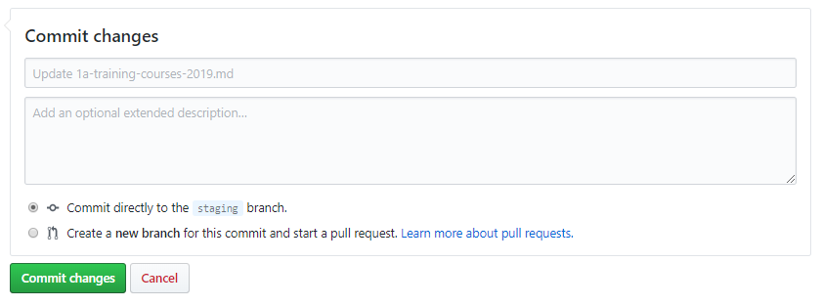
b. Update table in ‘training courses’ page
7. Click on ‘Commit changes’ button at the bottom of the text editor.

Slide 22
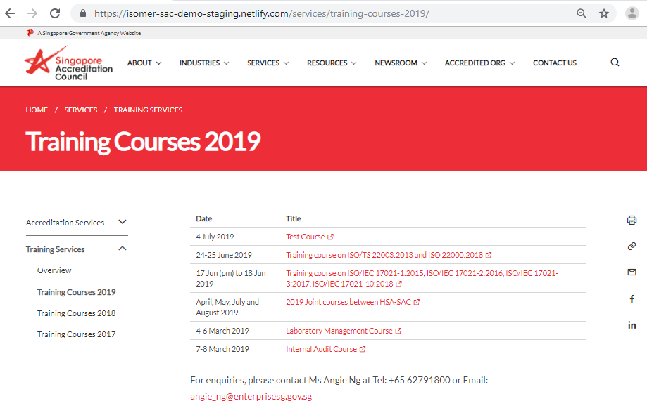
b. Update table in ‘training courses’ page
8. Wait a few minutes and refresh the ‘training courses’ webpage to view the updated courses table.

Slide 23
b. Update table in ‘training courses’ page
8. Wait a few minutes and refresh the ‘training courses’ webpage to view the updated courses table.
Clicking on the title will bring you to the ‘Test Course’ course details page

