Slide 1
Your Trusted Partner in Accreditation
Admin Guide for Revamped Website – Edit FAQ
Sharon
AAD
24th June 2019
www.sac-accreditation.gov.sg

Slide 2
SAC FAQ Page
The FAQ page uses the ‘our-team’ layout.
The ‘Our Organisation and Structure’ and ‘Certified Companies’ pages also use the same layout

Slide 3
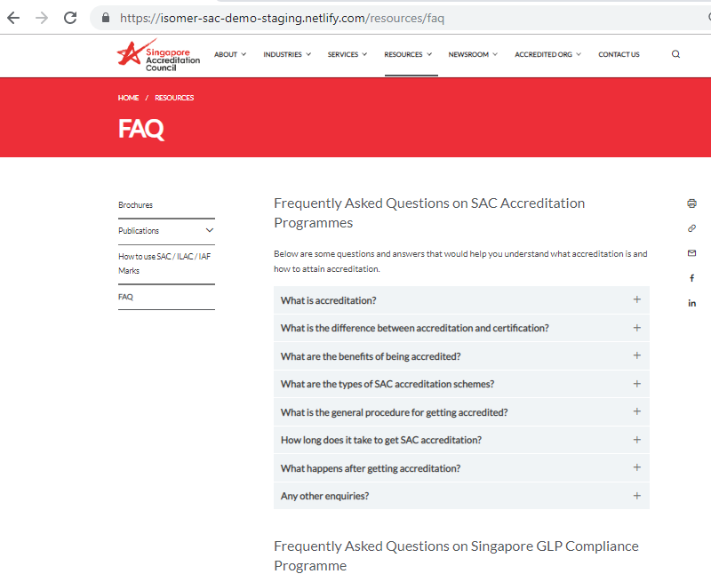
SAC FAQ Page
Contains an accordion (collapsible content). Each horizontal section contains a brief title, description, question etc.

Slide 4
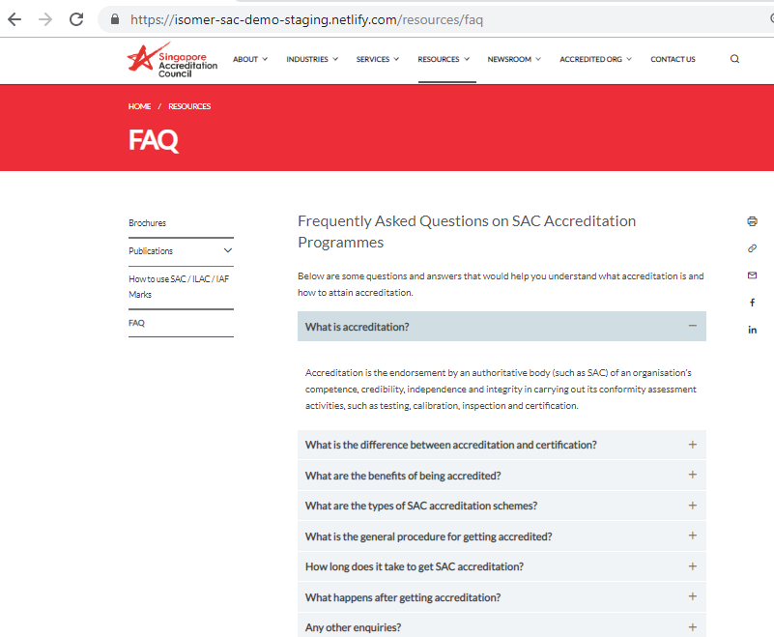
SAC FAQ Page
Contains an accordion (collapsible content). Each horizontal section contains a brief title, description, question etc.
When you click on each horizontal section, the content below it will expand.

Slide 5
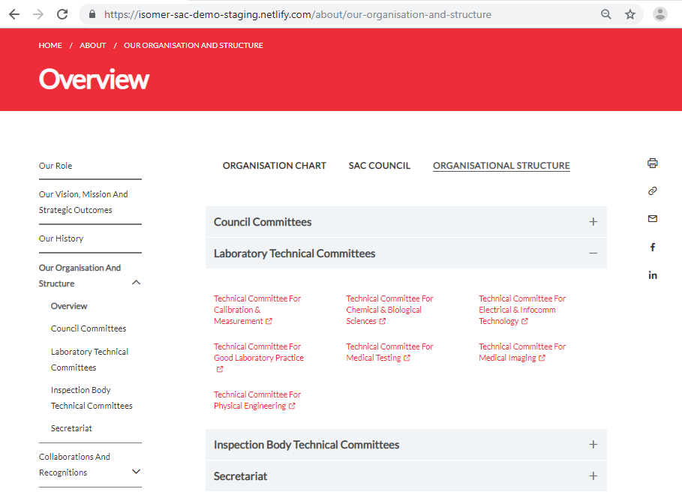
SAC ‘Our Organisation and Structure’ Page

Slide 6
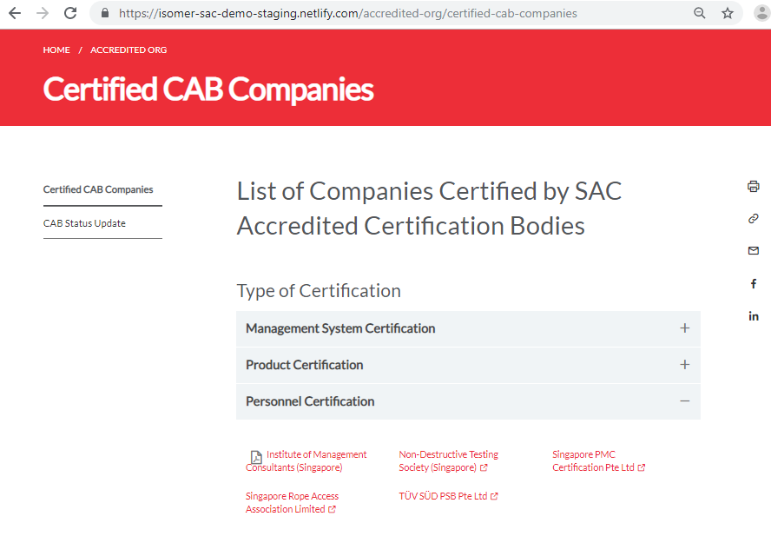
SAC ‘Certified Companies’ Page

Slide 7
Isomer ‘our-team’ layout
The FAQ page uses the ‘our-team’ layout.
The ‘Our Organisation and Structure’ and ‘Certified Companies’ pages also use the same layout
The content for these pages are stored in .yml files inside the _data folder of the Github Repository

Slide 8
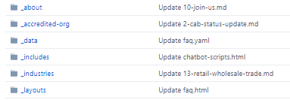
Isomer ‘our-team’ layout
_data folder contains .yml (or .yaml) files for editing certain sections of the website (e.g. homepage, navigation)

Slide 9
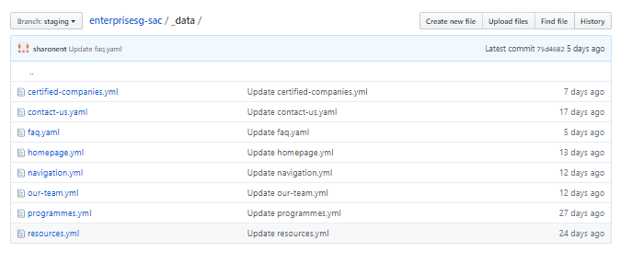
Isomer ‘our-team’ layout
_data folder contains .yml (or .yaml) files for editing certain sections of the website (e.g. homepage, navigation)
.yml file for certified companies page
.yml file for FAQ page
.yml file for ‘Organisational Structure’ section of ‘Our Organisation and Structure’ page

Slide 10
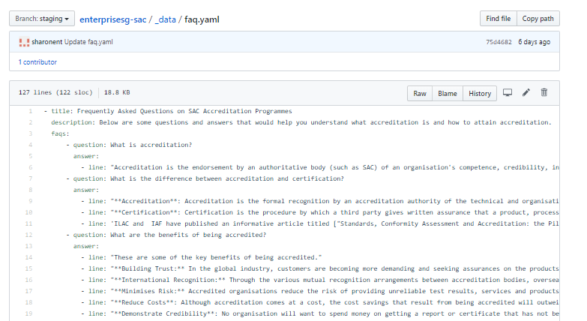
Edit faq.yml in Github Repository
1. Click on the ‘faq.yml’ file in the _data folder.
Make sure to set to ‘Staging’ branch first

Slide 11
Edit faq.yml in Github Repository
2. Click on the ‘edit’ (pencil icon) button.
Make sure to set to ‘Staging’ branch first
‘Edit’pencil icon is found on the top right hand corner of your file editor

Slide 12
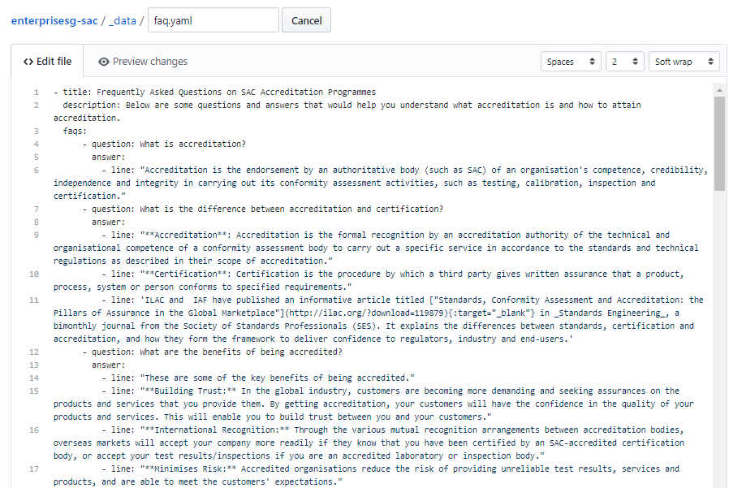
Edit faq.yml in Github Repository
3. Edit the content in the relevent section of the file.

Slide 13
Edit faq.yml in Github Repository
3. Edit the content in the relevent section of the file.
Each horizontal section in the FAQ accordion corresponds to a section / block of code in the file

Slide 14
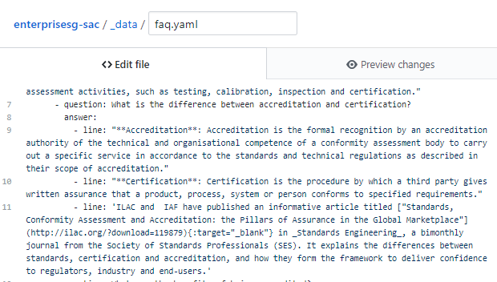
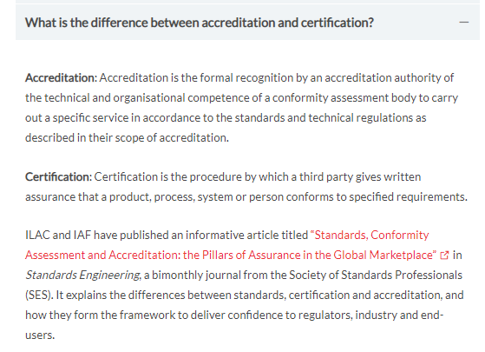
Edit faq.yml in Github Repository
Each horizontal section (and the collapsible content below it) in the FAQ accordion corresponds to a section / block of code in the file.

Slide 15
Edit faq.yml in Github Repository
Each horizontal section (and the collapsible content below it) in the FAQ accordion corresponds to a section / block of code in the file.

Slide 16
Edit faq.yml in Github Repository
Data Format:
question: Fill in your question here
answer:
- line: “Fill in markdown content of the first paragraph of your answer”
- line: “Fill in markdown content of the second paragraph of your answer”
- line: “Fill in markdown content of the third paragraph of your answer”
The answer portion can have one or multiple paragraphs.
Note: Be very careful with the indentation spacing in the .yml file. Your website will break if the spacing are incorrect.

Slide 17
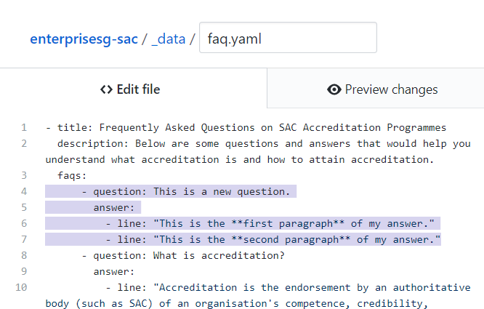
Edit faq.yml in Github Repository
Example:

Slide 18
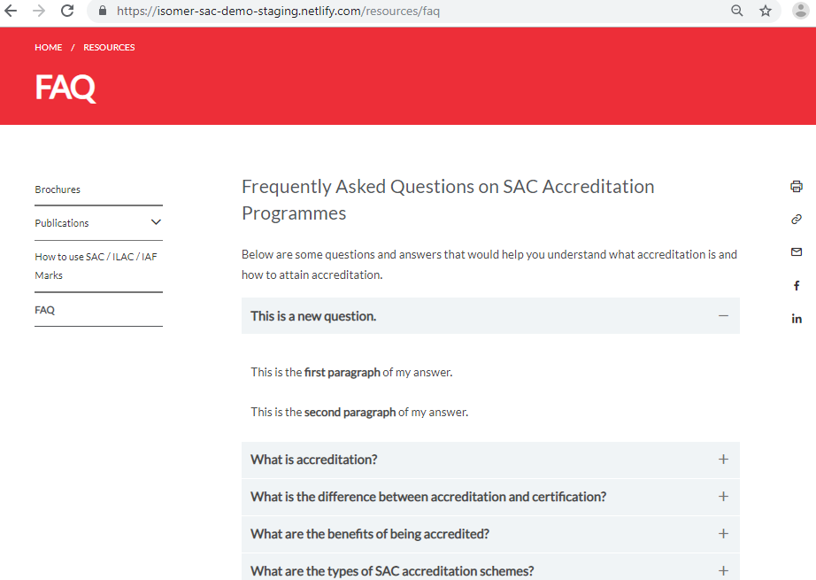
Edit faq.yml in Github Repository
Example:

Slide 19
Edit faq.yml in Github Repository
Example:

Slide 20
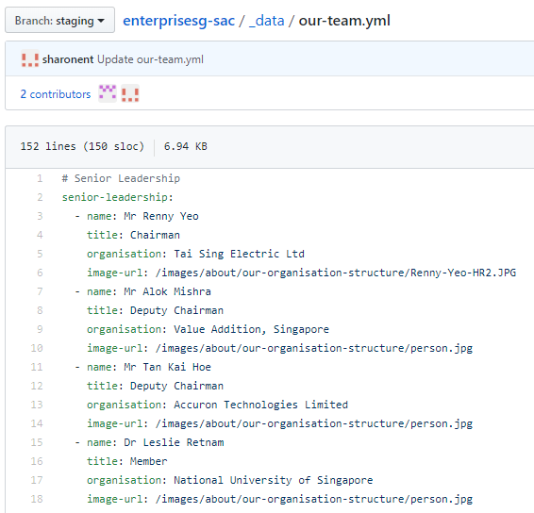
‘Our Organisation and Structure’ layout
Data for the content in ‘Our Organisation and Structure’ page is in ‘our-team.yml’ file inside the_data directory
name: Fill in person’s name
title: Fill in person’s title
organisation: Fill in person’s organisation name
image-url: link path to person’s image (if no image, use the default “/image/about/our-organisation- structure/person.jpg”)

Slide 21
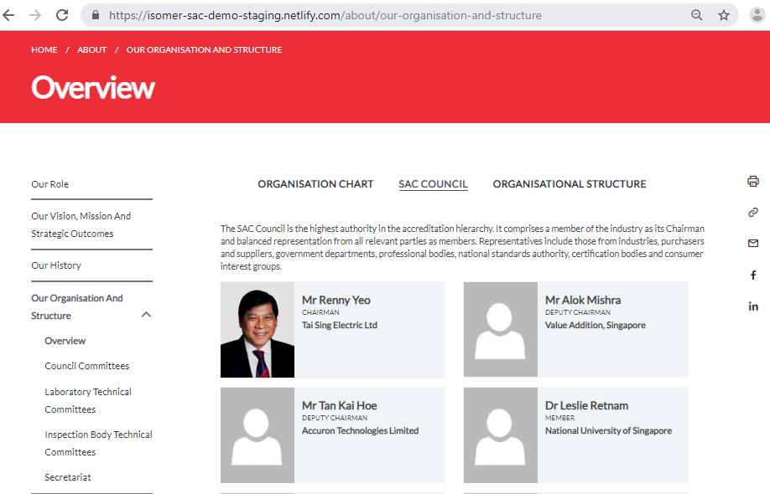
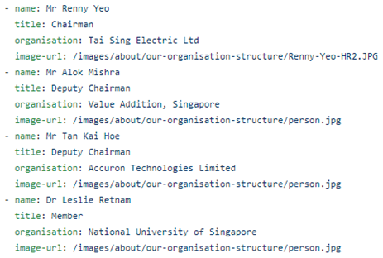
‘Our Organisation and Structure’ layout

Slide 22
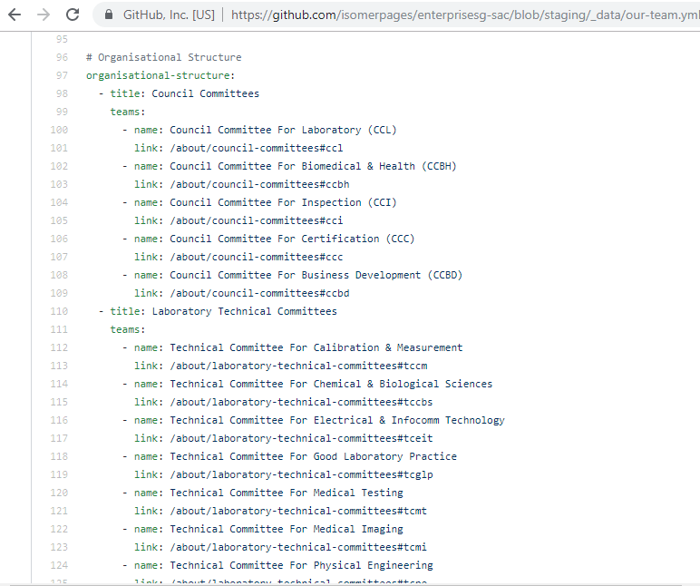
‘Our Organisation and Structure’ layout
‘Organisational Structure’ portion of the ‘our-team.yml’ file corresponds to the ‘Organisational Structure’ section in the ‘Our Organisation and Structure’ SAC website page
title: Fill in name of Committee
teams:
- name: Fill in name of committee group
link: Fill in SAC website permalink of committee group
- name: Fill in name of 2nd committee group
link: Fill in SAC website permalink of 2nd committee group
- name: Fill in name of 3rd committee group
link: Fill in SAC website permalink of 3rd committee group

Slide 23
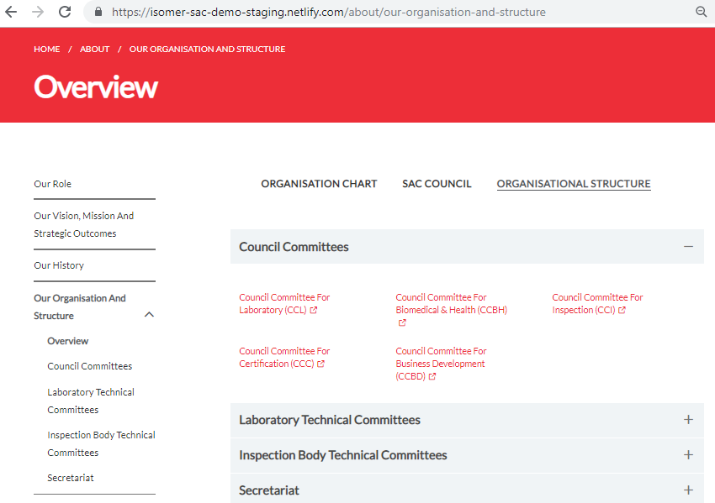
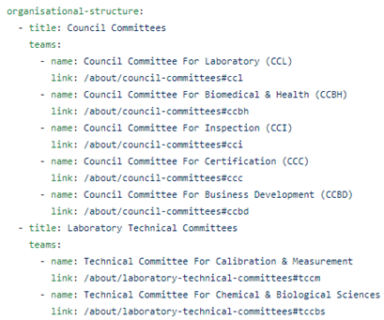
‘Our Organisation and Structure’ layout

Slide 24
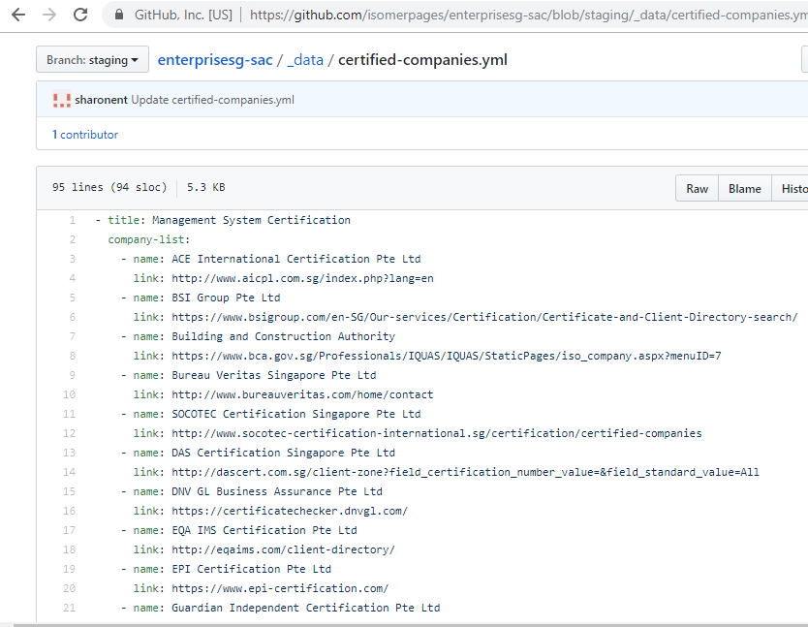
‘Certified Companies’ layout
Data for the content in ‘Certified CAB Companies’ page is in ‘certified-companies.yml’ file inside the_data directory
title: type of certification
company-list:
- name: name of certified company
link: url of company’s website
- name: name of 2nd certified company
link: url of 2nd certified company’s website

Slide 25
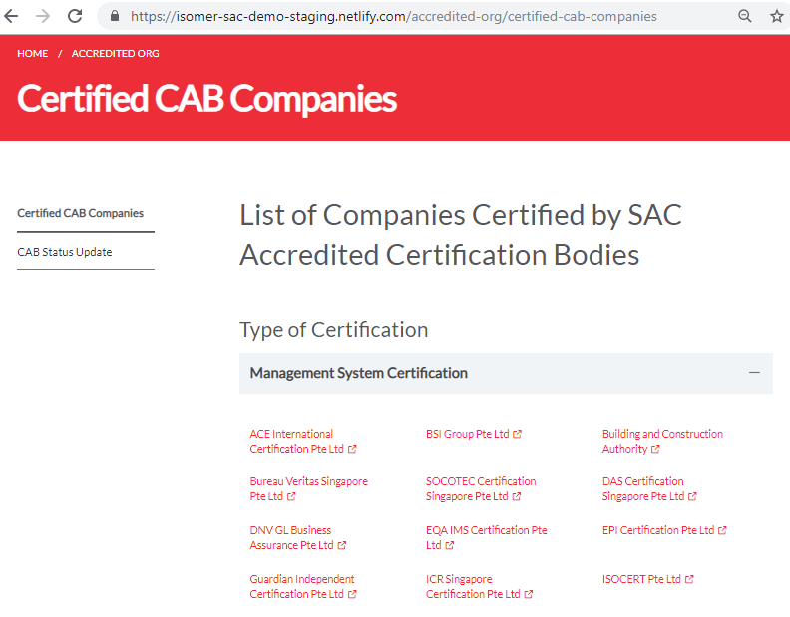
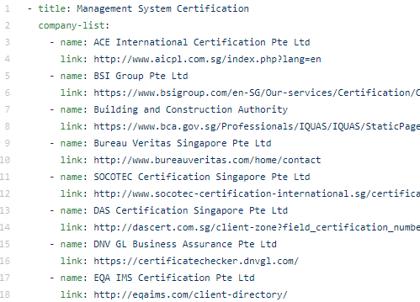
‘Certified Companies’ layout

