Slide 1
Your Trusted Partner in Accreditation
Admin Guide for Revamped Website - Overview
Sharon
AAD
24th June 2019
www.sac-accreditation.gov.sg

Slide 2

SAC Website Homepage

Slide 3
SAC Website Homepage
Homepage Hero Banner
Main Navigation Banner
Key Highlights

Slide 4
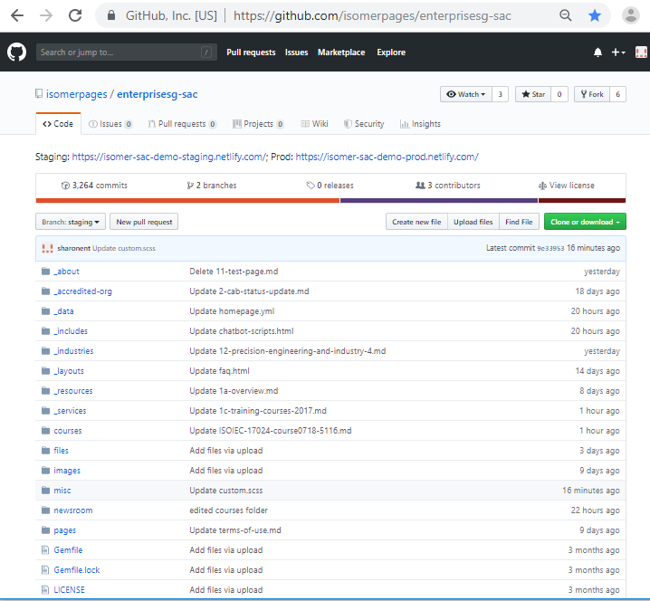
Github Repository

Slide 5
Github Repository
Link of the staging website
Make sure the branch is always set to ‘staging’ when you are editing anything

Slide 6
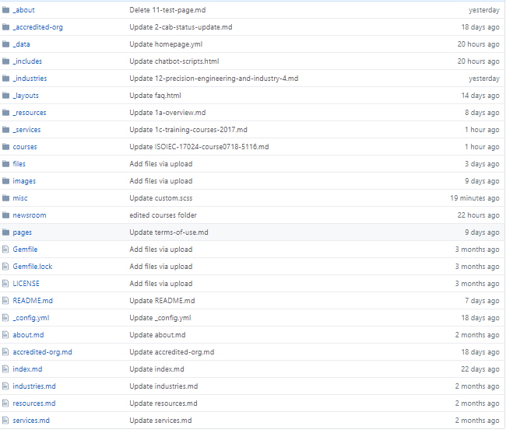
Github Repository
Each tab in the SAC website main navigation banner contains a folder of all the sub-pages, e.g. ‘about’, ‘accredited-org’, ‘ services’
Each main navigation tab (except newsroom) also contains a markdown (.md) file that lists information about the layout, title and url (e.g. about.md, accredited-org.md)

Slide 7
Github Repository
Documents for the website such as .pdf or .doc files are uploaded into the ‘files’ folder
NOTE: when uploading documents, images etc, always replace the spaces in the filename with dash(-) or underscore(_).
Images for the website such as .png, .jpg, .gif are uploaded into the ‘images’ folder

Slide 8
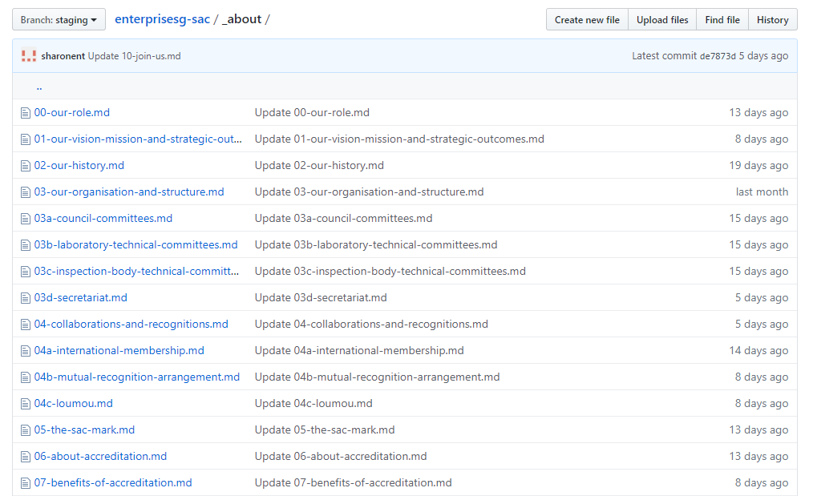
Example: _about folder
Clicking on the folders in the repository will bring you inside the folder directory

Slide 9
Example: _about folder
Current path / directory that you are in (i.e. inside _about folder)
Filenames correspond to the names of the sub-pages under the ‘about’ navigation section of the website

Slide 10
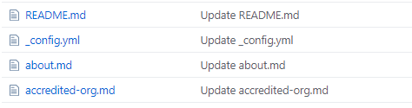
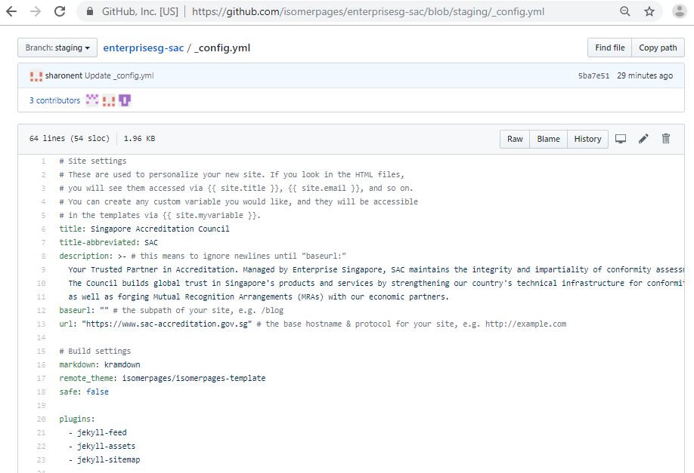
Github Repository - _config.yml
_config.yml file contains general settings for the website

Slide 11
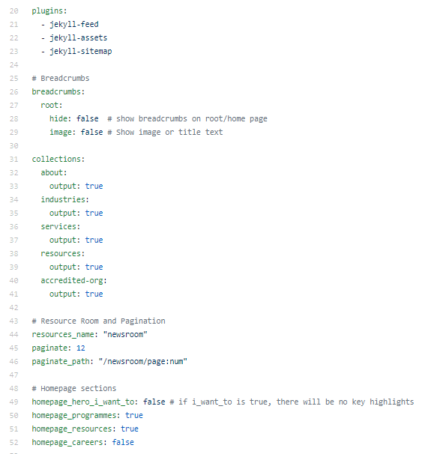
Github Repository - _config.yml
“collections” section contains the preset names for the main collections in your website (corresponds to the main navigation tabs)

Slide 12
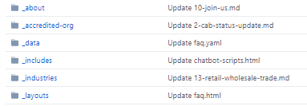
Github Repository - _data folder
_data folder contains configuration files (with the extension .yaml or .yml) for editing certain sections of the website (e.g. homepage, navigation)

Slide 13
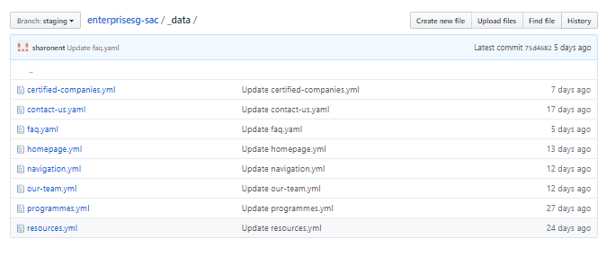
Github Repository - _data folder
_data folder contains configuration files (with the extension .yaml or .yml) for editing certain sections of the website (e.g. homepage, navigation)
Clicking on the _data folder will bring you to all the configuration files used for the SAC website (e.g. homepage.yml, navigation.yml)

Slide 14
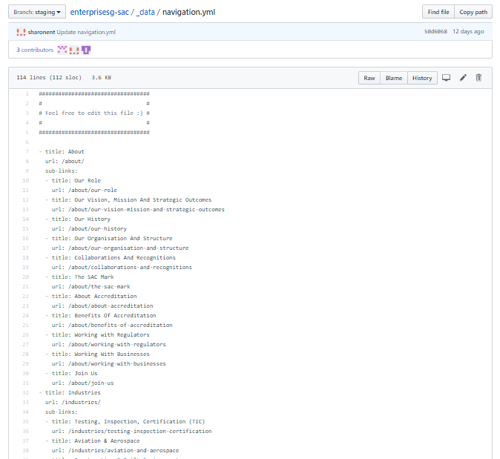
Github Repository – Navigation Banner Tabs
The titles and links for all the tabs in the main navigation bar and their sub-pages are contained inside the ‘navigation.yml’ file inside the ‘_data’folder

Slide 15
Github Repository – Navigation Banner Tabs
The titles and links for all the tabs in the main navigation bar and their sub-pages are contained inside the ‘navigation.yml’ file inside the ‘_data’folder
Title and url of a main banner navigation tab (e.g. ‘About’)
The spacing in the navigation.yml file must be correct, otherwise the website may break.
Title and url of a sub-link under the ‘about’ navigation tab

Slide 16
Isomer Templates
The SAC website uses 3 Isomer template layouts
leftnav-page
post
our-team

Slide 17
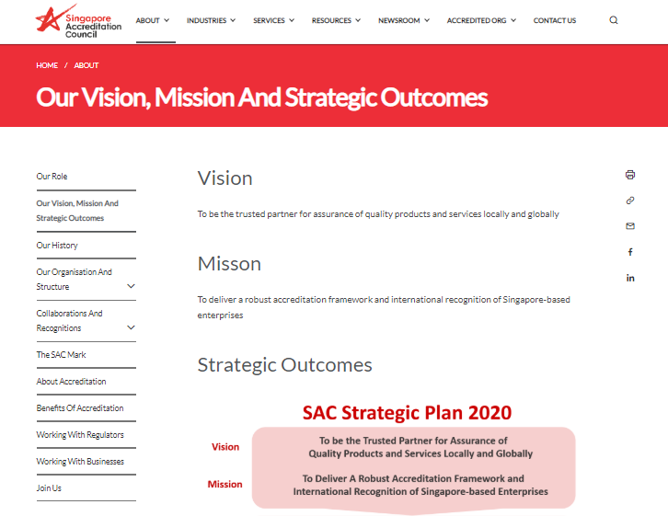
Isomer Templates – leftnav-page
The leftnav-page template is used for most of the pages in the SAC website.
Pages using the leftnav-page template have a left navigation bar that contains the links of all the sub-pages

Slide 18
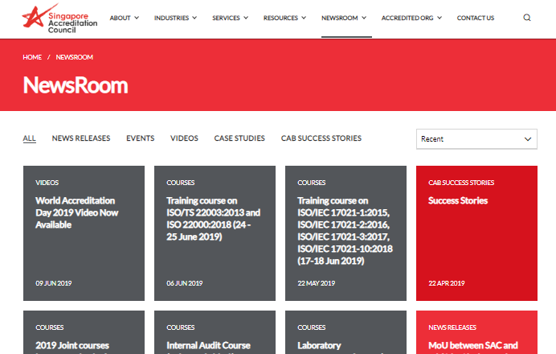
Isomer Templates – post
The post template is used for the pages inside the Newsroom link.
Each box in the NewsRoom page corresponds to a single ‘post’ template page

Slide 19
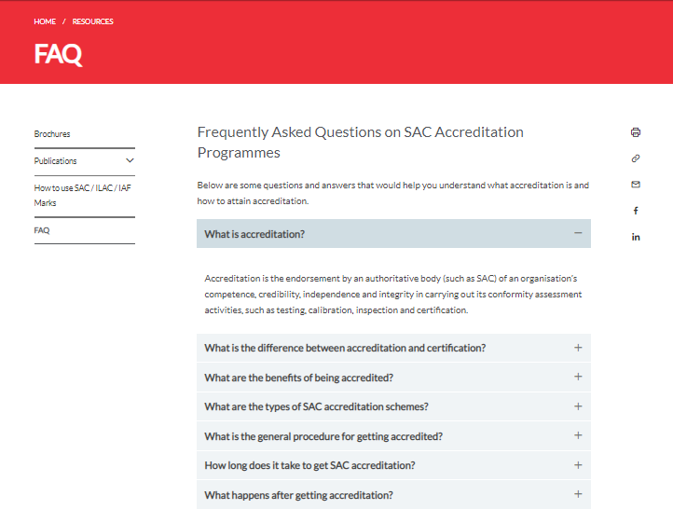
Isomer Templates – our-team
The our-team layout is used in only specific pages like ‘Our Organisation and Structure’, ‘FAQ’ and ‘Certified Companies’.
Contains an accordion (collapsible content). Each horizontal section contains a brief title, description, question etc.
When you click on each horizontal section, the content below it will expand.

