Slide 1
Your Trusted Partner in Accreditation
Admin Guide for Revamped Website – Edit homepage
Sharon
AAD
24th June 2019
www.sac-accreditation.gov.sg

Slide 2

SAC Website Homepage

Slide 3
SAC Website Homepage
Favicon
Agency Logo
Hero Banner
Hero Title
Hero Subtitle
Key Highlights

Slide 4

SAC Website Homepage

Slide 5
SAC Website Homepage
Info Section title
Info Section Subtitle
Isomer Info Section
Info Section description
Info Section Image Path
Info Section more button
Resources title
Resources subtitle
Isomer Resources Section
Resources more button

Slide 6
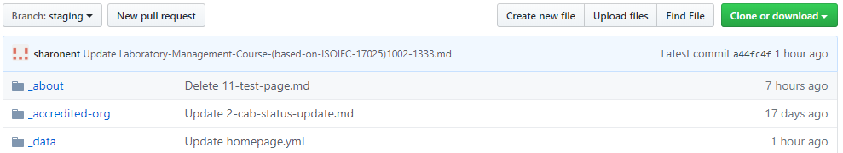
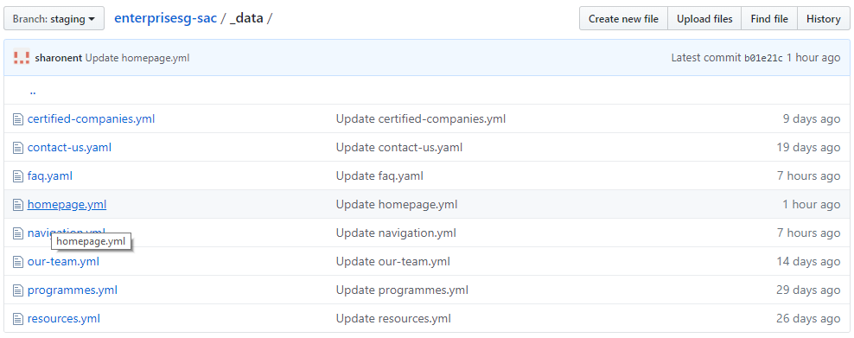
Editing Homepage in Github Repository
Make sure you are at the ‘staging’ branch
1. Click on the _data folder inside the Github Repository
_data folder contains configuration files (with the extension .yaml or .yml) for editing certain sections of the website (e.g. homepage, navigation)
2. Click on the homepage.yml file

Slide 7
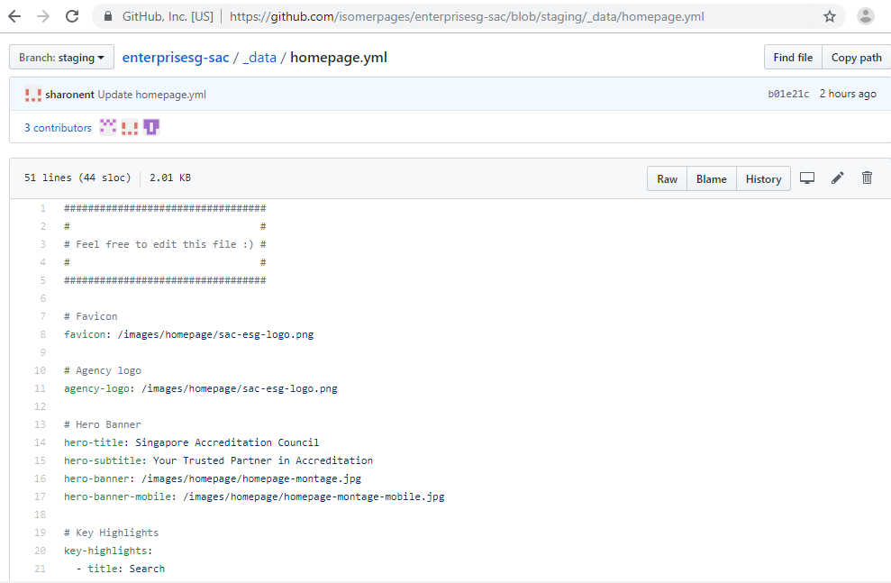
Editing Homepage in Github Repository
Current path shows that you are at homepage.yml file inside the _data folder of the enterprisesg-sac Github repository
3. Click on “Edit” (pencil icon) button

Slide 8
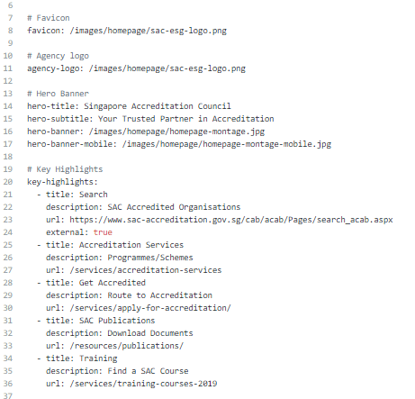
Editing Homepage in Github Repository
Landing page and hero banner section

Slide 9
Editing Homepage in Github Repository

Slide 10

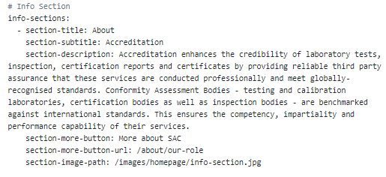
Editing Homepage in Github Repository
Isomer Info section

Slide 11
Editing Homepage in Github Repository
Isomer Info section
the SAC website link when the user clicks on the ‘More About SAC’ button

Slide 12


Editing Homepage in Github Repository
Isomer Resources section

Slide 13
Editing Homepage in Github Repository
Isomer Resources section
the SAC website link when the user clicks on the ‘More News& Events ’ button
The boxes are automatically updated when new posts are added under the NewsRoom tab

Slide 14
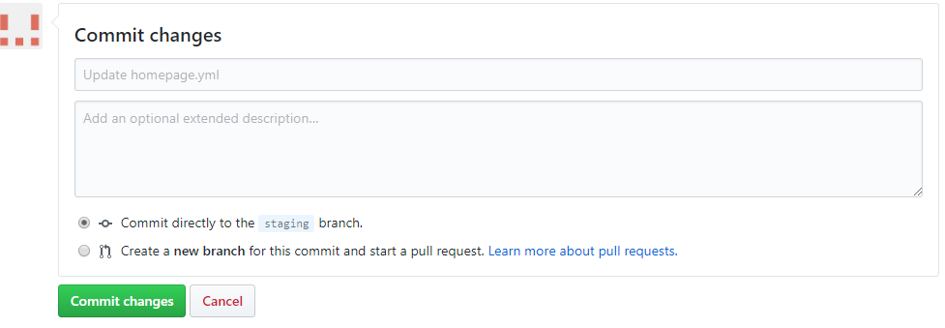
Editing Homepage in Github Repository
4. Edit in the relevant section of homepage.yml
Note: Be very careful with the indentation / spacing in the homepage.yml file. The website may break if the indentation is incorrect.
Do not change the wording of the key values (e.g. “favicon:”, “agency-logo:”, “hero-title:”)
5. Click on “Commit changes” button at the bottom of the file.

Slide 15
GovTech Example (Animation)

