Slide 1
Your Trusted Partner in Accreditation
Admin Guide for Revamped Website – Markdown Usage
Sharon
AAD
24th June 2019
www.sac-accreditation.gov.sg

Slide 2
Setting Font Size for Headers
In Markdown:
On Isomer webpage:
#### A small sized header
### A medium sized header
## A big sized header
# A super big sized header
A small sized header
A medium sized header
A big sized header
A super big sized header

Slide 3

Formatting Text
In Markdown:
On Isomer webpage:
**Add 2 asterisks directly before and after a text without spacing to make it bold.**
*Add 1 asterisk directly before and after a text without spacing to make it italized.*
You can **bold** and *italicize* your text in the same line.
> Use blockquotes to make your text stand out
Add 2 asterisks directly before and after a text without spacing to make it bold.
Add 1 asterisk directly before and after a text without spacing to make it italicized.
You can bold and italicize your text in the same line.

Slide 4
Using Lists
In Markdown:
On Isomer webpage:
You can create bullet/subbullet list (asterisk followed by space):
* Item 1
* Item 2
* Item 2.1
* Item 2.2
Or, you can also create number list:
1. Item A
2. Item B
You can create bullet/subbullet list (asterisk followed by space):
Item 1
Item 2
Item 2.1
Item 2.2
Or, you can also create number list:
Item A
Item B

Slide 5

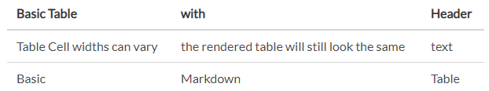
Using Tables
Markdown
| Basic | Markdown | Table |
| Tables | are | cool |
| Basic Table | with | Header |
| --- | --- | --- |
| Table Cell widths can vary | the rendered table will still look the same | text |
| Basic | Markdown | Table |
SAC Isomer Webpage

Slide 6
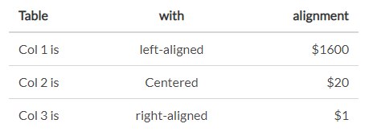
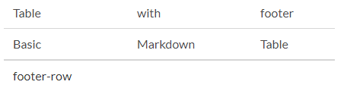
Using Tables
In Markdown:
On Isomer webpage:
| Table | with | alignment |
| :--- | :----: | ---: |
| Col 1 is | left-aligned | $1600 |
| Col 2 is | Centered | $20 |
| Col 3 is | right-aligned | $1 |
| Table | with | footer |
| Basic | Markdown | Table |
|=========|
| footer-row |

Slide 7
Using Tables
Use online markdown table generator https://www.tablesgenerator.com/markdown_tables to create simple Markdown tables easily.
For more complicated tables, it is best to use HTML tables. https://www.tablesgenerator.com/html_tables

Slide 8
Adding Website Link
In Markdown:
On Isomer webpage:
Here's how to create a [website link](http://github.com)
*Square brackets containing website name followed by round bracket or parenthesis containing the website URL address*
Here's how to create a [website link](http://github.com){:target="_blank"} that opens in a new window
*To create a website link that opens in a new window, we add {:target="_blank"} after the inline Markdown website link*
Here's how to create a website link
Square brackets containing the website name followed by round brackets or parenthesis containing the website URL address
Here's how to create a website link that opens in a new window
To create a website link that opens in a new window, we add {:target="_blank"} after the inline Markdown website link

Slide 9
Adding word, pdf, excel etc. document link
Documents must be first uploaded to the files folder in the SAC Github Repository
Select your "Staging" Branch
Go to the "files" folder and then select the folder that you wish to add or delete a file.
Click on "Upload files" button.
Choose your file. It can be of pdf, doc, excel. Remember to replace the space in the filename with dash (-) for better readability.
Click on “Commit Changes” button.
Add the file download link in your webpage.

Slide 10

Adding word, pdf, excel etc. document link
In Markdown:
On Isomer webpage:
Here's how to create a
Here's how to create a [file download link](/files/github-setup.pdf)
*Square brackets containing the file name followed by round brackets or parenthesis containing the file path*
Square brackets containing the file name followed by round brackets or parenthesis containing the file path

Slide 11
Adding Images
Images must be first uploaded to the images folder in the SAC Github Repository
Select your "Staging" Branch
Go to the “images" folder and then select the folder that you wish to add or delete a file.
Click on "Upload files" button.
Choose your file. It can be of jpg, png, gif. Remember to replace the space in the filename with dash (-) for better readability.
Click on “Commit Changes” button.
Add the image name and path in your webpage.

Slide 12

Adding Images
In Markdown:
On Isomer webpage:
![Image title](/images/hero-banner.png)
Exclamation mark followed by square brackets containing the image title followed by round brackets or parenthesis containing the image path
The image title is used as alternative text for screen readers or if the image cannot be displayed.
The image file path points to the actual location in the Github Repository where the image file is stored .
Exclamation mark followed by square brackets containing the image title followed by round brackets or parenthesis containing the image path
This image title is used as alternative text for screen readers or if the image cannot be displayed.
The image file path points to the actual location in the Github Repository where the image file is stored.

Slide 13
Adding Images
All Isomer images are displayed in the centre as a single block / paragraph (i.e. no other text / objects can be on either side of the image) and set to its actual width or the maximum width of the webpage.
To edit the size of the image, you have to either:
process it beforehand by changing the size of the image before uploading to the website; or
Add additional attributes (inline styles) after the Markdown image, i.e.
![image title](image-path){:style=“width:100px;height:100px;”}

Slide 14
Adding Images
In Markdown:
On Isomer webpage:
Changing Image width:
**Changing Image width:**
![Hero Banner](/images/hero-banner.png){:style=“width:100px;”}
**Changing Image width and height:**
![Hero Banner](/images/hero-banner.png){:style=“width:100px;height:100px;”}
Changing Image width and height:

Slide 15
Adding Images
In Markdown:
On Isomer webpage:
**Alight Left:**
![Hero Banner](/images/hero-banner.png){:style=“width:100px;height:100px;margin-left:0;”}
**Alight Right:**
![Hero Banner](/images/hero-banner.png){:style=“width:100px;height:100px;margin-right:0;”}
Alight Left:
Alight Right:

Slide 16
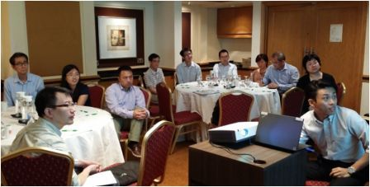
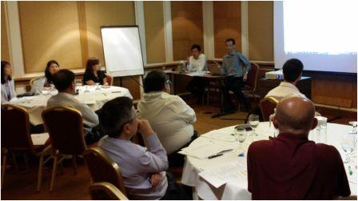
Adding Images
In Markdown:
On Isomer webpage:
![Hero Banner](/images/hero-banner.png)
*Add a text caption below the image*
**Align 2 images side-by-side using a table:**
| ![Title 1](/images/img1.jpg) | ![Title 2](/images/img2.jpg2) |
Add a text caption below the image
Alight 2 images side-by-side using a table:

Slide 17

Adding Youtube Video
In Markdown:
On Isomer webpage:
This is how you add a Youtube video:
1. Click on "Share" button on your Youtube video
2. Click on "Embeded" button
3. Copy "iframe" embed content
4. Paste it between the "div" tag
This is a example how it looks like:
<div class="bp-youtube">
<iframe width="560" height="315" src="https://www.youtube.com/embed/BBcR4KGDdL0" frameborder="0" allow="autoplay; encrypted-media" allowfullscreen></iframe>
</div>
This is how you add a Youtube video:
Click on "Share" button on your Youtube video
Click on "Embeded" button
Copy "iframe" embed content
Paste it between the "div" tag
This is a example how it looks like:

Slide 18
Adding email link
In Markdown:
On Isomer webpage:
Here's how to create a email link, <email@something.com>
*angle brackets containing the email address*
Here’s how to create an email link, email@something.com
angle brackets containing the email address

