Slide 1


Exploratory Data Analysis of
King County
02/20/2026
by Isabell Durieux

Slide 2


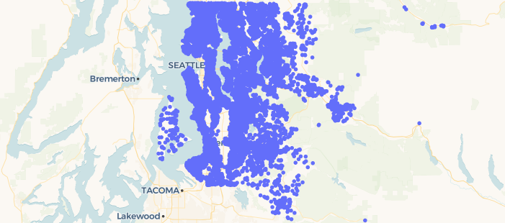
- Invest in poor neighborhood
- Buying & selling
- Costs back + little profit
- Socially responsible
Buying requirements
Houses of King County
Erin Robinson
Goal: Recommendations for affordable houses in King County

Slide 3

Summary of Hypotheses
Hypothesis 1: The lower the grade and condition, the cheaper the house
Hypothesis 2: Cheap houses are accumulated in a specific council district
Hypothesis 3: Houses at the waterfront are more expensive compared to houses without a waterfront

Slide 4

Data analysis
Data overview Target variable: Price
Main features: Bedrooms, bathrooms, sqft living, sqft lot, floors, sqft above, sqft basement, sqft living 15, sqft lot15, date of selling
Quality and location factors: Waterfront, view, condition, grade, zipcode, lat, long
Age, Modernization: Year built, year renovated
Quality and location factors
Parameter |  | Information
Condition |  | How good is the overall condition of the house
Grade |  | Overall grade given to the housing unit, based on King County grading system
Lat |  | Latitude coordinate
Long |  | Longitude coordinate
Price |  | Is prediction target
Waterfront |  | House which has a view to a waterfront
Id |  | Unique identified for a house

Slide 5
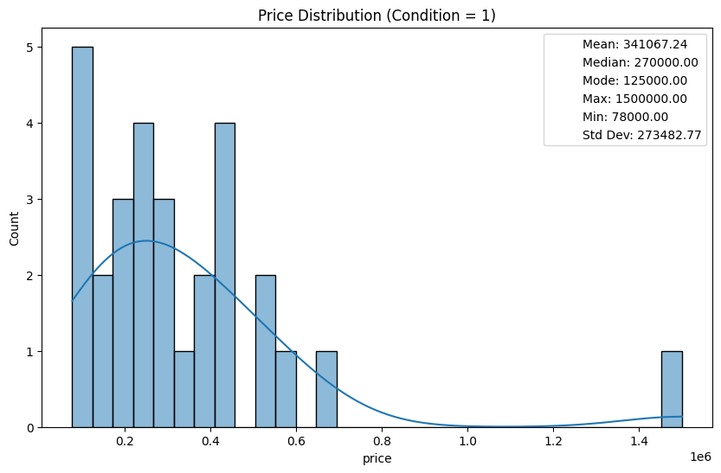
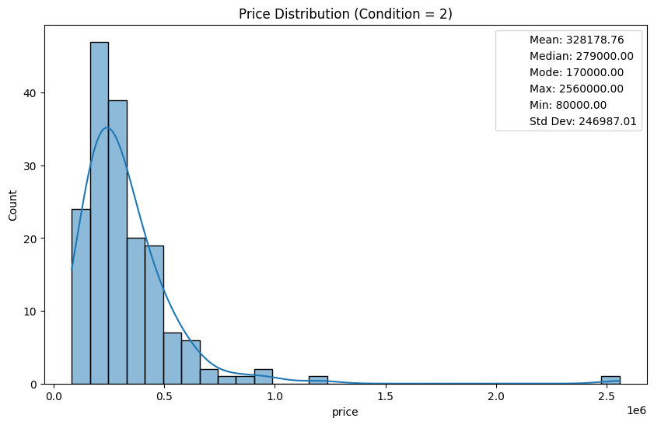
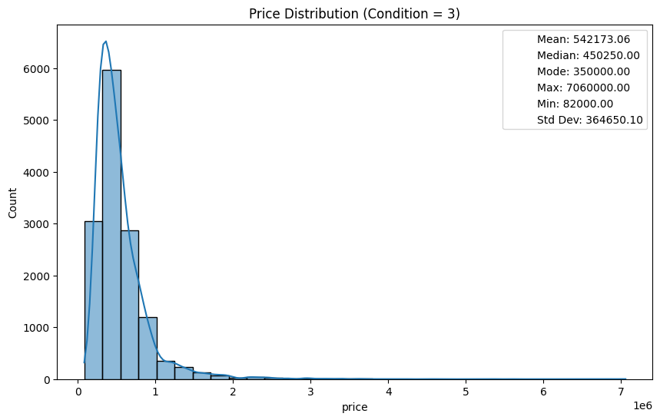
Hypothesis 1: The lower the grade and condition, the cheaper the house
Price distribution of conditions 1-5
Condition 1
Condition 2
Condition 3
Condition 4 and 5 were plotted in the same way as the other conditions.
House prices generally increase with better condition
The standard deviation increases with condition, suggesting greater price variability among homes in better condition
Condition | Mean price in mio dollar | Median price in mio dollar | Mode price in mio dollar | Max price in mio dollar | Min price in mio dollar | Std. dev. in mio dollar
1 | 0,341 | 0,270 | 0,125 | 1,500 | 0,078 | 0,273
2 | 0,328 | 0,279 | 0,170 | 2,560 | 0,080 | 0,247
3 | 0,542 | 0,450 | 0,350 | 7,060 | 0,082 | 0,365
4 | 0,521 | 0,440 | 0,450 | 7,700 | 0,089 | 0,359
5 | 0,613 | 0,526 | 0,550 | 3,650 | 0,110 | 0,411
Mode = Price with the highest frequency
Median = Mean value, resistant to extreme prices

Slide 6
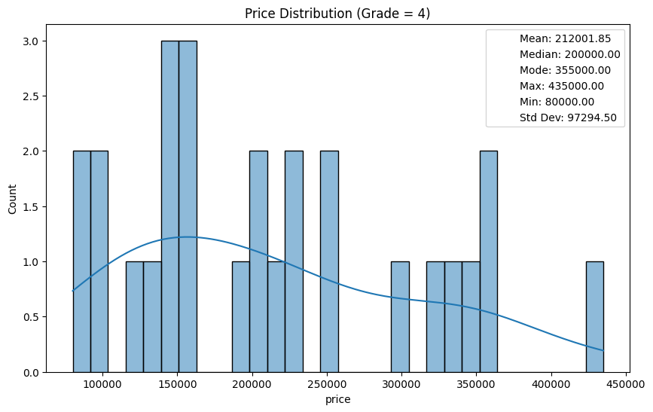
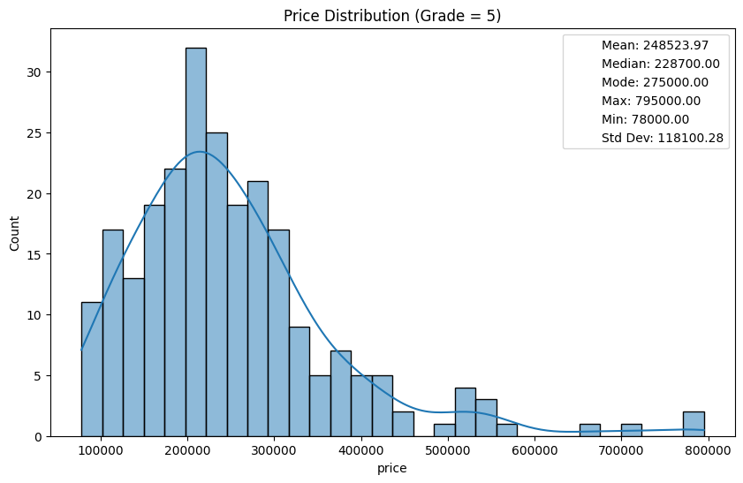
Hypothesis 1: The lower the grade and condition, the cheaper the house
Price distribution of grade 3-13
Grade 4
Grade |  | Mean price in mio dollar | Median price in mio dollar | Mode price in mio dollar | Max price in mio dollar | Min price in mio dollar | Std. dev. in mio dollar
3 |  | 0,262 | 0,262 | 0,262 | 0,262 | 0,262 | nan
4 |  | 0,212 | 0,200 | 0,355 | 0,435 | 0,080 | 0,097
5 |  | 0,249 | 0,229 | 0,275 | 0,795 | 0,078 | 0,118
6 |  | 0,302 | 0,275 | 0,250 | 1,200 | 0,082 | 0,123
7 |  | 0,403 | 0,375 | 0,350 | 2,050 | 0,090 | 0,156
8 |  | 0,543 | 0,510 | 0,550 | 3,070 | 0,140 | 0,218
9 |  | 0,774 | 0,720 | 0,650 | 2,300 | 0,230 | 0,317
10 |  | 1,072 | 0,914 | 1,050 | 3,600 | 0,316 | 0,484
11 |  | 1,498 | 1,280 | 1,150 | 7,060 | 0,420 | 0,705
12 |  | 2,203 | 1,820 | 1,490 | 5,350 | 0,835 | 1,029
13 |  | 3,711 | 2,980 | 3,800 | 7,700 | 0,178 | 1,859
Grade 5
Grade 3, and 7-13 were plotted in the same way as the other conditions.
The table shows that house prices increase strongly with higher grade levels.

Slide 7
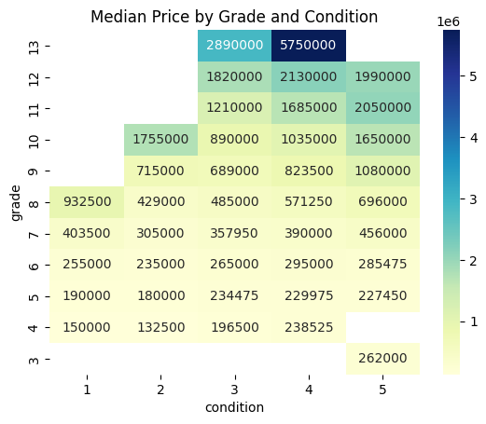
Lower grades and conditions are associated with lower median prices of homes
The heatmap shows the median house price by grade (y-axis) and condition (x-axis)
Higher grades (especially 10–13) are associated with substantially higher median prices
Condition has a positive but smaller impact compared to grade on median prices
Hypothesis 1 is confirmed
Focus on lower grades (grade 4-7) and conditions (condition 1-3) to find houses

Slide 8
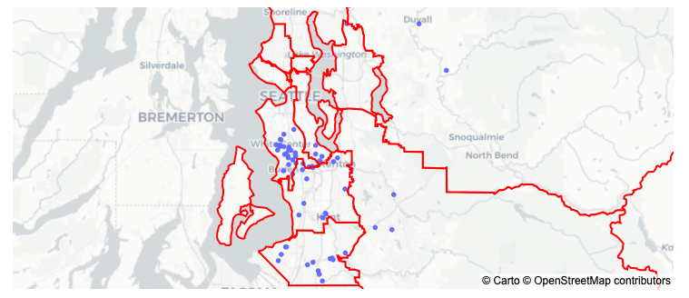
Hypothesis 2: Cheap houses are accumulated in a specific council district
Definition cheap houses: Up to 120,000 dollars
9 King County Council Districts
1
4
4
6
8
2
3
8
5
7
9
Most accumulation of cheap houses in district 5, 7, and 8
Hypothesis 2 is confirmed

Slide 9
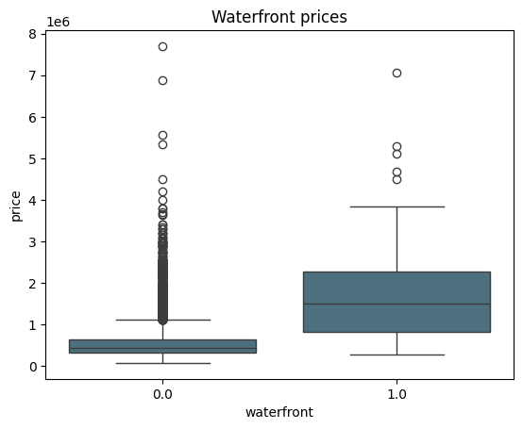
Hypothesis 3: Houses at the waterfront are more expensive compared to houses wo a waterfront
Waterfront | Mean price | Median price | Max price | Min price | Std. dev. price
Yes | 0.533 | 0.450 | 7.700 | 0.078 | 0.345
No | 1.717 | 1.510 | 7.060 | 0.285 | 1.145
Prices of houses with a waterfront are 3x higher compared to houses without a waterfront
Focus on houses without a waterfront
Hypothesis 3 is confirmed

Slide 10
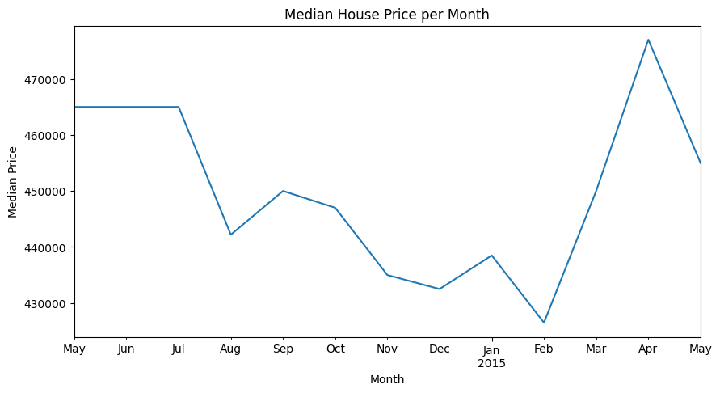
Recommendations for King County
Year 2014: 450,000 dollar
Year 2015: 451,000 dollar
Summary for affordable houses in King County
Most accumulation of affordable houses in district 5, 7, 8
Use the King Counting grading system, focus on low grades (grade 4-7) and conditions (condition 1-3)
Houses without waterfront are more likely to be cheaper
Lower prices on the King County real estate market between November and February

