Slide 1

New Jersey Residential Rental Market Statistics
Presented By
Isabella A
Jan Earl A
Deepak H

Slide 2

New Jersey Rental Market Trends
Market Trends: The Big Picture
Understanding The Local Market(s) You’re Renting Your 1st Apartment/Home Or Making Your Next Move To.
Process & Strategies for Renting The Right Home/Apartment

Slide 3
Objective
Collect as much rental and income data as we can for all counties of NJ
Look at rental and income trends per county over a 6 year period
Use these trends to predict with a reasonable amount of certainty the next month, quarter, or year
Show which counties are best suited for individuals within certain income brackets in terms of renting property

Slide 4
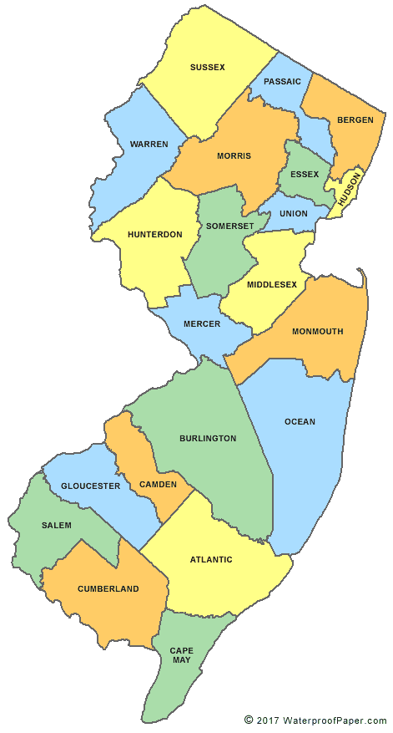
The Map Of New Jersey

Slide 5
Economic Factors
 | 2013 | 2014 | 2015 | 2016 | 2017 | 2018
Gas Per Gallon | $3.81 | $3.36 | $2.40 | $2.14 | $2.41 | $2.72
NJ Household Income | $66,476.71 | $67,539.78 | $69.348.33 | $70.529.76 | $72,804.57 | $76.503.33
Employed | 4,173,828 | 4,183,541 | 4,229,158 | 4,252,062 | 4,247,535 | 4,239,567
Unemployed | 374,732 | 303,497 | 259,843 | 222,627 | 205,990 | 183,375
NJ Unemployment Rate | 8.2 | 6.8 | 5.8 | 5.0 | 4.6 | 4.1

Slide 6
What people Look For Before Renting An Apartment/House
Location
Near school or work
Near shopping (Grocery stores, Malls, Restaurants…..)
Near public transportation
Finances
Amount of monthly rent
Amount of security deposit (often the same as one month’s rent)
Cost of utilities (is anything included in your rent)
Building
Condition of building and grounds
Parking facilities
Security system
Condition of hallways, stairs, and elevators
Layout and Facilities
Size and condition of unit
Type and controls of heating and cooling units
Type and condition of appliances
Condition of doors, locks, windows, closets, and floors

Slide 7
Finance: Household Income Vs Rental Cost
Analyze rental trends by County and rental types (Studio, 1BHK, 2 BHK, Condo….) for the past 6 years
How is the rental market trending from 2013-2018?
Counties that are cheaper to live than others.
Are there any counties that are going in the reverse direction
Analyze average household income by County for the past 6 years
Average household salary based on county
Average unemployment rate based on county

Slide 8
Average household salary by county and year
County Name | 2013 | 2014 | 2015 | 2016 | 2017 | 2018
Camden County | $58,572.00 | $57,641.00 | $61,685.00 | $63,589.00 | $65,838.00 | $65,817.00
Cape May County | $48,691.00 | $49,443.00 | $51,322.00 | $53,981.00 | $55,875.00 | $58,324.00
Cumberland County | $34,109.00 | $34,349.00 | $35,366.00 | $36,814.00 | $37,408.00 | $38,893.00
Essex County | $54,783.00 | $55,369.00 | $57,817.00 | $60,131.00 | $61,287.00 | $63,554.00
Gloucester County | $44,895.00 | $45,826.00 | $47,305.00 | $49,636.00 | $50,589.00 | $52,506.00
Hudson County | $47,628.00 | $48,344.00 | $51,776.00 | $55,354.00 | $57,081.00 | $59,623.00
Hunterdon County | $103,301.00 | $107,203.00 | $103,876.00 | $102,797.00 | $113,336.00 | $113,083.00
Mercer County | $67,662.00 | $70,575.00 | $73,750.00 | $72,172.00 | $76,988.00 | $78,161.00
Middlesex County | $77,044.00 | $76,515.00 | $77,330.00 | $78,249.00 | $82,183.00 | $85,187.00

Slide 9
Average Rental cost by county and year
County Name | 2013 | 2014 | 2015 | 2016 | 2017 | 2018
Camden County
Cape May County
Cumberland County
Essex County
Gloucester County
Hudson County
Hunterdon County
Mercer County
Middlesex County

Slide 10
Graphs and Charts

Slide 11
Data Limitations
Only New Jersey county data was used for this analysis.
Comparing rental price data from other states like New York, Connecticut, Pennsylvania… would have been helpful in determining if other neighboring states are better for renting.
Missing values
There was some data missing on average rental prices which at times does skew the data in one direction
Purchase instead of Rent (Next gen analysis)
Additional research would benefit when rental numbers are compared to home sales numbers to determine if the current market is better for renting or purchasing houses/apartments.

Slide 12
Questions
?

