Slide 1
Yeet Machine 3000
Chase Banyai, Isabella Boone,
Joel Gingrich, Joshua Jackson

Slide 2
Development Process
Explain how the coding was done.
We met over discord and created a private chat to keep tabs on people.
We used the school’s gitlab to push to so everyone in the group had access to it.
Mostly individual coding and met up if someone needed help.
Most people did small or medium bits, very few large bits.
Sometimes it wouldn’t let us push to git because someone else pushed. Not everyone’s schedule lined up.

Slide 3
Overview of Database
Purpose of database
Store information about various aspects of a game. Including:
Players
Creatures
Items
Locations
Applications
Could be used in an MMO or RPG?

Slide 4
ItemsLayout
The Layout displays All of the items in the database.
The values displayed are Id, Volume, Weight, LocationId, and Character Name.
This is Useful for seeing what items there are in the database and who has it or where it is.

Slide 5
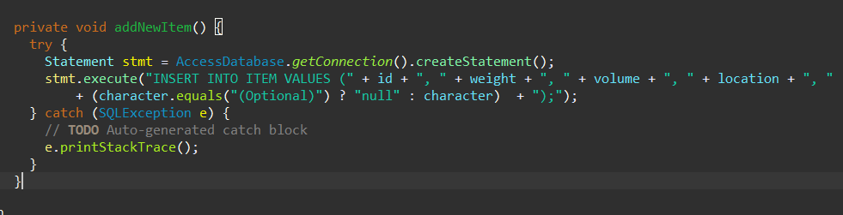
AddItem
This brings up another window with input textboxes.

Slide 6
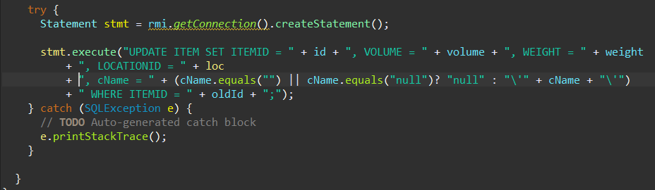
EditItem
This opens another window with existing data in text boxes.

Slide 7
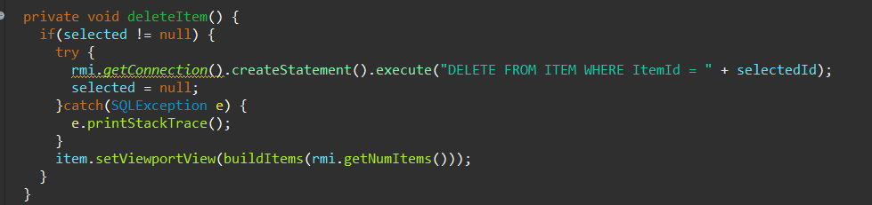
DeleteItem
This deletes the selected Item in on the screen.

Slide 8
CharactersLayout
CharactersLayout displays all characters in the database and the stats for each player the user selects.
Useful for seeing what characters belong to what users, seeing how much health, stamina, strength, and location of character

Slide 9
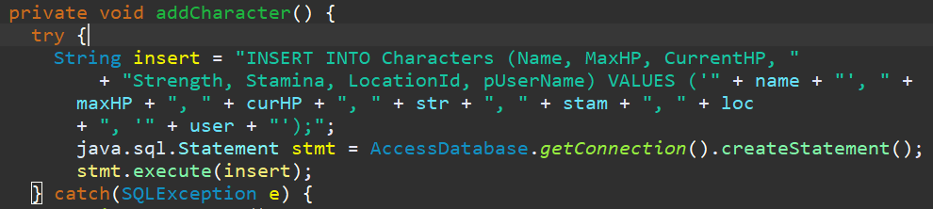
CharactersLayout: Insert
AddCharacter and AddUser are classes that utilize the insert SQL functions.
Example:

Slide 10
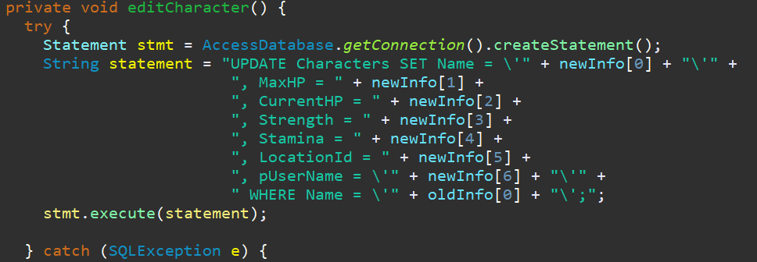
CharactersLayout: Update
EditCharacter is a class that utilizes the update SQL function.
Example:

Slide 11
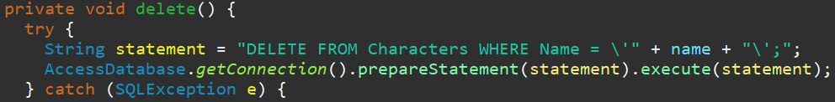
CharactersLayout: Delete
EditCharacter is a class that utilizes the delete SQL function.
Example:

Slide 12
CharactersLayout: Select
genCharactersPanel and genStatsPanel are two functions inside the CharactersLayout class that utilizes the select statements frequently.
genCharactersPanel a stored procedure that looks like this:

Slide 13
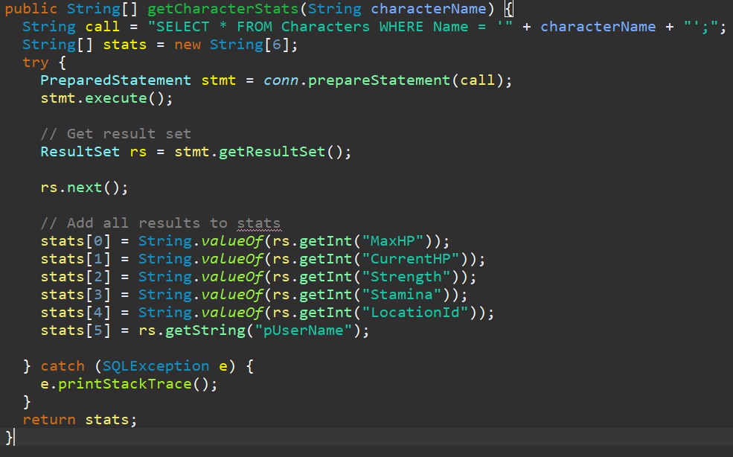
CharactersLayout: Select
genStatsPanel calls this function to retrieve all of its stats:

Slide 14
PlayerLayout
This layout displays information regarding the player’s character, what items specific characters are holding, and the character’s stats
This screen is useful for getting a wide view on the stats of the character and knowing what they are holding

Slide 15
Location Layout
Location Layout displays a list of location IDs and the contents held within them.
It can add, edit and delete items and creatures from locations.

Slide 16

Location Layout: Insert
Location Layout uses classes AddItem and AddCreature to insert data.

Slide 17
Location Layout: Update
LocationLayout uses classes editItem and editCreature to update data.

Slide 18
Location Layout: Delete
LocationLayout can delete items and creatures using their ID.

Slide 19

Location Layout: Select
LocationLayout uses SQL select statements to fill out the lists of items and locations. To get the list of locations it uses a stored procedure

Slide 20
Application Demo There should be a Part for each person in the group
What aspects of the application this part provides functionality for.
For a Table Illustrate: Insert, Update, and Delete functions.
For Selection Tool: Illustrate using it on at least two different tables.
Lastly, show key blocks of the code (formatting, comments, and names).

