Slide 1
MCA MINI PROJECT PRESENTATION
Urban Bike Sharing Demand Forecasting
Predicting Station-Level Hourly Bike Demand Using Machine Learning
PRESENTED BY
Isabella Dennis (Roll No: 30)
Department of Computer Applications
PROJECT GUIDE
Prof. Sibu Skaria
Professor, Department of Computer Applications
Notes:
Good morning respected guide Mr. Sibu Skaria, external examiners, and panel members.
My name is Isabella Dennis, Roll Number 30, from the Department of Computer Applications.
Today, I am presenting my MCA Mini Project on 'Urban Bike Sharing Demand Forecasting: Predicting Station-Level Hourly Bike Demand Using Machine Learning'.
In this project, we address a critical logistical problem in modern smart cities: forecasting hourly bicycle departures at each docking station across a regional network using historical transaction data.
Notice that our target is explicitly formulated as station-level hourly departure demand, which provides a direct and actionable metric for transit operators to maintain system balance.

Slide 2
THE CHALLENGE & THE GOALS
02 / 15
Problem Statement & Project Objectives
THE CHALLENGE: PROBLEM STATEMENT
THE GOALS: PROJECT OBJECTIVES
Station Imbalance, Illustrated
1
Forecast Demand
Predict station-level bike-sharing demand using machine learning models.
STATION A
0 BIKES
SHORTAGE: Riders cannot start trips
STATION B
FULL
SURPLUS: Docks cannot accept returns
2
Analyze Patterns
Study demand variation across time, stations and environmental conditions.
1
Uneven Demand
Bike-sharing demand varies sharply across stations and across the hours of the day.
3
Leverage Historical Data
Use historical trip and weather information as predictors.
2
Shortages
Popular stations frequently run out of bikes during peak hours.
3
Surpluses
Other stations fill up with returned bikes and cannot accept more.
4
Flag Imbalances
Identify potential shortage and surplus situations before they occur.
4
Manual Redistribution
Moving bikes between stations by hand is slow, costly and timetaken.
5
Support Redistribution
Enable smarter, data-driven bike redistribution through an interactive app.
5
Multiple Drivers
Demand is shaped by temporal patterns, station characteristics and weather.
Department of Computer Applications | MACE
Slide 2 of 15
Notes:
The main problem is that bike demand varies between different stations and different times of the day.
During peak hours, some stations may run out of bikes, while other stations may become full.
This creates shortage at some stations and surplus at others.
However, Manual redistribution of bikes is slow, costly and time taken.
Demand is influenced by factors such as time, station characteristics and weather.
So, my project aims to forecast station-level demand and support efficient bike redistribution.
The first objective is to forecast bike demand at the station level using machine learning.
The second objective is to analyze demand patterns across time, stations and environmental conditions.
I also use historical trip and weather information as predictors.
Another objective is to identify possible shortage and surplus situations in advance.
Finally, the system will support data-driven bike redistribution through an interactive application.

Slide 3
RELATED WORKS
Literature Review
03 / 15
PAPER 1
Aydın et al. (2023)
"Prediction bike-sharing demand with gradient boosting methods"
WHAT THE PAPER SAYS:
Predicts hourly bike demand in two cities (Konya and Washington D.C.) using weather and time features to help balance bike collection.
RELEVANT ALGORITHMS:
XGBoost, LightGBM, CatBoost
MODEL FOUND AS BEST:
CatBoost and XGBoost
PAPER 2
Karunanithi et al. (2024)
"A predictive analytics approach for forecasting bike rental demand"
WHAT THE PAPER SAYS:
Uses bike rental demand data compares different machine learning models to forecast hourly rental demand and prevent stations from becoming empty or full.
RELEVANT ALGORITHMS:
Random Forest, Gradient Boosting, Decision Tree, MLP
MODEL FOUND AS BEST:
Random Forest and Gradient Boosting
PAPER 3
Yao et al. (2024)
"GSTGAT: Gated spatiotemporal graph attention network"
WHAT THE PAPER SAYS:
Uses the SF Bay Area dataset to study how demand at one bike station influences neighboring stations across the city network.
RELEVANT ALGORITHMS:
GSTGAT (Graph Attention Network), GRU,Random Forest
MODEL FOUND AS BEST:
GSTGAT model
Notes:
In our literature review on Slide 3, we studied three relevant papers.
• Paper 1 by Aydın et al. (2023) evaluated gradient boosting methods across two cities, showing CatBoost and XGBoost capture non-linear hourly demand effectively.
• Paper 2 by Karunanithi et al. (2024) compared multiple machine learning models and proved that tree ensemble methods significantly outperform standard neural networks on structured tabular time features.
• Paper 3 by Yao et al. (2024) analyzed spatial network relationships on this exact SF Bay Area dataset.
GSTGAT = Graph Spatial-Temporal Graph Attention Network , GRU = Gated Recurrent Unit.
• Research Foundation: These studies directly justify our algorithm selection of Random Forest, XGBoost, and CatBoost, while highlighting our unique contributions in full zero-demand grid expansion and strict chronological leakage audits.

Slide 4
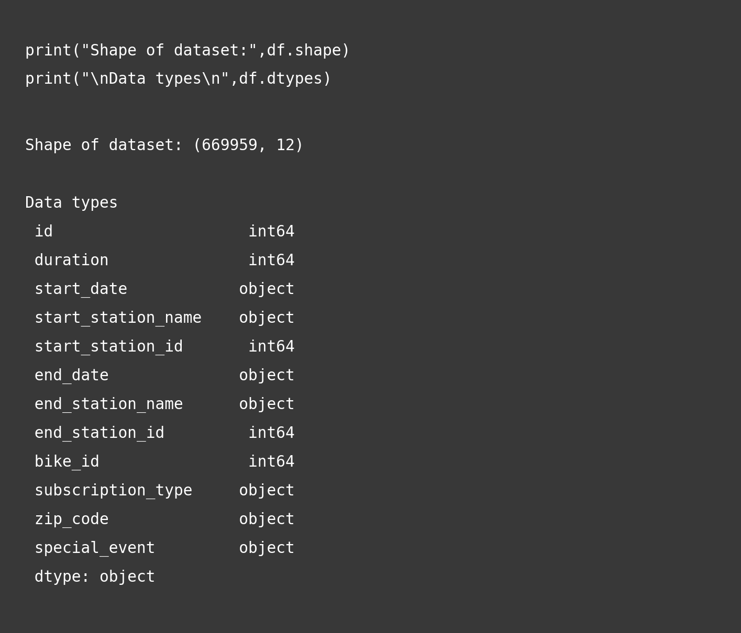
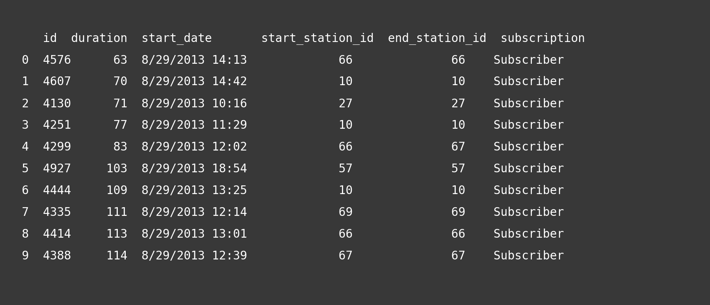
DATASET INFORMATION • STAGE 1: RAW DATA (669,959 ROWS, 12 COLUMNS)
About the Dataset
04 / 15
DATASET SUMMARY
• Dataset Source: SF Bay Area Bike Share Dataset (trip.csv)
• Total Records: 669,959 trip departure transactions
• Total Columns: 12 columns (receipts, timestamps, dock IDs, user type)
• Time Span: Aug 29, 2013 to Aug 31, 2015 (733 days / ~2 full years)
• Active Stations: 70 unique docking stations across the region
• Target Variable: Hourly demand = number of bike trips starting from a station during an hour.
Notes:
Slide 4 introduces Stage 1 of our pipeline: Raw Data Collection.
• Dataset Overview: I use the real-world San Francisco Bay Area Bike Share dataset from Kaggle, specifically trip.csv.
• Key Specifications: It records 669,959 raw trip transactions spanning August 29, 2013 to August 31, 2015. That represents 733 days, or two full years, covering 17,583 continuous hourly timestamps across 70 unique docking stations.
• Why Hourly Departures as Target?: Trip durations in raw data have extreme outliers ranging from 60 seconds to over 200 days due to unreturned bikes. Meanwhile, trip.csv only logs departure events, not live dock occupancy. Formulating the target as hourly departures provides a clean, stable, and operationally actionable metric.
• Visuals: Figure 3.1 on the right shows the dataset shape (669,959 rows by 12 columns) and data types. Figure 3.3 displays the first 10 raw ride receipts.
• Stage 1 Summary: We begin with 669,959 raw checkout records and 12 columns.

Slide 5
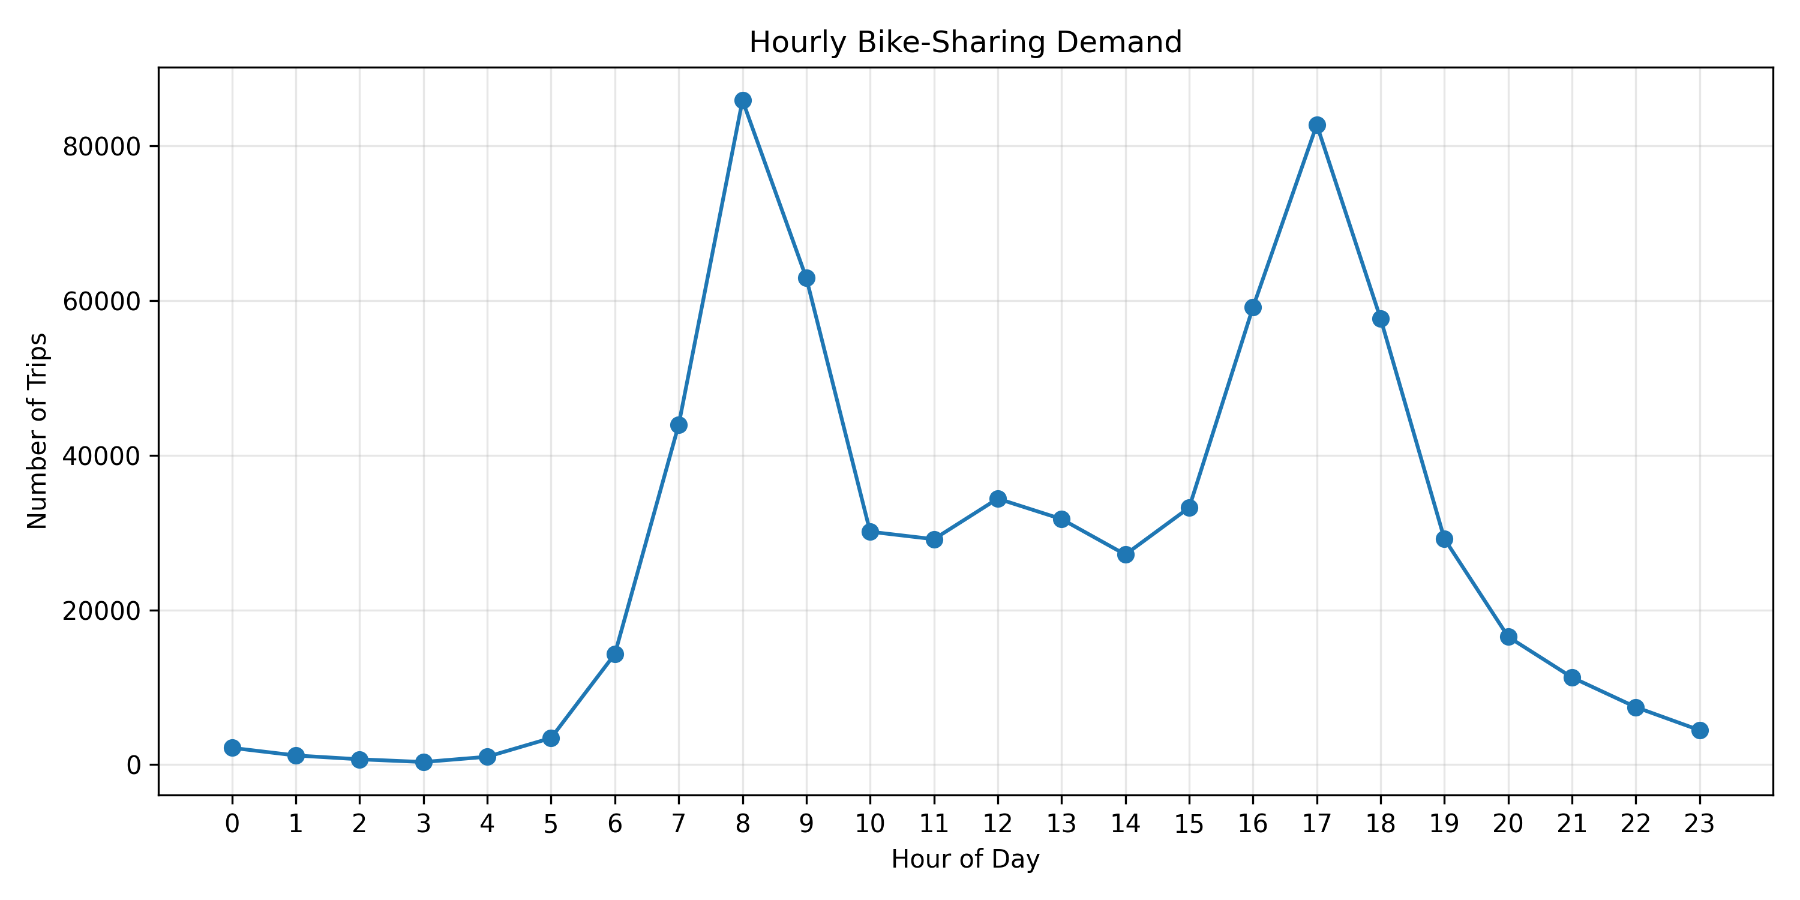
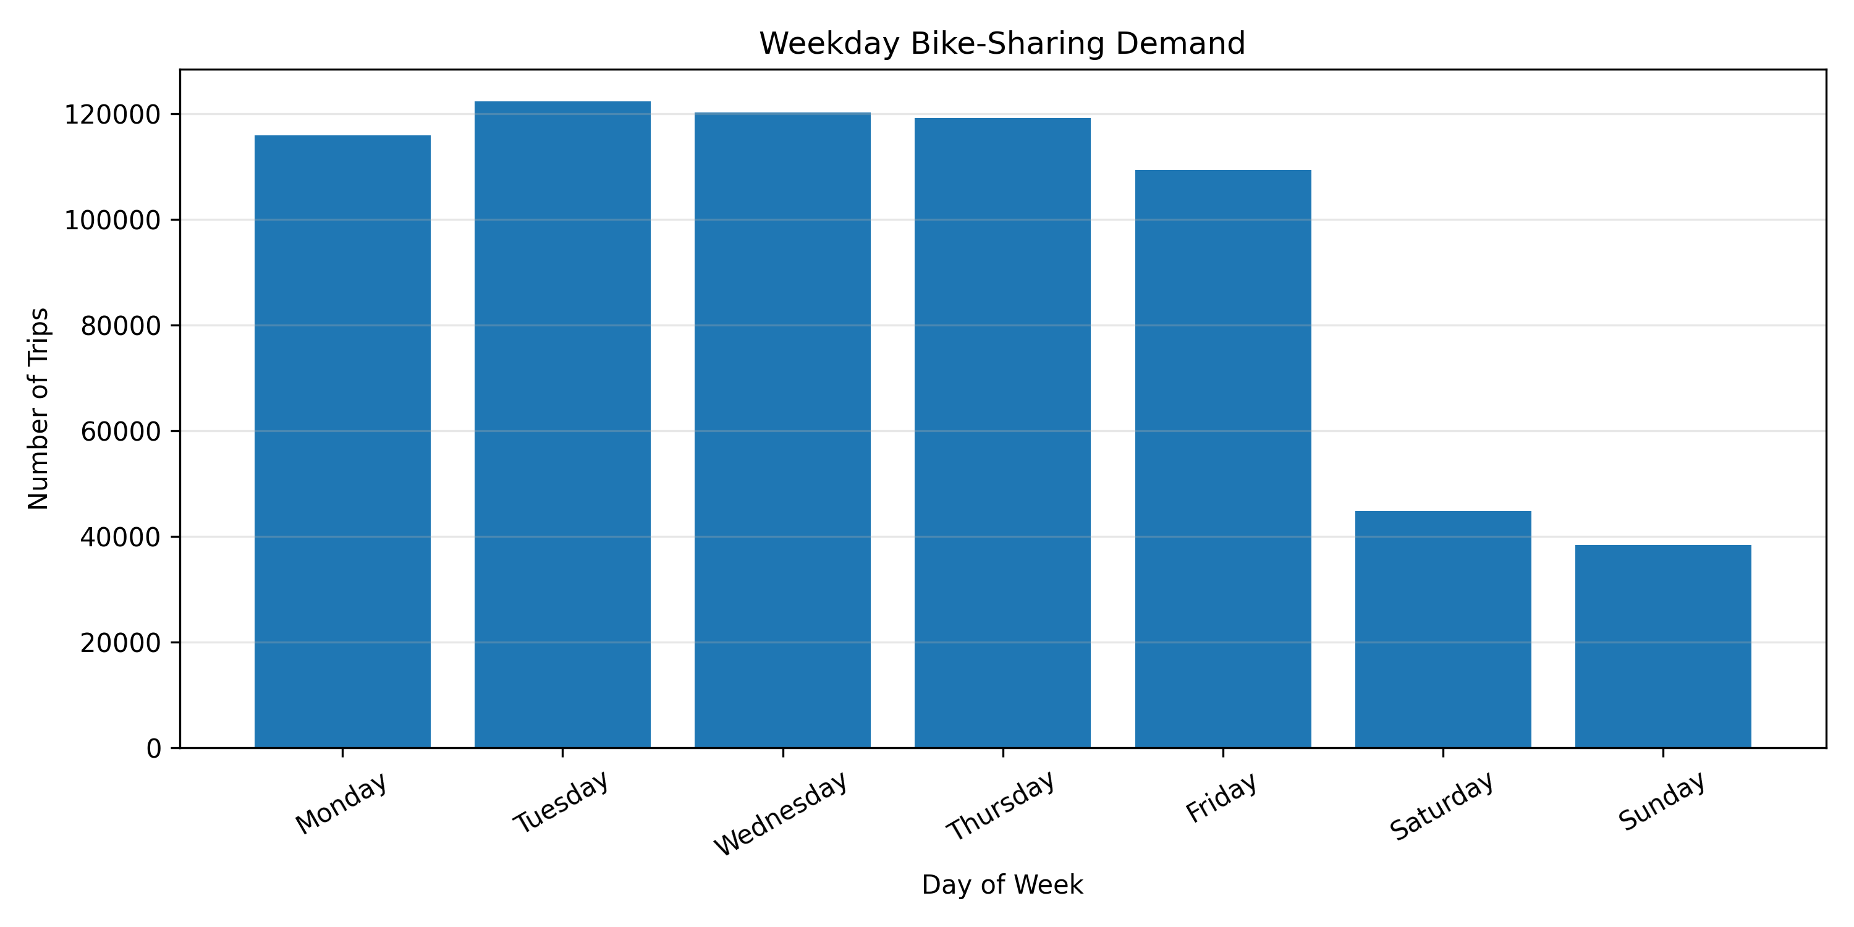
DATA INSIGHTS • QUALITY & COMMUTER BEHAVIOR
Exploratory Data Analysis (EDA)
05 / 15
DATA QUALITY AUDIT (669,959 TRIPS)
• Missing Values: Only 6,619 in zip_code , an optional input field. All other 11 columns have 0 missing values.
• Duplicate Rows: Exactly 0 duplicate rows detected in the entire dataset.
• Active Network: 70 unique docking stations across the Bay Area.
• User Categories: 84% Annual Subscribers (daily customers) and 16% Casual Customers (tourists/casual users).
RIDER BEHAVIOR PATTERNS
• Weekdays (Mon–Fri): Two sharp commuter rush hour peaks — Morning (8:00 AM) and Evening (5:00 PM).
• Weekends (Sat–Sun): Rush hour peaks vanish completely. Demand forms a gentle recreational curve peaking between 12:00 PM and 3:00 PM.
• Station Volumes: SF Caltrain recorded the highest demand with 49,000+ trip departures.
Notes:
Slide 5 presents our Exploratory Data Analysis, examining data quality and rider behavior patterns.
• Data Quality Audit (Top Card):
The raw data is remarkably high quality. Only 6,619 records had missing values in zip_code (~0.98%), which is an optional personal field. All other 11 columns have zero missing values. Duplicate check revealed exactly zero duplicates across all 669k records. User breakdown shows that 84% of riders are Annual Subscribers (daily office commuters) and 16% are Casual Customers (tourists).
• Rider Behavior Patterns (Bottom Card):
On weekdays, demand displays a sharp twin commuter rush hour peak at 8:00 AM and 5:00 PM. On weekends, the commuter spikes vanish completely, replaced by a gentle recreational midday curve between 12:00 PM and 3:00 PM. Station demand varies drastically: SF Caltrain recorded over 49,000 trips, while quiet suburban stations had fewer than 1,000 trips over two years.
• Visuals: The top graph shows the twin-peak weekday commute curve vs the weekend curve. The bottom graph confirms higher total demand on workdays.
• Key Insight: Demand fluctuates heavily by hour, day of week, and station, proving the necessity of automated machine learning forecasts.

Slide 6
DATA PREPARATION • STAGE 2: GRID EXPANSION (1,230,810 ROWS)
Data Preprocessing: Solving the Zero-Demand Problem
06 / 15
STEP 1: HOURLY ROUNDING
Rounding Datetime to Hour
WHAT IS IT?
Round the exact start datetime down to the beginning of that hour:
2013-08-29 09:08:24 → 2013-08-29 09:00:00
2013-08-29 09:35:10 → 2013-08-29 09:00:00
WHY DO WE USE IT?
Individual trips have different seconds. Rounding allows us to group and count all trips that started in that hour.
STEP 2: THE PROBLEM
The Zero-Demand Problem
WHAT IS IT?
In raw logs, if nobody rents a bike at Station #12 at 3:00 AM, NO row is recorded.
WHY IS THIS DANGEROUS?
If we only train on hours when rides occurred, the model never learns when demand is 0! It will severely over-predict nighttime demand.
STEP 3: COMPLETE TIMELINE
Grid Expansion (70 × 17,583)
WHY MULTIPLY 70 × 17,583?
Stations exist even when 0 rides occur. In raw logs, quiet hours have no record. To teach the model when demand is 0, we create a record for EVERY station at EVERY hour across the 2 years:
70 stations × 17,583 hours = 1,230,810 station-hour records.
ZERO-FILLING:
Hours with trips get their actual count; quiet hours get demand = 0.
STEP 4: EVENT CALENDAR
Adding Special Events
WHAT IS IT?
Extracted holiday and festival dates from trip.csv into a calendar lookup dictionary.
WHY DO WE USE IT?
Every newly added 0-demand station-hour row correctly inherits its holiday label (e.g. Halloween, Christmas).
STAGE 2 SUMMARY (ROW COUNT PROGRESSION):
Expanded raw 669,959 individual trips into 1,230,810 station-hour records (70 stations × 17,583 hourly timestamps). Features: 3 base columns (station_id, hour_timestamp, demand). Inactive hours now have demand = 0, teaching the model when stations are idle.
Notes:
Slide 6 describes Stage 2: Data Preprocessing and Solving the Zero-Demand Problem.
• Step 1 - Hourly Rounding: Exact ride timestamps contain arbitrary minutes and seconds. We floor every start datetime down to the beginning of the hour (e.g., 2013-08-29 09:08:24 becomes 2013-08-29 09:00:00). This groups all rides within each 60-minute window.
• Step 2 - The Zero-Demand Problem: In raw logs, if nobody rents a bike at Station 12 at 3:00 AM, no row is recorded. If we only train on rows where rides occurred, the model never learns when demand is zero and will severely over-predict nighttime demand.
• Step 3 - Grid Expansion: To fix this, we generate a complete Cartesian product of 70 stations multiplied by 17,583 hours = exactly 1,230,810 station-hour records. For active hours, we record actual trip counts; for quiet hours, we explicitly assign demand = 0.
• Step 4 - Event Calendar: We extracted city holidays and festivals from trip.csv into a lookup table so that every newly created station-hour row inherits its holiday status (e.g., Thanksgiving, Christmas).
• Stage 2 Summary: Row count expanded from 669,959 trips into 1,230,810 station-hour records across 3 base features: station_id, hour_timestamp, and demand.

Slide 7
DATA PREPROCESSING • STAGE 3: COLUMN SELECTION (12 RAW COLUMNS FILTERED)
Raw Dataset Columns (Why Kept or Removed)
07 / 15
Column Name | Data Type | Meaning | Example Value | Decision & Simple Reason
id | Integer | Unique trip receipt number | 4576 | Removed: Just a receipt number for one ride
duration | Integer | Trip duration in seconds | 63 | Removed: Future info (we only know duration after ride ends)
start_date | Object (String) | Time when bike unlocked | 8/29/2013 09:08 | Transformed: Floored to hour_timestamp to group trips
start_station_name | Object (String) | Origin station name | San Jose City Hall | Kept: Station name for display and reports
start_station_id | Integer | Origin station number | 10 | Kept: Target station ID to predict demand for
end_date | Object (String) | Time when bike returned | 8/29/2013 09:09 | Removed: Future info (unknown before ride happens)
end_station_name | Object (String) | Destination station name | San Jose City Hall | Removed: Future info (destination is unknown at start)
end_station_id | Integer | Destination station number | 10 | Removed: Destination is unknown when predicting departures
bike_id | Integer | Bicycle serial number | 520 | Removed: Individual bike ID is not needed for station-level demand prediction
subscription_type | Object (String) | Subscriber or Customer | Subscriber | Removed: Belongs to individual rider, not hourly station total
zip_code | Object (String) | Rider postal code | 94127 (6,619 missing) | Removed: Has missing values and is personal to rider
special_event | Object (String) | Holiday or event flag | No Event, Halloween | Kept: Tells if the day is a holiday across the city
STAGE 3 SUMMARY: 12 raw columns filtered down to core station/time identifiers + target variable demand across all 1,230,810 rows.
Notes:
Slide 7 details Stage 3: Raw Dataset Column Selection, auditing why each of the 12 raw columns was kept, transformed, or removed.
• id: Removed, as it is simply an individual ride transaction receipt with no predictive power.
• duration: Removed, because it is future leakage—we only know duration after a trip finishes, which is unknown when predicting upcoming departures!
• start_date: Transformed, by flooring it to the hour to group rides into hourly departure buckets.
• start_station_name & start_station_id: Kept, as station identifiers.
• end_date, end_station_name, end_station_id: Removed, because destination is unknown when predicting departures at the start of an hour. Including them would introduce future target leakage.
• bike_id: Removed, because individual bike serial numbers do not affect aggregate station-level demand.
• subscription_type & zip_code: Removed, as they are individual rider attributes rather than station totals, and zip code has missing values.
• special_event: Kept, to identify holidays.
• Stage 3 Summary: Across all 1,230,810 rows, the 12 raw columns are filtered down to core station/time base identifiers.

Slide 8
CREATING MODEL INPUTS • STAGE 4: FEATURE EXTRACTION (1,230,810 ROWS, 62 FEATURES)
Feature Engineering (62 Candidate Features)
08 / 15
ILLUSTRATIVE EXAMPLE (Not actual model output):
Imagine forecasting demand for Tuesday, Oct 15, 2013 at 8:00 AM at Station #2 (San Jose Train Station). Below are the 5 feature groups with key examples:
1. Calendar & Flags (14)
• hour (0–23): Direct hour of day; captures daily travel cycles.
• weekday (0–6): Separates Mon–Fri workdays from weekend free time.
• morning_peak (1): Flags 7:00–9:00 AM morning rush hour departures.
• is_weekend (0/1): Binary flag isolating Saturday & Sunday behavior.
Takeaway: Captures daily travel patterns and peak hours.
2. Cyclical Sine/Cos (8)
• The Clock Gap: 23:00 and 00:00 are 1h apart, but arithmetic sees 23!
• hour_sin & cos: Maps 24 hours onto a continuous 360° circular face.
• weekday_sin & cos: Connects Sunday night smoothly into Monday morning.
• month_sin & cos: Connects December into January for yearly seasons.
Takeaway: Preserves seamless continuous time without jumps.
3. Interactions (4)
• weekday_hour: is_weekday × hour: gives weight to workday rush hours.
• weekend_hour: is_weekend × hour: captures weekend midday leisure curves.
• month_hour: month × hour: adapts rush hour intensity by season.
• peak_station: Flags rush hours specifically at busy transit hubs.
Takeaway: Separates busy Tuesday 8 AM from calm Sunday 8 AM.
4. Past Demand Lags (16)
• lag_1h (12 trips): Departures in previous 1h
• lag_2h (4 trips): Departures 2 hours ago (shows rising or falling trend).
• lag_24h (14 trips): Departures yesterday at same hour (daily baseline).
• lag_168h (15 trips): Departures same hour last week (weekly habit baseline).
Takeaway: Uses past demand to understand recent and repeated demand patterns.
5. Rolling Averages (20)
• rolling_mean_3h (5.7): Moving average over past 3h; filters single spikes.
• rolling_mean_24h (2.1): Past full day's average hourly trip rate.
• rolling_max_24h (16): Maximum single-hour surge recorded in the last 24h.
• lag_1h_ratio_24h (5.71): Surge ratio showing station running hotter than normal.
Takeaway: Detects sudden real-time spikes above daily baseline.
Notes:
This slide is explaining the 5 groups of features used in my model
What to say
“This slide shows an illustrative example of how our feature engineering works.
Suppose we want to forecast the demand for Tuesday, October 15, 2013, at 8 AM, at Station #2, San Jose Train Station.
First, Calendar and Flags.
“We use features such as the hour, weekday, morning peak, and whether it is a weekend. For example, 8 AM tells the model that this is a morning commuting period, and Tuesday tells it that it is a weekday.”
Second, Cyclical Sine and Cosine features.
“Time is naturally circular. For example, 11 PM and 12 AM are very close in real time, but their numerical values are far apart. Sine and cosine help the model understand this circular relationship.”
Third, Interaction features.
“These features combine two pieces of information. For example, weekday and hour together can tell the model that 8 AM on a weekday may have a different demand pattern from 8 AM on a weekend.”
Fourth, Past Demand Lags.
“Here we use previous demand values. For example, lag_1h represents demand in the previous hour, lag_24h represents demand at the same hour on the previous day, and lag_168h represents demand at the same hour one week earlier.”
Finally, Rolling Averages.
“Rolling features summarize recent demand. For example, a 3-hour rolling mean gives the average demand over the previous three hours. This helps the model understand the recent demand trend.”
Finish with this sentence
“So, these five feature groups provide the model with information about the current time, repeating time patterns, combinations of conditions, previous demand, and recent demand trends.”
Category 1: Calendar & Flags (14 Features)
These tell the model about the date, time of day, commuter rush hours, and holidays:
start_station_id — The ID number of the bike station we want to predict for.
Example: 2
special_event — Tells whether today is a city holiday or festival.
Example: 0 (No special event)
hour — The hour of the day (from 0 to 23).
Example: 8
day — The day of the month (from 1 to 31).
Example: 15
weekday — The day of the week (0 for Monday up to 6 for Sunday).
Example: 1 (Tuesday)
month — The month of the year (1 for January to 12 for December).
Example: 10 (October)
year — The year of the record (2013, 2014, or 2015).
Example: 2013
day_of_year — The continuous day number in the year (from 1 to 365).
Example: 288
week_of_year — The calendar week number (from 1 to 52).
Example: 42
is_weekend — 1 if the day is Saturday or Sunday, and 0 for weekdays.
Example: 0
is_weekday — 1 if the day is Monday through Friday, and 0 for weekends.
Example: 1
morning_peak — 1 during morning rush hours (7:00 AM to 9:00 AM), and 0 otherwise.
Example: 1
evening_peak — 1 during evening rush hours (4:00 PM to 7:00 PM), and 0 otherwise.
Example: 0
peak_hour — 1 if the hour is either a morning or evening rush hour, and 0 otherwise.
Example: 1
Category 2: Cyclical Features (8 Features)
These convert time into a continuous 24-hour circular clock so that 11:00 PM and midnight are treated as right next to each other, without an artificial jump from 23 to 0:
We convert the hour into an angle on a 24-hour circle. For 8 AM, the angle is 120 degrees. The sine of 120 degrees is approximately 0.866 and the cosine is -0.5. These two values represent the position of 8 AM in the daily cycle
hour_sin — The sine value of the hour, capturing the 24-hour daily cycle.
Example: 0.866 hour_sin=sin(2π×hour/24​)
hour_cos — The cosine value of the hour, working with sine to form a complete clock circle.
Example: -0.500 hour_cos=cos(2π×hour/24​)
weekday_sin — The sine value of the weekday, smoothly connecting Sunday night to Monday morning.
Example: 0.782
weekday_cos — The cosine value of the weekday.
Example: 0.623
month_sin — The sine value of the month, smoothly connecting December to January.
Example: -0.866
month_cos — The cosine value of the month.
Example: 0.500
day_of_year_sin — The sine value of the day of the year, connecting the end of the year to the new year.
Example: -0.975
day_of_year_cos — The cosine value of the day of the year.
Example: 0.223
Category 3: Interaction Features (4 Features)
These combine two time variables together so the model can easily separate different days and times (for example, busy Tuesday 8:00 AM versus calm Sunday 8:00 AM):
hour_weekday — Combines the hour and the weekday to identify specific time slots in the week.
Example: 8
weekend_hour — Combines weekend flags with the hour to capture weekend afternoon leisure trips.
Example: 0
month_hour — Combines the month and the hour to capture seasonal differences between summer and winter rush hours.
Example: 80
Category 4: Past Demand Lags & Deltas (16 Features)
These look backwards at how many bike trips started from this station in earlier hours and earlier days:
lag_1h — Number of bike departures in the previous 1 hour (captures current momentum).
Example: 18
lag_2h — Number of bike departures 2 hours ago.
Example: 15
lag_3h — Number of bike departures 3 hours ago.
Example: 12
lag_6h — Number of bike departures 6 hours ago.
Example: 8
lag_12h — Number of bike departures 12 hours ago.
Example: 5
lag_24h — Number of bike departures yesterday at this exact same hour.
Example: 21
lag_48h — Number of bike departures 2 days ago at this same hour.
Example: 19
lag_72h — Number of bike departures 3 days ago at this same hour.
Example: 20
lag_168h — Number of bike departures exactly 7 days ago at this same hour (weekly routine).
Example: 23
same_hour_previous_day — Demand at the same hour 1 day ago.
Example: 21
same_hour_previous_2days — Demand at the same hour 2 days ago.
Example: 19
same_hour_previous_3days — Demand at the same hour 3 days ago.
Example: 20
same_hour_previous_week — Demand at the same hour 7 days ago.
Example: 23
demand_change_1h (Removed in audit) — Difference between current demand and demand 1 hour ago.
Example: 3 (candidate value before removal)
demand_change_24h (Removed in audit) — Difference between current demand and demand yesterday.
Example: -2 (candidate value before removal)
demand_change_week (Removed in audit) — Difference between current demand and demand last week.
Example: 4 (candidate value before removal)
Category 5: Rolling Averages & Historical Statistics (20 Features)
Rolling features help the model understand the recent demand trend by summarizing demand over a group of previous hours, instead of looking at only one previous hour.
rolling_mean_3h — Average hourly departures over the past 3 hours.
Example: 15.0
rolling_mean_6h — Average hourly departures over the past 6 hours.
Example: 12.5
rolling_mean_12h — Average hourly departures over the past 12 hours.
Example: 10.2
rolling_mean_24h — Average hourly departures over the past 24 hours (full-day baseline).
Example: 11.8
rolling_mean_168h — Average hourly departures over the past 7 days (full-week baseline).
Example: 13.4
rolling_max_24h — Highest single-hour departures recorded at this station in the last 24 hours.
Example: 28
rolling_max_168h — Highest single-hour departures recorded at this station in the last 7 days.
Example: 35
rolling_min_24h — Lowest departures recorded in the last 24 hours.
Example: 2
rolling_min_168h — Lowest departures recorded in the last 7 days.
Example: 1
rolling_std_24h — Variation or spread in departures over the last 24 hours (shows volatility).
Example: 6.3
rolling_std_168h — Variation or spread in departures over the last 7 days.
Example: 7.1
rolling_median_24h — Middle departure value over the past 24 hours.
Example: 10
historical_demand (Removed in audit) — Overall station average across the entire dataset.
Example: 14.6 (candidate value before removal)
historical_max_demand (Removed in audit) — Maximum demand across the entire dataset.
Example: 42 (candidate value before removal)
historical_min_demand (Removed in audit) — Minimum demand across the entire dataset.
Example: 0 (candidate value before removal)
station_hour_historical_mean (Removed in audit) — Average demand for that station and hour over 2 full years.
Example: 17.2 (candidate value before removal)
station_weekday_hour_mean (Removed in audit) — Average demand for that station, weekday, and hour over 2 full years.
Example: 19.5 (candidate value before removal)
lag_1h_ratio_24h — Ratio showing if the last hour is running busier than the 24-hour daily average.
Example: 1.53
(18 ÷ 11.8 ≈ 1.53)
lag_24h_ratio_week — Ratio comparing yesterday's demand to the 7-day weekly average.
Example: 1.57
(21 ÷ 13.4 ≈ 1.57)
rolling_ratio_24h_168h — Ratio comparing the 24-hour daily average to the 7-day weekly average.
Example: 0.88

Slide 9
DATA LEAKAGE CHECK • STAGE 5: LEAKAGE AUDIT (62 → 54 FEATURES)
Feature Audit: Removing Future Information
09 / 15
WHAT IS DATA LEAKAGE?
Data leakage happens when a feature accidentally uses information that would not be available in real life at prediction time.
WHY DID WE REMOVE 8 FEATURES?
1. Removed 3 Demand Deltas: Features like demand_change_1h used the formula (current_demand - lag). But when we make a prediction at 8:00 AM, we do not yet know the demand between 8:00 AM and 9:00 AM!
2. Removed 5 Global Averages: Features like historical_mean averaged the entire 2-year dataset. That meant 2013 rows were using future numbers from 2015!
RESULT: 62 candidate features - 8 removed = 54 final features.
Removed Features | Why It Was Cheating | Real-Life Truth
3 Demand Deltas (demand_change_1h, etc.) | The feature calculation used the actual demand we were supposed to predict. | At 8:00 AM, you cannot know the demand at 9:00 AM!
5 Global Averages (historical_mean, etc.) | Used future 2015 data to calculate averages for 2013 | In 2013, you cannot see data from 2015!
STAGE 5 SUMMARY: AUDIT PASSED
1,230,810 rows with 54 final features. All features strictly use information available prior to the prediction timestamp.
Notes:
Slide 9 presents Stage 5: our Feature Leakage Audit.
Data leakage happens when a feature accidentally uses information that would not be available in real life at prediction time. If uncorrected, the model achieves artificial 99% accuracy in training but fails completely in deployment.
We audited all 62 features and removed 8 non-causal features:
• 1. Removed 3 Demand Deltas: Features like demand_change_1h used the formula (current_demand - lag_1h). But when predicting at 8:00 AM, current demand is the target answer we are trying to predict! Using it was cheating.
• 2. Removed 5 Global Averages: Features like historical_mean averaged demand over the entire two-year dataset (2013 to 2015). That meant 2013 records were using future numbers from 2015!
• Strict Lags Verified: We confirmed that lag_1h, lag_24h, and lag_168h look strictly backwards in time.
• Stage 5 Summary: 62 candidate features minus 8 removed equals 54 final features. All 54 features strictly use information available prior to the prediction timestamp.

Slide 10
TRAIN / VALIDATION / TEST • STAGE 6: CHRONOLOGICAL PARTITION
Splitting Data by Time (70% / 15% / 15%)
10 / 15
WHY WE DO NOT USE RANDOM SHUFFLING IN TIME SERIES:
If you randomly shuffle time data, the model uses Wednesday to predict Tuesday, or June to predict May! It memorizes future answers to predict the past. We must split strictly by date.
TRAIN SET (70%)
861,560 rows × 54 features
Aug 29, 2013 to Jan 24, 2015
WHAT THIS SET DOES:
The model learns normal patterns, rush hours, and station demand levels.
VALIDATION SET (15%)
184,590 rows × 54 features
Jan 24, 2015 to May 14, 2015
WHAT THIS SET DOES:
Used to tune settings (tree depth, number of trees) without touching the test set.
TEST SET (15%)
184,660 rows × 54 features
May 14, 2015 to Aug 31, 2015
WHAT THIS SET DOES:
Kept untouched. Tests how well models perform on completely new, future months.
Notes:
Slide 10 explains Stage 6: our Chronological Data Partitioning strategy.
• Why No Random Shuffling?: In standard tabular machine learning, random train_test_split is common. In time-series forecasting, this is strictly forbidden! Random shuffling allows the model to use Wednesday to predict Tuesday, or June to predict May. It memorizes future answers to predict the past.
• Strict Chronological Splits:
1. Training Set (70%): 861,560 rows from Aug 29, 2013 to Jan 24, 2015. The model learns baseline traffic, rush hour dynamics, and station profiles across 17 full months.
2. Validation Set (15%): 184,590 rows from Jan 24, 2015 to May 14, 2015. Used exclusively to tune hyperparameters like tree depth and learning rate without ever touching the test set.
3. Test Set (15%): 184,660 rows from May 14, 2015 to Aug 31, 2015. Kept strictly locked until final evaluation to test true real-world generalization on unseen future months.
• Stage 6 Summary: 54 causal features evaluated across Train (861k), Validation (184k), and Test (184k) rows.

Slide 11
ALGORITHMS USED
Model Selection: How Each Model Works
11 / 15
MODEL 1: RANDOM FOREST
Random Forest
HOW DOES IT WORK?
Builds many decision trees at the same time in parallel. Takes the average prediction of all trees.
EXAMPLE:
Tree 1 says: 14 trips
Tree 2 says: 16 trips
Tree 3 says: 15 trips
Average: (14 + 16 + 15) / 3 = 15 trips
WHY WE USE IT?
Averaging many independent trees reduces errors and handles noisy data well.
MODEL 2: XGBOOST
XGBoost
HOW DOES IT WORK?
Builds trees one after another in a line. Each new tree tries to correct the previous tree's mistake.
EXAMPLE:
Real demand = 15 trips.
Tree 1 guesses 11 (mistake = +4).
Tree 2 tries to predict the +4 mistake!
WHY WE USE IT?
Very good at learning difficult patterns like rush hour spikes.
MODEL 3: CATBOOST
CatBoost
HOW DOES IT WORK?
CatBoost builds trees one after another, similar to XGBoost. It uses ordered boosting to improve how the model learns.
ORDERED BOOSTING:
Calculates residuals without target leakage, preventing overfitting on repetitive time data.
WHY WE USE IT?
Provides another boosting model for comparison and gives fast predictions.
Notes:
Slide 11 details our Model Selection: how each of the three tree-based algorithms works.
•Random Forest (Bagging):
Random Forest builds hundreds of decision trees simultaneously in parallel. Each tree votes independently, and we take their average. For example, if Tree 1 predicts 14 trips, Tree 2 predicts 16, and Tree 3 predicts 15, the average prediction is 15 trips. Averaging independent trees reduces variance and handles noisy data well.
XGBoost: When calculating how big its mistake is, it checks against the entire dataset at once. Because the same data is seen over and over, it can sometimes become slightly overconfident or overfit repeating patterns.
CatBoost: It uses Ordered Boosting. It pretends the data arrived in a sequence. To calculate the error for a row, it only uses trees trained on other rows. This prevents the model from "peeking" at its own answers, resulting in less overfitting on repetitive tabular data.
We used 200 trees for Random Forest and 600 trees for XGBoost and CatBoost. We selected these counts by evaluating error curves on our 15% validation dataset, picking the point where validation error was lowest without increasing training time or causing overfitting.

Slide 12
PERFORMANCE COMPARISON
Model Results on Test Set (184,660 Rows)
12 / 15
Model | Features | Test MAE | Test RMSE | Test R²
Random Forest | 54 | 0.439206 | 0.908465 | 0.731390
XGBoost | 54 | 0.430550 | 0.898213 | 0.737418
CatBoost | 54 | 0.436126 | 0.897665 | 0.737738
1. Random Forest Performance
• Test MAE: 0.439206 | RMSE: 0.908465 | R²: 0.731390
• Demonstrates solid performance, explaining about 73% of the demand variation.
• Validates that bagging decision trees provides a reliable baseline on tabular data.
2. XGBoost Performance
• Test MAE: 0.430550 | RMSE: 0.898213 | R²: 0.737418
• Achieved the lowest MAE (0.430550) among all three models.
• This means it has the lowest average absolute error on test predictions.
3. CatBoost Performance
• Test MAE: 0.436126 | RMSE: 0.897665 | R²: 0.737738
• Achieved the lowest RMSE (0.897665) and highest R² (0.737738).
• Its lower RMSE means slightly lower error when larger errors are given more weight.
Notes:
Slide 12 presents our final Model Results evaluated on 184,660 completely unseen test rows.
• Performance Table:
- Random Forest: Test MAE = 0.439206 | RMSE = 0.908465 | R² = 0.731390
- XGBoost: Test MAE = 0.430550 | RMSE = 0.898213 | R² = 0.737418
- CatBoost: Test MAE = 0.436126 | RMSE = 0.897665 | R² = 0.737738
• Detailed Analysis by Card:
1. Random Forest: Delivers solid baseline performance, explaining about 73.1% of demand variation. It confirms that bagging decision trees creates a reliable, stable baseline on tabular time features.
2. XGBoost: Achieved the lowest MAE (0.430550) among all three models. This means it has the lowest average absolute error on hourly trip predictions.
3. CatBoost: Achieved the lowest RMSE (0.897665) and highest R² (0.737738). Lower RMSE means better performance when penalizing large surge mistakes.
• Metric Interpretation: MAE of ~0.43 means our forecast is off by less than half a bike per station-hour on average. R² of ~0.74 means the models explain nearly 74% of the total variation in demand on unseen future data.

Slide 13
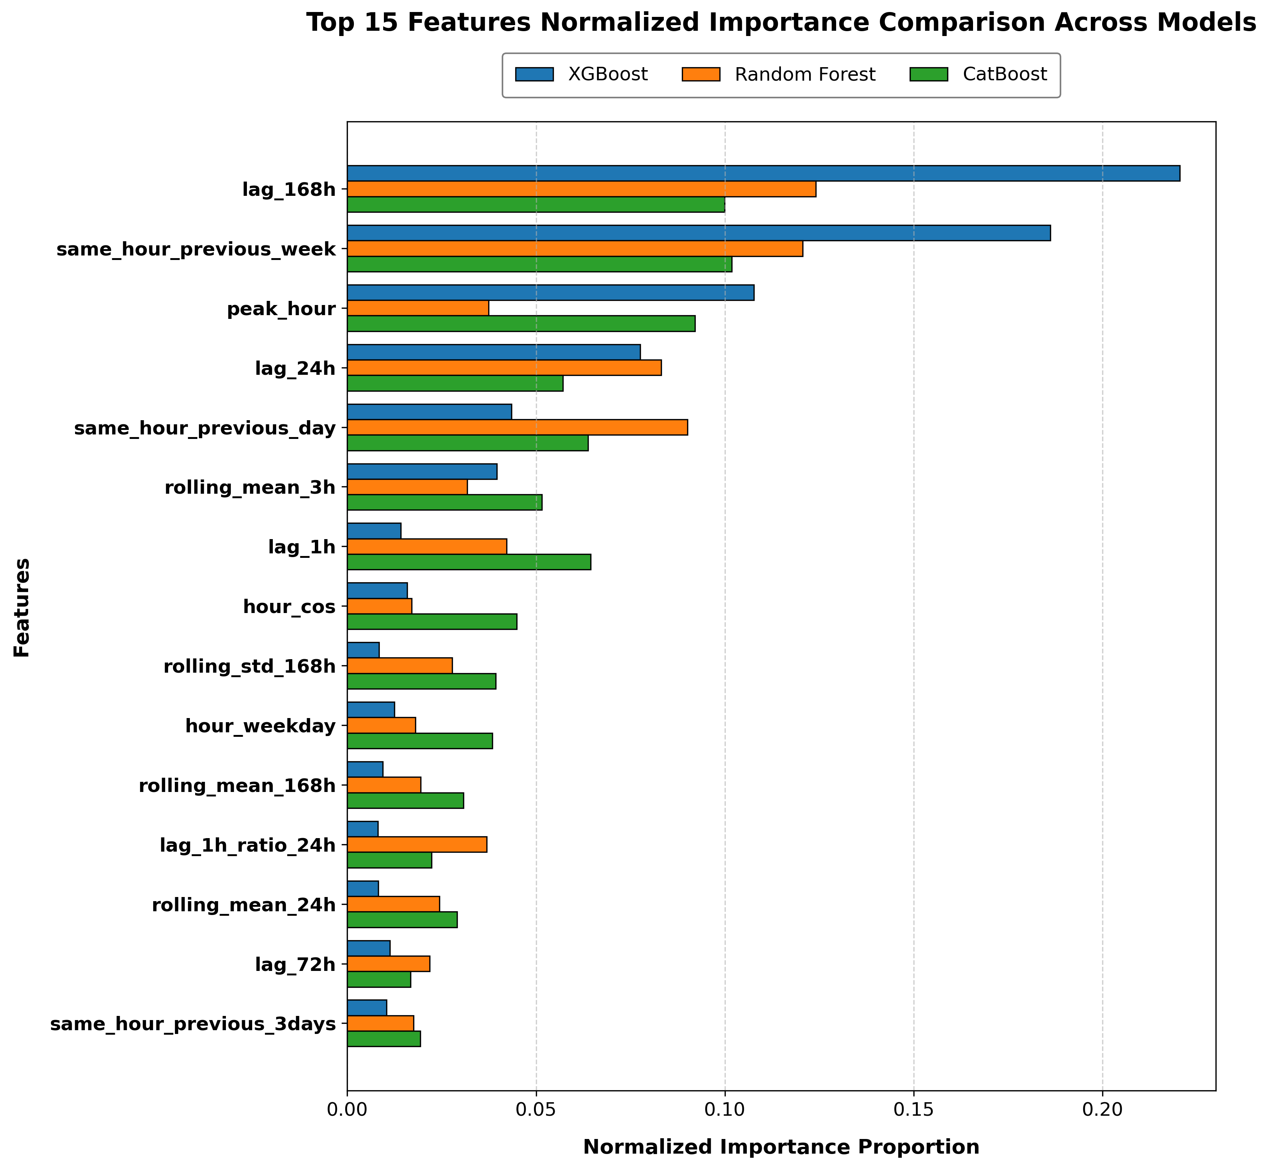
MODEL EXPLANATION
What Influenced the Predictions? (Top 5 Features)
13 / 15
TOP 5 FEATURES ACROSS ALL MODELS
• 1. lag_168h: Demand at the same station 168 hours (7 days) ago. It captures the previous week's demand pattern.
• 2. same_hour_previous_week: Demand at the same station at the same hour one week ago.
• 3. peak_hour: Indicates whether the current time is a morning peak (7–9 AM) or evening peak (4–7 PM)
• 4. lag_24h: Demand at the same station 24 hours ago, at the same hour.
• 5. same_hour_previous_day: Demand at the same station at the same hour on the previous day.
Takeaway: Past demand, especially weekly patterns and peak-hour information, were important for the model predictions.
Notes:
Slide 13 examines Feature Importance: what influenced the predictions across all models.
• Top 5 Features Across All Models:
1. same_hour_previous_week: Demand at this exact station 7 days ago at the same hour was the single most powerful predictor.
2. lag_168h: Demand 168 hours ago, reinforcing identical weekly commuter travel habits.
3. peak_hour: Morning rush (7 to 9 AM) and evening rush (4 to 7 PM) binary flags.
4. lag_1h: Departures in the immediately preceding hour, capturing real-time station momentum.
5. lag_24h / same_hour_prev_day: Demand yesterday at the same hour.
• Visual Insights:
The graph shows the normalized importance of the top 15 features across the three models. lag_168h and same_hour_previous_week have high importance, showing that demand from the previous week is useful for prediction. peak_hour and lag_24h are also important. Overall, past demand and time-related features contribute strongly to the model predictions.

Slide 14
FUTURE WORK
Next Phase: Implementation Plan
14 / 15
WHAT WE PLAN TO DO IN THE NEXT PHASE:
1. Build Streamlit UI: Create an interactive and clean web interface using Python Streamlit.
2. Connect Trained Model: Load the trained model into the application backend to generate instant predictions.
3. Station and Time Selection: Allow users to pick a specific station, date, and hour from simple dropdowns.
4. Display Predicted Demand: Show the predicted number of bike checkouts clearly for that hour.
5. Show Demand Visualizations: Display simple charts showing historical trends and daily peak patterns.
6. Redistribution Support: Provide demand-based redistribution support to assist transit managers in planning.
7. Test the Complete Application: Run end-to-end testing with different inputs to ensure reliable behavior.
Notes:
Slide 14 outlines our roadmap for the Next Phase of implementation:
1. Build Streamlit UI: Develop an interactive, user-friendly web interface using Python Streamlit.
2. Connect Trained Model: Load the serialized CatBoost/XGBoost model into the backend pipeline for instant inference.
3. Station and Time Dropdowns: Allow transit managers to select any of the 70 stations, a target date, and an hour from simple dropdowns.
4. Display Predicted Demand: Instantly display the forecasted number of bike checkouts for that station-hour.
5. Interactive Visualizations: Show 24-hour historical curves and expected peak rush hour demand.
6. Redistribution Support: Provide proactive rebalancing recommendations so transit operators can move bikes before shortages occur.
7. End-to-End Testing: Perform comprehensive testing across edge cases, holidays, and high-traffic stations to ensure production reliability.

Slide 15
THANK YOU!
Notes:
Slide 15 concludes our presentation.
• Summary of Achievements:
We successfully resolved the zero-demand problem by expanding 669k trips into a continuous 1.23 million row grid, engineered 54 strictly causal features with zero leakage, and proved that tree ensemble models explain approximately 74% of demand variation on unseen future test data.
I would like to express my sincere gratitude to my project guide, Mr. Sibu Skaria, for his continuous guidance, and to the Department of Computer Applications.
Thank you, respected panel members. I am now ready to take your questions and discussion.

