Slide 1
Discrimination and Classification
Johnson,RA & Wichern, DW. "Applied Multivariate Analysis", Chapter 11, 6th edition, Pearson International Edition, 2007.
This chapter will focus on
(1) SEPARATING distinct sets of observations, and (2) ALLOCATING new observations to previously defined groups.
The two goals can be described as
DISCRIMINATION = finding "discriminants", i.e. features, whose numerical values are such that collections of observations are separated as much as possible.
CLASSIFICATION = deriving a rule that can optimally allocate new observations to labelled classes.
Examples include
Using measurements on education, income, family size, amount of previous brand switching to classify consumers as either "purchasers of a new product" or as "laggards".
Using measurements on income, age, number of credit cards and family size to classify people as (1) good or (2) poor credits risks.
Using measurements on easily observed external symptoms to classify people as either (1)diseased, or (2) nondiseased.

Slide 2
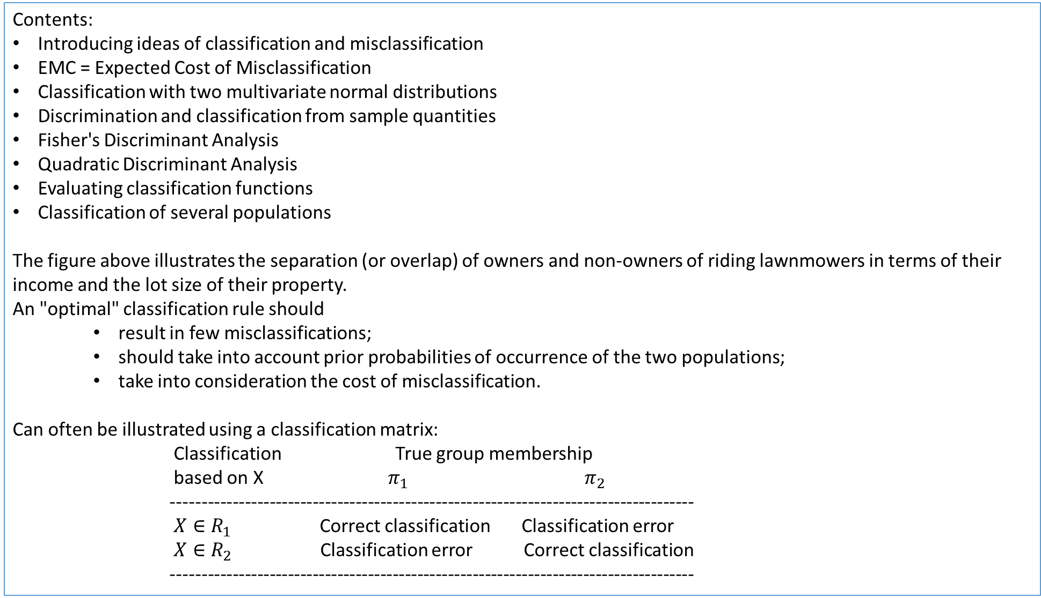
Contents:
Introducing ideas of classification and misclassification
EMC = Expected Cost of Misclassification
Classification with two multivariate normal distributions
Discrimination and classification from sample quantities
Fisher's Discriminant Analysis
Quadratic Discriminant Analysis
Evaluating classification functions
Classification of several populations
The figure above illustrates the separation (or overlap) of owners and non-owners of riding lawnmowers in terms of their income and the lot size of their property.
An "optimal" classification rule should
result in few misclassifications;
should take into account prior probabilities of occurrence of the two populations;
take into consideration the cost of misclassification.
Can often be illustrated using a classification matrix:
Classification True group membership
based on X $π_{1}$ $π_{2}$
-------------------------------------------------------------------------------------
$X∈R_{1}$ Correct classification Classification error
$X∈R_{2}$ Classification error Correct classification
-------------------------------------------------------------------------------------
Shows that owners and non-owners can be separated by linear line. Also shows that owners had higher income whilst separation based on lots size slightly less clear.

Slide 3
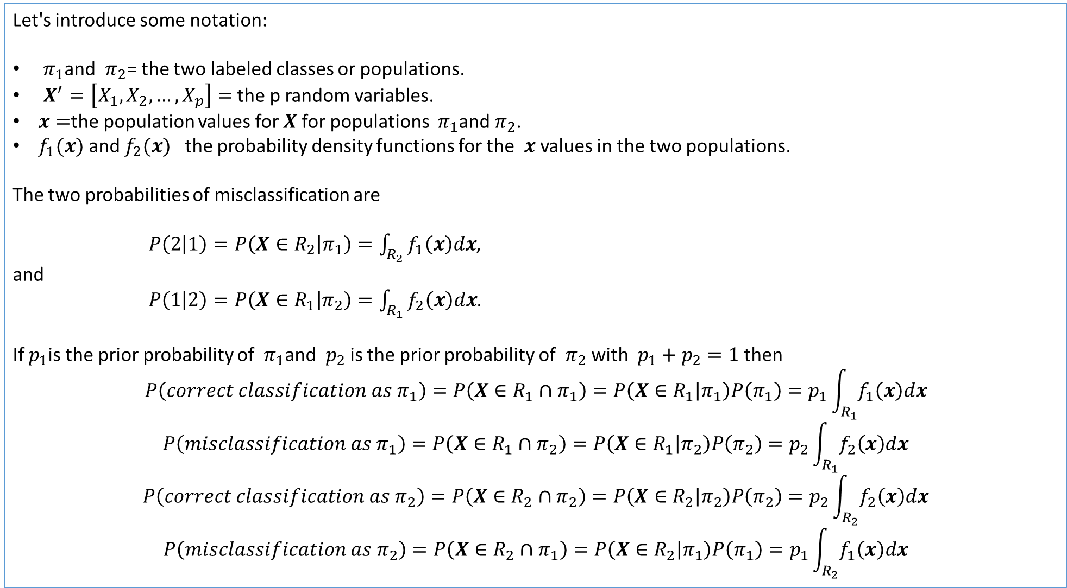
Let's introduce some notation:
$π_{1}$and $π_{2}$= the two labeled classes or populations.
$X^{′}=\left[X_{1},X_{2},…,X_{p}\right]=$ the p random variables.
$x=$the population values for $X$for populations $π_{1}$and $π_{2}$.
$f_{1}(x)$ and $f_{2}(x)$ the probability density functions for the $x$ values in the two populations.
The two probabilities of misclassification are
$P\left(2 | 1\right)=P\left(X∈R_{2} | π_{1}\right)=\int_{R_{2}}^{ }{f_{1}\left(x\right)dx}$,
and
$P\left(1 | 2\right)=P\left(X∈R_{1} | π_{2}\right)=\int_{R_{1}}^{ }{f_{2}\left(x\right)dx}$.
If $p_{1}$is the prior probability of $π_{1}$and $p_{2}$is the prior probability of $π_{2}$ with $p_{1}+p_{2}=1$then
$$P\left(correct classification as π_{1}\right)=P\left(X∈R_{1}∩π_{1}\right)=P\left(X∈R_{1} | π_{1}\right)P\left(π_{1}\right)=p_{1}\int_{R_{1}}^{ }{f_{1}\left(x\right)dx}$$
$$P\left(misclassification as π_{1}\right)=P\left(X∈R_{1}∩π_{2}\right)=P\left(X∈R_{1} | π_{2}\right)P\left(π_{2}\right)=p_{2}\int_{R_{1}}^{ }{f_{2}\left(x\right)dx}$$
$$P\left(correct classification as π_{2}\right)=P\left(X∈R_{2}∩π_{2}\right)=P\left(X∈R_{2} | π_{2}\right)P\left(π_{2}\right)=p_{2}\int_{R_{2}}^{ }{f_{2}\left(x\right)dx}$$
$$P\left(misclassification as π_{2}\right)=P\left(X∈R_{2}∩π_{1}\right)=P\left(X∈R_{2} | π_{1}\right)P\left(π_{1}\right)=p_{1}\int_{R_{2}}^{ }{f_{1}\left(x\right)dx}$$
This integral measure the area under f_1(x) that falls in region 2. So f_1(x) refers to correct population and integral measures misclassifications.
Note the inclusion of prior probabilities based on relationship between joint and conditional probabilities.

Slide 4
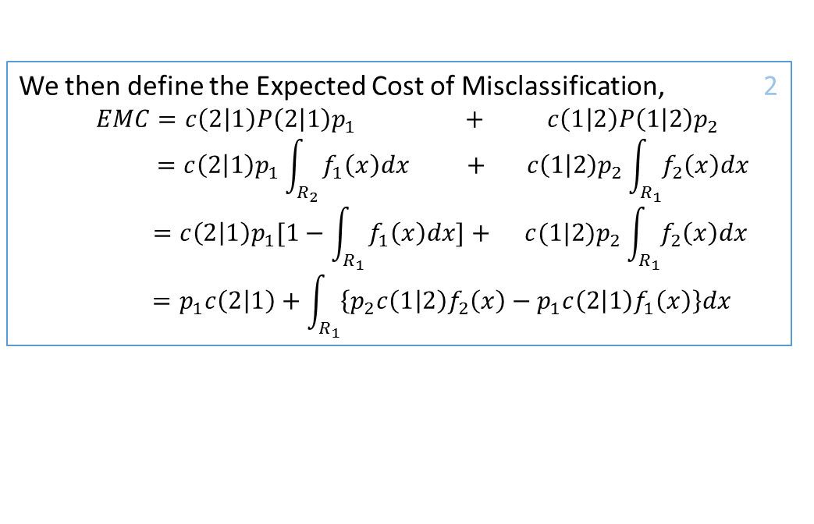
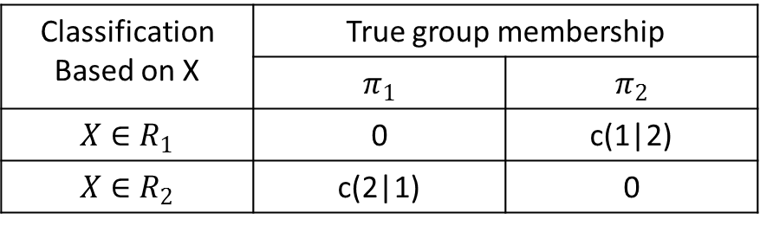
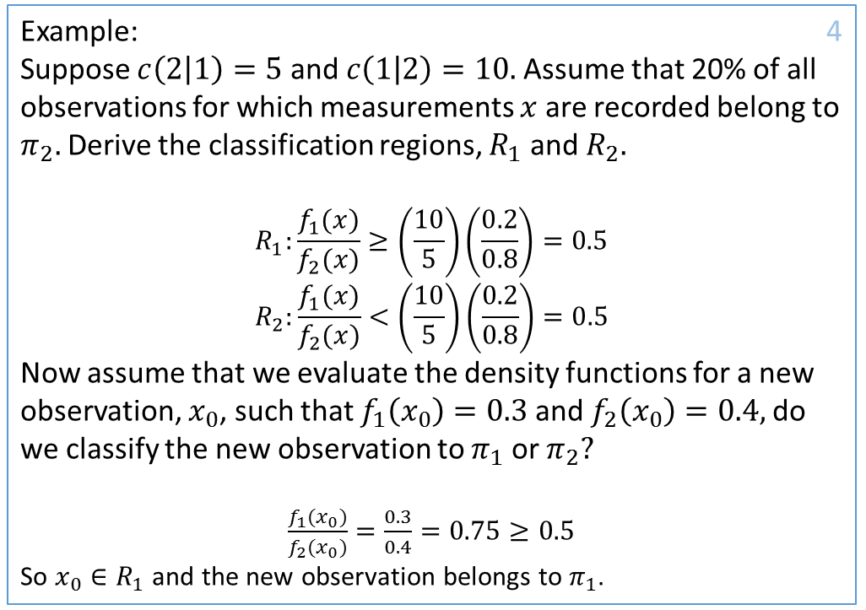
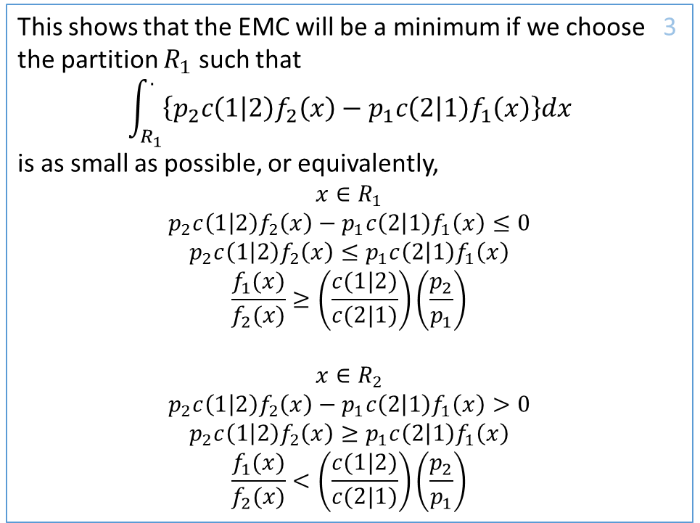
The costs of misclassification can be defined by a cost 1 matrix,
We then define the Expected Cost of Misclassification, 2
$$EMC=c\left(2 | 1\right)P\left(2 | 1\right)p_{1} + c\left(1 | 2\right)P\left(1 | 2\right)p_{2}$$
$$=c\left(2 | 1\right)p_{1}\int_{R_{2}}^{ }{f_{1}\left(x\right)dx + c\left(1 | 2\right)p_{2}\int_{R_{1}}^{ }{f_{2}\left(x\right)dx}}$$
$$=c\left(2 | 1\right)p_{1}[1−\int_{R_{1}}^{ }{f_{1}\left(x\right)dx]+ c(1|2)p_{2}\int_{R_{1}}^{ }{f_{2}\left(x\right)dx}}$$
$$=p_{1}c\left(2 | 1\right)+\int_{R_{1}}^{ }{\left\{p_{2}c\left(1 | 2\right)f_{2}\left(x\right)−p_{1}c\left(2 | 1\right)f_{1}\left(x\right)\right\}dx}$$
Classification Based on X | True group membership
 | $$π_{1}$$ | $$π_{2}$$
$$X∈R_{1}$$ | 0 | c(1|2)
$$X∈R_{2}$$ | c(2|1) | 0
Manipulation so that we work with integral in same region
This shows that the EMC will be a minimum if we choose 3 the partition $R_{1}$ such that
$$\int_{R_{1}}^{.}{\left\{p_{2}c\left(1 | 2\right)f_{2}\left(x\right)−p_{1}c\left(2 | 1\right)f_{1}\left(x\right)\right\}dx}$$
is as small as possible, or equivalently,
$$x∈R_{1}$$
$$p_{2}c\left(1 | 2\right)f_{2}\left(x\right)−p_{1}c\left(2 | 1\right)f_{1}\left(x\right)≤0$$
$$p_{2}c\left(1 | 2\right)f_{2}\left(x\right)≤p_{1}c\left(2 | 1\right)f_{1}\left(x\right)$$
$$\frac{f_{1}(x)}{f_{2}(x)}≥\left(\frac{c(1|2)}{c(2|1)}\right)\left(\frac{p_{2}}{p_{1}}\right)$$
$$x∈R_{2}$$
$$p_{2}c\left(1 | 2\right)f_{2}\left(x\right)−p_{1}c\left(2 | 1\right)f_{1}\left(x\right)>0$$
$$p_{2}c\left(1 | 2\right)f_{2}\left(x\right)≥p_{1}c\left(2 | 1\right)f_{1}\left(x\right)$$
$$\frac{f_{1}(x)}{f_{2}(x)}<\left(\frac{c(1|2)}{c(2|1)}\right)\left(\frac{p_{2}}{p_{1}}\right)$$
Example: 4
Suppose $c\left(2 | 1\right)=5$ and $c\left(1 | 2\right)=10.$Assume that 20% of all observations for which measurements $x$ are recorded belong to $π_{2}.$ Derive the classification regions, $R_{1}$ and $R_{2}.$
$$R_{1}:\frac{f_{1}(x)}{f_{2}(x)}≥\left(\frac{10}{5}\right)\left(\frac{0.2}{0.8}\right)=0.5$$
$$R_{2}:\frac{f_{1}(x)}{f_{2}(x)}<\left(\frac{10}{5}\right)\left(\frac{0.2}{0.8}\right)=0.5$$
Now assume that we evaluate the density functions for a new observation, $x_{0}$, such that $f_{1}\left(x_{0}\right)=0.3$ and $f_{2}\left(x_{0}\right)=0.4,$do we classify the new observation to $π_{1}$ or $π_{2}?$
$\frac{f_{1}(x_{0})}{f_{2}(x_{0})}=\frac{0.3}{0.4}=0.75≥0.5$
So $x_{0}∈R_{1}$ and the new observation belongs to $π_{1}$.

Slide 5
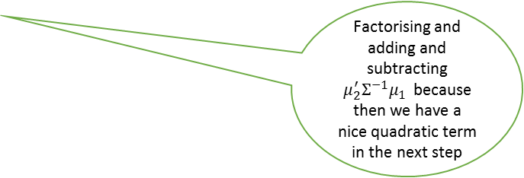
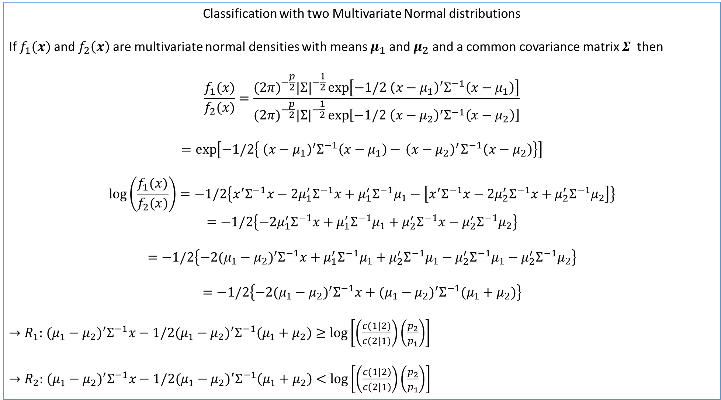
Classification with two Multivariate Normal distributions
If $f_{1}(x)$ and $f_{2}\left(x\right)$ are multivariate normal densities with means $μ_{1}$ and $μ_{2}$ and a common covariance matrix $Σ$ then
$$\frac{f_{1}(x)}{f_{2}(x)}=\frac{(2π)^{−\frac{p}{2}}|Σ|^{−\frac{1}{2}}\exp\left[−1/2{ \left(x−μ_{1}\right)}^{′}Σ^{−1}\left(x−μ_{1}\right)\right]}{(2π)^{−\frac{p}{2}}|Σ|^{−\frac{1}{2}}\exp\left[−1/2{ \left(x−μ_{2}\right)}^{′}Σ^{−1}\left(x−μ_{2}\right)\right]}$$
$$=\exp\left[−1/2\left\{{ \left(x−μ_{1}\right)}^{′}Σ^{−1}\left(x−μ_{1}\right)−{ \left(x−μ_{2}\right)}^{′}Σ^{−1}\left(x−μ_{2}\right)\right\}\right]$$
$$\log\left(\frac{f_{1}(x)}{f_{2}(x)}\right)=−1/2\left\{x^{′}Σ^{−1}x−2μ_{1}^{′}Σ^{−1}x+μ_{1}^{′}Σ^{−1}μ_{1}−\left[x^{′}Σ^{−1}x−2μ_{2}^{′}Σ^{−1}x+μ_{2}^{′}Σ^{−1}μ_{2}\right]\right\}$$
$$=−1/2\left\{−2μ_{1}^{′}Σ^{−1}x+μ_{1}^{′}Σ^{−1}μ_{1}+μ_{2}^{′}Σ^{−1}x−μ_{2}^{′}Σ^{−1}μ_{2}\right\}$$
$$=−1/2\left\{−2(μ_{1}−μ_{2})^{′}Σ^{−1}x+μ_{1}^{′}Σ^{−1}μ_{1}+μ_{2}^{′}Σ^{−1}μ_{1}−μ_{2}^{′}Σ^{−1}μ_{1}−μ_{2}^{′}Σ^{−1}μ_{2}\right\}$$
$$=−1/2\left\{−2(μ_{1}−μ_{2})^{′}Σ^{−1}x+(μ_{1}−μ_{2})^{′}Σ^{−1}(μ_{1}+μ_{2})\right\}$$
${→R}_{1}:$ $(μ_{1}−μ_{2})^{′}Σ^{−1}x−1/2(μ_{1}−μ_{2})^{′}Σ^{−1}(μ_{1}+μ_{2})≥\log\left[\left(\frac{c(1|2)}{c(2|1)}\right)\left(\frac{p_{2}}{p_{1}}\right)\right]$
${→R}_{2}:$ $(μ_{1}−μ_{2})^{′}Σ^{−1}x−1/2(μ_{1}−μ_{2})^{′}Σ^{−1}\left(μ_{1}+μ_{2}\right)<\log\left[\left(\frac{c(1|2)}{c(2|1)}\right)\left(\frac{p_{2}}{p_{1}}\right)\right]$
Using exp(A)/exp(B)=exp(A-B)
Taking logs to get rid of exp on RHS
Multiplying out and cancelling common terms.
Factorising and adding and subtracting $μ_{2}^{′}Σ^{−1}μ_{1}$ because then we have a nice quadratic term in the next step

Slide 6
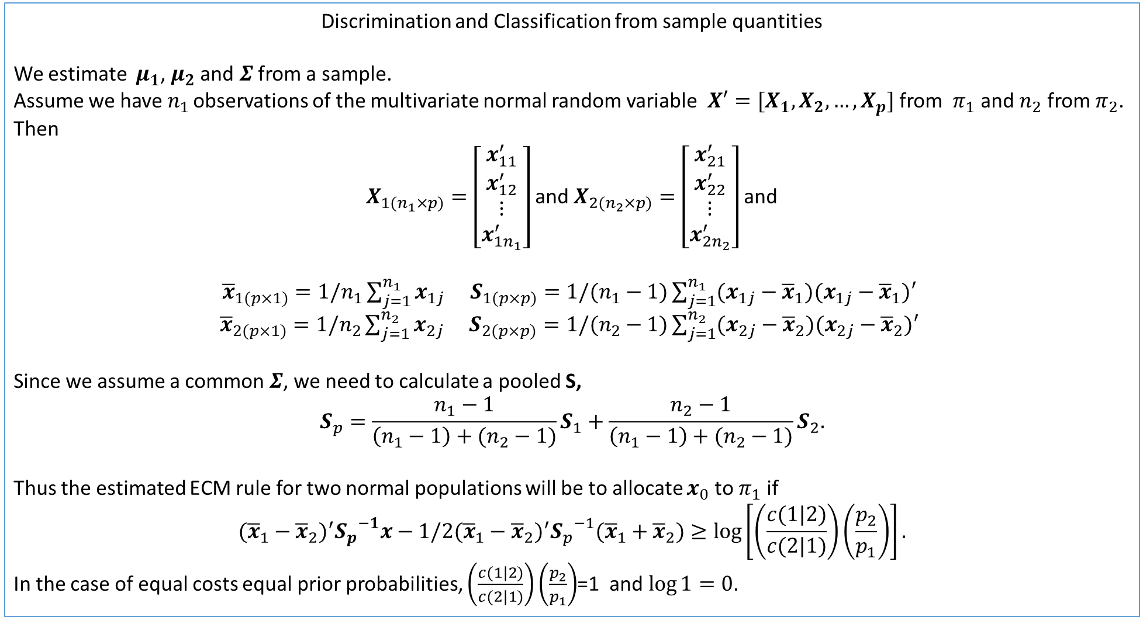
Discrimination and Classification from sample quantities
We estimate $μ_{1}$, $μ_{2}$ and $Σ$ from a sample.
Assume we have $n_{1 }$observations of the multivariate normal random variable $X′=[X_{1},X_{2},…,X_{p}]$ from $π_{1}$ and $n_{2}$ from $π_{2}$. Then
$X_{1(n_{1}×p)}=\left[\begin{matrix}x_{11}^{′} \\ x_{12}^{′} \\ ⋮ \\ x_{1n_{1}}^{′}\end{matrix}\right]$ and $X_{2(n_{2}×p)}=\left[\begin{matrix}x_{21}^{′} \\ x_{22}^{′} \\ ⋮ \\ x_{2n_{2}}^{′}\end{matrix}\right]$ and
${\overline{x}}_{1(p×1)}=1/n_{1}\sum_{j=1}^{n_{1}}{x_{1j}}$ $S_{1(p×p)}=1/(n_{1}−1)\sum_{j=1}^{n_{1}}{(x_{1j}−{\overline{x}}_{1})(x_{1j}−{\overline{x}}_{1})′ }$
${\overline{x}}_{2(p×1)}=1/n_{2}\sum_{j=1}^{n_{2}}{x_{2j}}$ $S_{2(p×p)}=1/(n_{2}−1)\sum_{j=1}^{n_{2}}{(x_{2j}−{\overline{x}}_{2})(x_{2j}−{\overline{x}}_{2})′ }$
Since we assume a common $Σ$, we need to calculate a pooled S,
$$S_{p}=\frac{n_{1}−1}{\left(n_{1}−1\right)+(n_{2}−1)}S_{1}+\frac{n_{2}−1}{\left(n_{1}−1\right)+(n_{2}−1)}S_{2}.$$
Thus the estimated ECM rule for two normal populations will be to allocate $x_{0}$ to $π_{1}$ if
$$({\overline{x}}_{1}−{\overline{x}}_{2})^{′}{S_{p}}^{−1}x−1/2({\overline{x}}_{1}−{\overline{x}}_{2})^{′}{S_{p}}^{−1}({\overline{x}}_{1}+{\overline{x}}_{2})≥\log\left[\left(\frac{c(1|2)}{c(2|1)}\right)\left(\frac{p_{2}}{p_{1}}\right)\right].$$
In the case of equal costs equal prior probabilities, $\left(\frac{c(1|2)}{c(2|1)}\right)\left(\frac{p_{2}}{p_{1}}\right)$=1 and $\log{1}=0$.
With equal costs and equal prior probabilities, we have zero on RHS.

Slide 7
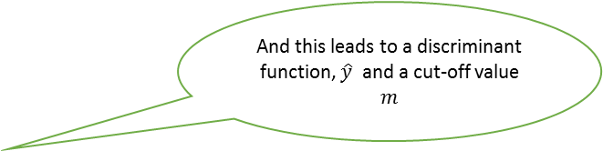
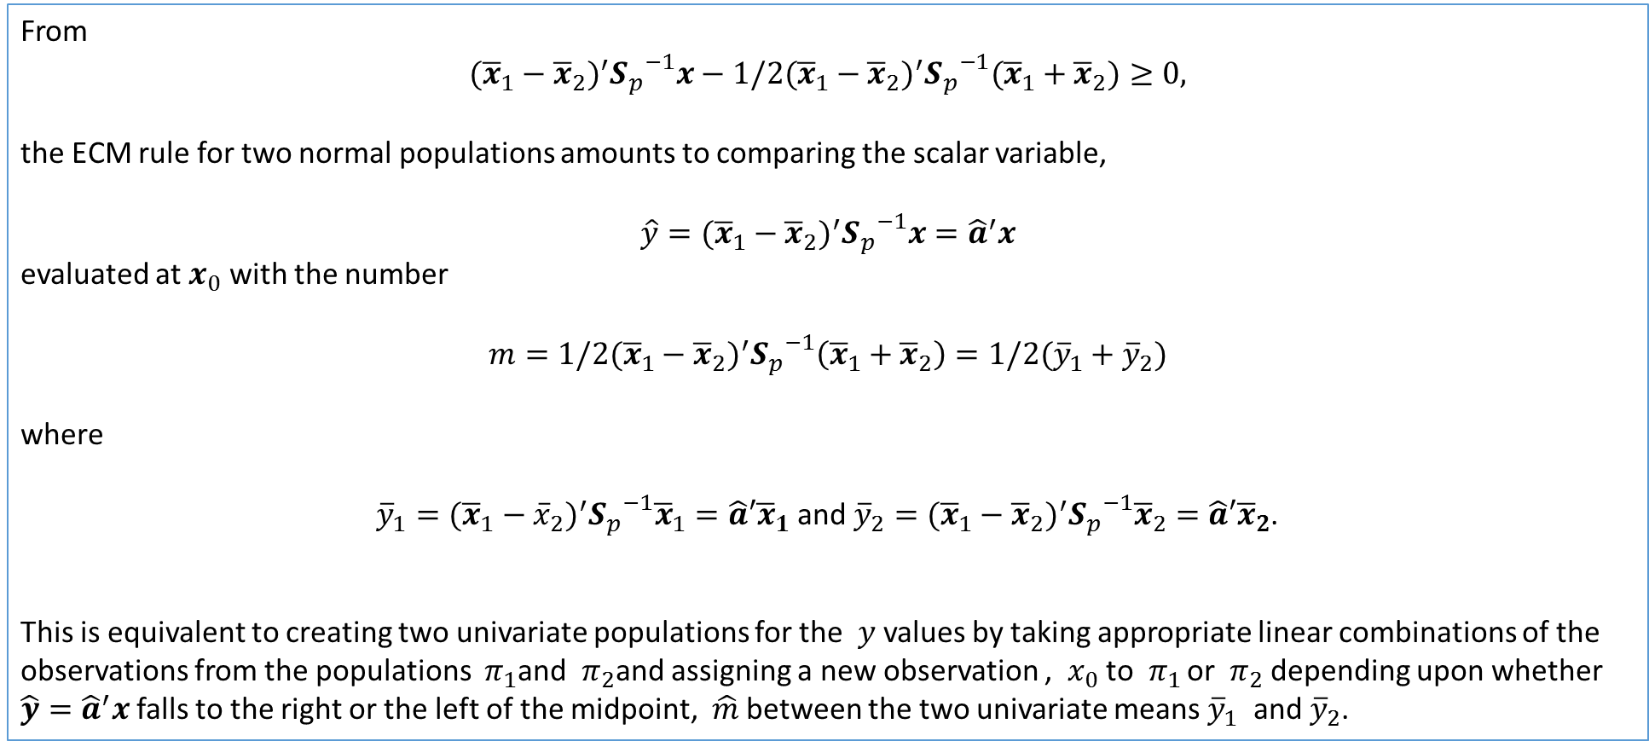
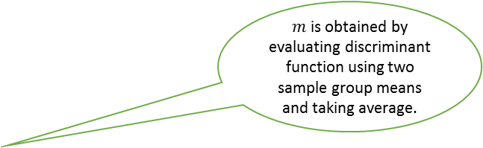
From
$$({\overline{x}}_{1}−{\overline{x}}_{2})^{′}{S_{p}}^{−1}x−1/2({\overline{x}}_{1}−{\overline{x}}_{2})^{′}{S_{p}}^{−1}({\overline{x}}_{1}+{\overline{x}}_{2})≥0,$$
the ECM rule for two normal populations amounts to comparing the scalar variable,
$$\hat{y}=({\overline{x}}_{1}−{\overline{x}}_{2})^{′}{S_{p}}^{−1}x={\hat{a}}^{′}x$$
evaluated at $x_{0}$ with the number
$$m=1/2({\overline{x}}_{1}−{\overline{x}}_{2})^{′}{S_{p}}^{−1}\left({\overline{x}}_{1}+{\overline{x}}_{2}\right)=1/2({\overline{y}}_{1}+{\overline{y}}_{2})$$
where
${\overline{y}}_{1}=({\overline{x}}_{1}−{\overline{x}}_{2})^{′}{S_{p}}^{−1}{\overline{x}}_{1}=\hat{a}′{\overline{x}}_{1}$ and ${\overline{y}}_{2}=({\overline{x}}_{1}−{\overline{x}}_{2})^{′}{S_{p}}^{−1}{\overline{x}}_{2}=\hat{a}′{\overline{x}}_{2}$.
This is equivalent to creating two univariate populations for the $y$values by taking appropriate linear combinations of the observations from the populations $π_{1}$and $π_{2}$and assigning a new observation , $x_{0}$ to $π_{1 }$or $π_{2}$depending upon whether $\hat{y}={\hat{a}}^{′}x$falls to the right or the left of the midpoint, $\hat{m}$ between the two univariate means ${\overline{y}}_{1}$ and ${\overline{y}}_{2}$.
And this leads to a discriminant function, $\hat{y}$ and a cut-off value $m$
$m$ is obtained by evaluating discriminant function using two sample group means and taking average.

Slide 8
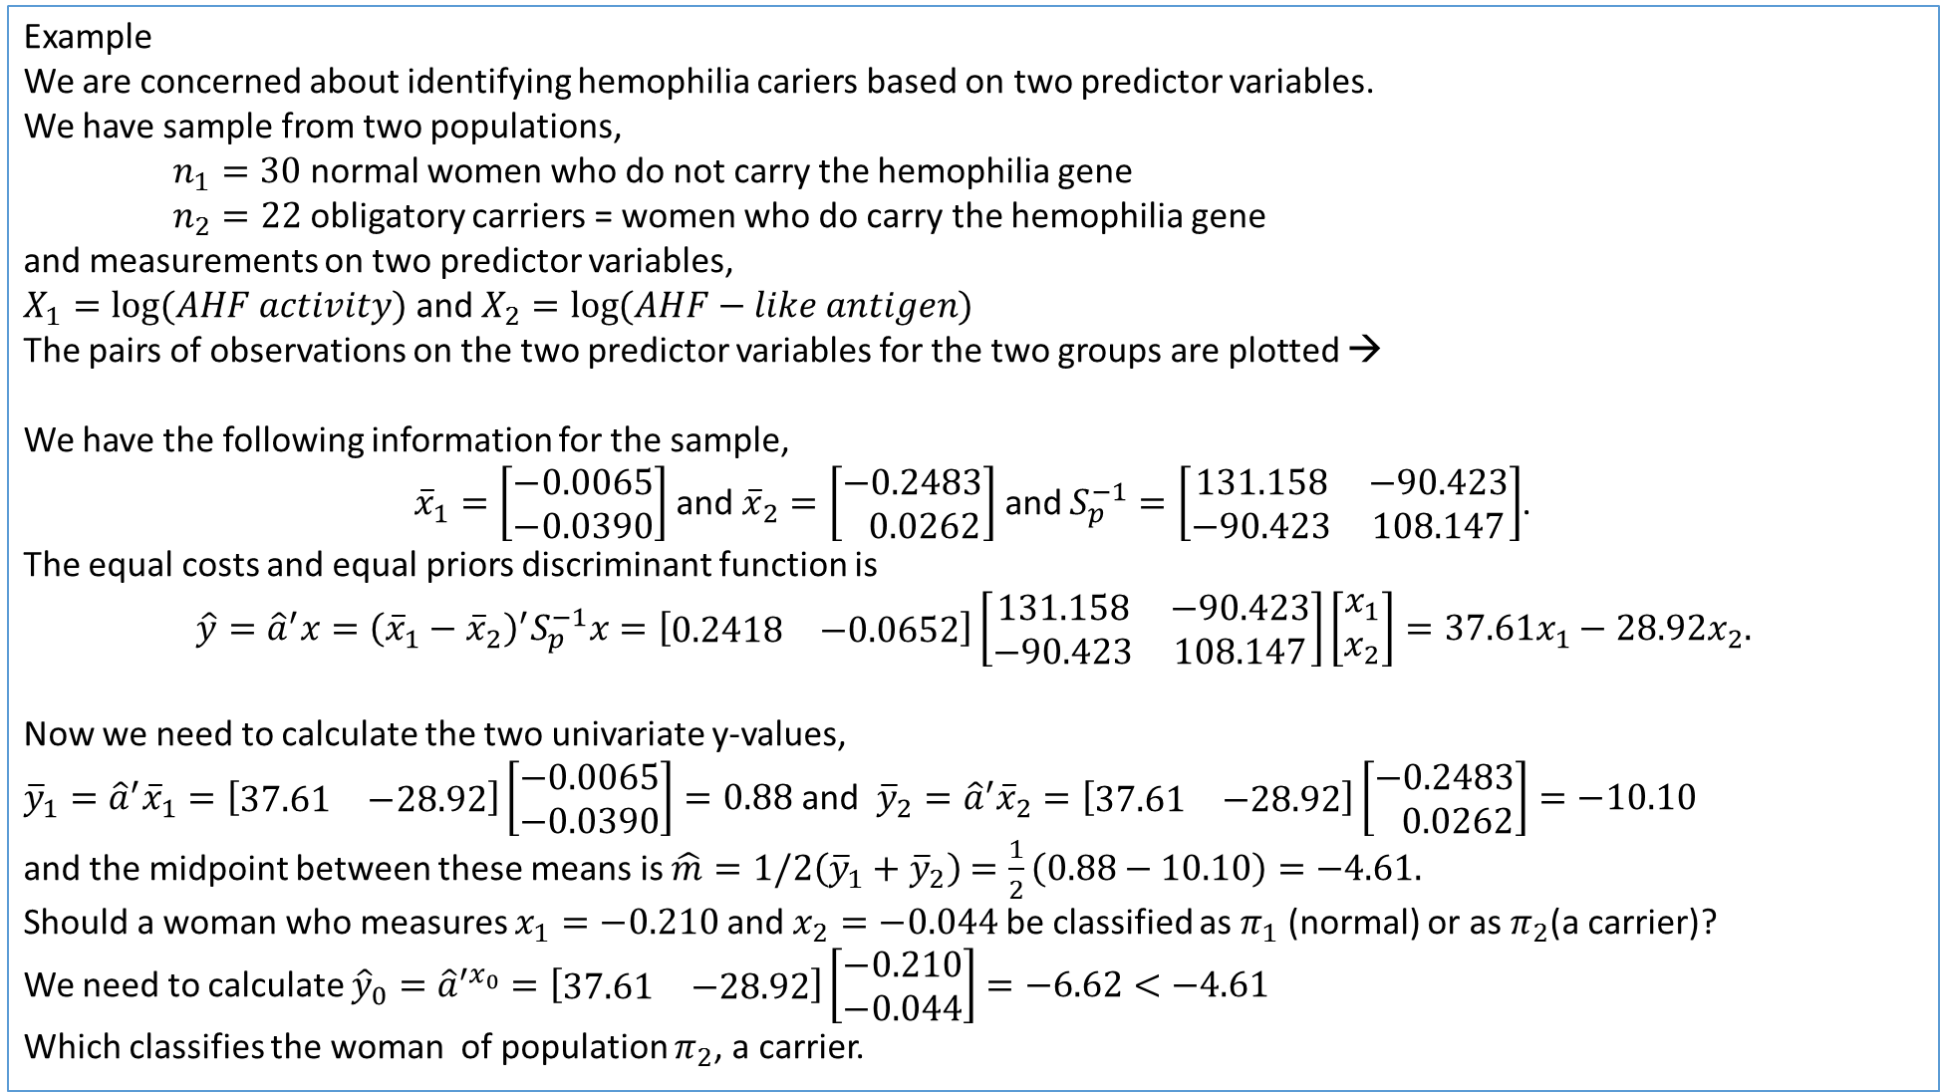
Example
We are concerned about identifying hemophilia cariers based on two predictor variables.
We have sample from two populations,
$n_{1}=30$ normal women who do not carry the hemophilia gene
$n_{2}=22$obligatory carriers = women who do carry the hemophilia gene
and measurements on two predictor variables,
$X_{1}=\log{(AHF activity)}$ and $X_{2}=\log{(AHF−like antigen)}$
The pairs of observations on the two predictor variables for the two groups are plotted →
We have the following information for the sample,
${\overline{x}}_{1}=\left[\begin{matrix}−0.0065 \\ −0.0390\end{matrix}\right]$ and ${\overline{x}}_{2}=\left[\begin{matrix}−0.2483 \\ 0.0262\end{matrix}\right]$ and $S_{p}^{−1}=\left[\begin{matrix}131.158 & −90.423 \\ −90.423 & 108.147\end{matrix}\right]$.
The equal costs and equal priors discriminant function is
$$\hat{y}={\hat{a}}^{′}x={\left({\overline{x}}_{1}−{\overline{x}}_{2}\right)}^{′}S_{p}^{−1}x=\left[\begin{matrix}0.2418 & −0.0652\end{matrix}\right]\left[\begin{matrix}131.158 & −90.423 \\ −90.423 & 108.147\end{matrix}\right]\left[\begin{matrix}x_{1} \\ x_{2}\end{matrix}\right]=37.61x_{1}−28.92x_{2}.$$
Now we need to calculate the two univariate y-values,
${\overline{y}}_{1}={\hat{a}}^{′}{\overline{x}}_{1}=\left[\begin{matrix}37.61 & −28.92\end{matrix}\right]\left[\begin{matrix}−0.0065 \\ −0.0390\end{matrix}\right]=0.88$ and ${\overline{y}}_{2}={\hat{a}}^{′}{\overline{x}}_{2}=\left[\begin{matrix}37.61 & −28.92\end{matrix}\right]\left[\begin{matrix}−0.2483 \\ 0.0262\end{matrix}\right]=−10.10$
and the midpoint between these means is $\hat{m}=1/2\left({\overline{y}}_{1}+{\overline{y}}_{2}\right)$ $=\frac{1}{2}\left(0.88−10.10\right)=−4.61.$
Should a woman who measures $x_{1}=−0.210$ and $x_{2}=−0.044$ be classified as $π_{1}$ (normal) or as $π_{2}$(a carrier)?
We need to calculate ${\hat{y}}_{0}={\hat{a}}^{′x_{0}}=\left[\begin{matrix}37.61 & −28.92\end{matrix}\right]\left[\begin{matrix}−0.210 \\ −0.044\end{matrix}\right]=−6.62<−4.61$
Which classifies the woman of population $π_{2}$, a carrier.
Shows normal ellipses and separation between two groups

Slide 9
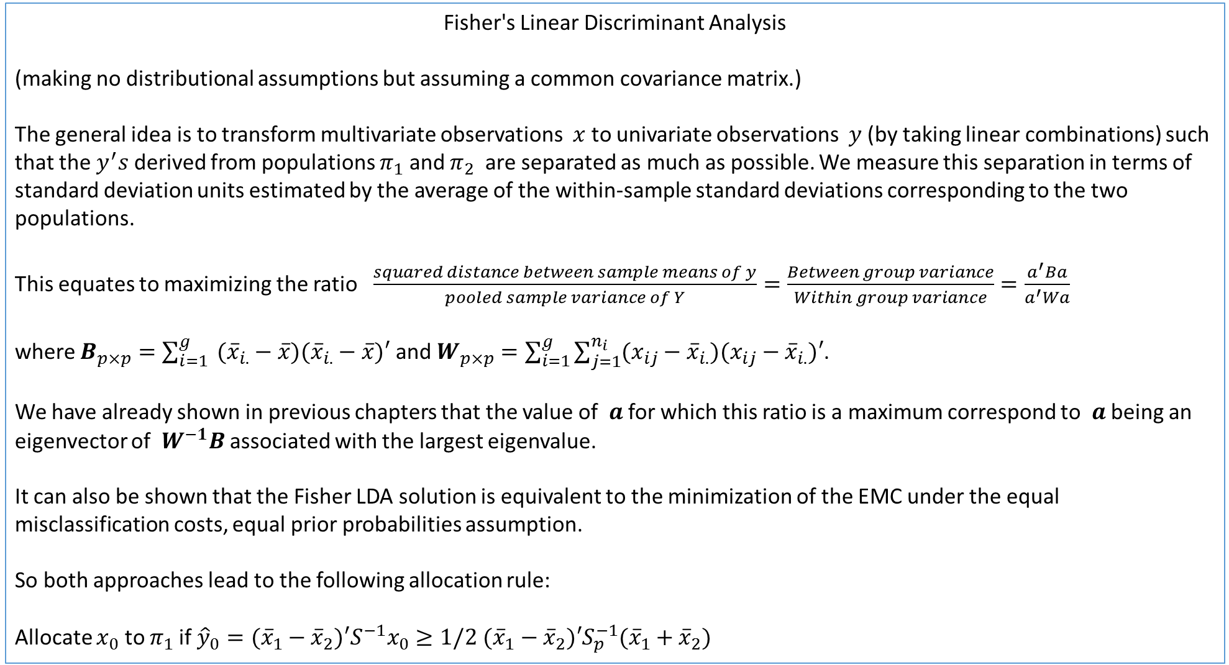
Fisher's Linear Discriminant Analysis
(making no distributional assumptions but assuming a common covariance matrix.)
The general idea is to transform multivariate observations $x$to univariate observations $y$ (by taking linear combinations) such that the $y^{′}s$ derived from populations $π_{1}$ and $π_{2}$ are separated as much as possible. We measure this separation in terms of standard deviation units estimated by the average of the within-sample standard deviations corresponding to the two populations.
This equates to maximizing the ratio $\frac{squared distance between sample means of y}{pooled sample variance of Y}=\frac{Between group variance}{Within group variance}=\frac{a^{′}Ba}{a^{′}Wa}$
where $B_{p×p}=\sum_{i=1}^{g}{ ({\overline{x}}_{i.}−\overline{x})({\overline{x}}_{i.}−\overline{x})′}$ and $W_{p×p}=\sum_{i=1}^{g}{\sum_{j=1}^{n_{i}}{(x_{ij}−{\overline{x}}_{i.})(x_{ij}−{\overline{x}}_{i.})′}}$.
We have already shown in previous chapters that the value of $a$ for which this ratio is a maximum correspond to $a$ being an eigenvector of $W^{−1}B$ associated with the largest eigenvalue.
It can also be shown that the Fisher LDA solution is equivalent to the minimization of the EMC under the equal misclassification costs, equal prior probabilities assumption.
So both approaches lead to the following allocation rule:
Allocate $x_{0}$ to $π_{1}$if ${\hat{y}}_{0}=({\overline{x}}_{1}−{\overline{x}}_{2})′S^{−1}x_{0}≥1/2$ $({\overline{x}}_{1}−{\overline{x}}_{2})′S_{p}^{−1}({\overline{x}}_{1}+{\overline{x}}_{2})$
An ANOVA type approach.

Slide 10
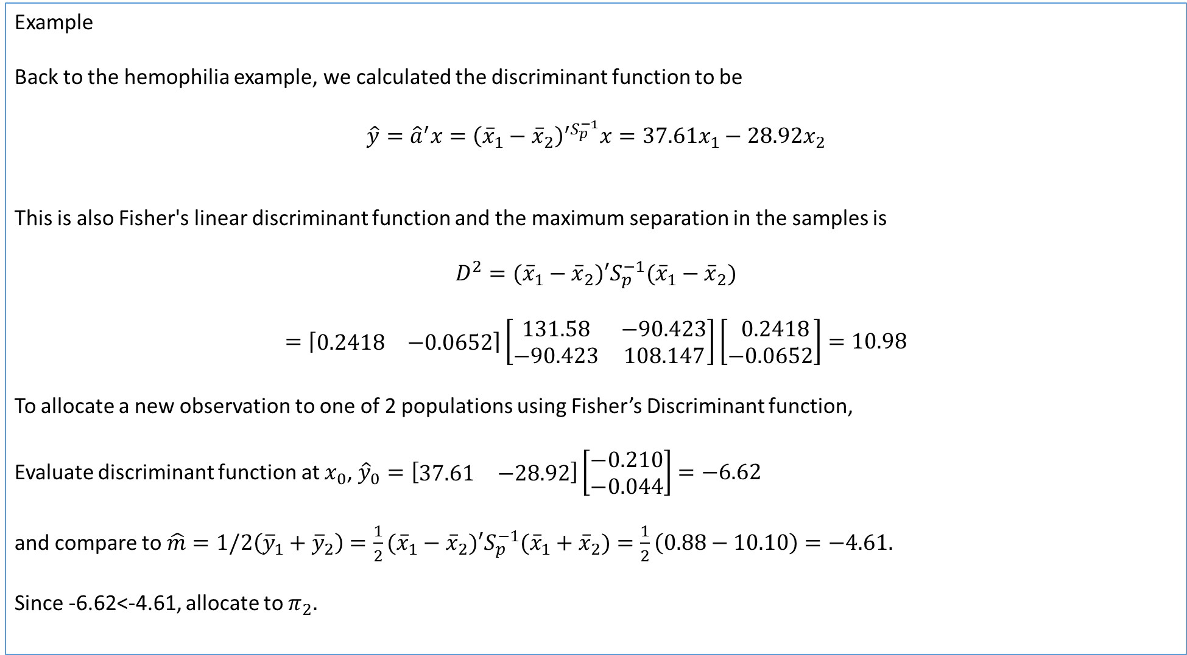
Example
Back to the hemophilia example, we calculated the discriminant function to be
$$\hat{y}={\hat{a}}^{′}x={\left({\overline{x}}_{1}−{\overline{x}}_{2}\right)}^{′S_{p}^{−1}}x=37.61x_{1}−28.92x_{2}$$
This is also Fisher's linear discriminant function and the maximum separation in the samples is
$$D^{2}=({\overline{x}}_{1}−{\overline{x}}_{2})′S_{p}^{−1}({\overline{x}}_{1}−{\overline{x}}_{2})$$
$$=\left\lceil \begin{matrix}0.2418 & −0.0652\end{matrix}\right\rceil \left[\begin{matrix}131.58 & −90.423 \\ −90.423 & 108.147\end{matrix}\right]\left[\begin{matrix} 0.2418 \\ −0.0652\end{matrix}\right]=10.98$$
To allocate a new observation to one of 2 populations using Fisher’s Discriminant function,
Evaluate discriminant function at $x_{0}$, ${\hat{y}}_{0}=\left[\begin{matrix}37.61 & −28.92\end{matrix}\right]\left[\begin{matrix}−0.210 \\ −0.044\end{matrix}\right]=−6.62$
and compare to $\hat{m}=1/2\left({\overline{y}}_{1}+{\overline{y}}_{2}\right)$ $=\frac{1}{2}({\overline{x}}_{1}−{\overline{x}}_{2})′S_{p}^{−1}({\overline{x}}_{1}+{\overline{x}}_{2})=\frac{1}{2}\left(0.88−10.10\right)=−4.61.$
Since -6.62<-4.61, allocate to $π_{2}.$

Slide 11
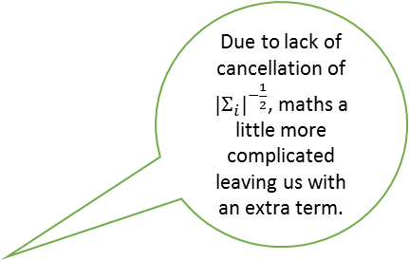
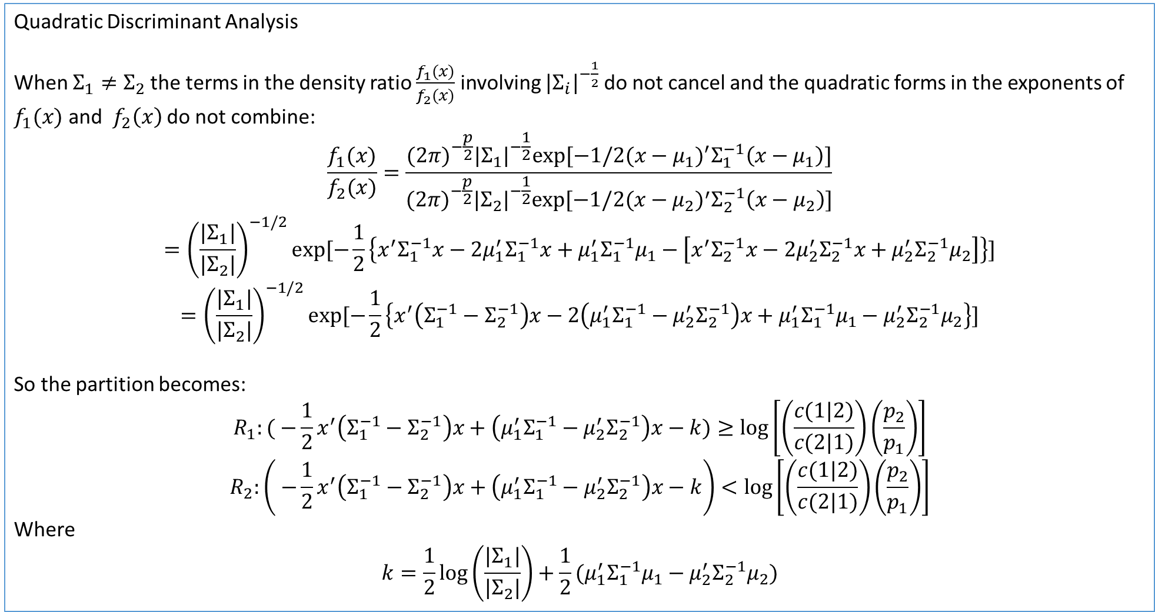
Quadratic Discriminant Analysis
When $Σ_{1}≠Σ_{2}$the terms in the density ratio $\frac{f_{1}(x)}{f_{2}(x)}$ involving $|Σ_{i}|^{−\frac{1}{2}}$ do not cancel and the quadratic forms in the exponents of $f_{1}(x)$ and $f_{2}\left(x\right)$ do not combine:
$$\frac{f_{1}(x)}{f_{2}(x)}=\frac{(2π)^{−\frac{p}{2}}|Σ_{1}|^{−\frac{1}{2}}exp⁡[−1/2(x−μ_{1})^{′}Σ_{1}^{−1}\left(x−μ_{1}\right)]}{(2π)^{−\frac{p}{2}}|Σ_{2}|^{−\frac{1}{2}}exp⁡[−1/2(x−μ_{2})^{′}Σ_{2}^{−1}\left(x−μ_{2}\right)]}$$
$$={\left(\frac{{|Σ}_{1}|}{|Σ_{2}|}\right)}^{−1/2}exp⁡[−\frac{1}{2}\left\{x^{′}Σ_{1}^{−1}x−2μ_{1}^{′}Σ_{1}^{−1}x+μ_{1}^{′}Σ_{1}^{−1}μ_{1}−\left[x^{′}Σ_{2}^{−1}x−2μ_{2}^{′}Σ_{2}^{−1}x+μ_{2}^{′}Σ_{2}^{−1}μ_{2}\right]\right\}]$$
$$={\left(\frac{{|Σ}_{1}|}{|Σ_{2}|}\right)}^{−1/2}exp⁡[−\frac{1}{2}\left\{x^{′}\left(Σ_{1}^{−1}−Σ_{2}^{−1}\right)x−2\left(μ_{1}^{′}Σ_{1}^{−1}−μ_{2}^{′}Σ_{2}^{−1}\right)x+μ_{1}^{′}Σ_{1}^{−1}μ_{1}−μ_{2}^{′}Σ_{2}^{−1}μ_{2}\right\}]$$
So the partition becomes:
$$R_{1}:( −\frac{1}{2}x^{′}\left(Σ_{1}^{−1}−Σ_{2}^{−1}\right)x+\left(μ_{1}^{′}Σ_{1}^{−1}−μ_{2}^{′}Σ_{2}^{−1}\right)x−k)≥\log\left[\left(\frac{c(1|2)}{c(2|1)}\right)\left(\frac{p_{2}}{p_{1}}\right)\right]$$
$$R_{2}:\left( −\frac{1}{2}x^{′}\left(Σ_{1}^{−1}−Σ_{2}^{−1}\right)x+\left(μ_{1}^{′}Σ_{1}^{−1}−μ_{2}^{′}Σ_{2}^{−1}\right)x−k\right)<\log\left[\left(\frac{c(1|2)}{c(2|1)}\right)\left(\frac{p_{2}}{p_{1}}\right)\right]$$
Where
$$k=\frac{1}{2}\log\left(\frac{|Σ_{1}|}{|Σ_{2}|}\right)+\frac{1}{2}(μ_{1}^{′}Σ_{1}^{−1}μ_{1}−μ_{2}^{′}Σ_{2}^{−1}μ_{2})$$
Due to lack of cancellation of $|Σ_{i}|^{−\frac{1}{2}}$, maths a little more complicated leaving us with an extra term.

Slide 12
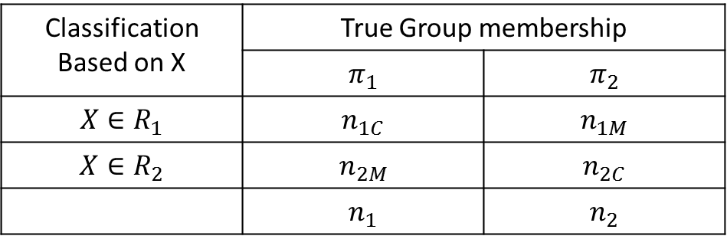
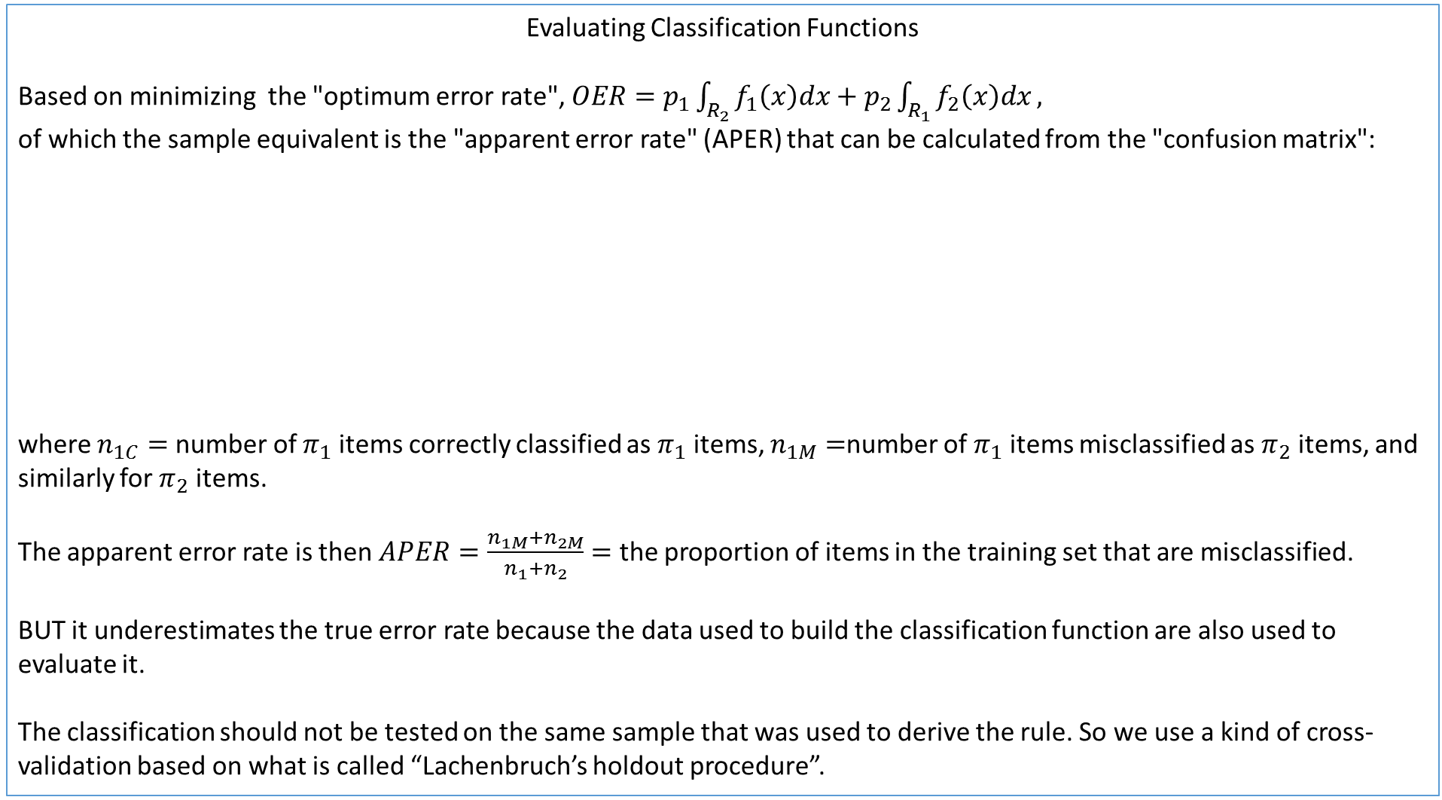
Evaluating Classification Functions
Based on minimizing the "optimum error rate", $OER=p_{1}\int_{R_{2}}^{ }{f_{1}\left(x\right)dx+p_{2}\int_{R_{1}}^{ }{f_{2}\left(x\right)dx}},$
of which the sample equivalent is the "apparent error rate" (APER) that can be calculated from the "confusion matrix":
where $n_{1C}=$ number of $π_{1}$ items correctly classified as $π_{1}$ items, $n_{1M}=$number of $π_{1}$ items misclassified as $π_{2}$ items, and similarly for $π_{2}$ items.
The apparent error rate is then $APER=\frac{n_{1M}+n_{2M}}{n_{1}+n_{2}}=$ the proportion of items in the training set that are misclassified.
BUT it underestimates the true error rate because the data used to build the classification function are also used to evaluate it.
The classification should not be tested on the same sample that was used to derive the rule. So we use a kind of cross-validation based on what is called “Lachenbruch’s holdout procedure”.
Classification Based on X | True Group membership
 | $$π_{1}$$ | $$π_{2}$$
$$X∈R_{1}$$ | $$n_{1C}$$ | $$n_{1M}$$
$$X∈R_{2}$$ | $$n_{2M}$$ | $$n_{2C}$$
 | $$n_{1}$$ | $$n_{2}$$

Slide 13
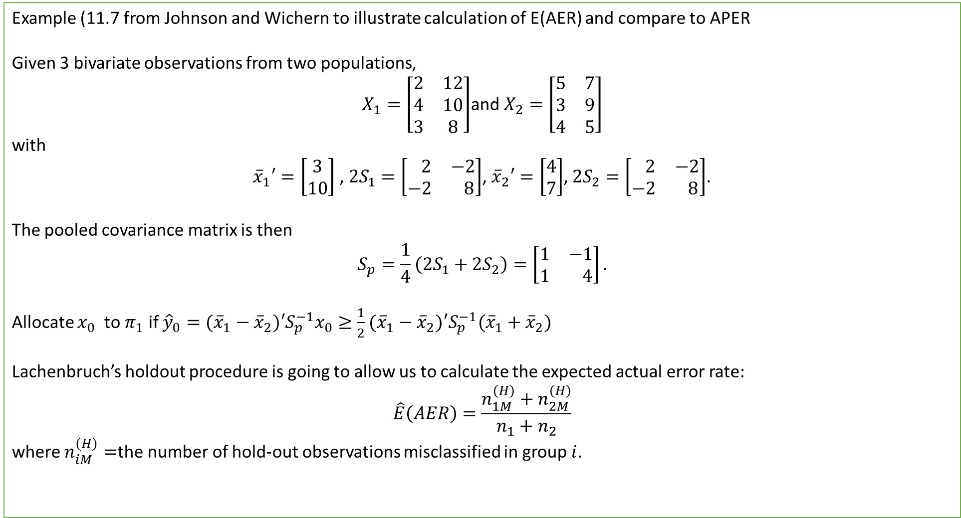
Example (11.7 from Johnson and Wichern to illustrate calculation of E(AER) and compare to APER
Given 3 bivariate observations from two populations,
$X_{1}=\left[\begin{matrix}2 & 12 \\ 4 & 10 \\ 3 & 8\end{matrix}\right]$and $X_{2}=\left[\begin{matrix}5 & 7 \\ 3 & 9 \\ 4 & 5\end{matrix}\right]$
with
${\overline{x}}_{1}′=\left[\begin{matrix}3 \\ 10\end{matrix}\right]$ , $2S_{1}=\left[\begin{matrix} 2 & −2 \\ −2 & 8\end{matrix}\right]$, ${\overline{x}}_{2}′=\left[\begin{matrix}4 \\ 7\end{matrix}\right]$, $2S_{2}=\left[\begin{matrix} 2 & −2 \\ −2 & 8\end{matrix}\right]$.
The pooled covariance matrix is then
$$S_{p}=\frac{1}{4}\left(2S_{1}+2S_{2}\right)=\left[\begin{matrix}1 & −1 \\ 1 & 4\end{matrix}\right].$$
Allocate $x_{0}$ to $π_{1}$ if ${\hat{y}}_{0}=({\overline{x}}_{1}−{\overline{x}}_{2})′S_{p}^{−1}x_{0}≥\frac{1}{2}({\overline{x}}_{1}−{\overline{x}}_{2})′S_{p}^{−1}({\overline{x}}_{1}+{\overline{x}}_{2})$
Lachenbruch’s holdout procedure is going to allow us to calculate the expected actual error rate:
$$\hat{E}\left(AER\right)=\frac{n_{1M}^{(H)}+n_{2M}^{(H)}}{n_{1}+n_{2}}$$
where $n_{iM}^{(H)}=$the number of hold-out observations misclassified in group $i$.

Slide 14
#Read in data matrices and calculate means
> X1<-matrix(c(2,12,4,10,3,8),3,2,byrow=TRUE)
> X1
[,1] [,2]
[1,] 2 12
[2,] 4 10
[3,] 3 8
> X2<-matrix(c(5,7,3,9,4,5),3,2,byrow=TRUE)
> X2
[,1] [,2]
[1,] 5 7
[2,] 3 9
[3,] 4 5
> X11mean<-mean(X1[,1])
> X11mean<-as.matrix(X11mean)
> X12mean<-mean(X1[,2])
> X12mean<-as.matrix(X12mean)
> X1bar<-rbind(X11mean,X12mean)
> X1bar
[,1]
[1,] 3
[2,] 10
> X21mean<-mean(X2[,1])
> X21mean<-as.matrix(X21mean)
> X22mean<-mean(X2[,2])
> X22mean<-as.matrix(X22mean)
> X2bar<-rbind(X21mean,X22mean)
> X2bar
[,1]
[1,] 4
[2,] 7
#read in covariance matrices and calculate inverse
> Sp<-matrix(c(1,-1,-1,4),2,2,byrow=TRUE)
> Sp
[,1] [,2]
[1,] 1 -1
[2,] -1 4
> SPinverse<-solve(Sp)
> SPinverse
[,1] [,2]
[1,] 1.3333333 0.3333333
[2,] 0.3333333 0.3333333
> #Calculate LHS = discrminant function for each of the 3 observations of X1
> LHS11<-t(X1bar-X2bar)%*%SPinverse%*%X1[1,]
> LHS11
[,1]
[1,] 7.333333
> LHS12<-t(X1bar-X2bar)%*%SPinverse%*%X1[2,]
> LHS12
[,1]
[1,] 5.333333
> LHS13<-t(X1bar-X2bar)%*%SPinverse%*%X1[3,]
> LHS13
[,1]
[1,] 4.333333
> #Calculate RHS cutoff
> RHS<-t(X1bar-X2bar)%*%SPinverse%*%(X1bar+X2bar)
> RHS<-RHS/2
> RHS
[,1]
[1,] 4.5
#Do the same for observation from X2
> LHS21<-t(X1bar-X2bar)%*%SPinverse%*%X2[1,]
> LHS21
[,1]
[1,] 3
> LHS22<-t(X1bar-X2bar)%*%SPinverse%*%X2[2,]
> LHS22
[,1]
[1,] 5
> LHS23<-t(X1bar-X2bar)%*%SPinverse%*%X2[3,]
> LHS23
[,1]
[1,] 2
If LHS values > 4.5 then allocate to Population 1, else to Population 2
Thus LHS1 and LHS2 correctly classified as Population 1,
LHS3 misclassified as Population 2.
Thus APER=2/6=0.33
LHS21 and LHS23 <4.5 and hence allocated to Population 2. LHS22 > 4,5 and hence misclassified as Population 1

Slide 15
> #Implement Lachenbruch' holdout procedure to calculate E(AER)
> #Leave out first observation from X1:
> X1h<-X1[2:3,]
> X1h
[,1] [,2]
[1,] 4 10
[2,] 3 8
> X1h1mean<-mean(X1h[,1])
> X1h1mean<-as.matrix(X1h1mean)
> X1h2mean<-mean(X1h[,2])
> X1h2mean<-as.matrix(X1h2mean)
> X1hbar<-rbind(X1h1mean,X1h2mean)
> X1hbar
[,1]
[1,] 3.5
[2,] 9.0
> S1h<-cov(X1h)
> S1h
[,1] [,2]
[1,] 0.5 1
[2,] 1.0 2
> S1hp<-1/3*(S1h+2*S2)
> S1hp
[,1] [,2]
[1,] 0.8333333 -0.3333333
[2,] -0.3333333 3.3333333
> S1hpInverse<-solve(S1hp)
> S1hpInverse
[,1] [,2]
[1,] 1.250 0.1250
[2,] 0.125 0.3125
#Calculate distances from X1 observation left out to two group means, X1hbar and X2bar
> t(X1[1,]-X1hbar)%*%S1hpInverse%*%(X1[1,]-X1hbar)
[,1]
[1,] 4.5
> t(X1[1,]-X2bar)%*%S1hpInverse%*%(X1[1,]-X2bar)
[,1]
[1,] 10.3125
> #and classify to population corresponding to shortest distance, in this case population 1
> #Leave out second observation from X1:
> X1h<-X1[-2,]
> X1h
[,1] [,2]
[1,] 2 12
[2,] 3 8
> X1h1mean<-mean(X1h[,1])
> X1h1mean<-as.matrix(X1h1mean)
> X1h2mean<-mean(X1h[,2])
> X1h2mean<-as.matrix(X1h2mean)
> X1hbar<-rbind(X1h1mean,X1h2mean)
> X1hbar
[,1]
[1,] 2.5
[2,] 10.0
>
> S1h<-cov(X1h)
> S1h
[,1] [,2]
[1,] 0.5 -2
[2,] -2.0 8
> S1hp<-1/3*(S1h+2*S2)
> S1hp
[,1] [,2]
[1,] 0.8333333 -1.333333
[2,] -1.3333333 5.333333
> S1hpInverse<-solve(S1hp)
> S1hpInverse
[,1] [,2]
[1,] 2.0 0.5000
[2,] 0.5 0.3125
> #Calculate distances from X1 observation left out to two group means, X1hbar and X2bar
> t(X1[2,]-X1hbar)%*%S1hpInverse%*%(X1[2,]-X1hbar)
[,1]
[1,] 4.5
> t(X1[2,]-X2bar)%*%S1hpInverse%*%(X1[2,]-X2bar)
[,1]
[1,] 2.8125
> #and classify to population corresponding to shortest distance, in this case population 2
> #Leave out third observation from X1:
> X1h<-X1[-3,]
> X1h
[,1] [,2]
[1,] 2 12
[2,] 4 10
> X1h1mean<-mean(X1h[,1])
> X1h1mean<-as.matrix(X1h1mean)
> X1h2mean<-mean(X1h[,2])
> X1h2mean<-as.matrix(X1h2mean)
> X1hbar<-rbind(X1h1mean,X1h2mean)
> X1hbar
[,1]
[1,] 3
[2,] 11
>
> S1h<-cov(X1h)
> S1h
[,1] [,2]
[1,] 2 -2
[2,] -2 2
> S1hp<-1/3*(S1h+2*S2)
> S1hp
[,1] [,2]
[1,] 1.333333 -1.333333
[2,] -1.333333 3.333333
> S1hpInverse<-solve(S1hp)
> S1hpInverse
[,1] [,2]
[1,] 1.25 0.5
[2,] 0.50 0.5
> #Calculate distances from X1 observation left out to two group means, X1hbar and X2bar
> t(X1[3,]-X1hbar)%*%S1hpInverse%*%(X1[3,]-X1hbar)
[,1]
[1,] 4.5
> t(X1[3,]-X2bar)%*%S1hpInverse%*%(X1[3,]-X2bar)
[,1]
[1,] 0.75
> #and classify to population corresponding to shortest distance, in this case population 2.
So this leaves to 2 misclassification and one correct classification
> #We can do the same for the second group of variables and it will lead to 1 misclassification
> #and 2 correct classifications. Thus E(AER)=3/6=0.5
compared to APER of 0.33
Note calculation of S_p takes into account different n in the 2 X matrices due to holding out 1 obs from X1

Slide 16

Example (From Johnson & Wichern 11.8, page 603)
Salmon fish are born in freshwater streams and after a year or two they swim into the ocean. The growth rings on their scales are predictive of their birthplace in that the rings associated with fish from Alaska are smaller than those born in Canadian waters.
We wish to predict whether Salmon comes from Canada or Alaska based on the diameter of rings for the first-year freshwater growth and the diameter of rings for the first-year marine growth.
> library(MASS)
> T11_2<-read.table(file.choose())
> dimnames(T11_2) <- list (1:nrow(T11_2), c("Country","Gender","Freshwater","Marine"))
> head(T11_2)
Country Gender Freshwater Marine
1 1 2 108 368
2 1 1 131 355
3 1 1 105 469
4 1 2 86 506
5 1 1 99 402
6 1 2 87 423
> table(T11_2$Country)
1 2
50 50
> attach(T11_2)

Slide 17
> fit2<-lda(Country~Freshwater+Marine,data=T11_2)
> fit2
Call:
lda(Country ~ Freshwater + Marine, data = T11_2)
Prior probabilities of groups:
1 2
0.5 0.5
Group means:
Freshwater Marine
1 98.38 429.66
2 137.46 366.62
Coefficients of linear discriminants:
LD1
Freshwater 0.04458572
Marine -0.01803856
> fit.hat<-predict(fit2)
> fit.hat$class
[1] 2 2 1 1 1 1 1 1 1 1 1 2 2 1 1 1 1 1 1 1 1 1 1 1 1 1 1 1 1 2 1 2 1 1 1 1 1 1 1 1 1 1 1 1 1 1 1 1 1 1 2 2 2 2 2
[56] 2 2 2 2 2 2 2 2 2 2 2 2 2 2 2 1 2 2 2 2 2 2 2 2 2 2 2 2 2 2 2 2 2 2 2 2 2 2 2 2 2 2 2 2 2
Levels: 1 2
> tab2 <- table(T11_2$Country, fit.hat$class)
> tab2
1 2
1 44 6
2 1 49
> conCV12 <- rbind(tab2[1, ]/sum(tab2[1, ]), tab2[2, ]/sum(tab2[2, ]))
> dimnames(conCV12) <- list(Actual = c("1", "2"), "Predicted (cv)" = c("1","2"))
> print(round(conCV12, 3))
Predicted (cv)
Actual 1 2
1 0.88 0.12
2 0.02 0.98
The lda function in the MASS library performs a linear discriminant analysis
$$({\overline{x}}_{1}−{\overline{x}}_{2})^{′}{S_{p}}^{−1}x−1/2({\overline{x}}_{1}−{\overline{x}}_{2})^{′}{S_{p}}^{−1}({\overline{x}}_{1}+{\overline{x}}_{2})≥0$$
This is the estimated linear discriminant function . You will substitute the values for Freshwater and Marine into this function and compare the outcome with a cut-off of 0.
The outcome of the classification
We calculate row percentages to tell us what percentage of observations in each observed group(country) were correctly and incorrectly classified by model.
A much more useful and labelled table, showing us that 88% of salmon in country 1 and 98% of salmon in country 2 were correctly classified.

Slide 18
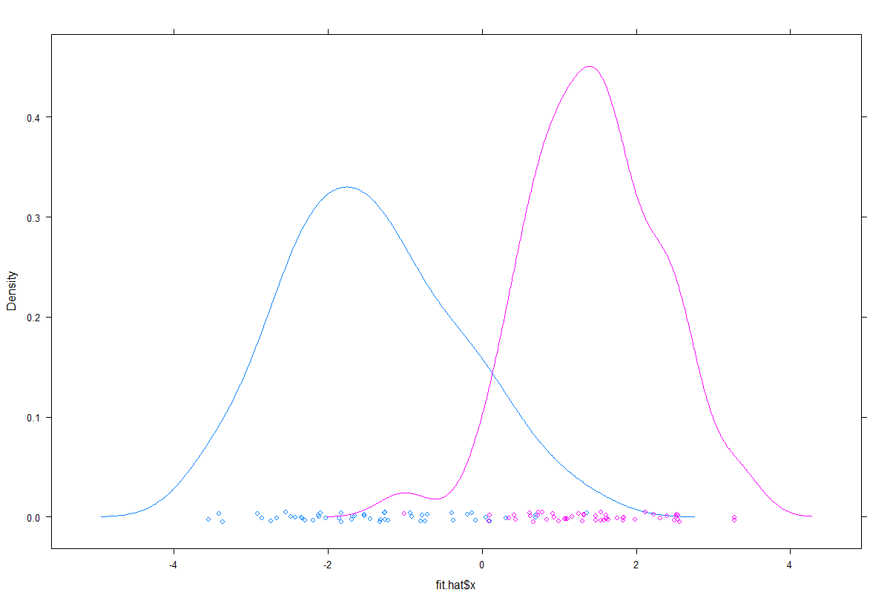
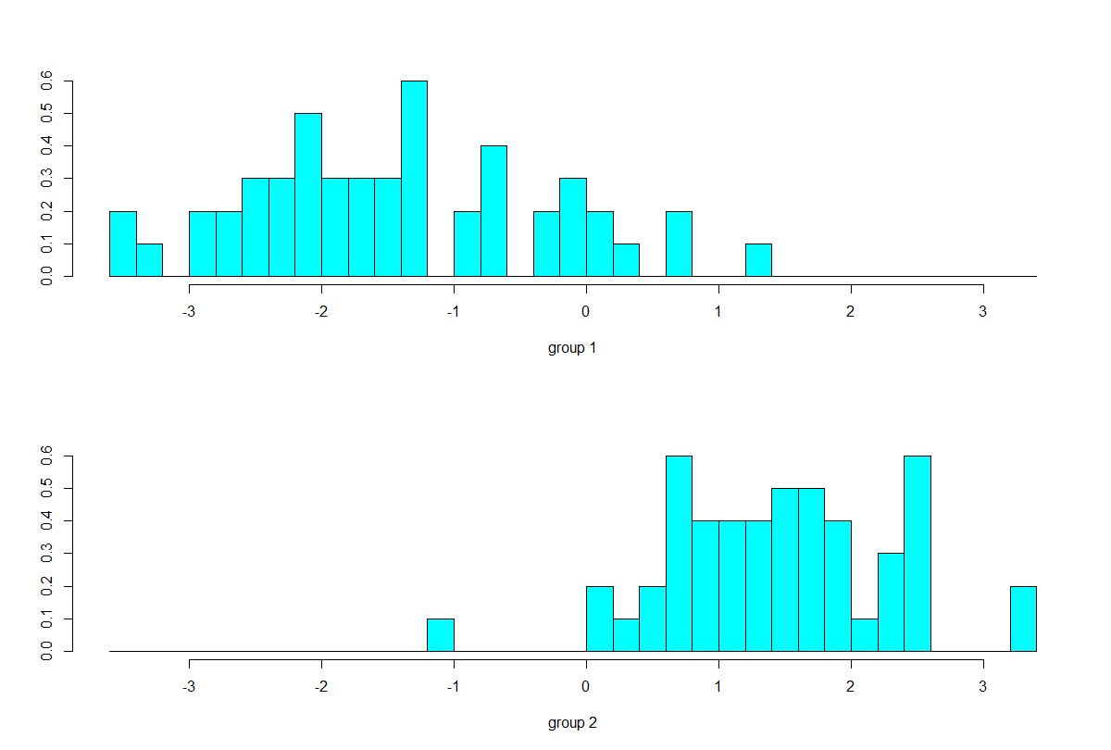
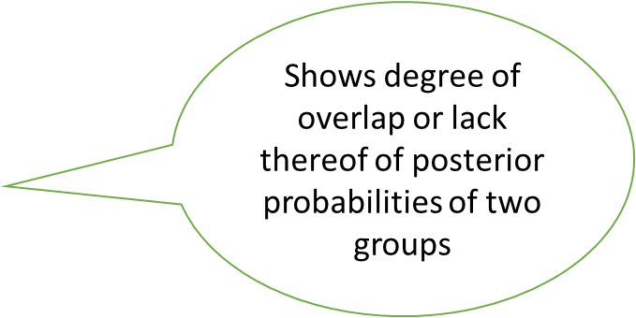
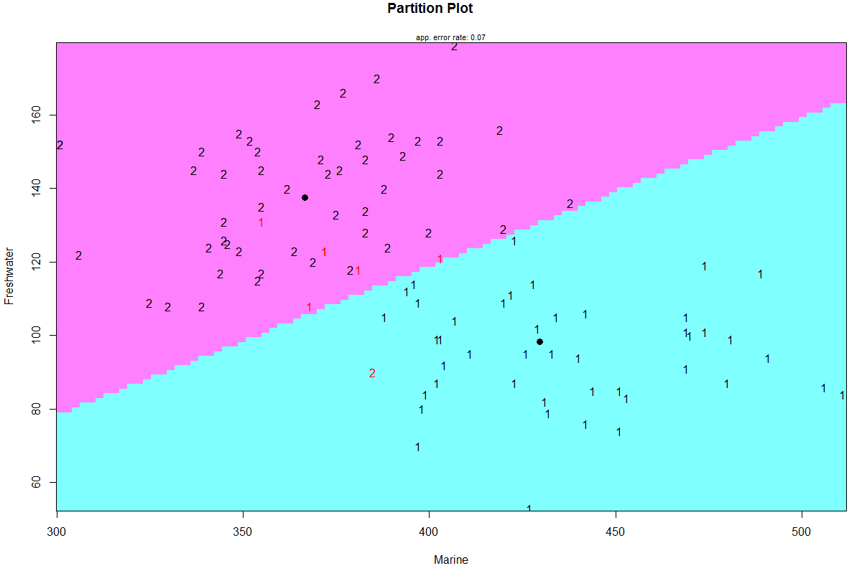
> plot(fit2)
> library(lattice)
> densityplot(~fit.hat$x, groups = T11_2$Country)
> fit$posterior
1 2
1 3.948409e-01 6.051591e-01
2 1.175753e-02 9.882425e-01
3 9.949318e-01 5.068154e-03
4 9.999539e-01 4.613785e-05
5 9.302454e-01 6.975460e-02
6 9.945646e-01 5.435388e-03
7 9.944957e-01 5.504346e-03
….
96 7.623827e-04 9.992376e-01
97 2.459784e-02 9.754022e-01
98 2.772808e-02 9.722719e-01
99 1.029729e-03 9.989703e-01
100 1.631781e-01 8.368219e-01
library(klaR)
T11_2$Country<-as.factor(T11_2$Country)
partimat(Country~Freshwater+Marine,data=T11_2,method="lda")
The posterior probabilities of class membership.
Another nice way of illustrating the DA results

Slide 19
> fit<-lda(Country~Freshwater+Marine,data=T11_2,CV=TRUE)
> tab <- table(T11_2$Country, fit$class)
> tab
1 2
1 44 6
2 1 49
> conCV1 <- rbind(tab[1, ]/sum(tab[1, ]), tab[2, ]/sum(tab[2, ]))
> dimnames(conCV1) <- list(Actual = c("1", "2"), "Predicted (cv)" = c("1","2"))
> print(round(conCV1, 3))
Predicted (cv)
Actual 1 2
1 0.88 0.12
2 0.02 0.98
We set the option CV equal to TRUE so that they evaluate the classification based on cross-validation.
The classification table, rows are actual, columns are predicted
A much more useful and labelled table, showing us that 88% of salmon in country 1 and 98% of salmon in country 2 were correctly classified.
Note that in this case CV based classification was same as non-CV based classification but it need not be.
> #Try quadratic LDA
> fit_qda<-qda(Country~Freshwater+Marine,data=T11_2)
> fit_qda
Call:
qda(Country ~ Freshwater + Marine, data = T11_2)
Prior probabilities of groups:
1 2
0.5 0.5
Group means:
Freshwater Marine
1 98.38 429.66
137.46 366.62
> fitQ.hat<-predict(fit_qda)
> tab3 <- table(T11_2$Country, fitQ.hat$class)
> tab3
1 2
1 45 5
2 2 48
> conCV12 <- rbind(tab3[1, ]/sum(tab3[1, ]), tab3[2, ]/sum(tab3[2, ]))
> dimnames(conCV12) <- list(Actual = c("1", "2"), "Predicted (cv)" = c("1","2"))
> print(round(conCV12, 3))
Predicted (cv)
Actual 1 2
1 0.90 0.10
2 0.04 0.96
Based on distribution, variances in 2 groups potentially different, so perform qda. Leads to slightly different classification.

Slide 20
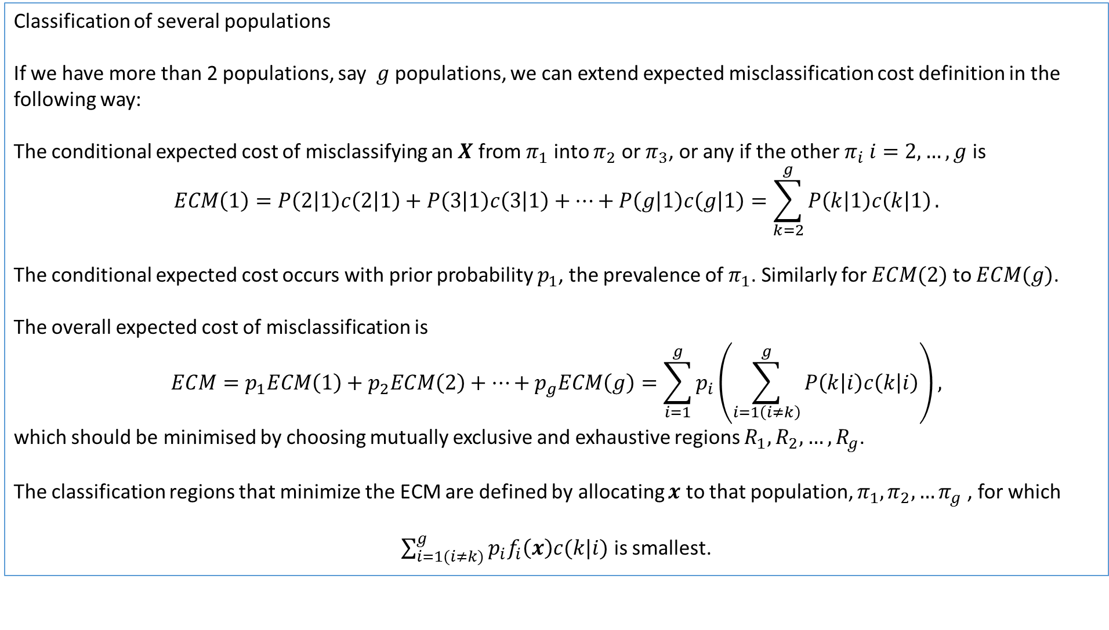
Classification of several populations
If we have more than 2 populations, say $g$ populations, we can extend expected misclassification cost definition in the following way:
The conditional expected cost of misclassifying an $X$ from $π_{1}$ into $π_{2}$ or $π_{3}$, or any if the other $π_{i} i=2,…,g$ is
$$ECM\left(1\right)=P\left(2 | 1\right)c\left(2 | 1\right)+P\left(3 | 1\right)c\left(3 | 1\right)+…+P\left(g | 1\right)c\left(g | 1\right)=\sum_{k=2}^{g}{P\left(k | 1\right)c\left(k | 1\right)}.$$
The conditional expected cost occurs with prior probability $p_{1}$, the prevalence of $π_{1}$. Similarly for $ECM(2)$ to $ECM(g)$.
The overall expected cost of misclassification is
$$ECM=p_{1}ECM\left(1\right)+p_{2}ECM\left(2\right)+…+p_{g}ECM\left(g\right)=\sum_{i=1}^{g}{p_{i}\left(\sum_{i=1\left(i≠k\right)}^{g}{P\left(k | i\right)c\left(k | i\right)}\right),}$$
which should be minimised by choosing mutually exclusive and exhaustive regions $R_{1}, R_{2},…,R_{g}$.
The classification regions that minimize the ECM are defined by allocating $x$ to that population, $π_{1},π_{2},…π_{g}$ , for which
$\sum_{i=1(i≠k)}^{g}{p_{i}f_{i}\left(x\right)c(k|i)}$ is smallest.

Slide 21
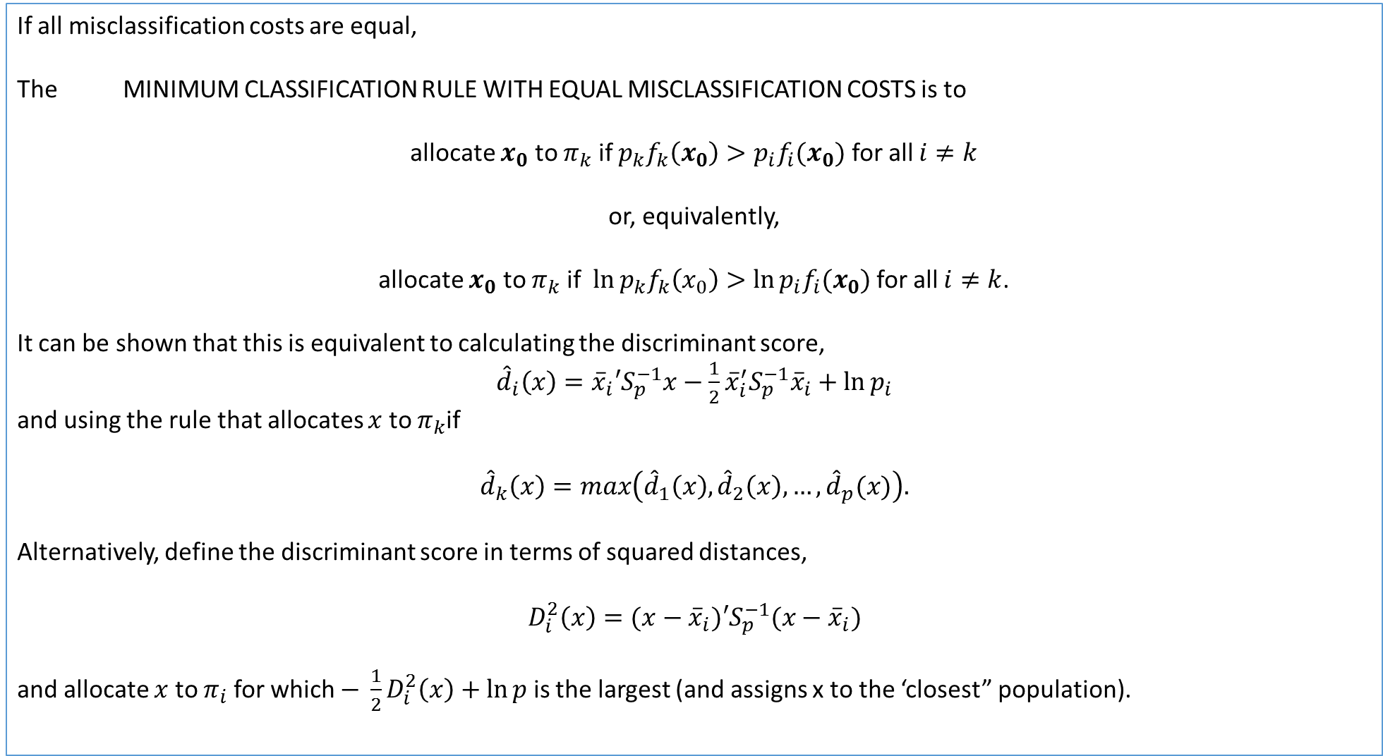
If all misclassification costs are equal,
The MINIMUM CLASSIFICATION RULE WITH EQUAL MISCLASSIFICATION COSTS is to
allocate $x_{0}$ to $π_{k}$ if $p_{k}f_{k}\left(x_{0}\right)>p_{i}f_{i}(x_{0})$ for all $i≠k$
or, equivalently,
allocate $x_{0}$ to $π_{k}$ if $\ln{p_{k}f_{k}\left(x_{0}\right)>\ln{p_{i}f_{i}(x_{0})}}$for all $i≠k$.
It can be shown that this is equivalent to calculating the discriminant score,
${\hat{d}}_{i}\left(x\right)={\overline{x}}_{i}′S_{p}^{−1}x−\frac{1}{2}{\overline{x}}_{i}^{′}S_{p}^{−1}{\overline{x}}_{i}+\ln{p_{i}}$
and using the rule that allocates $x$ to $π_{k}$if
$${\hat{d}}_{k}\left(x\right)=max\left({\hat{d}}_{1}\left(x\right), {\hat{d}}_{2}\left(x\right),…,{\hat{d}}_{p}(x)\right).$$
Alternatively, define the discriminant score in terms of squared distances,
$$D_{i}^{2}\left(x\right)=(x−{\overline{x}}_{i})′S_{p}^{−1}(x−{\overline{x}}_{i})$$
and allocate $x$ to $π_{i}$ for which $− \frac{1}{2}D_{i}^{2}\left(x\right)+\ln{p}$ is the largest (and assigns x to the ‘closest” population).
SO when we have >2 groups, instead of comparing discriminant function to a cut-off value, we evaluate it for all groups and chose either ma or min depending on criterion.

Slide 22
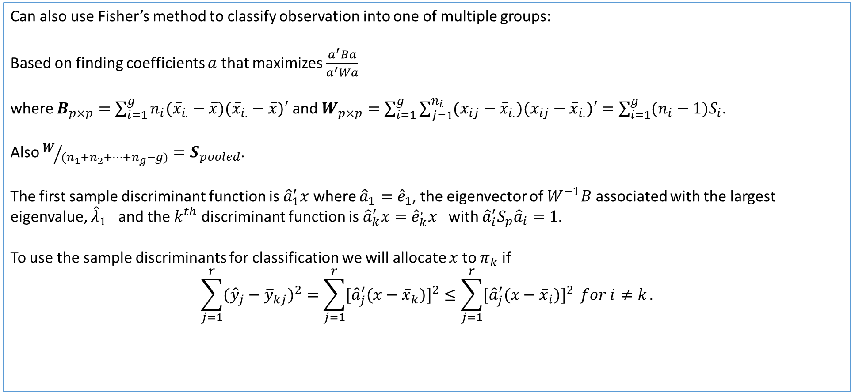
Can also use Fisher’s method to classify observation into one of multiple groups:
Based on finding coefficients $a$ that maximizes $\frac{a^{′}Ba}{a^{′}Wa}$
where $B_{p×p}=\sum_{i=1}^{g}{n_{i}({\overline{x}}_{i.}−\overline{x})({\overline{x}}_{i.}−\overline{x})′}$ and $W_{p×p}=\sum_{i=1}^{g}{\sum_{j=1}^{n_{i}}{(x_{ij}−{\overline{x}}_{i.})(x_{ij}−{\overline{x}}_{i.})′}}=\sum_{i=1}^{g}{{(n_{i}−1)S}_{i}}$.
Also $W/{(n_{1}+n_{2}+…+n_{g}−g)}=S_{pooled}$.
The first sample discriminant function is ${\hat{a}}_{1}^{′}x$ where ${\hat{a}}_{1}={\hat{e}}_{1}$, the eigenvector of $W^{−1}B$ associated with the largest eigenvalue, ${\hat{λ}}_{1}$ and the $k^{th}$ discriminant function is ${\hat{a}}_{k}^{′}x={\hat{e}}_{k}^{,}x$ with ${\hat{a}}_{i}^{′}S_{p}{\hat{a}}_{i}=1.$
To use the sample discriminants for classification we will allocate $x$ to $π_{k}$ if
$$\sum_{j=1}^{r}{({\hat{y}}_{j}−{\overline{y}}_{kj})^{2}=\sum_{j=1}^{r}{[{\hat{a}}_{j}^{′}(x−{\overline{x}}_{k})]^{2}≤\sum_{j=1}^{r}{[{\hat{a}}_{j}^{′}(x−{\overline{x}}_{i})]^{2}}} for i≠k}.$$

Slide 23
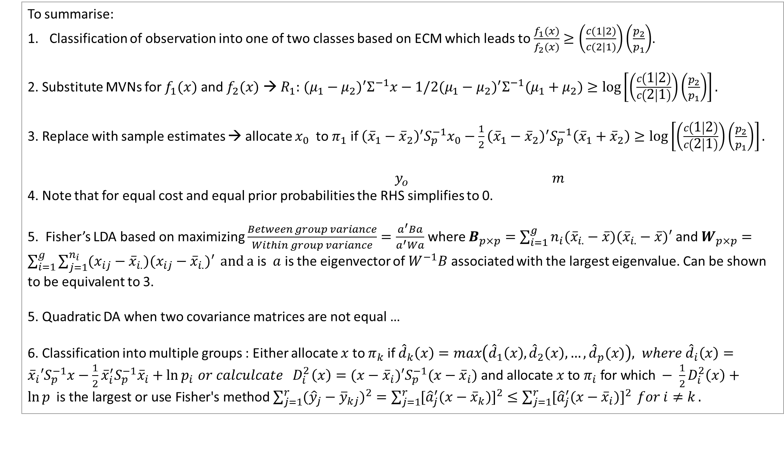
To summarise:
Classification of observation into one of two classes based on ECM which leads to $\frac{f_{1}(x)}{f_{2}(x)}≥\left(\frac{c(1|2)}{c(2|1)}\right)\left(\frac{p_{2}}{p_{1}}\right)$.
2. Substitute MVNs for $f_{1}(x)$ and $f_{2}(x)$ → $R_{1}:$ $(μ_{1}−μ_{2})^{′}Σ^{−1}x−1/2(μ_{1}−μ_{2})^{′}Σ^{−1}(μ_{1}+μ_{2})≥\log\left[\left(\frac{c\left(1 | 2\right)}{c\left(2 | 1\right)}\right)\left(\frac{p_{2}}{p_{1}}\right)\right].$
3. Replace with sample estimates → allocate $x_{0}$ to $π_{1}$ if ${\left({\overline{x}}_{1}−{\overline{x}}_{2}\right)}^{′}S_{p}^{−1}x_{0}−\frac{1}{2}{\left({\overline{x}}_{1}−{\overline{x}}_{2}\right)}^{′}S_{p}^{−1}\left({\overline{x}}_{1}+{\overline{x}}_{2}\right)≥\log\left[\left(\frac{c\left(1 | 2\right)}{c\left(2 | 1\right)}\right)\left(\frac{p_{2}}{p_{1}}\right)\right].$
$y_{o}$ $m$
4. Note that for equal cost and equal prior probabilities the RHS simplifies to 0.
5. Fisher’s LDA based on maximizing $\frac{Between group variance}{Within group variance}=\frac{a^{′}Ba}{a^{′}Wa}$ where $B_{p×p}=\sum_{i=1}^{g}{n_{i}({\overline{x}}_{i.}−\overline{x})({\overline{x}}_{i.}−\overline{x})′}$ and $W_{p×p}=\sum_{i=1}^{g}{\sum_{j=1}^{n_{i}}{(x_{ij}−{\overline{x}}_{i.})(x_{ij}−{\overline{x}}_{i.})′}} and a$ is $a$ is the eigenvector of $W^{−1}B$ associated with the largest eigenvalue. Can be shown to be equivalent to 3.
5. Quadratic DA when two covariance matrices are not equal …
6. Classification into multiple groups : Either allocate $x$ to $π_{k}$ if ${\hat{d}}_{k}\left(x\right)=max\left({\hat{d}}_{1}\left(x\right), {\hat{d}}_{2}\left(x\right),…,{\hat{d}}_{p}(x)\right), where {\hat{d}}_{i}\left(x\right)={\overline{x}}_{i}′S_{p}^{−1}x−\frac{1}{2}{\overline{x}}_{i}^{′}S_{p}^{−1}{\overline{x}}_{i}+\ln{p_{i}}{ or calculcate D}_{i}^{2}\left(x\right)=(x−{\overline{x}}_{i})′S_{p}^{−1}(x−{\overline{x}}_{i}) \text{and} \text{allocate} x \text{to} π_{i} \text{for} \text{which} − \frac{1}{2}D_{i}^{2}\left(x\right)+\ln{p} \text{is} \text{the} \text{largest} \text{or} \text{use} \text{Fisher}\text{′}\text{s} \text{method}$ $\sum_{j=1}^{r}{({\hat{y}}_{j}−{\overline{y}}_{kj})^{2}=\sum_{j=1}^{r}{[{\hat{a}}_{j}^{′}(x−{\overline{x}}_{k})]^{2}≤\sum_{j=1}^{r}{[{\hat{a}}_{j}^{′}(x−{\overline{x}}_{i})]^{2}}} for i≠k}.$
All you need on one page!

Slide 24
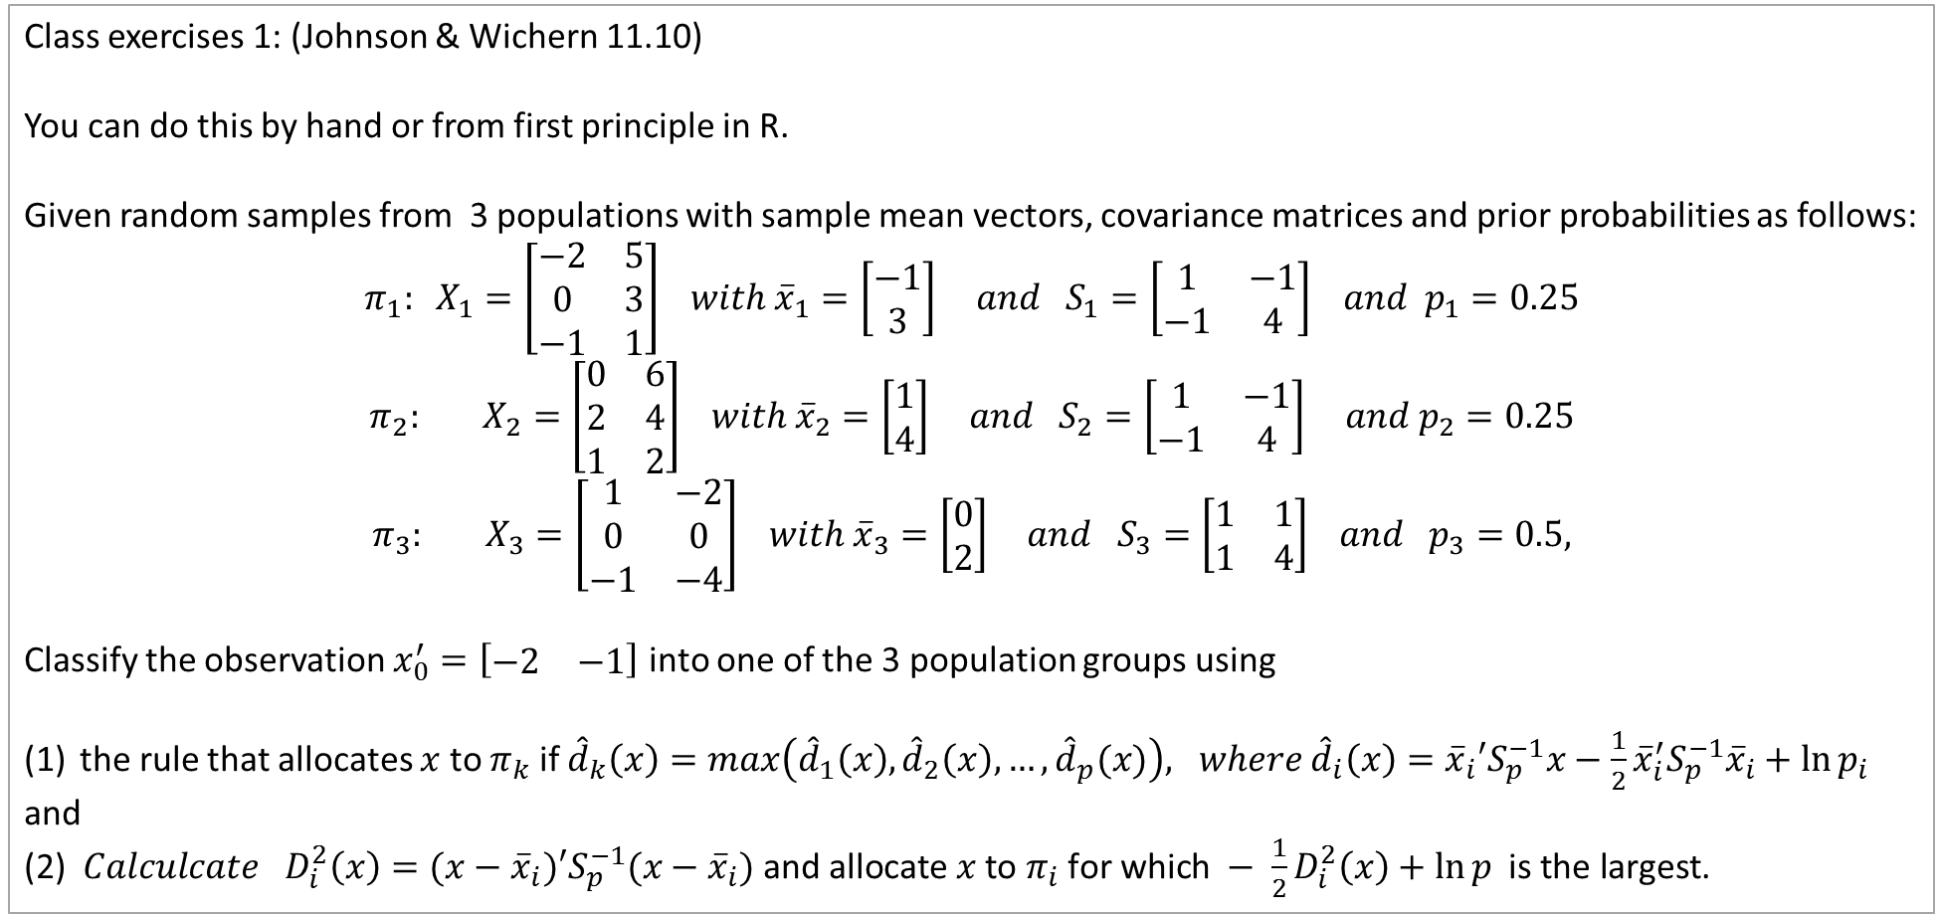
Class exercises 1: (Johnson & Wichern 11.10)
You can do this by hand or from first principle in R.
Given random samples from 3 populations with sample mean vectors, covariance matrices and prior probabilities as follows:
$$π_{1}: X_{1}=\left[\begin{matrix}−2 & 5 \\ 0 & 3 \\ −1 & 1\end{matrix}\right] with {\overline{x}}_{1}=\left[\begin{matrix}−1 \\ 3\end{matrix}\right] and S_{1}=\left[\begin{matrix}1 & −1 \\ −1 & 4\end{matrix}\right] and p_{1}=0.25$$
$$π_{2}: X_{2}=\left[\begin{matrix}0 & 6 \\ 2 & 4 \\ 1 & 2\end{matrix}\right] with {\overline{x}}_{2}=\left[\begin{matrix}1 \\ 4\end{matrix}\right] and S_{2}=\left[\begin{matrix}1 & −1 \\ −1 & 4\end{matrix}\right] and p_{2}=0.25$$
$$π_{3}: X_{3}=\left[\begin{matrix}1 & −2 \\ 0 & 0 \\ −1 & −4\end{matrix}\right] with {\overline{x}}_{3}=\left[\begin{matrix}0 \\ 2\end{matrix}\right] and S_{3}=\left[\begin{matrix}1 & 1 \\ 1 & 4\end{matrix}\right] and p_{3}=0.5,$$
Classify the observation $x_{0}^{′}=\left[\begin{matrix}−2 & −1\end{matrix}\right]$ into one of the 3 population groups using
the rule that allocates $x$ to $π_{k}$ if ${\hat{d}}_{k}\left(x\right)=max\left({\hat{d}}_{1}\left(x\right), {\hat{d}}_{2}\left(x\right),…,{\hat{d}}_{p}(x)\right), where {\hat{d}}_{i}\left(x\right)={\overline{x}}_{i}′S_{p}^{−1}x−\frac{1}{2}{\overline{x}}_{i}^{′}S_{p}^{−1}{\overline{x}}_{i}+\ln{p_{i}}$
and
(2) ${ Calculcate D}_{i}^{2}\left(x\right)=(x−{\overline{x}}_{i})′S_{p}^{−1}(x−{\overline{x}}_{i}) \text{and} \text{allocate} x \text{to} π_{i} \text{for} \text{which} − \frac{1}{2}D_{i}^{2}\left(x\right)+\ln{p} \text{is} \text{the} \text{largest}$.

Slide 25
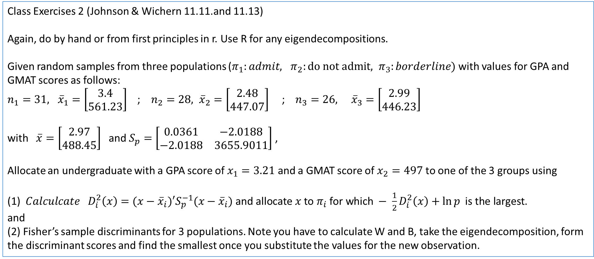
Class Exercises 2 (Johnson & Wichern 11.11.and 11.13)
Again, do by hand or from first principles in r. Use R for any eigendecompositions.
Given random samples from three populations ($π_{1}:admit, π_{2}:do not admit, π_{3}:borderline)$with values for GPA and GMAT scores as follows:
$n_{1}=31, {\overline{x}}_{1}=\left[\begin{matrix}3.4 \\ 561.23\end{matrix}\right]$ ; $n_{2}=28, {\overline{x}}_{2}=\left[\begin{matrix}2.48 \\ 447.07\end{matrix}\right]$ ; $n_{3}=26, {\overline{x}}_{3}=\left[\begin{matrix}2.99 \\ 446.23\end{matrix}\right]$
with $\overline{x}=\left[\begin{matrix}2.97 \\ 488.45\end{matrix}\right]$ and $S_{p}=\left[\begin{matrix}0.0361 & −2.0188 \\ −2.0188 & 3655.9011\end{matrix}\right]$ ,
Allocate an undergraduate with a GPA score of $x_{1}=3.21$ and a GMAT score of $x_{2}=497$ to one of the 3 groups using
(1) ${ Calculcate D}_{i}^{2}\left(x\right)=(x−{\overline{x}}_{i})′S_{p}^{−1}(x−{\overline{x}}_{i}) \text{and} \text{allocate} x \text{to} π_{i} \text{for} \text{which} − \frac{1}{2}D_{i}^{2}\left(x\right)+\ln{p} \text{is} \text{the} \text{largest}$.
and
(2) Fisher’s sample discriminants for 3 populations. Note you have to calculate W and B, take the eigendecomposition, form the discriminant scores and find the smallest once you substitute the values for the new observation.

Slide 26

Example using R:
iris {datasets} R Documentation
Edgar Anderson's Iris Data
Description
This famous (Fisher's or Anderson's) iris data set gives the measurements in centimetres of the variables sepal length and width and petal length and width, respectively, for 50 flowers from each of 3 species of iris. The species are Iris setosa, versicolor, and virginica.
iris is a data frame with 150 cases (rows) and 5 variables (columns) named Sepal.Length, Sepal.Width, Petal.Length, Petal.Width, and Species.
> #Load the library containing lda() function
> library(MASS)
> #Store the dataset
> dataset=iris
> head(dataset)
Sepal.Length Sepal.Width Petal.Length Petal.Width Species
1 5.1 3.5 1.4 0.2 setosa
2 4.9 3.0 1.4 0.2 setosa
3 4.7 3.2 1.3 0.2 setosa
4 4.6 3.1 1.5 0.2 setosa
5 5.0 3.6 1.4 0.2 setosa
6 5.4 3.9 1.7 0.4 setosa
> table(dataset$Species)
setosa versicolor virginica
50 50 50

Slide 27
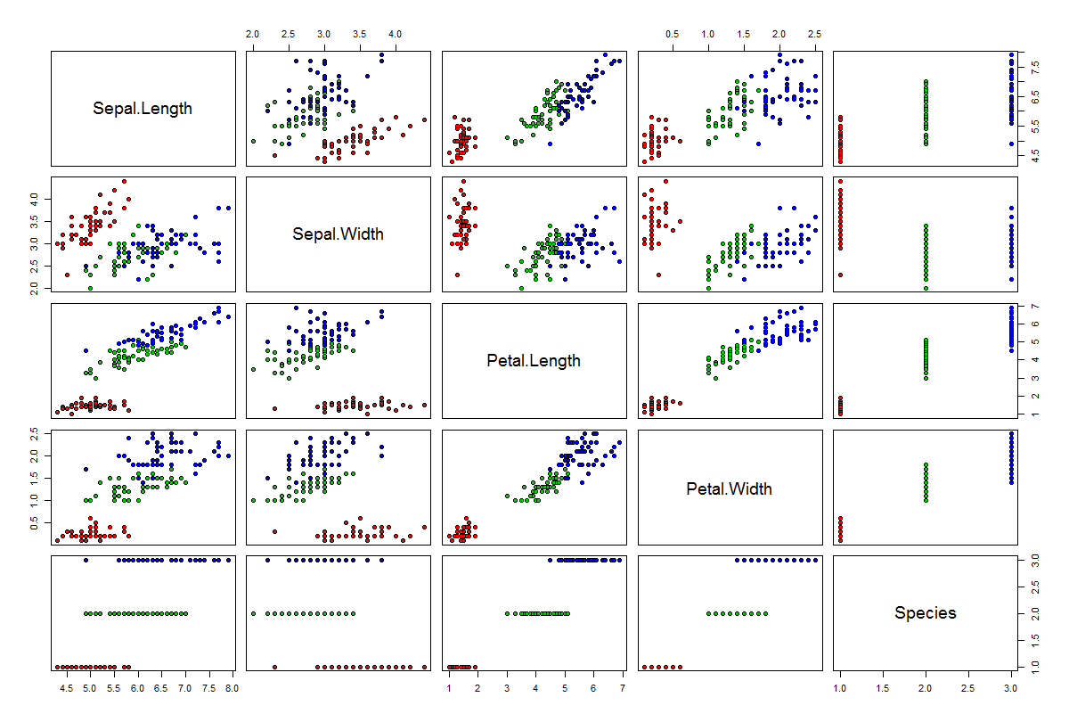
> #Perform LDA over the data
> lda_iris=lda(Species~.,data=dataset)
> #Prior Probabilities and coefficients of Linear discriminants
> lda_iris
Call:
lda(Species ~ ., data = dataset)
Prior probabilities of groups:
setosa versicolor virginica
0.3333333 0.3333333 0.3333333
Group means:
Sepal.Length Sepal.Width Petal.Length Petal.Width
setosa 5.006 3.428 1.462 0.246
versicolor 5.936 2.770 4.260 1.326
virginica 6.588 2.974 5.552 2.026
Coefficients of linear discriminants:
LD1 LD2
Sepal.Length 0.8293776 0.02410215
Sepal.Width 1.5344731 2.16452123
Petal.Length -2.2012117 -0.93192121
Petal.Width -2.8104603 2.83918785
Proportion of trace:
LD1 LD2
0.9912 0.0088
> #Check the accuracy of our analysis
> Predictions=predict(lda_iris,dataset)
> table(Predictions$class, dataset$Species)
setosa versicolor virginica
setosa 50 0 0
versicolor 0 48 1
virginica 0 2 49
> #Check how easily we can linearly separate the iris dataset
pairs(dataset,pch=21,bg=c("red","green3","blue")[unclass(dataset$Species)])
Shows classes linearly separable.
Discriminant function coefficients based on first and second eigenvectors
> #LDA with CV
> lda_cv_iris=lda(Species~.,data=dataset,CV=TRUE)
>
> #The predictions are already generated in lda_cv_iris
> table(lda_cv_iris$class, dataset$Species)
setosa versicolor virginica
setosa 50 0 0
versicolor 0 48 1
virginica 0 2 49
All but 3 observations correctly classified.
Cross-validation give equivalent results.

Slide 28
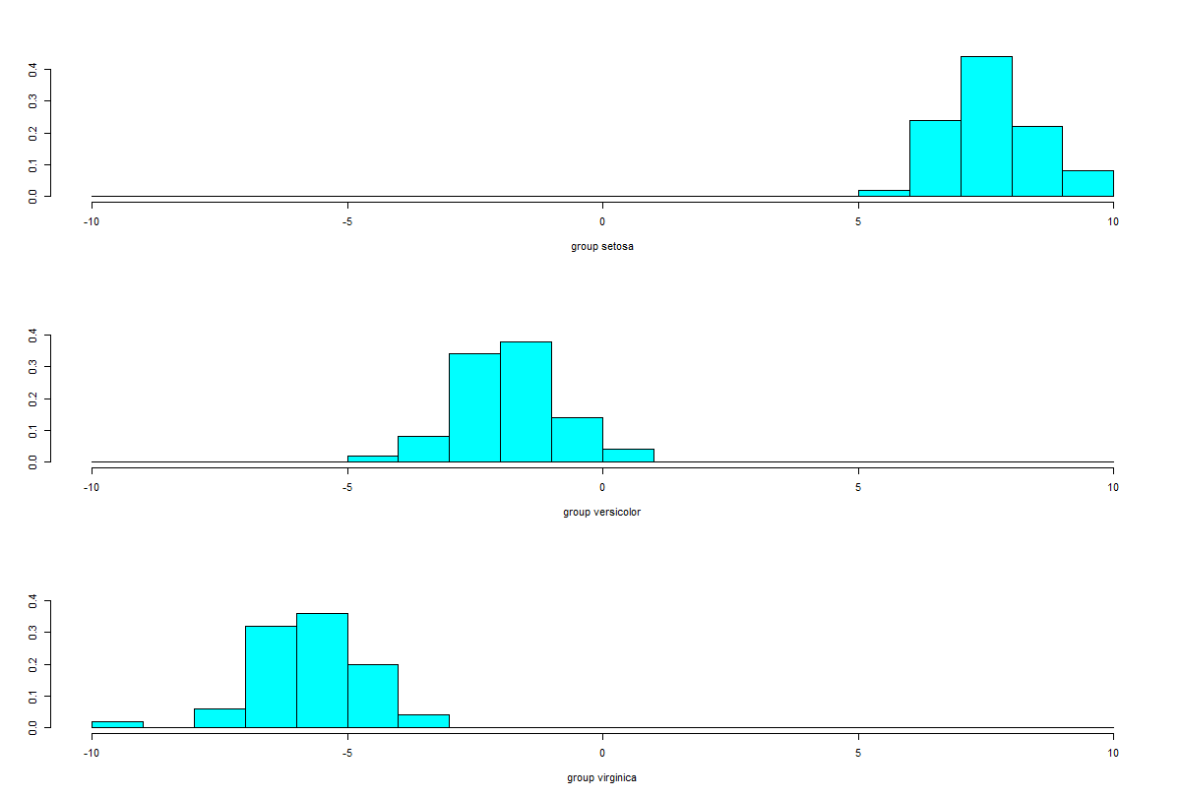
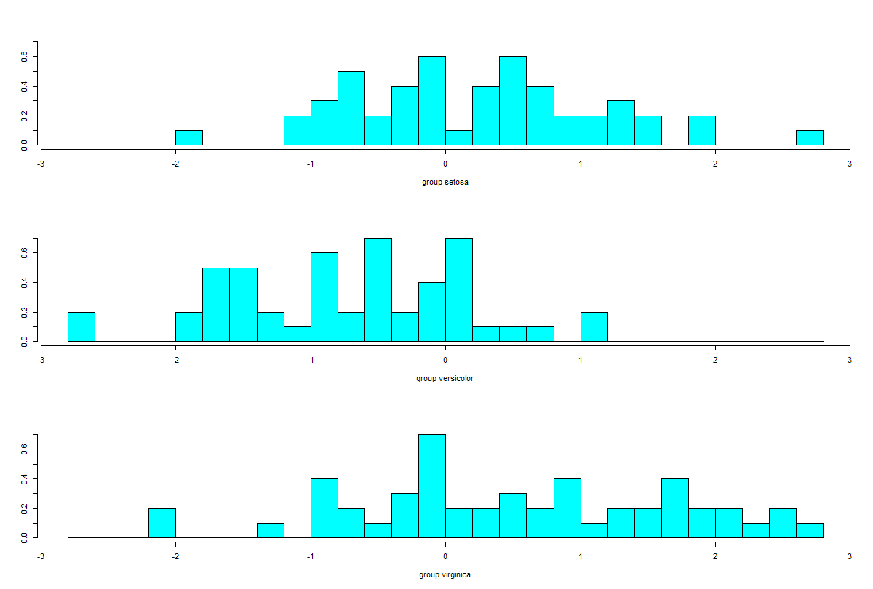
> #Plot the predictions - first linear discriminant
> ldahist(data = Predictions$x[,1], g=dataset$Species)
>
> #Plot the predictions - second linear discriminant
> ldahist(data = Predictions$x[,2], g=dataset$Species)
Populations well separated by first discriminant function
Populations not at all separated by second discriminant function.

Slide 29
> #QDA
> qda_iris=qda(Species~.,data=dataset)
> qda_iris
Call:
qda(Species ~ ., data = dataset)
Prior probabilities of groups:
setosa versicolor virginica
0.3333333 0.3333333 0.3333333
Group means:
Sepal.Length Sepal.Width Petal.Length Petal.Width
setosa 5.006 3.428 1.462 0.246
versicolor 5.936 2.770 4.260 1.326
virginica 6.588 2.974 5.552 2.026
>
> #Check the accuracy of our analysis of qda
> Predictions_qda=predict(qda_iris,dataset)
> table(Predictions_qda$class, dataset$Species)
setosa versicolor virginica
setosa 50 0 0
versicolor 0 48 1
virginica 0 2 49
>
Quadratic DA produces equivalent results.

Slide 30
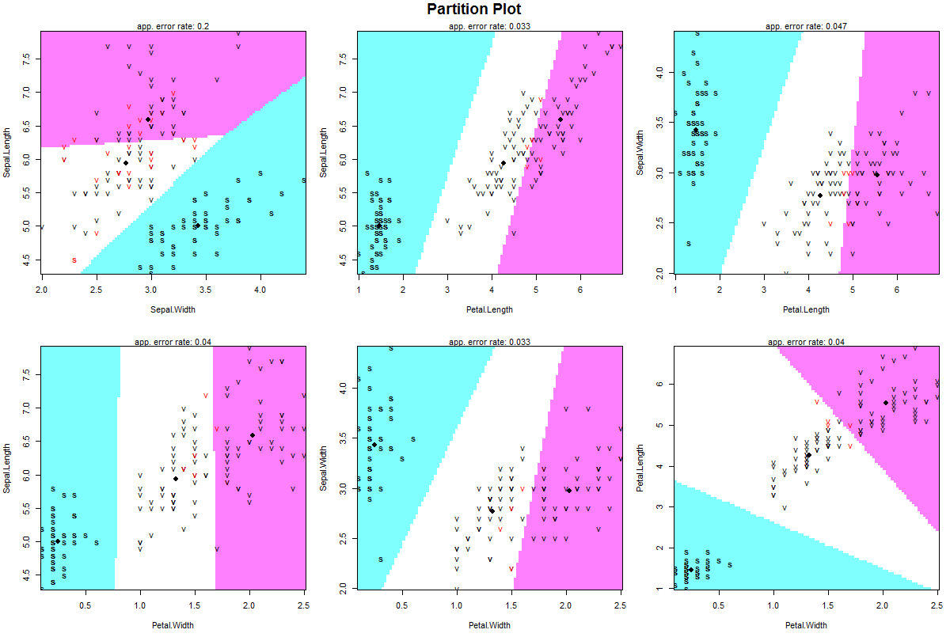
> #Using the klarR packagew
> # install.packages("klaR")
> library(klaR)
partimat(Species~.,data=dataset,method="lda")
Up front check whether features of data will lead to separate groups. Looks at pairs if features.
Shows good separation between setosa and other 2 species. More difficult to distinguish between versicolor and virginica

Slide 31
Class Exercise 3 (Johnson & Wichern Exercise 11.29)
The data relating to the GPA and GMAT scores are stored in the text file T11-6. Note V1=GPA score, V2=GMAT score and V3=Population
Use R to perform a linear discriminant analysis to classify the students into one of the 3 populations.
> head(gmat)
V1 V2 V3
1 2.96 596 1
2 3.14 473 1
3 3.22 482 1
4 3.29 527 1
5 3.69 505 1
6 3.46 693 1
Note: NO quiz this week because of 3 class exercises.

