Slide 1

1/9
LOST TODAY, FOUND RIGHT AWAY
AI-Powered Lost & Found
Recovery Platform
From complexity to smart recovery
CSCI318
LuckyThree

Slide 2
2/11
Introduction
Current UOW Process
Opportunity
Our Solution
Submit lost-property enquiry form
Managed by Security
Users mainly submit enquiries rather than actively search
Limited visibility into potential matches and recovery progress
Report
Search
AI Matching
Connect
Verify
Recover

Slide 3
Requirements & Domain Modelling
3/11
15 Functional Requirements (Overview)
Refined Bounded Contexts
Account
Search
Connect
& Claim
Real-time
Updates
User Management
Report
Match
Verify
& Recover
User identity and contact information
Lost Item Management
Lost item reports, details and status
Key requirements include:
User registration and login
Report lost and found items (with AI assistance)
Search and filter listings
AI matching and ranking
Submit and verify ownership claims
Real-time notifications
User profiles and contact
Manage item status
Verify ownership claims using submitted evidence
System administration
Found Item Management
Found item reports, details and status
Matching Service
Search, filtering and AI-assisted matching
Claim & Recovery Management
Ownership claims, verification and recovery

Slide 4
System Architecture Overview
4/11
Client / Interface
Persistence
(Data Ownership)
Microservices (Backend)
User Service
(Owns user data)
Lost Item Service
(Owns lost item data)
Found Item Service
(Owns found item data)
Web Interface
(Browser)
Each service
owns its data
Matching Service
(Owns matching data)
Claim & Recovery Service
(Owns claim data)
</>
H2 for local
development / testing
REST API
(Postman)
Apache Kafka
Event-driven communication & stream processing
AI / LLM Agent
Reporting assistance & intelligent matching

Slide 5
Implementation Progress
5/11
Task / Component
Status
Requirements & domain analysis
✓ Completed
Bounded contexts (DDD)
✓ Completed
Backend service structure (project setup, basic skeleton)
● In Progress
Core REST APIs (endpoints & business logic)
● In Progress
Persistence integration (H2 + JPA)
● In Progress
Kafka integration (event publishing & consuming)
○ Not Started
AI integration (LangChain4j)
○ Not Started
Testing and documentation
○ Not Started

Slide 6
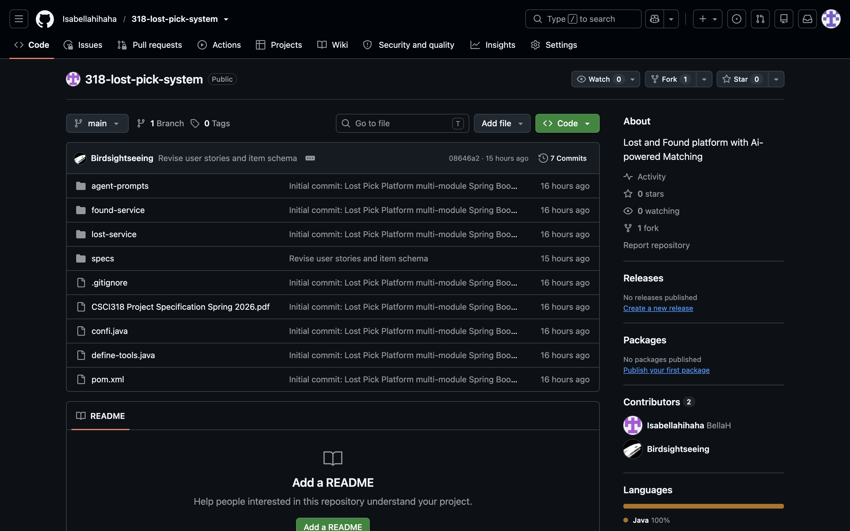
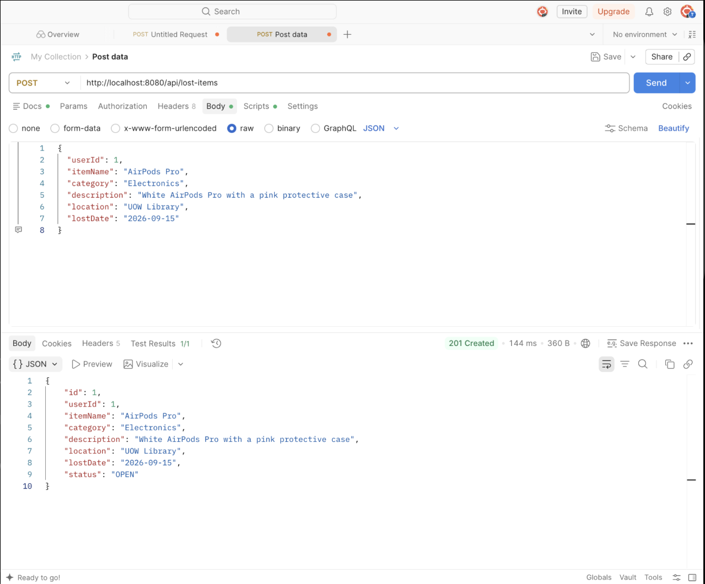
Demonstration (Live / Screenshots)
6/11
GitHub Repository
(code structure)
Postman
(API testing)

Slide 7
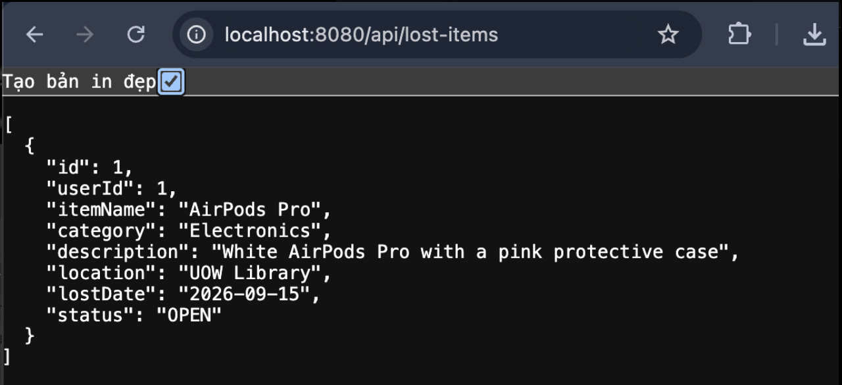
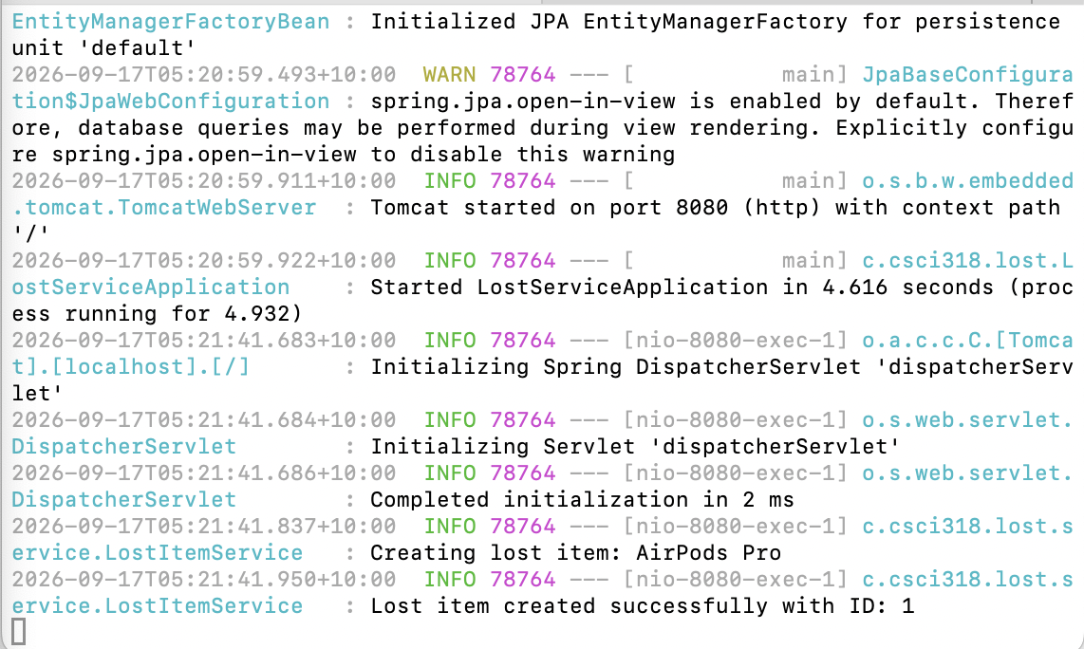
Demonstration (Live / Screenshots)
7/11
Running Application
(API / service demo)
Service Logs
(backend processing logs)

Slide 8
Event, Real-time & AI Design Progress
8/11
Key Events (Kafka)
Real-time Features
Agentic AI Features
Event-Driven Notifications
AI Reporting Assistant
LostItemReported
✓
Notify users when a potential match is found
✓
Extracts information from natural language
FoundItemReported
✓
Asks follow-up questions for missing details
✓
Send real-time updates when a claim status changes
✓
Populates a structured item report
PotentialMatchFound
Stream Processing (Real-time Analysis)
AI Search & Matching
ClaimSubmitted
✓
Live item activity by category / location (e.g. number of lost and found items over time)
✓
Asks relevant follow-up questions
✓
Narrows and ranks potential matches
ClaimVerified
✓
Track potential matches as new lost and found reports arrive
✓
Reduces large search result sets to the most relevant items
ItemRecovered
Events enable real-time communication between microservices.
Uses Kafka and stream processing to provide real-time insights and updates.
Leverages LLM / AI agents to improve reporting and matching experience.

Slide 9
Challenges & Design Decisions
9/11
Key Challenges
Design Decisions
Handling imprecise user input (e.g. vague descriptions)
Use AI to ask targeted follow-up questions and extract key information
1
✓
2
Too many similar search results
✓
Combine conventional search with AI-assisted ranking and filtering
Ensuring secure and fair ownership verification
Finder makes the final ownership verification decision (human-in-the-loop)
3
✓
Implementing real-time communication and stream processing between services
Adopt event-driven architecture with Kafka and implement stream processing
4
✓
Coordinating and integrating multiple microservices
Align each microservice with a DDD bounded context to keep responsibilities clear
5
✓

Slide 10
Remaining Plan
10/11
Week 8 - 9
Core Implementation
Week 9 - 10
Stream Processing & AI
Week 10 - 11
Integration, Testing & Report
Week 12
Final Submission & Presentation
Complete core REST APIs
Implement persistence (H2 + JPA)
Integrate services
Basic Kafka integration
Implement 2 stream-processing user stories
Integrate AI reporting assistant
Implement AI search & matching
Integration & AI testing
End-to-end integration testing
Complete system documentation
Finalise diagrams and analysis
Prepare demo environment
Review and proofreading
Submit report and source code repository (ZIP)
Final demonstration (Week 12 Lab or Lecture)
Final presentation
Prepare for Q&A
Milestone
A working end-to-end system with Kafka, stream processing and AI features by Week 11, then final report, demonstration and presentation in Week 12.

Slide 11
Member Contributions
11/11
Name
Main Responsibilities
Contribution So Far
Rating
(individual contribution)
Nguyen Thanh Van To
Requirements analysis, use cases, domain modelling, DDD documentation, presentation preparation
Completed requirements analysis, defined use cases and bounded contexts, developed the initial domain model, and prepared presentation content.
100%
(Contributed)
Yiheng Huang
Backend development, system architecture, microservices, REST APIs
Implemented initial services and APIs, working on service integration
100%
(Contributed)
Minh Phan
Event-driven architecture, Kafka integration, AI features, testing
Researched Kafka and stream processing, designed event models, explored AI integration approach
100%
(Contributed)
Together for a smarter UOW

