Slide 1
W S
MODEL
Social Network Analysis
xxx
<number>

Slide 2
1
Experimental principle
目录
CONTENTS
2
Model thinking
3
Network characteristics

Slide 3
01
Experimental principle

Slide 4
LOGO
Experimental principle
Given the desired number of nodes N, the mean degree K , and a special parameter P, satisfying 0≤P≤1 and N≫K≫lnN≫1, the model constructs an undirected graph with N nodes and NK/2 edges in the following way:
1
2
For every node n_{i} take every egde (n_{i} , n_{j}) with i < j, and rewire it with probability P. Rewiring is done by replacing (n_{i} , n_{j}) with (n_{i} , n_{k}) where K is chosen with uniform probability from all possible values
Construct a regular ring lattice, a graph with N nodes each connected to K neighbors, K/2 on each side.

Slide 5
02
Model thinking

Slide 6




LOGO
The original
model
2. The first improved model
3. The second improved model
4. The third improved model

Slide 7
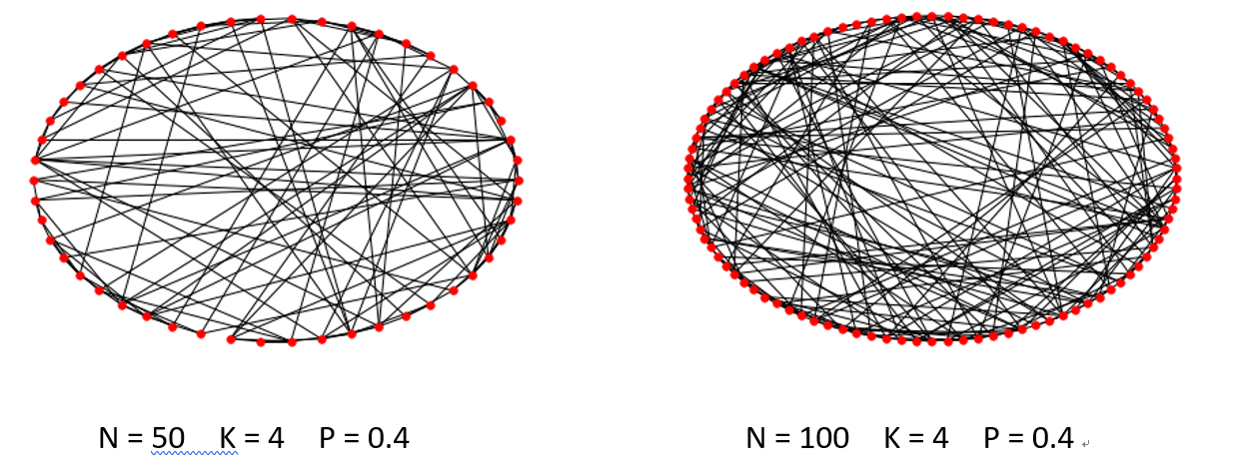
1. The original model

Slide 8
2. The first improved model
The first improved model is to change the initial connecting way. Hypothesis you take part in a birthday party, everyone must know the host and they maybe do not know other people. Extremly everone only know the host, so the host is the social center.

Slide 9
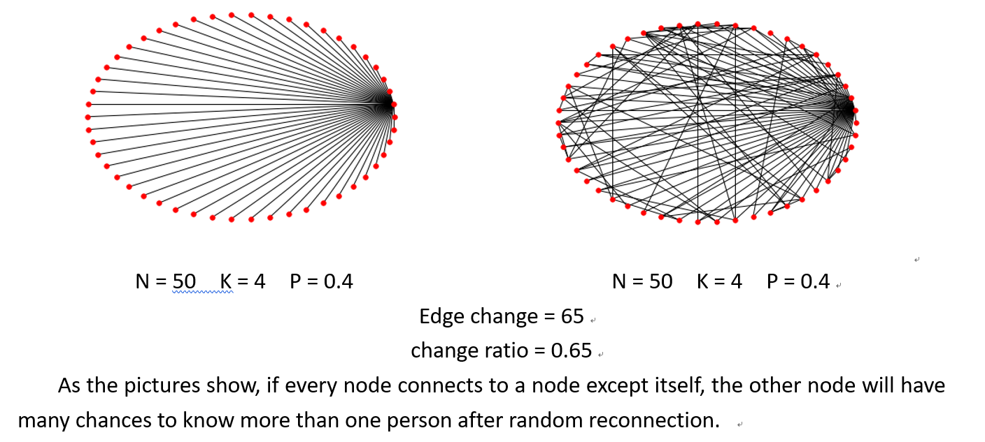
2. The first improved model

Slide 10
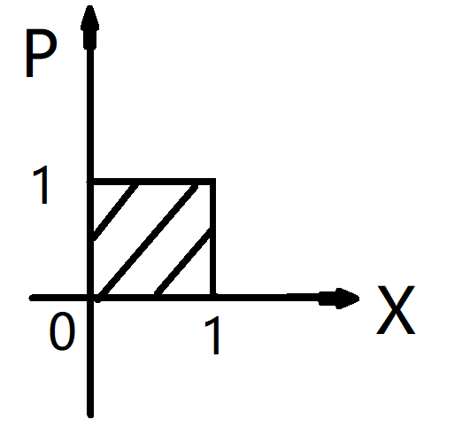
3. The second improved model
In the reality, p is a complex and fluctuating between the random and the regular. So I define p is the number of linear changes P = A * X + B. Setting x in the range of [0,1], p also in the range of [0,1]. I conclude that A determines the change speed in randomness and B determines the size of the initial randomness.
The first situation is on the basis of the original randomized reconnection, the second situation is randomized reconnection three times respectively.

Slide 11
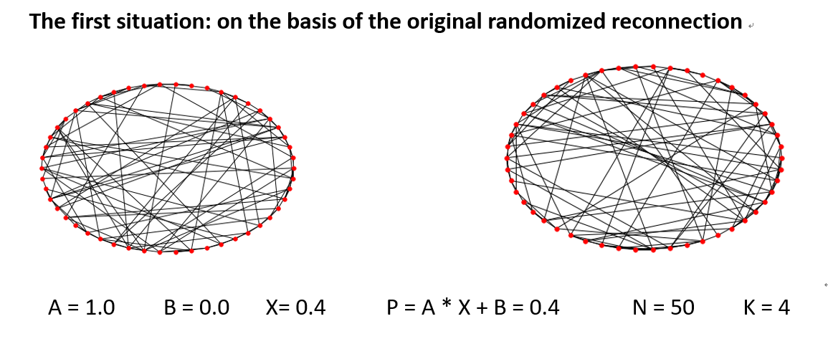
3. The second improved model

Slide 12
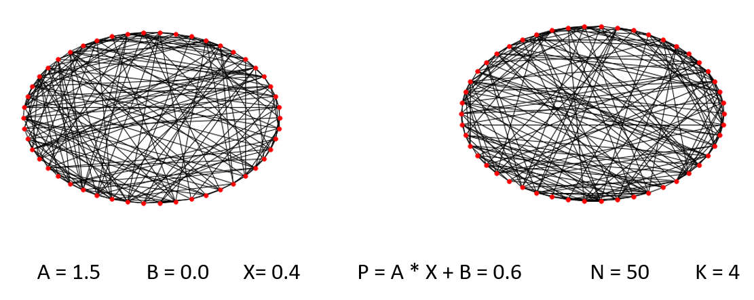
3. The second improved model

Slide 13
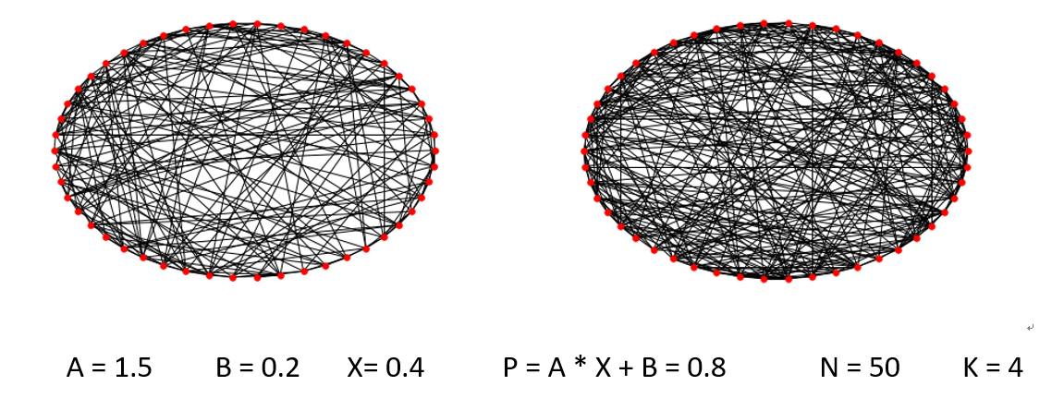
3. The second improved model

Slide 14
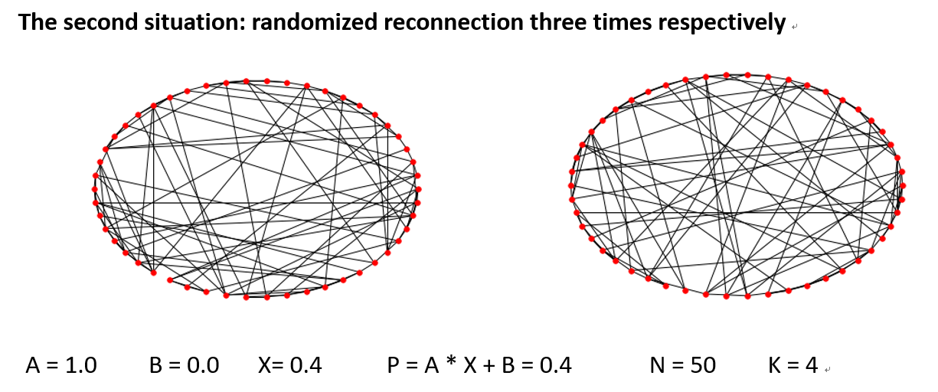
3. The second improved model

Slide 15
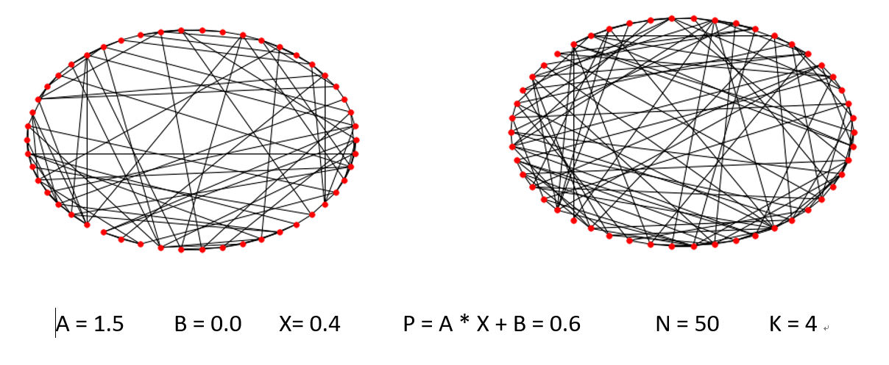
3. The second improved model

Slide 16
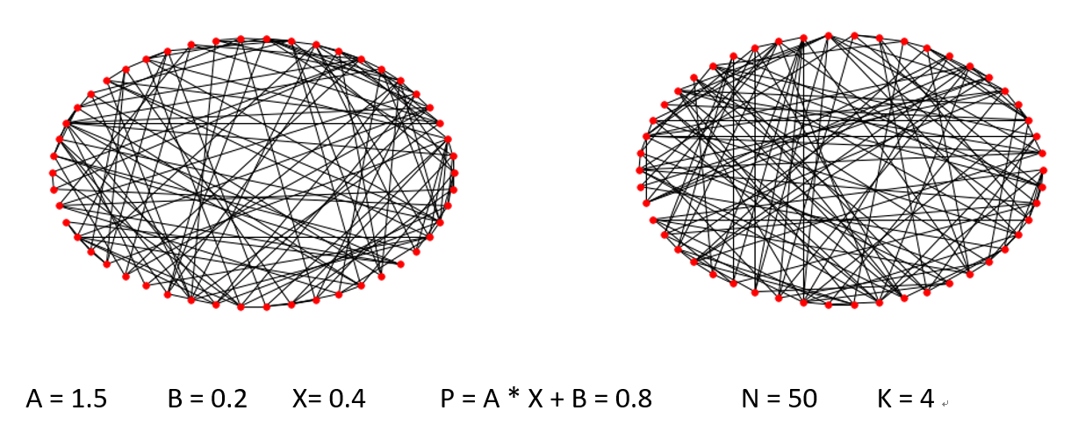
3. The second improved model

Slide 17
4. The third improved model
One of the constraints of the WS small world model is closed. In reality, the scale of network is constantly expanding. For example, hypothesis graduate sophomore can form a network. Graduate freshmen are newly added discrete nodes. And graduate sophomore and graduate freshmen form a new network now. At this time, the old network will affect the new network. How to deal with the hierarchical structure. I decide to change the WS model to grow. I set the half of the nodes form the old network, and the all of nodes form the new network.

Slide 18
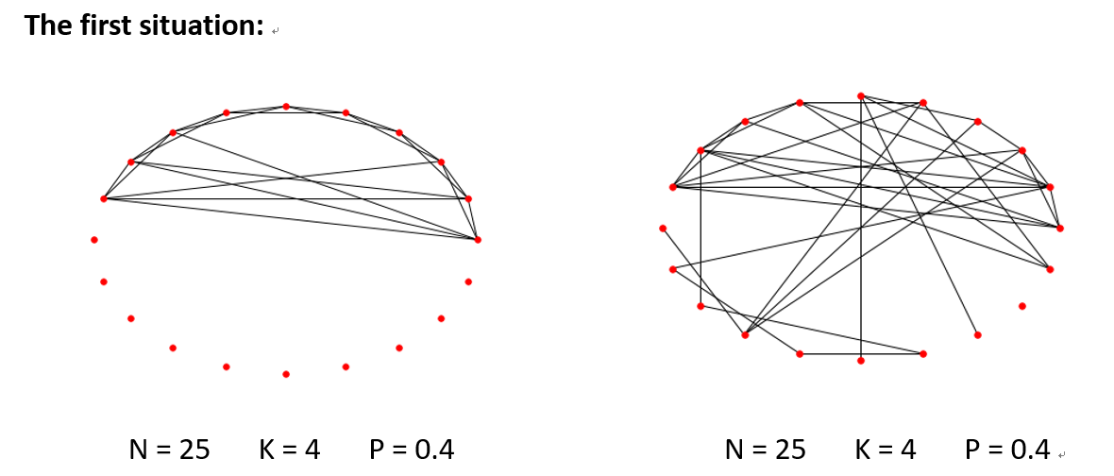
4. The third improved model

Slide 19
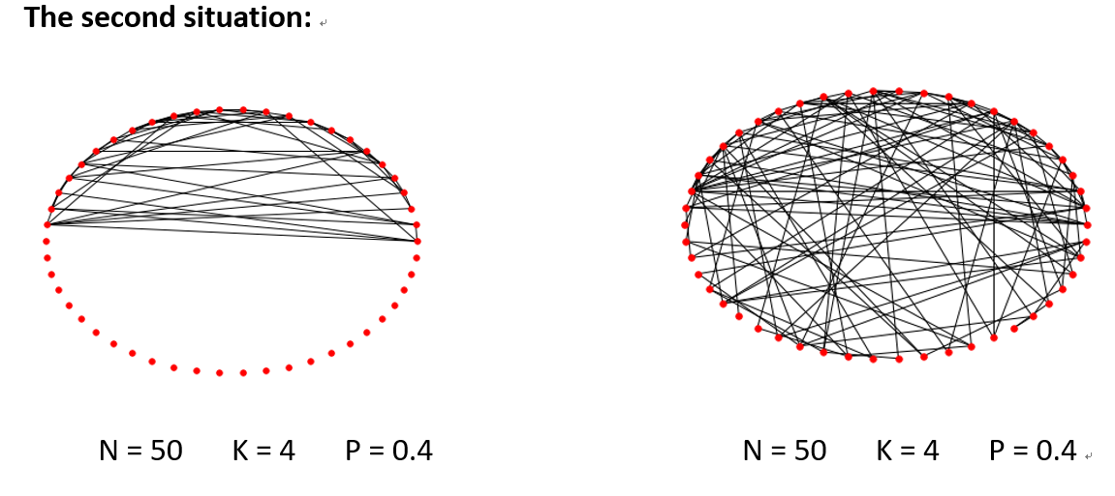
4. The third improved model

Slide 20
03
Network characteristics

Slide 21
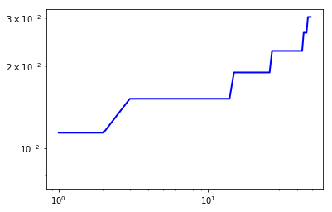
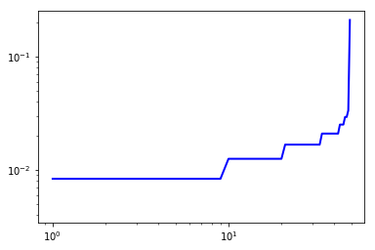
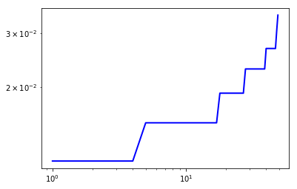
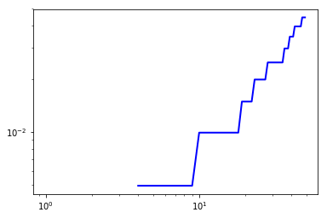
1.Node-degree distribution

Slide 22
2.Average shortest path-length
The original model：
average_shortest_path_length = 1.90530612245
The first improved model：
average_shortest_path_length = 1.90285714286
The second improved model：
average_shortest_path_length = 1.90612244898
The third improved model：
average_shortest_path_length = 10.2857142857

Slide 23
3.Clustering coefficient
The original model：
clustering_coefficient = 14.65411111111111
The first improved model：
clustering_coefficient = 36.61819727891157
The second improved model：
clustering_coefficient = 16.23684126984127
The third improved model：
clustering_coefficient = 17.105698412698413

Slide 24
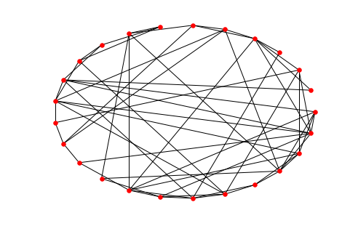
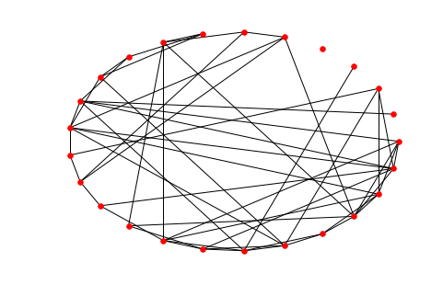
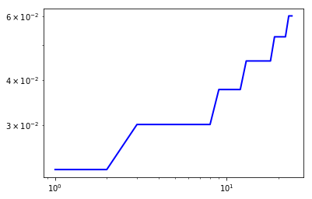
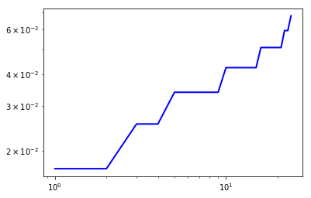
4.Robustness against intentional attack
The original model：
average_shortest_path_length = 1.80333333333
average_shortest_path_length = 2.68666666667
clustering_coefficient = 7.199238095238095
average_shortest_path_length = 2.68666666667
degree = [0, 2, 2, 3, 3, 4, 4, 4, 4, 4, 5, 5, 5, 5, 5, 5, 6, 6, 6, 6, 6, 6, 7, 7, 8]

Slide 25
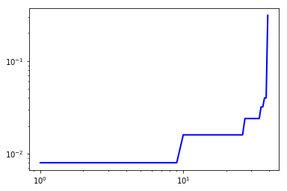
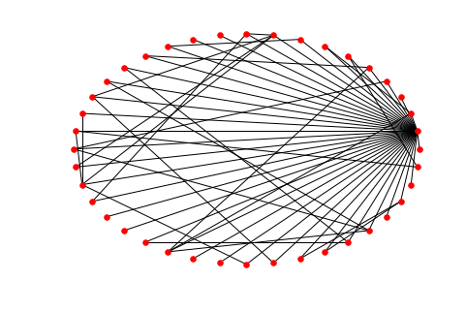
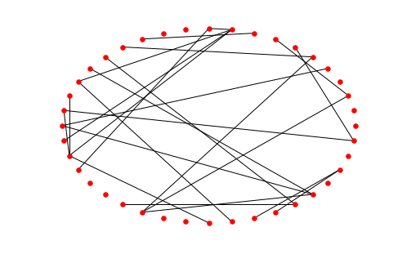
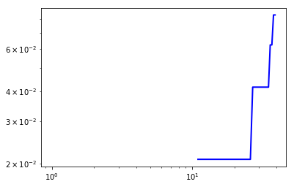
The first improved model：
clustering_coefficient = 30.807058029689614
average_shortest_path_length = 1.92051282051
clustering_coefficient = 0.0
average_shortest_path_length = 23.1282051282

Slide 26
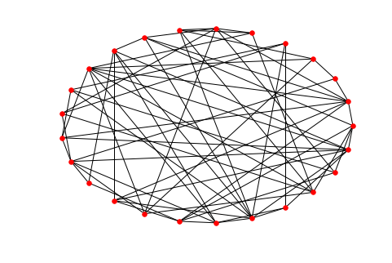
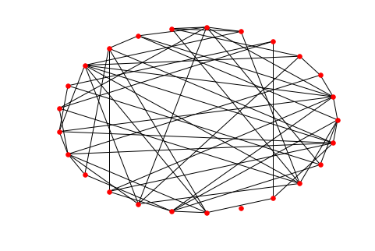
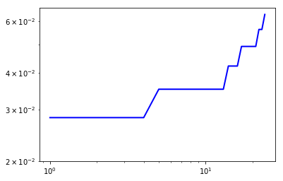
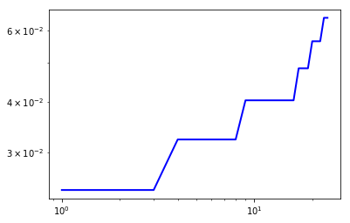
The second improved model：
The first situation:
clustering_coefficient = 4.718444444444445
average_shortest_path_length = 1.77333333333
clustering_coefficient = 5.230476190476192
average_shortest_path_length = 3.27666666667

Slide 27
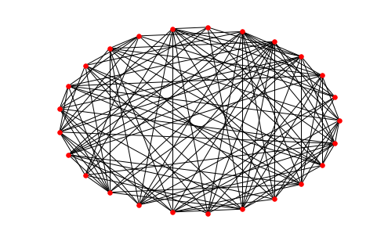
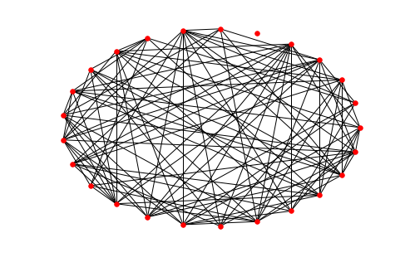
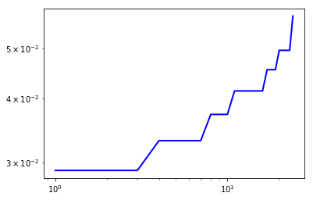
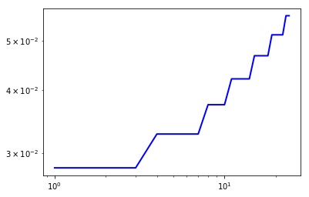
The second situation:
average_shortest_path_length = 1.59666666667
average_shortest_path_length = 2.51666666667

Slide 28
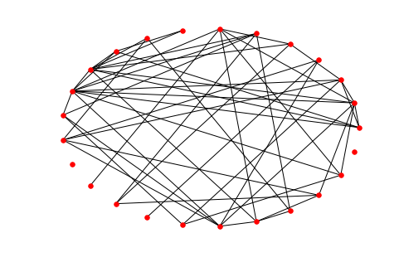
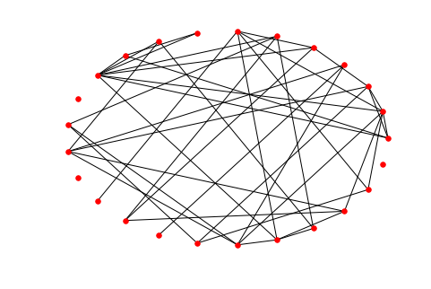
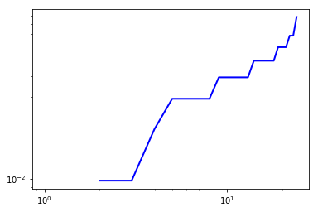
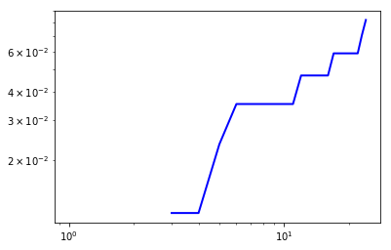
The third improved model：
The first situation:
clustering_coefficient = 5.927873015873016
average_shortest_path_length = 4.66333333333
clustering_coefficient = 4.927301587301587
average_shortest_path_length = 5.6

Slide 29
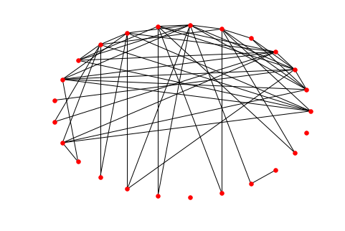
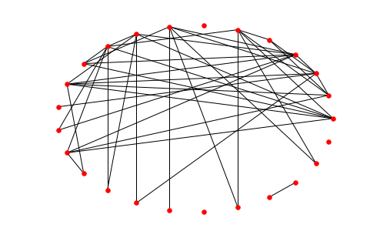
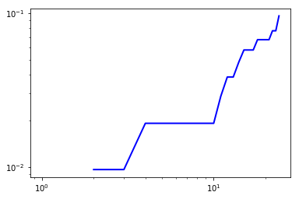
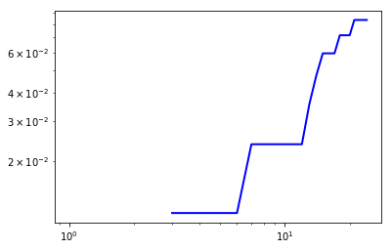
The second situation:
clustering_coefficient = 15.26015873015873
average_shortest_path_length = 4.92333333333
clustering_coefficient = 9.709142857142858
average_shortest_path_length = 8.32666666667

Slide 30
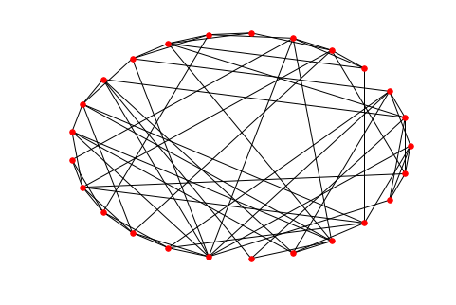
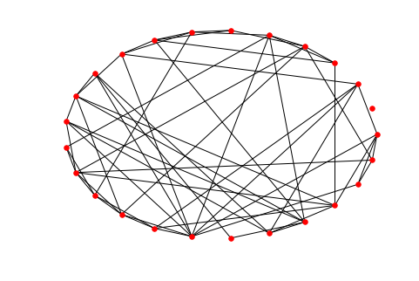
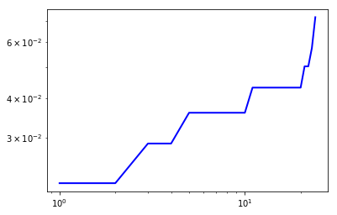
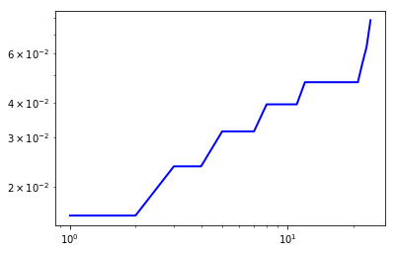
5.Random attack
The original model：
clustering_coefficient = 6.540825396825397
average_shortest_path_length = 1.78333333333
clustering_coefficient = 9.18336507936508
average_shortest_path_length = 2.64333333333

Slide 31
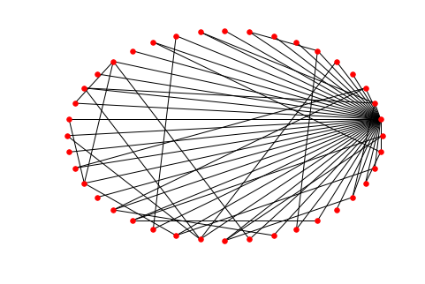

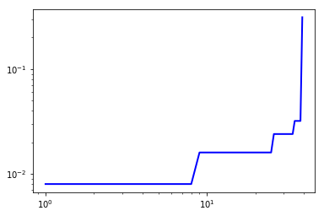
The first improved model

Slide 32
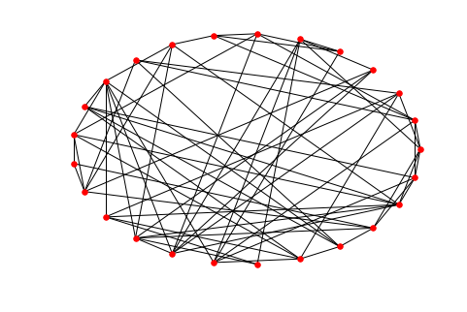
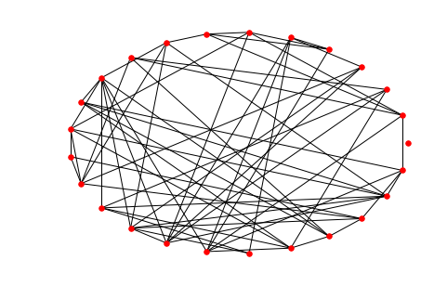
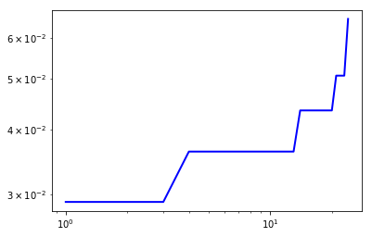
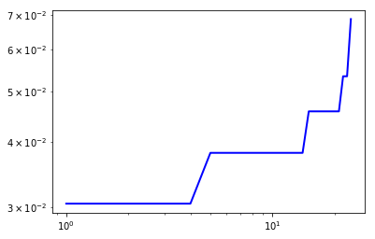
The second improved model： The first situation:

Slide 33
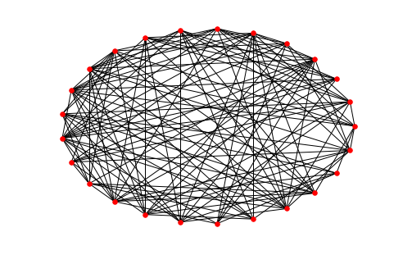



The second situation:

Slide 34


The third improved model： The first situation:
clustering_coefficient = 8.981142857142858
average_shortest_path_length = 4.63666666667
clustering_coefficient = 10.160571428571428
average_shortest_path_length = 5.60333333333

Slide 35




The second situation:

Slide 36
感谢您的聆听
PPT模板下载：www.1ppt.com/moban/ 行业PPT模板：www.1ppt.com/hangye/
节日PPT模板：www.1ppt.com/jieri/ PPT素材下载：www.1ppt.com/sucai/
PPT背景图片：www.1ppt.com/beijing/ PPT图表下载：www.1ppt.com/tubiao/
优秀PPT下载：www.1ppt.com/xiazai/ PPT教程： www.1ppt.com/powerpoint/
Word教程： www.1ppt.com/word/ Excel教程：www.1ppt.com/excel/
资料下载：www.1ppt.com/ziliao/ PPT课件下载：www.1ppt.com/kejian/
范文下载：www.1ppt.com/fanwen/ 试卷下载：www.1ppt.com/shiti/
教案下载：www.1ppt.com/jiaoan/ PPT论坛：www.1ppt.cn
<number>

