Slide 1

Carbo-CAT2018a
Introduction and model setup

Slide 2
Introduction

Slide 3
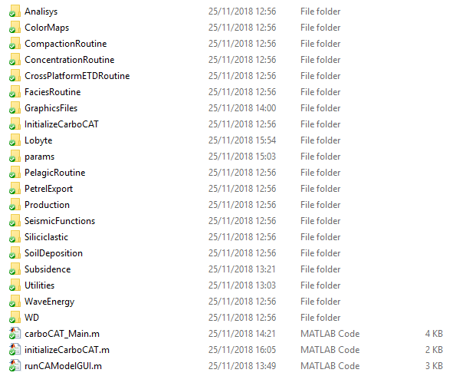
Carbo-CAT introduction
Carbo-CAT is a numerical stratigraphic forward model that can simulate carbonate platform development under various climatic and tectonic controls
Carbo-CAT is written in Matlab and the current version is under development using MATLAB R2018a
The program consist of:
a number of Matlab (.m) files, organized in different folders accordingly to the represented process (e.g. WaveEnergy, Siliciclastic, Production, PelagicRoutine, Lobyte…)
a number of .txt files where the input parameters can be defined (stored in the params folder)
a number of additional routines providing various, additional functionalities (see Analysis, SeismicFunctions, Utilities…)
Notes:
The current version of Carbo-CAT is written in Matlab. This flow chart summarizes the implemented algorithm.
The program starts calculating the parameters that controls the spatial distribution and deposition of the different type of carbonate sediments. The subsidence and the consequent water depth, the wave energy distribution over the model area and if present, the siliciclastic input. Afterwards, the model calculates the carbonate sediment spatial distribution and production and finally the removal, transport and redeposition of the produced carbonate.

Slide 4
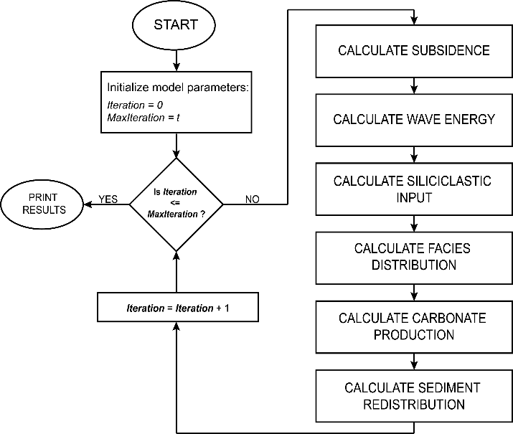
Carbo-CAT formulation
Controls on carbonate spatial distribution and production
Carbonate deposition
Controls on carbonate after deposition
Notes:
The current version of Carbo-CAT is written in Matlab. This flow chart summarizes the implemented algorithm.
The program starts calculating the parameters that controls the spatial distribution and deposition of the different type of carbonate sediments. The subsidence and the consequent water depth, the wave energy distribution over the model area and if present, the siliciclastic input. Afterwards, the model calculates the carbonate sediment spatial distribution and production and finally the removal, transport and redeposition of the produced carbonate.

Slide 5
Carbo-CAT introduction
The current version of Carbo-CAT does not have a GUI (yet) and carboCAT_Main.m is the main script where the program main variables are initialized and the function initializeCarboCAT.m is recalled
Notes:
The current version of Carbo-CAT is written in Matlab. This flow chart summarizes the implemented algorithm.
The program starts calculating the parameters that controls the spatial distribution and deposition of the different type of carbonate sediments. The subsidence and the consequent water depth, the wave energy distribution over the model area and if present, the siliciclastic input. Afterwards, the model calculates the carbonate sediment spatial distribution and production and finally the removal, transport and redeposition of the produced carbonate.

Slide 6

Carbo-CAT introduction
initializeCarboCAT.m function reads the .txt file where the imput parameters are specified, initializes model arrays and calculate the model subsidence and his evolution with model time accordingly to the input parameters.
Notes:
The current version of Carbo-CAT is written in Matlab. This flow chart summarizes the implemented algorithm.
The program starts calculating the parameters that controls the spatial distribution and deposition of the different type of carbonate sediments. The subsidence and the consequent water depth, the wave energy distribution over the model area and if present, the siliciclastic input. Afterwards, the model calculates the carbonate sediment spatial distribution and production and finally the removal, transport and redeposition of the produced carbonate.

Slide 7
Carbo-CAT introduction
runCAModel.m function containing the main model loop from where the main subroutines are recalled.
Notes:
The current version of Carbo-CAT is written in Matlab. This flow chart summarizes the implemented algorithm.
The program starts calculating the parameters that controls the spatial distribution and deposition of the different type of carbonate sediments. The subsidence and the consequent water depth, the wave energy distribution over the model area and if present, the siliciclastic input. Afterwards, the model calculates the carbonate sediment spatial distribution and production and finally the removal, transport and redeposition of the produced carbonate.

Slide 8
Model setup

Slide 9
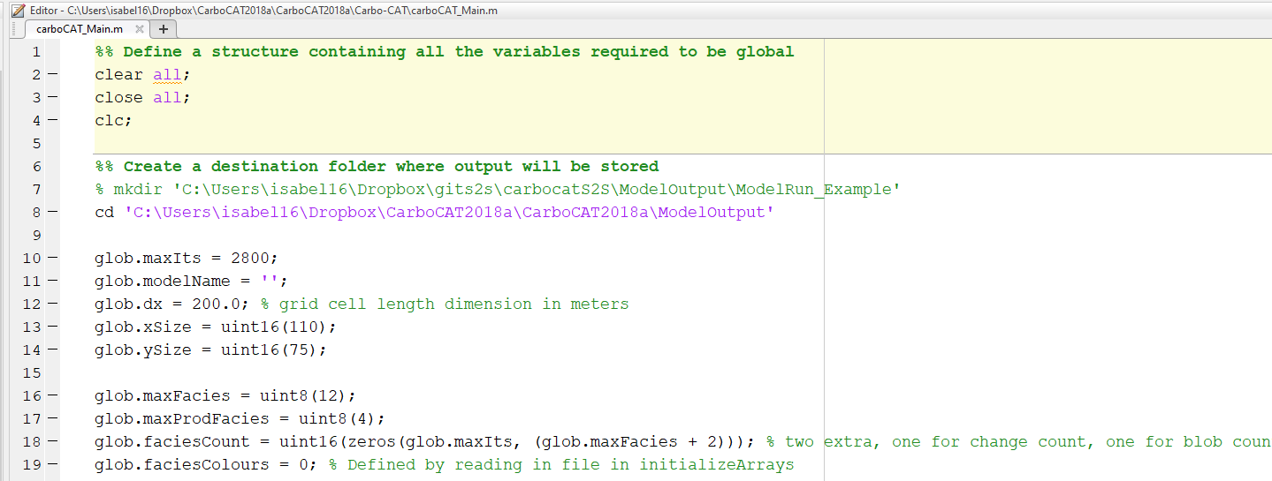
Carbo-CAT model setup
In carbo-CAT.m define:
Specify the folder path where output files/images will be stored
maximum number of model iterations
model dimensions,
cell size
Notes:
The current version of Carbo-CAT is written in Matlab. This flow chart summarizes the implemented algorithm.
The program starts calculating the parameters that controls the spatial distribution and deposition of the different type of carbonate sediments. The subsidence and the consequent water depth, the wave energy distribution over the model area and if present, the siliciclastic input. Afterwards, the model calculates the carbonate sediment spatial distribution and production and finally the removal, transport and redeposition of the produced carbonate.

Slide 10
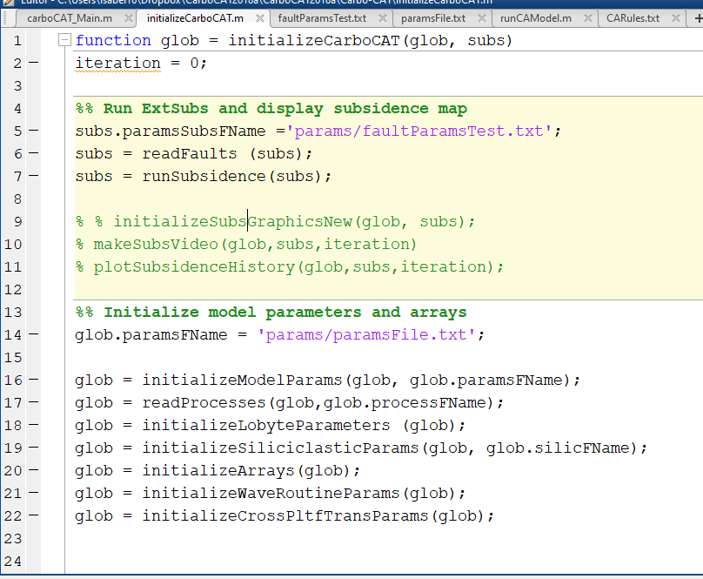
Carbo-CAT model setup
2. In initializaCarboCAT.m activate the desired functions to plot the input parameters
Plot the model final subsidence accordingly to the input parameters
Create a movie of the subsidence evolution during model time
Plot subsidence history (in a defined model cross section)
NB: images can be display immediately to check the result of the input params and/or saved
Notes:
The current version of Carbo-CAT is written in Matlab. This flow chart summarizes the implemented algorithm.
The program starts calculating the parameters that controls the spatial distribution and deposition of the different type of carbonate sediments. The subsidence and the consequent water depth, the wave energy distribution over the model area and if present, the siliciclastic input. Afterwards, the model calculates the carbonate sediment spatial distribution and production and finally the removal, transport and redeposition of the produced carbonate.

Slide 11
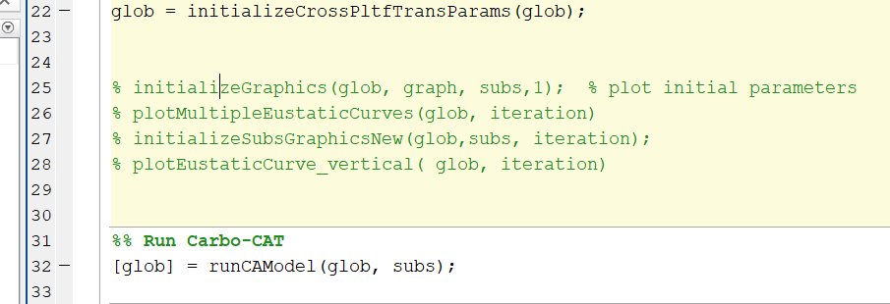
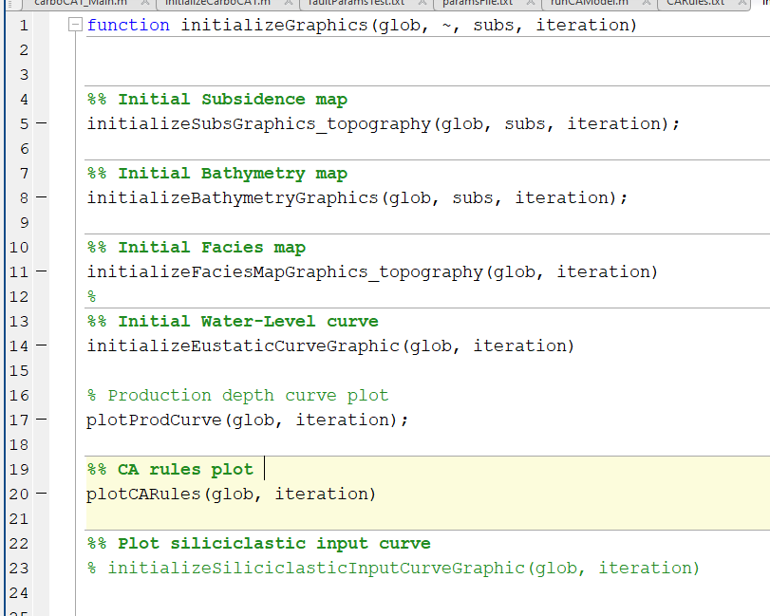
Carbo-CAT model setup
2. In initializaCarboCAT.m activate the desired functions to plot the input parameters
Plot various input parameters
NB: images can be display immediately to check the result of the input params and/or saved
Notes:
The current version of Carbo-CAT is written in Matlab. This flow chart summarizes the implemented algorithm.
The program starts calculating the parameters that controls the spatial distribution and deposition of the different type of carbonate sediments. The subsidence and the consequent water depth, the wave energy distribution over the model area and if present, the siliciclastic input. Afterwards, the model calculates the carbonate sediment spatial distribution and production and finally the removal, transport and redeposition of the produced carbonate.

Slide 12
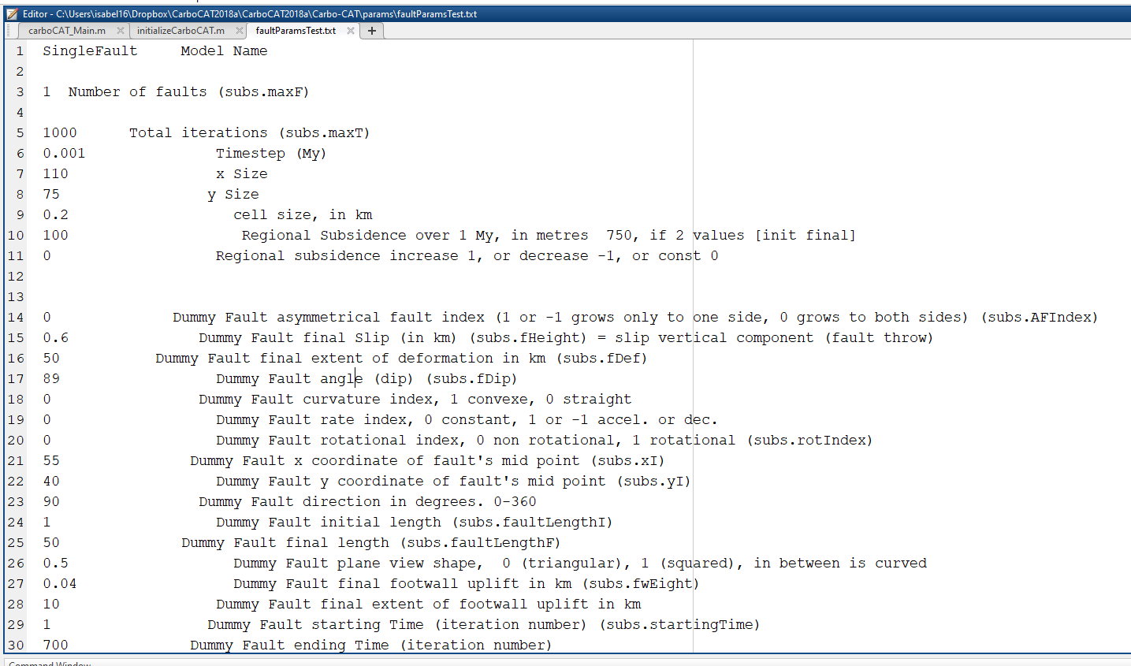
Carbo-CAT model setup
3. In faultParams.txt (params folder) specify the subsidence related parameters
(1)
General parameters
Regional subsidence parameters
Fault related parameters: copy and paste lines 14 to 30 to specify input parameters of multiple faults (1)
Notes:
The current version of Carbo-CAT is written in Matlab. This flow chart summarizes the implemented algorithm.
The program starts calculating the parameters that controls the spatial distribution and deposition of the different type of carbonate sediments. The subsidence and the consequent water depth, the wave energy distribution over the model area and if present, the siliciclastic input. Afterwards, the model calculates the carbonate sediment spatial distribution and production and finally the removal, transport and redeposition of the produced carbonate.

Slide 13
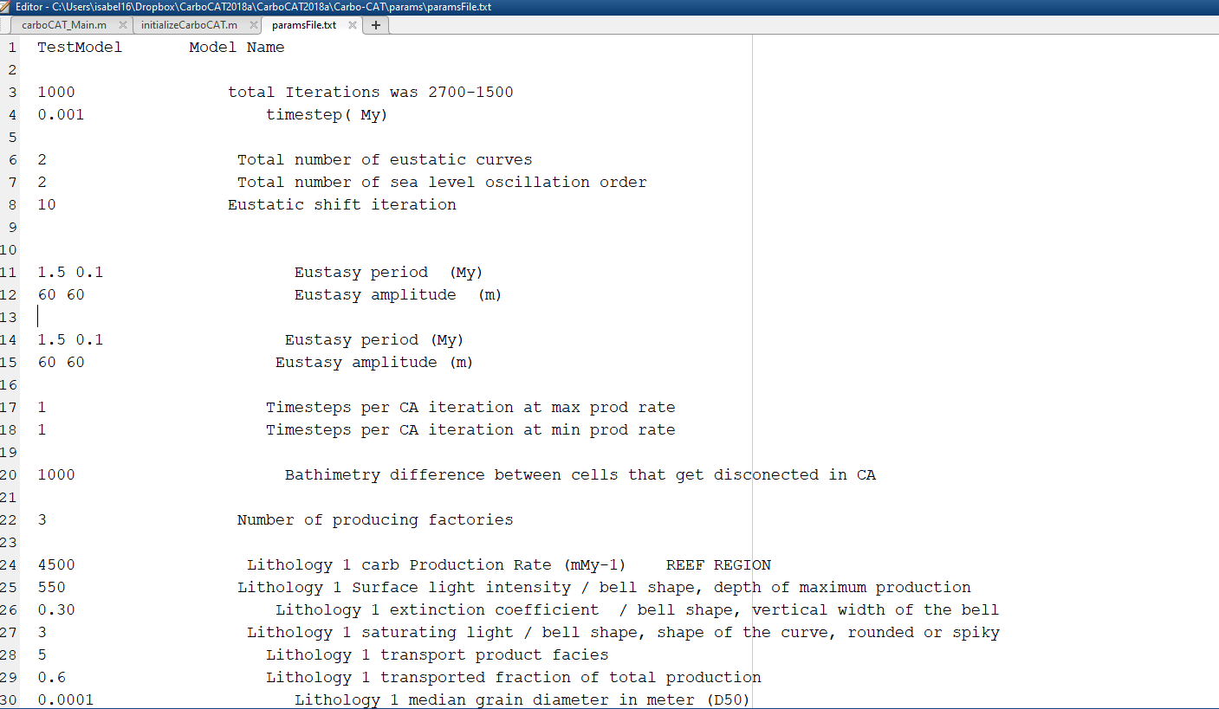
Carbo-CAT model setup
General parameters
In agreement with what previously specified
3. In paramsFile.txt (params folder) specify the general model parameters
Sea Level sinusoid
Higher and Lower frequency eustatic curves parameters
Notes:
The current version of Carbo-CAT is written in Matlab. This flow chart summarizes the implemented algorithm.
The program starts calculating the parameters that controls the spatial distribution and deposition of the different type of carbonate sediments. The subsidence and the consequent water depth, the wave energy distribution over the model area and if present, the siliciclastic input. Afterwards, the model calculates the carbonate sediment spatial distribution and production and finally the removal, transport and redeposition of the produced carbonate.

Slide 14
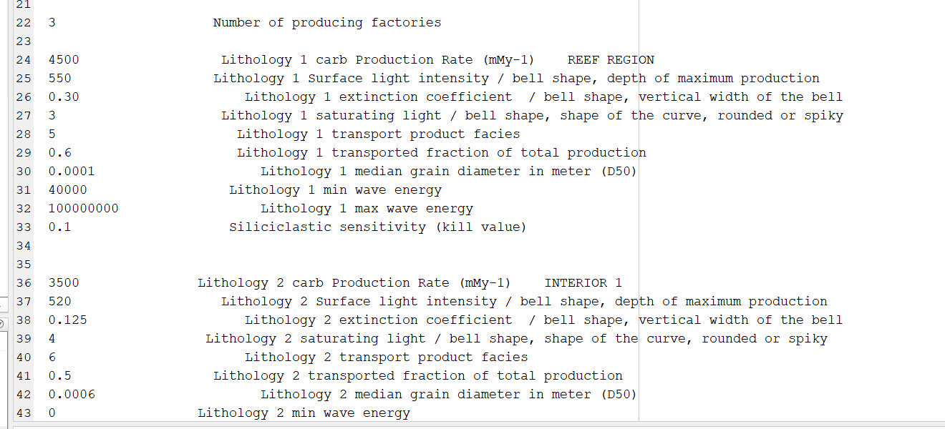
Carbo-CAT model setup
3. In paramsFile.txt (params folder) specify the general model parameters
Number of insitu factory/facies
Max 4!
Facies/Factory 1 input parameters
Copy and paste from line 24 to 33 for defining input parameters for multiple facies
Notes:
The current version of Carbo-CAT is written in Matlab. This flow chart summarizes the implemented algorithm.
The program starts calculating the parameters that controls the spatial distribution and deposition of the different type of carbonate sediments. The subsidence and the consequent water depth, the wave energy distribution over the model area and if present, the siliciclastic input. Afterwards, the model calculates the carbonate sediment spatial distribution and production and finally the removal, transport and redeposition of the produced carbonate.

Slide 15
3. In paramsFile.txt (params folder) specify the general model parameters
Carbo-CAT model setup
Params defining the shape of the production curve
Percentage of produced carbonate that is available for entrainment
Wave energy limits of existence (this factory can’t develop if wave energy is above max or below min values)
Between 0 and 1 (0 = high sensitivity to siliciclastic, carbonate production is killed, 1 = factory non influenced by siliciclastic poisoning)
Notes:
The current version of Carbo-CAT is written in Matlab. This flow chart summarizes the implemented algorithm.
The program starts calculating the parameters that controls the spatial distribution and deposition of the different type of carbonate sediments. The subsidence and the consequent water depth, the wave energy distribution over the model area and if present, the siliciclastic input. Afterwards, the model calculates the carbonate sediment spatial distribution and production and finally the removal, transport and redeposition of the produced carbonate.

Slide 16
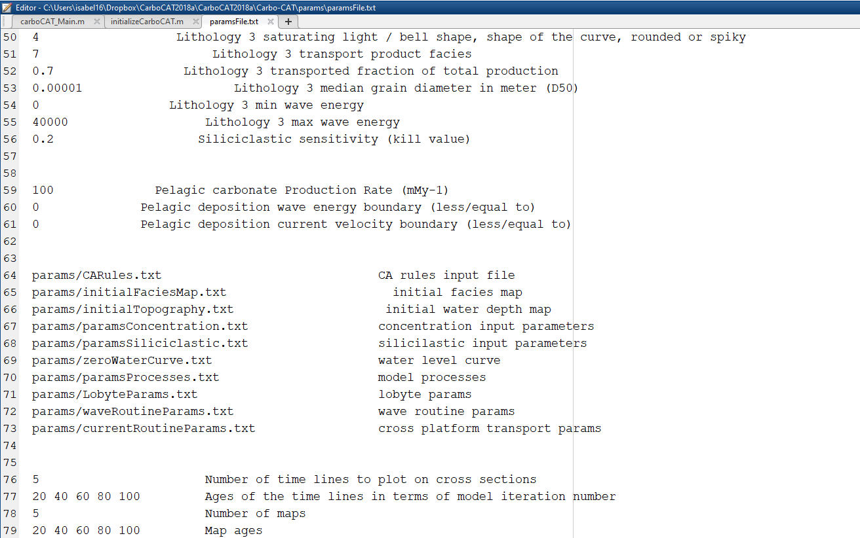
Carbo-CAT model setup
3. In paramsFile.txt (params folder) specify the general model parameters
Txt files with model input parameters
Notes:
The current version of Carbo-CAT is written in Matlab. This flow chart summarizes the implemented algorithm.
The program starts calculating the parameters that controls the spatial distribution and deposition of the different type of carbonate sediments. The subsidence and the consequent water depth, the wave energy distribution over the model area and if present, the siliciclastic input. Afterwards, the model calculates the carbonate sediment spatial distribution and production and finally the removal, transport and redeposition of the produced carbonate.

Slide 17
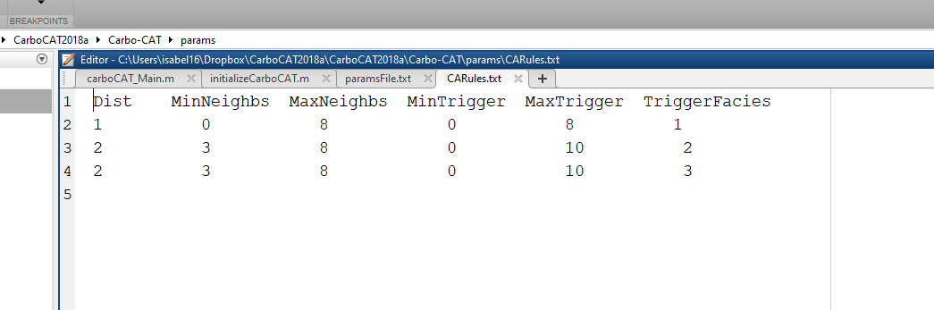
Carbo-CAT model setup
4. Specify Callular automata rules in CaRules.txt (params folder) in the example we have 3 facies – remember: max is 4 -
CA radius
Min number of neighbours cell with the same facies/state to allow survival
Max number of neighbours cell with the same facies/state to allow survival
Min number of neighbours cell with the same facies/state to trigger a new state (change of facies)
Max number of neighbours cell with the same facies/state to trigger a new state (change of facies)
Notes:
The current version of Carbo-CAT is written in Matlab. This flow chart summarizes the implemented algorithm.
The program starts calculating the parameters that controls the spatial distribution and deposition of the different type of carbonate sediments. The subsidence and the consequent water depth, the wave energy distribution over the model area and if present, the siliciclastic input. Afterwards, the model calculates the carbonate sediment spatial distribution and production and finally the removal, transport and redeposition of the produced carbonate.

Slide 18
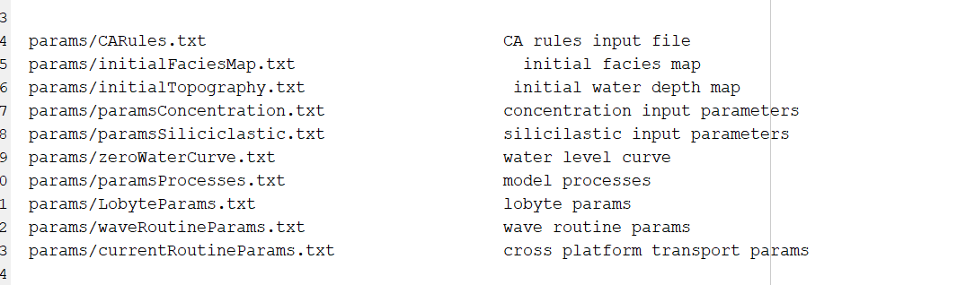

Carbo-CAT model setup
5.
File where the SL is specified at each time step (default value is zero) – if we don’t want to use the sinusoid --
If required, the map with initial distribution of facies and the initial topography map (default topography set as a flat surface with 2 meters water depth) can be calculated using the following utilities in the Utilities folder:
Notes:
The current version of Carbo-CAT is written in Matlab. This flow chart summarizes the implemented algorithm.
The program starts calculating the parameters that controls the spatial distribution and deposition of the different type of carbonate sediments. The subsidence and the consequent water depth, the wave energy distribution over the model area and if present, the siliciclastic input. Afterwards, the model calculates the carbonate sediment spatial distribution and production and finally the removal, transport and redeposition of the produced carbonate.

Slide 19
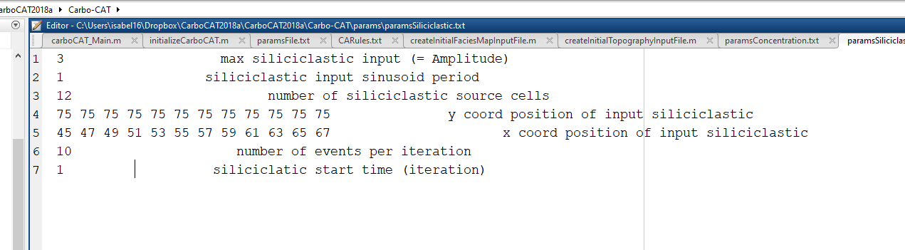
Carbo-CAT model setup
Sinusoid parameters to define the siliciclastic input volume
Siliciclastic source cells number and coordinates
6. In paramsSiliciclastic.txt (params folder) specify the siliciclastic input parameters (if present)
Number of siliciclastic input event for each iteration
Notes:
The current version of Carbo-CAT is written in Matlab. This flow chart summarizes the implemented algorithm.
The program starts calculating the parameters that controls the spatial distribution and deposition of the different type of carbonate sediments. The subsidence and the consequent water depth, the wave energy distribution over the model area and if present, the siliciclastic input. Afterwards, the model calculates the carbonate sediment spatial distribution and production and finally the removal, transport and redeposition of the produced carbonate.

Slide 20
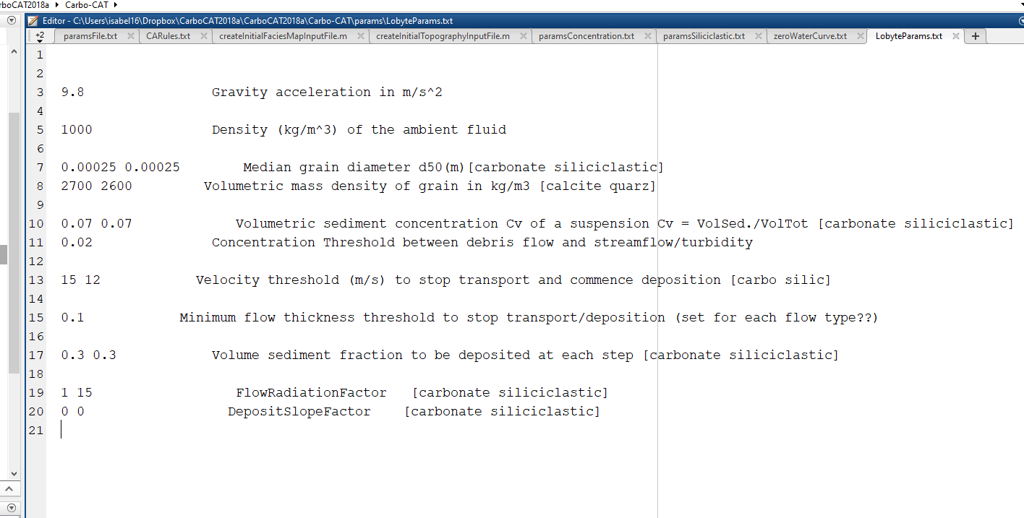
Carbo-CAT model setup
7. In LobyteParams.txt (params folder) specify the gravity driven transport and deposition parameters – or leave the default values-
Notes:
The current version of Carbo-CAT is written in Matlab. This flow chart summarizes the implemented algorithm.
The program starts calculating the parameters that controls the spatial distribution and deposition of the different type of carbonate sediments. The subsidence and the consequent water depth, the wave energy distribution over the model area and if present, the siliciclastic input. Afterwards, the model calculates the carbonate sediment spatial distribution and production and finally the removal, transport and redeposition of the produced carbonate.

Slide 21
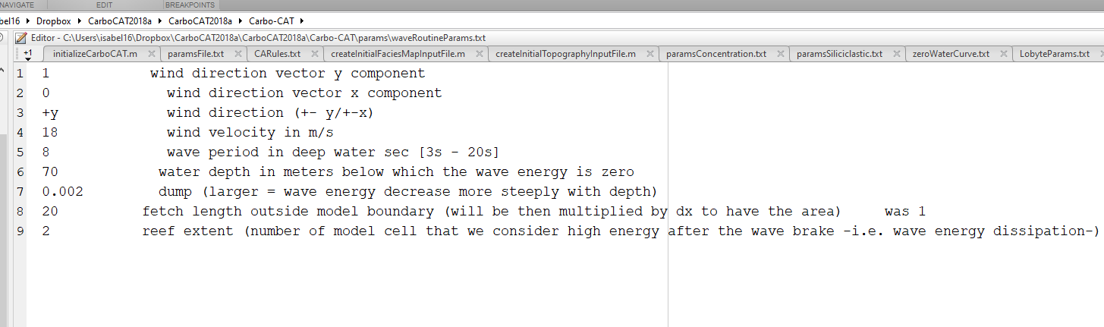
Carbo-CAT model setup
8. In WaveRoutineParams.txt (params folder) specify the wave routine parameters
Notes:
The current version of Carbo-CAT is written in Matlab. This flow chart summarizes the implemented algorithm.
The program starts calculating the parameters that controls the spatial distribution and deposition of the different type of carbonate sediments. The subsidence and the consequent water depth, the wave energy distribution over the model area and if present, the siliciclastic input. Afterwards, the model calculates the carbonate sediment spatial distribution and production and finally the removal, transport and redeposition of the produced carbonate.

Slide 22
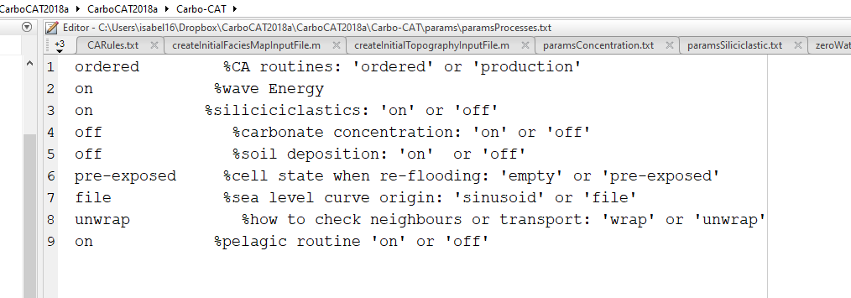
Carbo-CAT model setup
9. In paramsProcesse.txt (params folder) specify the desired processes
Notes:
The current version of Carbo-CAT is written in Matlab. This flow chart summarizes the implemented algorithm.
The program starts calculating the parameters that controls the spatial distribution and deposition of the different type of carbonate sediments. The subsidence and the consequent water depth, the wave energy distribution over the model area and if present, the siliciclastic input. Afterwards, the model calculates the carbonate sediment spatial distribution and production and finally the removal, transport and redeposition of the produced carbonate.

Slide 23
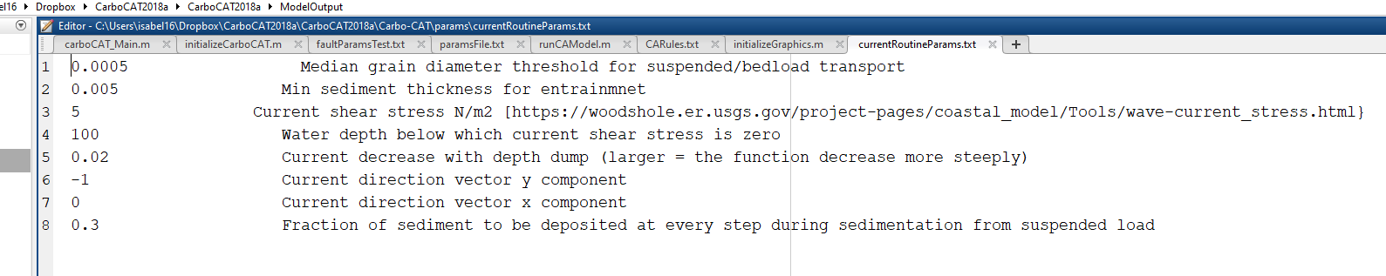
Carbo-CAT model setup
10. In currentRoutineParams.txt (params folder) specify the cross platform transport parameters
Notes:
The current version of Carbo-CAT is written in Matlab. This flow chart summarizes the implemented algorithm.
The program starts calculating the parameters that controls the spatial distribution and deposition of the different type of carbonate sediments. The subsidence and the consequent water depth, the wave energy distribution over the model area and if present, the siliciclastic input. Afterwards, the model calculates the carbonate sediment spatial distribution and production and finally the removal, transport and redeposition of the produced carbonate.

Slide 24
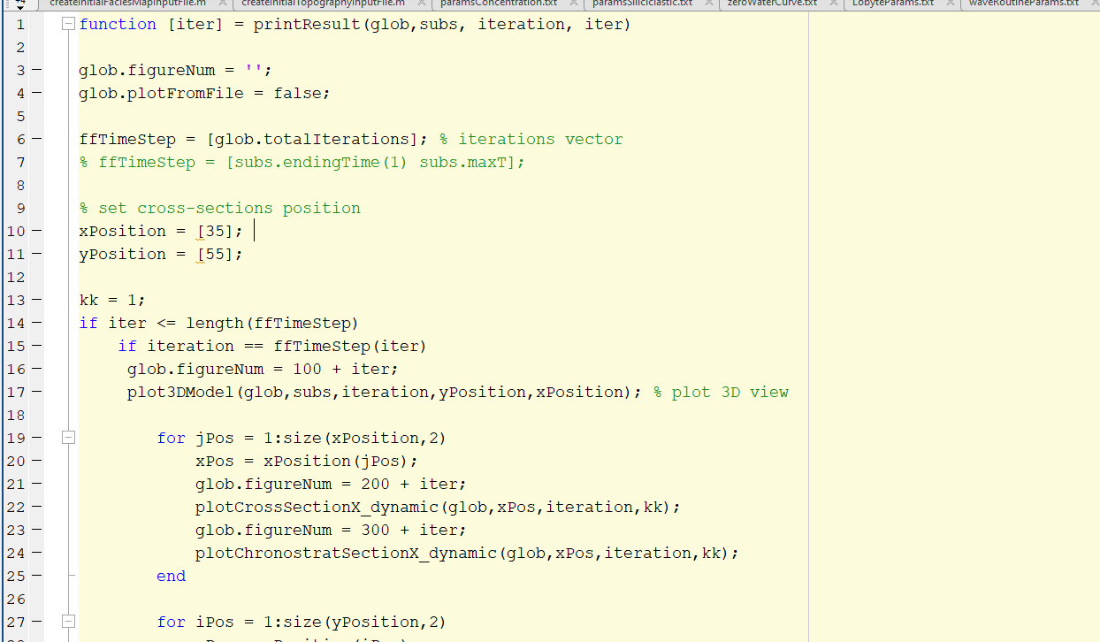
Carbo-CAT model setup
Model iterations at which we want to plot the results – default is at the end of the model run only, but more that one iteration number can be specified, not recommended, Matlab may crash for big arrays -
11. In the GraphicsFiles folder, open the printResults.m file and specify the desired options
Position of the desired cross sections (y and x), they can be more that one, e.g. :
xPosition = [35 70];
Notes:
The current version of Carbo-CAT is written in Matlab. This flow chart summarizes the implemented algorithm.
The program starts calculating the parameters that controls the spatial distribution and deposition of the different type of carbonate sediments. The subsidence and the consequent water depth, the wave energy distribution over the model area and if present, the siliciclastic input. Afterwards, the model calculates the carbonate sediment spatial distribution and production and finally the removal, transport and redeposition of the produced carbonate.

Slide 25
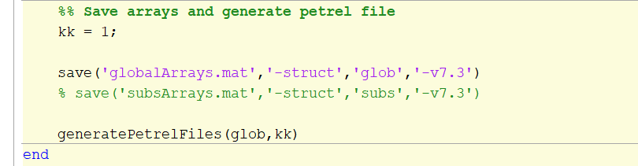
Carbo-CAT model setup
11. In the GraphicsFiles folder, open the printResults.m file and specify the desired options
Save all the model variables and results: facies distribution, water depth, wave energy, layer thickness…
Generates petrel eclipse file (grid and property) to import the resulting facies model in Petrel, recommended because it’s faster and easier to visualize cross sections and 3D view
Notes:
The current version of Carbo-CAT is written in Matlab. This flow chart summarizes the implemented algorithm.
The program starts calculating the parameters that controls the spatial distribution and deposition of the different type of carbonate sediments. The subsidence and the consequent water depth, the wave energy distribution over the model area and if present, the siliciclastic input. Afterwards, the model calculates the carbonate sediment spatial distribution and production and finally the removal, transport and redeposition of the produced carbonate.

Slide 26
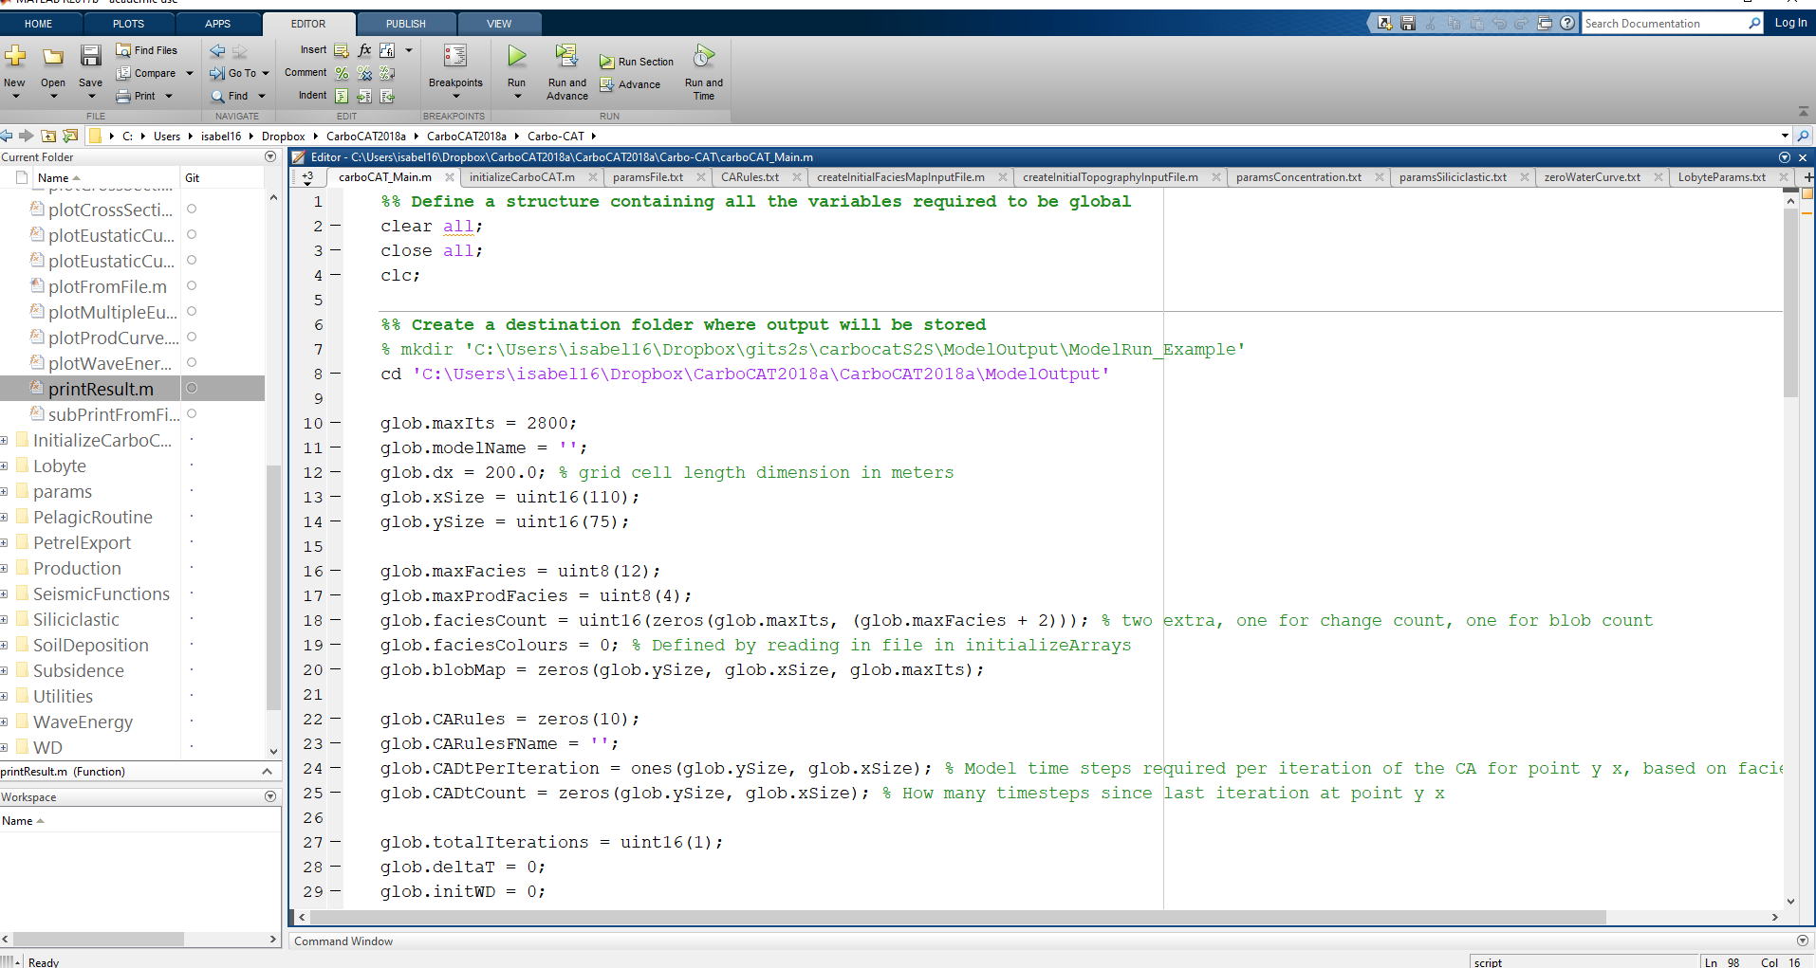
Carbo-CAT model setup
12. Run model from carboCAT_Main.m
Notes:
The current version of Carbo-CAT is written in Matlab. This flow chart summarizes the implemented algorithm.
The program starts calculating the parameters that controls the spatial distribution and deposition of the different type of carbonate sediments. The subsidence and the consequent water depth, the wave energy distribution over the model area and if present, the siliciclastic input. Afterwards, the model calculates the carbonate sediment spatial distribution and production and finally the removal, transport and redeposition of the produced carbonate.

Slide 27
Model outputs

Slide 28
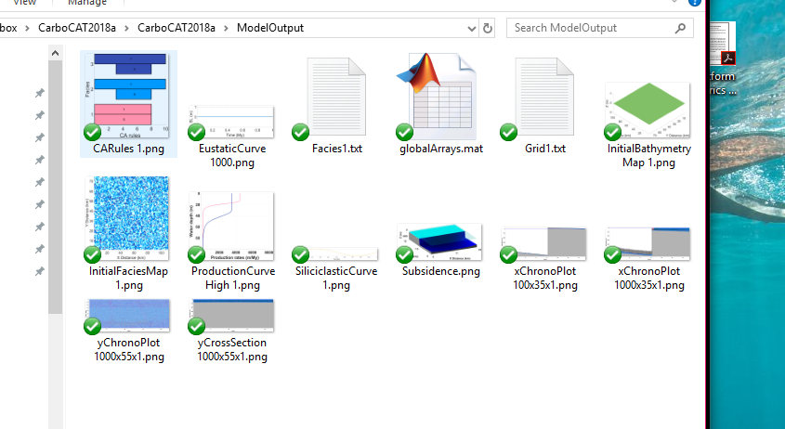
Carbo-CAT model output
ECLIPSE Grid and Property files for Petrel
.mat file with all the model variables/arrays (if we need to run analysis, plot…)
Notes:
The current version of Carbo-CAT is written in Matlab. This flow chart summarizes the implemented algorithm.
The program starts calculating the parameters that controls the spatial distribution and deposition of the different type of carbonate sediments. The subsidence and the consequent water depth, the wave energy distribution over the model area and if present, the siliciclastic input. Afterwards, the model calculates the carbonate sediment spatial distribution and production and finally the removal, transport and redeposition of the produced carbonate.

Slide 29
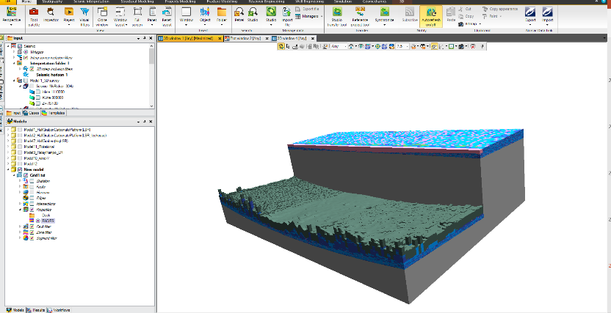

Carbo-CAT model output
3D from Petrel (Usually I don’t print the 3D facies model from Matlab because is time expensive, I comment the related graphic function to avoid it). In Petrel is also easier and quick to see model cross sections (anywhere in the model and with any direction)
Bedload or suspension accordingly to factory median grain diameter
Grey is pelagic
Notes:
The current version of Carbo-CAT is written in Matlab. This flow chart summarizes the implemented algorithm.
The program starts calculating the parameters that controls the spatial distribution and deposition of the different type of carbonate sediments. The subsidence and the consequent water depth, the wave energy distribution over the model area and if present, the siliciclastic input. Afterwards, the model calculates the carbonate sediment spatial distribution and production and finally the removal, transport and redeposition of the produced carbonate.

