Slide 1
Lobyte3D
Introduction and tutorial

Slide 2
Introduction
Lobyte3D is a reduced-complexity model that produces three-dimensional representations of fan strata using simple but logically consistent representations of various gravity-driven sediment transport mechanisms, for either siliciclastic or carbonate sediment. Each Lobyte3D run consists of a specified number of time steps, with one or more flow events per time step, each producing what we refer to as a bed. Flow deposition can be followed by deposition of a constant-per-time-step thickness of hemipelagic strata, which also form beds between successive flows, and often thicker beds deposited over several time steps when no flows are present. Model description and application has been recently described in the paper listed below.
Burgess, P.M., Masiero, I., Toby, S.C., Duller, R.A., 2019. A Big Fan of Signals? Exploring Autogenic and Allogenic Process and Product In a Numerical Stratigraphic Forward Model of Submarine-Fan Development. J. Sediment. Res. 89, 1–12. doi:10.2110/jsr.2019.3

Slide 3
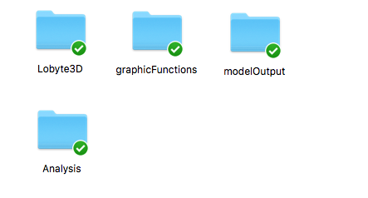
Program files and folders
Functions for printing results
Folder were Lobyte3D outputs can be stored
Folder with the main program file and functions
Folder containing all the programs/functions required to run the analysis performed in Burgess et. al. (2019). For example, the run analysis, power spectra…

Slide 4
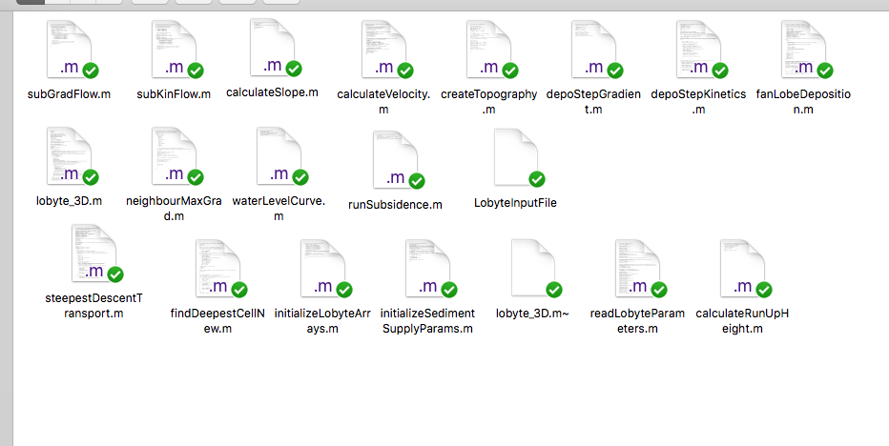
Program files and folders
LobyteInputFile.txt txt file where the main program input params can be defined
Lobyte_3D.m is the main script from where all the program sub function are called

Slide 5
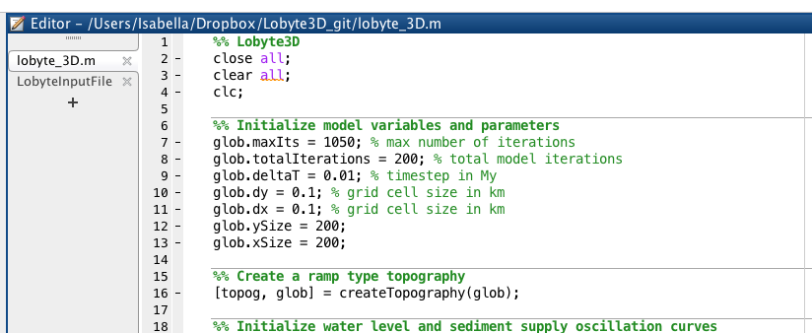
Model setup: global parameters
1. Open Lobyte_3D.m script and specify the desired model parameters. The number of model iterations (glob.totalIterations) determines the minimum number of transport and deposition events (at least one flow event for each iteration), however for each iteration we can set multiple flow event, also setting different input coordinates.

Slide 6
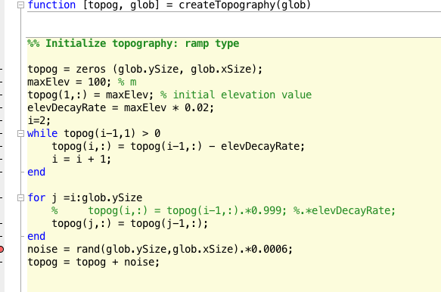
Model setup: topography
2. If required, open createTopography.m function to specify/modify the desired topography. The current topography is a ramp followed by a flat area.

Slide 7
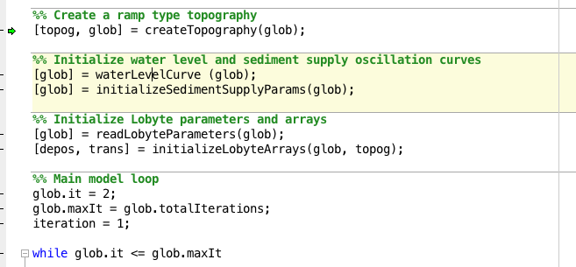
Model setup: sea level and sediment supply
3. Functions waterLevelCurve.m and initializeSedimentSupplyParams.m allow to define the desired sea level oscillation curve parameters (sinusoidal or constant) and sediment supply curve (sinusoidal or constant).

Slide 8
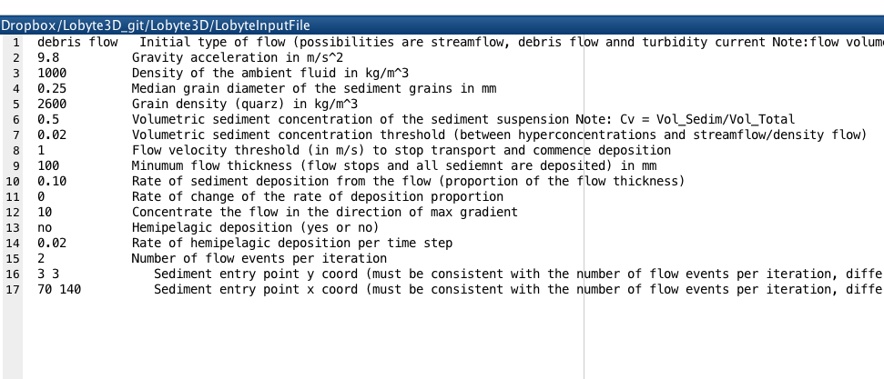
Model setup: main parameters file
4. Open LobyteInputFile.txt and define the main model parameters

Slide 9
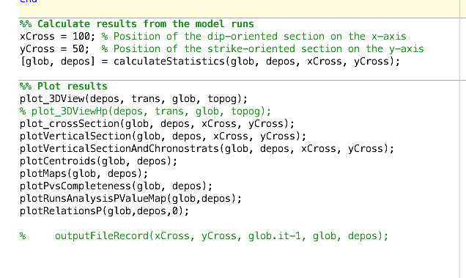
Model setup: graphic output
5. Specify the position of the cross sections
6. Comment/uncomment the desired plot and analysis.
Note: plot_3DViewHp is recommended when pelagic deposition is on.

Slide 10
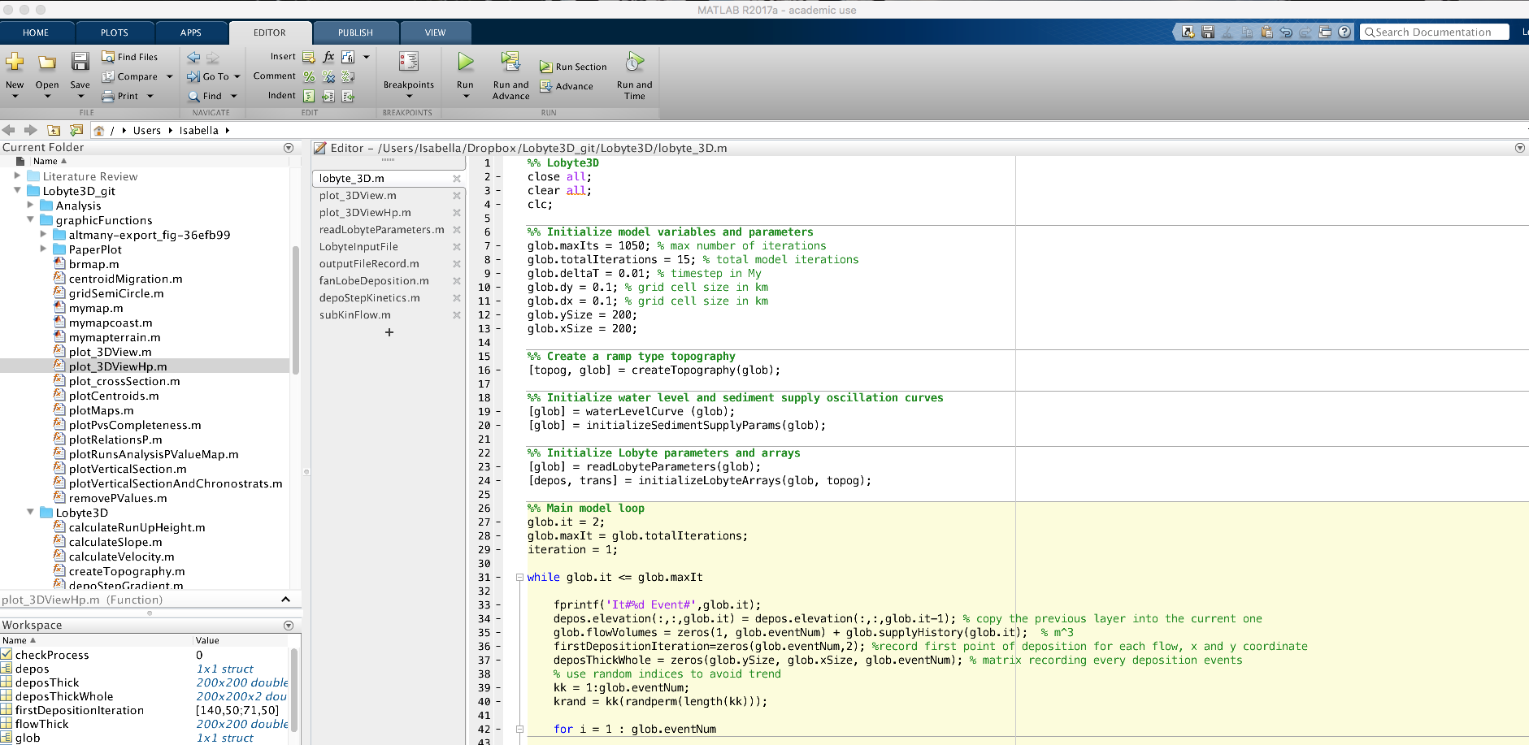
Model run
7. Run the model from the main script Lobyte_3D.m

Slide 11
For any query/bug report do not hesitate to get in touch:
Isabella.Masiero@live.com
Isabella.Masiero@liverpool.ac.uk
https://www.linkedin.com/in/masieroisabella/

