Slide 1
Virtual GlobeTrotter
Ergo G3:
Viola Nguyen
Atvars Apinis
Isabelle Deslé

Slide 2
Table of content
Team Role distribution
Project Description
Story Points
Technical Solution
Trello

Slide 3

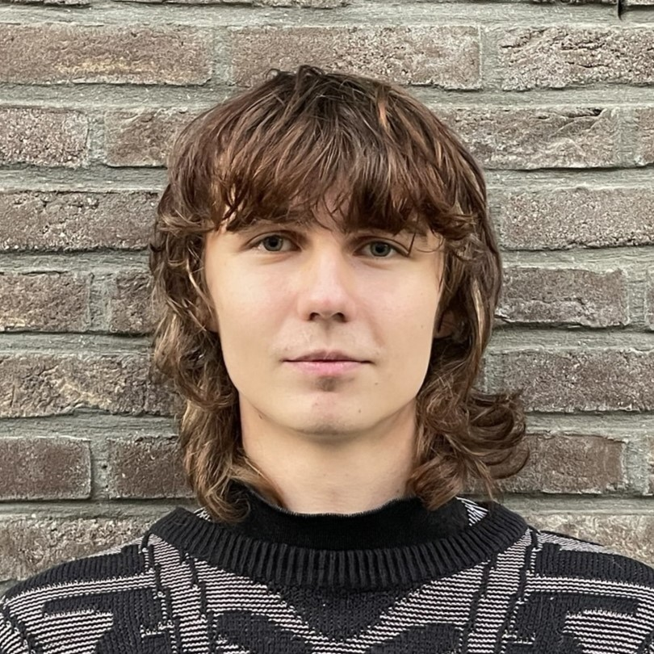
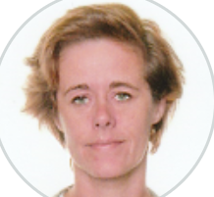
Team Role Distribution
Viola | Atvars | Isabelle
Scrum Master API UI Trello Connectivity | Development AI Unity Connectivity | Product Owner Database AI Documentation Connectivity

Slide 4
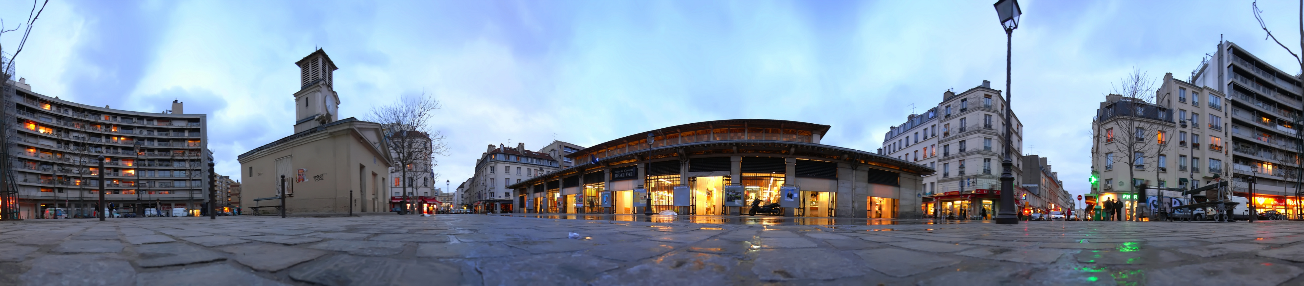
Project Description
What? 360° AI generated immersion based on voice input to
simulate a study trip.
For? Children around 10 yrs
Where? Immersive Room in Forum Core Howest
Tablet with user interface + world map
Continent choice and voice input.
A 360° image is shown and music is played.
The image and music is selected in a database of pregenerated images and music or a new image is created by an AI model. The image corresponds to the voice input, the music to the chosen continent

Slide 5
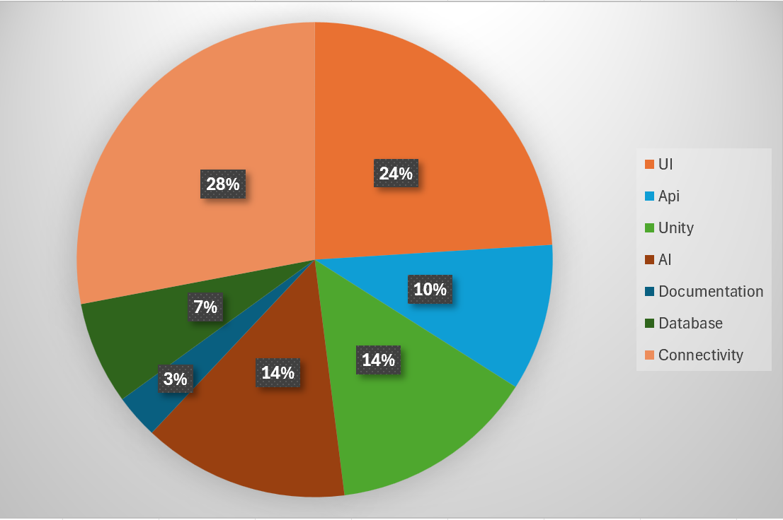
Story points

Slide 6
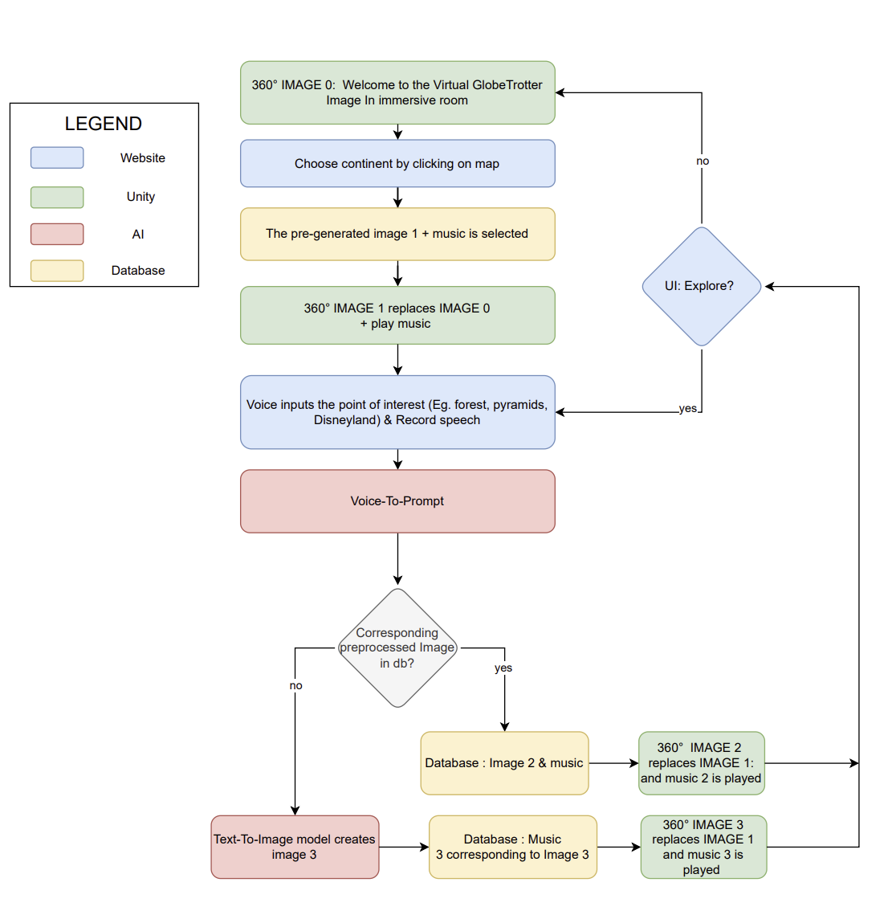
Technical solution Diagram

Slide 7
Website: The Start
Flask for API: established connection with the database and AI class.
Vue.js for Frontend
Docker container
Accessible through a local tablet
Easy to navigate
Visuals corresponding to the project concept
Connection point for all parts of the project

Slide 8
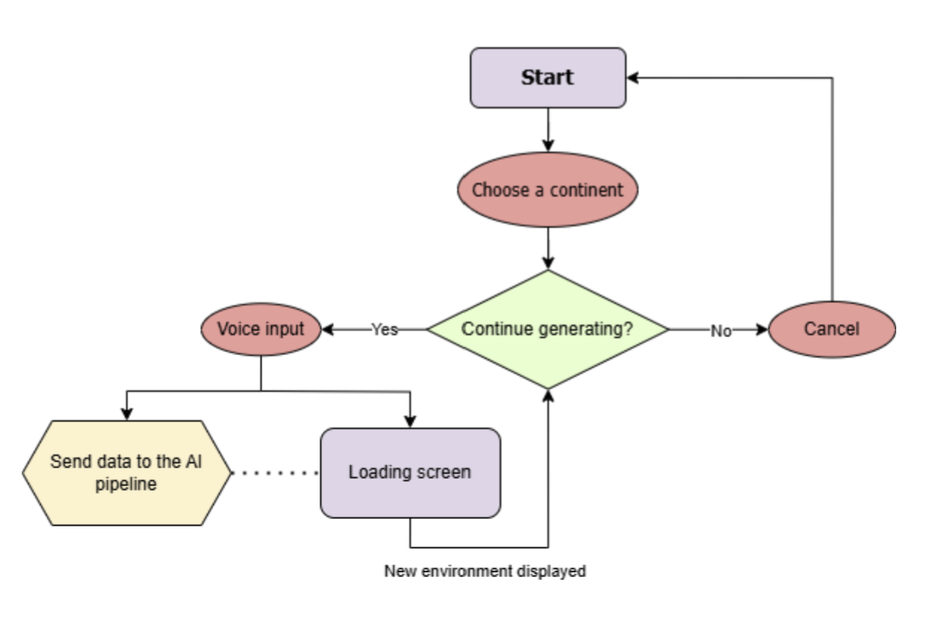
User Journey

Slide 9
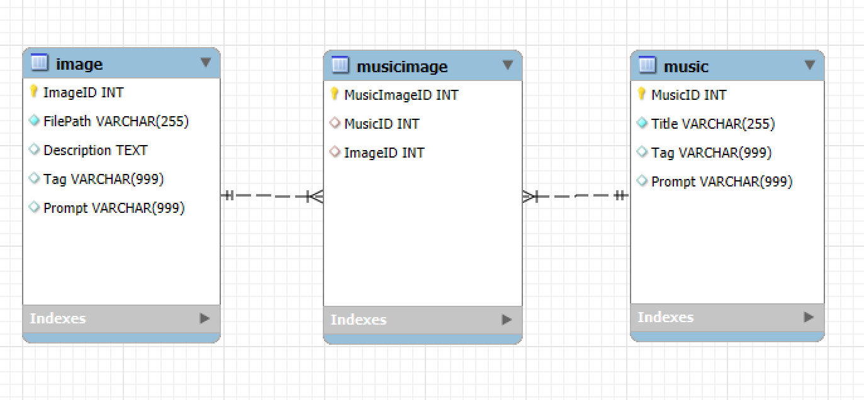
Database: find the right one
The database :
path to the generated images
prompt used to generate the images by the AI model.
5 Music / sounds by continent
1st idea : Relational Database / can be NoSql

Slide 10
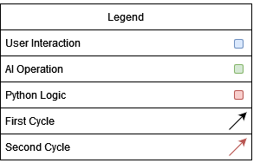

AI: and else create it!
AI Pipeline:
Voice-To-Text
Converts user input from audio to text
Text-To-Audio
Creates music from user prompt
Undecided yet whether real-time or pre-generated
Text-To-Text
Prompt enhancing
Text-To-Image
Creating the environment
Inpainting
Removing the seam
Image-To-Image
Adding user requested improvements to image

Slide 11
Unity: Ears and Eyes ready?
Needed for iteracting with the Immersive room
Empty environment with a giant sphere, user is in the centre
Image overlaid on inside surface of the sphere
AI generated music playing in the background

Slide 12
Biggest Challenge!
Connecting everything to 1 experience: is the biggest challenge!
Examples of connectivity
connecting AI model to the database: path to images and prompt / keywords
database to unity to show an image or the play music in the immersive room

Slide 13
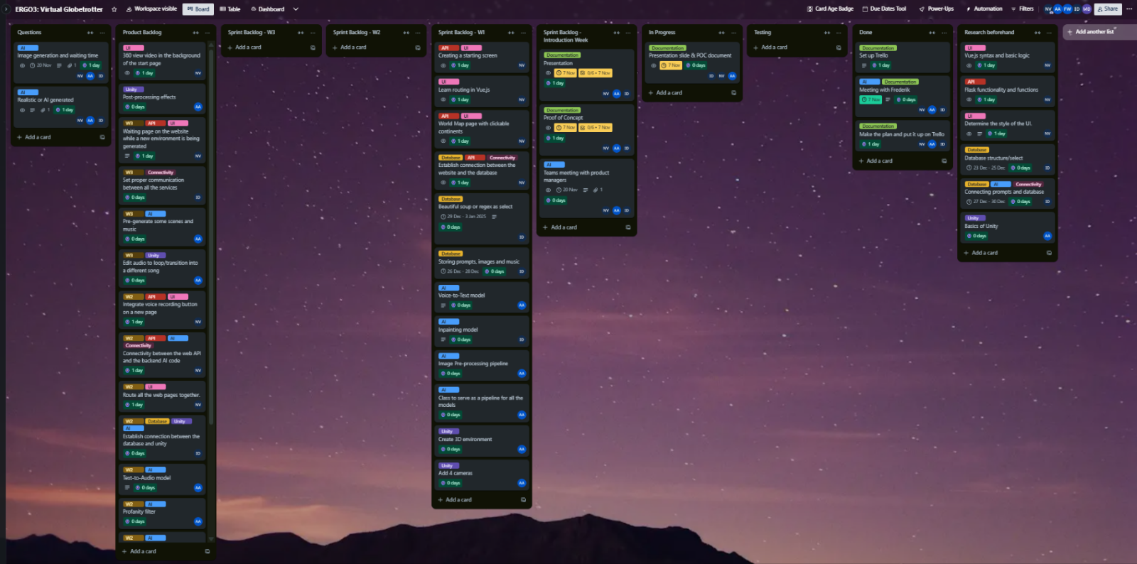
Trello

Slide 14
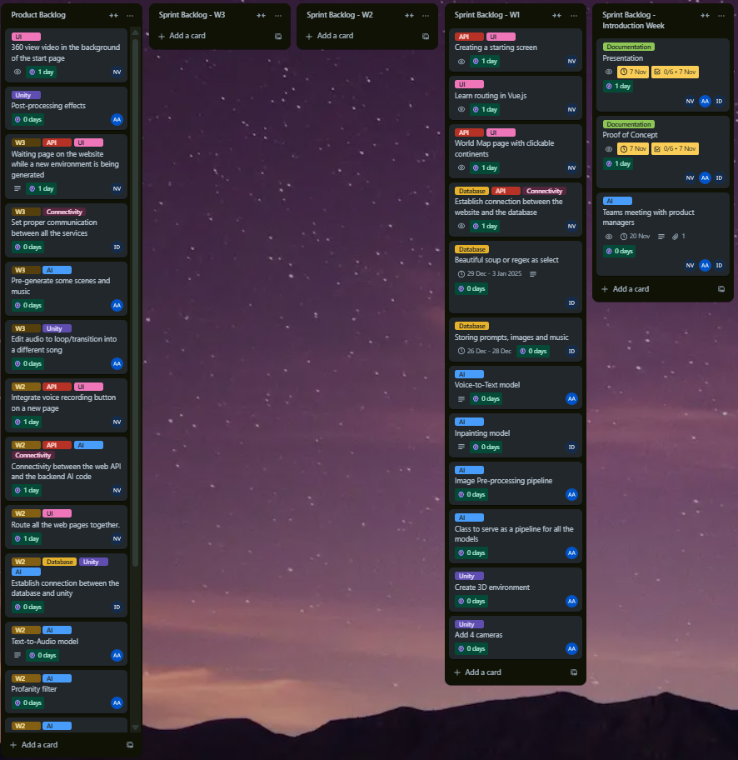
Trello

