Slide 1
Virtual GlobeTrotter : Travel and see nice spots * even when you have to stay home
Ergo G3:
Viola Nguyen
Atvars Apinis
Isabelle Deslé

Slide 2
Table of content
Team Role distribution
Project Description
Story Points
Trello
Technical Solution
You decide
Help us
Find the best one
Or else create it
Eyes and Ears Ready?

Slide 3

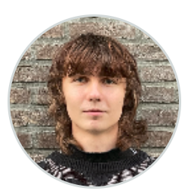
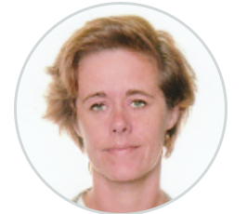
Team Role Distribution
Viola | Atvars | Isabelle
Scrum Master API UI Trello Connectivity | Development AI Unity Connectivity | Product Owner Database Documentation Connectivity

Slide 4
Project Description
What? 360° AI generated immersion based on voice input to simulate a study trip.
The "Virtual Globetrotter" project aims to provide children with an opportunity to experience the world virtually using our immersive room. Children can explore locations using an interactive map. These virtual trips will utilize AI-generated images, speech recognition, and real-time audio to create an immersive and enriching experience.
For? Children around 10 yrs?
Children who are vulnerable after surgery, during a treatment or because of a disability are not able to go on the trips the school or their family is doing. The child can go into the immersive room and travel to several spots in the world!
Where? Immersive Room in Forum Core Howest
The child is in the immersive room and has a tablet or phone with the user interface connected to the pc in the immersive room. The child chooses a continent shown on the user interface and a 360° image is shown and music is played corresponding to the choice.
The child is then asked to say a location, landmark or point of interest it wants to explore. For example, the beach, the pyramids or Disneyland.
The voice input is used by an AI model to generate another 360° image to show in the immersive room.

Slide 5
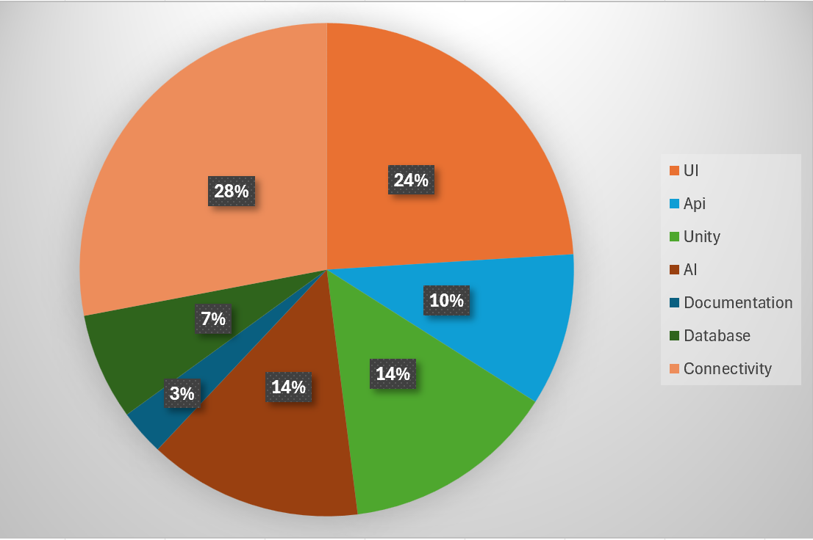
Story points

Slide 6
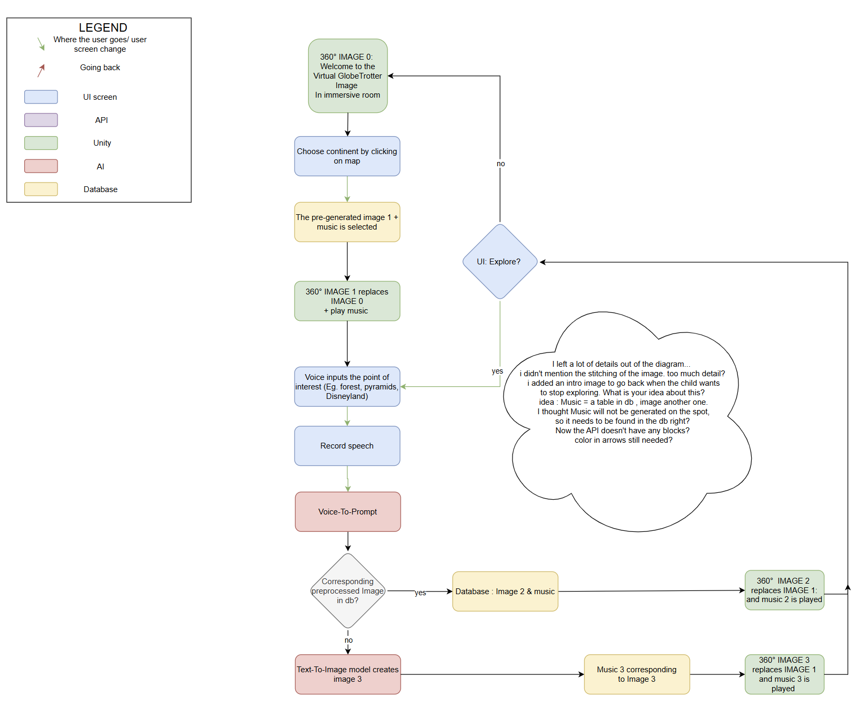
Technical solution Diagram
To update Thursday 07/11

Slide 7
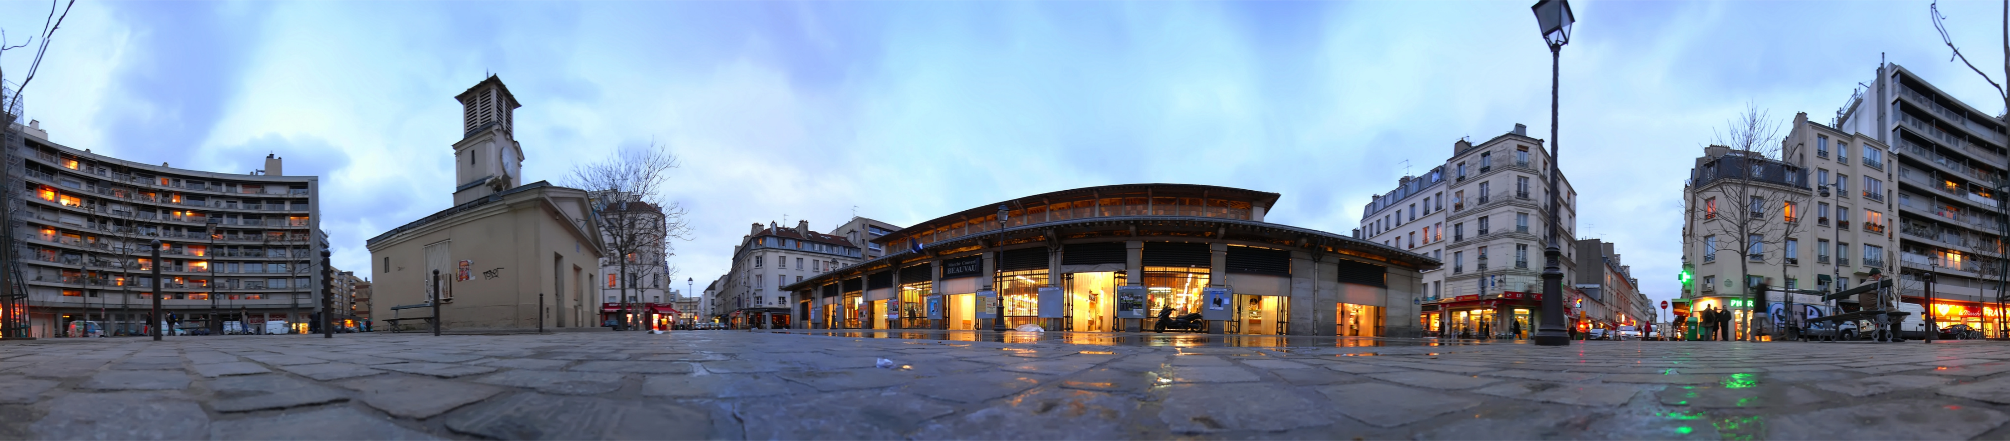
Technical solution UI
User Interface: The focus will be on creating a user-friendly interface that is accessible and enjoyable for children of different ages and abilities.

Slide 8
Technical solution Website
• Dynamic Environment Adaptation via Speech Input: The environments will dynamically adapt based on the child's spoken input. Speech-to-text technology combined with prompt engineering will ensure that elements in the environment change according to what the child says, making the experience more engaging and interactive.

Slide 9
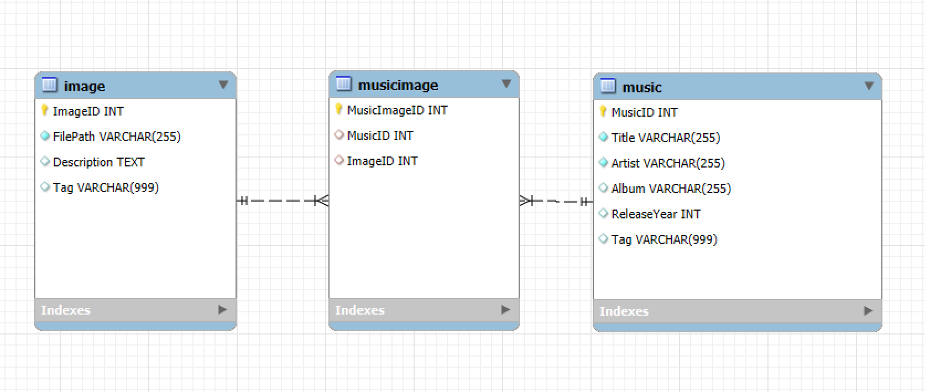
Technical solution Database

Slide 10
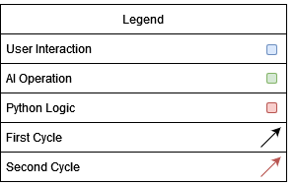

Technical solution AI
AI Pipeline:
Voice-To-Text
Converts user input from audio to text
Text-To-Audio
Creates music from user prompt
Undecided yet whether real-time or pre-generated
Text-To-Text
Prompt enhancing
Text-To-Image
Creating the environment
Inpainting
Removing the seam
Image-To-Image
Adding user requested improvements to image

Slide 11
Technical solution Unity
Needed for iteracting with the Immersive room
Empty environment with a giant sphere, user is in the centre
Image overlaid on inside surface of the sphere
AI generated music playing in the background
Basic user interface for entering prompts

Slide 12
Technical solution Connectivity
Connecting everything to 1 experience

Slide 13
Trello
AI-Generated Environments: The chosen locations will be brought to life with AI-generated 360-degree images and videos, offering immersive experiences such as nature (forests, snow-covered landscapes) or cities (Paris, Amsterdam, etc.).
No real time music generation?
Music Generation: Background music will be generated on beforehand and tailored to match the locatio
Music? Copyrights?
create a board and share it with the Scrum team & coaches
set up the product backlog
define sprints
add tasks and assign deadlines

Slide 14
Trello
AI-Generated Environments: The chosen locations will be brought to life with AI-generated 360-degree images and videos, offering immersive experiences such as nature (forests, snow-covered landscapes) or cities (Paris, Amsterdam, etc.).
No real time music generation?
Real-time Music Generation: Background music will be generated in real-time and tailored to match the location and the interactions of the child, adding to the immersive atmosphere.
Music? Copyrights?
create a board and share it with the Scrum team & coaches
set up the product backlog
define sprints
add tasks and assign deadlines

