Slide 1
Assignment 4 : BrokeBuddy App Screens

Slide 2
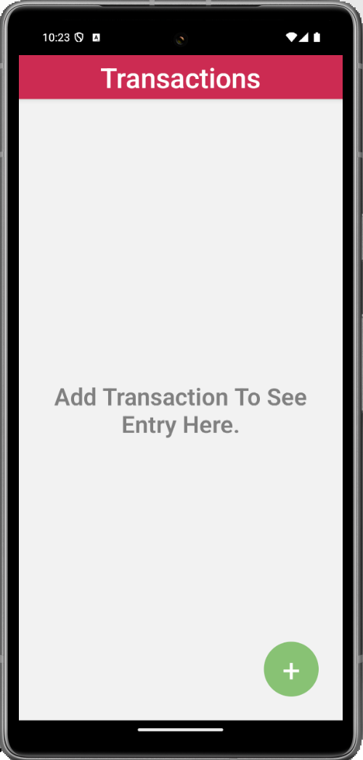
Header with Title
Empty View Message
FAB
Home Screen : Empty View

Slide 3
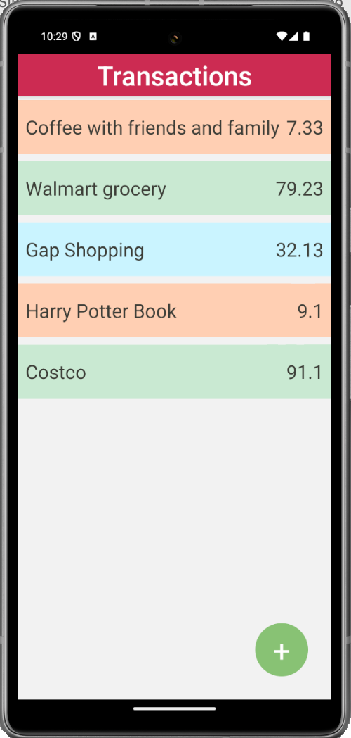
Leisure Transaction Type, Red background
Essential Transaction Type, Green background
Other Transaction Type, Blue background
Home Screen with list of transaction

Slide 4
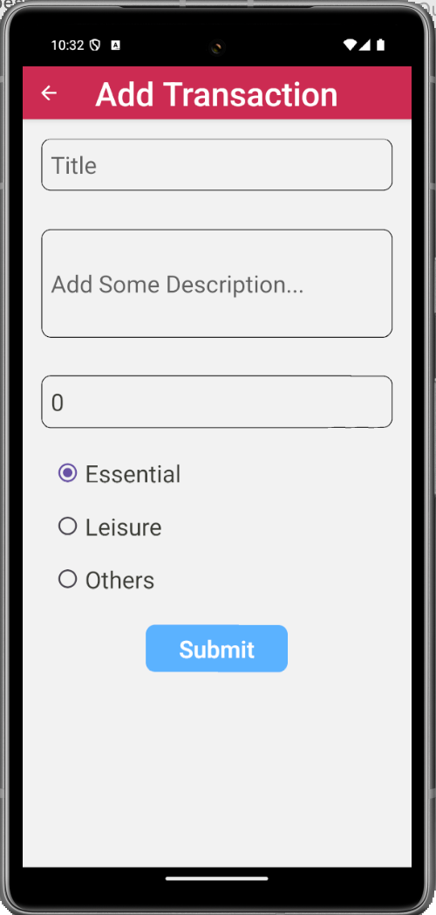
When user click on Submit button, after validating the fields, a unique id should be generated, and the transaction should be persisted.
Add transaction Screen

Slide 5
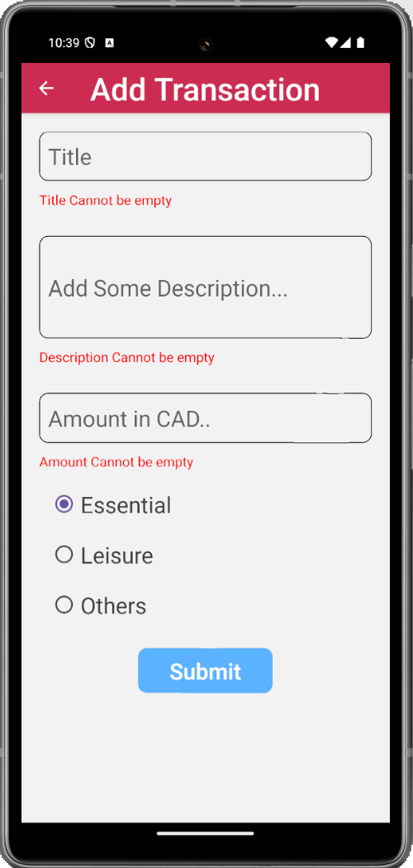
Add Transaction Screen with error messages

Slide 6
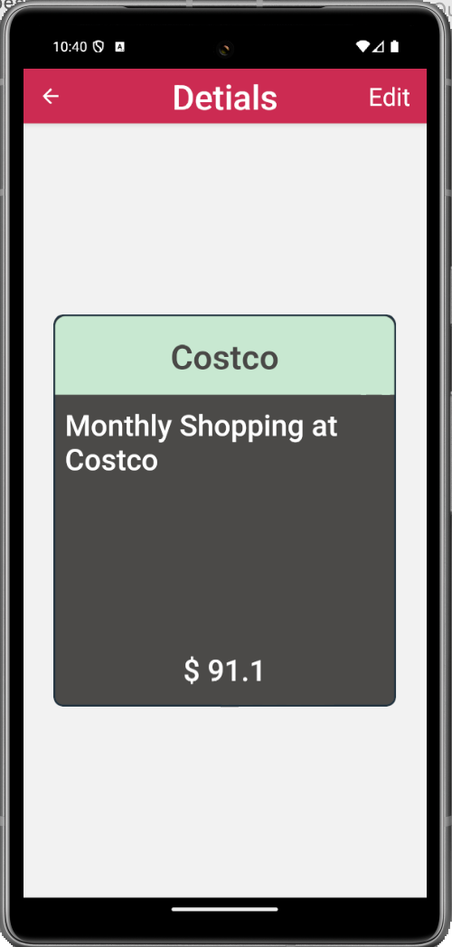
Header with title and Edit button. When user click on Edit button, app should open add transaction screen in edit mode
Card showing the transaction detail. (Not a very good-looking card, please create a better-looking card
View Details Screen

Slide 7
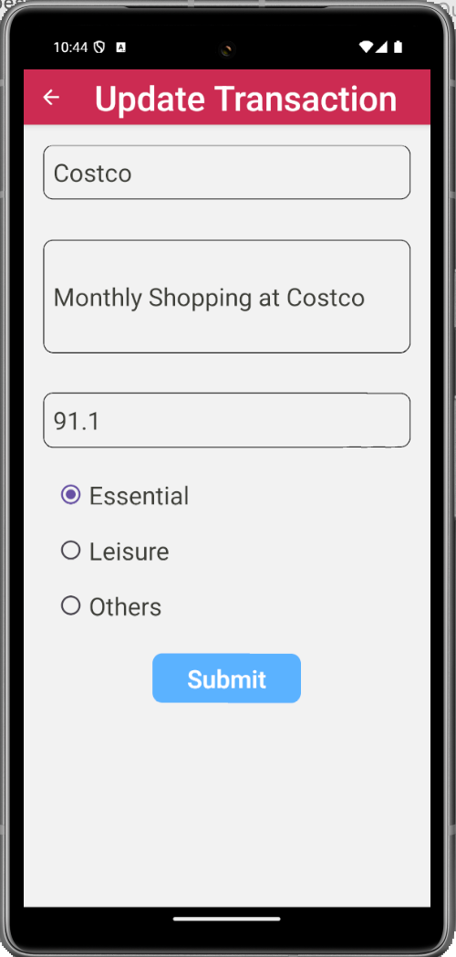
Header title is updated accordingly.
Transaction details are prefilled
In Edit mode, the transaction ID should remain same. Add some code to generate transaction ID only while adding new transaction but not while editing an existing transaction
Add Transaction Screen in Edit Mode

