Slide 1
Credit RISK SCORING
Project 7- Data Scientist
Isabelle Ravot-Boutherre
code: https://github.com/IsabelleRB1/OpenClassroom
dashboard: https://creditdashboard.herokuapp.com/

Slide 2
ObjectiVE

Slide 3




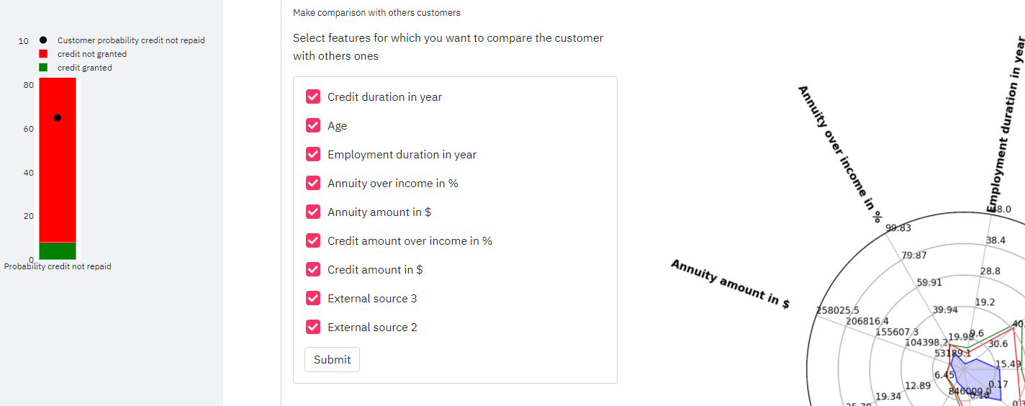
Objective
Develop a scoring model for the company “Prêt à depenser” in order to predict the probability that a customer will not repay his loan.
INPUT
Historical loans application data
OUTPUT
Contains information about 307’511 loans application described by 122 features (about the loan and the loan applicant) :
A supervised model allowing to calculate the probability that a customer will not repay the loan to decide to grant him the loan or not
An interactive dashboard to explain why the loan has been granted or not
Credit amount of the loan
Loan annuity
Contract type
Income of the customer
Age
Education type
Familiy status
Housing type
Days ID publish
Target: Payment difficulties

Slide 4
Training the model

Slide 5
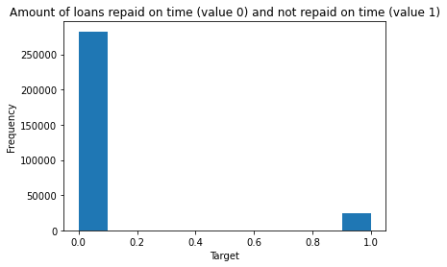
Data exploration and preparation
Data preparation based on the existing Kaggle kernel: https://www.kaggle.com/willkoehrsen/start-here-a-gentle-introduction
Available data are imbalanced → Must be taken into account when training the model
Categorical variables have been transformed using one hot encoding or label encoding
New features created to capture important information:
CREDIT_INCOME_PERCENT: the percentage of the credit amount relative to a client's income
ANNUITY_INCOME_PERCENT: the percentage of the loan annuity relative to a client's income
CREDIT_TERM: the length of the payment in years
DAYS_EMPLOYED_PERCENT: the percentage of the days employed relative to the client's age

Slide 6
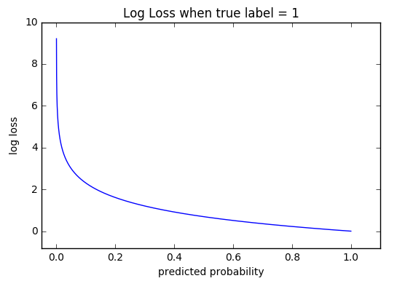
Choice of the model
Light Gradient Boosting Machine (LightGBM)
Advantage:
Fast training speed and high efficiency.
Low memory usage
Better accuracy than any other boosting algorithm
Compatibility with Large Datasets
Builds sequential decision trees
Each decision tree is built on the previous error. It used gradient descent method to optimize the loss function
Loss function
Function the model will minimize over the training:
Use default one: binary log loss
Model output
The probabilities that the customer will have payment difficulties for the loan
We must identify the optimal threshold for the payment difficulties probability above which the loan should not be granted.

Slide 7
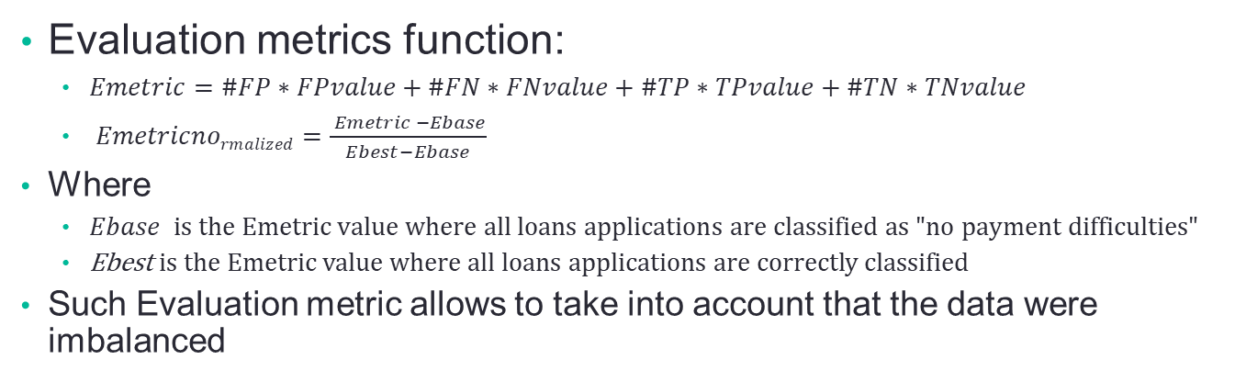
Choice of the evaluation metric
Evaluation metrics: This is the metric we want the model to optimize → It should reflect the business need
Granting a loan to a customer that will default is more costly than not granted it to a customer that will repay it.
We define our own evaluation metric
We associate to each prediction a value reflecting the gain or cost depending if the prediction was correct or not
False positive
Wrong prediction of « payment difficulties»
Cost: Interest revenue Lost
FPvalue = -1
False negative
Wrong prediction of « no payment difficulties»
Cost: Amount of the loan not repaid
FNvalue = -10
True positive
Correct prediction of «payment difficulties»
No cost/gain
TPvalue = 0
True negative
Correct prediction of «no payment difficulties»
Gain: Interest revenue earned
TNvalue = 1
Evaluation metrics function:
$Emetric=\#FP∗FPvalue+\#FN∗FNvalue+\#TP∗TPvalue+\#TN∗TNvalue$
$Emetricnormalized=\frac{ Emetric −Ebase}{Ebest−Ebase}$
Where
$Ebase is the Emetric value where all loans applications are classified as "no payment difficulties"$
Ebest is the Emetric value where all loans applications are correctly classified
Such Evaluation metric allows to take into account that the data were imbalanced

Slide 8
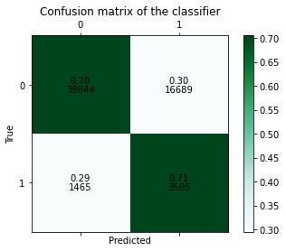
Training of the model
LightGBM has several hyperparameters that can be tuned
Others classical hyperparameters: n_estimators, learning_rate, max_depth…
Ts = The threshold of the payment difficulties probabilities
Use cross-validation to tune the hyperparameters
Whole Dataset
Training set
Test set
Training folds
validation fold
Emetric1
Emetric2
Mean
Emetric3
Best combination of hyperparameters
Training set
Model
Prob_{difficulties} <0,08 →0 (No payment difficulties)
Prob_{difficulties} >0,08 →1 (Payment difficulties)
Test Prediction
Emetric
+
Confusion Matrix

Slide 9
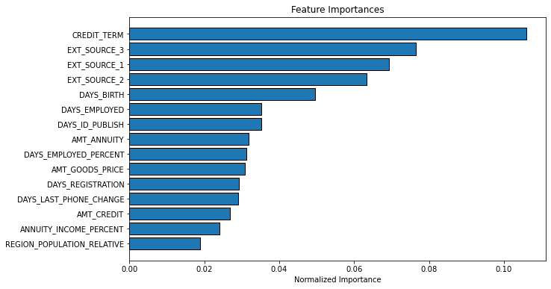
Interpretability of the model
One of the objective of this model is also to be able to explain why a loan has been granted or not
The lightGBM provides an output called ‘feature importances’
For each feature, a score is calculated that represents how relevant is the feature towards the prediction
Desgning a dashboard to compare the features of a given loan applications with others loans applications for sales representative to be able to explain the decision : https://creditdashboard.herokuapp.com/

Slide 10
Conclusion

Slide 11
Conclusion
Build a model able to predict whether the loan should be granted or not
This model takes into account the business need: wrongly granting a loan is more costly than wrongly not granting it
Provide a dashboard allowing sales representative to explain the decision to grant or not a loan
Possible improvements
Obtaining more information about important features such Ext_Source to better explain the decision
Improving the Evaluation metric to be closer to reality
Use all the data available
Test more models
code: https://github.com/IsabelleRB1/OpenClassroom
dashboard: https://creditdashboard.herokuapp.com/

