Slide 1
Parallel programming for
HPC
Final project
Isac Pasianotto, 2024-06-08

Slide 2
Matrix-Matrix multiplication

Slide 3
Requirements
Implement an algorithm to solve
Three different implementations are required:
  Naive: 3-nested loop.
  Blas: cblas_dgemm function
  Cuda: cublasDgemm function
Multi-node computation with MPI
Scaling test

Slide 4
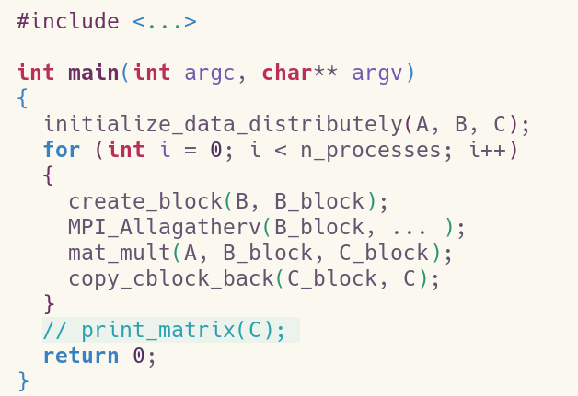
Implementation

Slide 5
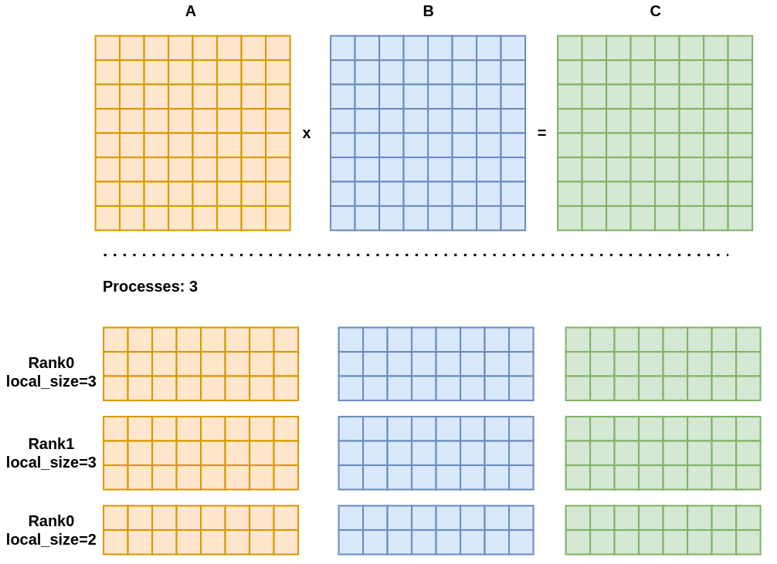
Distributed initialization
Matrices divided by rows
(Almost) homogeneous distribution of the workload between processes
local_size = (rank < N % size) ? N / size + 1 : N / size;

Slide 6
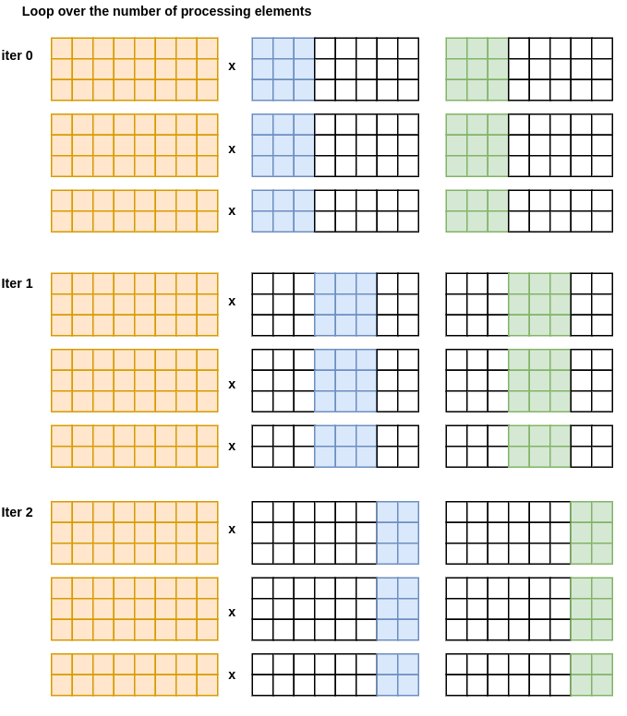
Loop over the
# of processes
Create B_block
Communicate it to other processes
Compute C_block

Slide 7
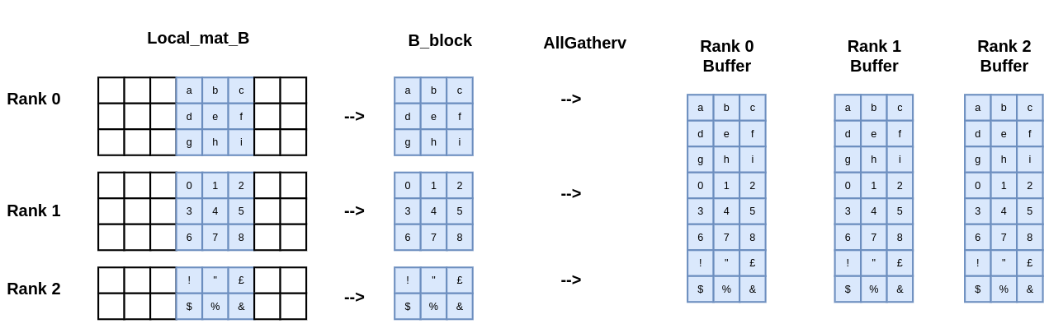
Gather the column block

Slide 8
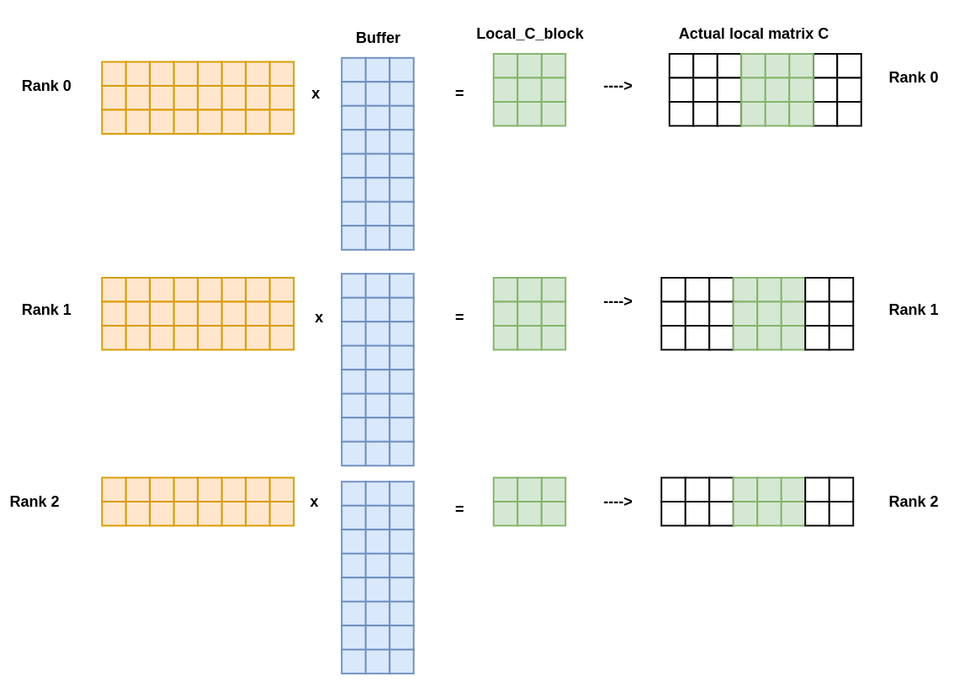
Result: C_block

Slide 9
Results: a initial disclaimer
 | Time (s)
Initialize A, B, C | 1.925907
Compute B_block | 0.071962
Perform MPI_Allgatherv | 0.085323
Compute C_block | 725.593634
mpirun -np $nproc ./main.x
srun -N $nproc ./main.x
 | Time (s)
Initialize A, B, C | 36.501742
Compute B_block | 0.016431
Perform MPI_Allgatherv | 0.088304
Compute C_block | 7.639606

Slide 10
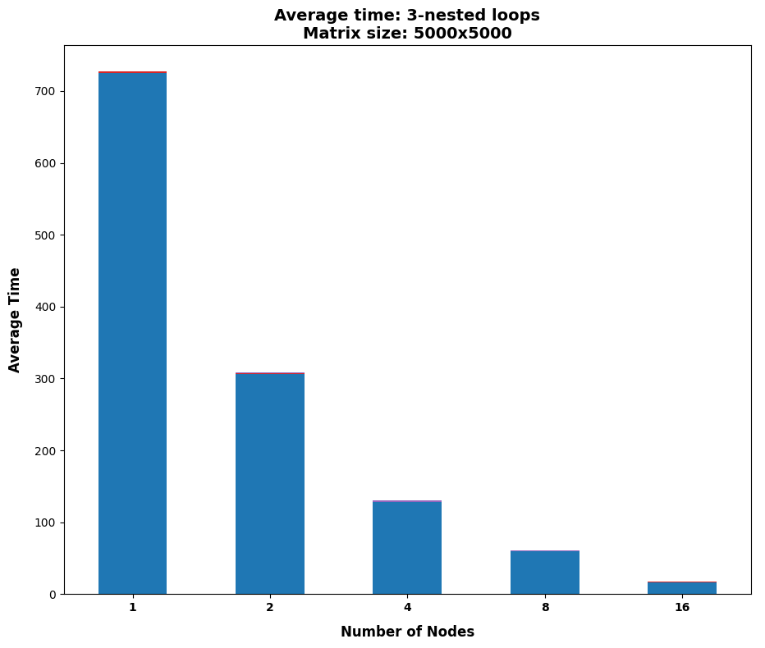
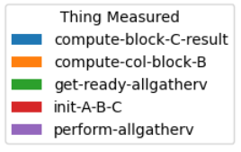
Results:
3-nested loop

Slide 11
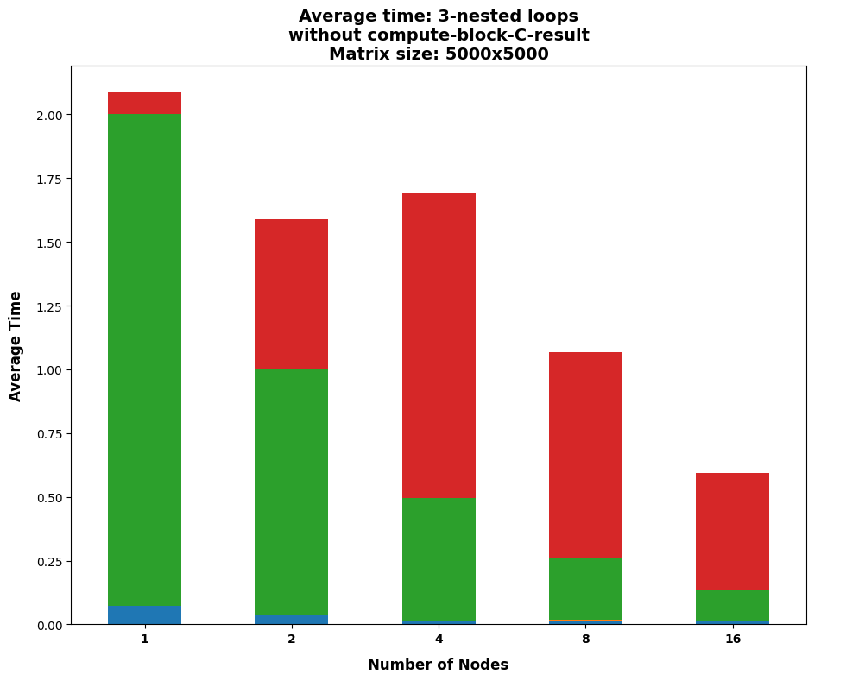
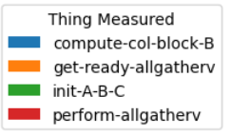
Results:
3-nested loop
(Cont’d)

Slide 12
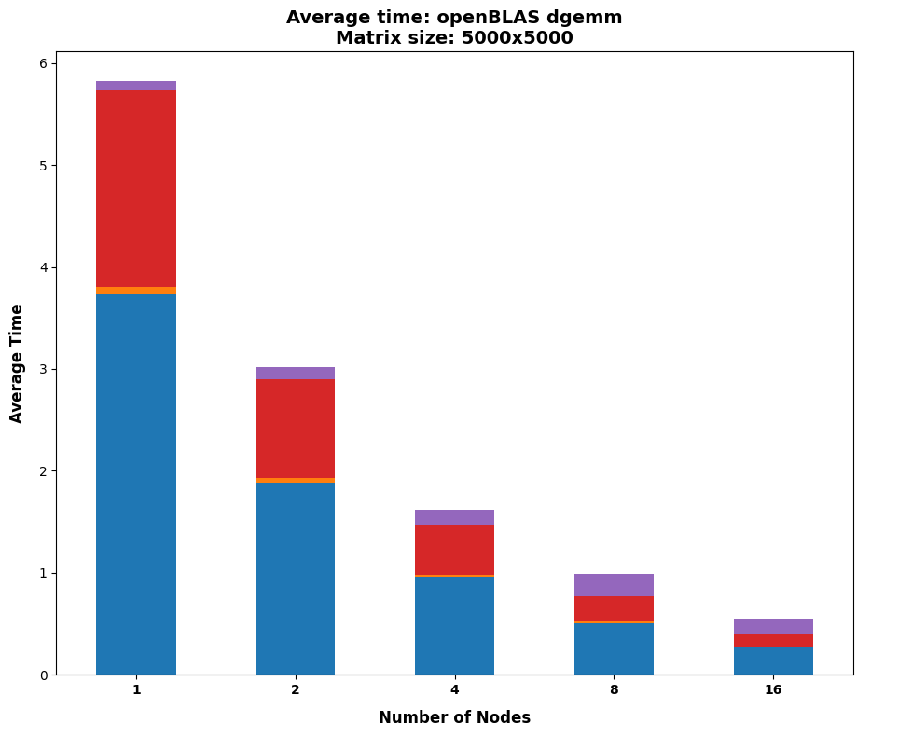
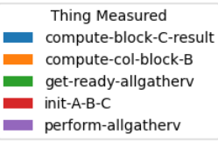
Results:
BLAS
In theory it should not scale so good

Slide 13
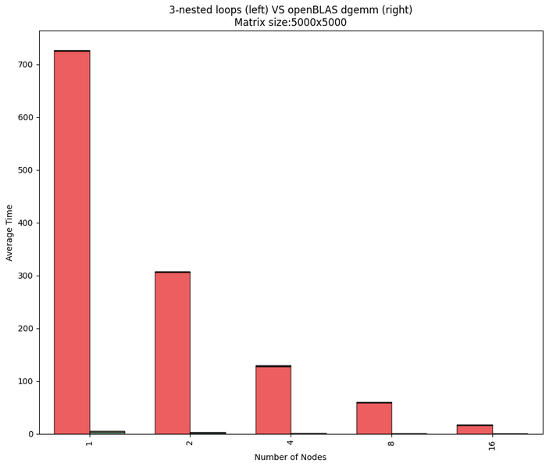
Results:
CPU

Slide 14
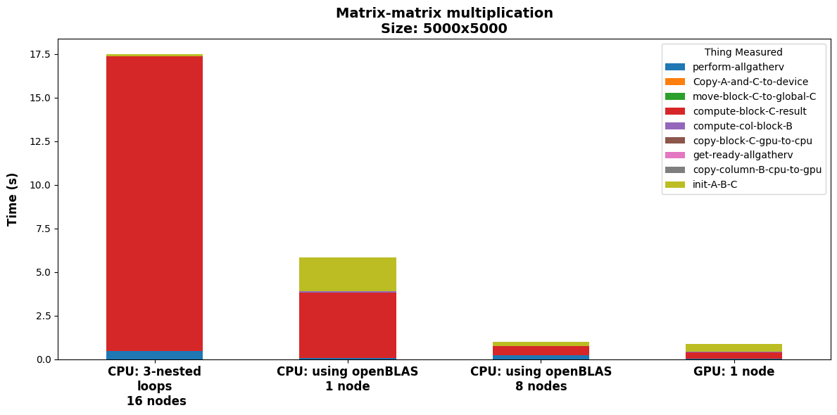
Results: cuda

Slide 15
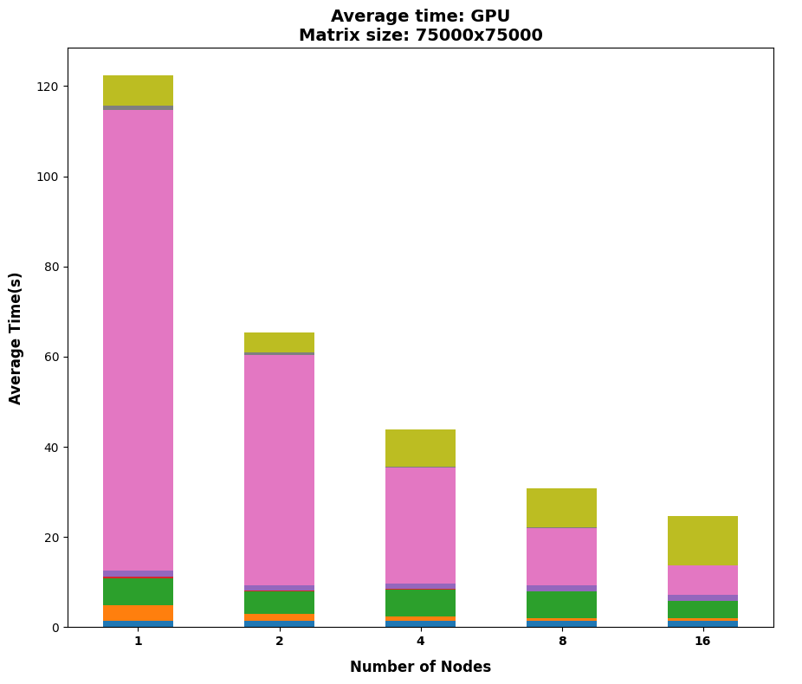
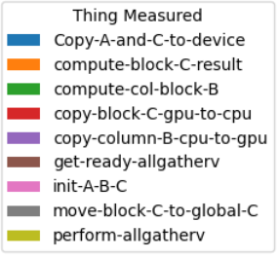
Results: cuda
(Cont’d)
Increased the matrix size to 75,000

Slide 16
Jacobi

Slide 17

Requirements
Take an already existing code jacobi.c
Make it parallel using MPI
Port the code on GPUs using openACC
Reduce as much as possible
data transfer
Scaling test :
  1,200 x 1,200 -- 10 iteration
  12,000 x 12,000 -- 10 iterations

Slide 18
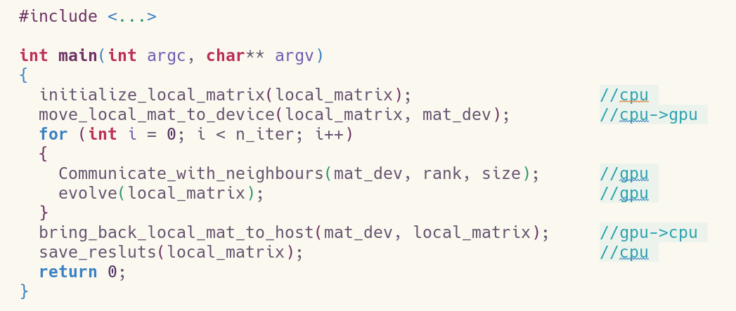
Implementation

Slide 19
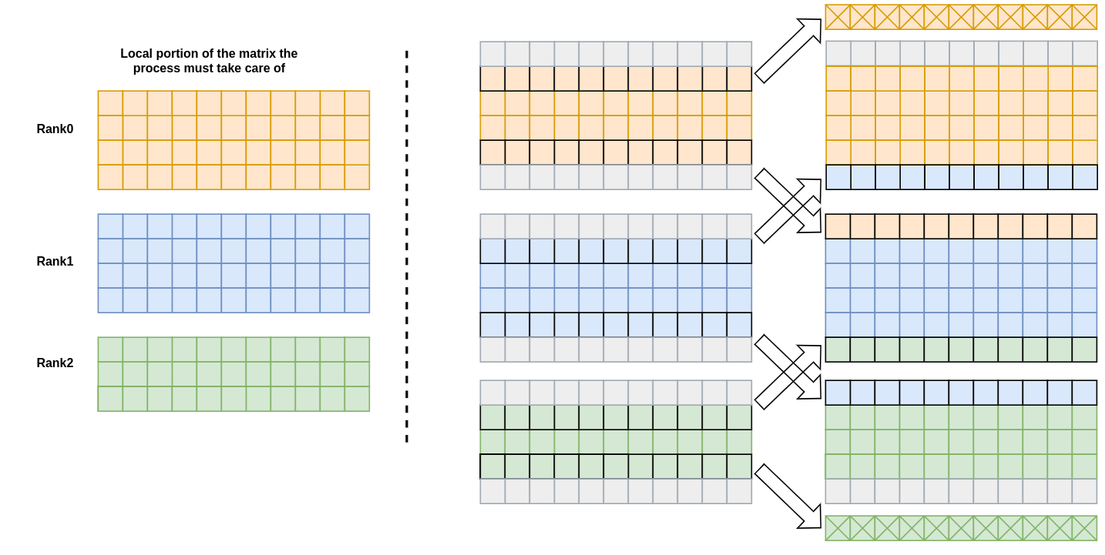
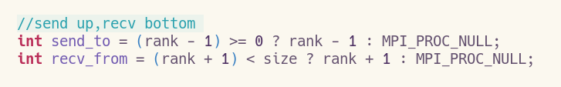
Communication

Slide 20
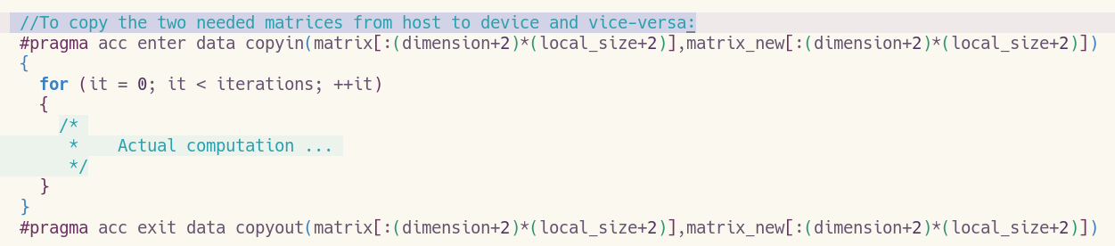
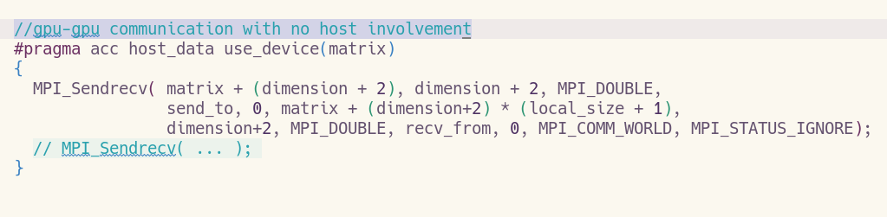
openACC

Slide 21
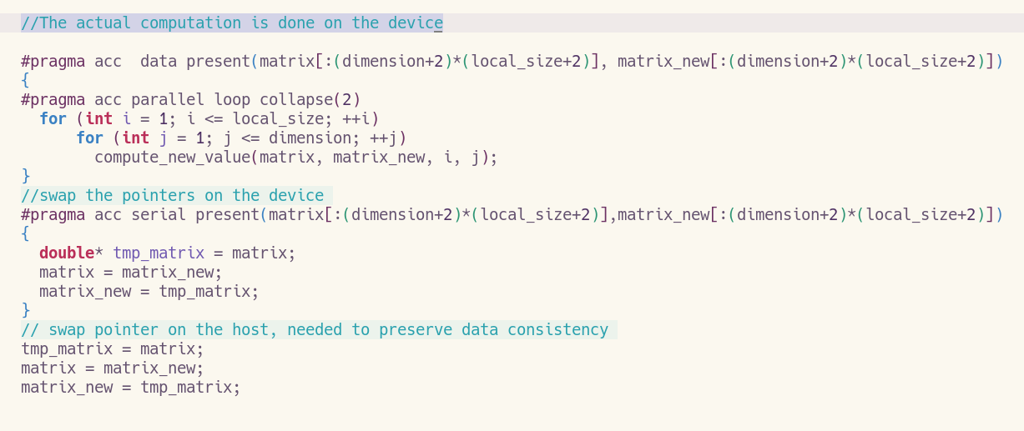
OpenACC (Cont’d)

Slide 22

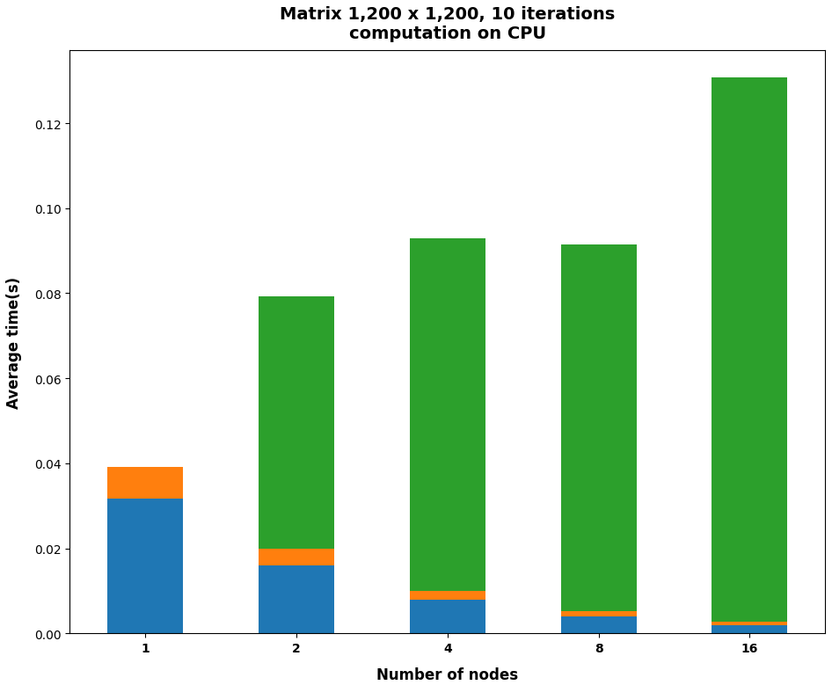
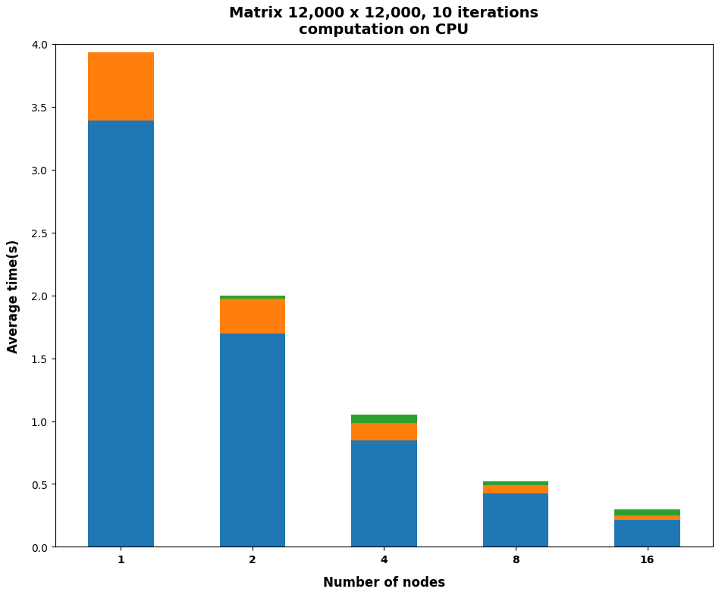
Results: CPU

Slide 23
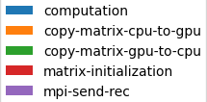
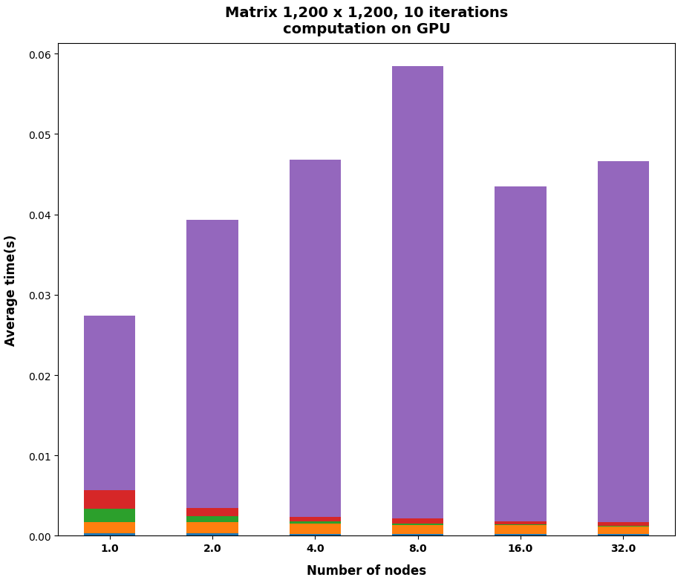
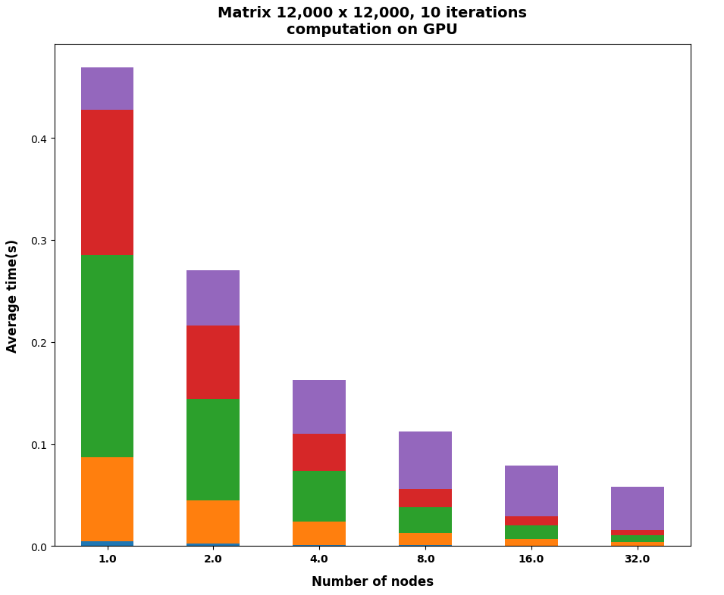
Results: GPU

Slide 24

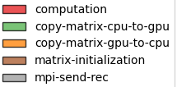
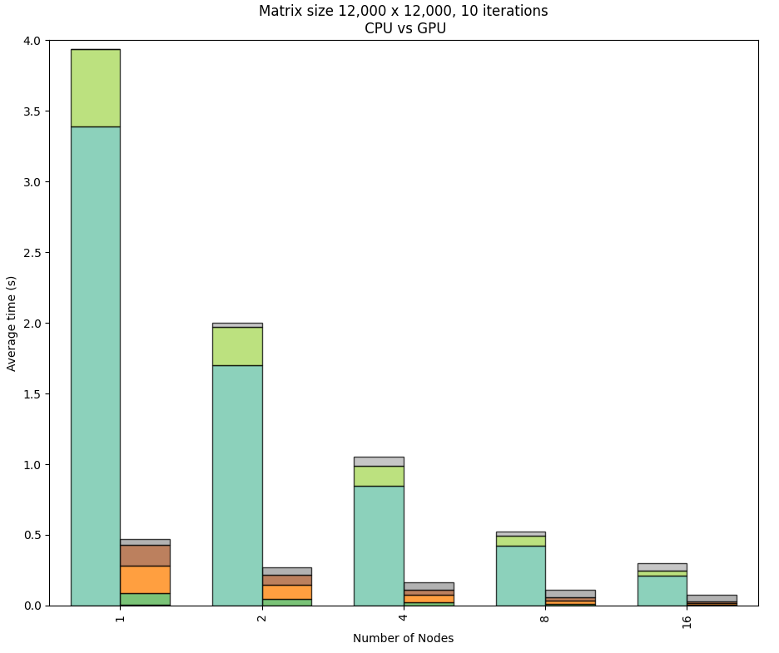
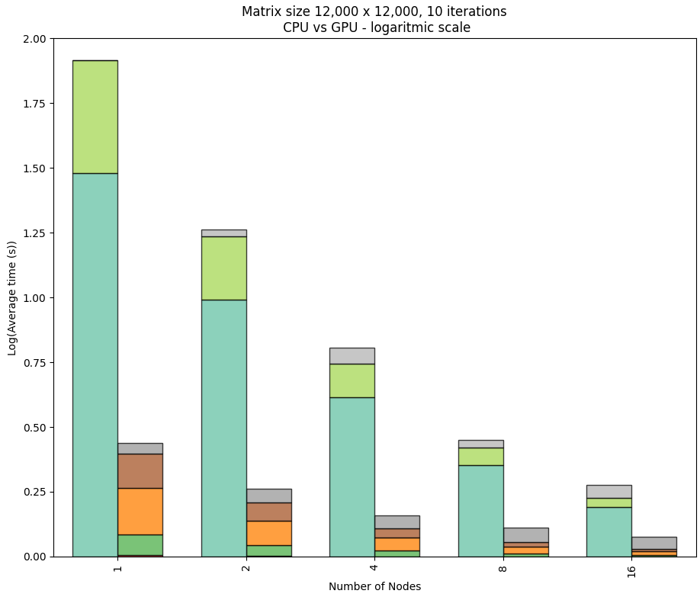
Results: CPU vs GPU

Slide 25
Jacobi-one-side

