Slide 1
EE 464 PROJECT PROPOSAL
Klerans
İsa ERSÖZ
Fatih ERDEN
Arda KASIM

Slide 2
Overview
Topology Selection
Discussion
Our Topology
Simulation Results
Ideal Case
With Non-idealities
Magnetic Design
Wire Selection
Core Selection
Winding Calculations
Inductor Design
Component Selection
Converter
Control
Loss Analysis
Future Work

Slide 3
Topology Selection - Discussion
Flyback
Forward
Push-Pull
Half-Bridge
Full-Bridge

Slide 4
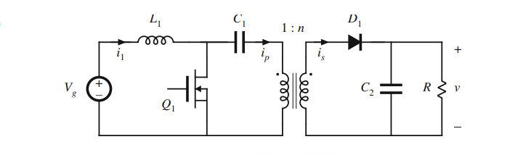
Topology Selection - Our Topology
Isolated SEPIC Converter

Slide 5
Isolated SEPIC Converter - Pros & Cons
Advantages:
Simple transformer design
Inductor and Lm currents are the same (with correct design)
Snubber is not essential
Topology Bonus
Disadvantages:
Extra inductor
Fourth order transfer function
Analog-ICs are not available
High MOSFET current

Slide 6
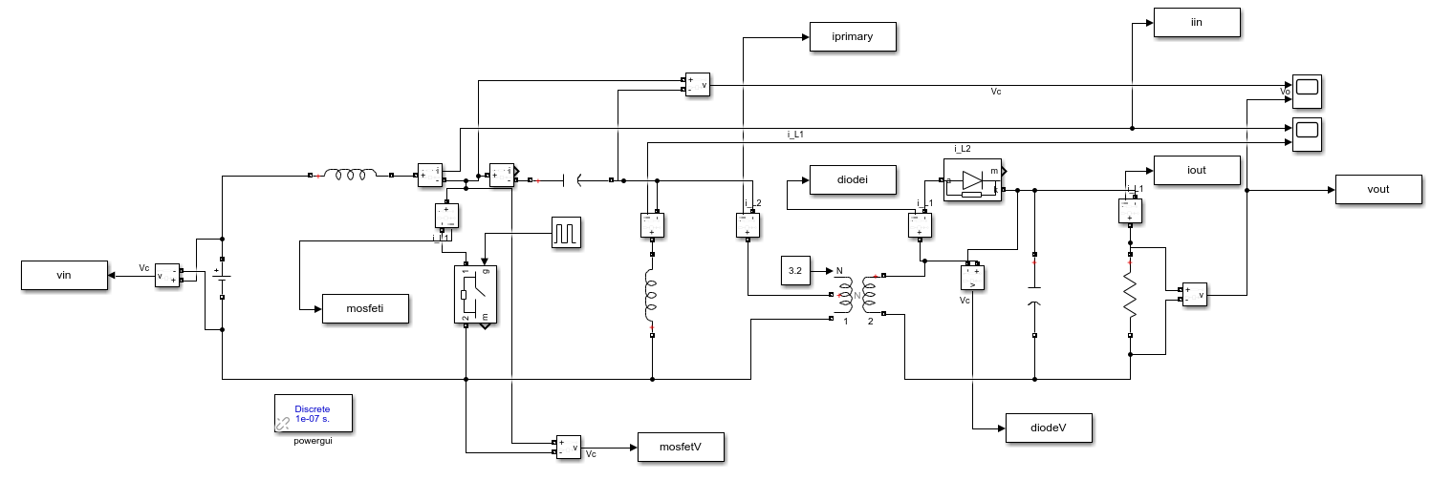
Simulation Results(Ideal Case)
Figure 1. Circuit diagram on Simulink.

Slide 7
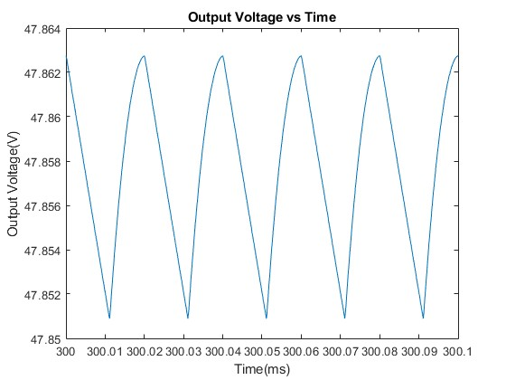
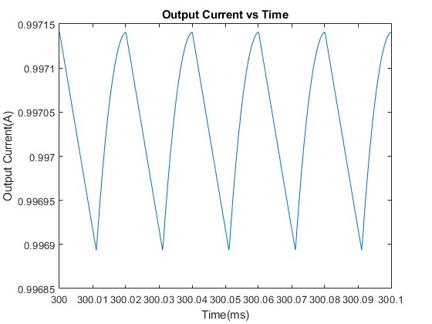
Simulation Results(Ideal Case)
Figure 2.Output voltage waveform for ideal case.
Figure 3.Output current waveform for ideal case.

Slide 8
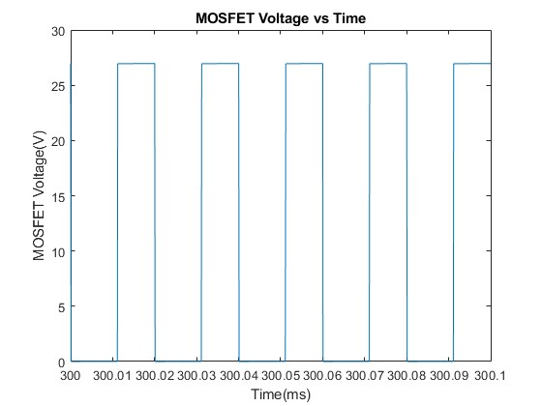
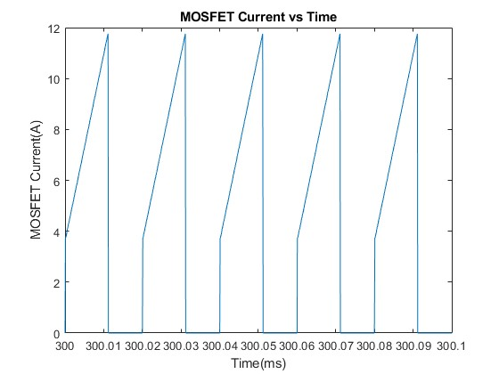
Simulation Results(Ideal Case)
Figure 4.MOSFET voltage waveform for ideal case.
Figure 5.MOSFET current waveform for ideal case.

Slide 9
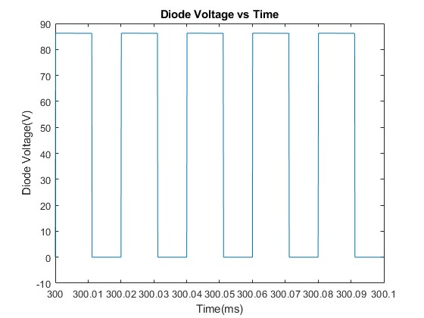
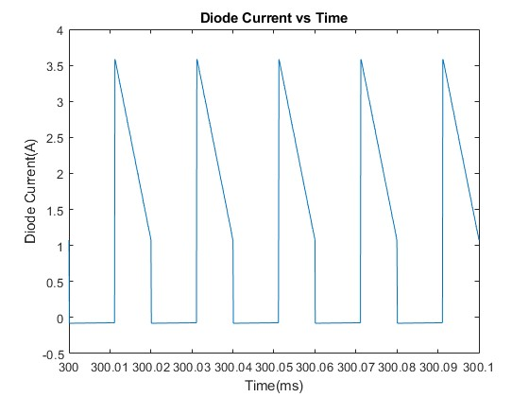
Simulation Results(Ideal Case)
Figure 6. Diode voltage waveform for ideal case.
Figure 7. Diode currentwaveform for ideal case.

Slide 10
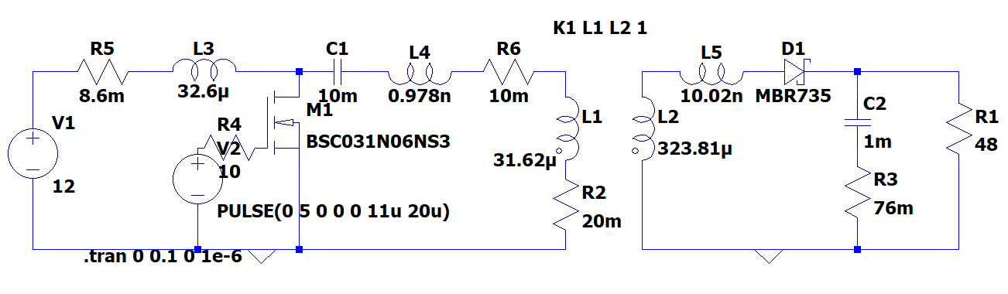
Simulation Results(With Non-idealities)
Figure 8. Circuit diagram on LTspice.

Slide 11
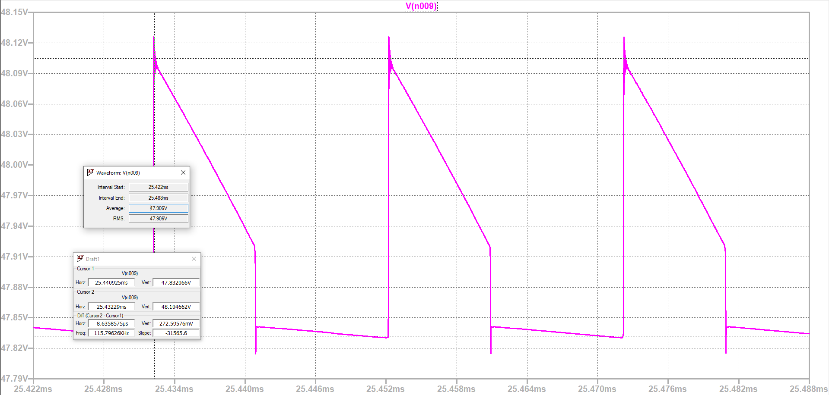
Simulation Results(With Non-idealities)
Figure 9. Output voltage waveform when non-idealities added.

Slide 12
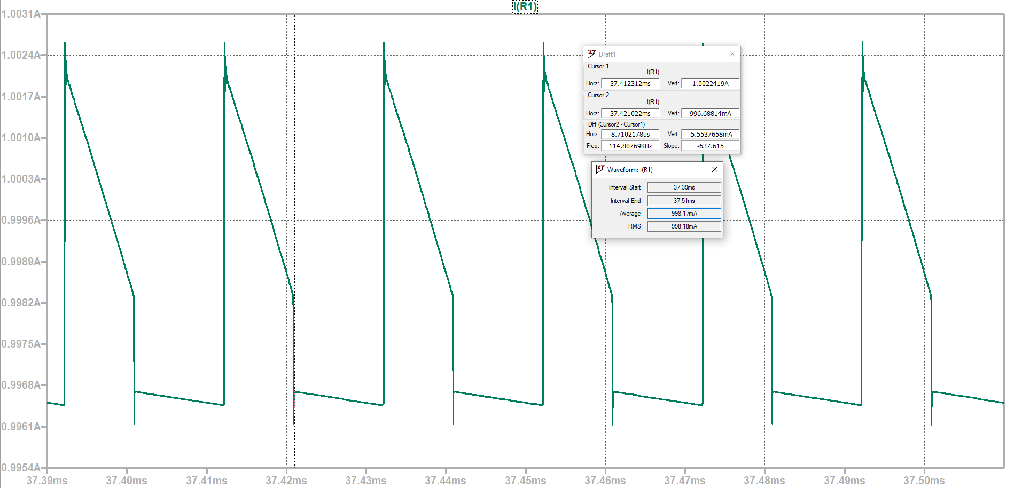
Simulation Results(With Non-idealities)
Figure 10. Output current waveform when non-idealities added.

Slide 13
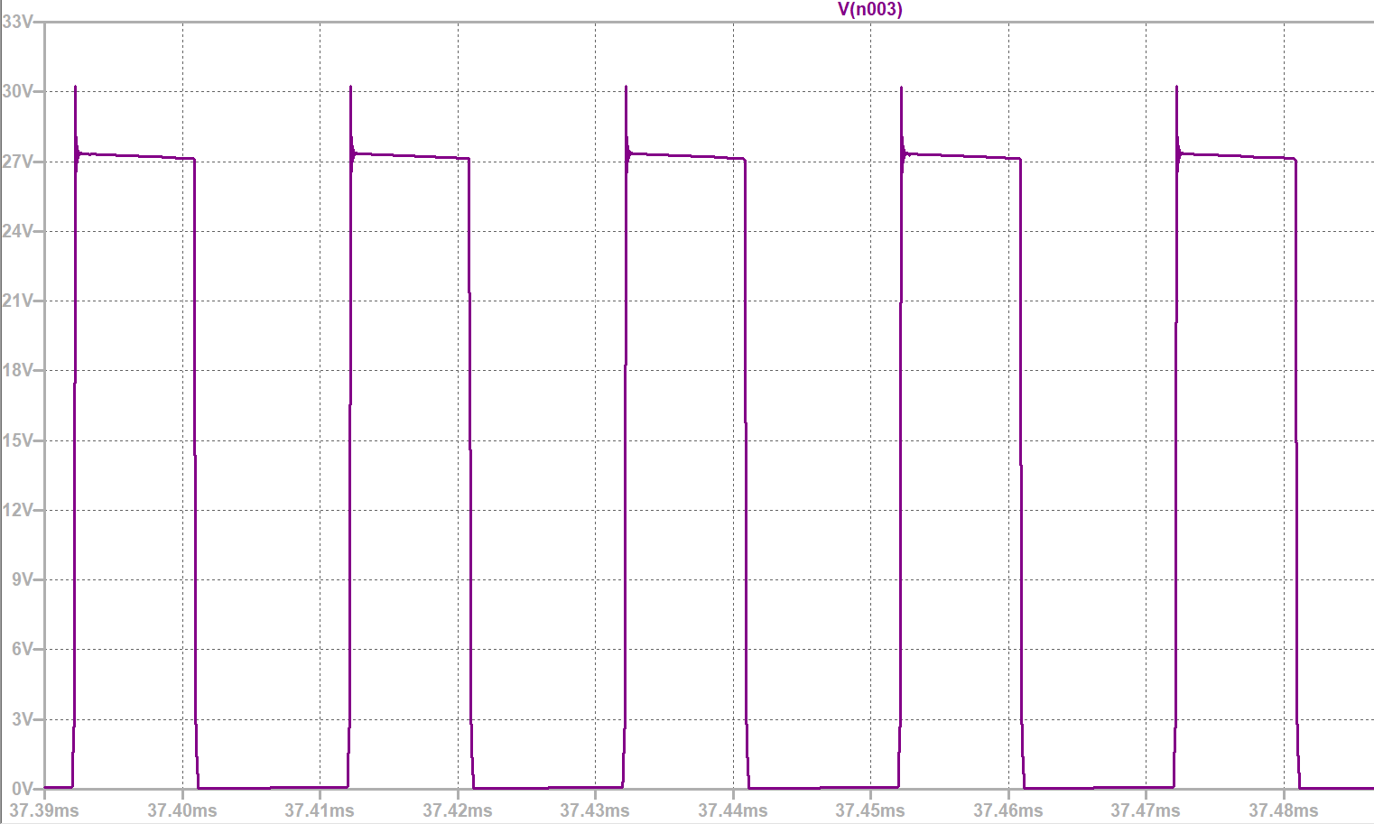
Simulation Results(With Non-idealities)
Figure 11. MOSFET voltage waveform when non-idealities added.

Slide 14
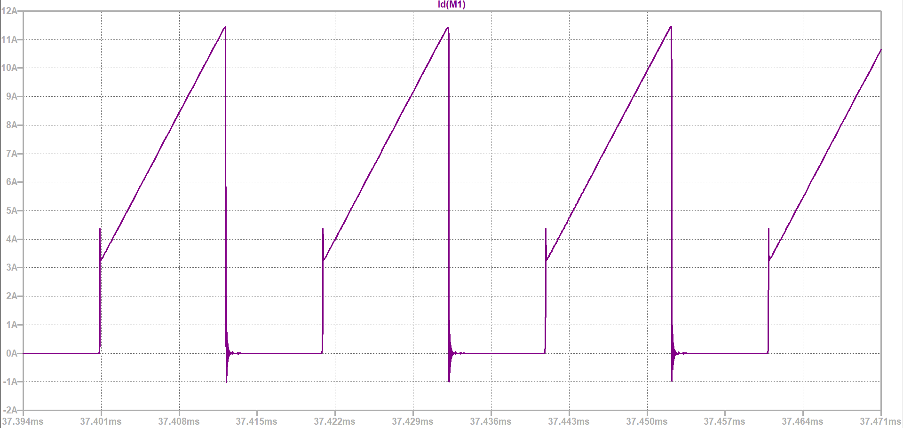
Simulation Results(With Non-idealities)
Figure 12. MOSFET current waveform when non-idealities added.

Slide 15
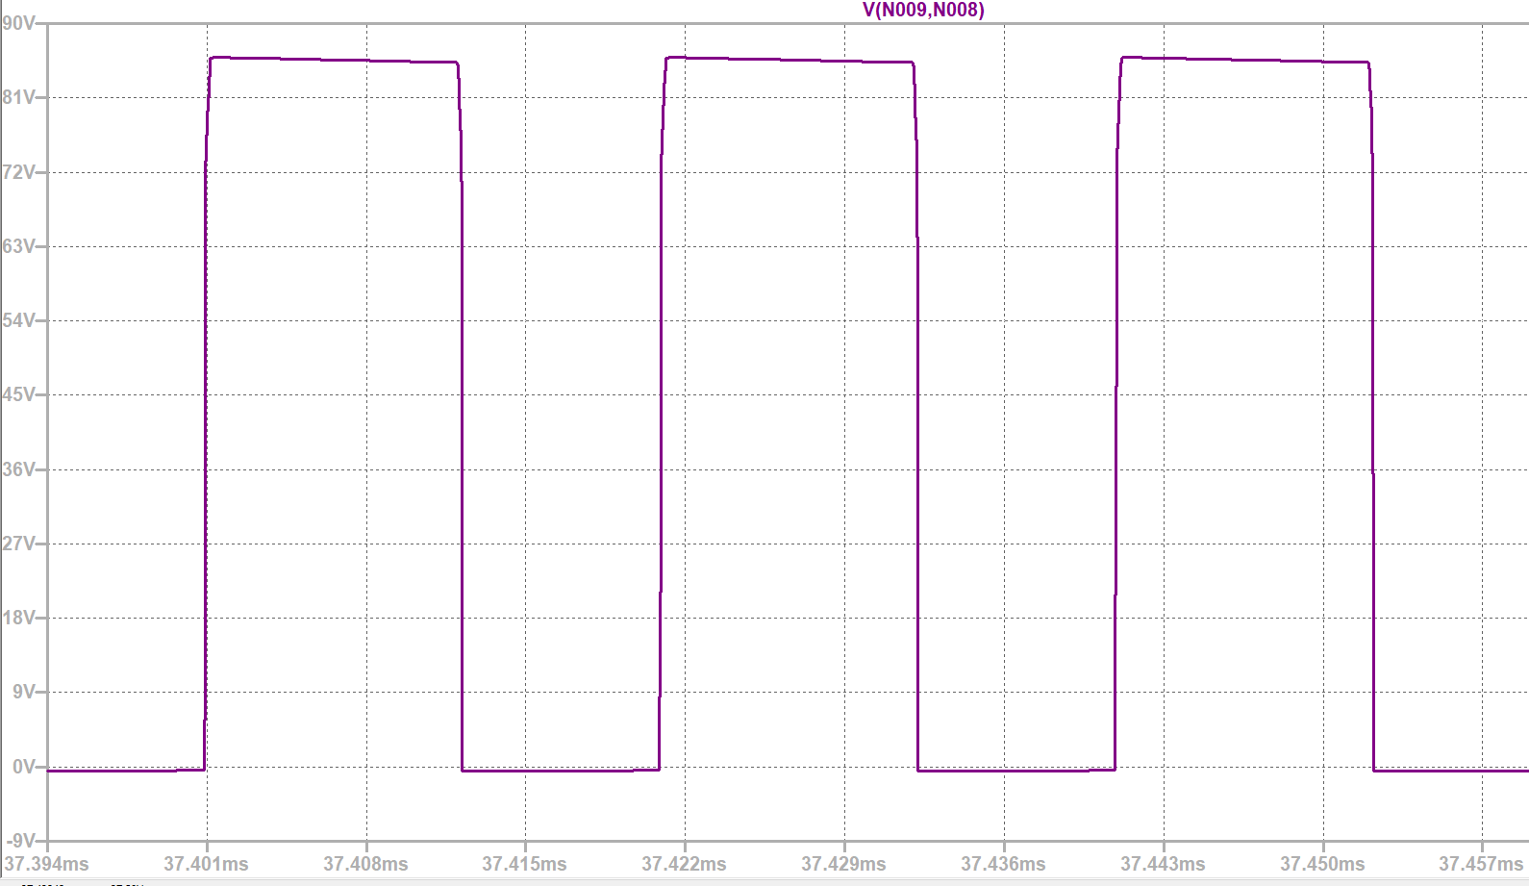
Simulation Results(With Non-idealities)
Figure 13. Diode voltage waveform when non-idealities added.

Slide 16
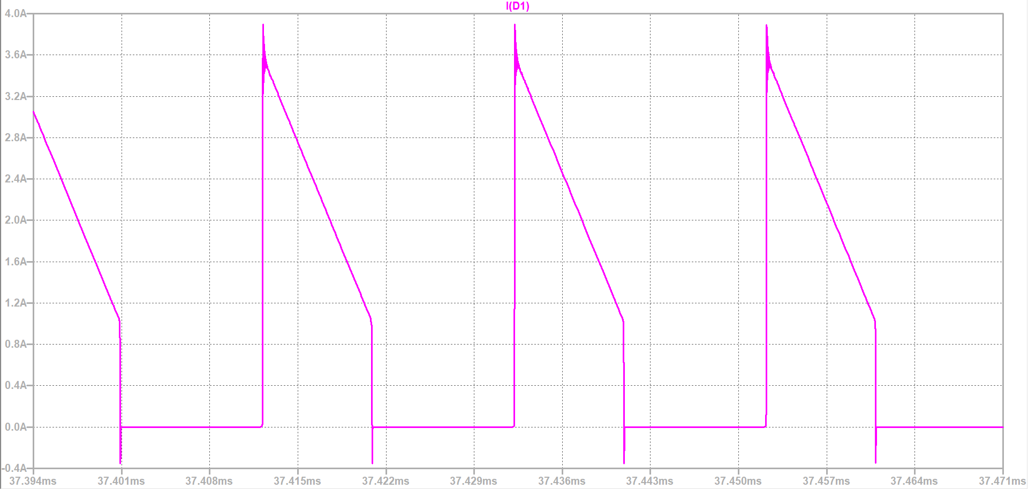
Simulation Results(With Non-idealities)
Figure 14. Diode current waveform when non-idealities added.

Slide 17
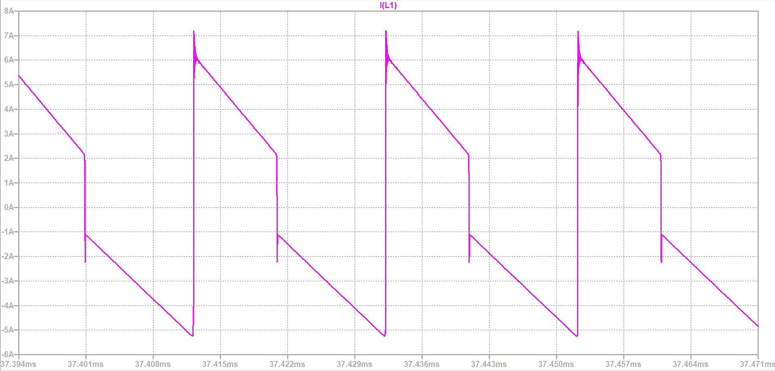
Simulation Results(With Non-idealities)
Figure 15. Transformer primary winding current waveform when non-idealities added.

Slide 18
Magnetic Design - Wire Selection
AWG 26
Max Amp. rate: | 0.361 A
Conductor diameter: | 0.4 mm
Conductor Cross-section area: | 0.128 mm²
Max. frequency for 100% skin depth: | 107 kHz
Transformer side | Assumed Current Level | # of parallel wires
Primary | 4.4 A | 12
Secondary | 1 A | 3

Slide 19
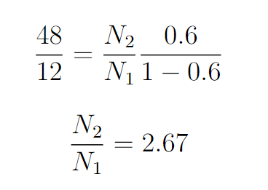
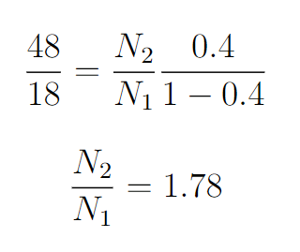
Magnetic Design - Winding Calculations
0.4<D<0.6
Preferred N1/N2 = 3.2

Slide 20
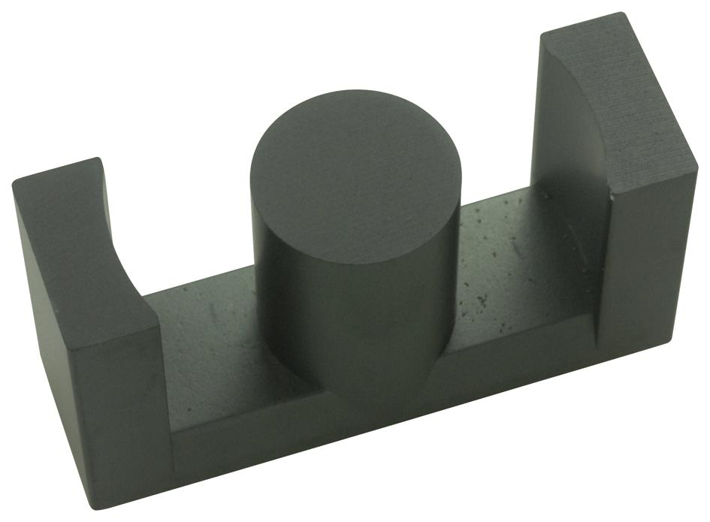
Magnetic Design - Core Selection
ETD39
Fill factor = A_{wire}/A_{e}=0.22
A_{L}= 326 nH/T²
Ferrite
Saturation B = 0.3 T

Slide 21
Magnetic Design - Inductor Design
Inductor specifications
Part no: | 0077548A7
Core material: | Kool Mu
Permeability: | 125
Inductance Ratio: | 127 nH/T²
Dimensions in mm: | 33x33x11
Calculated ESR: | 8.6 mΩ

Slide 22
Component Selection - Converter
MOSFET
Vq,max = 18 + 48*N1/N2 = 33V
Iq,on = 8A average, (+20% margin)
Parallelling is considered due to high current
2x IRFU014PBF
60V
7A
Diode
Vd,max = 48 + 18 * N2/N1 = 105.6V
Id,on = 3.6A (+20% margin)
Schottky diode is considered due to its speed
MBR10150_T0_00001
150V - 10A
Schottky

Slide 23
Component Selection - Converter
Primary Side Capacitor:
Needs to be very large
Vc,max = Vin,max = 18 V (KVL)
4A average ripple current (RMS, 10% margin)
3x 3300uF in parallel
35V
1960mA ripple current
Output Capacitor:
Moderately large
Vc,max = 48*18/12 (considering an instant change at the input)
1000uF
100V

Slide 24
Component Selection - Control
Sensors:
Isolated Delta Sigma Modulator
AMC 1306/1336
Voltage/current sensing
Gate Driver:
UCC23313B
Peak current output: 5.3 A
Output supply: 14-33 V
Digital Controller
STM32-Nucleo-F334R8
Recommonded for DC-DC converters
Easily programmable

Slide 25
Loss Analysis
Operating Conditions for Loss Calculation
Switching Frequency | 50 kHz
Duty Cycle | 0.5
Input Voltage | 16 V

Slide 26
Loss Analysis
MOSFET Conduction Losses
Diode Conduction Losses

Slide 27

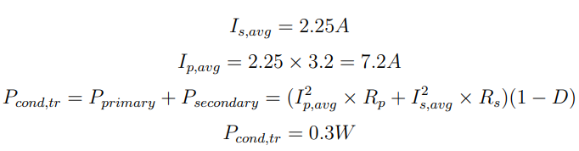
Loss Analysis
Transformer Core and Conduction Losses

Slide 28
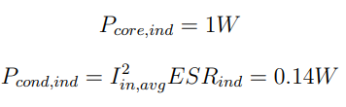
Loss Analysis
Inductor Core and Conduction Losses

Slide 29
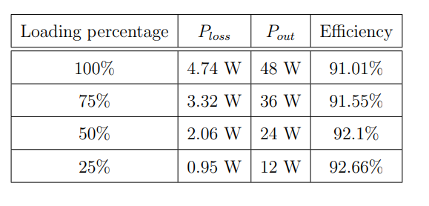
Loss Analysis
Efficiency Calculation for Different Load Cases

Slide 30
Future Works
Transformer winding
Implementing the converter on stripboard
Obtaining voltage feedback
Implementing single supply circuitry (if enough time)
PCB drawing
Implementing a case for the converter (if enough time)

