Slide 1

Task 2
By Isagani Hernandez

Slide 2
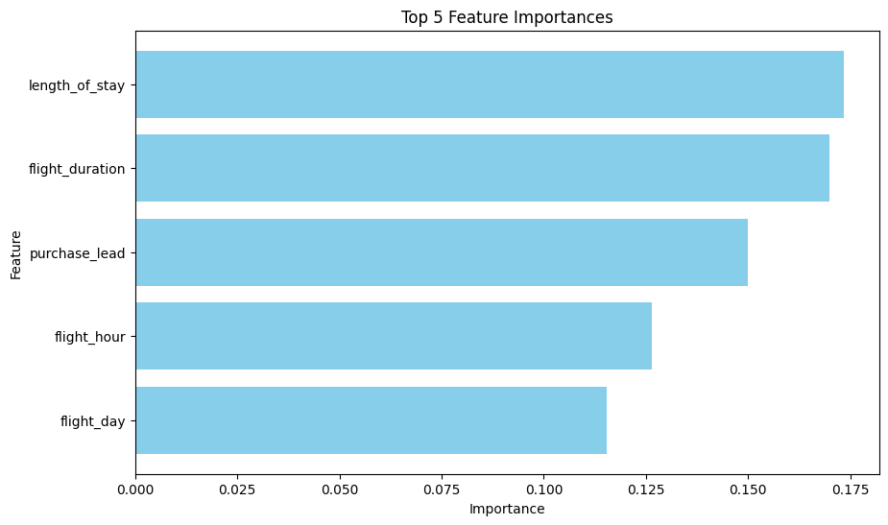
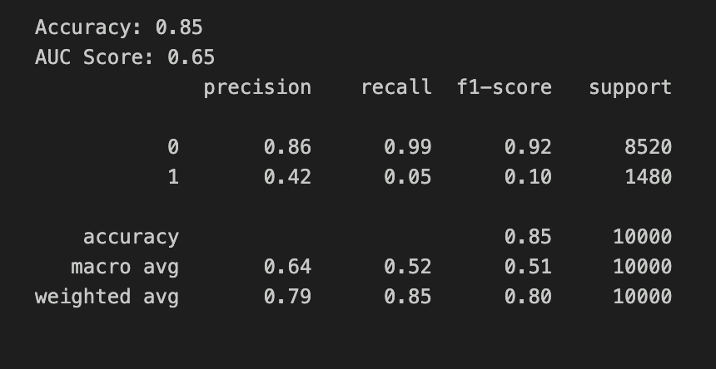
Predictive Modeling to Identify Customer Behavioral Trends
The visualization on the right depicts the top 5 important features affecting customer bookings.
The image to the left depicts the output for the Random Forest Classifier Model. Class 0 depicts incomplete bookings, while class 1 depicts the completed bookings.
The Random Forest model has an accuracy of 85% and an AUC score of 65%.

