Slide 1
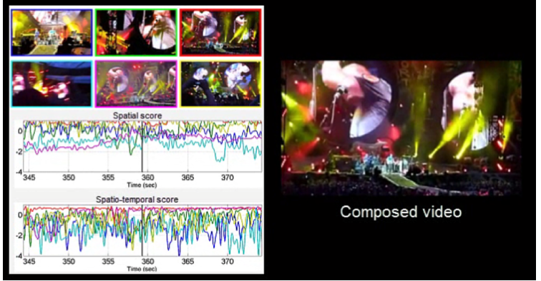
Video composition
Audio and visual-based video composition
Spatial and spatio-temporal assessments
View diversity and ranked-based camera selection
S. Bano, A. Cavallaro. ViComp: Composition of User-Generated Videos. Multimedia Tools and Applications, 2016

Slide 2

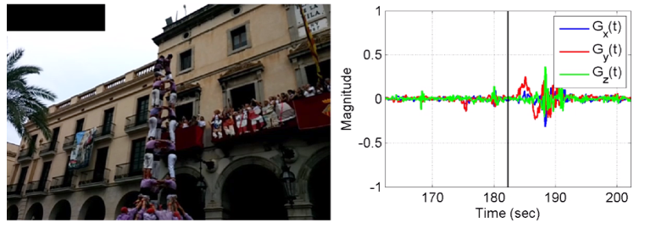
Gyro-based video analysis
x
Gyro-based camera-motion detection
Need to synchronise the gyro-visual data
Motion detection from filtered gyroscope data
Collection of 24 multi-modal UGVs using smartphones
G_{x}(t)
G_{y}(t)
z
y
G_{z}(t)
S. Bano, A. Cavallaro, X. Parra. Gyro-based camera motion detection in user-generated videos. ACM Multimedia, 2015
Notes:
Independent of object motion and lighting changes

Slide 3
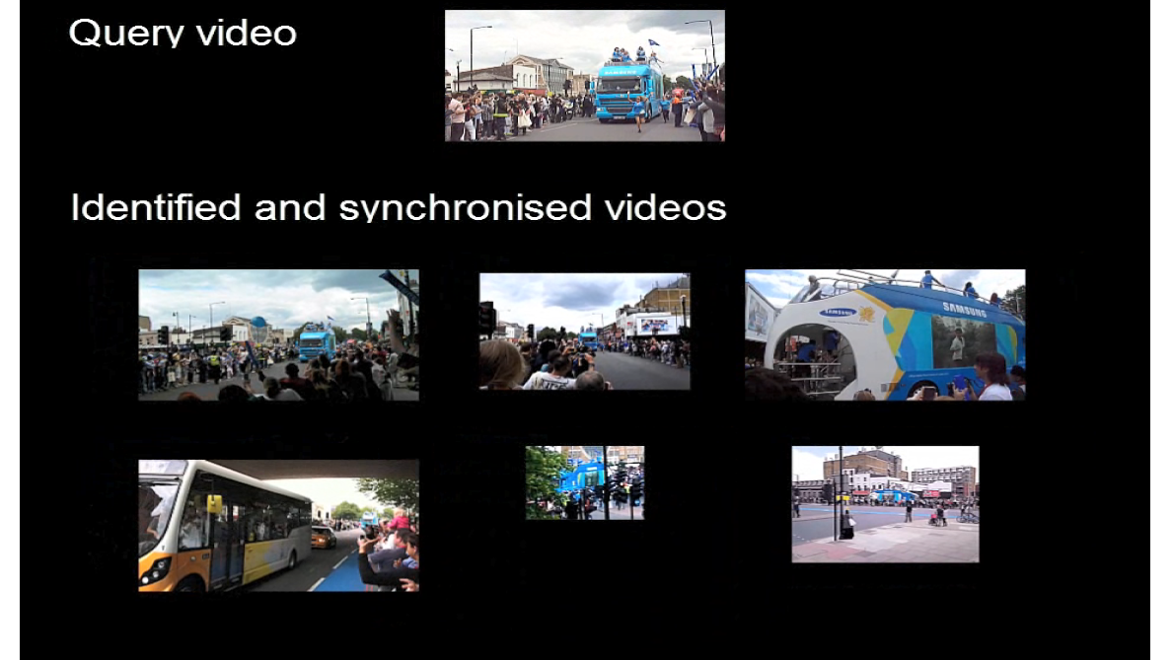
Identification and synchronisation
Develop using audio chroma feature
Match and cluster UGVs that capture the same spatio-temporal event
Estimate the time-shift for synchronisation
S. Bano, A. Cavallaro. Discovery and organization of user-generated videos of the same event. Information Sciences, 302:108-121, 2015.

