Slide 1

Excel Macros and VBA
Automate Microsoft Excel Tasks by Using Excel Macros and VBA
Kyle Pew

Slide 2
WHY MACROS AND VBA
Microsoft Excel Macros allow users to automate routine tasks saving loads of manually process and time.
Report Creation
Complex Formulas
Cleaning and Transforming Data
Excel VBA is the language used to program with Excel and create the automation.
Visual Basic for Applications
Object Oriented Programming Language

Slide 3
WHAT YOU’LL LEARN
What are Excel Macros?
How to Program Excel Using Excel VBA
Working with Excel VBA Procedures
Streamline VBA Code Using Variables
Create Logic in Your VBA Procedures
Create VBA User Interfaces with VBA UserForms
How to Interact with the User and Get User Input
Catch Potential Errors in Your VBA Code
And Much More...

Slide 4
COURSE RESOURCES
Downloadable Exercise files and Resources
QA Board to ask questions
Lifetime Access

Slide 5
WELCOME TO THE COURSE

Slide 6
PRACTICAL USES OF MACROS
Import Data
Cleaning Up and Formatting Data
Sorting and Filtering Data
Q&A

Slide 7
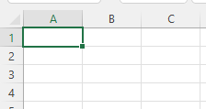
EXCEL VBA CONCEPTS
VBA is short for VISUAL BASIC FOR APPLICATIONS
VBA is an OBJECT-ORIENTED PROGRAMMING LANGUAGE
VBA procedure code is stored in MODULES
RANGE = OBJECT
PROPERTIES
ADDRESS
COLUMN
ROW
FONT
METHODS
COPY
CUT
DELETE

Slide 8
EXCEL VBA CONCEPTS
VISUAL BASIC FOR APPLICATIONS
OBJECT ORIENTED PROGRAMMING LANGUAGE
VBA PROCEDURE CODE IS STORE IN MODULES

Slide 9
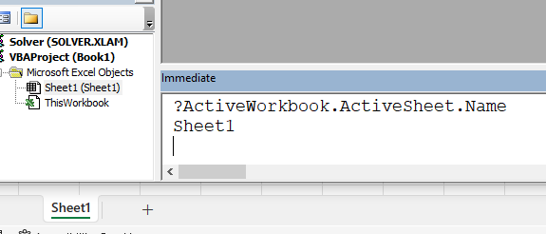
EXCEL VBA OBJECTS
Excel is a collection of various OBJECTS
Workbook, Worksheets, Charts, PivotTables, etc… are all Excel Objects
VBA allows users to communicate/manipulate Excel Objects

Slide 10
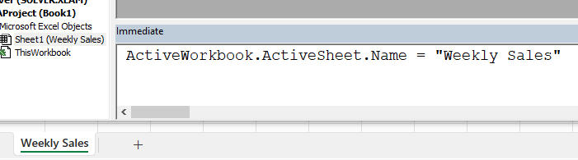
EXCEL VBA OBJECTS
Excel is a collection of various OBJECTS
Workbook, Worksheets, Charts, PivotTables, etc… are all Excel Objects
VBA allows users to communicate/manipulate Excel Objects

Slide 11
EXCEL VBA RANGE.SORT METHOD
Sorts a Range of Values
SYNTAX
expression.Sort (Key1, Order1, Key2, Type, Order2, Key3, Order3, Header, OrderCustom, MatchCase, Orientation, SortMethod, DataOption1, DataOption2, DataOption3)
Range.Sort method (Excel) | Microsoft Docs

Slide 12
CONGRATULATIONS

