Slide 1
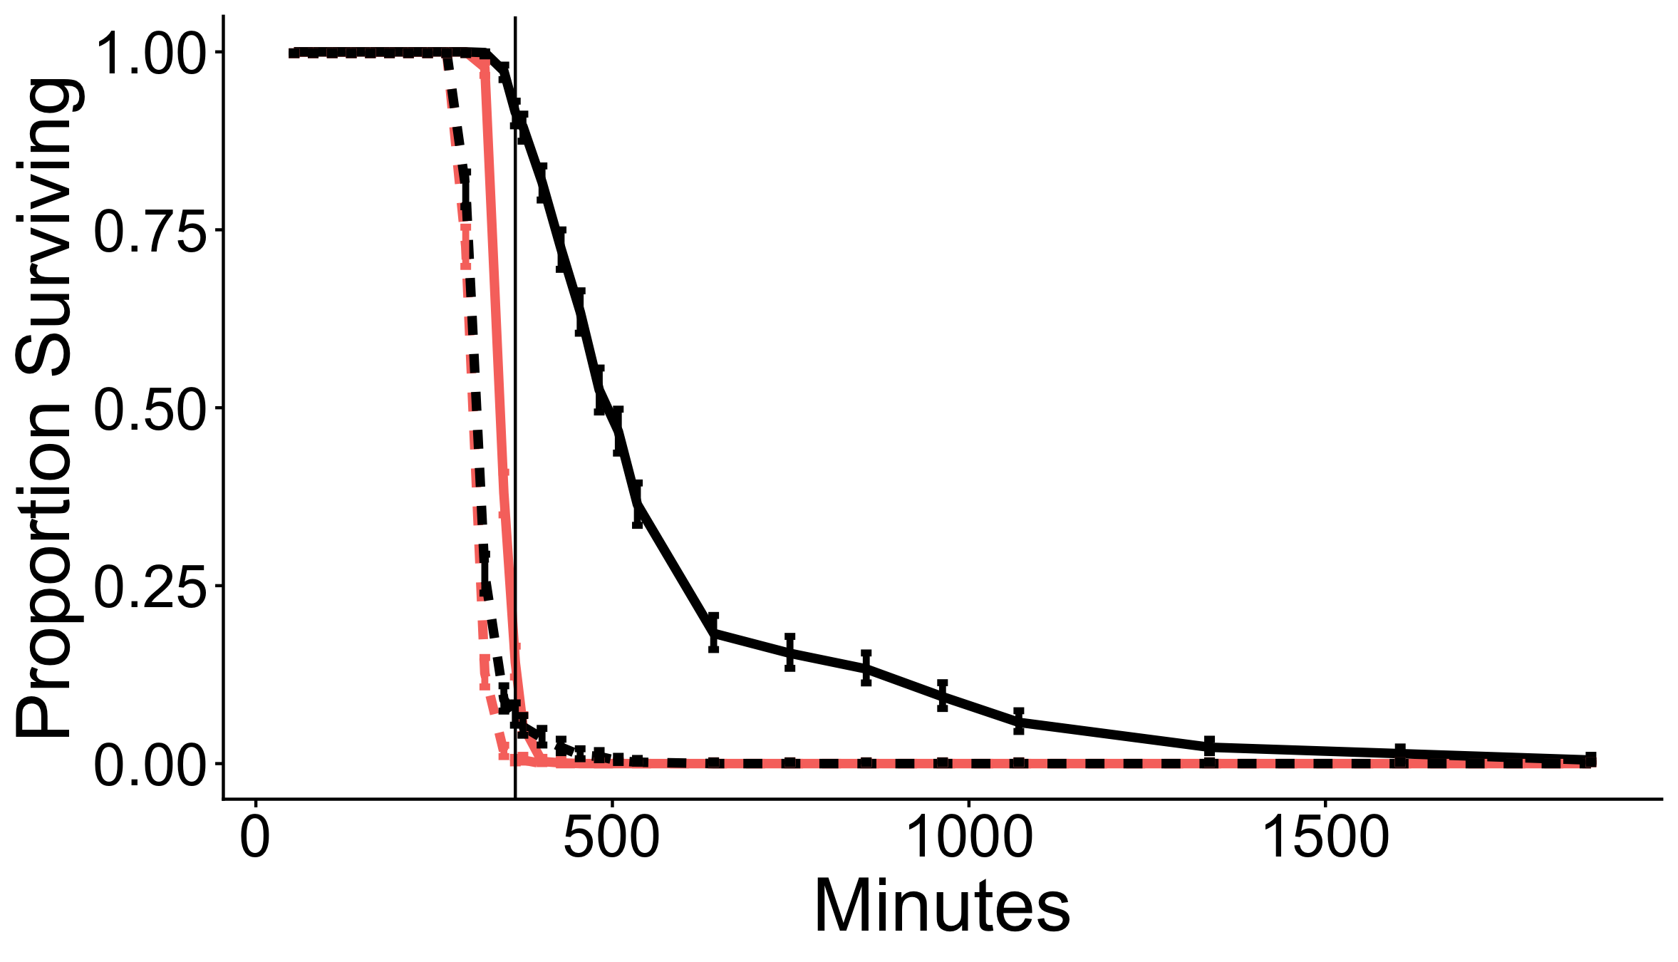
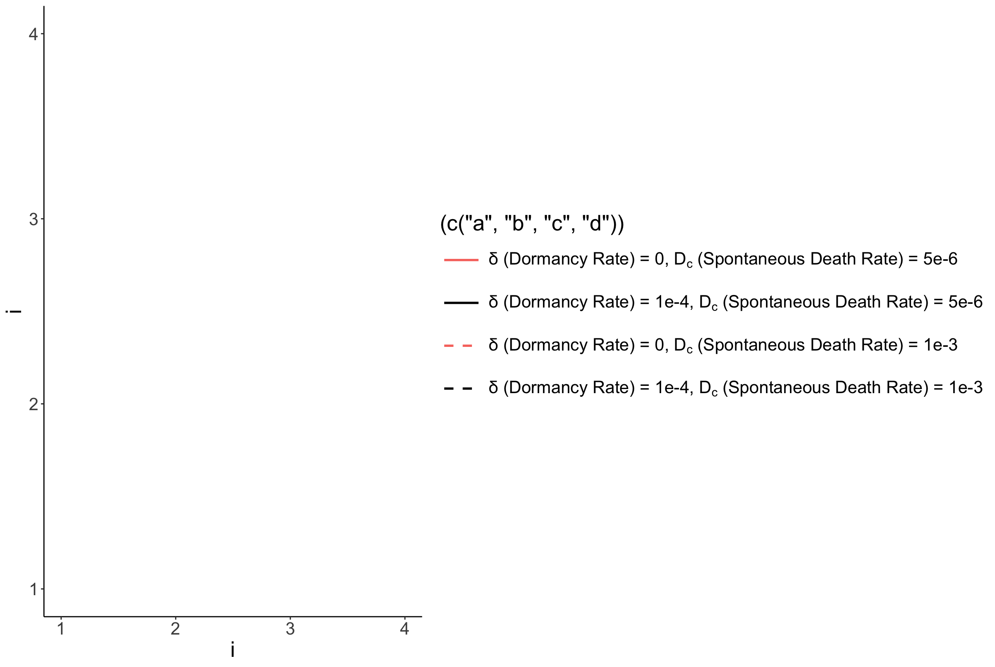
No Dormancy, default death rate
Dormancy, default death rate
No Dormancy, high death rate
Dormancy, high death rate

