Slide 1
Kickstarter Project Analysis
Isaiah Navarrete
Bana 320
Wednesday 7:00-9:45pm

Slide 2
Abstract
This research is dedicated to unraveling the mystery of Kickstarter project success, with a primary focus on discerning the pivotal factors that contribute to project triumph. The dataset comprises essential variables such as project category, currency, deadline, launch timing, funding goal in native currency, pledged amounts in native currency, project state (success or failure), backer count, project location, USD pledged, and the actual USD goal.
Central to our investigation is the project 'state' variable, serving as the label for our predictive analysis. Our primary goal is to develop a predictive model that accurately anticipates the success or failure of Kickstarter projects. By leveraging machine learning techniques, we aim to identify the underlying patterns and dependencies among the provided variables that significantly impact project outcomes.
The findings of this study hold significant implications for project creators, backers, and the crowdfunding community, offering actionable insights into the recipe for Kickstarter success. A successful predictive model can empower stakeholders to make informed decisions, optimize project planning, and enhance the overall effectiveness of crowdfunding initiatives, fostering a more resilient and prosperous crowdfunding landscape.

Slide 3
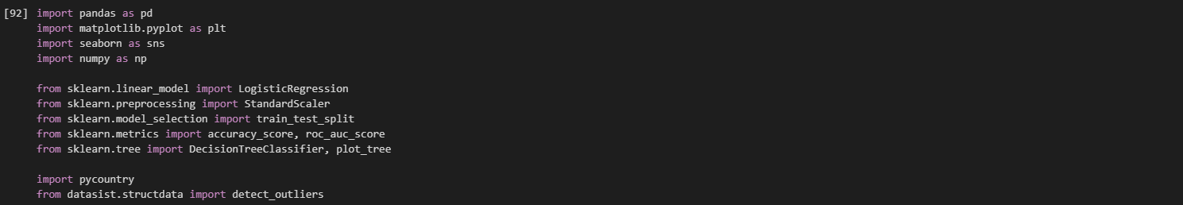
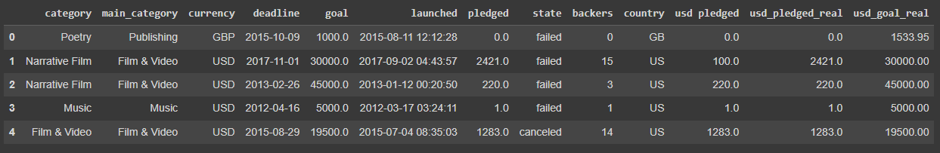
Data Exploration

Slide 4
Data Exploration
Variables:
Originally 18 variables, however, we removed redundant/ID variables
main_category
currency
deadline
goal
launched
pledged
state
backers
country
usd pledged
usd_pledged_real
usd_goal_real
Duration

Slide 5
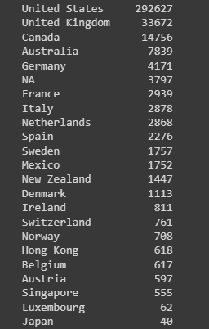


Data Exploration
We have 13 variables and 374864 entries

Slide 6
Data Exploration
The mean for Goal is about 7 times greater than our median. This indicated a positively skewed distribution.
The same pattern could be seen with USD_pledged_real.

Slide 7
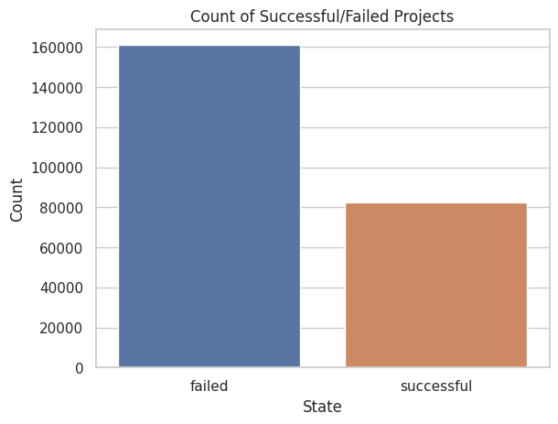
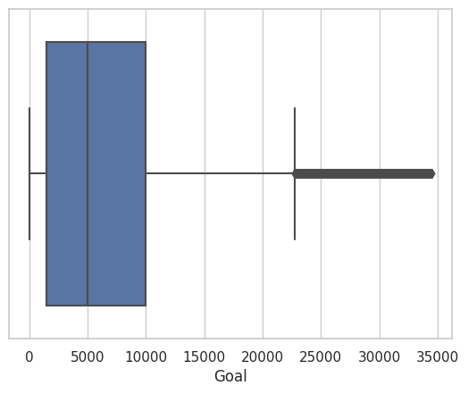
Data Exploration
Used Fences and IQR to make Box and Whisker Plot

Slide 8
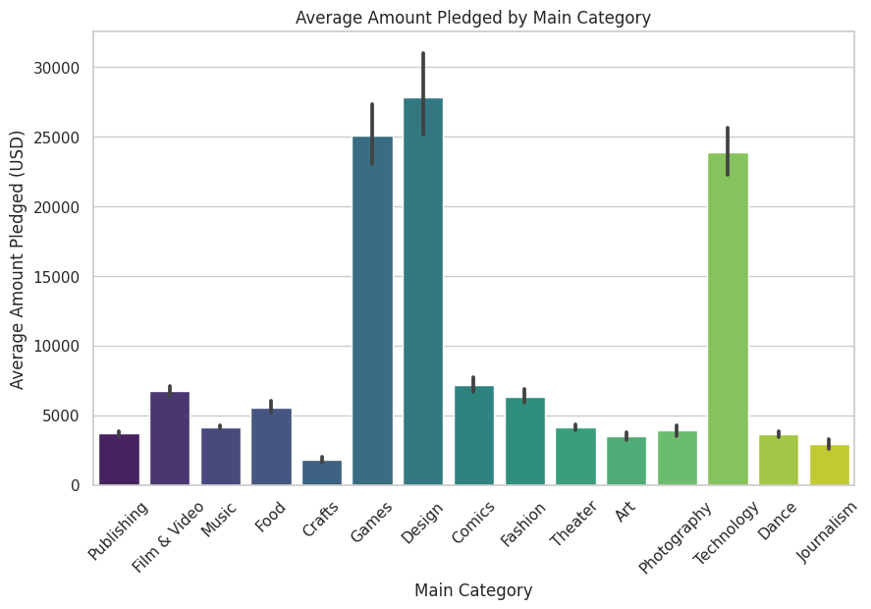
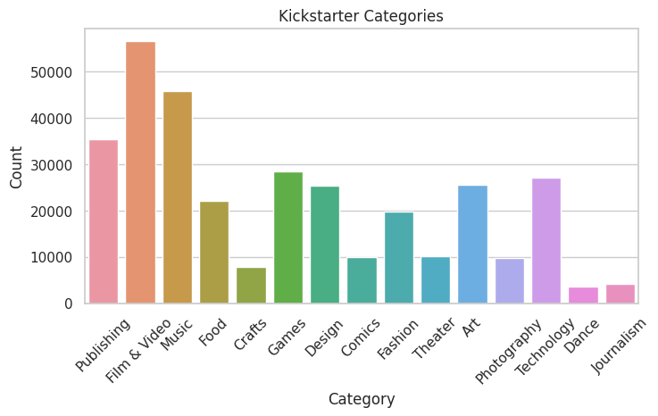
Data Exploration: What is the main category?

Slide 9
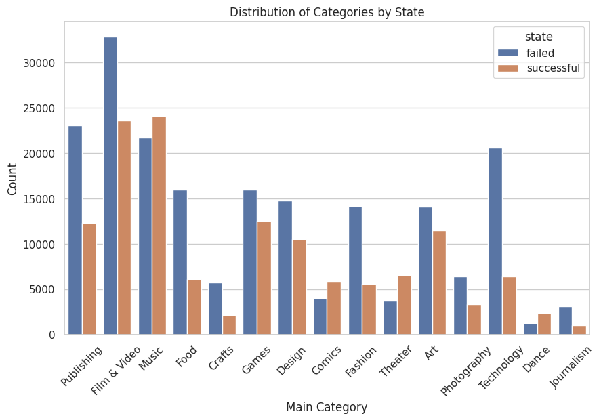
Data Exploration

Slide 10
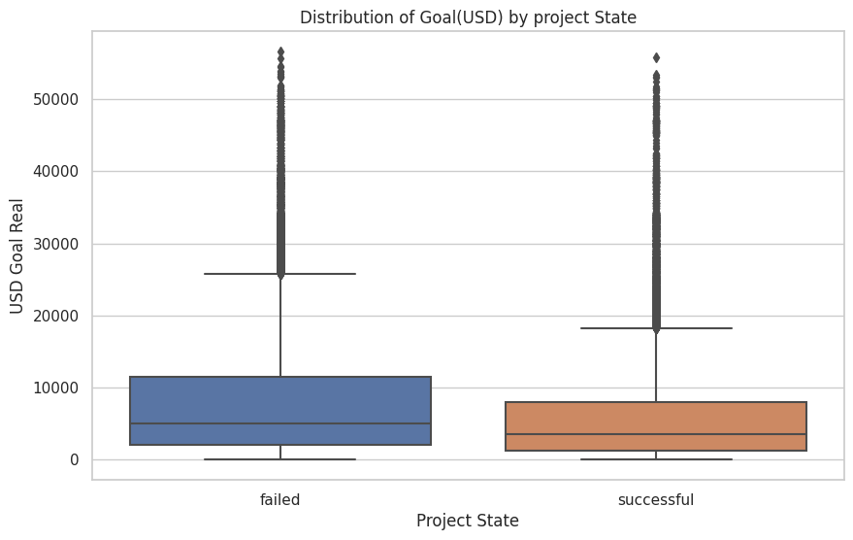
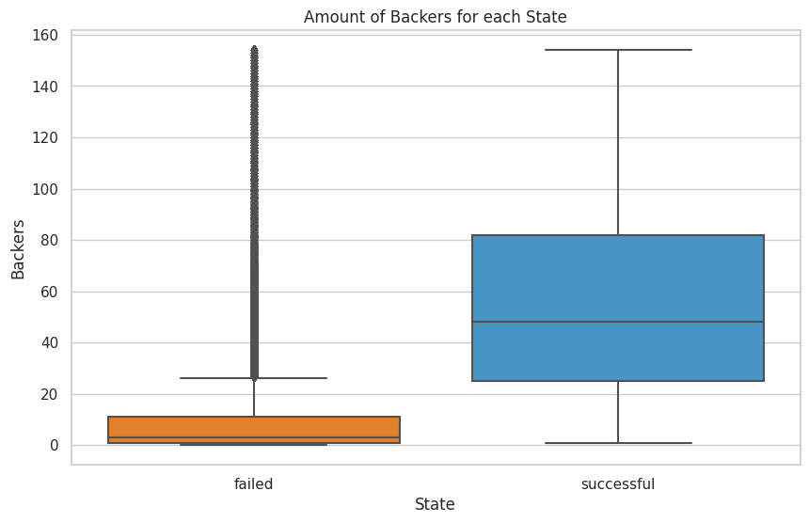
Data Exploration

Slide 11
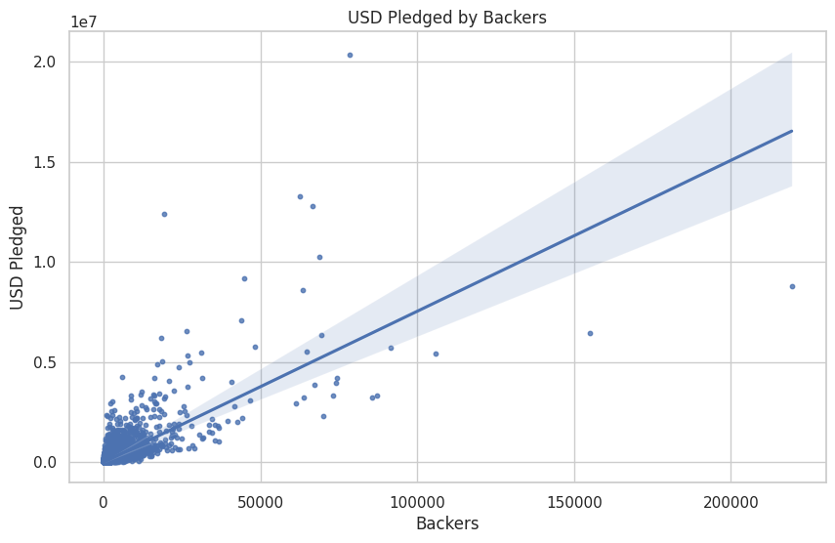
Data Exploration
Does a higher amount of backers correlate to more USD pledged?

Slide 12
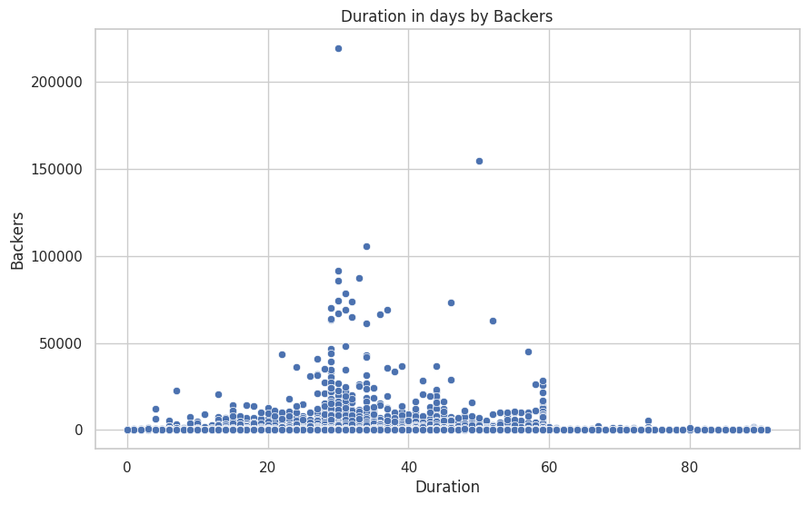
Data Exploration
Does higher duration of a project equate to more backers?

Slide 13
Data Cleaning/Preprocessing
Removed missing (NA) information (<1% of the dataset)
Standardized numeric variables
Dropped outliers (reduced to 243469 entries)

Slide 14
Creating Data Model
Separate variables into features and label
Features:
Main Category
Currency
Country
Duration
Backers
USD Goal
Label:
State

Slide 15
Creating Data Model
Split dataset into 80% training and 20% testing

Slide 16
Logistic Regression Model

Slide 17
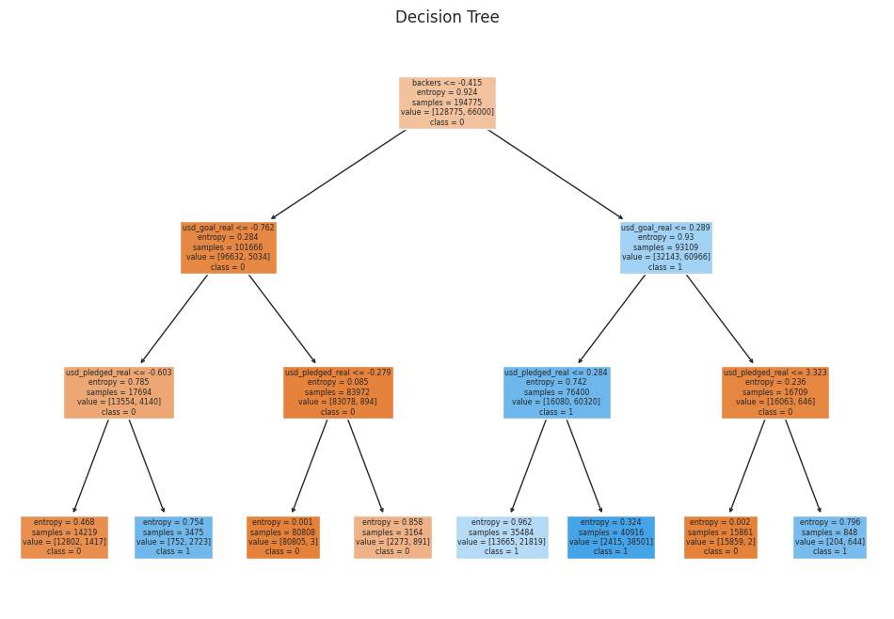

Decision Tree Model

Slide 18
Conclusion
In summary, the analysis of Kickstarter projects underscores the pivotal role of backers in determining campaign success, with a strong positive correlation between the number of backers and project outcomes. Notably, campaigns with lower funding goals exhibit a higher likelihood of success, emphasizing the significance of setting realistic targets. Surprisingly, campaign duration does not significantly influence the number of backers, suggesting that other factors, such as project appeal and community engagement, play a more substantial role. The Music category stands out as a particularly successful and popular genre, while the Technology category, despite attracting substantial funding, faces a higher risk of failure. Additionally, machine learning models, specifically logistic regression and decision trees, demonstrate potential in predicting project success, with logistic regression outperforming the decision tree in accuracy and AUC. These findings collectively provide valuable insights for creators and backers, informing strategic decisions to enhance campaign success on the Kickstarter platform.

