Slide 1



第二届体育节颁奖典礼
Award Ceremony of the Second Sports Festival of CUHK-Shenzhen

Slide 2

《每个人心中，都有一个体育梦》
Everyone Has a Sports Dream
HSS PEU

Slide 3
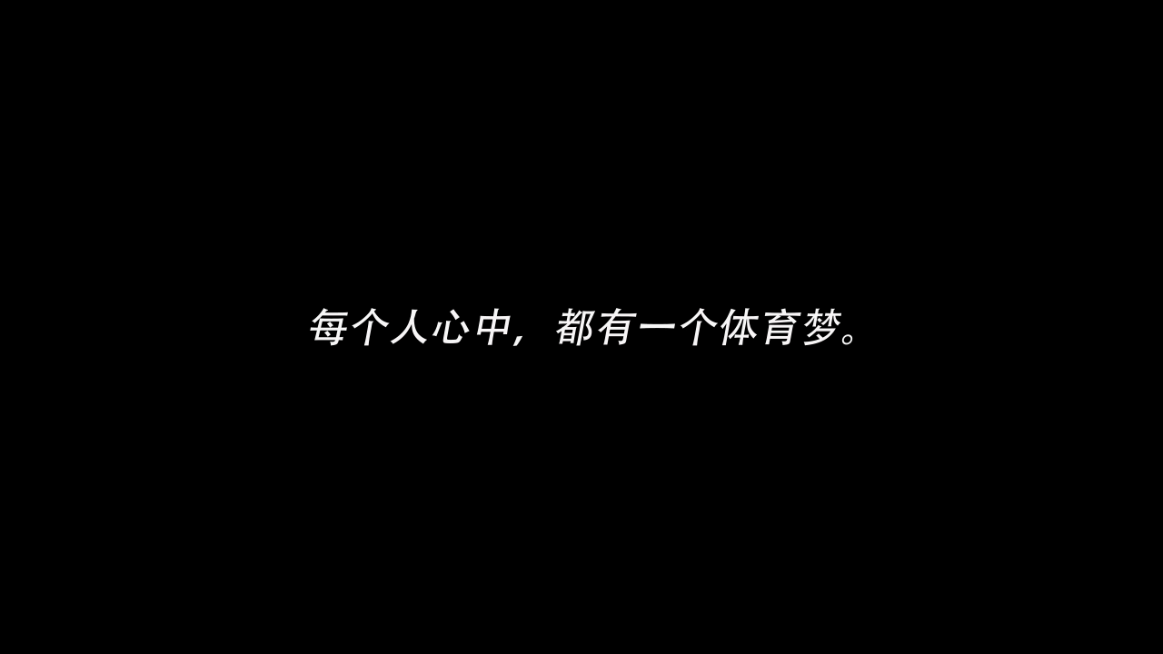

Slide 4

运动员代表发言
Speeches Given by Athlete Representatives

Slide 5
颁奖典礼
The Award Ceremony

Slide 6
环校跑
Campus Perimeter Run

Slide 7
女子组
Women’s Race
冠军: 刘秀妹 (逸夫书院)
Champion: Xiumei LIU (Shaw College)
亚军: 李雨晴 (逸夫书院)
Second Place: Yuqing LI (Shaw College)
季军: 章吉芳 (思廷书院)
Third Place: Jifang ZHANG (Muse College)

Slide 8
男子组
Men’s Race
冠军: 高廷恺 (学勤书院)
Champion: Tingkai GAO (Diligentia College)
亚军: 陈树翌 (思廷书院)
Second Place: Shuyi CHEN (Muse College)
季军: 夏丁林 (逸夫书院)
Third Place: Dinglin XIA (Shaw College)

Slide 9
定向越野
Orienteering Competition

Slide 10
小组排名
Group Ranking
冠军: 吕哲闻、王也、李昕、郑陈欣 (思廷书院)
Champion: Zhewen LÜ, Ye WANG, Xin LI and Chenxin ZHENG (Muse College)
亚军: 吕姝潼、杨卓凡、谢漪、孙元森 (思廷书院)
Second Place: Shutong LÜ, Zhuofan YANG, Yi XIE and Yuansen SUN (Muse College)
季军: 袁珮恩、曹立鹤、李文心、池家辉 (思廷书院)
Third Place: Peien YUAN, Lihe CAO, Wenxin LI and Jiahui CHI (Muse College)

Slide 11
团体排名
Team Ranking
冠军: 逸夫书院
Champion: Shaw College
亚军: 思廷书院
Second Place: Muse College
季军: 学勤书院
Third Place: Diligentia College

Slide 12
乒乓球
Table Tennis Competition

Slide 13
女子单打
Women’s Singles
冠军: 杨雨闲 (思廷书院)
Champion: Yuxian YANG (Muse College)
亚军: 徐央 (思廷书院)
Second Place: Yang XU (Muse College)
季军: 向阳 (思廷书院)
Third Place: Yang XIANG (Muse College)

Slide 14
男子单打
Men’s Singles
冠军: 陈树翌 (思廷书院)
Champion: Shuyi CHEN (Muse College)
亚军: 潘明轩 (逸夫书院)
Second Place: Mingxuan PAN (Shaw College)
季军: 季思远 (逸夫书院)
Third Place: Siyuan JI (Shaw College)

Slide 15
女子双打
Women’s Doubles
冠军: 李丹丹 支晨曦 (学勤书院)
Champion: Dandan LI & Chenxi ZHI (Diligentia College)
亚军: 宋怡凡 林羽佳 (学勤书院)
Second Place: Yifan SONG & Yujia LIN (Diligentia College)
季军: 刘逸彤 周喆媛 (思廷书院)
Third Place: Yitong LIU & Zheyuan ZHOU (Muse College)

Slide 16
男子双打
Men’s Doubles
冠军: 牛景涛 姜柏延 (思廷书院)
Champion: Jingtao NIU & Boyan JIANG (Muse College)
亚军: 韩宗益 宁述亮 (逸夫书院)
Second Place: Zongyi HAN & Shuliang NING (Shaw College)
季军: 陈睿凡 朱孔阳 (逸夫书院)
Third Place: Ruifan CHEN & Kongyang ZHU (Shaw College)
Gold Metal Silver Metal Bronze Metal

Slide 17
团体排名
Team Ranking
冠军:思廷书院
Champion: Muse College
亚军:逸夫书院
Second Place: Shaw College
季军: 学勤书院
Third Place: Diligentia College

Slide 18
羽毛球
Badminton Competition

Slide 19
团体排名
Team Ranking
冠军:学勤书院
Champion: Diligentia College
亚军:思廷书院
Second Place: Muse College
季军:逸夫书院
Third Place: Shaw College

Slide 20
网球
Tennis Competition

Slide 21
团体排名
Team Ranking
冠军:学勤书院
Champion: Diligentia College
亚军:逸夫书院
Second Place: Shaw College
季军:思廷书院
Third Place: Muse College

Slide 22
台球
Billiards Competition

Slide 23
冠军: 方冲 许高远 (学勤书院)
Champion: Chong FANG & Gaoyuan XU (Diligentia College)
亚军: 陈诗玮 邓力瑞 (思廷书院)
Second Place: Shiwei CHEN & Lirui DENG (Muse College)
季军: 刘峻佑 钟国仁 (学勤书院)
Third Place: Junyou LIU & Guoren ZHONG (Diligentia College)

Slide 24
篮球
Basketball Competition

Slide 25
团体排名
Team Ranking
冠军:逸夫书院
Champion: Shaw College
亚军:学勤书院
Second Place: Diligentia College
季军:思廷书院
Third Place: Muse College

Slide 26
排球
Volleyball Competition

Slide 27
团体排名
Team Ranking
冠军:学勤书院
Champion: Diligentia College
亚军:思廷书院
Second Place: Muse College
季军:逸夫书院
Third Place: Shaw College

Slide 28
足球
Soccer Competition

Slide 29
团体排名
Team Ranking
冠军:思廷书院
Champion: Muse College
亚军:逸夫书院
Second Place: Shaw College
季军:学勤书院
Third Place: Diligentia College

Slide 30
体育节总奖
Total Score Ranking

Slide 31
冠军:学勤书院
Champion: Diligentia College
亚军:逸夫书院
Second Place: Shaw College
季军:思廷书院
Third Place: Muse College

Slide 32
颁奖仪式结束，请移步享用茶歇 You may now enjoy a tea reception.

Slide 33
第二届体育节颁奖典礼
Award Ceremony of the Second Sports Festival of CUHK-Shenzhen

