Slide 1
MMS236 DT1 Presentation
Connecting humanity again – environmentally friendly this time!

Slide 2

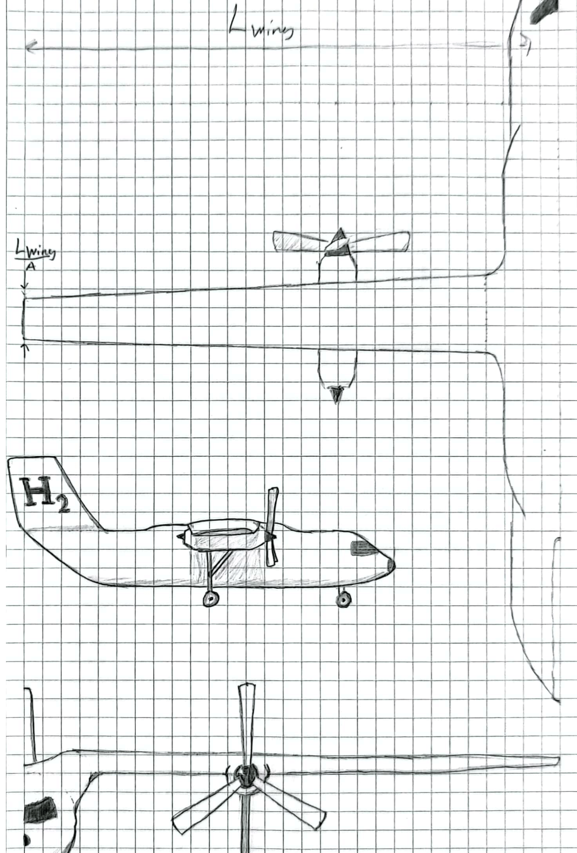
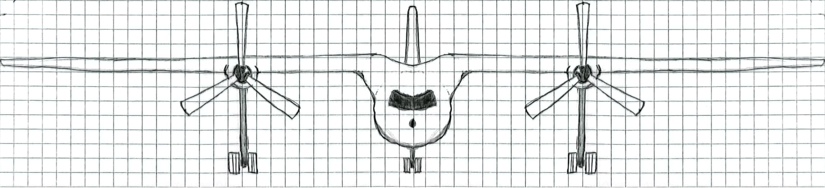
Hand-drawing concept
Turboprop – the perfect engine for the job
Top wing - allowing for a bigger propeller
Wing root tanks – an eagle needs its shoulders

Slide 3
Sizing mission
Take-off – 0.97
Climb – 0.985
Cruise – 0.916
Diversion climb – 0.985
Diversion cruise – 0.992
Loiter – 0.99
Land – 0.995
OEW/MTOW – 0.585
Fuel fraction – 0.138 (Corrected for reserve and trapped fuel, 6%)

Slide 4
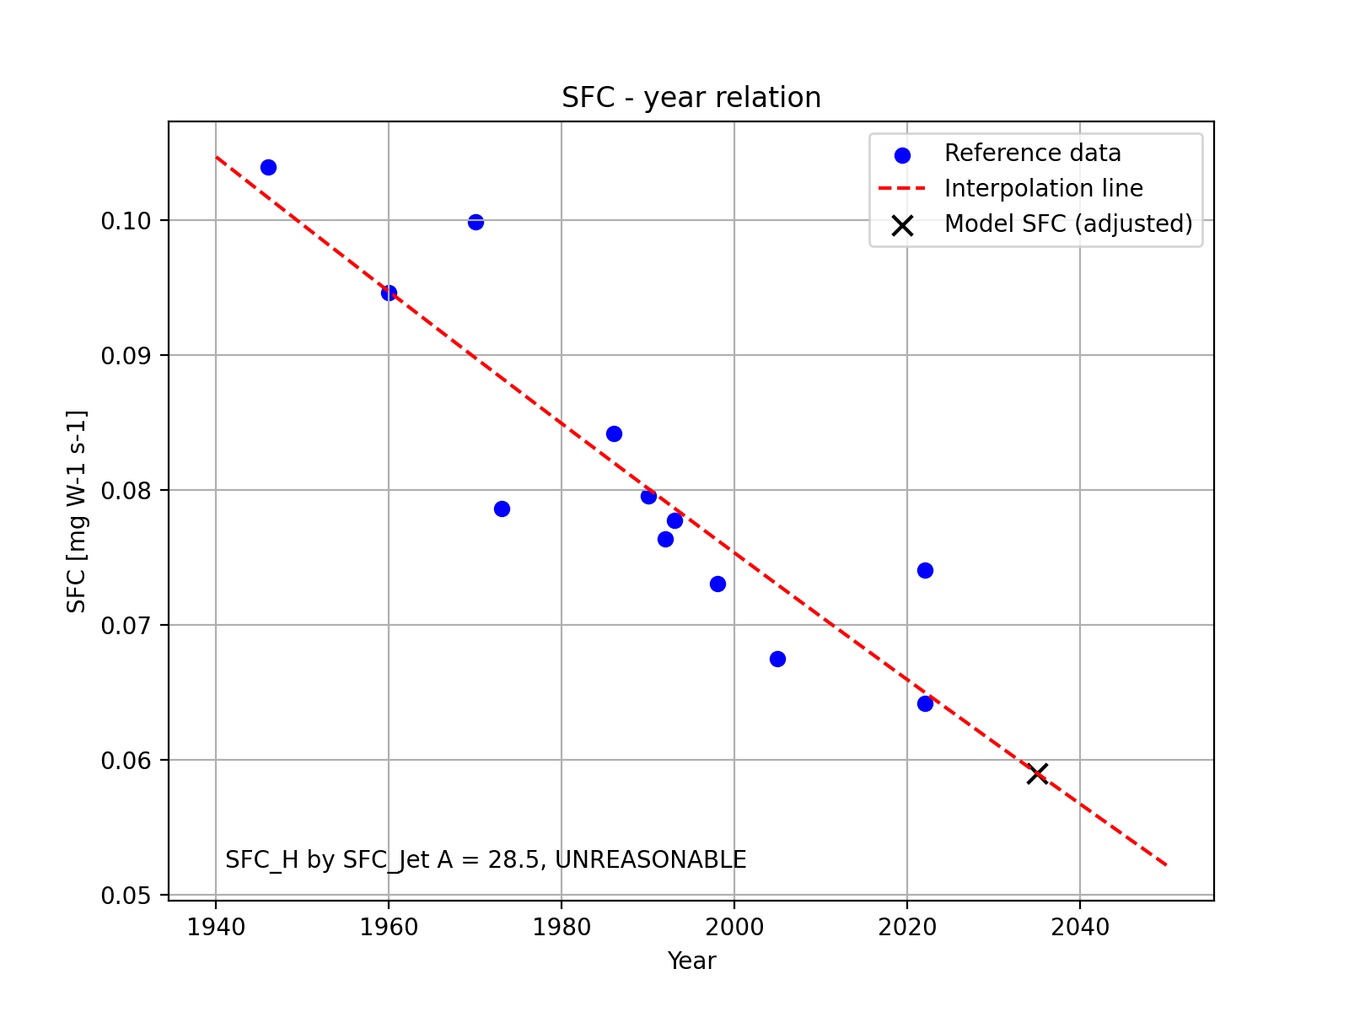
Technology Assumptions – Engine performance
SFC = 11.4 mg/Ns
Tried to do a dimensional analysis to get for hydrogen, but to no avail

Slide 5

Technology Assumptions - Aerodynamics
Based on the ATR 72 Turboprop family
Aspect ratio = 12
Swet/Sref = 6.1
L/D_max = 16.8
L/D_cruise = 16.8
L/D_loiter = 14.6

Slide 6

Technology Assumptions - Weight
$W_{e}/W_{0}$ = 0.585
Assumed a 4% improvement of $W_{e}/W_{0}$ due to technological achievements
Assumed a 12% worsening of $W_{e}/W_{0}$ due to hydrogen tanks being heavy in themselves

Slide 7
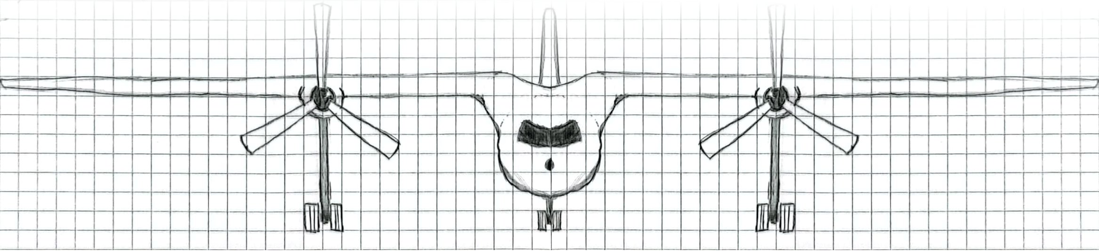

Selected concept
$W_{0}$ = 36.1 tonnes
$W_{f}$ = 5 tonnes
Tank volume = 70.4 $m^{3}$
“If I have seen further, it is by standing on the shoulders of giants.”

