Slide 1
MMS236 DT1 Presentation
Connecting humanity again – environmentally friendly this time!

Slide 2

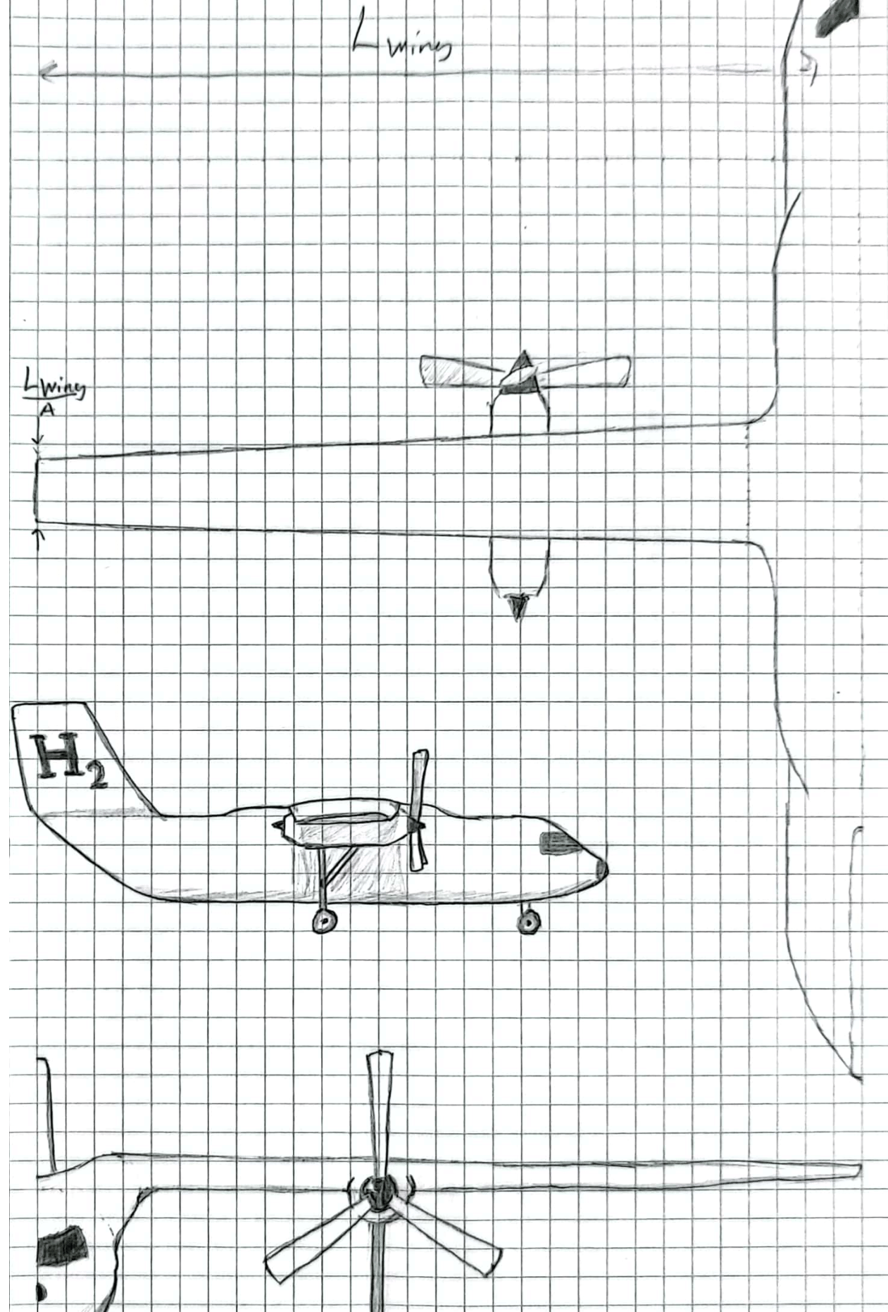
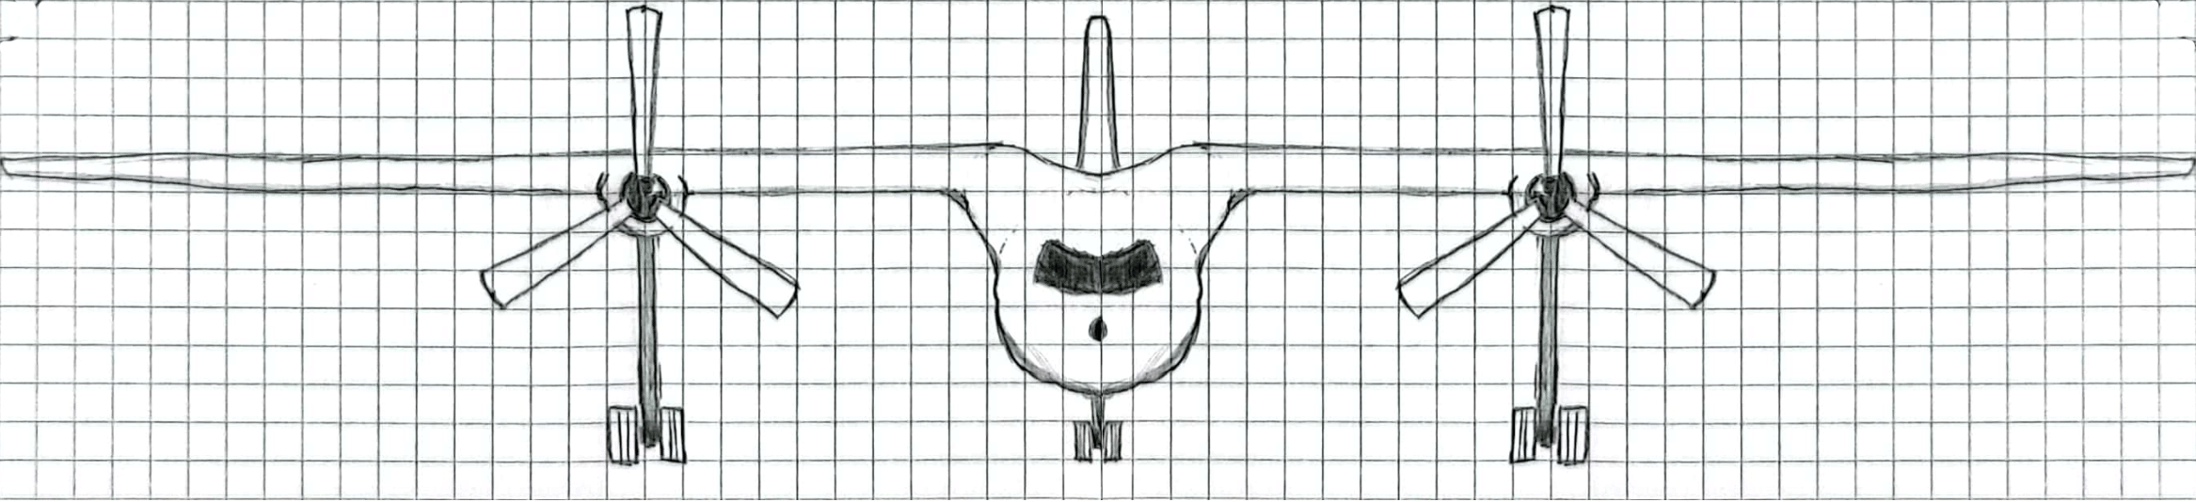
Hand-drawing concept
Turboprop – the perfect engine for the job
Top wing - allowing for a bigger propeller
Wing root tanks – an eagle needs its shoulders

Slide 3
Sizing mission
Show your sizing mission here
Take-off
Cruise
Descent
Land
Loiter
Diversion
Reserve

Slide 4
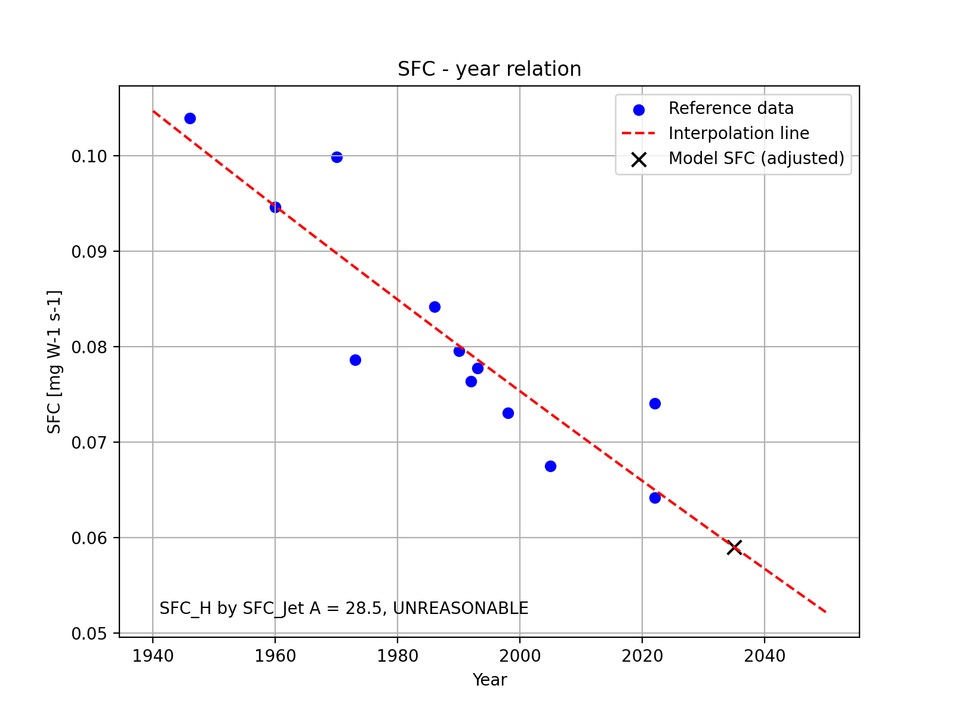
Technology Assumptions – Engine performance
SFC = 11.4 mg/Ns
Tried to do a dimensional analysis to get for hydrogen, but to no avail

Slide 5
Technology Assumptions - Aerodynamics
How will your aircraft perform?
Aspect ratio = 12
Swet/Sref = 6.1
L/D_max = 16.8
L/D_cruise = 16.8
L/D_loiter = 14.6

Slide 6

Technology Assumptions - Weight
What assumptions have you made with respect to weight improvements and how are these accounted for.
$W_{e}/W_{0}$ = 0.588
Tank mass =

Slide 7

Selected concept (Summary)
$W_{0}$ = 33.4 tonnes
$W_{f}$ = 3.81 tonnes
Tank volume =
What makes your aircraft unique?
Sell it!

