Slide 1
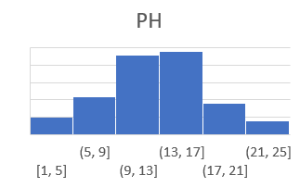
Clarifier
Auxiliaries
 | Alum | Blowdown | Backwash
Manual
Auto
Sp
PV
Alum output:
Influent Turbidity
Pump1
Pump2
Clarifier Mod Valve: 85%
Effluent Turbidity
Filter stats
 | Filter Pumps | Filter plant flow control | Filter Plant
Manual
Auto
Sp
PV

