Slide 1
TinyCRM: ML-Augmented CRM SaaS Platform
Project Defense Presentation

Slide 2
Abstract
Development of a SaaS CRM platform with ML-based lead scoring and churn prediction.
Target: SMEs in Kazakhstan with data residency compliance and low-cost deployment.

Slide 3
Problem Statement
- High CRM costs for SMEs
- Lack of data residency compliance
- No built-in ML intelligence in affordable CRM tools
- Complex deployment requirements

Slide 4
Objectives
O1 Literature review
O2 CRM system analysis
O3 Backend API design
O4 ML model development
O5 Frontend SPA
O6 Deployment & evaluation

Slide 5
Literature Review
- CRM theory: operational, analytical, collaborative CRM
- SaaS architecture patterns (monolith-first)
- ML for lead scoring and churn prediction
- Importance of SHAP interpretability

Slide 6
Methodology
- Design Science Research (DSR)
- Phased development model
- Requirements via MoSCoW method
- Cross-validation ML evaluation

Slide 7
System Architecture
Three-tier architecture:
- Vue.js frontend, nginx reverse-proxy
- FastAPI backend, joblib for ML
- PostgreSQL database

Slide 8
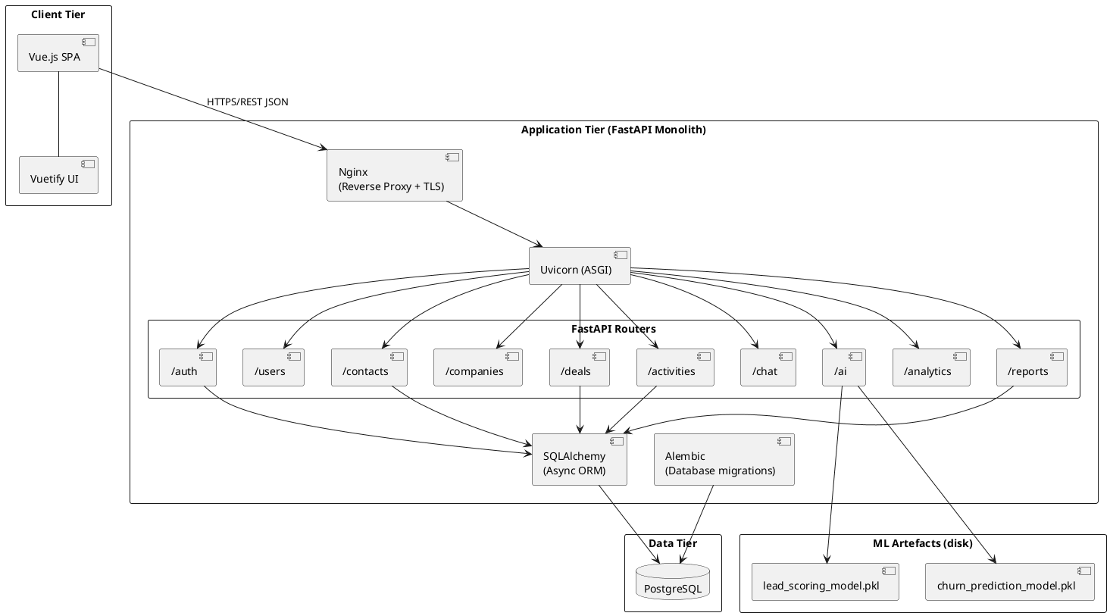
System Architecture

Slide 9
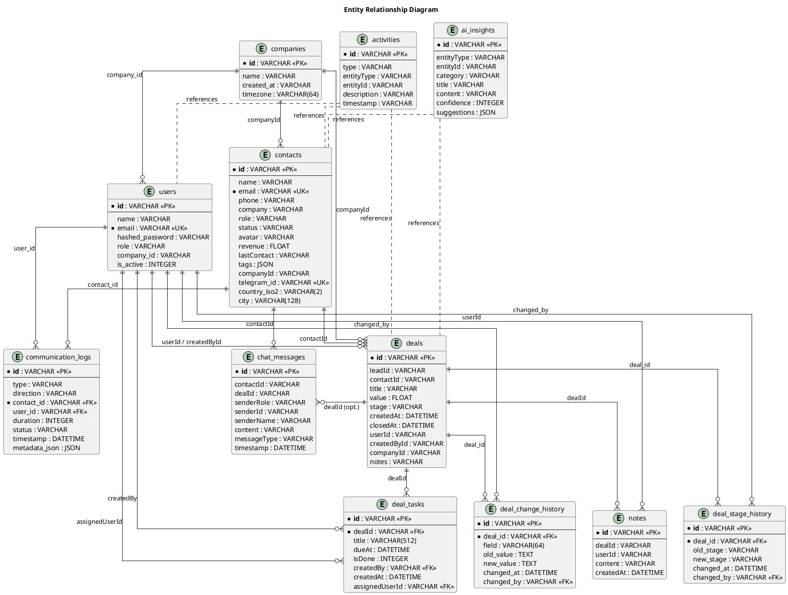
System Architecture

Slide 10
Machine Learning Models
- Lead Scoring: Gradient Boosting / HistGradientBoosting
- Churn Prediction: Random Forest / Boosting
- Features: activity, engagement, tenure, revenue
- SHAP explanations included

Slide 11
Results
Lead Scoring:
- F1 ≈ 0.93
- AUC ≈ 0.98
Churn Prediction:
- F1 ≈ 0.63
- AUC ≈ 0.83

Slide 12
Discussion
- Strong ML performance on held-out data
- Behavioural features most predictive
- Limitation: non-Kazakhstani datasets
- Good architectural scalability

Slide 13
Deployment & Tech Stack
- FastAPI + SQLAlchemy
- Vue.js 3 + Vuetify
- Docker Compose deployment
- Serverspace.io (Almaty) hosting

Slide 14
Conclusion & Future Work
- Successful ML-integrated CRM MVP
- Meets SME requirements in Kazakhstan
- Future: microservices, real local datasets, NLP (Kazakh)
- Expand integrations (WhatsApp, email automation)

