Slide 1
2. The Systems Development Life Cycle
(SDLC)

Slide 2
The System Development Life Cycle (SDLC)
It was started in the 1960s and 1970s as the first documented approach to computer systems development. All the stages of the development system are thought about, planned, monitored and Completed.
SDLC is the process by which an Information System comes to life and maintains its usefulness to a business as it moves from inception to replacement.
SDLC is a systematic approach to solving business problems.

Slide 3
System Development Challenges
Critical Success Factors for Systems Development:
  effectively meet the stated business needs
  build a flexible and maintainable system
  build a reliable system
  produce a system on time and within budget
1-<number>

Slide 4
The Systems Development Process (Overview)
The system development process
comprises of :
1. Techniques
2. Methods
3. Strategies.

Slide 5
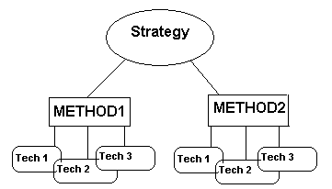

Slide 6
Techniques and Methods
Techniques: Are designed to do a particular task within the analysis and design process. Several techniques may be applied for a given method/methodology /approach.Examples include: Data flow diagrams, Flow charts, Logical data structures, Context diagrams, Decision tables, Gantt charts, Tree diagrams.
Methods/Methodology
  A system analysis method embodies a number of techniques each chosen for its appropriateness to a particular task within a method/ methodology. Several methods May be combined for a given computer systems development strategy.

Slide 7
SDLC phases
Many organisations and many authors use different terminology for the phases of the SDLC
However essentially the same activities are performed
Refer to examples of other terminology

Slide 8
System Development Life Cycle
(Kendall & Kendall terminology)
Investigation
  Identify problems and opportunities
Determine requirements
Analysis
Design
Develop software
System Test
Implement and evaluate

Slide 9
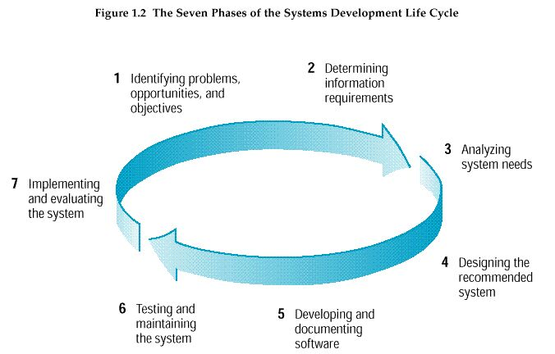
System Development Life Cycle
(Kendall & Kendall terminology)
CSC 2202 Systems Analysis and Design

Slide 10
Phase 1
Identifying: Problems, Opportunities and Objectives.
Personnel involved: Analyst, User and system management.
Work products:-
  Statement of scope and objectives.
  preliminary investigation report
1-<number>

Slide 11
Problem Solving Frame-work:
P the need to improve performance
I the need to improve information (and data)
E the need to improve economics, control costs, or
increase profits
C the need to improve control or security
E the need to improve efficiency of people and
processes
S the need to improve service to customers, suppliers, partners, employees, etc.
1-<number>

Slide 12
Phase 2
Determining information requirements:
Here a number of tools of Data collection/ gathering are used, like:-
  Gather systems/operating documents, Use questionnaires.
  Observe the system and personnel involved, interviews and
  Research
  Historical documents
  N.B: Learn the who, what, where, when, and how, and the why for each of these.
  Personnel involved: Analyst, User management, User operations workers and Systems management.
Work Product: Information Requirements Specification
1-<number>

Slide 13
Phase 3
Analyzing system needs:
  Create data flow diagrams.
  Document procedural logic for data flow diagram processes.
  Complete the data dictionary.
  Make semi-structured decisions.
  Prepare and present the system proposal.
  Recommend the optimal solution to management.
    Personnel involved: Analyst, User management and Systems management.
    Work Product: System Requirements Specification (SRS)
1-<number>

Slide 14
Phase 4
Designing the recommended system:
  Design the user interface. (Design output and Design input)
  Design system controls.
  Design files and/or database.
  Produce program specifications.
  Produce decision trees or tables.
1-<number>

Slide 15
Phase 4 (Cont..)
Questions to answer:-
  How can the user requirements understood in analysis stage be translated into an information system?
  And What technologies will be used for construction and Implementation?
  Personnel involved: Analyst, System designer, User management, User operations workers and Systems management.
The Work product:- Systems Design Specification – (SDS)
  Purpose is to satisfy all documented requirements
  Identify all outputs, inputs, files, manual procedures, & application programs
  Avoid misunderstanding through manager and user involvement

Slide 16
Programming and Design Aim
Design aim must ensure that the system is:
  Accurate • Implementable
  Maintainable • Acceptable
  Timely • Flexible
  Robust • Economic
  Efficient • Secure
  Compatible • Portable

Slide 17
Phase 5
Developing and documenting software:
  Design computer programs using structure charts and pseudo-code.
  Walkthrough program design.
  Write computer programs.
  Document software with help files, procedure manuals, and Web sites with Frequently Asked Questions.
  Personnel involved: Analyst, System designer, Programmers, and Systems management.
1-<number>

Slide 18
Phase 6
Testing and maintaining the system:
  Test and debug computer programs.
  Test the computer system.
  Enhance system.
  Personnel involved: Analyst, System designer, Programmers, and Systems management.
Sign-Off document - signed by Customer Coordinator
1-<number>

Slide 19
Phase 7
Implementing and evaluating the system:
  Plan conversion: run programs to convert files into new format
  Train users.
  Purchase and install new equipment.
  Convert files.
  Install system : critical system transition to production
      Options for installation are:
      Cutover can be abrupt
      Operate old and new systems in parallel
      (for 2 weeks)
      Phase in new system, over time
      Install version of the system
1-<number>

Slide 20
Phase 7 (Cont….)
  Review and evaluate system.
    team review of project, for benefit of future projects
  Personnel involved: Analyst, System designer, Programmers, User management, User operations workers and Systems management.
  End product is Complete functioning information system
Post implementation review and evaluation
  evaluate how well the system is working
  to what extent are project benefits being achieved?

Slide 21
System Maintenance
System maintenance is:
  Removing undetected errors, and
  Enhancing existing software.
Time spent on maintenance typically ranges from 48-60 percent of total time.
Ensure customer changes to the system:
  retain quality
  adhere to standards and procedures
Now back at the beginning of the SDLC
Size of maintenance change will determine whether all (or subset of) phases of the system Development Life Cycle are required
1-<number>

Slide 22
SDLC phases
The phases of the SDLC are described
Differently depending on the author:
Kendall & Kendall terminology
Shelly terminology
Powers et al terminology
Etc.

Slide 23
Read more on:
Life-Cycle Models
The waterfall model
The spiral model
Rapid application development
Joint application development
The V model

Slide 24
Rapid Application Development
Rapid Application development (RAD) is an object-oriented approach to systems development.
Emphasizes speed of development through extensive user involvement in the rapid, iterative, and incremental construction of series of functioning prototypes of a system that eventually evolves into the final system.
  Prototype – a small-scale, representative, or working model of the users’ requirements or a proposed design for an information system.
1-<number>

Slide 25
CASE Tools
  CASE tools are automated, microcomputer-based software packages for systems analysis and design.
  Four reasons for using CASE tools are:
    To increase analyst productivity.
    Facilitate communication among analysts and users.
    Providing continuity between life cycle phases.
    To assess the impact of maintenance.
1-<number>

Slide 26
CASE Tools
Computer-aided systems engineering (CASE) – the use of automated software tools that support the drawing and analysis of system models and associated specifications. Some CASE tools also provide prototyping and code generation capabilities.
  CASE repository – a system developers’ database where developers can store system models, detailed descriptions and specifications, and other products of system development. Synonyms include dictionary and encyclopedia.
  Forward engineering – a CASE tool capability that can generate initial software or database code directly from system.
  Reverse engineering – a CASE tool capability that can generate initial system models from software or database code.
1-<number>

Slide 27
CASE Tool Categories
CASE tools may be divided into several categories
  Upper CASE (also called front-end CASE) tools, used to perform analysis and design.
  Lower CASE (also called back-end CASE). These tools generate computer language source code from CASE design.
  Integrated CASE, performing both upper and lower CASE functions.
1-<number>

Slide 28
Upper CASE
Upper CASE tools:
  Create and modify the system design.
  Store data in a project repository.
  The repository is a collection of records, elements, diagrams, screens, reports, and other project information.
  These CASE tools model organizational requirements and define system boundaries.
1-<number>

Slide 29
Lower CASE
Lower CASE tools generate computer source code from the CASE design.
Source code may usually be generated in several languages.
1-<number>

Slide 30
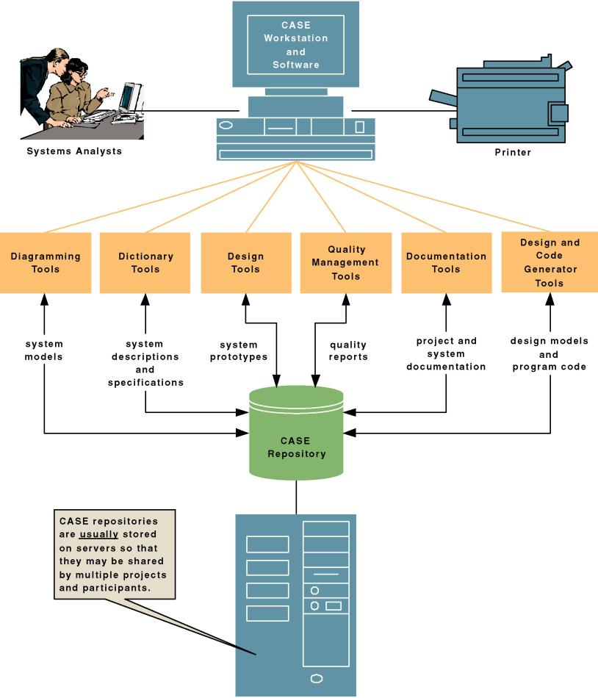
CASE Tool Architecture:
1-<number>

Slide 31
Advantages of Generating Code
  Time to develop new systems decreases.
  The time to maintain generated code is less than to maintain traditional systems.
  Computer programs may be generated in more than one language.
  CASE design may be purchased from third-party vendors and tailored to organizational needs.
  Generated code is free from program coding errors.
1-<number>

Slide 32
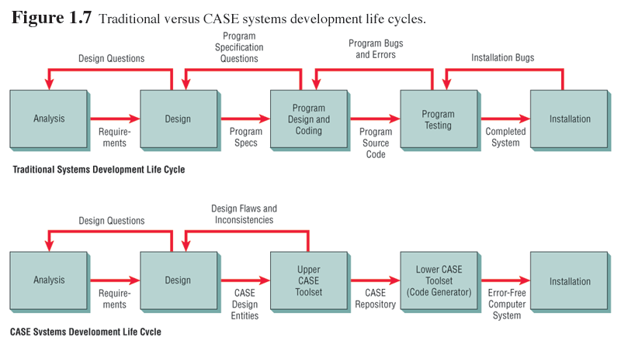
1-<number>

Slide 33
Reverse Engineering
Reverse engineering is generating the CASE design from computer program code.
Source code is examined, analyzed, and converted into repository entities.
1-<number>

Slide 34
Reverse Engineering (Continued)
Reverse engineering produces (depending on the tool set used):
  Data structures and elements, describing the files, records, and field.
  Screen designs, if the program is online.
  Report layouts for batch programs.
  A structure chart showing the hierarchy of the modules in the program.
  Database design and relationships.
1-<number>

Slide 35
Advantages of Reverse Engineering
Reverse Engineering has the following advantages:
  Reduced system maintenance time.
  Program documentation is produced for loosely documented programs.
  Structured programs may be generated from unstructured, older programs.
  Future system maintenance is easier to implement.
  Unused portions of programs may be eliminated.
1-<number>

Slide 36
Object-Oriented Analysis and Design
Is an approach that is intended to facilitate the development of systems that must change rapidly in response to dynamic business environments.
Object-oriented (O-O) analysis and design is used to build object-oriented programs.
O-O programming examines the objects of a system.
Objects are grouped into classes for optimal reuse and maintainability.
1-<number>

Slide 37
The Unified Modeling Language
The Unified Modeling Language (UML) is an industry standard for modeling object-oriented systems.
It breaks down a system into a use case model.
1-<number>

Slide 38
Extreme Programming (XP)
Extreme programming takes good software development practices and pushes them to the limit.
It is based on:
  Values.
  Principles.
  Core practices.
1-<number>

Slide 39
Extreme Programming (XP) (Continued)
Extreme programming values are:
  Communication.
  Simplicity.
  Feedback.
  Courage.
1-<number>

Slide 40
Alternate Methodologies
Alternate methodologies are available for analyzing systems.
These include:
  Prototyping.
  ETHICS.
  Project Champions.
  Soft Systems Methodology.
  Multi-view.
1-<number>

Slide 41
Principles of Systems Dev’t
Get the system users involved.
Use a problem-solving approach.
Establish phases and activities.
Document through development.
Establish standards.
Manage the process and project.
Justify systems as capital investments.
Don’t be afraid to cancel or revise scope.
Divide and conquer.
Design systems for growth and change.
1-<number>

Slide 42
Review Questions
List and describe the major stages of the systems development life cycle.
What is prototyping and what advantages does it offer in the SDLC?
Explain why the investigation phase and the initial analysis and design phases are perhaps the most critical stages of the SDLC.
Explain the systems life cycle and describe why this concept is important to systems developers.
1-<number>

