Slide 1
Feasibility Analysis

Slide 2
Learning Objectives
Determining project feasibility
Understand the purpose of a feasibility study.
Define & Describe types of feasibility

Slide 3
System Projects
Projects are initiated for 3 broad reasons:
  Problems (prevent Org from fully achieving its purpose, objectives & goals)
  Opportunities (chance to improve business in absence of specific problems) e.g sys to help increase revenue, profit & lower costs
  Directive ( new requirement imposed by mgt, Govt, or external influence)

Slide 4
Purpose & Objectives of the Survey & Study.
To Understand the current system and its problems and to determine if solving the problems would be beneficial
Survey: a preliminary investigation of the system.
Study: A more detailed investigation

Slide 5
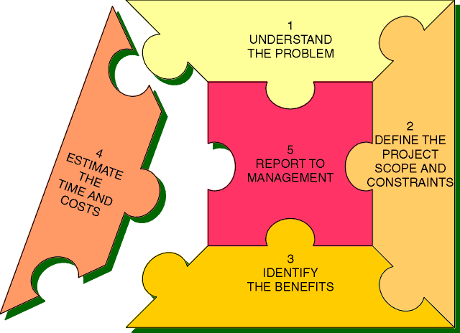
Preliminary Investigation Objectives
.

Slide 6
Terms of Reference
As part of the planning process, analysts must ensure that:
  They understand the objectives and terms of reference agreed with the client.
  They are aware of constraints that affect the analysis process.
  They plan to manage tasks in time.

Slide 7
TOR..ctd
The stated objectives of the client are usually recorded in the TOR document.
These are agreed on by the client before analysis starts.
The Mnemonic “SCOPE” summarizes the main areas included in the Terms of reference.

Slide 8
TOR…
S - System boundary (area of study + limits)
C - Constraints (factors that may restrict study)
O - Objectives (expectations of client frm project)
P - Permission (who’s the supervisor/decision maker?)
E - End products (description of deliverables)
The TOR document has to define the above
parameters.

Slide 9
Feasibility Study
Is a measure of how beneficial or practical the dev’t of an IS would be to the Organization.
Therefore a preliminary investigation is done at this stage
Once the need for an IS & its basic functionalities is established, a business case is made hence the project is justified

Slide 10
Feasibility Study
It helps the Organisation understand opportunities & limitations associated with the project.
It guides in determining whether to proceed with the project or terminate it.
It identifies important risks associated with the project that must be addressed if the project is approved.
Each Organisation has its own way of requesting for a system & feasibility analysis.

Slide 11
Purpose of Feasibility Study
Define the problem.
Set project bounds.
Identify users of the system.
Specify resources to be made available for the project.
Propose general h/w & s/w system options.
Perform a value assessment.
Assess project risks.
Recommend whether to proceed with the project or abandon it.

Slide 12
Technical Feasibility
Is the measure of the practicality of a specific IS solution & the availability of technical resources (skills, technology)
It’s the extent to which the system can successfully be designed, developed & installed.
Technical risks are assessed and the “can we build it” question answered.
Sources of risks: familiarity of members with application being developed, ignorance of business domain (new pdts are riskier than extensions of existing ones), familiarity with technology and project size (size of team, project lifespan, no of distinct features and level of integration)

Slide 13
Operational/Org’al Feasibility
Is the measure of how well the IS will work in a given environment or be accepted by users & incorporated into the Org’al operations.
Commonly done by conducting a stakeholder analysis.
Common risks: change mgt, system conforming to user needs, effects of the system on users.

Slide 14
Economic Feasibility
Is the measure of the cost-effectiveness of an IS soln. (4 gain of competitive adv.)
Sometimes called Cost/benefit analysis.
Involves analysis of costs of project & benefits associated with the system.
Values are assigned and cash flow & ROI calculated.

Slide 15
Economic feasibility ctd
Costs & benefits are identified and categorized. (read about FIG)
Categories:
  Development costs.
  Operational costs.
  Tangible benefits.
  Intangible costs & benefits

Slide 16
Economic feasibility ctd
Assign monetary values to identified costs & benefits.
Cost estimates can be made from existing information & sales projections but intangible costs & benefits can be listed without values
Determine cash flow over time (benefits should outweigh the costs for viability).
Determine ROI (measure of amt received in return for amt spent on project
= ttl bnfts/ttl costs OR (ttl bnfts – ttl costs)/ttl costs

Slide 17
Economic feasibility ctd
The NPV (net present value) is used to calculate the present value of future cash flows with the investment outlay required to implement the project.
NPV = ttl bnfts/(1+ interest rate)n

Slide 18
Techniques for Evaluating Economic feasibility
Cost benefit analysis:comparing anticipated costs & benefits
Return on Total Assets (ROTA):%age an investment earns (net income from project/ttl assets invested)
Payback Analysis:how long it’ll take org to pay back dev’t costs (original investment/avg annual ROI)
Net Present Value:time value of money (compare current costs with future costs = ttl bnfts/(1+ interest rate)n )
Break Even Analysis: evaluation of point (break even pt) when new IS becomes profitable to org.

Slide 19
Example:`Repair and maintenance business
Capital = 10,000,000 /=
In the first year will attain the following;
    Cash inflows = 6 millions
    Cash outflows = 3 millions
At a discount rate/interest rate of 10%
Calculate the following:
  Payback analysis
  Net Present Value

Slide 20
Capital = machinery, salaries, rent, utility bills (power and water)
Inflows= benefits
Outflows = costs/expenses

Slide 21
Legal feasibility: analysis of civil law to assess potential liabilities & assess possibilities of law suits in case of non-conformities with existing laws.
Ethical feasibility: analysis of whether proposed IS will conform to the norms of ethics.
Results of feasibility study are availed to the steering committee.

Slide 22
The feasibility study report
Has the following sections
Background (incl. TOR, reasons for study)
The current situation (overview of current situation, problems & reqs identified)
The proposed solution (reqs for new soln, technical, cost & operational implications described)
Costs and Benefits (comparison of costs & benefits)
Recommendations (how client should proceed)

Slide 23
Other Aspects of Feasibility Study
Volumes of data to be handled including:
  Number of users to be supported & categories (& levels of service).
  File & DB capacities the system will need to maintain.
The interface to be provided based on skills & computer proficiency of users.
Control measures to be undertaken in the system

