Slide 1
Project Management
Systems Analysis and Design
CSC:3211 (2008/2009)
By: Fiona C. Ssozi – Mugarura

Slide 2
Major Topics
Project initiation
Project scheduling
Causes of Project Failure
Project Management tools & Techniques
Manage systems analysis team members
Basic Functions of a project Manager
3-<number>

Slide 3
Project Management
IS project management is a process of directing the development of an acceptable IS at a minimum cost within a specified time frame.
This is applied during analysis, design & implementation. IS development is almost always done under the auspices of a project.
3-<number>

Slide 4
NB: the acceptability, deadline & budget criteria must all be for a project to be considered completely successful. The role of Project management is to recognize such factors to eliminate or minimize their negative effects.
3-<number>

Slide 5
Project Initiation
Systems Development Projects come from one of 3 sources:
  Problems to solve: something usually isn’t working correctly & needs fixing.
  Opportunities to exploit: for improvement through system upgrade, system alteration & installation.
  A directive/mandate: from somebody such as Government, management or organization like a labor Union or even a revenue body
3-<number>

Slide 6
Organizational Problems
Identify problems by looking for the following signs:
Check output against performance criteria
  Too many errors.
  Work completed slowly.
  Work done incorrectly.
  Work done incompletely.
  Work not done at all.
3-<number>

Slide 7
Organizational Problems (Continued)
Observe behavior of employees
  High absenteeism.
  High job dissatisfaction.
  High job turnover.
3-<number>

Slide 8
Organizational Problems (Continued)
Listen to feedback from vendors, customers, and suppliers
  Complaints.
  Suggestions for improvement.
  Loss of sales.
  Lower sales.
3-<number>

Slide 9
Project Selection
Five specific criteria for project selection:
  Backed by management.
  Timed appropriately for commitment of resources.
  It moves the business toward attainment of its goals.
  Practicable.
  Important enough to be considered over other projects.
3-<number>

Slide 10
Possibilities for Improvement
Many possible objectives exist including:
  Speeding up a process.
  Streamlining a process.
  Combining processes.
  Reducing errors in input.
  Reducing redundant storage.
  Reducing redundant output.
  Improving system and subsystem integration.
3-<number>

Slide 11
Activity Planning
Activity planning includes:
  Selecting a systems analysis team.
  Estimating time required to complete each task.
  Scheduling the project.
Two tools for project planning and control i.e. Gantt chart and PERT (Program Evaluation & Review Technique) diagram.
3-<number>

Slide 12
Estimating Time
Project is broken down into phases.
Further project is broken down into tasks or activities.
Finally project is broken down into steps or even smaller units.
Time is estimated for each task or activity.
Most likely, pessimistic, and optimistic estimates for time may be used.
3-<number>

Slide 13
Gantt Charts
Commonly used for project scheduling & progress reporting.
Easy to construct and use.
Shows activities over a period of time.
3-<number>

Slide 14
Gantt Chart
The chart is based on a 2-dimensional graph scale.
Each of the significant project tasks is listed along the vertical axis of the graph, & estimated elapsed calendar time to complete the entire project is listed along the horizontal axis.
An appropriate calendar time interval, e.g days, weeks or months, is selected for the horizontal axis
3-<number>

Slide 15
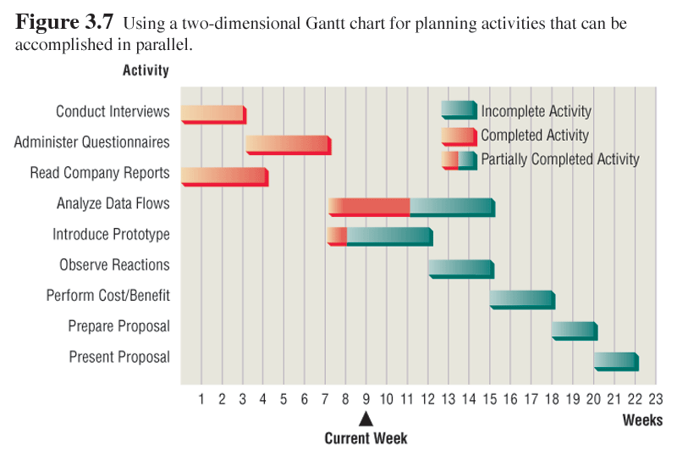
Gantt Chart Example
3-<number>

Slide 16
Gantt Chart
This chart is at its best for visually showing each of the project’s task status at any moment in time simply by drawing a vertical bar from top to bottom on the chart at the calendar time of interest.
Once drawn, a visual inspection of the shading within each of the bars on the chart gives an indication of project task status for each task.
Its useful for showing any overlapping or parallel tasks. It doesn’t clearly show task dependencies even though it does show task start & end times but it clearly shows that tasks start after others have already begun or are already finished.
3-<number>

Slide 17
Gantt Chart Strengths & Weaknesses
Strengths:
Clearly shows overlapping/parallel tasks.
Shows status of each project task at any point in time.
Weaknesses:
It cant be determined whether the entire project is on time, behind time or ahead of schedule.
Doesn’t show task dependancies.
3-<number>

Slide 18
PERT Diagram
Commonly used for project planning & modification and is a graphical representation of project tasks laid out in form of a critical path network
  PERT diagrams show precedence, activities that must be completed before the next activities may be started.
  Once a diagram is drawn it is possible to identify the critical path, the longest path through the activities.
  Monitoring critical path will identify shortest time to complete the project.
3-<number>

Slide 19
Creating a PERT Chart
Determine the duration time for each task.
Assign a task identification letter to each task.
Draw the PERT network, number each node.
Label each task with its identification letter.
Connect each node
From start to finish.
Put each task’s duration on the network.
Determine the need for any dummy tasks.
Determine the earliest completion time for each task node.
Verify the PERT network for correctness.
3-<number>

Slide 20
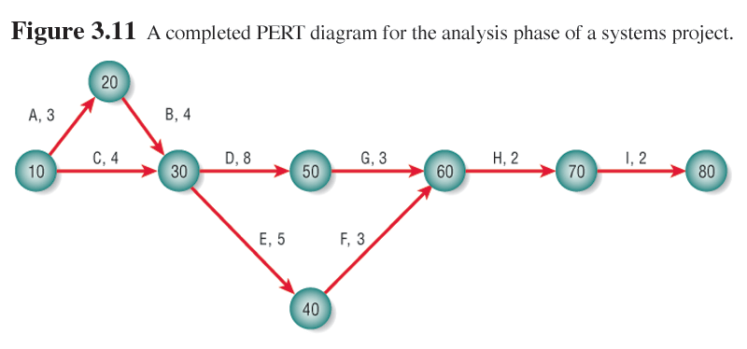
PERT Diagram Example
3-<number>

Slide 21
PERT Diagram Advantages
Easy identification of the order of precedence & task dependencies.
Easy identification of the critical path and thus critical activities
Easy determination of slack time, the leeway to fall behind on noncritical paths & focus more on the critical aspects of project-time, costs & people.
3-<number>

Slide 22
Its straight forward in its concept & supported by software.
Its continuously useful to project managers prior to and during the project.
3-<number>

Slide 23
PERT- Disadvantages
Does not deal with task overlap and assumes that tasks are followed after the preceding tasks have ended.
Tasks have to be clearly defined as well as their relationship to each other.
Its only as good as the time estimates that are entered by the project manager.
By design, the project manager normally focuses more on critical path tasks , this could be problematic for near-critical path tasks if overlooked.
3-<number>

Slide 24
Time boxing
Time boxing sets an absolute due date for project delivery.
The most critical features are developed first and implemented by the due date.
Other features are added later.
3-<number>

Slide 25
Personal Information Manager Software
Personal information manager (PIN) software is useful for scheduling activities and includes features such as:
  Telephone and fax number lists.
  To-do lists.
  Online calendars.
3-<number>

Slide 26
Team Management
Teams often have two leaders:
  One who leads members to accomplish tasks.
  One concerned with social relationships.
The systems analyst must manage:
  Team members.
  Their activities.
  Their time and resources.
3-<number>

Slide 27
Goal Setting
Successful projects require that reasonable productivity goals for tangible outputs and process activities be set.
Goal setting helps to motivate team members.
3-<number>

Slide 28
Ecommerce Project Management
Ecommerce and traditional software project management differences:
  The data used by ecommerce systems is scattered across the organization.
  Ecommerce systems need a staff with a wide variety of skills.
  Partnerships must be built externally and internally well ahead of implementation.
  Security is of utmost importance.
3-<number>

Slide 29
Causes of Project Failure:
Use of undisciplined development methodologies or approaches.
Inadequate or not understood (appreciated) development tools.
Project scope not clearly defined at start.
Use of poor or no estimating techniques e.g resource tools.
Schedule delays e.g from weather, resources, e.t.c.
3-<number>

Slide 30
Causes (ctd)
Beliefs in the mythical person-month syndrome. E.g. a manager with this mindset thinks that if 2 developers can do or finish up a project in 6 weeks, then simply adding a 3rd developer to the project will allow it to be completed in 4 weeks.
The reality is much different from this.
3-<number>

Slide 31
What constitutes a Systems development Project Failure
The organization completely abandons the project at some point prior to its implementation.
The delivered system is okay but the project was way over time & budget, therefore, defined a failure.
The delivered IS doesn’t meet the user requirements or expectations, therefore deemed a failure
3-<number>

Slide 32
Prevention of Project Failures
Project failures may be prevented by:
  Training.
  Experience.
  Learning why other projects have failed.
3-<number>

Slide 33
Functions of a Project Manager
Planning project tasks & staffing the project team: a good manager always has a plan. The manager estimates resource requirements & formulates a plan to deliver the target system. Each task required to complete the project must be planned.
Some of the planning issues include:
how much time will be required?
How many people will be needed?
How much will the task cost?
What tasks must be completed before others are started?
Can some of the tasks overlap?
3-<number>

Slide 34
Functions (Ctd)
Organizing & scheduling the project effort: members of the project team should understand their own individual roles & responsibilities as well as their reporting relationship to the project manager. The project schedule should be developed with an understanding of task time requirements, personnel assignments & inter-task dependencies
3-<number>

Slide 35
Functions (Ctd)
Directing & controlling the project: Once the project has begun, the project manager becomes the project leader. As a leader, the project manager directs the team’s activities & evaluates progress. The manager must frequently report progress to superiors. The manager’s job is to monitor tasks, schedules & costs in order to control those elements.
3-<number>

