Slide 1
Anitrack
Personal Anime Watchlist & Analytics
Web Technologies I · HSBI · May 2026
Dengfeng Qiao · Yurun Zhu · Zhaoze Yu

Slide 2
Team & responsibilities
Member | Main focus
Dengfeng Qiao | Frontend — Next.js, UI, i18n, responsive
Yurun Zhu | Backend — NestJS, MongoDB, Bee
Zhaoze Yu | API contract, tests, live demo

Slide 3
Problem & goals
Track anime: Planned → Watching → Completed
Monthly heatmap (GitHub-style)
Seasonal timetable & dashboard picks (local mirror)
API-first full-stack for course requirements

Slide 4
Course requirements ↔ solution
Content requirements: implemented. Organizational requirements: fulfilled in this presentation.
Requirement | Anitrack
NestJS backend | anitrack-backend :3001
CRUD HTTP API | /api/anime
API first | swagger.json, /api-docs
Tests | Jest, Vitest, contract-validator
Thin frontend | Logic in backend
Responsive | Mobile + desktop

Slide 5
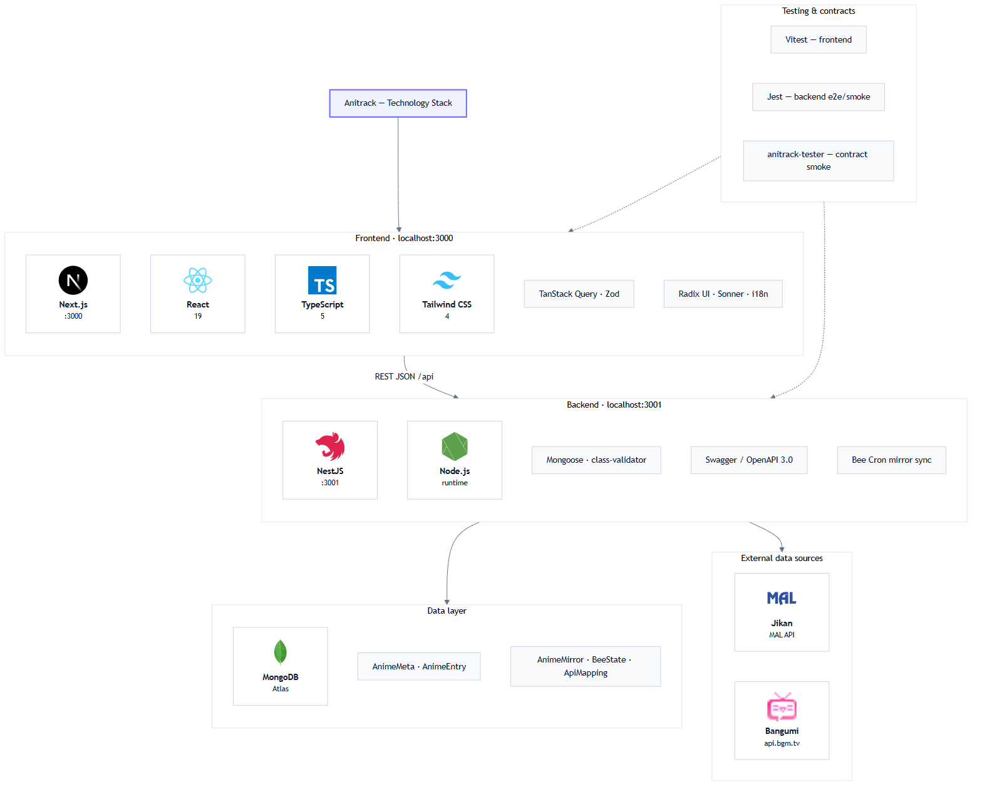
Technology stack
Frontend · Backend · MongoDB · Jikan · Bangumi

Slide 6
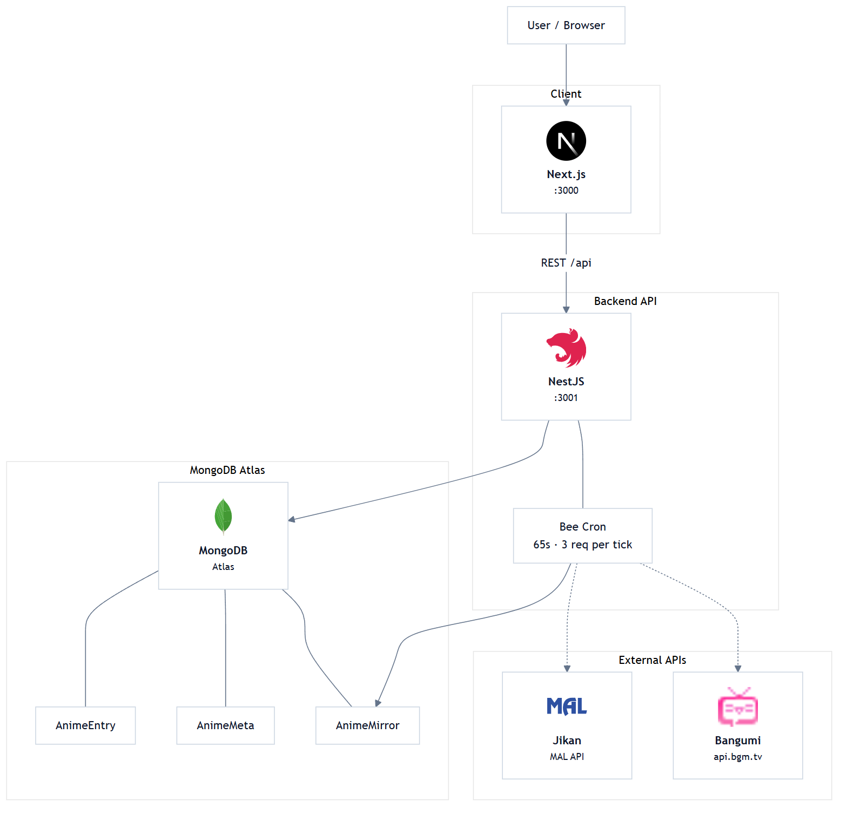
System architecture
Bee mirrors Jikan/Bangumi
↓
MongoDB; client
↓
NestJS API only

Slide 7
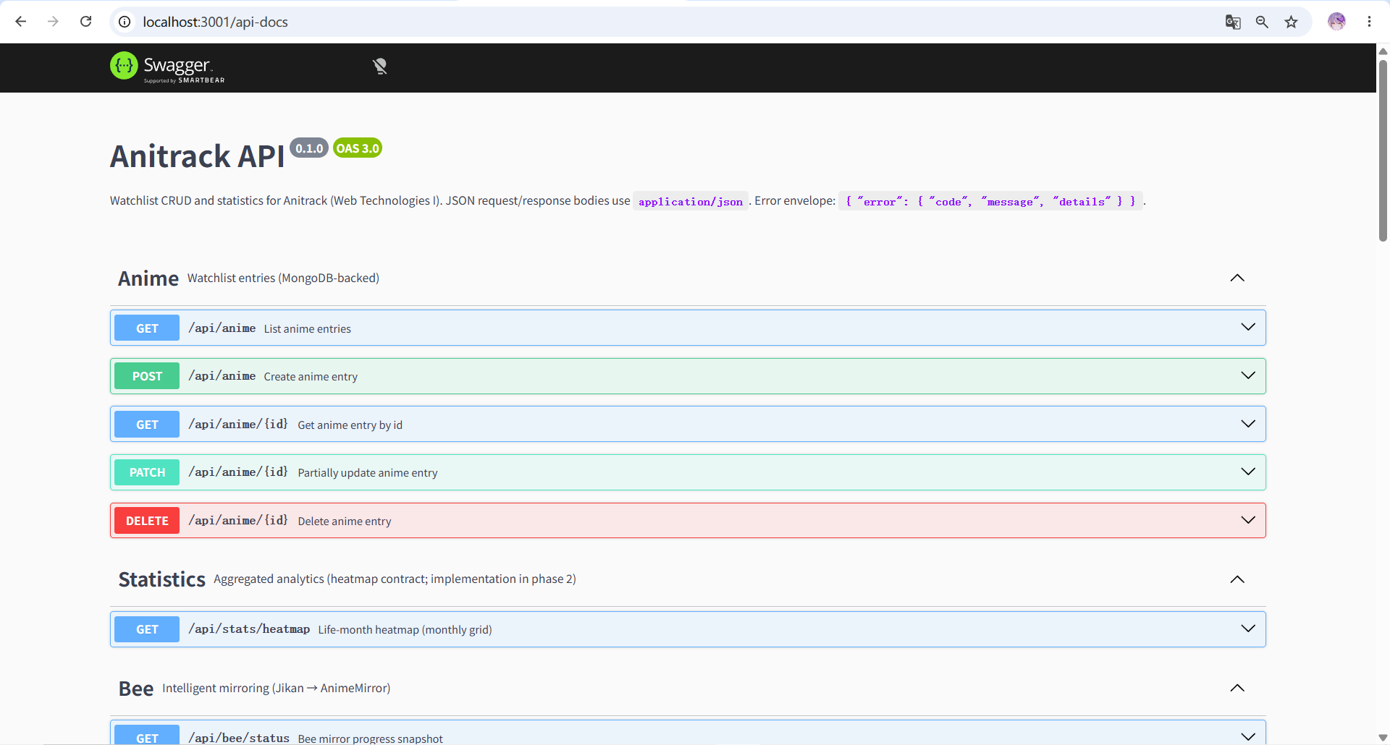
API-first & OpenAPI
Swagger UI: http://localhost:3001/api-docs
Contract: anitrack-backend/swagger.json
Same API for UI + script clients (anitrack-tester)
Errors: { error: { code, message, details } }
screenshot: localhost:3001/api-docs

Slide 8
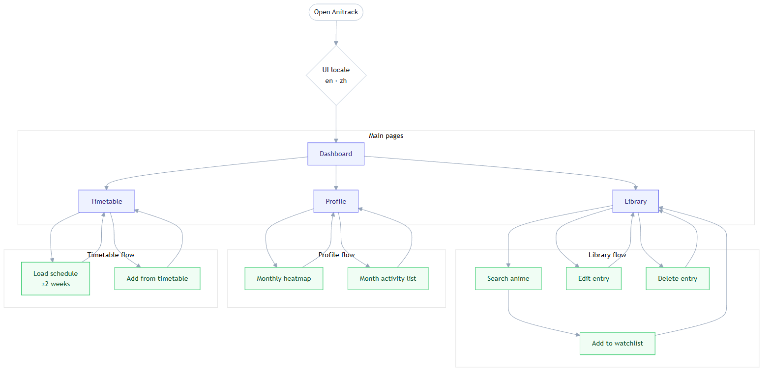
User flows
Dashboard · Timetable · Library · Profile

Slide 9
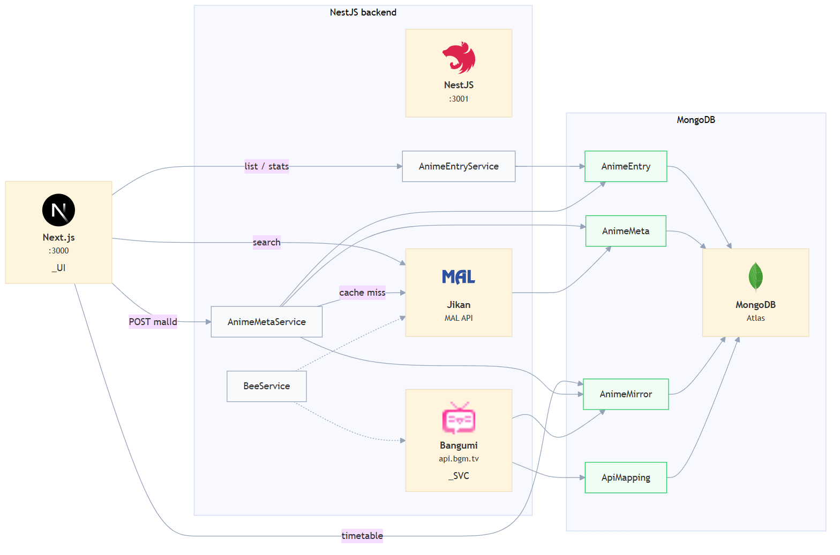
Data flow & caching
Cache-aside AnimeMeta by malId
User progress → AnimeEntry
Bee → AnimeMirror for timetable / seasonal

Slide 10
Backend business logic
State machine → illegal status = HTTP 409
Heatmap aggregation on server (intensity 0–4)
Bee: 65s / 3 requests, Bangumi mapping
No business rules in React frontend

Slide 11
Testing strategy
Unit: heatmap mapping (Vitest)
Integration: API + MongoDB (Jest, Vitest)
Contract: OpenAPI vs runtime (anitrack-tester)

Slide 12
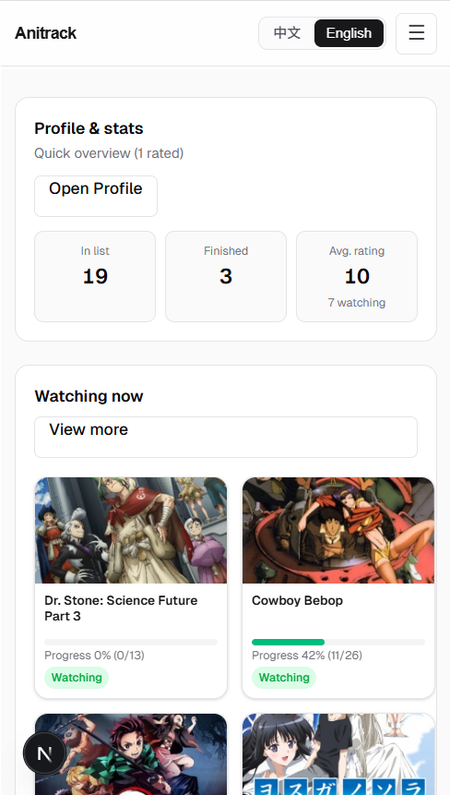
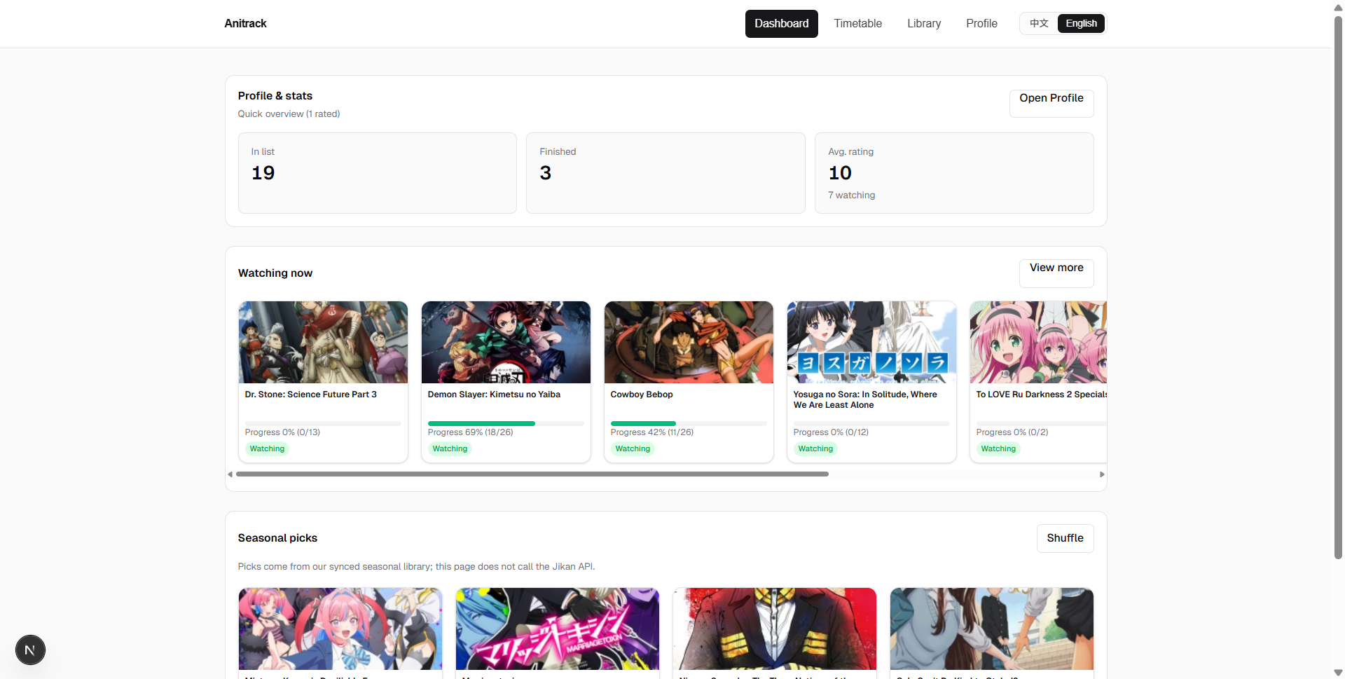
Responsive UI
Hamburger navigation · date strip ±2 weeks · heatmap scroll
Mobile / narrow
Desktop / wide

Slide 13
Live demo plan
1. Dashboard — watching & seasonal picks
2. Library — search → add to watchlist
3. Profile — heatmap → month activity
4. (Optional) Timetable — pick date
Before demo: backend :3001, frontend :3000, UI = English

Slide 14
Live Demo
http://localhost:3000
(Switch to browser — no further slides during demo)

Slide 15
Limitations & outlook
Timetable air times sometimes TBD (upstream data)
Single user (TEMP_USER_ID) — no auth yet
Future: multi-user, recommendations
Course core scope is complete

Slide 16
Thank you for your attention.
Questions?

