Slide 1

https://github.com/Isantipov/HotScroll

Slide 2
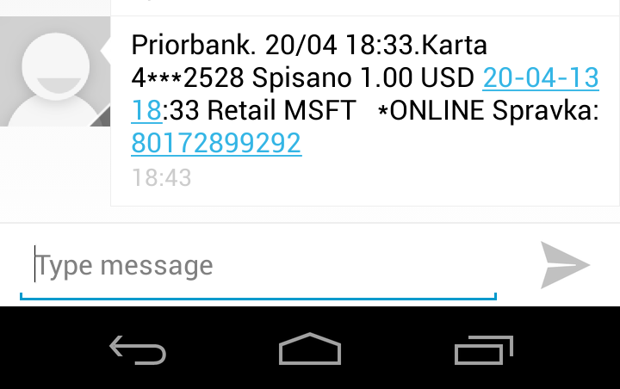
First Round of Investment
USD 1

Slide 3
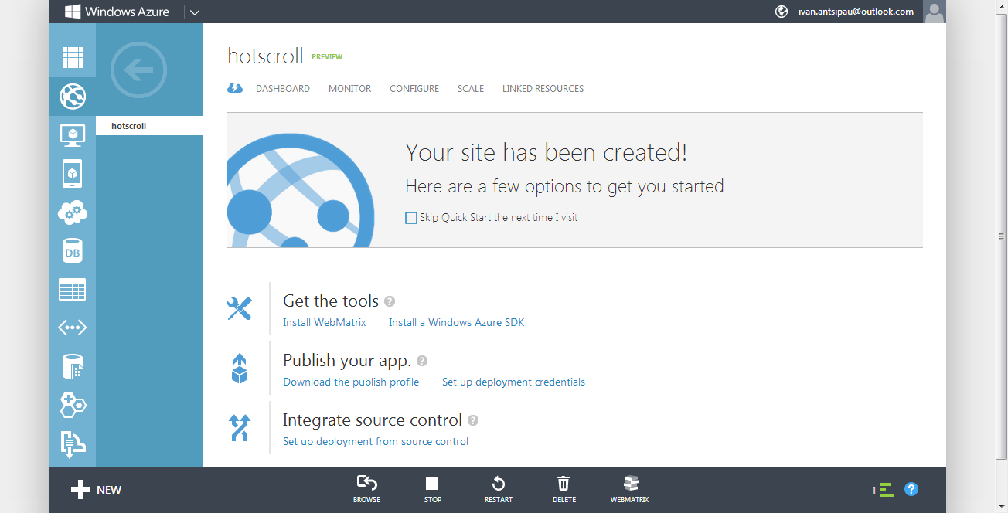
Azure Deployment

Slide 4
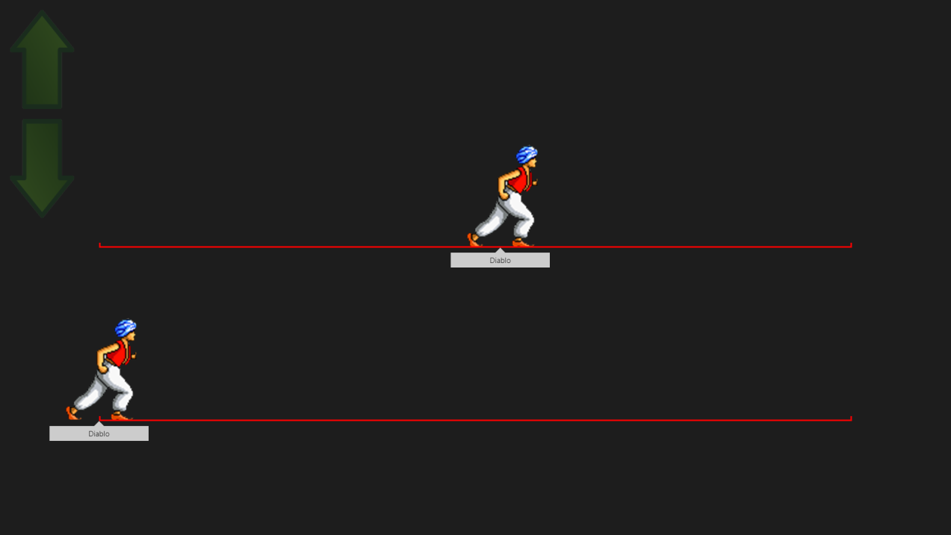
Done
Client:
Initialization
Running UI & Controls
Back End:
Deploy to Azure
Initialization
Search partners
Start Game

