Slide 1

https://github.com/Isantipov/HotScroll

Slide 2
13:00

Slide 3
22:00
Get ready!

Slide 4
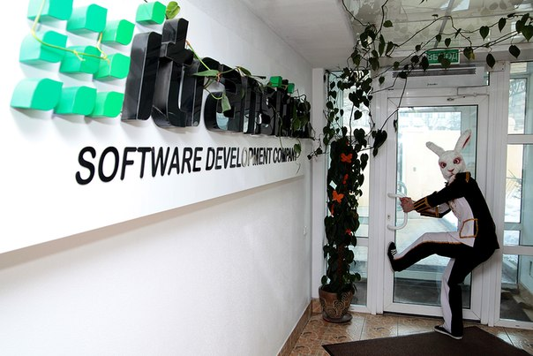

Thank You!
https://github.com/Isantipov/HotScroll
Team (Client app):
alex.skakun@me.com
e.leychenok@gmail.com
19graff91@gmail.com
Team (Back-End):
d.parf@live.com
ivan.antsipau@gmail.com

Slide 5
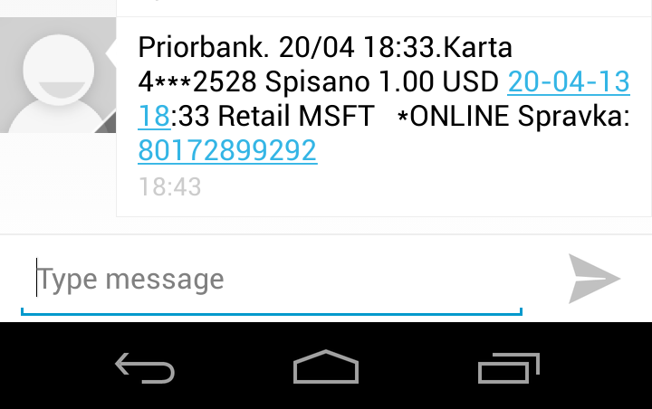
First Round of Investment
USD 1

Slide 6
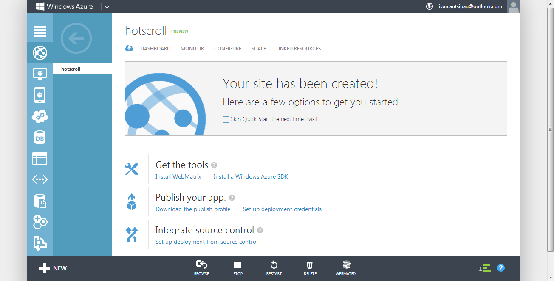
Azure Deployment

Slide 7
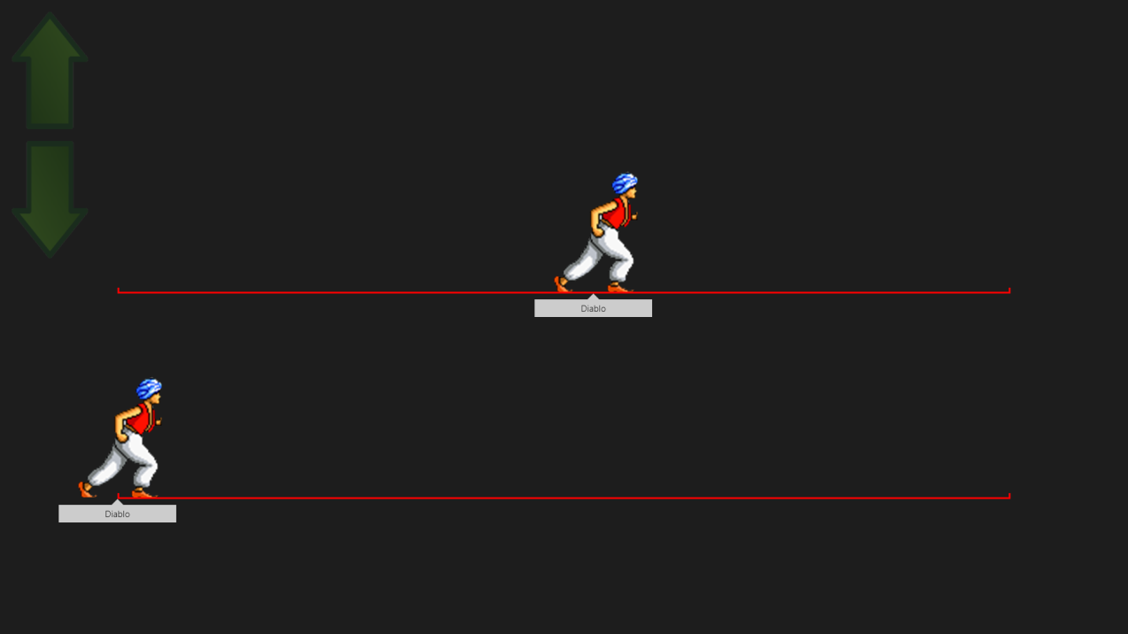
Done
Client:
Initialization
Running UI & Controls
Back End:
Deploy to Azure
Initialization
Search partners
Start Game

