Slide 1
Programming & Compiler Toolchain for Multi-Agent Systems
Group 07
E/17/398 Hashini Wijerathne
E/17/159 Kavinaya Yogendran
E/17/352 Isara Tillekeratne
Supervisors
Dr Isuru Nawinne
Dr Mahanama Wickramasinghe
Prof Roshan Ragel
Dr Sithumini Ekanayake

Slide 2
Introduction
01
Background and Problem Statement

Slide 3
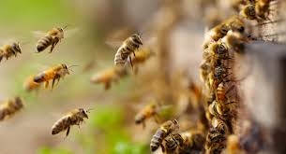
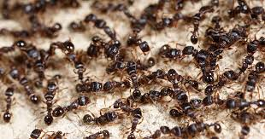
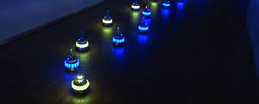
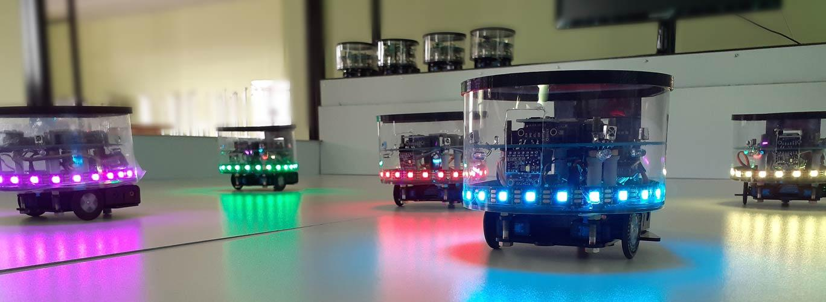
Multi-Agent Systems
Swarm Robotics
Composed of multiple independent entities cooperating to achieve common goals
Inspired by the collective behaviour observed in natural swarms
Autonomous
Homogeneous
Locality
Decentralised
Notes:
Natural swarms - such as flocks of birds, schools of fish, or colonies of ants
multiple autonomous robots, known as agents, that work together to achieve common goals.
Explain the 4 characteristics
simple individual agents, following simple rules, can collectively exhibit complex behaviours and accomplish tasks that would be challenging for a single robot

Slide 4
Problems
Complexity in programming swarm robots to achieve a collective behaviour
No support for block-based visual programming
Limited to software-level simulations rather than comprehensive development libraries
Lack of support for both physical and virtual robots
Limited to a few pre-programmed sets of behaviours & bias towards specific algorithms
Notes:
Mention we did our literature survey on two areas, tools and behaviours.

Slide 5
02
Methodology

Slide 6
High-level algorithm composition
Block-based visual programming
IDE Features
Converts the graphical-level algorithm to executables
Compatible with Physical and Virtual Robots
Code generation and compilation
OTA code upload and execution
Reprogram multiple robots without physical access
Notes:
The ability of high-level algorithm composition is the main characteristic of the proposed
IDE. It allows the users to program swarm behaviours in a graphical interface in a
code-less approach. The swarm behaviours are designed based on a bottom-up design
approach where the users can program more complex top-level behaviours using the
low-level atomic behaviours. The behaviours are categorized into multiple levels, giving
the users a clear understanding of combining and scaling them up without delving into
low-level details. This abstraction can help manage the complexity of programming large
swarms with sophisticated swarm behaviours with less effort.
● The IDE automatically converts the graphical-level algorithm to a programming language
which then facilitates the compilation process for creating binaries that can be executed
on the robots supporting various hardware platforms.
● As the final characteristic, it supports uploading the binaries to the robots over the air
(OTA). OTA programming refers to the ability to update or reprogram hardware devices
remotely without physical access. This capability is attained by wireless communication
using WiFi, MQTT messaging protocol, and a central server which enables quick
deployment of updates to multiple robots simultaneously and gives higher convenience,
efficiency, and flexibility.

Slide 7
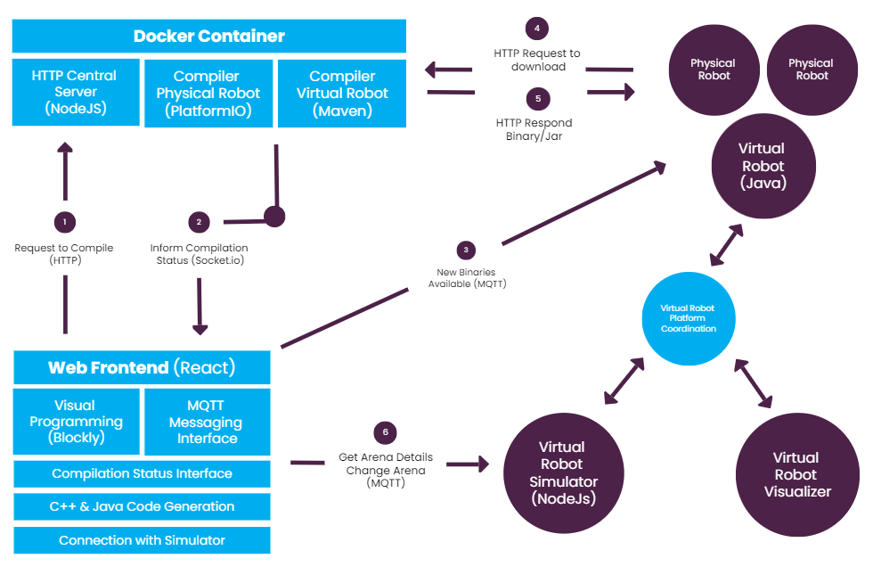
Solution Architecture

Slide 8
03
Progress
Completed Tasks & Experiments

Slide 9

Completed Tasks
Defined a block structure and implemented new blocks supporting swarm behaviours
Java code generation for virtual robots
Compilation process using Maven for virtual robots
Integrating the IDE to the Virtual Robot Simulator and Visualizer
Testing some simple robot behaviours using both Physical and Virtual robots
Implementing the random movement with collision avoidance behaviour
Programming & testing a complex swarm behaviour using Virtual robots
Notes:
Dynamic task - say that we’ll explain in the next slide
Behavioral, IO, General

Slide 10
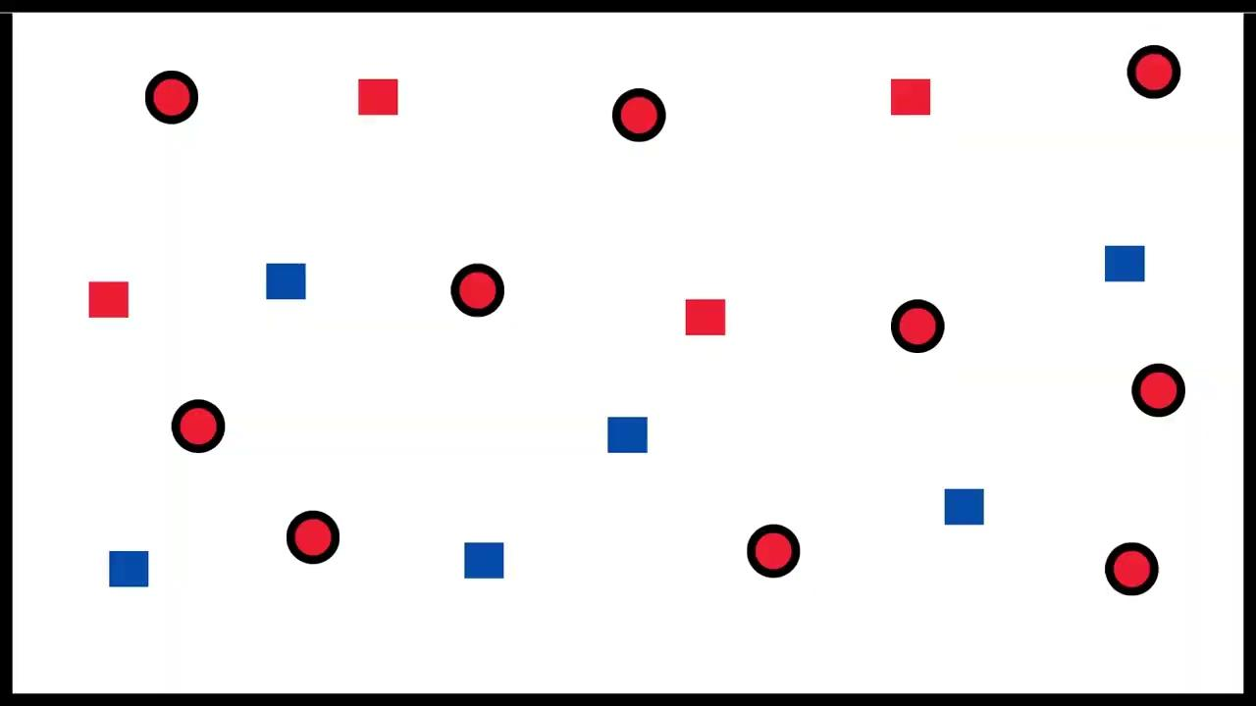
Experiments
Selected behaviour: Dynamic Task Allocation using Response Threshold Model
End goal: Converging to the desired task distribution
Task Demand & Supply History Queues
Evaluate Task Demand & Supply
Update Response Threshold Value
Select Task
Task Selection Probability Function
Lee, W., & Kim, D. E. (2019). Adaptive approach to regulate task distribution in swarm robotic systems. Swarm and Evolutionary Computation, 44
Notes:
Explain the behaviour briefly Recent history demand queue populate - colour sensor, supply queue - inter robot communication
Simply idea —- If demand > supply - threshold goes down - more likely to select it
All behave same manner - together achieve the desired task distribution

Slide 11
Bottom-up Design Approach
GLOBAL BEHAVIOURS
Dynamic Task Allocation
Foraging
Aggregation
CLUSTER BEHAVIOURS
Observe
Evaluate Task Demand
Evaluate Task Supply
Select Task
Move Random no collision
PAIR BEHAVIOURS
Move Closer
Go Away
Collision Avoidance
ATOMIC
BEHAVIOURS
Show Task
Move Random
Random Turn
Move Along a Direction
Stop
Angular Turn
Notes:
● Global behaviours: Complex collective behaviours. This is the highest level ● Cluster behaviours: Behaviours that involve multiple entities ● Pair behaviours: Behaviours that only involve two entities (two robots or a robot and an object) ● Atomic behaviours: Behaviours that a single robot can perform without any interaction, sensing involving others suited for incremental development
We will follow the bottom-up design approach when designing
blocks such that the users will be able to program complex global-level behaviours by
integrating low-level behaviours.

Slide 12
04
Findings

Slide 13
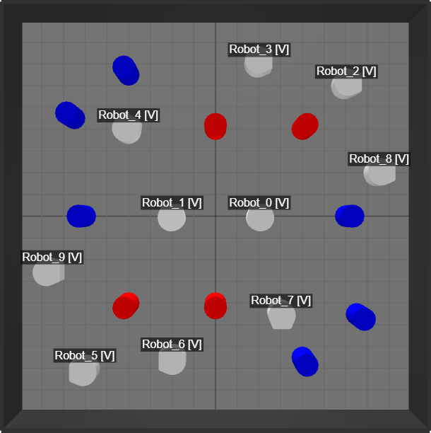
Simulation Environment
Number of Robots = 10 (Initially Red)
Number of Objects = 10
(Denoting Red & Blue tasks)
Task Distribution: 40% Red, 60% Blue
Robots and Objects are placed randomly on the arena
Red Assigned Robot - White
Blue Assigned Robot - Green

Slide 14
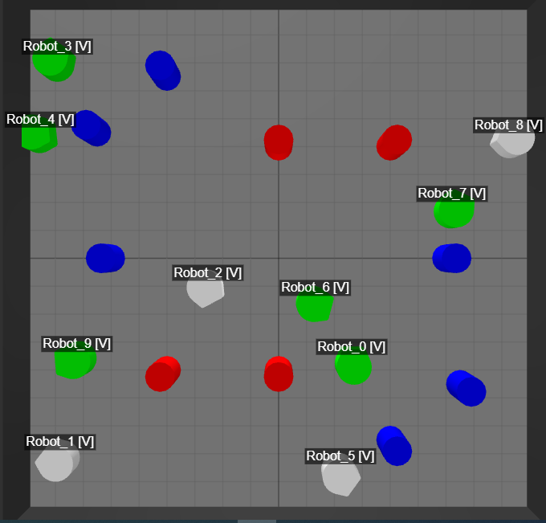
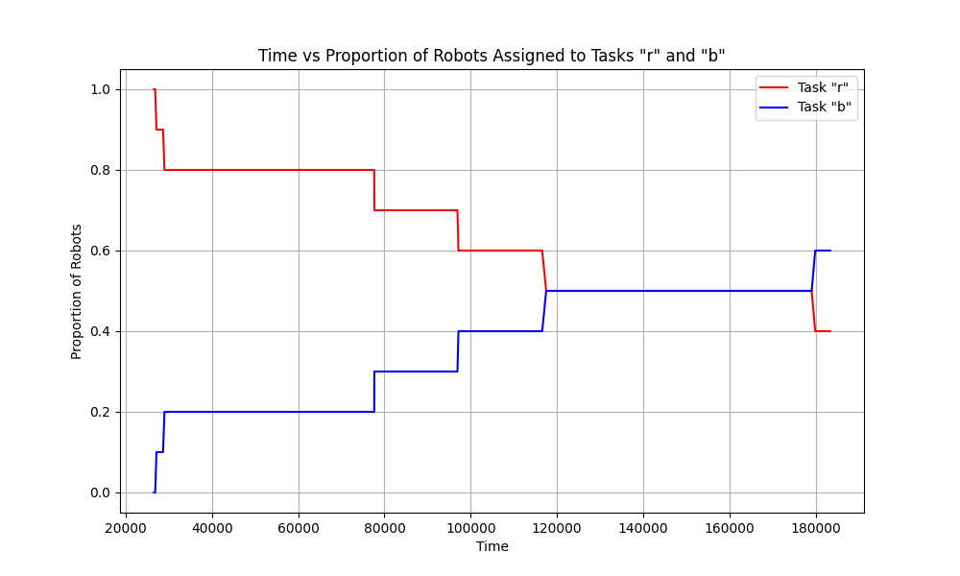
Time Vs Proportion of Robots Assigned to Task Red/Blue
Task Distribution: 40% Red, 60% Blue
Observation: The robots started switching between tasks. Eventually converged into the desired task distribution
Notes:
● Global behaviours: Complex collective behaviours. This is the highest level ● Cluster behaviours: Behaviours that involve multiple entities ● Pair behaviours: Behaviours that only involve two entities (two robots or a robot and an object) ● Atomic behaviours: Behaviours that a single robot can perform without any interaction, sensing involving others

Slide 15
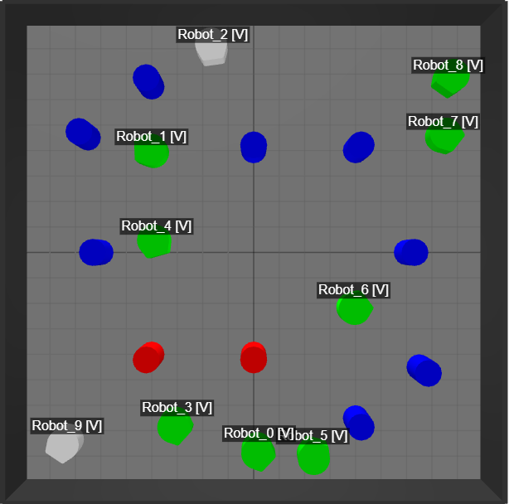
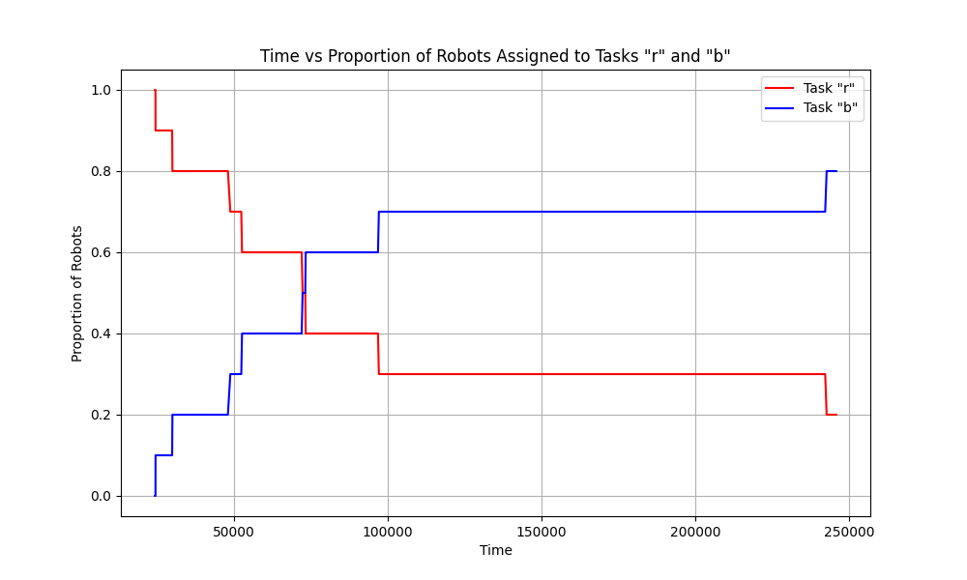
Task Distribution: 20% Red, 80% Blue
Notes:
● Global behaviours: Complex collective behaviours. This is the highest level ● Cluster behaviours: Behaviours that involve multiple entities ● Pair behaviours: Behaviours that only involve two entities (two robots or a robot and an object) ● Atomic behaviours: Behaviours that a single robot can perform without any interaction, sensing involving others

Slide 16
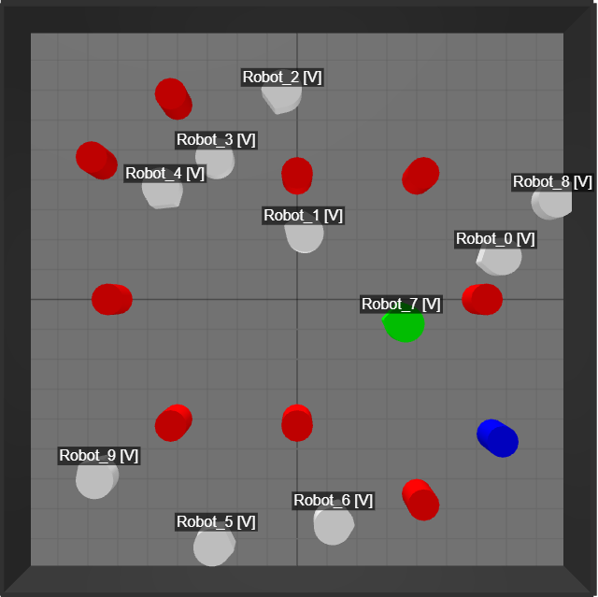
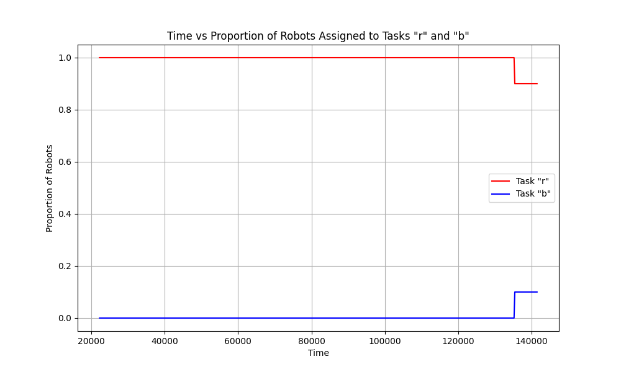
Task Distribution: 90% Red, 10% Blue
Notes:
● Global behaviours: Complex collective behaviours. This is the highest level ● Cluster behaviours: Behaviours that involve multiple entities ● Pair behaviours: Behaviours that only involve two entities (two robots or a robot and an object) ● Atomic behaviours: Behaviours that a single robot can perform without any interaction, sensing involving others

Slide 17
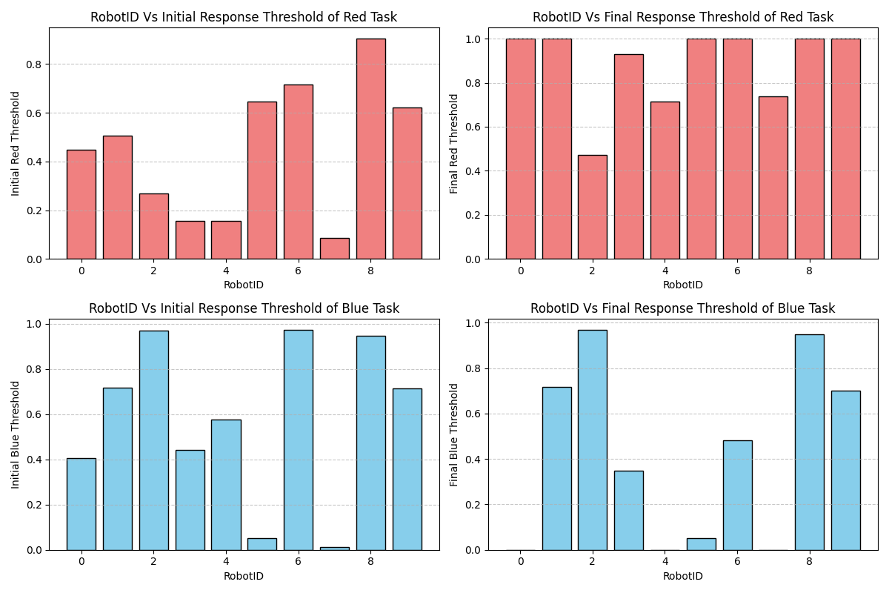
Robot Id Vs Initial/Final Threshold Values for Task Red/Blue
Task Distribution: 40% Red, 60% Blue
Observation: Some robots are strongly specialized (0, 4, 7) while some are weakly specialized
Notes:
● Global behaviours: Complex collective behaviours. This is the highest level ● Cluster behaviours: Behaviours that involve multiple entities ● Pair behaviours: Behaviours that only involve two entities (two robots or a robot and an object) ● Atomic behaviours: Behaviours that a single robot can perform without any interaction, sensing involving others

Slide 18
05
Problems Encountered

Slide 19
Problems Encountered
Methods used to Resolve
Robots are not equipped with cameras to distinguish between objects & robots
Mapped Red allocation to White robot & Blue allocation to Green robot
Only possible to read a single colour sensor reading at an instance
Demand queue update - Sensor reading
Supply queue update - Inter robot communication
Virtual robot update to read colour sensor data from multiple directions
Delays affected the underlying random movement behaviour
Multithreading to handle movement and task allocation parallely

Slide 20
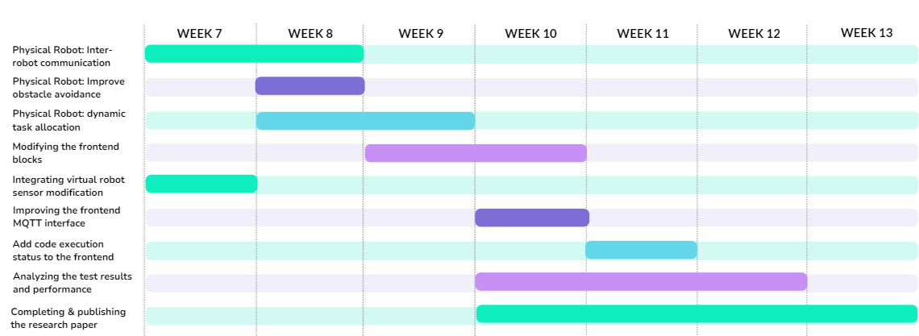
06. Future Work Plan
06

Slide 21
Project Deliverables
& their Impact
07
Fully completed IDE for programming both physical and virtual swarm robots
Comprehensive set of low level behaviours implemented as blocks
Demonstration of the dynamic task allocation in both physical & virtual robots

Slide 22
Demonstration
Simple Behaviour and Dynamic Task Allocation Behaviour

Slide 23
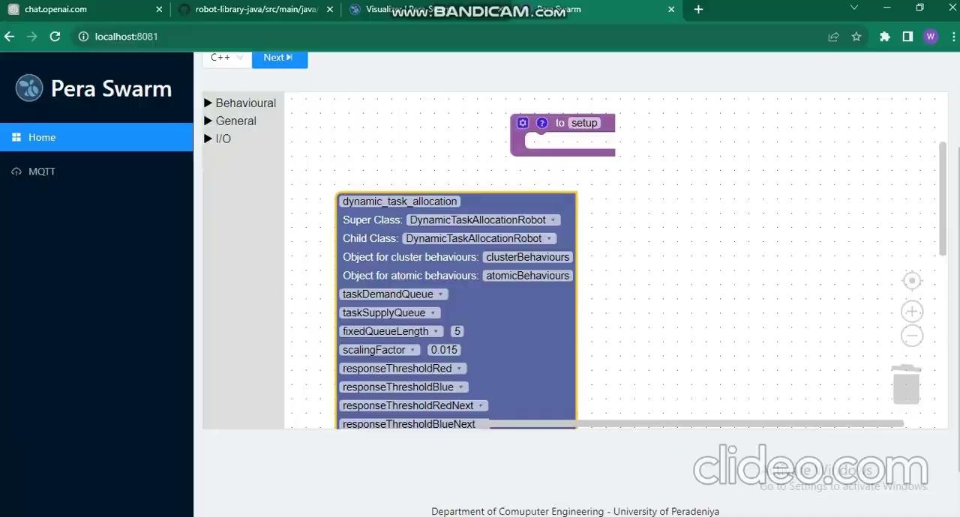

Slide 24
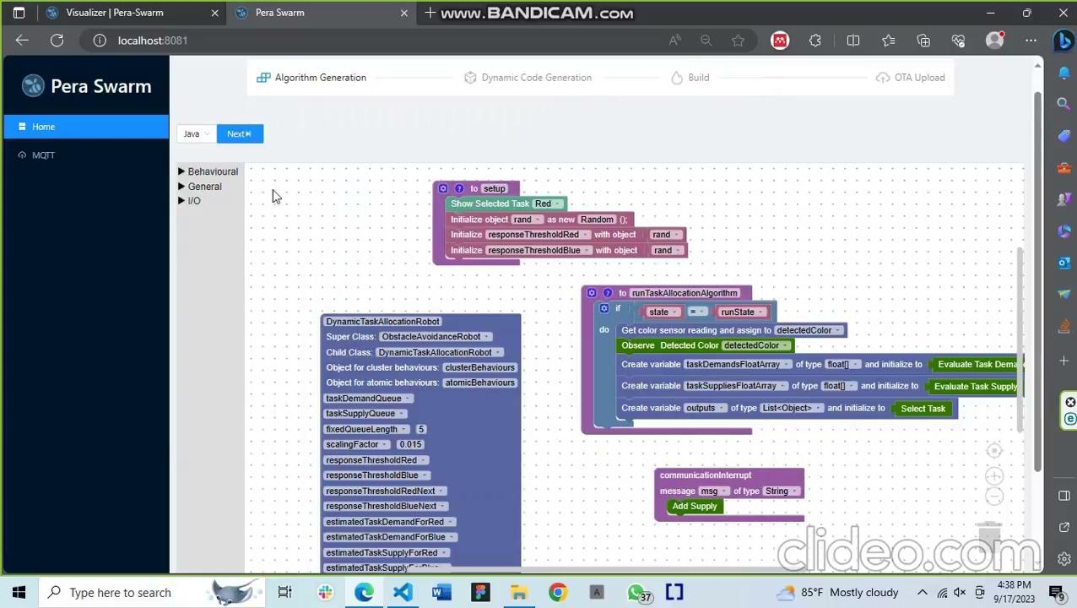

Slide 25
THANK YOU

Slide 27
Q&A

Slide 28
Block Structure in Visual Programming
IO Blocks
Behavioural Blocks
General Blocks
Level 1
Level 2
Sensors
Logic
Loops
Atomic
Intermediate
Pair
Directly read sensors
Functions
Math
Level 3
Level 4
Actuators
Cluster
Global
Directly control actuators
Variables
Arrays
Notes:
Tell that behavioural blocks are defined based on bottom up design strategy levels

Slide 29
End goal: Demonstrating a complex swarm behaviour using the proposed IDE
Selected behaviour: Dynamic task allocation
Robots
Objects
6
4
Desired Task distribution 60% Blue 40% Red
Notes:
Adapts to changes
Desired task distribution

Slide 30
