Slide 1
Programming & Compiler Toolchain for Multi-Agent Systems
Group 07
E/17/398 Hashini Wijerathne
E/17/159 Kavinaya Yogendran
E/17/352 Isara Tillekeratne
Supervisors
Dr Isuru Nawinne
Dr Mahanama Wickramasinghe
Prof Roshan Ragel

Slide 2
Introduction
01
Domain, Literature Review and Problem Statement

Slide 3
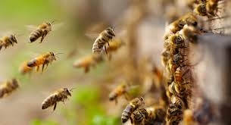
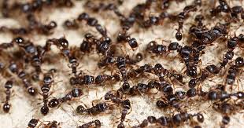

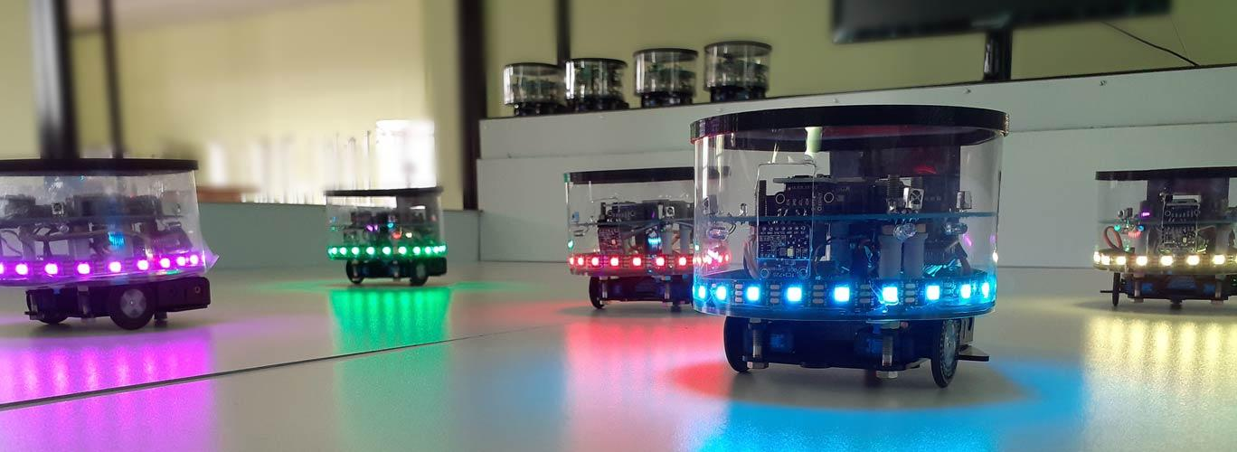
Multi-Agent Systems
Swarm Robotics
Composed of multiple independent entities cooperating to achieve common goals
Inspired by the collective behaviour observed in natural swarms
Autonomous
Homogeneous
Locality
Decentralised
Notes:
Natural swarms - such as flocks of birds, schools of fish, or colonies of ants
multiple autonomous robots, known as agents, that work together to achieve common goals.
Explain the 4 characteristics
simple individual agents, following simple rules, can collectively exhibit complex behaviours and accomplish tasks that would be challenging for a single robot

Slide 4
Literature review
Swarm Programming Tools-Based Studies
PySwarm
Limited to focus on only Particle Swarm Optimization (PSO)
Madhushanka, H. M. K., & Perera, A. L. H. E. (2023). _Swarm Intelligence Programming Framework _ Literature Review. February.
No support for block-based visual programming
SwarmOps
Madhushanka, H. M. K., & Perera, A. L. H. E. (2023). _Swarm Intelligence Programming Framework _ Literature Review. February.
Limited to collection of swarm intelligence optimization algorithms
SwarmLib
Dassanayaka, M., Bandara, T., Adikari, N., Nawinne, I., & Ragel, R. (2020, July). A Programming Framework for Robot Swarms. In 2020 Moratuwa Engineering Research Conference (MERCon) (pp. 578-583). IEEE
Tested only with pre-programmed behaviours
‹#›

Slide 5
Literature review
Swarm Programming Tools-Based Studies
Physicomimetics
Limited to a small set of behaviours
Limit the system’s adaptability and responsiveness to changes in the environment or swarm conditions
Spears, W. M., Spears, D. F., Heil, R., Kerr, W., & Hettiarachchi, S. (2005). An overview of physicomimetics. Lecture Notes in Computer Science, 3342, 84–97. https://doi.org/10.1007/978-3-540-30552-1_8
Buzz
Limited hardware compatibility
Limited to coordination and communication among individual robots aspects of swarm robotics
Pinciroli, C., Lee-Brown, A., & Beltrame, G. (2015). Buzz: An Extensible Programming Language for Self-Organizing Heterogeneous Robot Swarms. http://arxiv.org/abs/1507.05946
‹#›

Slide 6
Literature review
2. Swarm Behavioural Algorithms-Based Studies
Decentralised
Yes
Flocking
Moeslinger, C., Schmickl, T., & Crailsheim, K. (n.d.). LNAI 5778 - A Minimalist Flocking Algorithm for Swarm Robots.
Reynolds, C. W. (1987). Flocks, Herds, and Schools: A Distributed Behavioral Model. In Computer Graphics (Vol. 21, Issue 4).
Communication
Yes
No
Computational Power
High
Low
Main rules
Collision Avoidance Flock Centring
Velocity Matching
Collision Avoidance
Robot Separation
Flock cohesion Emergent Alignment
Decentralised
Yes
Dynamic Task Allocation
Lee, W., & Kim, D. E. (2019). Adaptive approach to regulate task distribution in swarm robotic systems. Swarm and Evolutionary Computation, 44
Nedjah, N., de Mendonça, R. M., & de Macedo Mourelle, L. (2015). Pso-based distributed algorithm for dynamic task allocation in a robotic swarm. Procedia Computer Science
Communication
No
Yes
Features
Dynamic, Converges to desired task distribution
Base
Response Threshold Model, keeps history on task demand & supply
PSO
Updates positions & velocities of the neighbours
Notes:
Flocks can be described as aggregations of many individuals which move together with cohesion, flexibility, and alignment.

Slide 7
Problems
Complexity in programming swarm robots to achieve a collective behaviour
No support for block-based visual programming
Limited to software-level simulations rather than comprehensive development libraries
Lack of support for both physical and virtual robots
Limited to a few pre-programmed sets of behaviours & bias towards specific algorithms
Notes:
requires dealing with low-level complexities of handling and programming each robot and the interactions between the robots
Most of the available frameworks for swarm programming focus only on software-level simulations, which do not discuss extending them to real hardware robot platforms,
few pre-programmed sets of behaviours and do not give developers the ability to change the inbuilt behaviours or use them to integrate and build new behaviours.

Slide 8
02
Proposed Solution

Slide 9
High-level algorithm composition
Block-based visual programming
IDE with a programming and compiler toolchain for swarm robots
Converts the graphical-level algorithm to executable binaries
Supporting both hardware and virtual robot platforms
OTA code upload to multiple robots
Reprogram multiple robots without physical access
Notes:
The ability of high-level algorithm composition is the main characteristic of the proposed
IDE. It allows the users to program swarm behaviours in a graphical interface in a
code-less approach. The swarm behaviours are designed based on a bottom-up design
approach where the users can program more complex top-level behaviours using the
low-level atomic behaviours. The behaviours are categorized into multiple levels, giving
the users a clear understanding of combining and scaling them up without delving into
low-level details. This abstraction can help manage the complexity of programming large
swarms with sophisticated swarm behaviours with less effort.
● The IDE automatically converts the graphical-level algorithm to a programming language
which then facilitates the compilation process for creating binaries that can be executed
on the robots supporting various hardware platforms.
● As the final characteristic, it supports uploading the binaries to the robots over the air
(OTA). OTA programming refers to the ability to update or reprogram hardware devices
remotely without physical access. This capability is attained by wireless communication
using WiFi, MQTT messaging protocol, and a central server which enables quick
deployment of updates to multiple robots simultaneously and gives higher convenience,
efficiency, and flexibility.

Slide 10
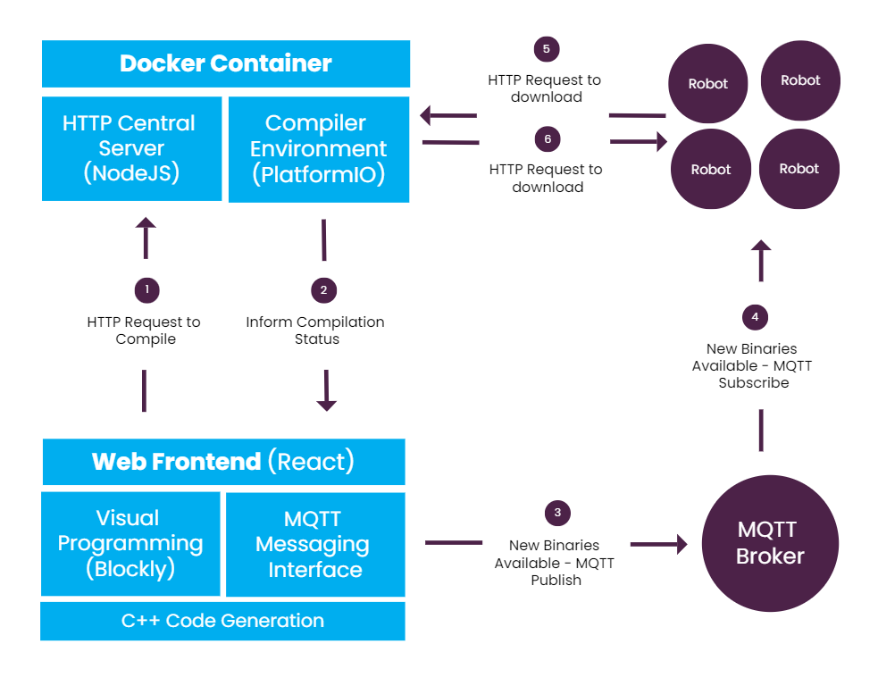
Solution Architecture of the Existing Tool
Notes:
Functionalities of current tool
Visual programming - A simple graphical interface created for block-based programming
using the Google Blockly framework. Supports code generation for C++.
● Compilation - PlatformIO CLI tool is integrated to compile the C++ code to binaries. The
compilation process is shown in the frontend.
● OTA code upload - An OTA code upload mechanism is created using WIFI
communication and MQTT protocol. UI is created to send MQTT messages from the
frontend.

Slide 11
Identified Weaknesses
Proposed Solutions
Block-based visual programming doesn’t support complex behaviours
Modify existing blocks, design & build new blocks. Enable users to create complex behaviours by integrating low level blocks and save for later use
Some blocks don’t fully function
Doesn’t support programming virtual robots
Parallel code generation in Java to program virtual robots in simulation environment
Software level improvements
User convenience MQTT messaging
Binary generation for multiple robots
Lack of an inter-robot communication mechanism
Implement an inter-robot communication mechanism. Eg: virtual pheromone based
Notes:
Modify the block-based programming feature, providing a good level of abstraction to support complex collective swarm behaviours. We will modify the existing blocks and introduce new blocks. We will follow the bottom-up design approach when designing blocks such that the users will be able to program complex global-level behaviours by integrating low-level behaviours.
User inconvenience - Enable users to program new behaviours and save them to use in future implementations,
Modify the MQTT message-sending feature, resolving the current issues. Provide guidance for users on MQTT topics and message formats to use. ● Support programming virtual robots. We will support generating codes in Java, parallel to C++ such that the IDE is capable of programming virtual robots along with physical ones. Integrate our IDE with the Mixed Reality Environment for Swarm Robotics Simulations. This feature will enable us to test the scalability of the complex swarm algorithms. ● Study and identify the improvements which can be done at the compiler level (Currently, the PlatformIO tool is used for the compilation process

Slide 12
Work Plan
03

Slide 13
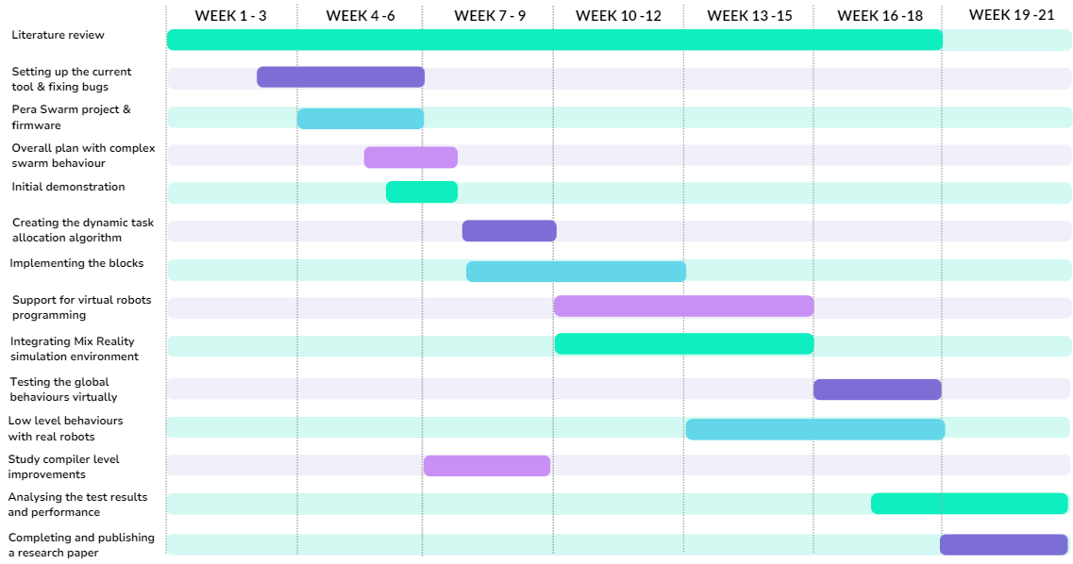

Slide 14
Project Deliverables & Current Progress
04

Slide 15
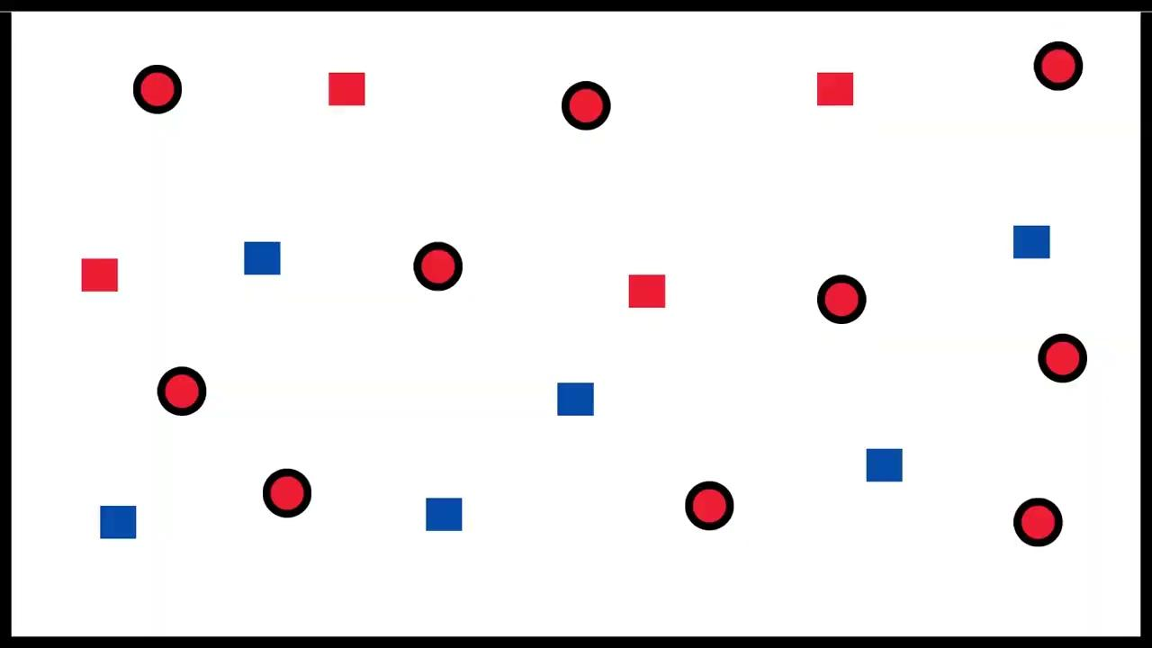
End goal: Demonstrating a complex swarm behaviour using the proposed IDE
Selected behaviour: Dynamic task allocation
Robots
Objects
6
4
Desired Task distribution 60% Blue 40% Red
Notes:
Adapts to changes
Desired task distribution

Slide 16
Algorithm: Uses response threshold model, decentralised, without communication
Two queues on local Task Demand & Supply
Estimation of global status
Update Response Threshold Value
Select Task
Task Selection Probability Function
Lee, W., & Kim, D. E. (2019). Adaptive approach to regulate task distribution in swarm robotic systems. Swarm and Evolutionary Computation, 44
Notes:
We will follow the bottom-up design approach when designing
blocks such that the users will be able to program complex global-level behaviours by
integrating low-level behaviours.
We’ve been studying available algorithms under this behaviour which are compatible with the existing Pera Swarm robots’ hardware capabilities.

Slide 17
Bottom-up Design Approach
GLOBAL BEHAVIOURS
Dynamic Task Allocation
Foraging
Aggregation
CLUSTER BEHAVIOURS
Observe
Evaluate Task Demand
Evaluate Task Supply
Select Task
Move Random no collision
PAIR BEHAVIOURS
Move Closer
Go Away
Collision Avoidance
ATOMIC
BEHAVIOURS
Show Task
Move Random
Random Turn
Move Along a Direction
Stop
Angular Turn
Notes:
● Global behaviours: Complex collective behaviours. This is the highest level ● Cluster behaviours: Behaviours that involve multiple entities ● Pair behaviours: Behaviours that only involve two entities (two robots or a robot and an object) ● Atomic behaviours: Behaviours that a single robot can perform without any interaction, sensing involving others

Slide 18
Demonstration
With a single robot and an object

Slide 19
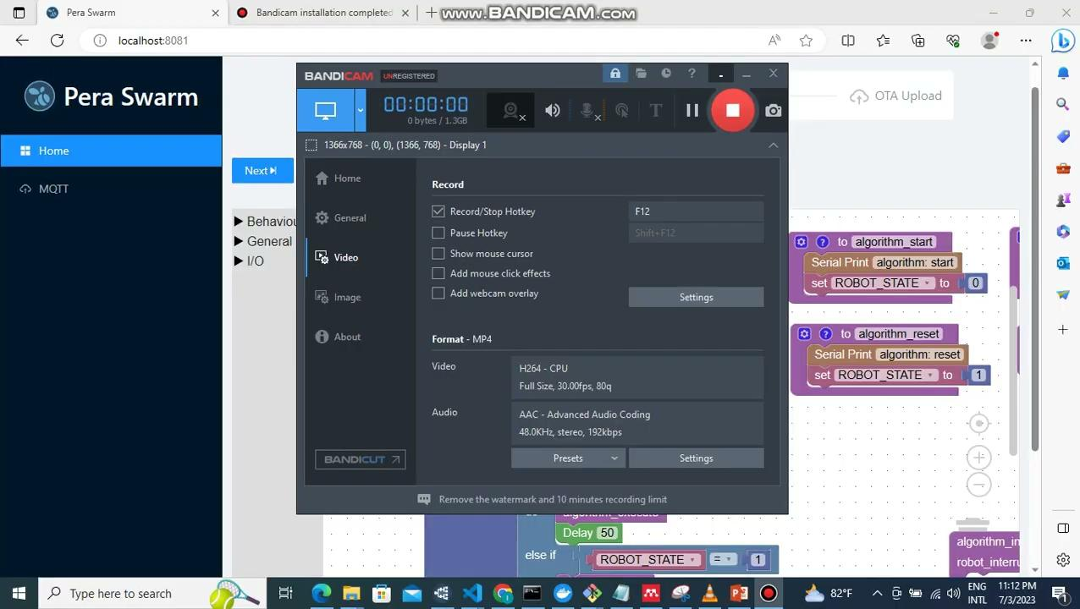

Slide 20
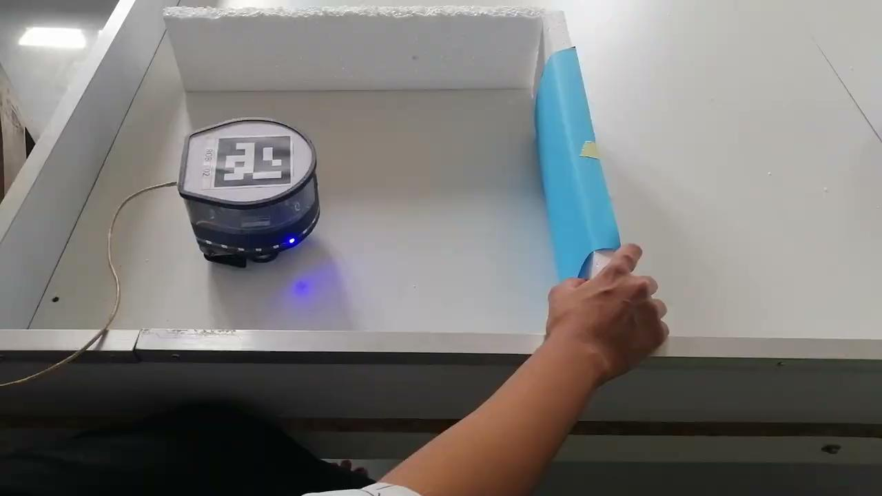

Slide 21
THANK YOU

