Slide 1

The role of climate legacies in shaping extinction risk throughout Earth's history
University of Bayreuth
Gregor Mathes
PhD Defense
02.02.2023

Slide 2

One of the defining features of the Anthropocene is that the world is changing in ways that compel species to move
Elizabeth Kolbert, The Sixth Extinction: An Unnatural History

Slide 3
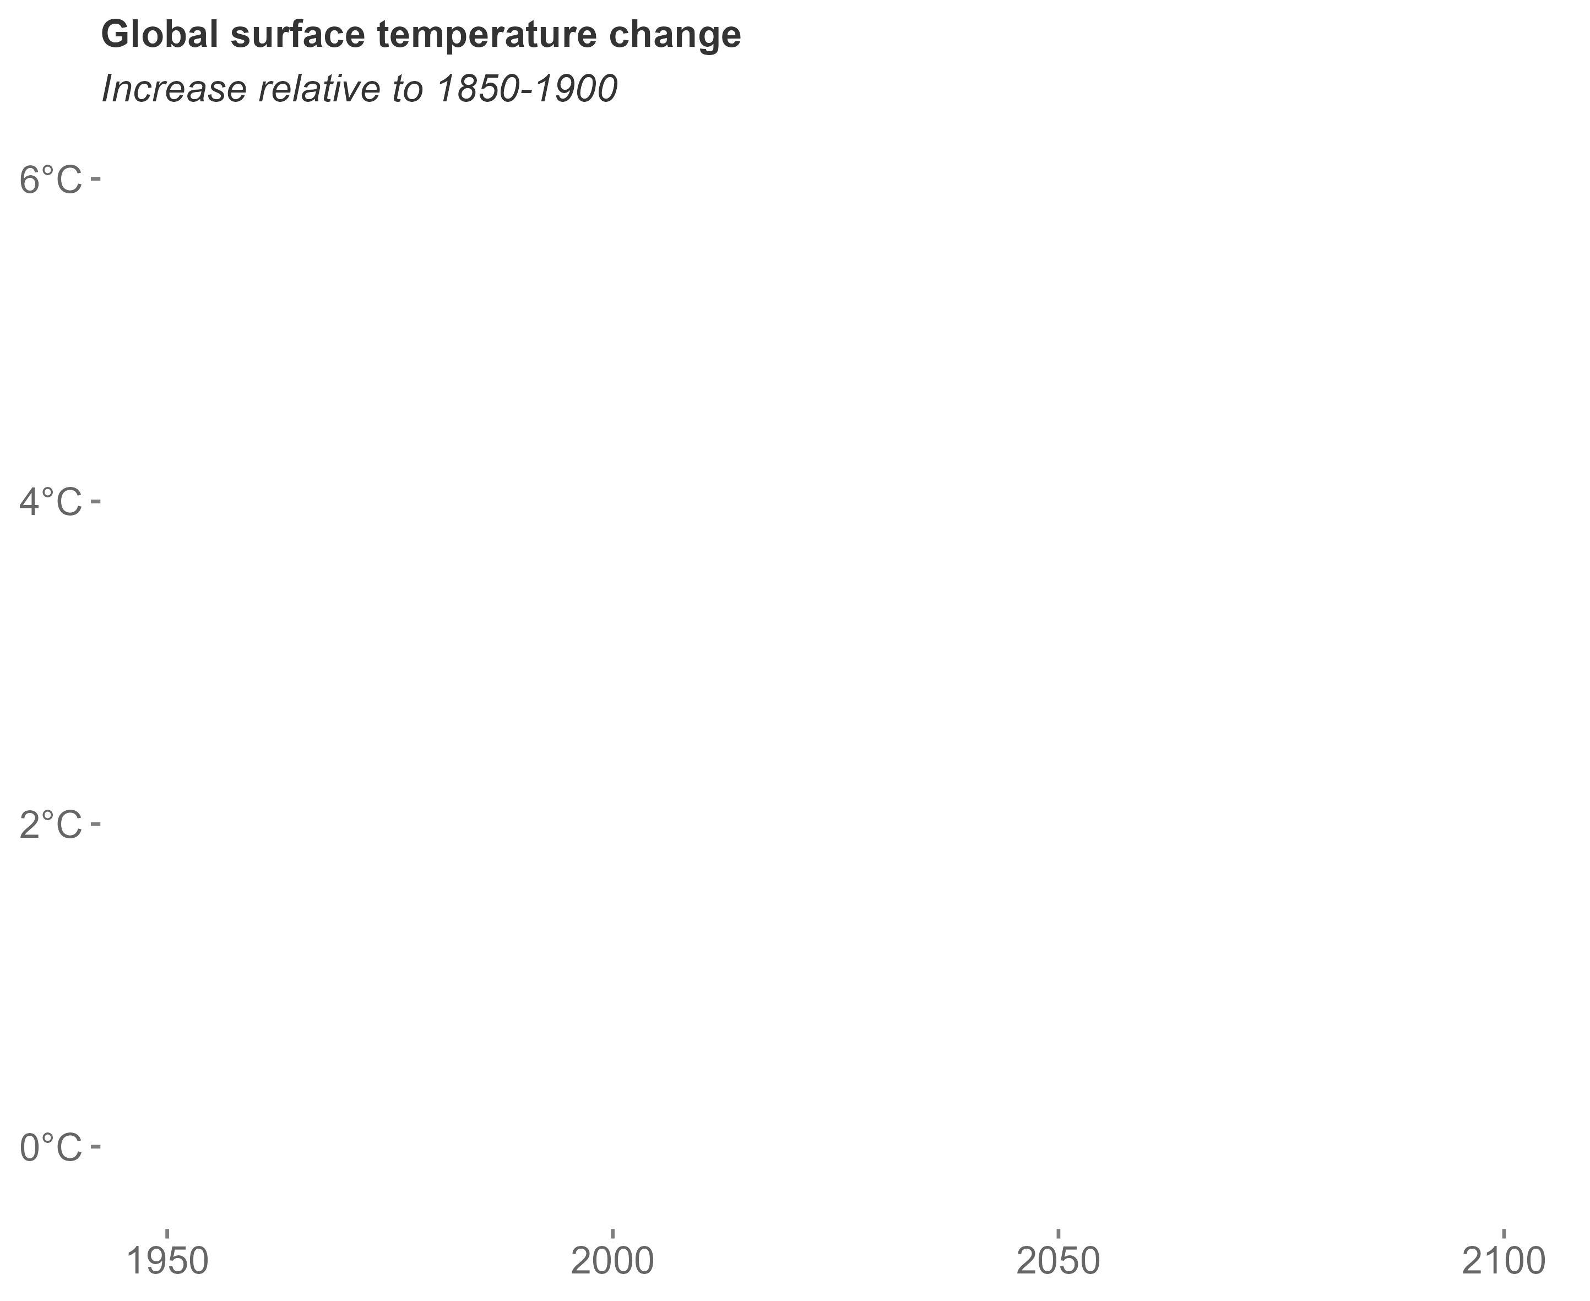
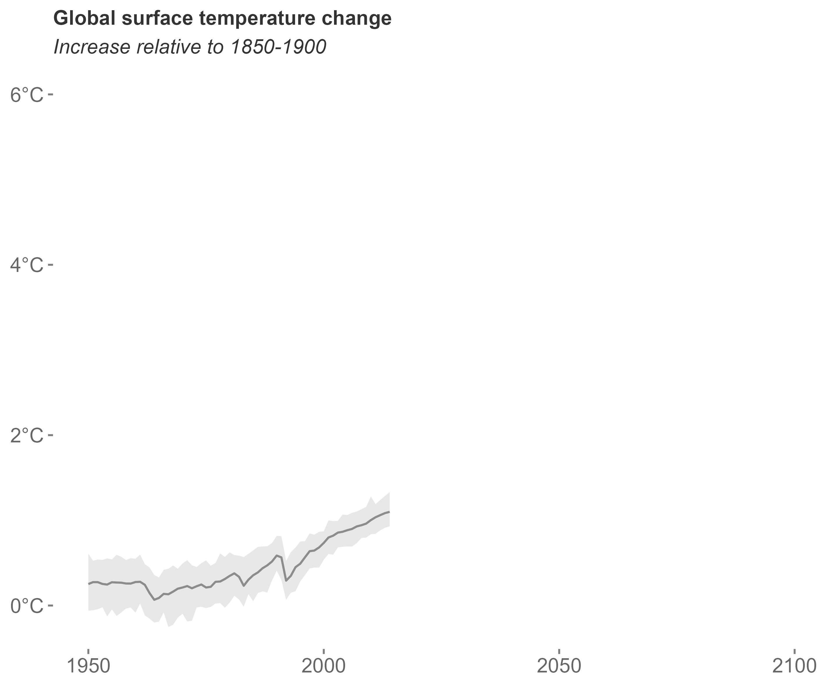
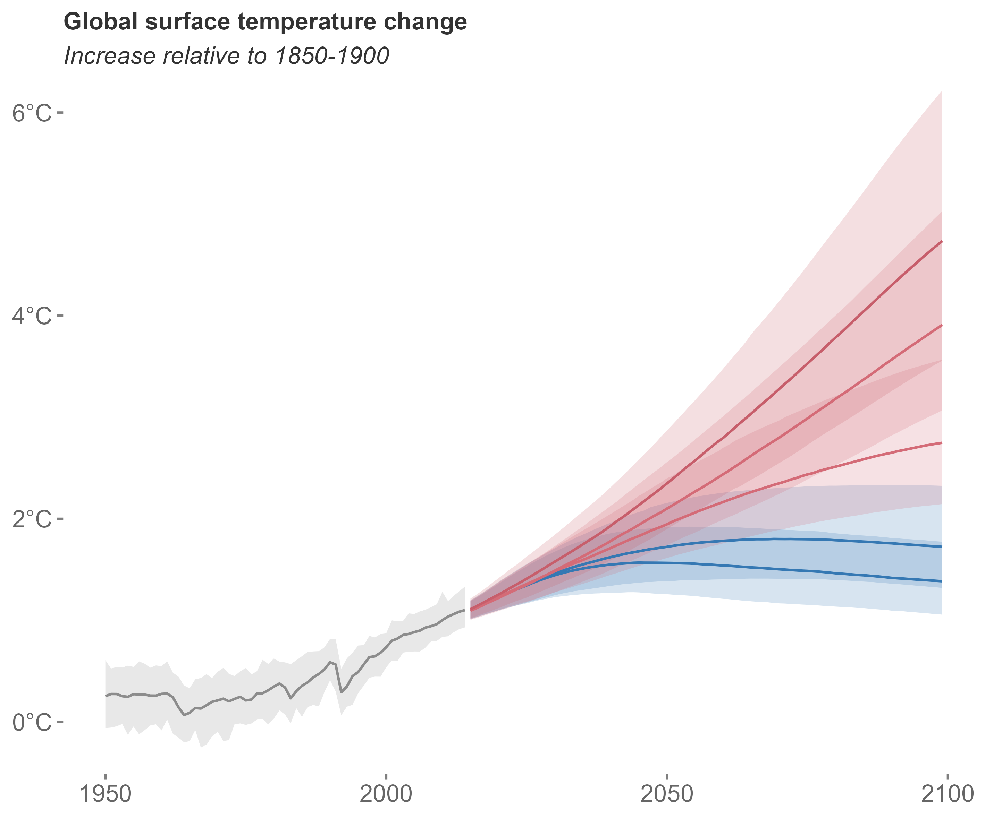
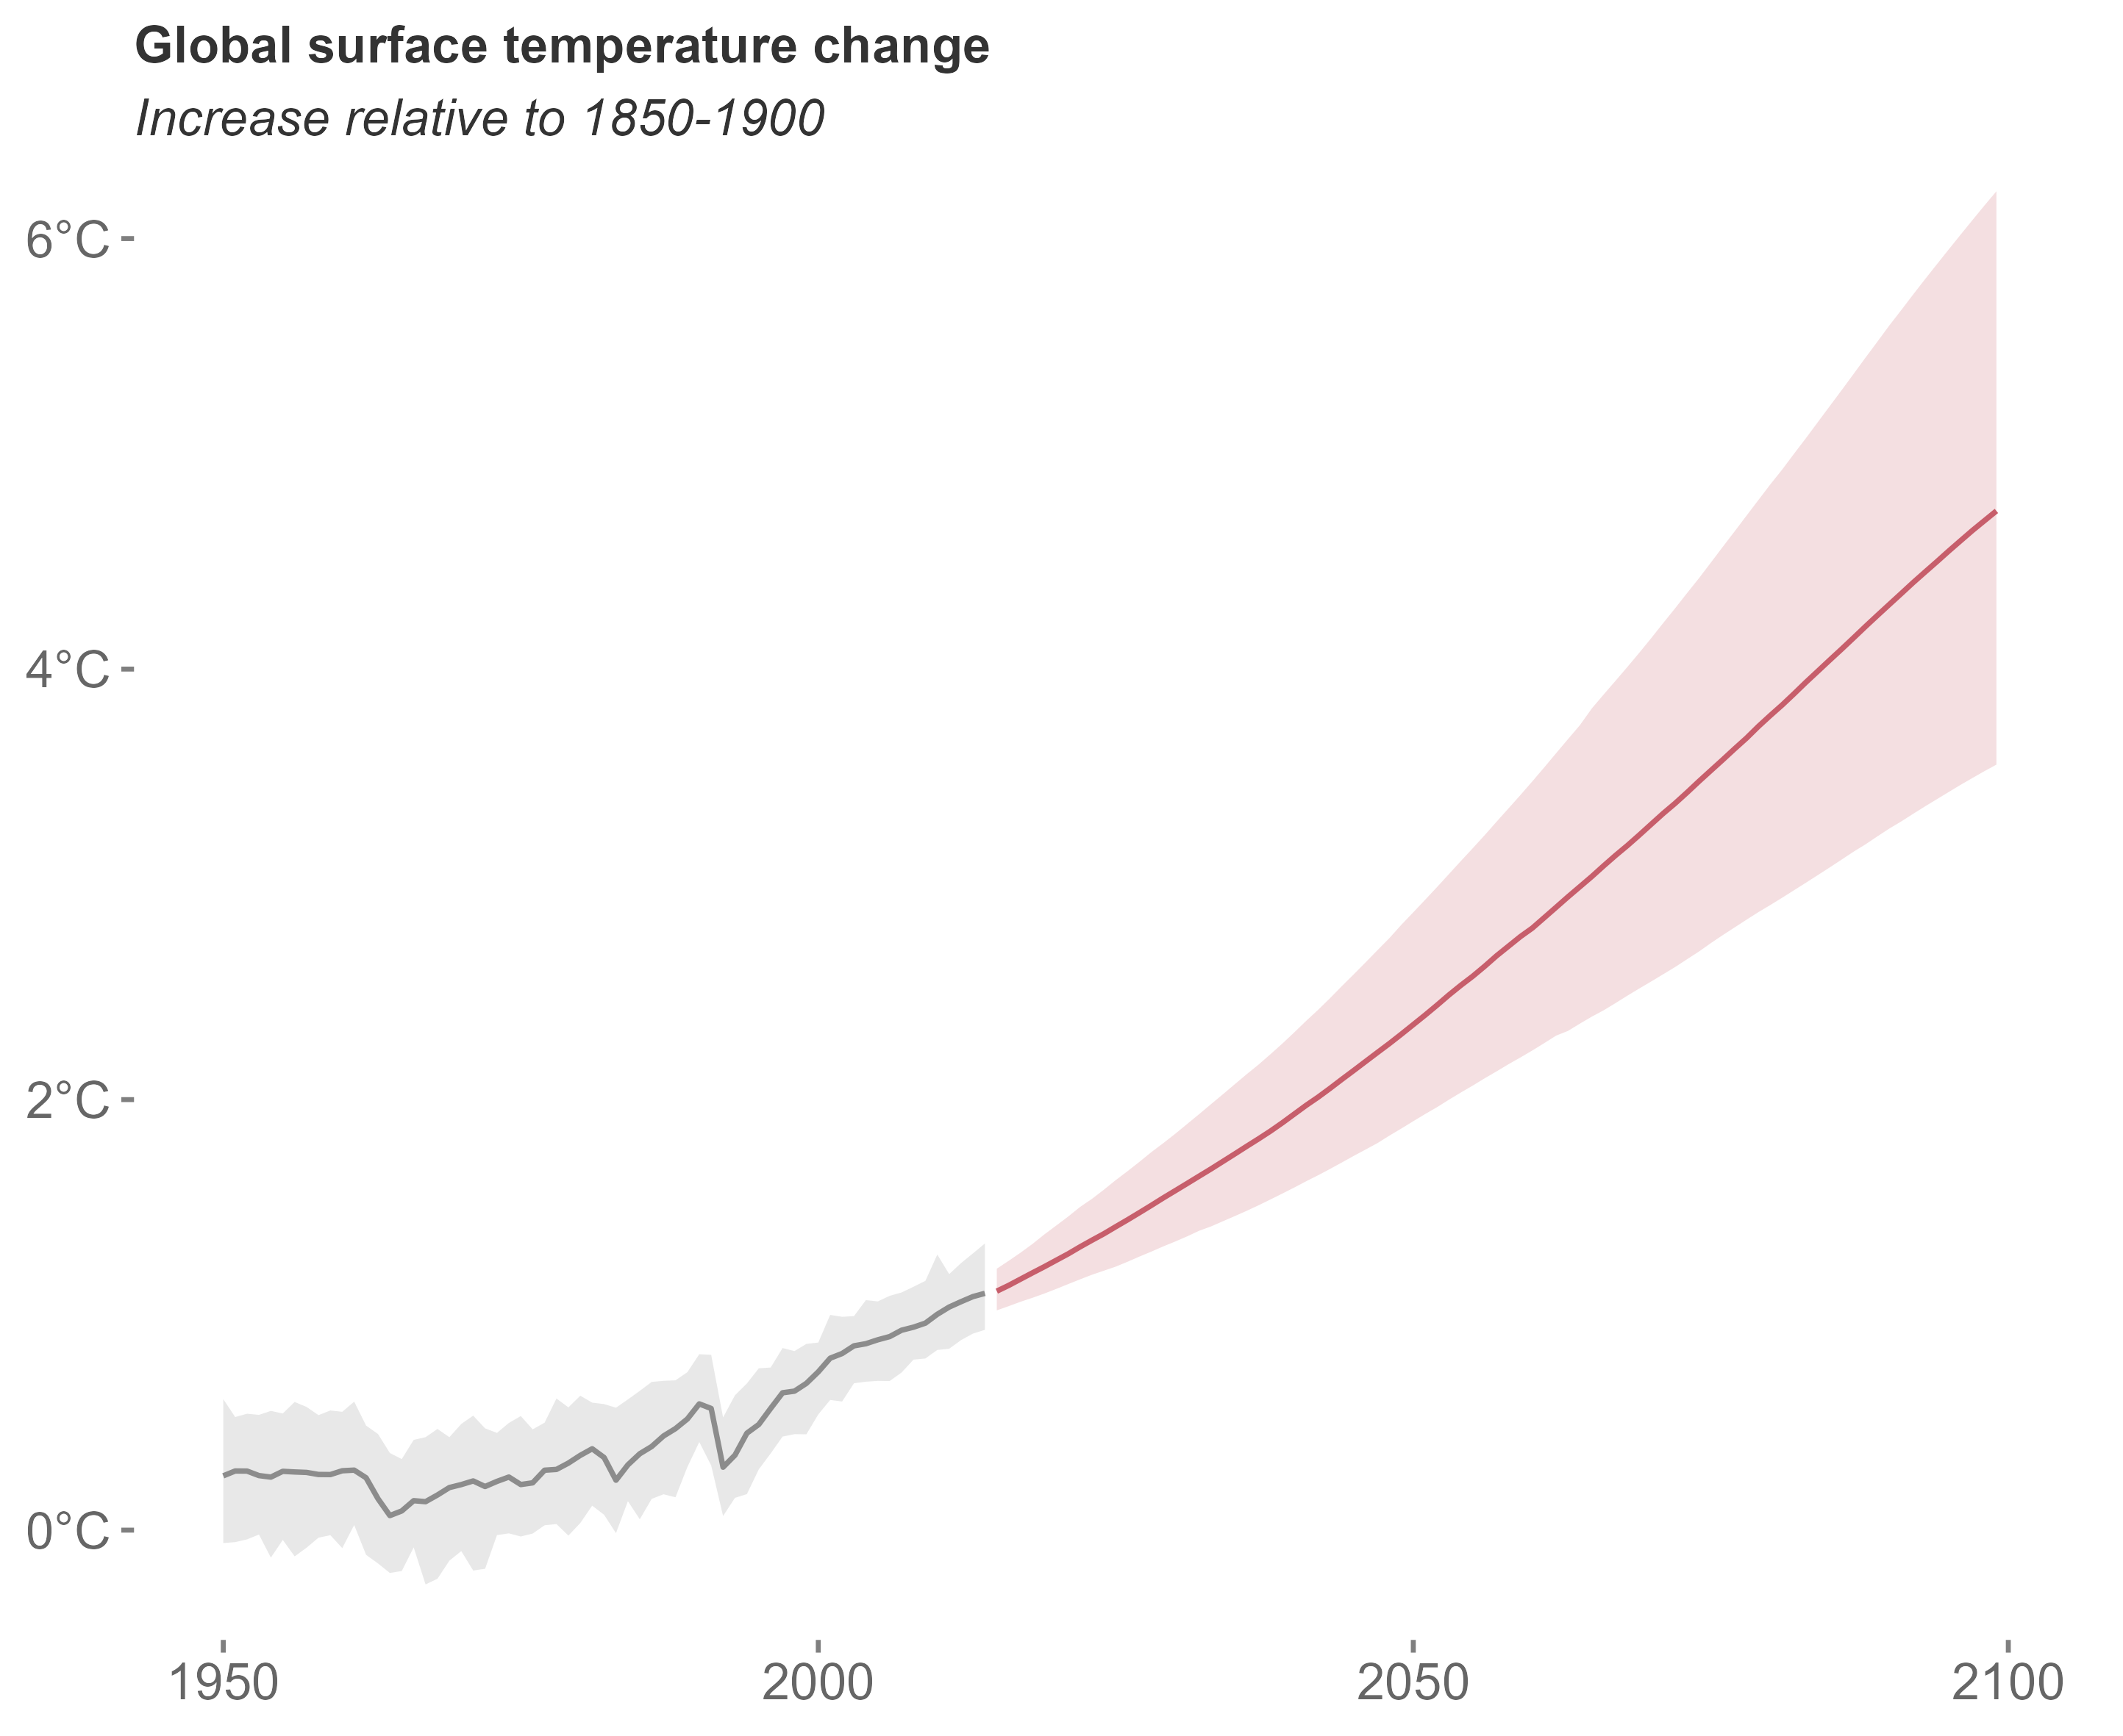
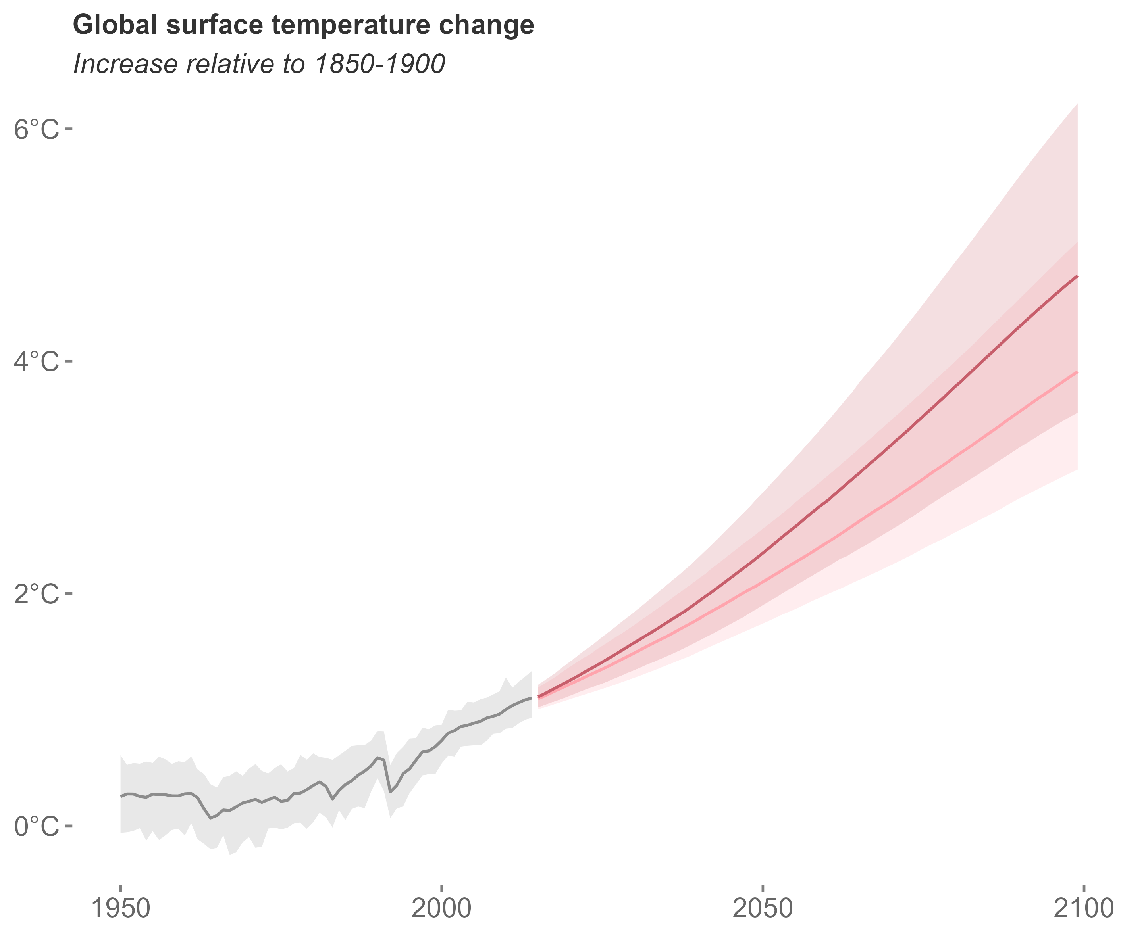
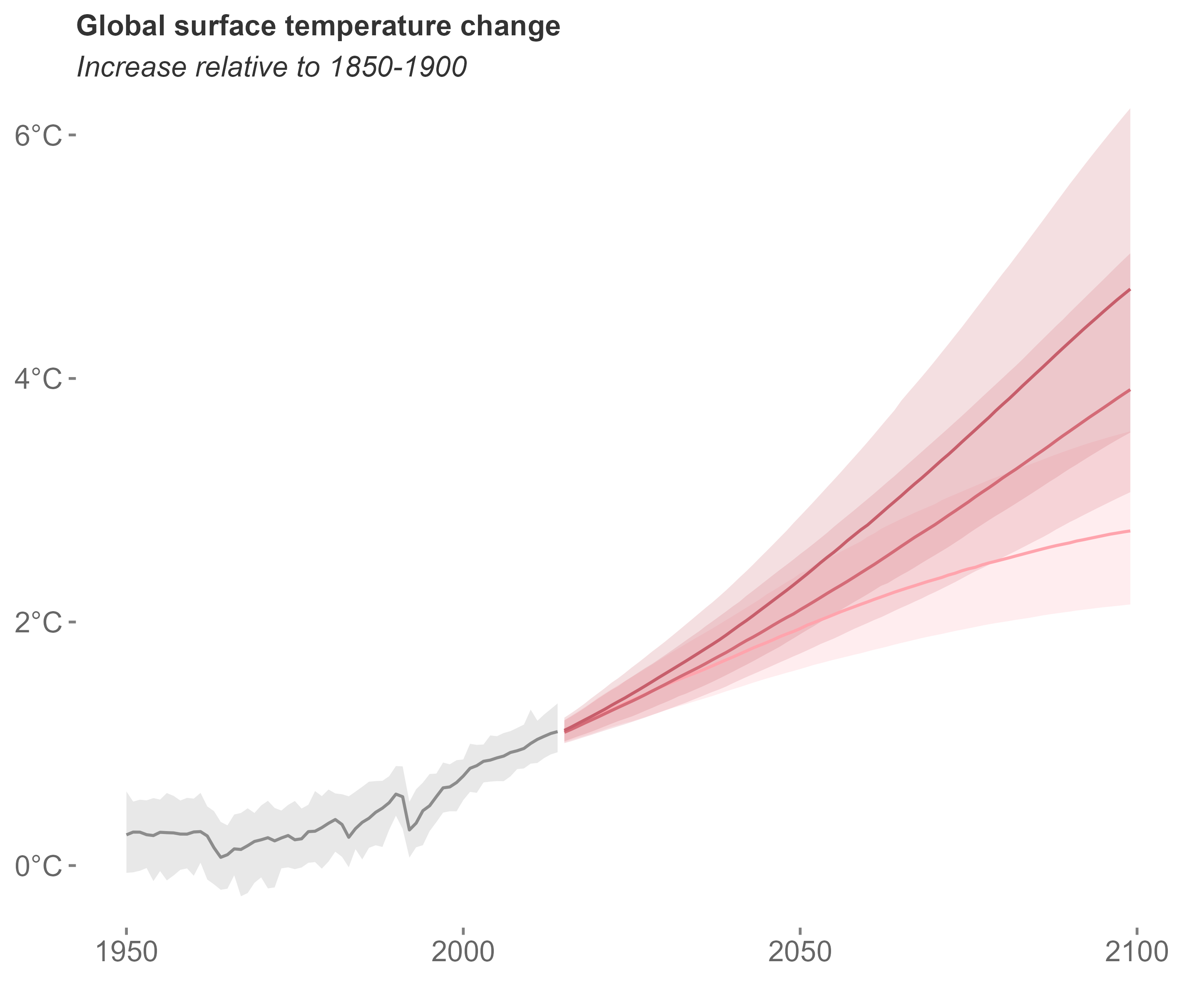
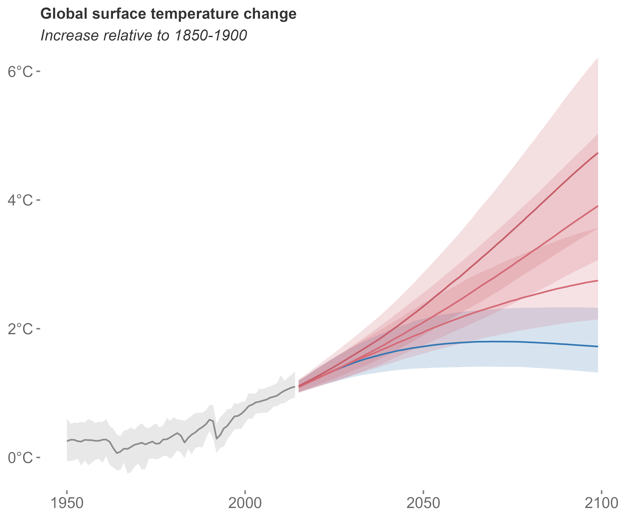
Two approaches
modified after IPCC 2022
Song et al. 2022

