Slide 1

The role of climate legacies in shaping extinction risk throughout Earth's history
University of Bayreuth
Gregor Mathes
PhD Defense
02.02.2023

Slide 2

One of the defining features of the Anthropocene is that the world is changing in ways that compel species to move
Elizabeth Kolbert, The Sixth Extinction: An Unnatural History

Slide 3
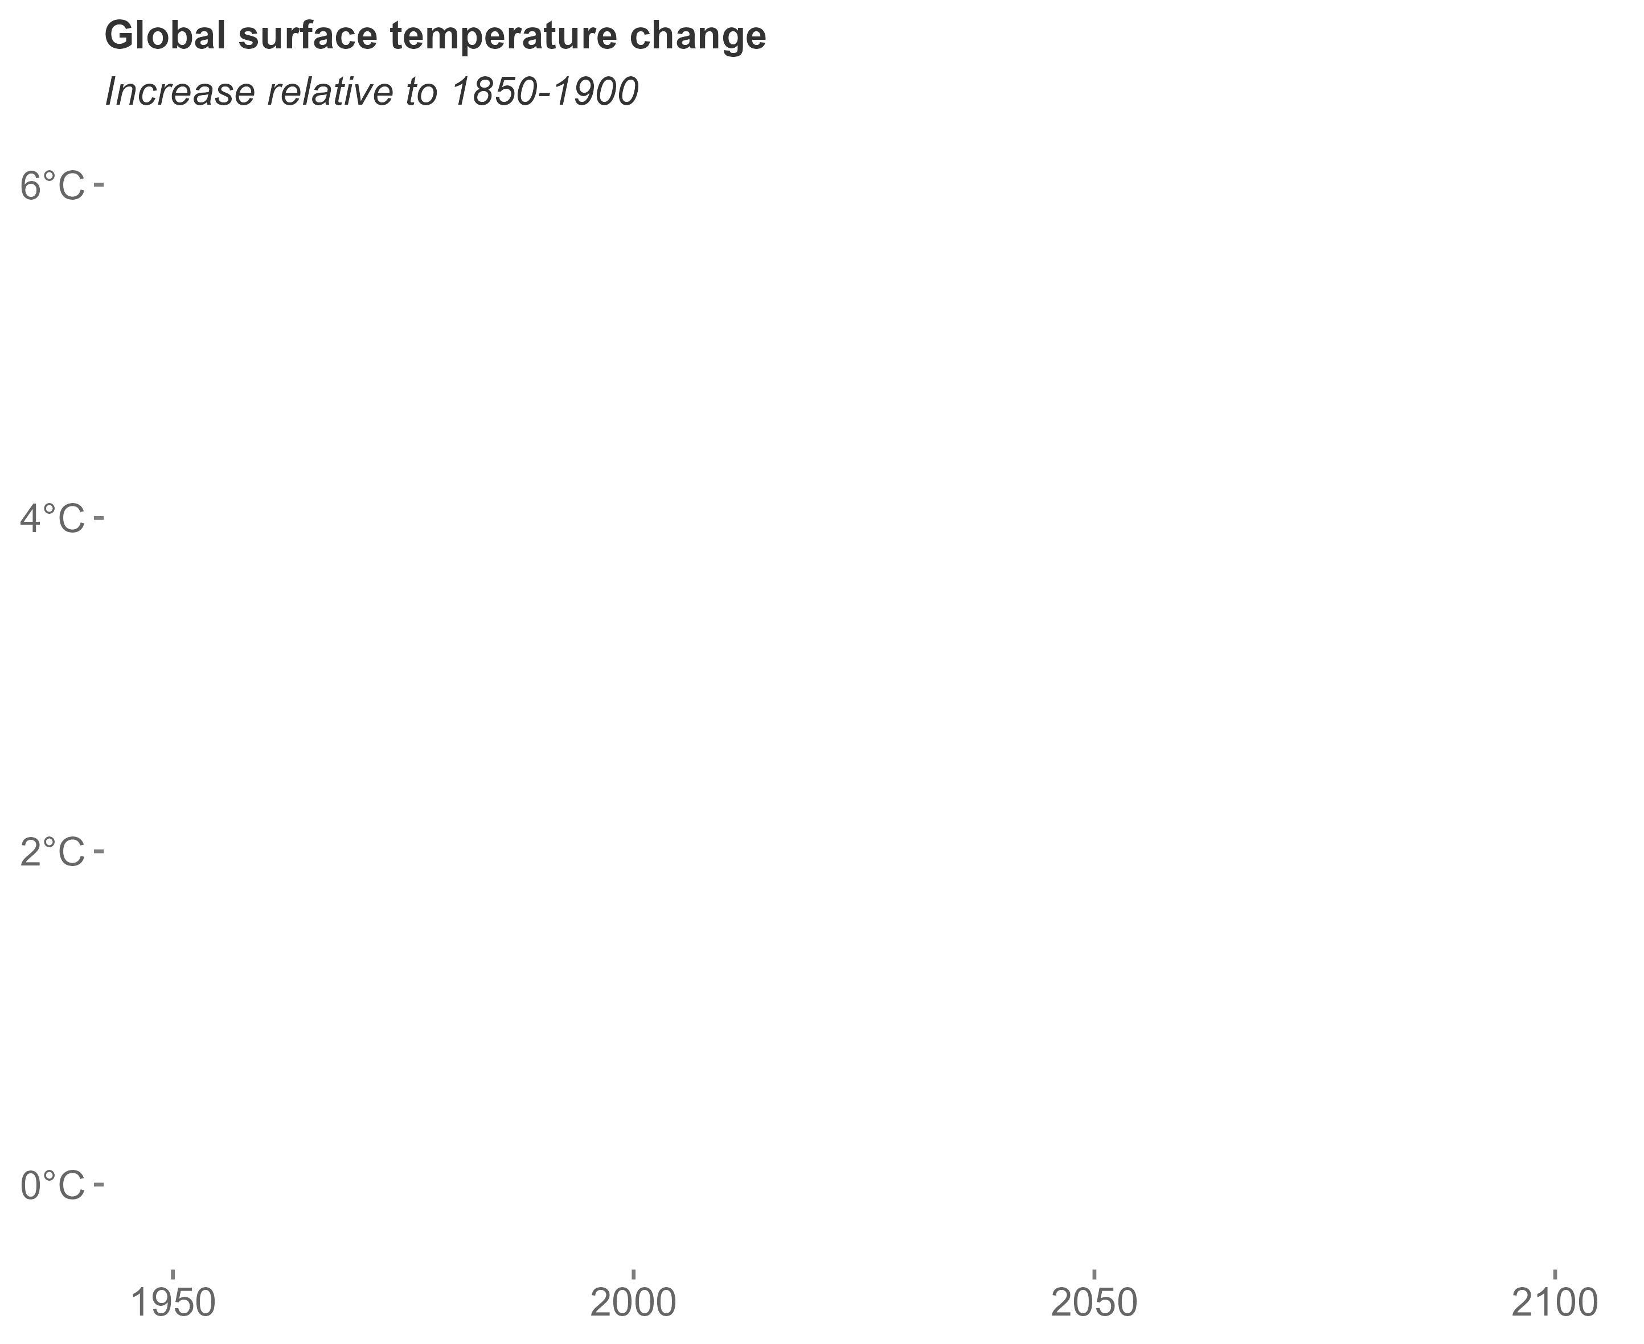
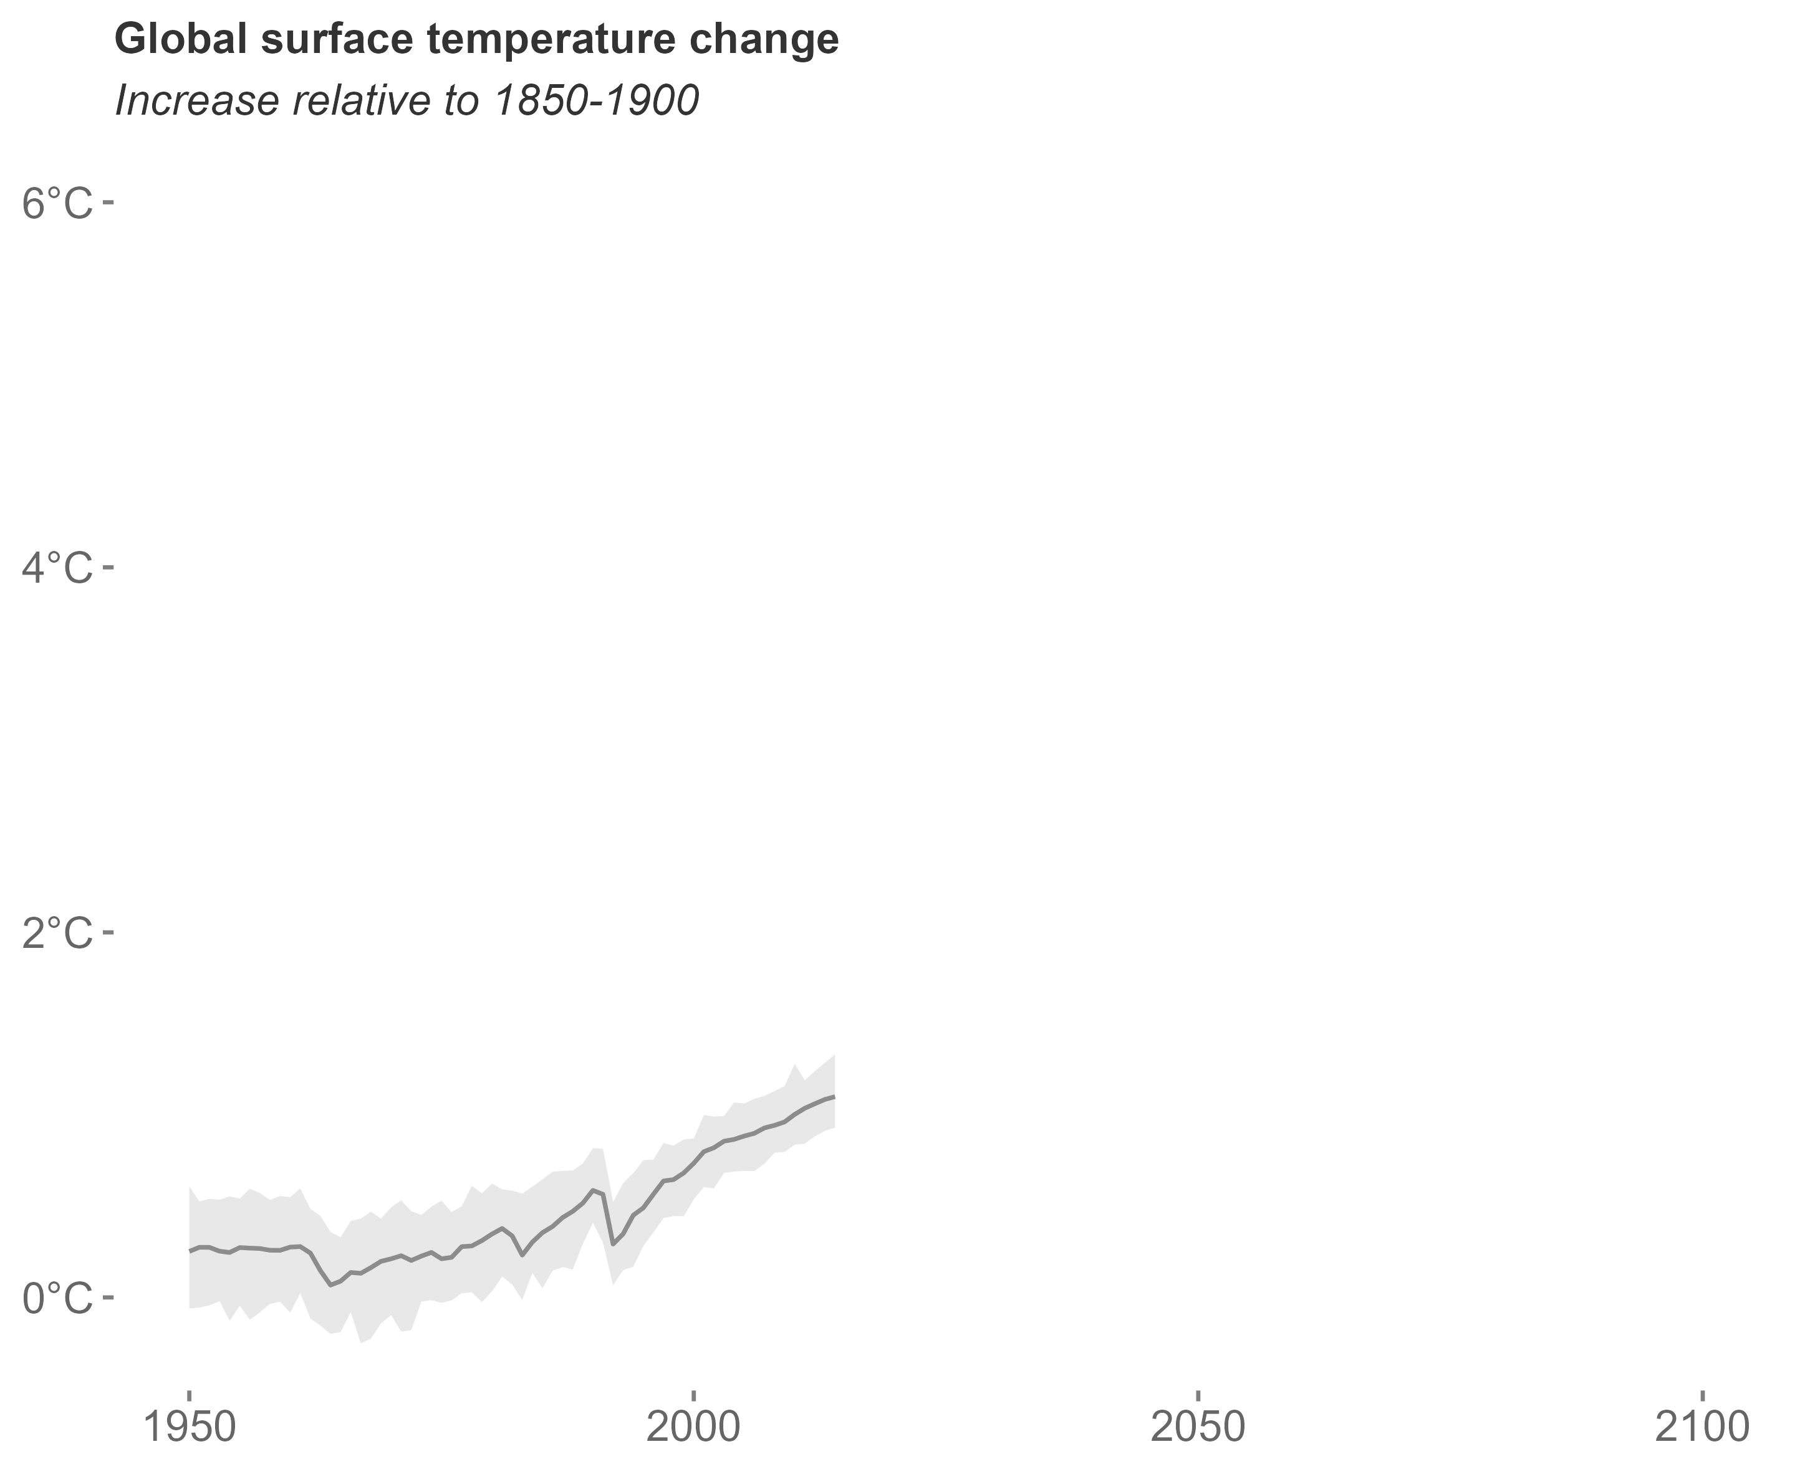
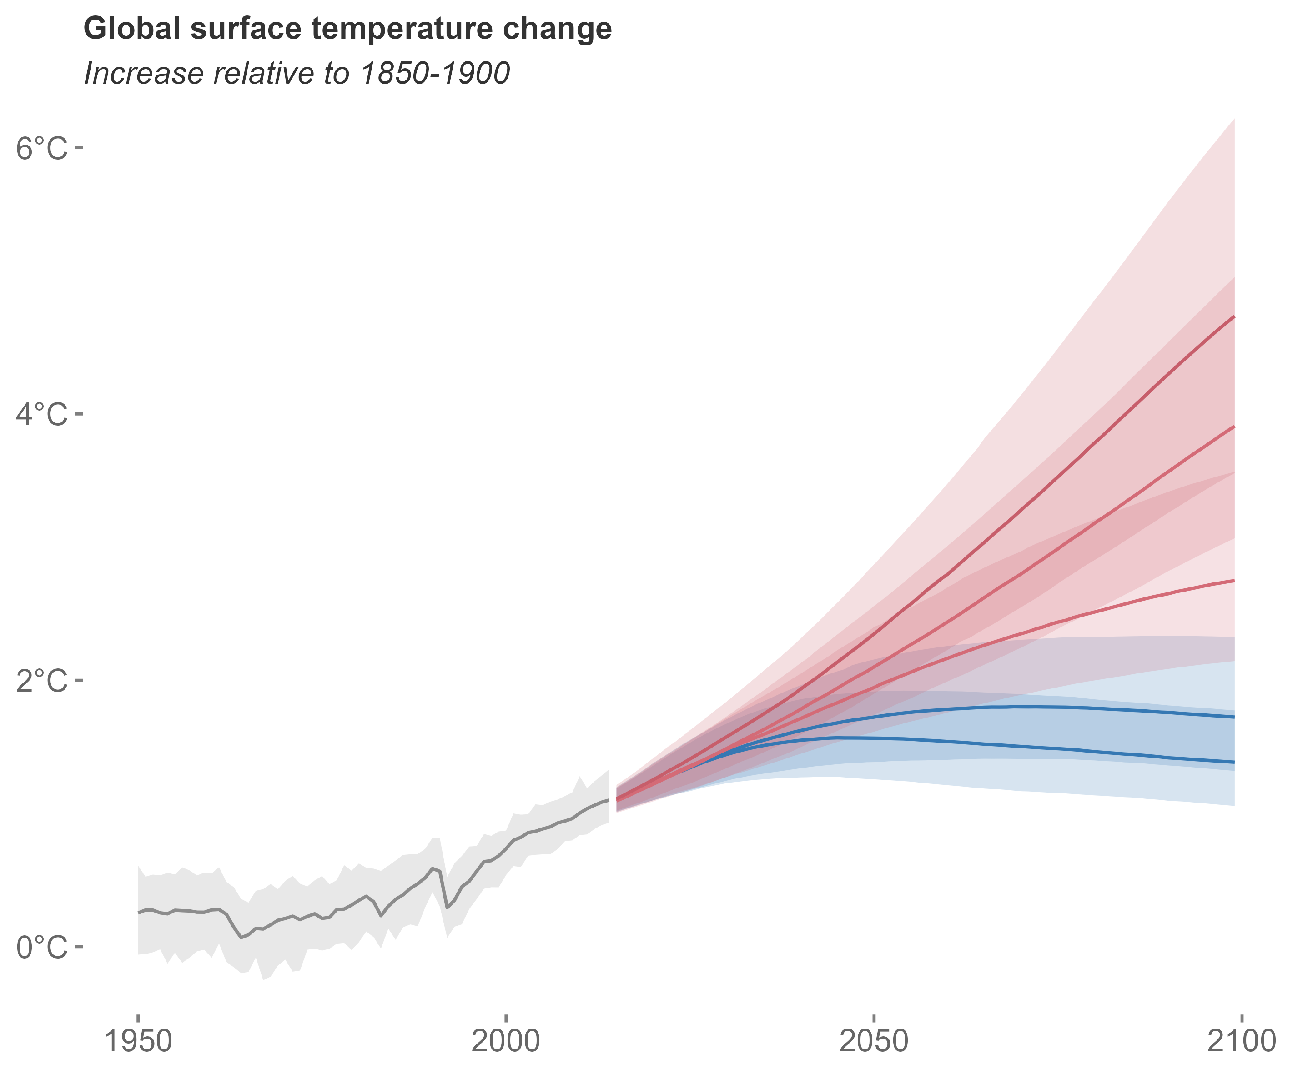
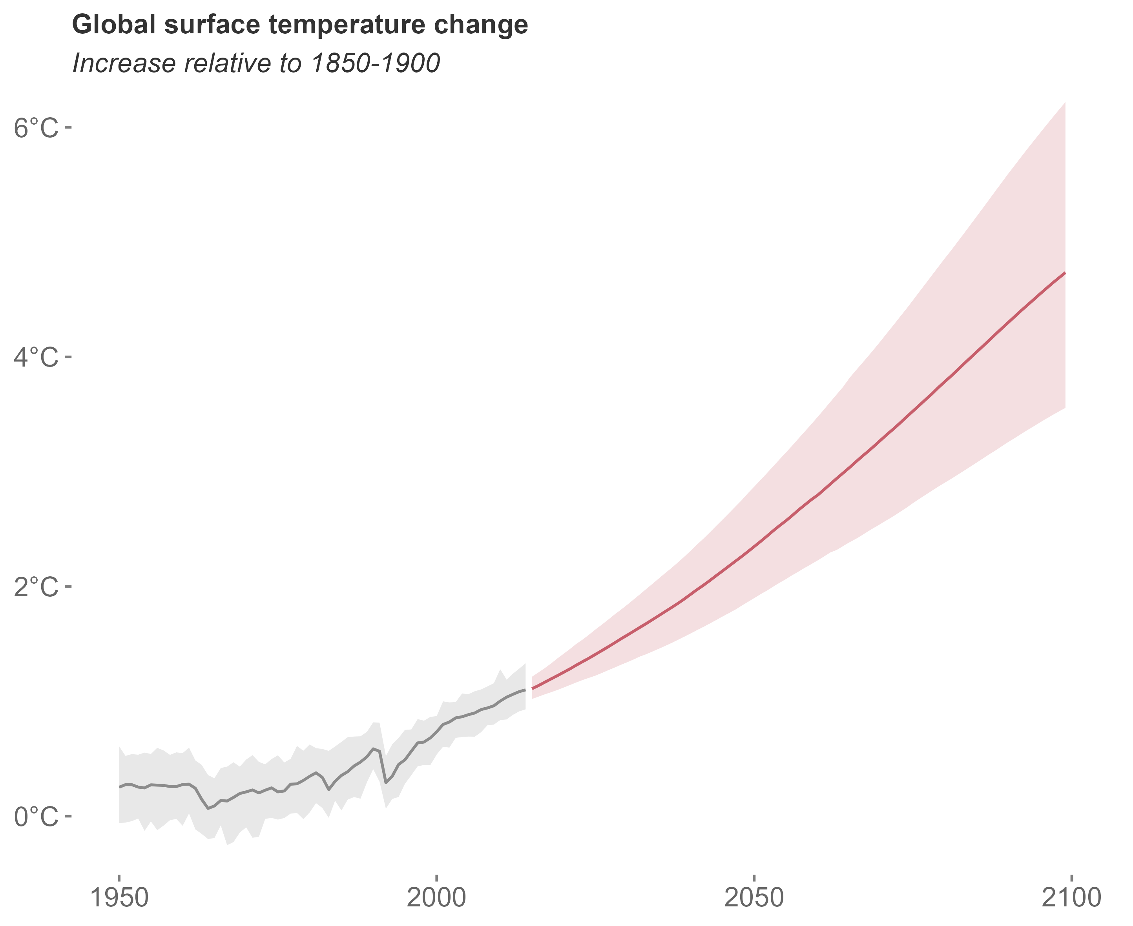
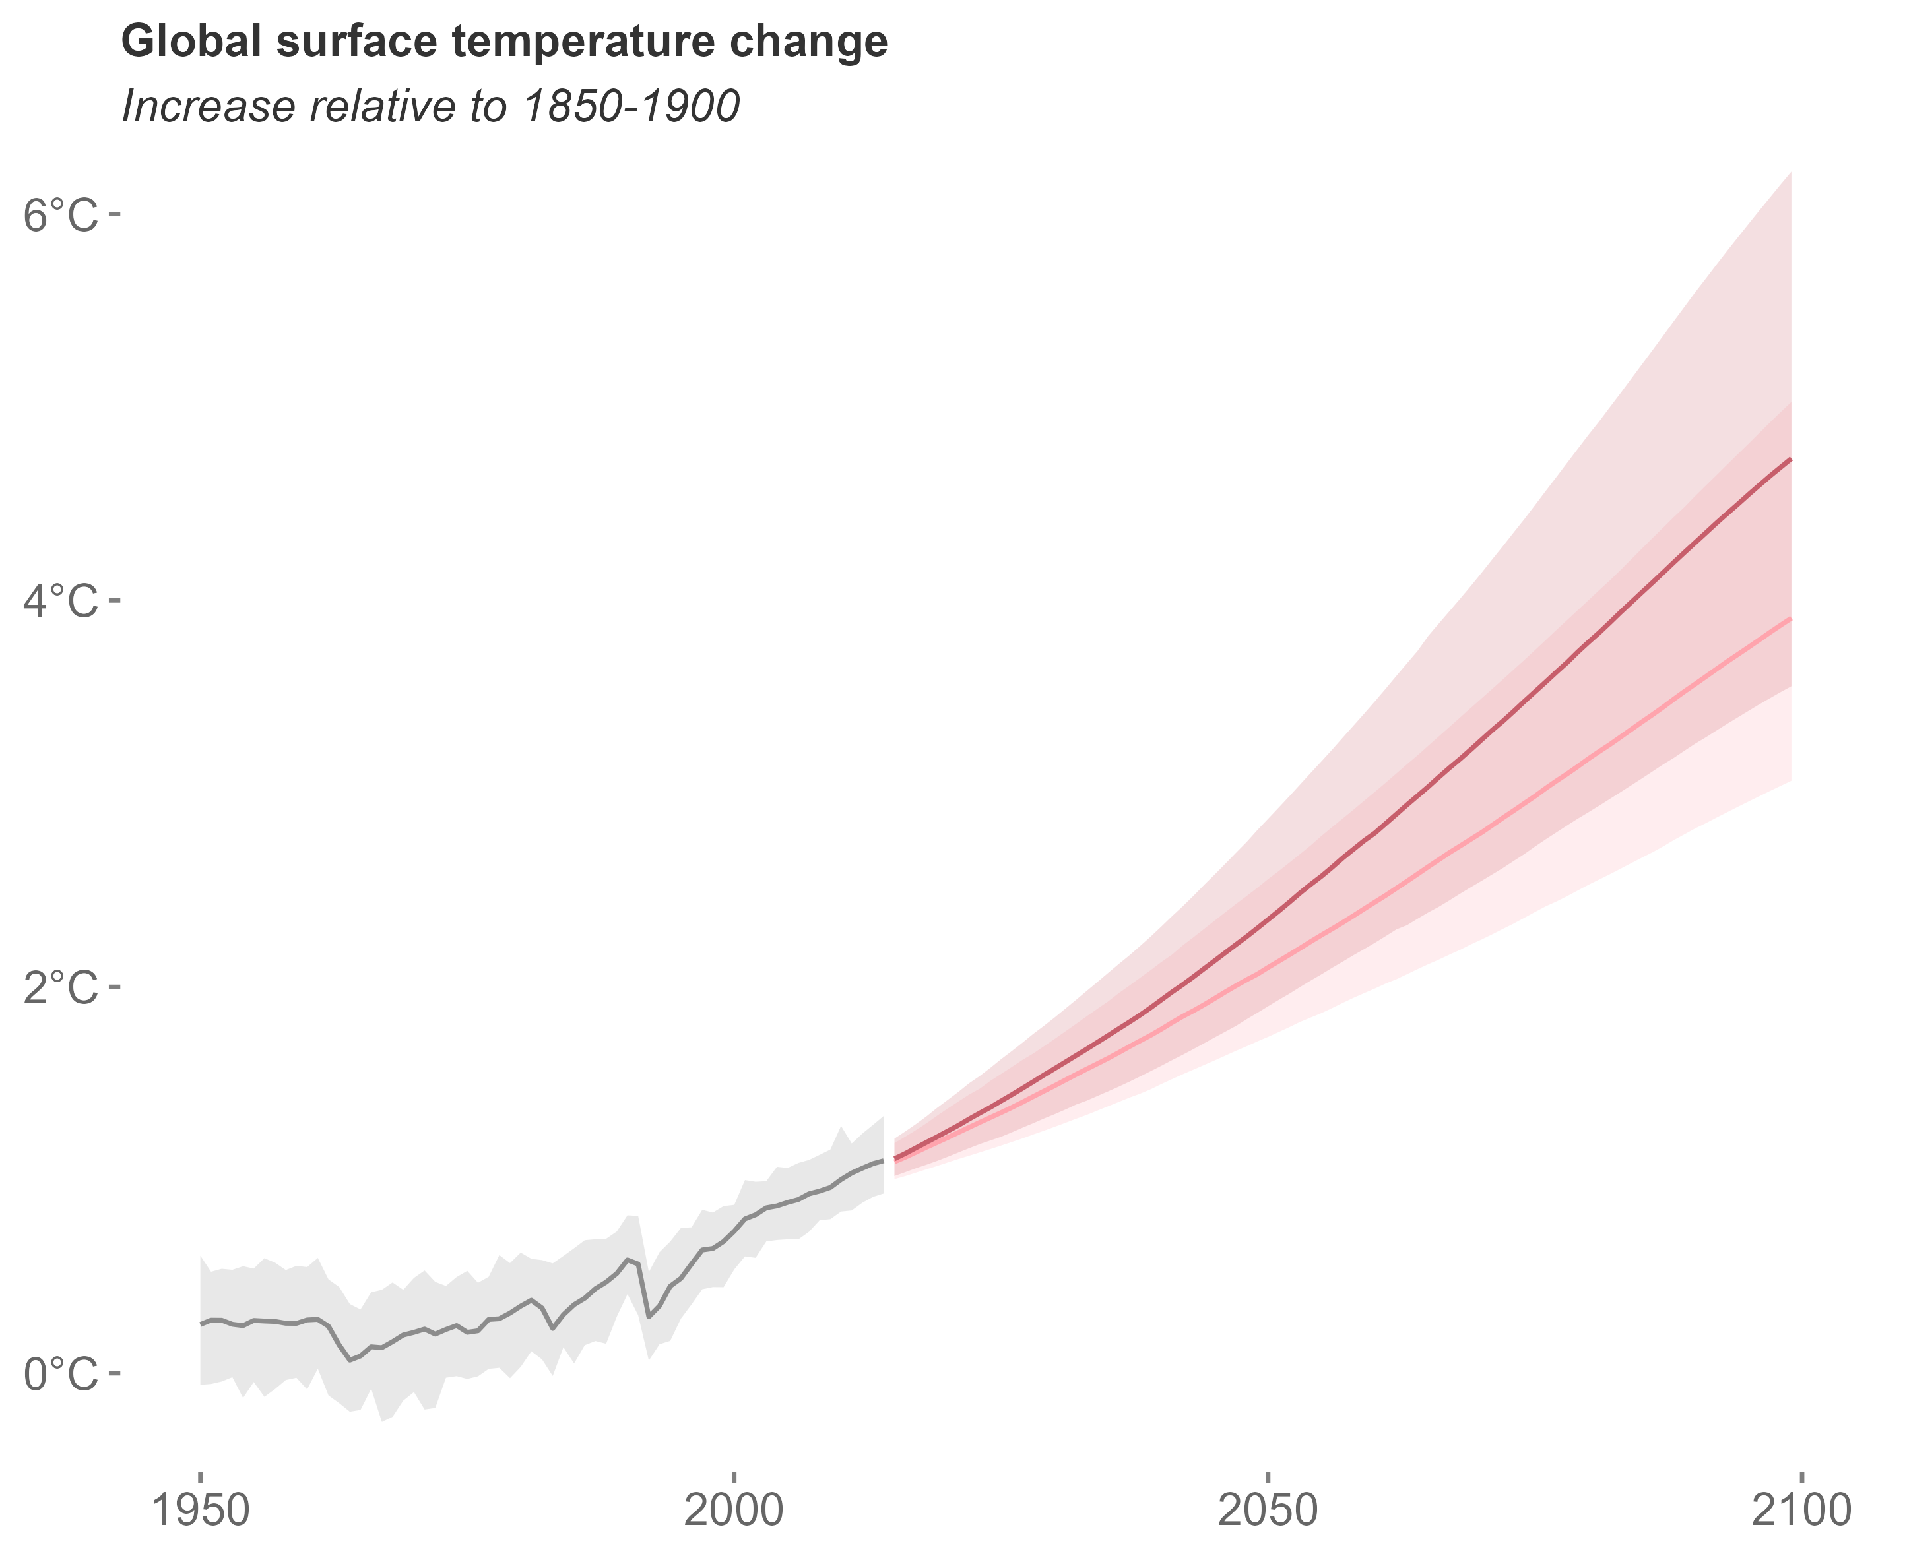
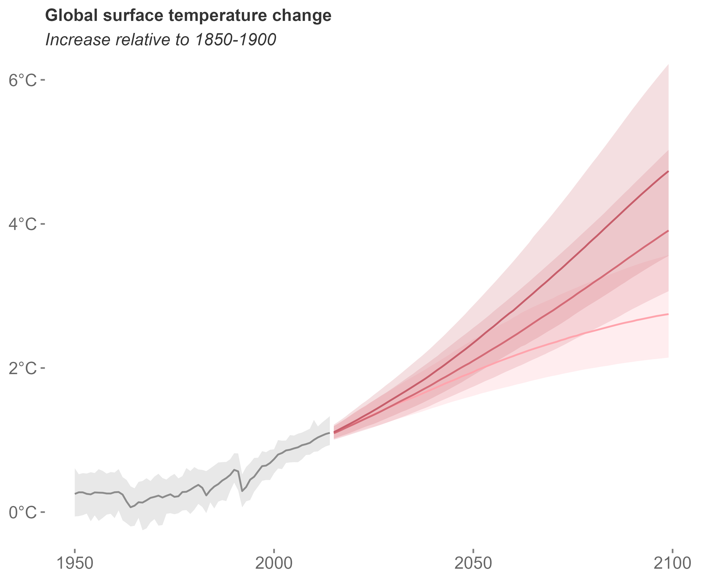
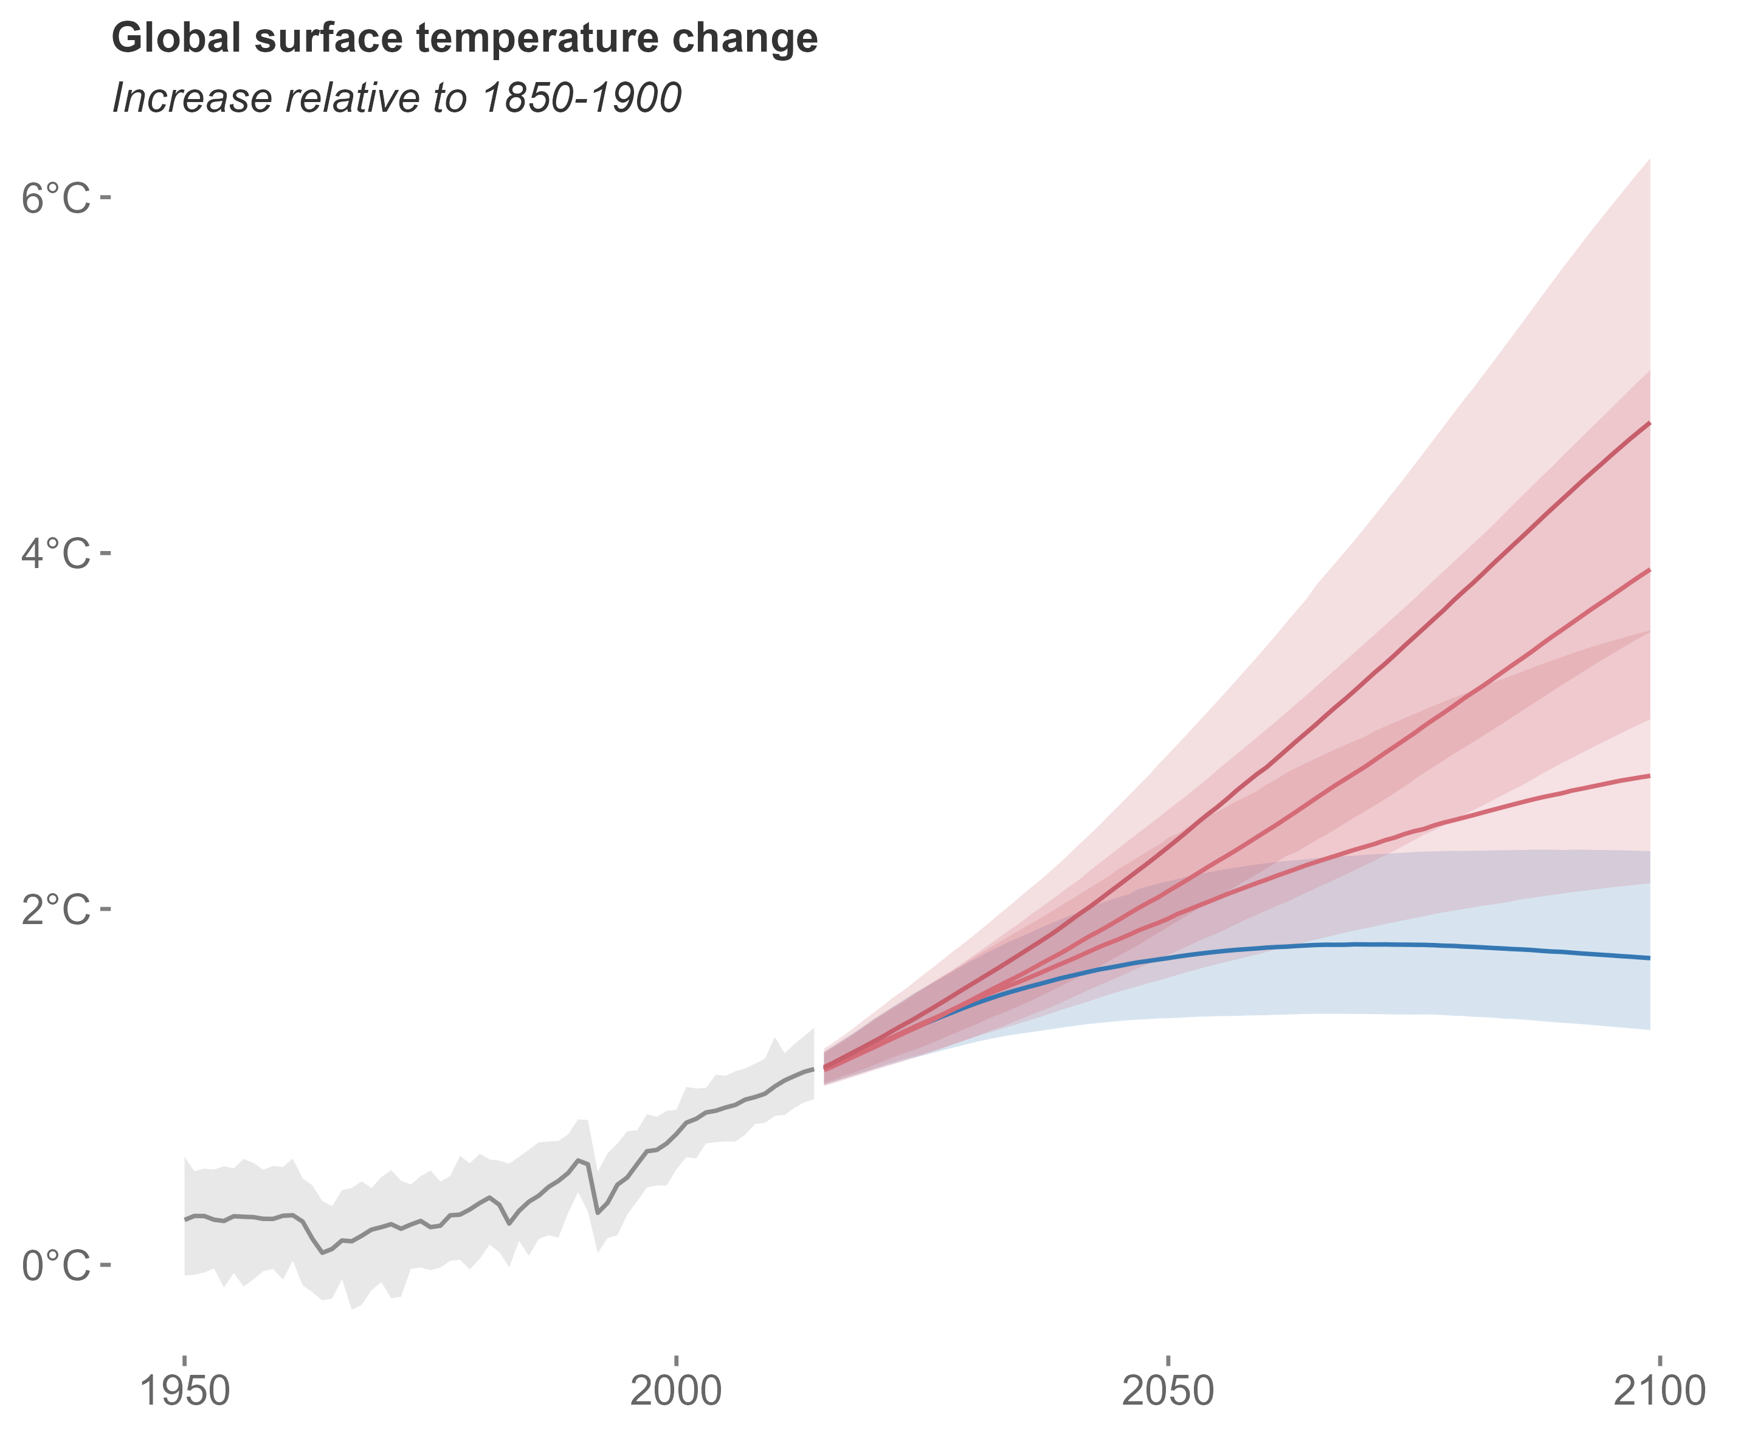
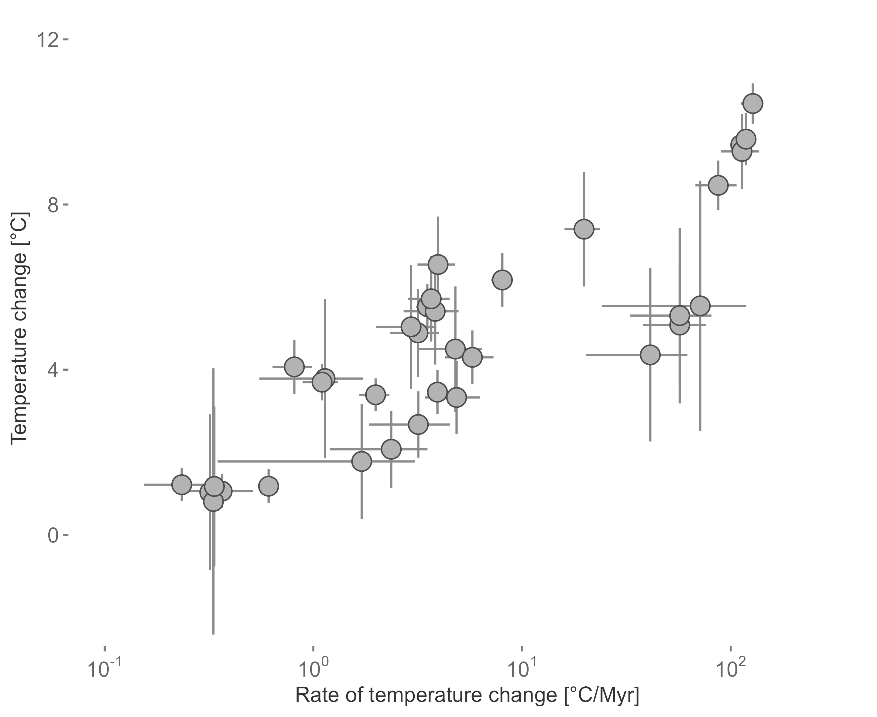
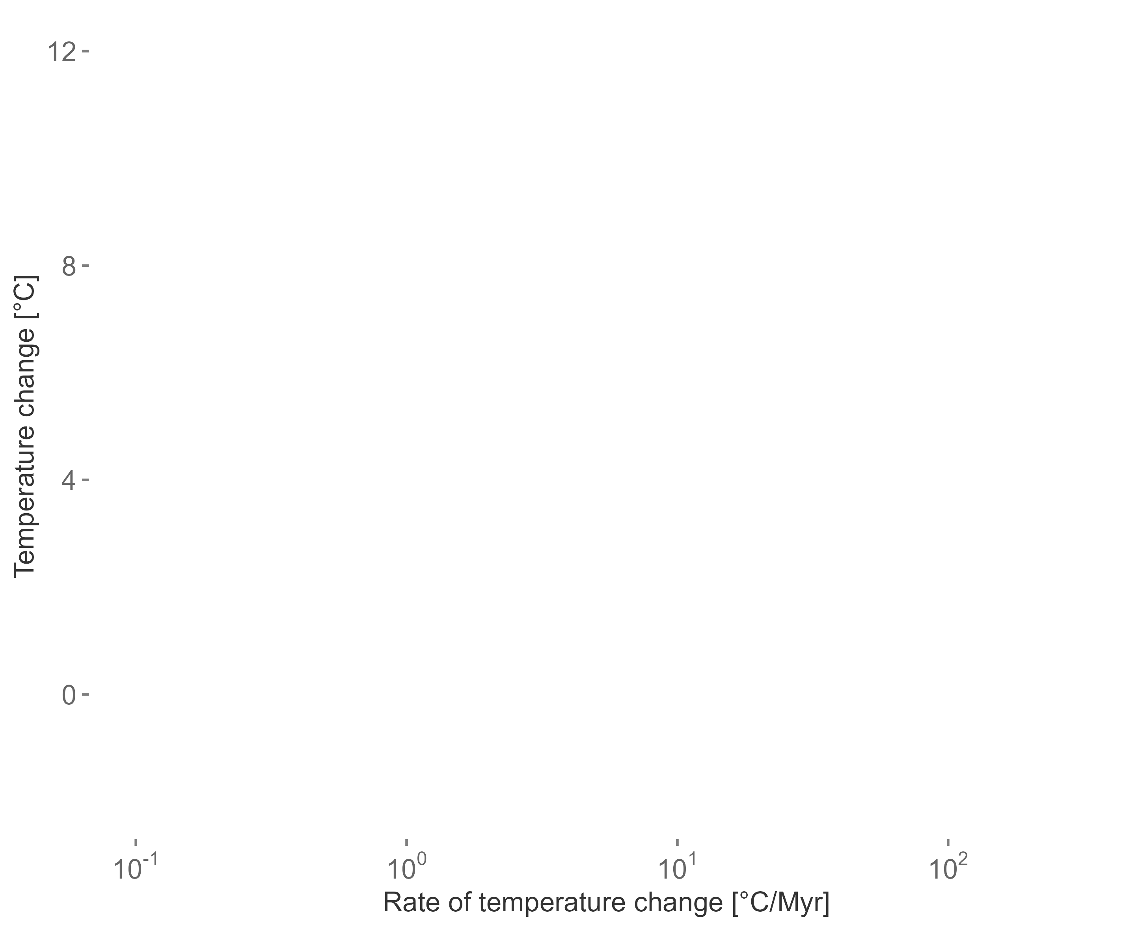
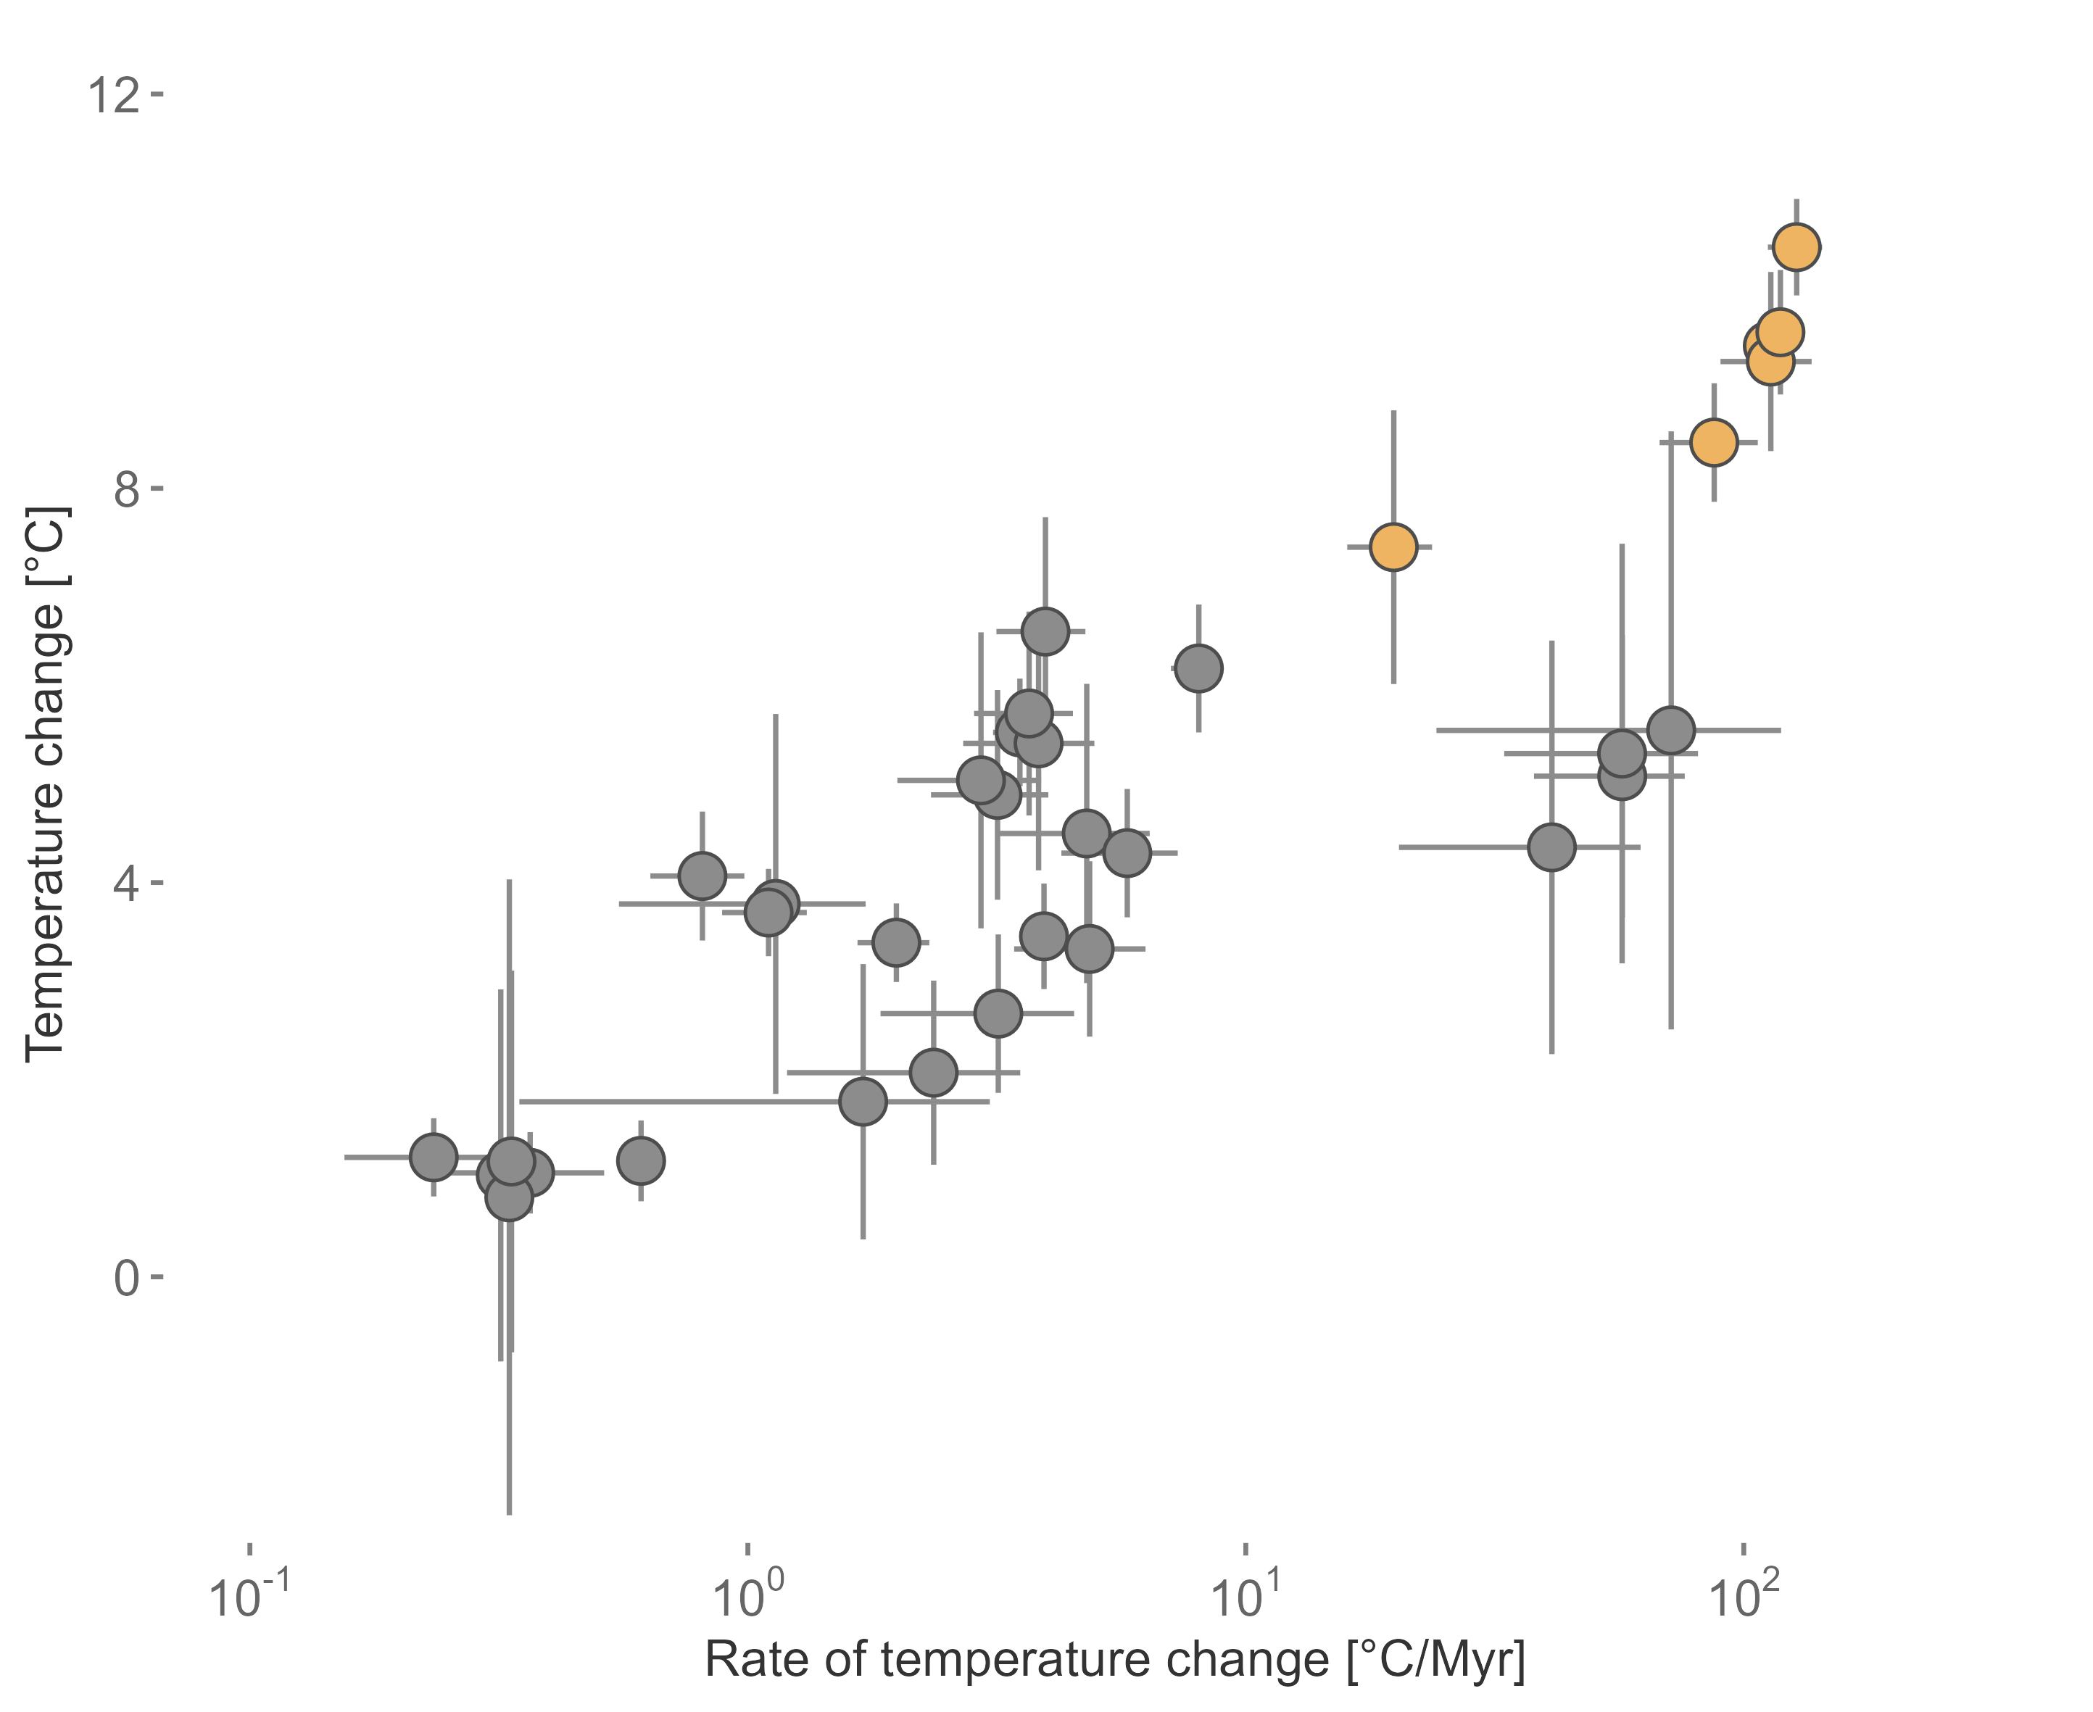


Two approaches
modified after IPCC 2022
modified after Song et al. 2022

Slide 4






Temporal context matters
Motivation and Background
PhD Chapters
Deep-Time
Extinction risk of fossils
Origination probability of fossils
Environmental data during extinction events
Near-Time
Rate of change in terrestrial plants
Assemblage turnover in planktonic foraminifera
Implementation in conservation science
Conclusion and Outlook
Meta-analysis and review

Slide 5
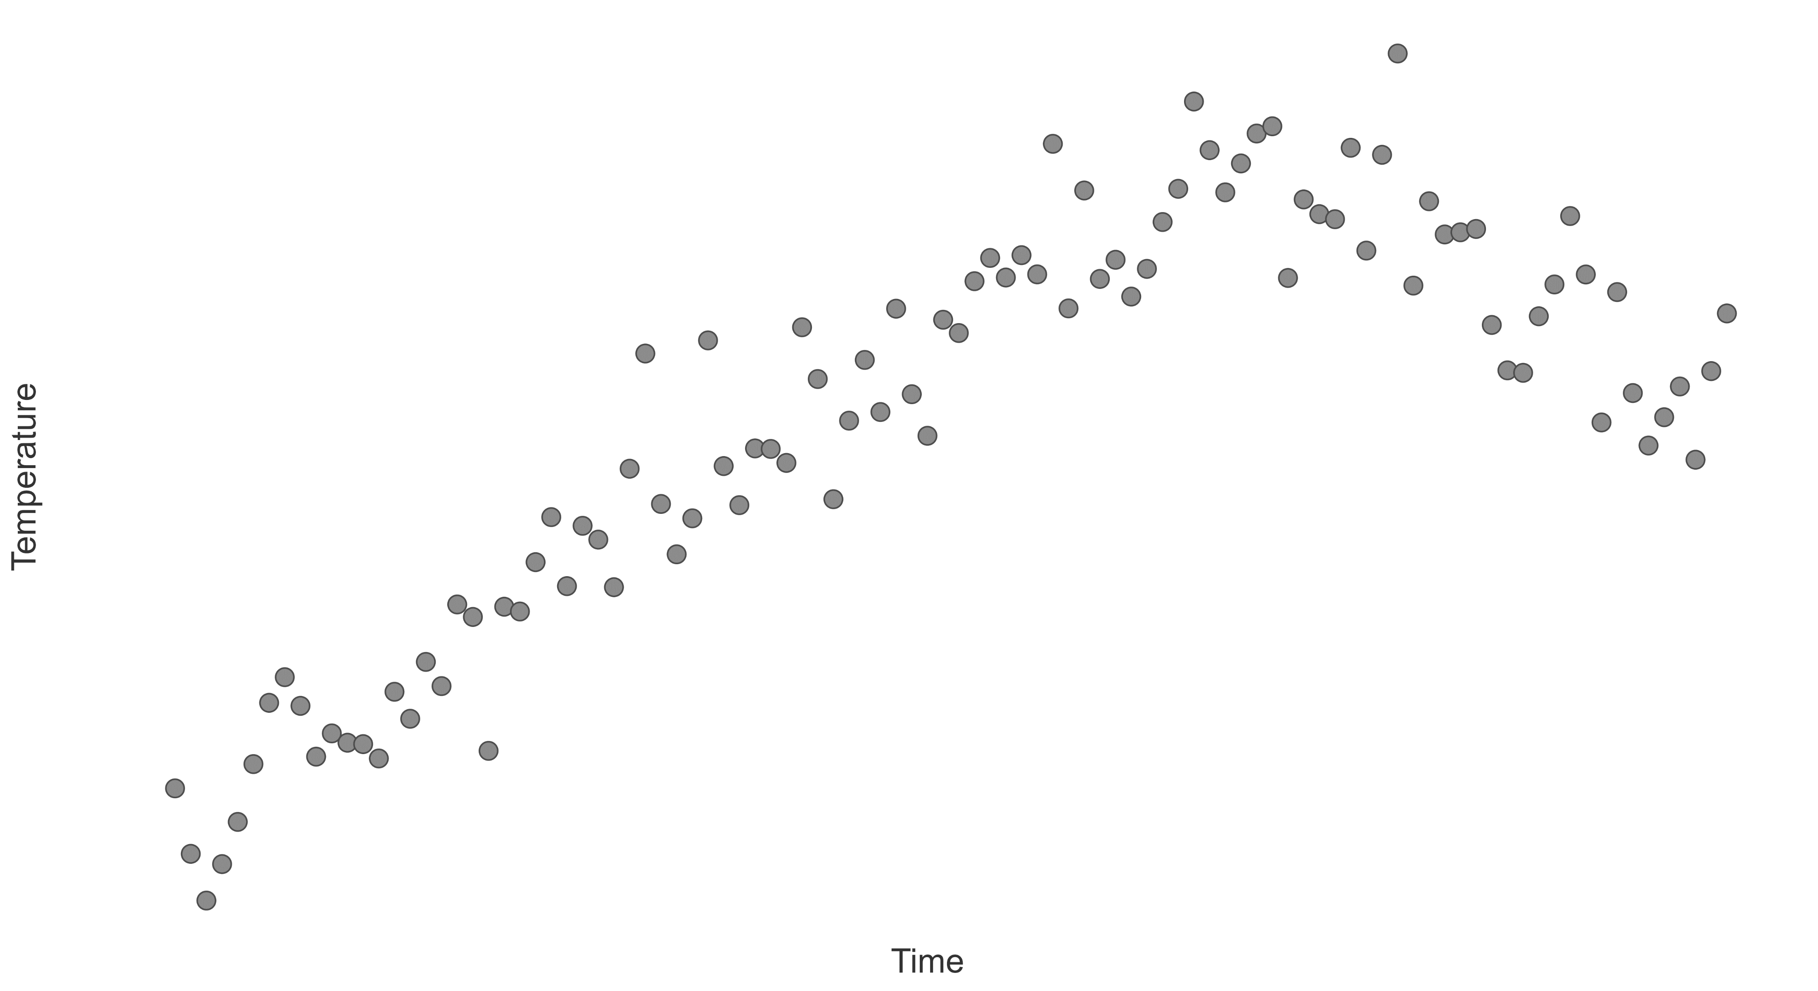
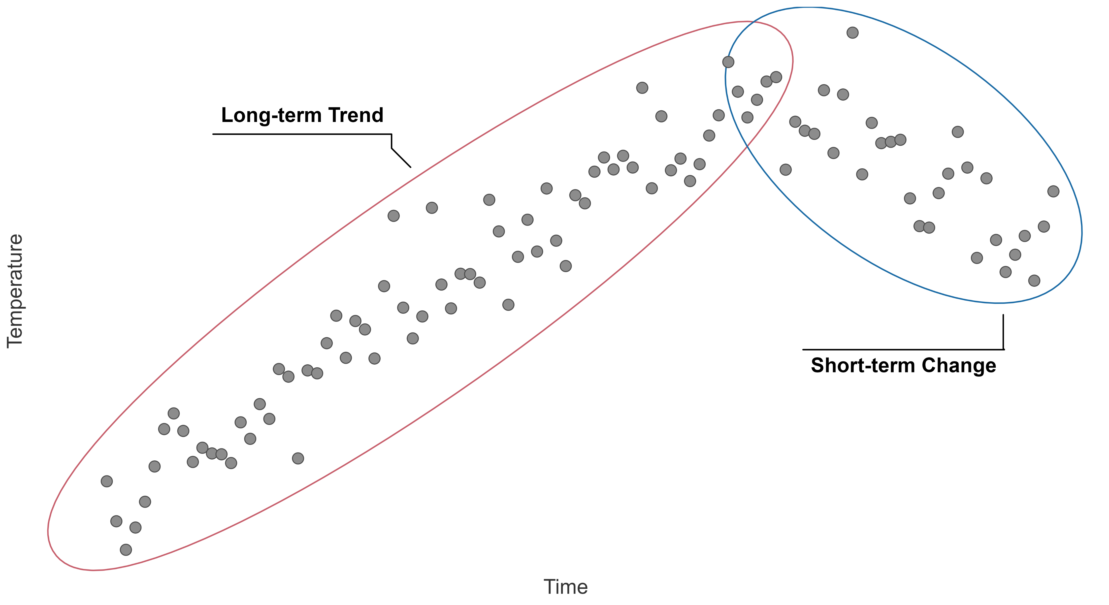
Temporal context

Slide 6
Niche stability
- Temperature +
Topt
Time
Performance
Tmin
Tmax
Temperature
Wiens and Graham 2005
Lieberman and Saupe 2016
Steinbauer et al. 2016

Slide 7
Niche stability
- Temperature +
Topt
Time
Performance
Tmin
Tmax
Temperature
Wiens and Graham 2005
Lieberman and Saupe 2016
Steinbauer et al. 2016

Slide 8
- Temperature +
- Temperature +
Time
Time
- Temperature +
- Temperature +
Time
Time

