Slide 1

The role of climate legacies in shaping extinction risk throughout Earth's history
University of Bayreuth
Gregor Mathes
PhD Defense
02.02.2023

Slide 2

One of the defining features of the Anthropocene is that the world is changing in ways that compel species to move
Elizabeth Kolbert, The Sixth Extinction: An Unnatural History

Slide 3
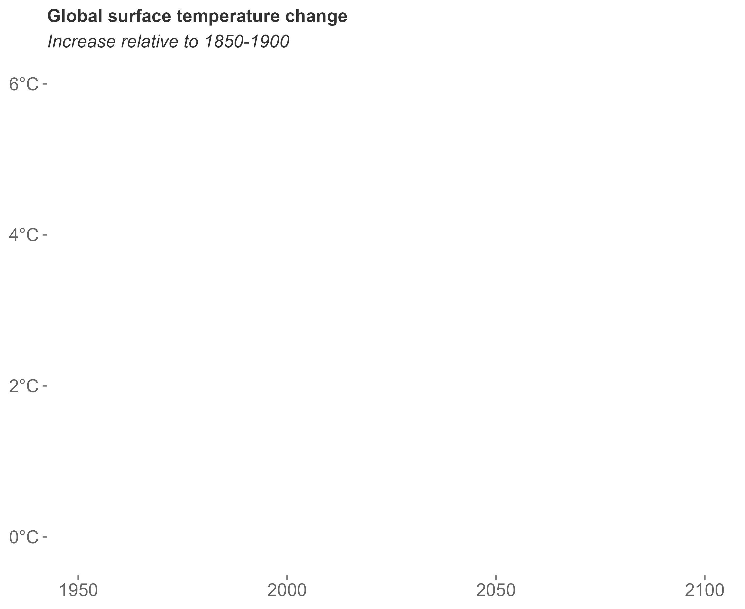
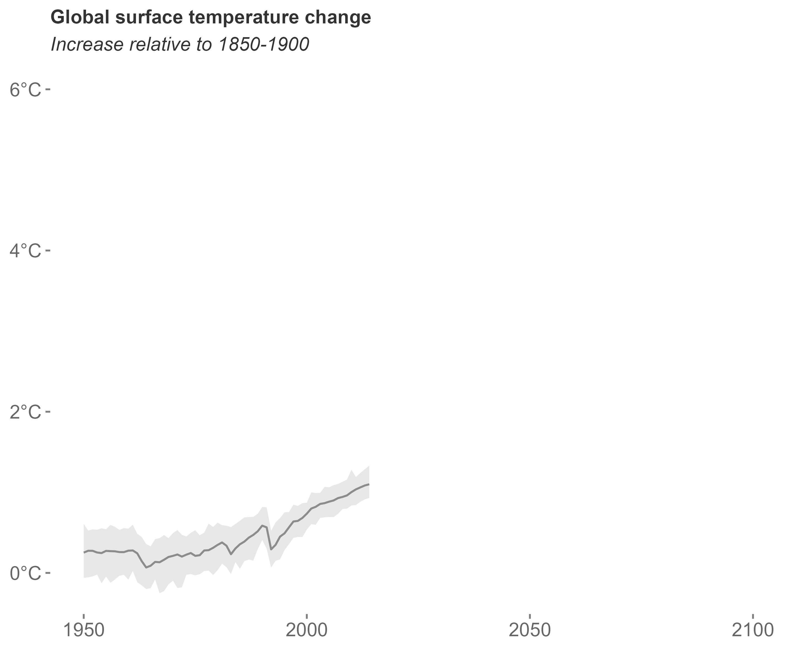
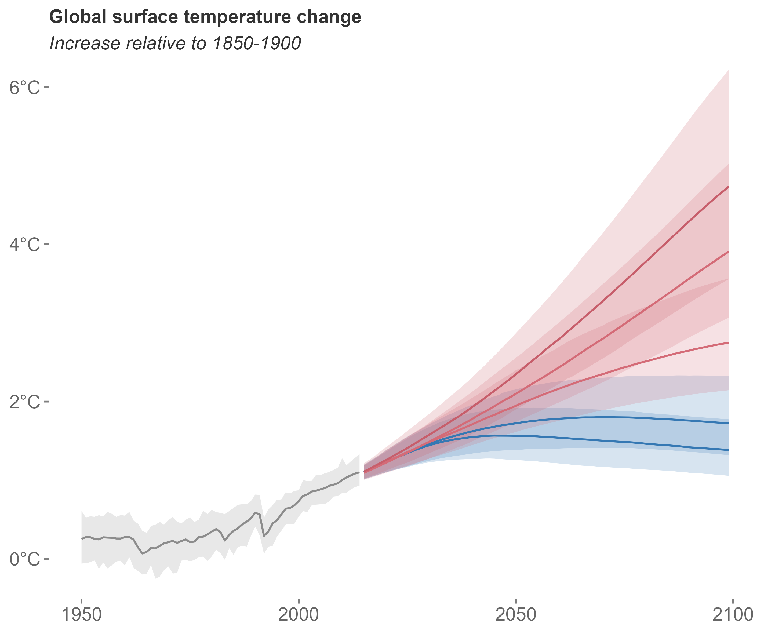
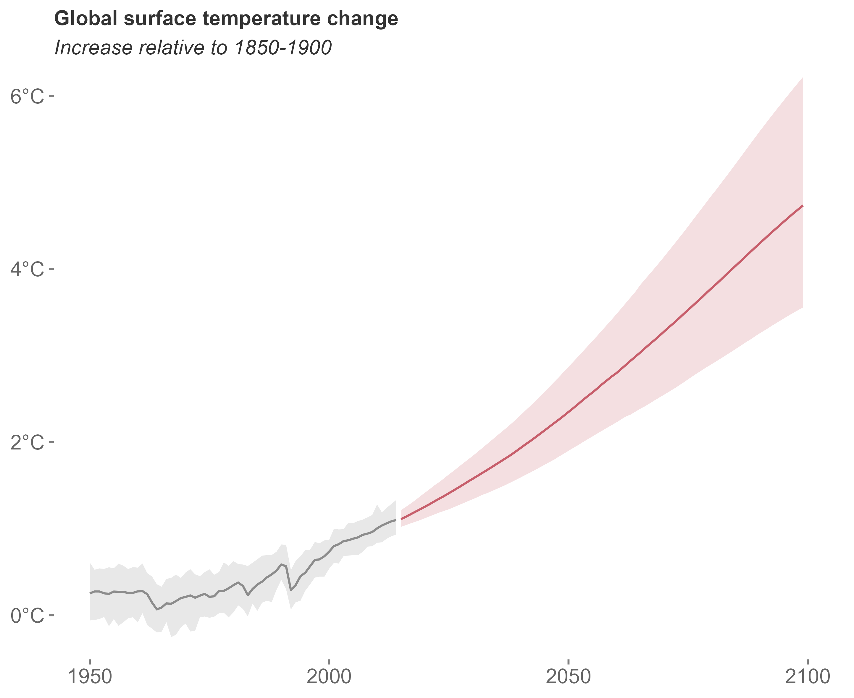
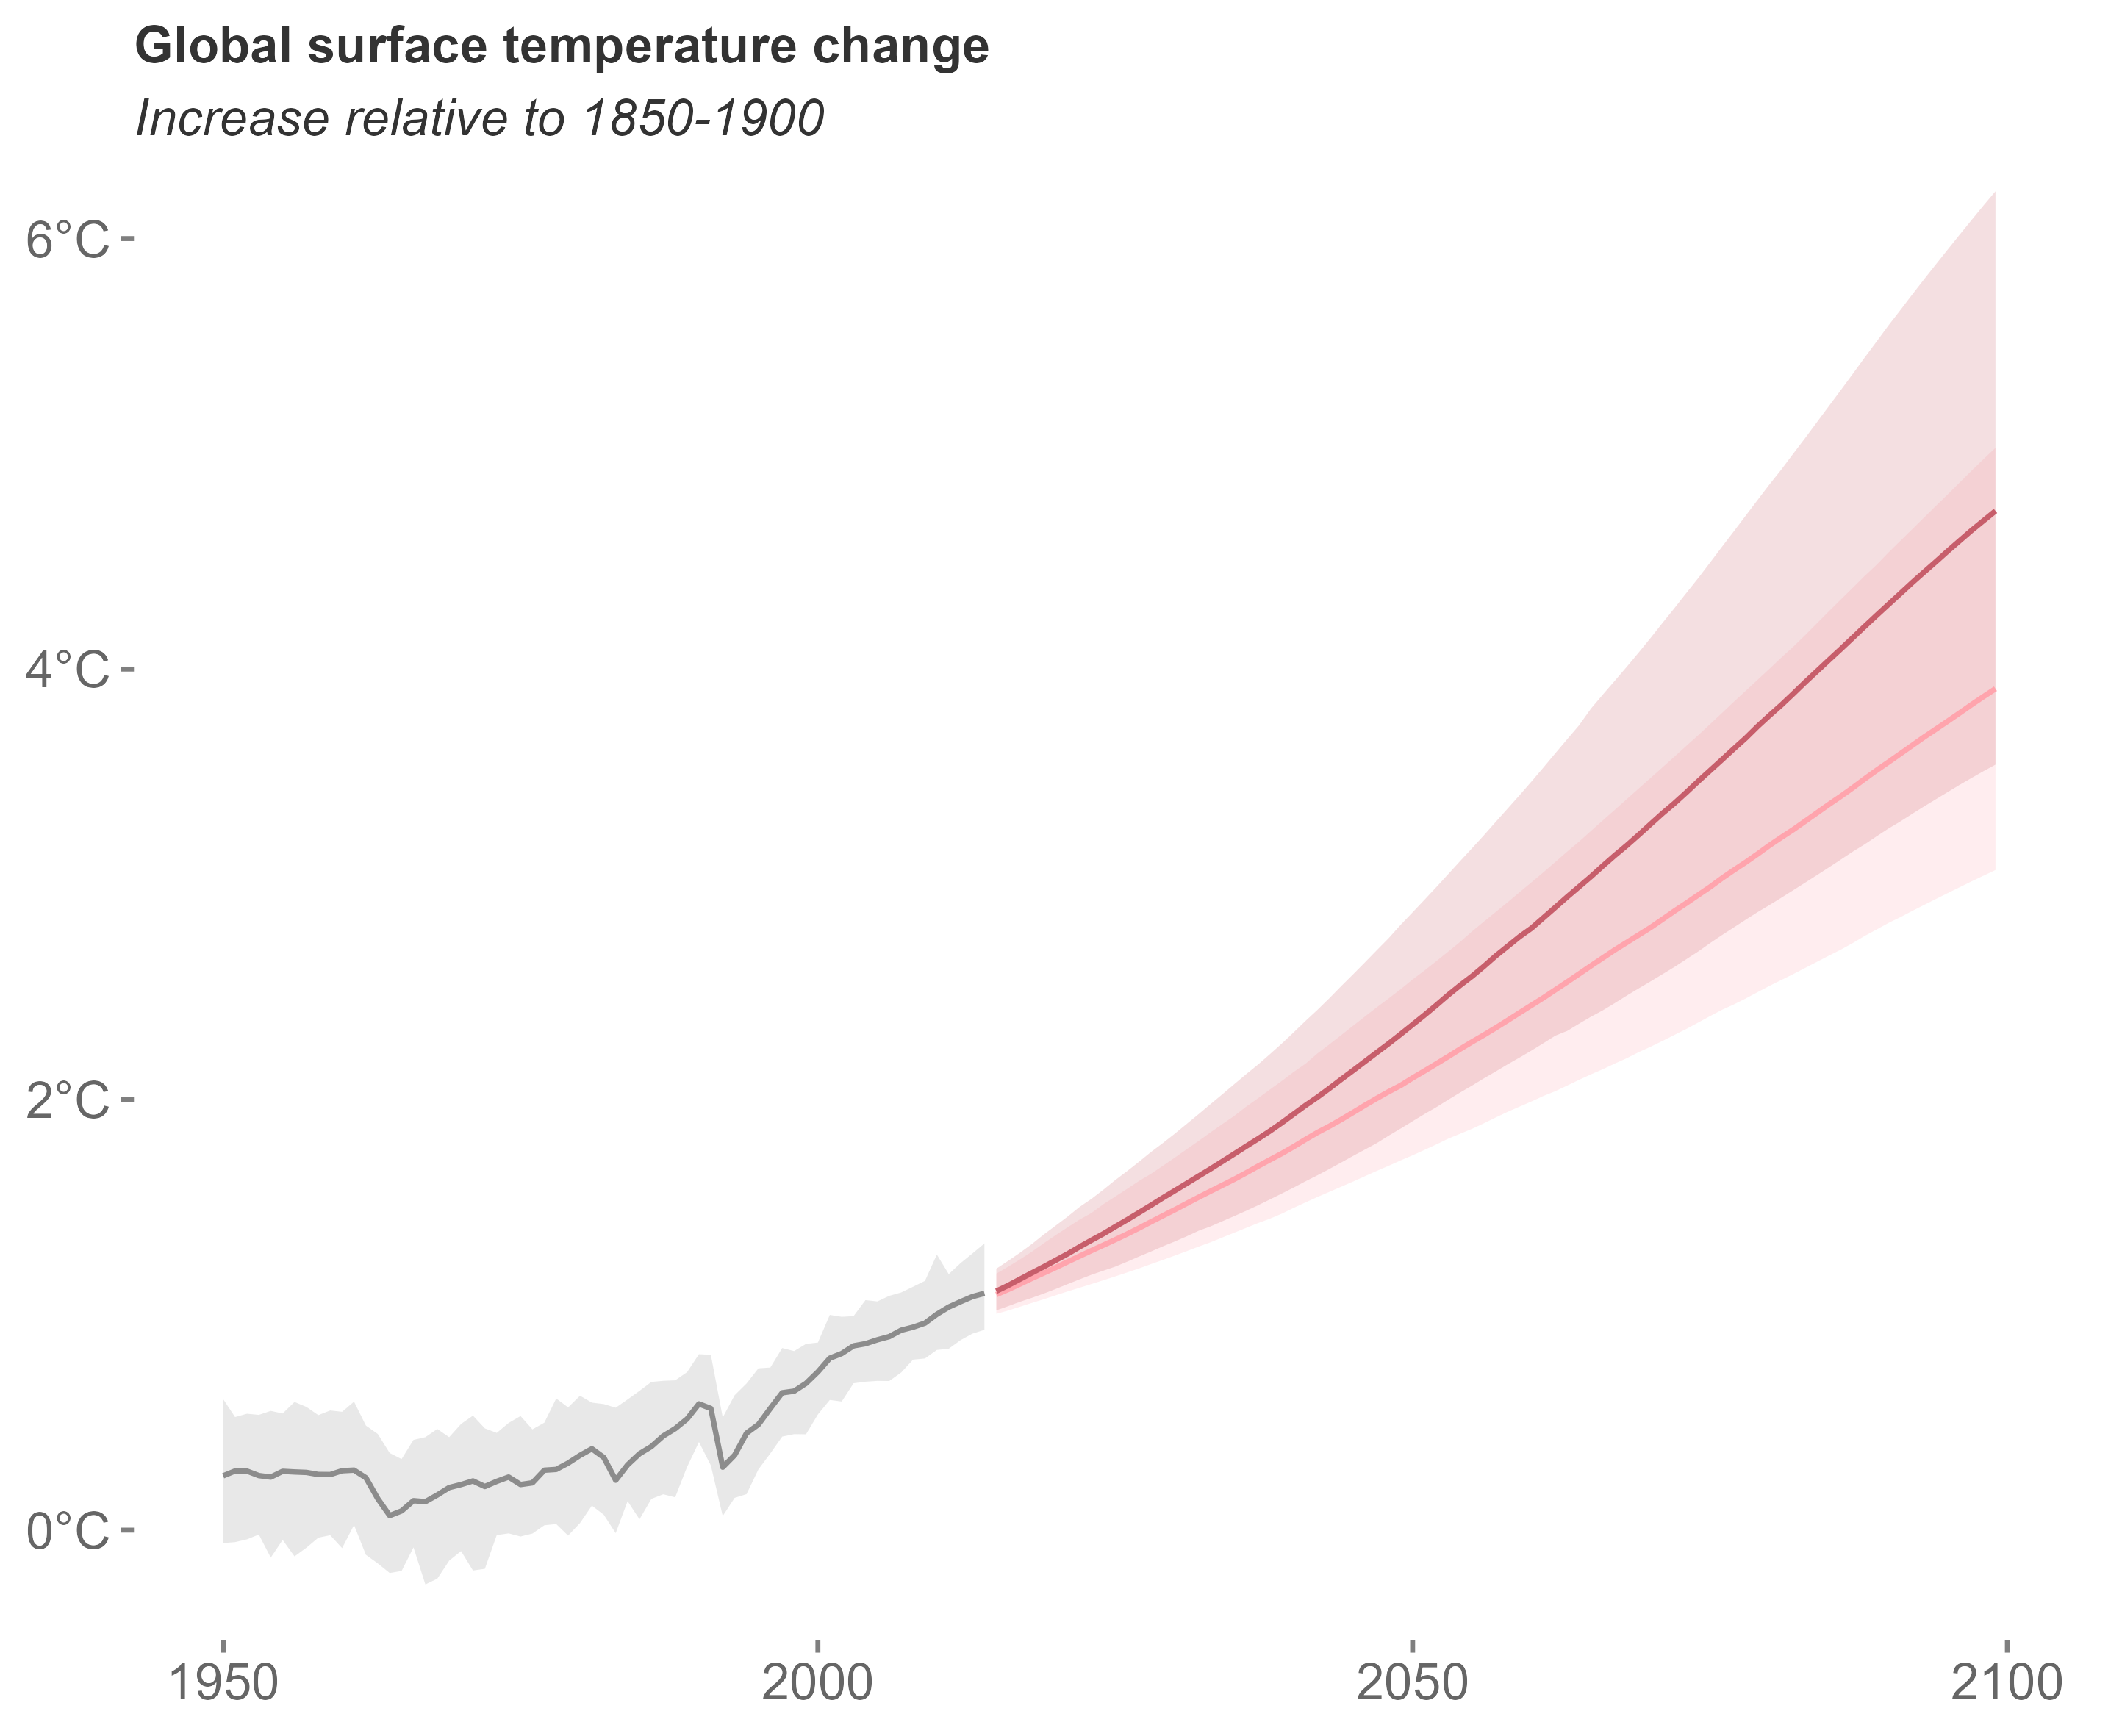
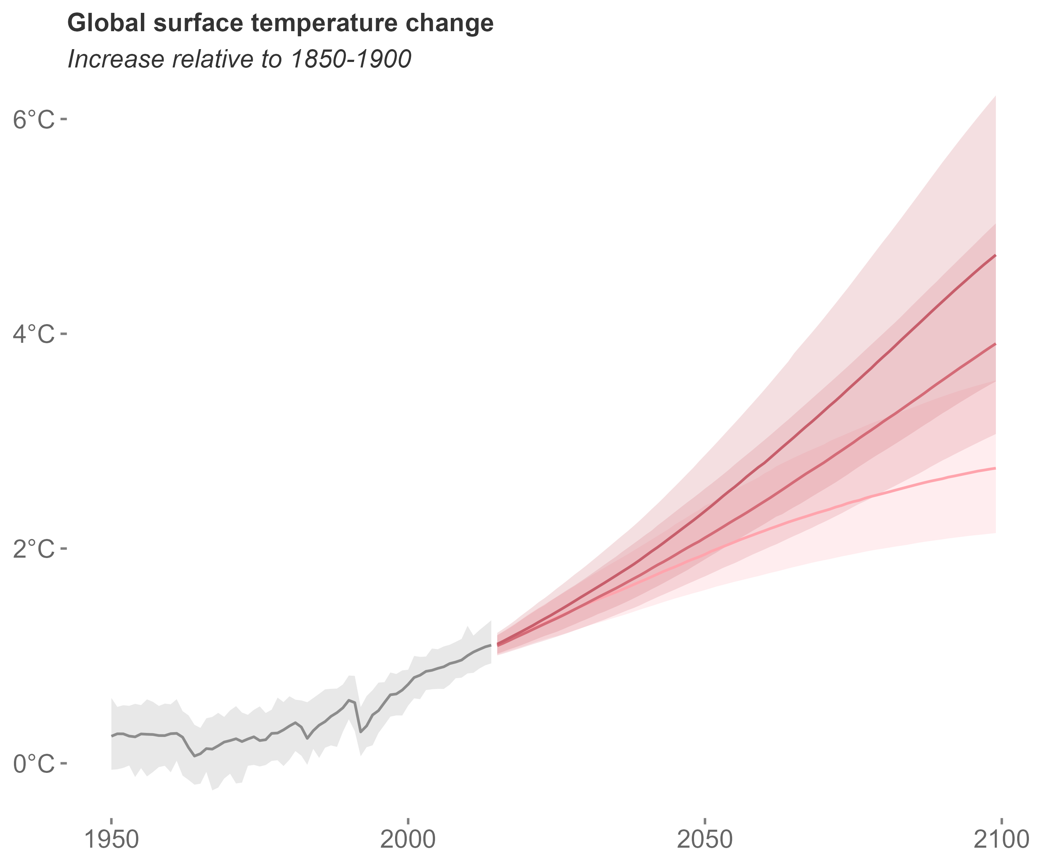
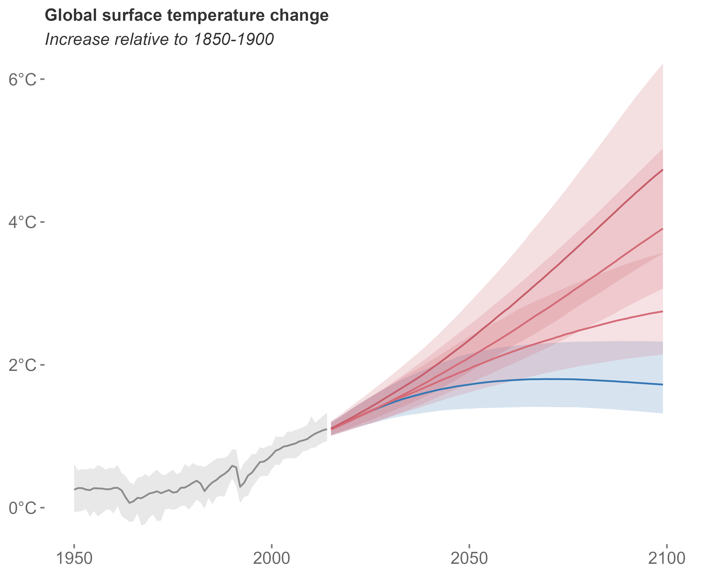
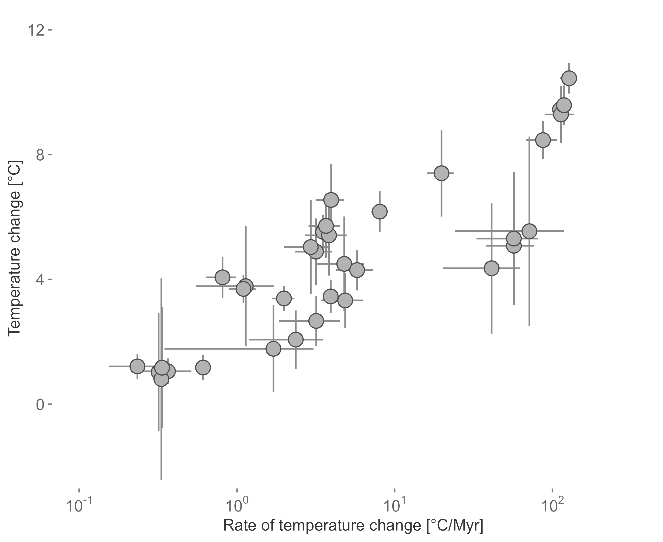
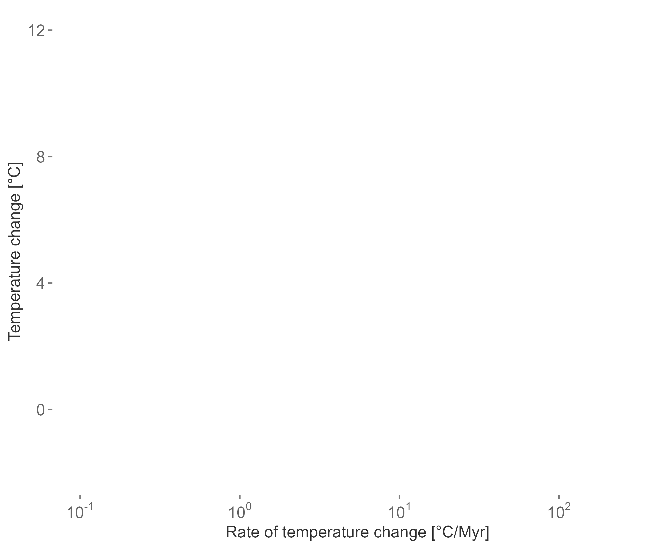
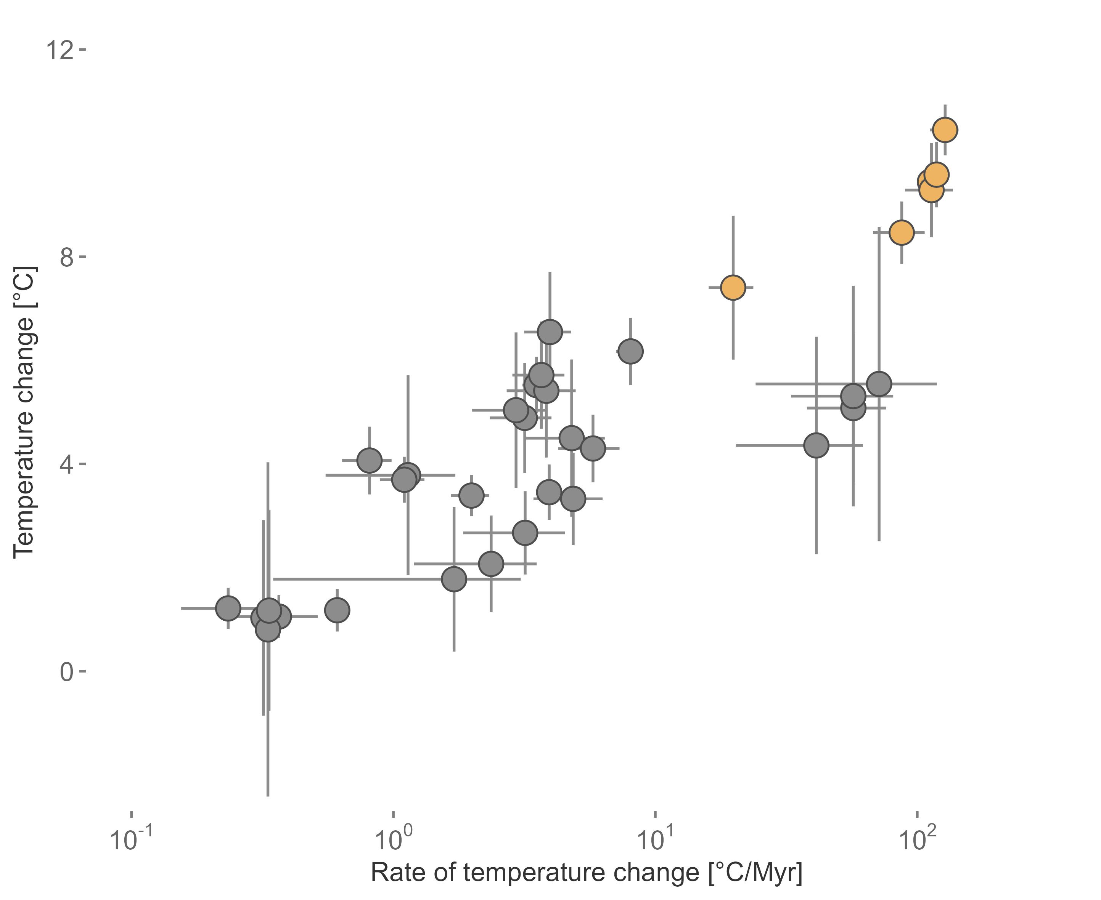


Two approaches
modified after IPCC 2022
modified after Song et al. 2022

Slide 4
Temporal context matters
Motivation and Background
PhD Chapters
Deep-Time
Extinction risk of fossils
Origination probability of fossils
Environmental data during extinction events
Near-Time
Rate of change in terrestrial plants
Assemblage turnover in planktonic foraminifera
Implementation in conservation science
Conclusion and Outlook
Meta-analysis and review

