Slide 1
1.Manage interest rate risk
1.1 Interest Rate Swap
In particular, they are designed to manage the risk on cash flows arising from investors’ assets and liabilities. Interest rate swaps and futures can also be used to modify the risk and return profile of a portfolio. This is associated with managing a portfolio of bonds that generally involves controlling the portfolio’s duration. Although futures are commonly used to make duration changes, swaps can also be used, and we shall see how in this reading. Finally, interest rate swaps are used by financial institutions to hedge the interest rate risk exposure deriving from the issuance of financial instruments sold to clients.

Slide 2
1.Manage interest rate risk
Example1:
Using an Interest Rate Swap to Convert Floating-Rate Securities into Fixed-Rate Securities
Here the firm initially expects continuing low interest rates, so it issues floating-rate bonds. But after concluding that rates are likely to increase, the firm seeks to convert its interest rate risk to a fixed obligation.

Slide 3
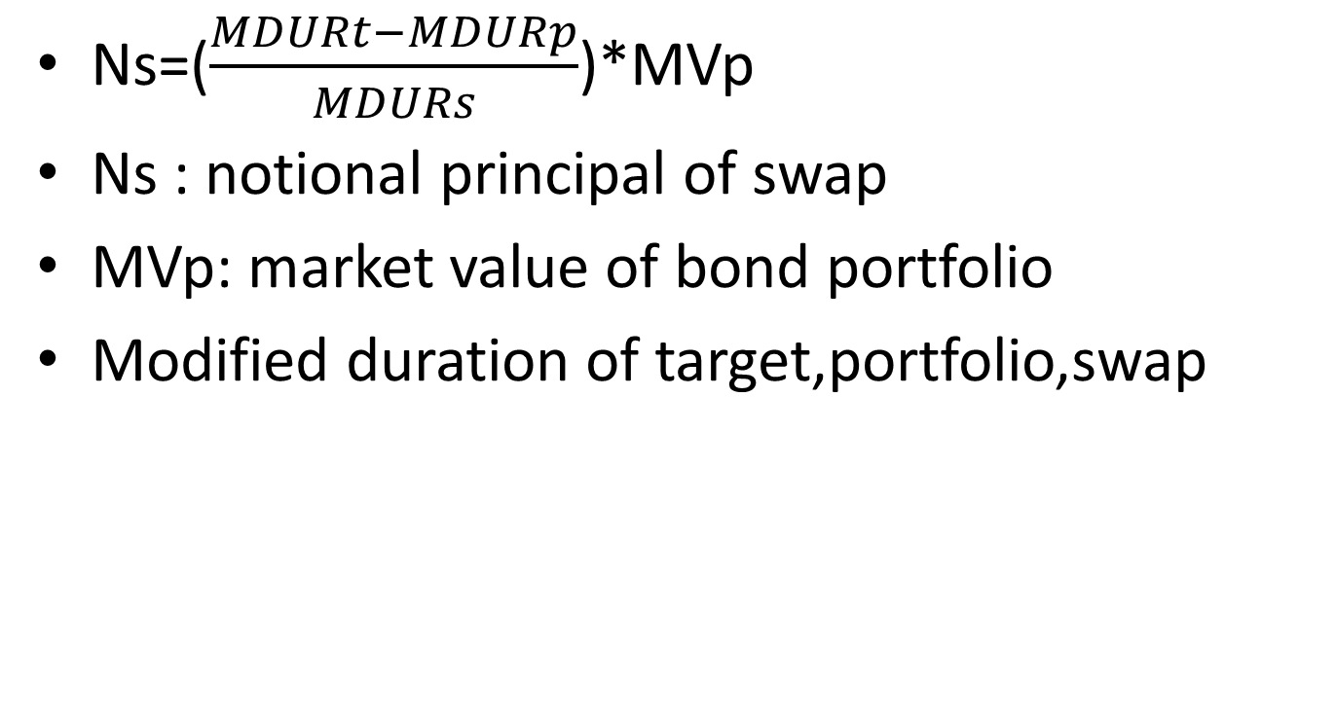
1.Manage interest rate risk
Ns=($\frac{MDURt−MDURp}{MDURs}$)*MVp
Ns : notional principal of swap
MVp: market value of bond portfolio
Modified duration of target,portfolio,swap

Slide 4
1.Manage interest rate risk
Example2:
Using an Interest Rate Swap to Achieve a Target Duration
Consider a portfolio manager with an investment portfolio of €50 million of fixed-rate German bonds with an average modified duration of 5.5. Because he fears that interest rates will rise, he wants to reduce the modified duration of the portfolio to 4.5, but he does not want to sell any of the securities. One way to do this would be to add a negative-duration position by entering into an interest rate swap where he pays the fixed rate and receives the floating rate. A two-year interest rate swap has an estimated modified duration of –2.00 from the perspective of the fixed-rate payer.

Slide 5
1.Manage interest rate risk
1.2 Interest Rate Forwards and Futures
Forward rate agreements and interest rate futures are widely used to hedge the risk associated with interest rates changing from the time a loan or a deposit is anticipated until it is actually implemented.

Slide 6
1.Manage interest rate risk
Example 3:
Using Interest Rate Futures to Lock in an Interest Rate
Amanda Wright, the chief investment officer (CIO) of a US-based philanthropic foundation is expecting a donation of $30 million in two months’ time from a member of the foundation’s founding family. This significant donation will then be invested for three months and subsequently will be divided into smaller grants to be made to medical and educational institutions supported by the foundation. The current (i.e., spot) three-month reference rate is 2.40% (annualized). The CIO expects interest rates to fall, and she decides to hedge the rate on the deposit with Eurodollar futures.

Slide 7
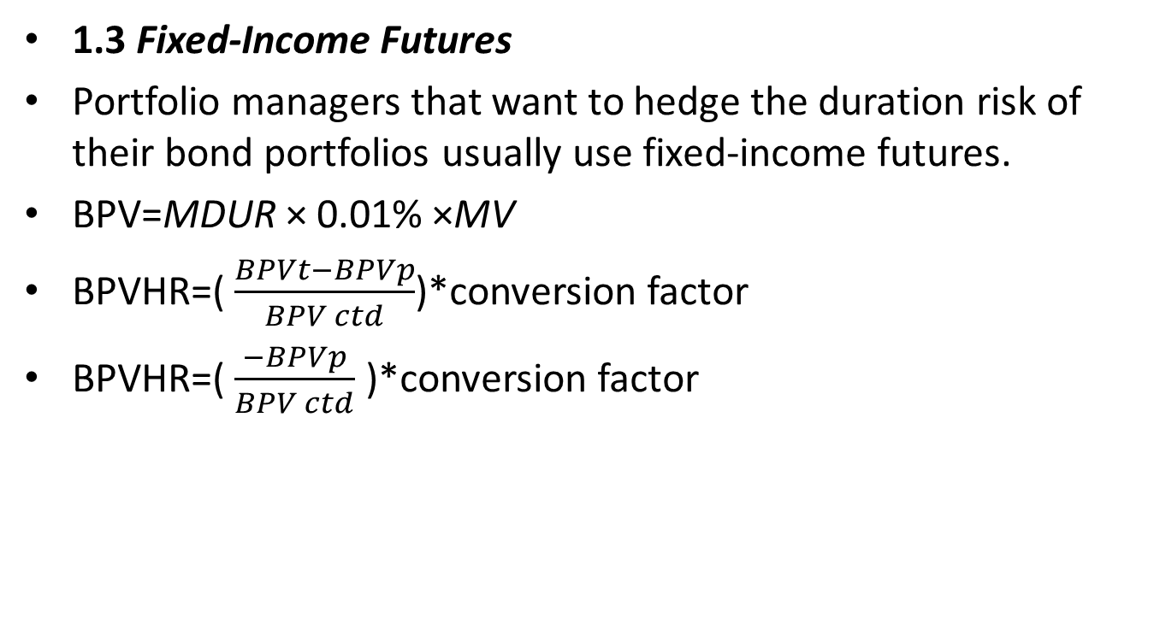
1.Manage interest rate risk
1.3 Fixed-Income Futures
Portfolio managers that want to hedge the duration risk of their bond portfolios usually use fixed-income futures.
BPV=MDUR × 0.01% ×MV
BPVHR=( $\frac{BPVt−BPVp}{BPV ctd}$)*conversion factor
BPVHR=( $\frac{−BPVp}{BPV ctd}$ )*conversion factor

Slide 8
1.Manage interest rate risk
Example 4:Hedging Bond Holdings with Fixed-Income Futures
A portfolio manager is holding €50 million (principal) in German bunds (DBRs) and wants to fully hedge the value of the bond investment against a rise in interest rates. The portfolio has a modified duration of 9.50 and a market value of €49,531,000. Moreover, the manager wishes to fully hedge the bond portfolio (so, BPVT = 0) with a short position in Euro-Bund futures with a price of 158.33. The cheapest-to- deliver bond is the DBR 0.25% 02/15/27 that has a conversion factor of 0.619489. The size of the futures contract is €100,000.

Slide 9
1.Manage interest rate risk
Example 4:Hedging Bond Holdings with Fixed-Income Futures
Cheapest-To-Deliver Bond
DBR 0. 02/15/27 Gov’t.
Modified Duration 8.623
Bond Price 98.14
Conversion Factor 0.619489
Determine the following:
1 The BPVP of the portfolio to be hedged
2 The BPVCTD of the futures contract hedging instrument
3 The number of Euro-Bund futures contracts to sell to fully hedge the portfolio

Slide 10
1.Manage interest rate risk
Example 5: Decreasing Portfolio Duration with Futures
Consider the portfolio manager from Example 4 who now decides to decrease the portfolio’s modified duration from 9.50 to 8.50. The yield curve is flat. Additionally, we have already demonstrated that given the portfolio’s market value of €49,531,000, the BPVP is €47,054.50. Finally, assume the CTD bond underlying the Euro-Bund futures is the same as before, DBR 0.25% 02/15/27, with a BPVCTD of €84.63 and a conversion factor of 0.619489.
Determine the following:
1 The BPVT of the portfolio to be hedged
2 The number of Euro-Bund futures contracts to sell to reduce the portfolio’s modified duration to 8.50

Slide 11
2.Manage currency exposure
2.1 currency swaps
A currency swap is similar to an interest rate swap, but it is different in two ways: (1) The interest rates are associated with different currencies, and (2) the notional principal amounts may or may not be exchanged at the beginning and end of the swap’s life.
In particular, a cross-currency basis swap exchanges notional principals because the goal of the transaction is to issue at a more favorable funding rate and swap the amount back to the currency of choice.

Slide 12
2.Manage currency exposure
2.2 Currency Forwards and Futures
These two financial instruments are used to hedge against undesired moves in the exchange rate by buying or selling a specified amount of foreign currency, at a defined time in the future and at an agreed-on price at contract initiation.

Slide 13
2.Manage currency exposure
Example 6:Hedging Currency Risk with Futures
Consider the same US-based VC firm that is calling down capital commitments and will receive CAD50 million in 30 days. The general partner now decides to sell futures contracts to lock in the current USD/CAD rate. The hedge ratio is assumed to be equal to 1. The firm hedges its risk by selling Canadian dollar futures contracts with the closest expiry to the future Canadian dollar inflow. Given a price for the Canadian dollar futures contract of USD/CAD 0.7838 (number of US dollars for 1 Canadian dollar) and a contract size of CAD100,000, determine how many Canadian dollar futures contracts the VC firm must sell to hedge its risk.

