Slide 1
1.Synthetic forward position
The combination of a long call and a short put with identical strike price and expiration, traded at the same time on the same underlying, is equivalent to a synthetic long forward position.
Instead, the trader can create a synthetic short forward position by selling a call and buying a put at the same strike price and maturity.

Slide 2
2.Synthetic put and call
The symmetric payoff of a short stock position can become asymmetrical if the investor transforms it into a synthetic long put position by buying a call.
An investor with a long stock position can change his payoff and risk profile into that of a long call by purchasing a put.

Slide 3
3.Investment objectives of covered calls
3.1 Yield enhancement
The most common motivation for writing covered calls is cash generation in anticipation of limited upside moves in the underlying.
It is important to remember that the call writer has given up an important benefit of stock ownership: capital gains above the strike price.
Risk: realized price lower than the current market price.

Slide 4
3.Investment objectives of covered calls
3.2 Reducing a position at a favorable price
Investor expect the price of stock to remain relatively stable over short term periods.
3.3 Target price realization
The research team believes the stock would be only slightly higher than its current price.

Slide 5
3.Investment objectives of covered calls
3.4 Profit and loss at expiration
Profit=(St-S0)+C0-max(St-X,0)
St>X: -S0+C0+X
St<X: St-S0+C0
Max profit: -S0+C0+X
Max loss: -S0+C0
Breakeven price: S0-C0
S0=stock price when option position opened
St=stock price at option expiration
X=option strike price
C0=call premium received or paid

Slide 6
4.Investment objectives of protective put
4.1 loss protection and upside preservation
A protective put can appear to be a great transaction with no drawbacks, because it provides downside protection with upside potential.
4.2 Profit and loss at expiration
Profit=(St-S0)-P0+max(X-St,0)
St>X: -S0+St-P0
St<X: -S0-P0+X
Max profit: unlimited
Max loss: -S0-P0+X
Breakeven price: S0+P0

Slide 7
5.Bull spread
For a bull spread, the investor buys the low strike option (struck at XL) and sells the high strike option (struck at XH)
5.1 Call bull spread
Profit= -CL+max(St-XL,0)+CH-max(St-XH,0)
St>XH: -CL-XL+CH+XH
XH>St>XL: -CL+St-XL+CH
XL>St: -CL+CH
Max profit:-CL-XL+CH+XH
Max loss: -CL+CH
Breakeven price:CL+XL-CH

Slide 8
5.Bull spread
5.2 Put bull spread
Profit= -PL+max(XL-St,0)+PH-max(XH-St,0)
St>XH: -PL+PH
XH>St>XL: -PL+St-XH+PH
XL>St: -PL+XL-XH+PH
Max profit:-PL+PH
Max loss: -PL+XL-XH+PH
Breakeven price: PL+XH-PH

Slide 9
6.Bear spread
With a bull spread, the investor buys the lower exercise price and writes the higher exercise price. It is opposite with a bear spread: buy the higher exercise price and sell the lower.
6.1 put bear spread
Profit= +PL-max(XL-St,0)-PH+max(XH-St,0)
St>XH: +PL-PH
XH>St>XL: +PL-St+XH-PH
XL>St: +PL-XL+XH-PH
Max profit:+PL-XL+XH-PH
Max loss: +PL-PH
Breakeven price: PL+XH-PH

Slide 10
6.Bear spread
6.2 call bear spread
Profit= +CL-max(St-XL,0)-CH+max(St-XH,0)
St>XH: +CL+XL-CH-XH
XH>St>XL: +CL-St+XL-CH
XL>St: +CL-CH
Max profit:+CL-CH
Max loss: +CL+XL-CH-XH
Breakeven price:CL+XL-CH

Slide 11
7.Straddle
7.1 long straddle
A long straddle is an option combination in which one buys both puts and calls, with the same exercise price and same expiration date, on the same underlying asset.
The long straddle is a bet that increased volatility will move the stock price strongly above or below the strike price
Profit= -p+max(X-St,0)-c+max(St-X,0)
St>X: –p-c+St-X
St<x: –p-c+X-St
Max profit: unlimited
Max loss: -p-c
Breakeven price: X+P+C or X-P-C

Slide 12
7.Straddle
7.2 short straddle
If someone writes both call and put options, with the same exercise price and same expiration date, on the same underlying asset, it is a short straddle.
Profit= +p-max(X-St,0)+c-max(St-X,0)
St>X: +p+c-St+X
St<x: +p+c-X+St
Max profit: p+c
Max loss: unlimited
Breakeven price: X+P+C or X-P-C

Slide 13
8.collars
A collar is an option position in which the investor is long shares of stock and then buys a put with an exercise price below the current stock price and writes a call with an exercise price above the current stock price.
Collars allow a shareholder to acquire downside protection through a protective put but reduce the cash outlay by writing a covered call.

Slide 14
8.collars
Profit: St-S0-p+max(XL-St,0)+c-max(St-XH,0)
St>XH: -S0-p+c+XH
XH>St>XL: St-S0-p+c
St<XL: -S0-p+XL+c
Max profit: -S0-p+c+XH
Max loss: -S0-p+XL+c
Breakeven price: S0+p-c

Slide 15
9.Calendar spread
A strategy in which one sells an option and buys the same type of option but with different expiration dates, on the same underlying asset and with the same strike, is commonly referred to as a calendar spread.
When the investor buys the more distant call and sells the near-term call, it is a long calendar spread. The investor could also buy a near-term call and sell a longer-dated one, known as a short calendar spread.

Slide 16
9.Calendar spread
A big move in the underlying market or a decrease in implied volatility will help a short calendar spread, whereas a stable market or an increase in implied volatility will help a long calendar spread.

Slide 17
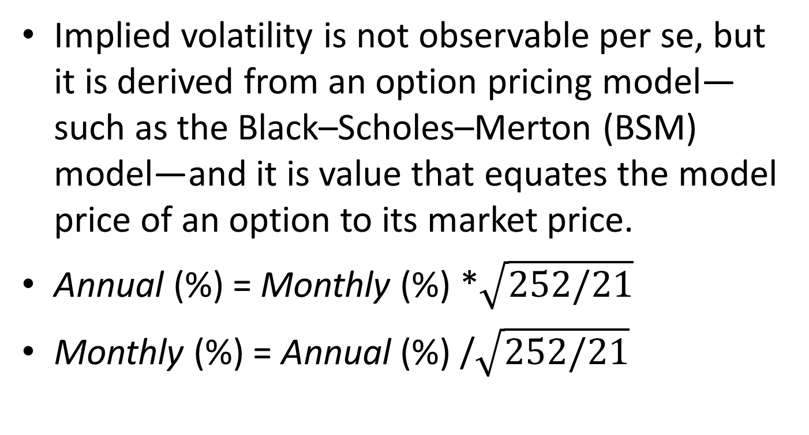
10. IMPLIED VOLATILITY AND VOLATILITY SKEW
Implied volatility is not observable per se, but it is derived from an option pricing model—such as the Black–Scholes–Merton (BSM) model—and it is value that equates the model price of an option to its market price.
Annual (%) = Monthly (%) *$\sqrt{252/21}$
Monthly (%) = Annual (%) /$\sqrt{252/21}$

Slide 18
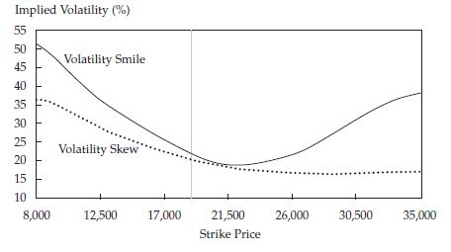
10. IMPLIED VOLATILITY AND VOLATILITY SKEW
When the implied volatilities priced into both OTM puts and calls trade at a premium to implied volatilities of ATM options (those with strike price at 19,000), the curve is U-shaped and is called a volatility smile, because it resembles the shape of a smile. The more common shape of the implied volatility curve, however, is a volatility skew, where the implied volatility increases for OTM puts and decreases for OTM calls, as the strike price moves away from the current price.

Slide 19
10. IMPLIED VOLATILITY AND VOLATILITY SKEW
Reasons for volatility skew:
Investors have generally less interest in OTM calls whereas OTM put options have found universal demand as portfolio insurance against a market sell-off.
In fact, when investors are looking to hedge the underlying asset, the demand for put options exceeds that for call options. Option traders, who meet this excess demand by selling puts, increase the relative price of these options, thereby raising the implied volatility.

Slide 20
11.Choosing Options Strategies Based on Direction and Volatility of the Underlying Asset
Options, like all derivatives, should always be used in connection with a well-defined investment objective. When using options strategies, it is important to have a view on the expected change in implied volatility and the direction of movement of the underlying asset.
The strategies identified are most profitable given the expected change in implied volatility and the outlook for the direction of movement of the underlying asset.

Slide 21
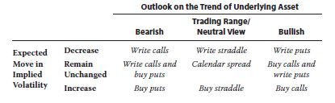
11.Choosing Options Strategies Based on Direction and Volatility of the Underlying Asset

Slide 22
11.Choosing Options Strategies Based on Direction and Volatility of the Underlying Asset
Consider an investor who is bearish about a market. If he expects that implied volatility will increase as the market sells off, then he will buy a put to protect his investments. If instead he believes that volatilities are expected to fall, writing a call would likely be a profitable strategy.
Now consider an investor who has a bullish view. Buying calls is an option strategy that will allow the investor to benefit if her outlook is correct and implied volatility increases. When implied volatilities are expected to fall, writing a put represents an alternative strategy to take advantage of a bullish market view with declining volatility.

