Slide 1
Alternative investments
Alternative Investment Features, Methods, and Structures
Alternative Investment Performance and Returns
Investments in Private Capital: Equity and Debt
Real Estate and Infrastructure
Natural Resources
Hedge Funds
Introduction to Digital Assets

Slide 2
Alternative Investment Features and Categories
Alternative investments are investments other than ownership of public equity securities, fixed-income instruments, or cash that represent the more traditional asset classes.
ALTERNATIVES
Private capital
Private equity
Private debt
Real asset
Hedge fund
Real estate
Natural resources
commodities
other real assets

Slide 3
Alternative Investment Features and Categories
Private capital
Private Capital is a broad term for funding provided to companies that is sourced from neither the public equity nor the public debt markets. Capital that is provided in the form of equity investments is called private equity, whereas capital that is provided as a loan or other form of debt is called private debt.

Slide 4
Alternative Investment Features and Categories
Real Assets
In contrast to financial assets, real assets generally are tangible physical assets, such as real estate (for example, land or buildings) and natural resources, but also include such intangibles as patents, intellectual property, and goodwill.
“Digital assets” is the umbrella term covering assets that can be created, stored, and transmitted electronically and have associated ownership or use rights.

Slide 5
Alternative Investment Features and Categories
Hedge funds
Hedge funds are private investment vehicles that may invest in public equities or publicly traded fixed-income assets, private capital, and/or real assets, but they are distinguished by their investment approach rather than by the investments themselves. Hedge funds make frequent use of leverage, derivatives, short selling, and other investment strategies.

Slide 6
Alternative Investment Features and Categories
Features
Some alternative investment features are shared with traditional public debt and equity securities, while others are significantly different. Features that may distinguish alternative investments include the following:
The need for specialized knowledge to value cash flows and risks
Typically low correlation of returns with more traditional asset classes
Illiquidity, long investment time horizons, and large capital outlays

Slide 7
practices
Identify which of the following choices is most likely an alternative investment:
A. An investment in a hedge fund focused on traditional assets
B. Shares in a manufacturing firm traded on the Bursa Malaysia exchange
C. A euro foreign exchange futures purchased on the Chicago Mercantile exchange

Slide 8
ALTERNATIVE INVESTMENT METHODS
Investors can access alternative investments in three ways:
Fund investment (such as a in a PE fund)
Co-investment into a portfolio company of a fund
Direct investment into a company or project (such as infrastructure or real estate)

Slide 9
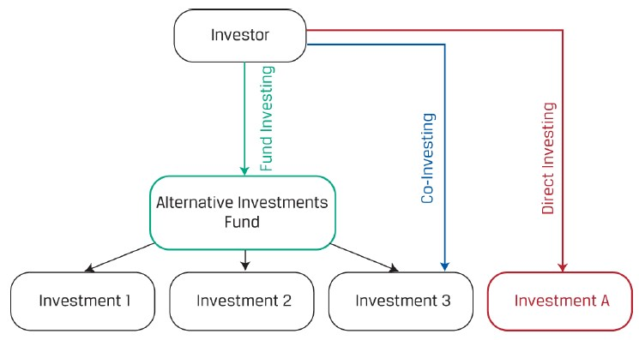
ALTERNATIVE INVESTMENT METHODS

Slide 10
ALTERNATIVE INVESTMENT METHODS
Fund investment
Investors with limited resources and/or experience generally enter into alternative investments through fund investing, where the investor contributes capital to a fund and the fund identifies, selects, and makes investments on the investor’s behalf.
Alternative funds usually involve
(1) the pre commitment of funds prior to investment selection and an extended period during which the fund may not be sold,
(2) higher management fees with more complex fee structures, and
(3) less frequent transparency on periodic returns and fund positions versus equity or fixed-income funds.

Slide 11
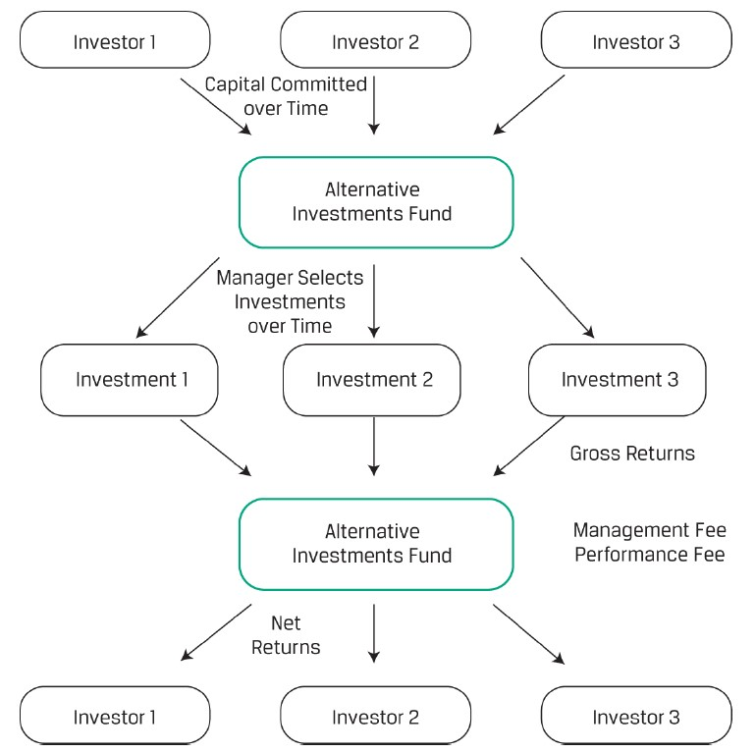

Slide 12
ALTERNATIVE INVESTMENT METHODS
Co-Investment
Once investors have some experience investing in funds, prior to investing directly themselves, many investors gain direct investing experience via co-investing, where the investor invests in assets indirectly through the fund but also possesses rights (known as co-investment rights) to invest directly in the same assets.
Co investing allows investors to expand their investment knowledge, skills, and experience beyond what they would gain from taking a fund-only investment approach.
Co-investors weigh the benefits of greater control and lower fees versus higher oversight costs.

Slide 13
ALTERNATIVE INVESTMENT METHODS
Co-Investment
Managers benefit from choosing one or more co-investors to
accelerate investment timing when available funds and expected inflows are insufficient for a specific deal,
expand the scope of available new investments, and
increase diversification of an existing pool of fund investments.

Slide 14
ALTERNATIVE INVESTMENT METHODS
Direct Investment
The largest, most sophisticated investors with sufficient skills and knowledge to manage individual alternative investments often do so via direct investing without the use of an intermediary.
Direct investors retain maximum flexibility and control when it comes to investment choice, methods of financing, and timing.

Slide 15
ALTERNATIVE INVESTMENT STRUCTURES
Ownership Structures
Limited partnerships, introduced in a corporate issuer lesson, involve at least one general partner (GP) with theoretically unlimited liability who is responsible for managing the fund. Limited partners (LPs) are outside investors who own a fractional interest in the partnership based on the amount of their initial investment and the terms set out in the partnership documentation.
LPs play passive roles and are not involved with the management of the fund, the operations and decisions of the fund are controlled solely by the GP.
LP investors must generally meet certain minimum regulatory net worth, institutional, or other requirements, as so-called accredited investors.

Slide 16
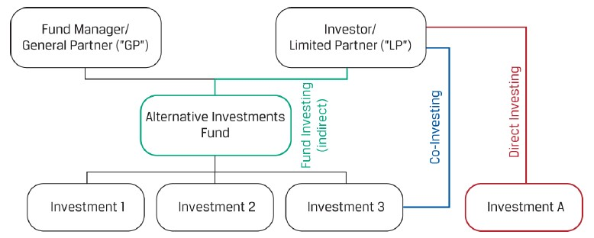
ALTERNATIVE INVESTMENT STRUCTURES

Slide 17
ALTERNATIVE INVESTMENT STRUCTURES
Ownership Structures
A limited partnership agreement (LPA) establishes terms of an LP as governed by a limited partnership agreement.
Adjustments to LP terms are sometimes made to address the unique legal, regulatory, or reporting requirements of a specific investor. In this case, a supplemental document known as a side letter is issued between a GP and one or more LPs with terms that override or modify the original LPA terms.

Slide 18
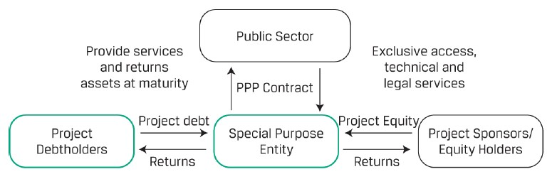
ALTERNATIVE INVESTMENT STRUCTURES
Ownership Structures
Infrastructure investors frequently enter into public–private partnerships, which are agreements between the public sector and the private sector to finance, build, and operate public infrastructure.

Slide 19
ALTERNATIVE INVESTMENT STRUCTURES
Ownership Structures
Real estate or natural resource fund investors are often classified as unitholders in what is referred to as a master limited partnership (MLP), which has similar features to the limited partnership described earlier but is usually a more liquid investment that is often publicly traded.

Slide 20
ALTERNATIVE INVESTMENT STRUCTURES
Compensation Structures
While hedge funds and REITs typically charge a management fee on assets under management, private equity funds often levy this fee on committed capital, which consists of the total amount that LPs have promised to fund future investments.
Performance fees are often subject to a minimum fund return or hurdle rate (also known as a “preferred return”), as well as other modifications, to align manager incentives as closely as possible with those of investors over long investment periods.
Hurdle rate agreements sometimes distinguish between a hard hurdle rate, where the manager earns fees on annual returns in excess of the hurdle rate, or a soft hurdle rate, where the fee is calculated on the entire return when the hurdle is exceeded.

Slide 21
ALTERNATIVE INVESTMENT STRUCTURES
Compensation Structures
In other instances, managers are penalized with fee reductions in cases of poor or declining performance. One example of this in the case of hedge funds is the use of a so-called high-water mark, which reflects the fund’s peak value as of a performance calculation date net of fees.
A clawback provision, in contrast, actually grants LPs the right to reclaim a portion of the GP’s performance fee.
There are two types of waterfalls: deal-by-deal (or American) waterfalls and whole-of-fund (or European) waterfalls.

Slide 22
Practices
Calculate the general partner’s performance fee earned based on the following terms: Single-period fund rate of return 20%， Hard hurdle rate 10%， GP performance fee 18%， Catch-up clause none。
A. 1.6%
B. 1.8%
C. 2.0%

Slide 23
Alternative investments
Alternative Investment Features, Methods, and Structures
Alternative Investment Performance and Returns
Investments in Private Capital: Equity and Debt
Real Estate and Infrastructure
Natural Resources
Hedge Funds
Introduction to Digital Assets

Slide 24
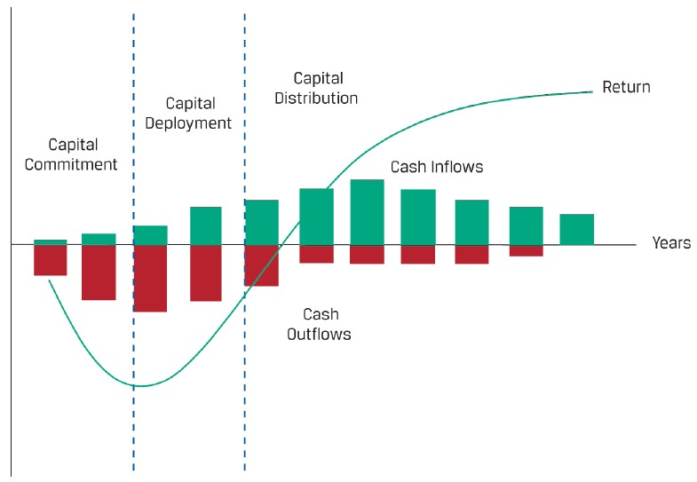
ALTERNATIVE INVESTMENT PERFORMANCE
1.Investment Life Cycle

Slide 25

ALTERNATIVE INVESTMENT PERFORMANCE
Peterburgh Capital, LLC, a private equity vehicle, is considering investment in various companies and is expecting the following cash flow pattern from these investments:
YEAR | CASH INFLOW | CASH OUTFLOW
0 |  | 2,500,000
1 |  | 4,000,000
2 |  | 1,700,000
3 | 500,000 | 1,000,000
4 | 1,000,000
5 | 3,000,000
6 | 12,500,000
IRR can be calculated by the standard formula $\sum_{t=0}^{n}{\frac{CFi}{\left(1+r\right)i}}=0$, or using a financial calculator, r
≈ 14.596%.

Slide 26

ALTERNATIVE INVESTMENT PERFORMANCE
MOIC(MULTIPLE OF INVESTED CAPITAL)
MOIC=$\frac{Realized value of investment+Unrealized value of investment}{Total amount of invested capital}$
Invested capital=paid in capital – management fee and fund expense
 | Amount | Year
Invested capital | -3,800,000 | 0
 |  | 1
Additional capital | -1,200,000 | 2
Additional capital | -200,000 | 3
Liquidity event | 8,500,000 | 8

Slide 27
ALTERNATIVE INVESTMENT PERFORMANCE
2.Use of Borrowed Funds
Alternative investments may use borrowed funds to increase investment returns. This form of financial leverage has the effect of magnifying both gains and losses by allowing investors to take a market position that is larger than the capital committed.
rL= [r×(Vc+Vb)–(Vb×rb)]/Vc
rL= r + Vb/Vc*(r – rb).

Slide 28
ALTERNATIVE INVESTMENT PERFORMANCE
Lupulus Opportunity Fund LLC, a hedge fund that has USD100 million of capital, ordinarily uses leverage to invest in a variety of equity-linked notes.
Scenario 1: Suppose Lupulus’s underlying positions return 8%. If it could add leverage of USD50 million to the portfolio at a funding cost of 4%, what would have been the leveraged return?
Scenario 2: Suppose Lupulus’s underlying positions incur a loss of 2% instead of earning a gain. What would have been the leveraged return if Lupulus had borrowed USD50 million at 4%?
Scenario 3: If Lupulus’s underlying positions make a gain of 6%, what is the breakeven borrowing rate at which Lupulus is indifferent to adding leverage to the portfolio?

Slide 29
ALTERNATIVE INVESTMENT PERFORMANCE
3.Valuation
Fair value hierarchy
Level | Description | Sample Application and Method
Level 1 | Quoted prices in active markets for identical asset/liability that may be accessed as of measurement date | Exchange-traded public equity securities (observed closing market price)
Level 2 | Inputs other than quoted market prices in Level 1 that are directly or indirectly observable for an asset/liability | Over-the-counter interest rate derivatives (pricing model using quoted market prices)
Level 3 | Unobservable inputs are used to measure fair value for asset/liability in which there is little, if any, market activity as of the measurement date | Private equity or real estate investments (cash flow projection models with reasonably available market participant assumptions)

Slide 30
ALTERNATIVE INVESTMENT PERFORMANCE
4.Fees
Performance appraisal for alternative investments can be difficult to generalize, because results may vary significantly based on which investor has invested when in a particular vehicle.
Which of the following is not a factor that makes comparison of performance between alternative investments and public securities difficult?
A. Alternative investments charge higher fees.
B. The use of leverage in alternative investments magnifies their risk and return measures.
C. The fair value of portfolio positions in alternative investments may not be readily available.

Slide 31
ALTERNATIVE INVESTMENT RETURNS
1.Custom Fee Arrangements
Fees based on liquidity terms and asset size
Founders shares
“Either/or” fees

Slide 32
ALTERNATIVE INVESTMENT RETURNS
2.Alternative Investment Return Calculations
R_{GP} = P₁*r_{m} + MAX[0,(P₁-P₀)*P]
R_{i} = (P₁-P₀-R_{GP})/P₀
Kettleside is a timberland investment management organization with $100 million of initial investment capital. It charges a 1% management fee based on year-end AUM (r_{m}) and a 20%performance fee (p). In its first year, Kettleside generates a 30% return. Assume management fees are calculated using an end-of-period valuation.

Slide 33
ALTERNATIVE INVESTMENT RETURNS
1. What are Kettleside’s fees if the performance and management fees are calculated independently? What is an investor’s effective return given this fee structure?
2. What are Kettleside’s fees if the performance fee is calculated from the return net of the management fee? What is an investor’s net return given this fee structure?

Slide 34
ALTERNATIVE INVESTMENT RETURNS
3. If Kettleside’s fee agreement specifies a 6% hurdle rate with performance fees based on returns in excess of the hurdle rate, what are Kettleside’s fees assuming the performance fee is calculated net of the management fee? What is an investor’s net return given this fee structure?

Slide 35
ALTERNATIVE INVESTMENT RETURNS
4.In the second year, Kettleside fund value declines to $110 million. The fee structure is as specified in Question 1 but also includes the use of a high-water mark (PHWM) computed net of fees. What are Kettleside’s fees in the second year? What is an investor’s net return for the second year given this fee structure?

Slide 36
ALTERNATIVE INVESTMENT RETURNS
5.In the third year, Kettleside’s fund value increases to $128 million. The fee structure is as specified in Question 1 but also includes the use of a high-water mark (PHWM) computed net of fees. What are Kettleside’s fees in the third year? What is an investor’s net return for the third year given this fee structure?

Slide 37
ALTERNATIVE INVESTMENT RETURNS
6.At the end of Year 2, Kettleside Timberland LP has capital of $108.9 million. Consider the Year 3 returns of a new investor assuming the same fund performance and fee structure—namely, a 1% management fee based on year-end AUM (rm), a 20% performance fee (p), and a high-water mark provision.

Slide 38
ALTERNATIVE INVESTMENT RETURNS
Tenderledge Opportunity Fund makes $20 million in new investments, evenly divided with $10 million into Arguston Inc. (a leveraged buyout) and $10 million to Heartfield Digital (an early-stage venture) One year later, Arguston is sold to a strategic buyer for $22 million after costs. Two years later, Heartfield Digital fails and Tenderledge is unable to recoup any of its original investment.
If Tenderledge’s fee agreement as general partner (GP) specifies a 20% performance fee of aggregate profits (p) with a clawback provision, which performance fees will Tenderledge accrue and what will it ultimately receive?

Slide 39
ALTERNATIVE INVESTMENT RETURNS
3.Relative Alternative Investment Returns and Survivorship Bias
The exclusion of failed funds from a given benchmark is a form of selection bias that can lead investors to overly optimistic return expectations known as survivorship bias.
A fund manager may launch several hedge fund investments at once and include only the most successful funds in an index a couple of years after inception. The subsequent inclusion or “backfilling” of prior performance data on a selective basis serves to increase average reported returns in what is known as backfill bias.

Slide 40
ALTERNATIVE INVESTMENT RETURNS
An investor is contemplating investing €100 million in either the ABC Hedge Fund (ABC HF) or the XYZ Fund of Funds (XYZ FOF). XYZ FOF has a “1 and 10” fee structure and invests 10% of its AUM in ABC HF. ABC HF has a standard “2 and 20” fee structure with no hurdle rate. Management fees are calculated on an annual basis on AUM at the beginning of the year. For simplicity, assume that management fees and incentive fees are calculated independently. ABC HF has a 20% return for the year before management and incentive fees.
1. Calculate the return to the investor from investing directly in ABC HF.

Slide 41
ALTERNATIVE INVESTMENT RETURNS
2. Calculate the return to the investor from investing in XYZ FOF. Assume that the other investments in the XYZ FOF portfolio generate the same return before management fees as those of ABC HF and that XYZ FOF has the same fee structure as ABC HF.
3. Why would the investor choose to invest in a fund of funds instead of a hedge fund given the effect of the “double fee” demonstrated in the answers to Questions 1 and 2?

Slide 42
Alternative investments
Alternative Investment Features, Methods, and Structures
Alternative Investment Performance and Returns
Investments in Private Capital: Equity and Debt
Real Estate and Infrastructure
Natural Resources
Hedge Funds
Introduction to Digital Assets

Slide 43
Corporate life cycle stages
Life cycle stage | Seed | Start up | Growth | Maturity | Decline
Revenues | None | Low to none | Increasing | Positive, predictable | declining
Cash flow | Negative | Negative | Increasing | Positive, predictable | declining
Business risk | Very high | High | High | Low | increasing

Slide 44
PRIVATE EQUITY INVESTMENT CHARACTERISTICS
1.Private Equity Investment Categories
Private equity strategies include leveraged buyout (LBO), venture capital (VC), and growth capital.

Slide 45
PRIVATE EQUITY INVESTMENT CHARACTERISTICS
Venture capital entails investing in or providing financing to private companies with high growth potential. Typically, these are start-ups or young companies, but venture capital can be injected at various stages, ranging from concept creation for a company or near the point of a company’s IPO (initial public offering) launch or its acquisition.
Pre-seed capital, or angel investing, is capital provided at the idea stage. Funds may be used to develop a business plan and to assess market potential. The amount of financing here is typically small and sourced from individuals, often friends and family, rather than by VC funds.
Seed-stage financing, or seed capital, generally supports product development and marketing efforts, including market research. This is the first stage at which VC funds usually invest.

Slide 46
PRIVATE EQUITY INVESTMENT CHARACTERISTICS
Early-stage financing (early-stage VC), or start-up stage financing, goes to companies moving toward operation but prior to commercial production or sales, in both of which early-stage financing may be injected to initiate.
Later-stage financing (expansion VC) comes after commercial production and sales have begun but before an IPO. Funds may be used to support initial growth, a major expansion (such as a physical plant upgrade), product improvements, or a major marketing campaign.

Slide 47
PRIVATE EQUITY INVESTMENT CHARACTERISTICS
Leveraged buyouts, or highly leveraged transactions, arise when private equity firms establish buyout funds (or LBO funds) to acquire public companies or established private companies, with a significant percentage of the purchase price financed through debt.
The LBO may also be of a specific type. In a management buyout (MBO), the current management team participates in the acquisition, and in a management buy-in (MBI), the current management team is replaced with the acquiring team involved in managing the company.

Slide 48
PRIVATE EQUITY INVESTMENT CHARACTERISTICS
Mezzanine-stage financing (mezzanine venture capital) prepares a company to go public as it continues to expand capacity and enhance its growth trajectory. It represents the bridge financing needed to fund a private firm until it can execute an IPO or be sold.
A PIPE (private investment in public equity) transaction is a private offering to select investors with fewer disclosures and lower transaction costs that allows the issuer to raise capital more quickly and cost effectively than with other means that may be more regulated, expensive, and lengthy.

Slide 49
PRIVATE EQUITY INVESTMENT CHARACTERISTICS
2. Private Equity Exit Strategies
There are two main exit strategies: trade sale and public listing, which can take the form of IPOs, direct listings, or SPACs
In a trade sale, a portion or a division of the private company is sold either via direct sale or auction to a strategic buyer interested in increasing the scale and scope of the existing business.
Public listing on an exchange can take place either as an initial public offering (IPO), a direct listing, or a special purpose acquisition company (SPAC).

Slide 50
PRIVATE EQUITY INVESTMENT CHARACTERISTICS
Strategy | Advantage | Disadvantage
Trade sale | 1. Immediate cash exit 2. Higher price from synergy-seeking strategic buyers 3. Fast and simple execution 4. Streamlined process on transaction cost, disclosure, and confidentiality from dealing with only one party | 1. Potential management opposition 2. Limited set of buyers 3. Reduced financial appeal to employees due to forgone monetization of ownership stakes/options
IPO | 1. Highest potential share price 2. Likeliest management approval 3. Sharing in potential share price appreciation from ongoing ownership stake | 1. High transaction costs 2. Long lead time 3. Stock market volatility creating value uncertainty 4. Onerous disclosure 5. Potential lockup period freezing capital committed to deal 6. Suitable mainly for large and fast growing companies

Slide 51
PRIVATE EQUITY INVESTMENT CHARACTERISTICS
Strategy | Advantage | Disadvantage
SPAC | 1. Extended disclosure time and ability to provide forward guidance to develop investor interest 2. Fixed valuation with lower share price volatility 3. Transaction structure flexibility 4. Involvement of high-profile, seasoned sponsors and their investor networks | 1. Potential higher capital costs of dilution, warrants, and fees 2. Divergence between announced and true equity value due to dilution 3. Deal and capital risk of potential redemptions 4. Prolonged post-merger stockholder overhang and churn
In addition to the previously discussed exit strategies, other exit strategies include recapitalization, secondary sale, and write-off/liquidation.

Slide 52
PRIVATE EQUITY INVESTMENT CHARACTERISTICS
3. Risk–Return from Private Equity Investments
Investing in private equity, including venture capital, is riskier than investing in common stocks and requires a higher return for accepting its higher risk, including illiquidity and leverage risks.
Published private equity indexes may be an unreliable measure of performance.

Slide 53
PRIVATE DEBT INVESTMENT CHARACTERISTICS
1. Private Debt Categories
We can organize the primary methods of private debt investing into four categories: venture debt, direct lending, mezzanine loans, and distressed debt.
Venture debt is private debt funding that provides venture capital backing to start-up or early-stage companies that may be generating little or negative cash flow.
Private debt investors get involved in direct lending by providing capital directly to borrowers and subsequently receiving interest, the original principal, and possibly other payments in exchange for their investment.
In direct lending, many firms may also provide debt in the form of a leveraged loan, a loan that is itself levered.

Slide 54
PRIVATE DEBT INVESTMENT CHARACTERISTICS
In private debt, mezzanine debt refers to private credit subordinated to senior secured debt but senior to equity in the borrower’s capital structure.
Involvement in distressed debt typically entails buying the debt of mature companies in financial difficulty. These companies may be in bankruptcy, have defaulted on debt, or seem likely to default on debt.
Another type of debt that could be directly extended to borrowers is unitranche debt. Unitranche debt consists of a hybrid or blended loan structure combining different tranches of secured and unsecured debt into a single loan with a single, blended interest rate.

Slide 55
Corporate life cycle stages
Life cycle stage | Seed | Start up | Growth | Maturity | Decline
Revenues | None | Low to none | Increasing | Positive, predictable | declining
Cash flow | Negative | Negative | Increasing | Positive, predictable | declining
Business risk | Very high | High | High | Low | increasing

Slide 56
PRIVATE DEBT INVESTMENT CHARACTERISTICS
2. Risk–Return of Private Debt
Overall, investing in private debt is riskier than investing in traditional bonds. Investors should be aware of these risks, including illiquidity and heightened default risk when loans are extended to riskier entities or borrowers in riskier situations.
Specialized knowledge for private debt financing is needed in order to add value for the investor. First, the financing and return on debt depends on the specific period of a company’s phase of life cycle. Second, the structure of the debt is also of importance. Finally, the investor needs to have special knowledge about underlying assets.

Slide 57
DIVERSIFICATION BENEFITS OF PRIVATe CAPITAL
Investments in private capital funds can add a moderate diversification benefit to a portfolio of publicly traded stocks and bonds. Correlations with public market indexes vary from 0.63 to 0.83, as shown in following chart.
Private capital’s average correlation with public market indexes
 | S&P 500 total return | Russell 2000 total return | Msci world total return
Private equity | 0.8 | 0.76 | 0.81
Venture all stage | 0.65 | 0.67 | 0.63
Buyout | 0.82 | 0.76 | 0.83
Private debt | 0.82 | 0.77 | 0.86

Slide 58
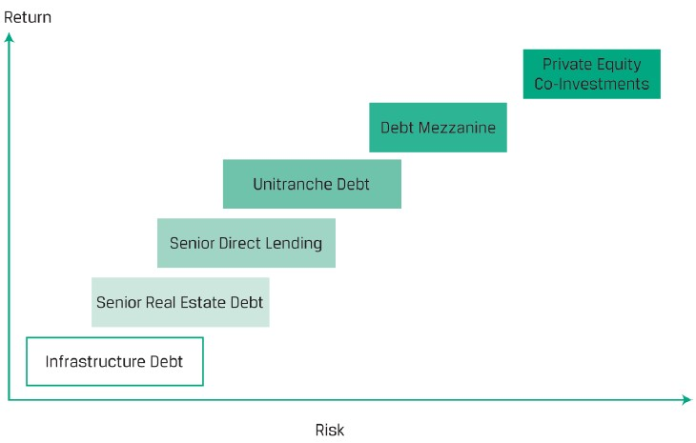
DIVERSIFICATION BENEFITS OF PRIVATe CAPITAL
Private capital risk and return levels by category

Slide 59
DIVERSIFICATION BENEFITS OF PRIVATe CAPITAL
The performance comparison of private capital and public debt and equity may not be appropriate. First, investing in a start-up carries greater risk than investing in a well-established firm. Second, investing in a company in a declining or disintermediated industry is unlikely to offer positive return over longer time horizons. Moreover, performance risk of a continuous investment in public equity and debt can easily be hedged away.
Each private equity fund carries a vintage year, typically defined as the year in which the fund makes its first investment.

Slide 60
DIVERSIFICATION BENEFITS OF PRIVATe CAPITAL
Because of changing business and valuation environments, funds of a certain vintage have the advantage of starting in a low-valuation, low-risk appetite, economic recovery phase and benefit from riding the wave of an economic recovery. Other vintages may be less fortunate and invest the bulk of their capital in a high-valuation environment preceding a market crash or a period of prolonged economic contraction.
Funds seeded during the expanding phase of the business cycle tend to earn excess returns if they fund early-stage companies. Funds seeded during the contracting phase of the business cycle tend to earn excess returns if they fund distressed companies.

Slide 61
Real estate features
Both individuals and institutions invest in real property: either in residential or commercial real estate.
Residential real estate, or the housing market, consists of individual single-family detached homes and multi-family attached units,
Commercial real estate includes primarily office buildings, retail shopping centers, commercial and residential rental properties, and warehouses.

Slide 62
Real estate features
Real Estate Investment structures
 | Equity | Debt
Private | Direct ownership Sole ownership Joint ventures Limited partnerships Indirect ownership Real estate funds Private REITs | Mortgage debt Construction loans Mezzanine debt
Public | Publicly traded shares Construction Operating Development Public REITs UCITS/Mutual funds/ETFs | MBS/CMBS/CMOs Covered bonds Mortgage REITs Mortgage ETFs

Slide 63
Real estate features
 | Advantage | Disadvantage
Direct real estate investment | Control Tax benefits(non cash property depreciation expense, tax deductible interest expense) Diversification | Complexity Need for specialized knowledge Significant capital needs Concentration risk Lack of liquidity
Indirect real estate investment | Elimination of double corporate taxation Greater transparency Buy or sell REITs shares | Higher correlation with the public equity market
The business strategy for equity REITs is simple: Maximize property occupancy rates and rents while minimizing ongoing operating and maintenance expenses to maximize cash income and dividends.
Equity REITs, like other public companies, must report earnings per share based on net income.

Slide 64
Real estate features
Open-end funds, infinite-life(stable return)
Core real estate strategies
well-leased, high-quality commercial and residential real estate in the best markets
Closed-end funds, finite-life(high return)
Core plus real estate strategies
Modest redevelopment or upgrades to lease any vacant space
Value add real estate strategies
larger-scale redevelopment and repositioning of existing assets
Opportunistic real estate strategies
major redevelopment, repurposing of assets

Slide 65
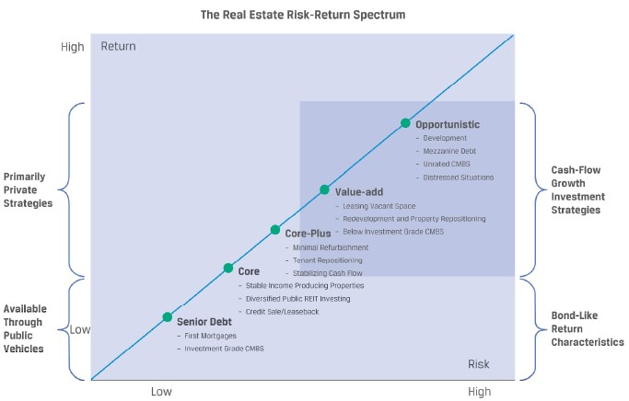
Real estate features

Slide 66
Real estate features
Real estate is uniquely different from other asset classes in several ways:
The initial investment is typically large.
There are multiple types of real estate investment alternatives available.
Real estate is unique and distinct because there aren’t two identical properties.
Private market indexes replicating the performance of real estate are not directly investable.
Diversification across all different types of real estate investment alternatives may be difficult to attain.

Slide 67
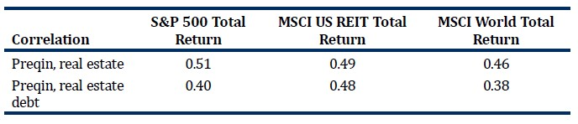
REAL ESTATE INVESTMENT CHARACTERISTICS
Real Estate Investment Diversification Benefits

Slide 68
REAL ESTATE INVESTMENT CHARACTERISTICS
Sources of returns
The return on real estate investments comes from income or asset appreciation or a combination of both.
Investing in real estate can generate either lower-risk, bond-like cash flows from leases or higher-risk, equity-like speculative returns from realizing value from development projects or price appreciation.

Slide 69
REAL ESTATE INVESTMENT CHARACTERISTICS
Akasaka Investment Company established a portfolio of warehouse properties with a total market value of THB3.60 billion. It secured mortgage financing of THB2.61 billion. The terms of the mortgage required Akasaka to maintain a loan-to-value ratio of 0.725. After 18 months, the portfolio value had dropped to THB3.23 billion and the mortgage liability was THB2.35 billion. By how much must Akasaka reduce its mortgage liability to return its LTV back to the required level?

Slide 70
INFRASTRUCTURE INVESTMENT FEATURES
Categories of Infrastructure Investments
Economic infrastructure investment |  |  | Social infrastructure investment
Transportation Assets | Information and communication technology assets | Utility and energy assets
Roads Bridges Tunnels Airports Seaports Railway | Telecommunication Towers Data centers | Electrical grid Potable water production Gas storage and distribution Oil and gas infrastructure | Educational assets Health care assets Social housing Government/ municipal building

Slide 71
INFRASTRUCTURE INVESTMENT FEATURES
Stages of Infrastructure Development
Infrastructure investments can also be categorized by the underlying assets’ stage of development. Typically, we distinguish among greenfield investments, secondary-stage investments, and brownfield investments.
Greenfield investments, developing new assets and new infrastructure, are opportunistic investments.
Brownfield investments expand existing facilities and may involve privatization of public assets or a sale leaseback of completed greenfield projects.
Secondary-stage investments invest in existing infrastructure facilities or fully operational assets that do not require further investment or development over the investment horizon.

Slide 72
INFRASTRUCTURE INVESTMENT FEATURES
Forms of Infrastructure Investment
Infrastructure investments can be direct or indirect.
It requires a large investment and results in both concentration and liquidity risks while the assets are managed and operated.
Investors concerned about liquidity and diversification may choose publicly traded infrastructure securities.

Slide 73
INFRASTRUCTURE INVESTMENT FEATURES
Infrastructure cash flows in most cases arise from contractual payments, such as the following:
Availability payments, which are payments are received to make the facility available
Usage-based payments, such as tolls and fees for using the facilities
“Take-or-pay” arrangements, which obligate buyers to pay a minimum purchase price to sellers for a pre-agreed volume.

Slide 74
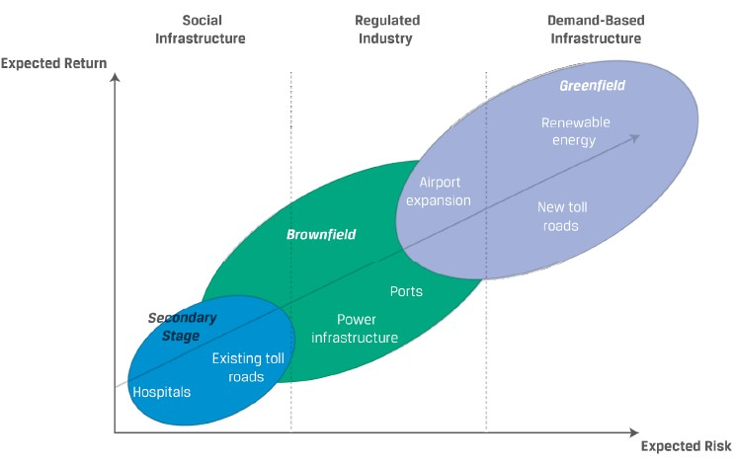
INFRASTRUCTURE INVESTMENT CHARACTERISTICS

Slide 75
INFRASTRUCTURE INVESTMENT CHARACTERISTICS
Infrastructure Diversification Benefits
Correlation | S&P 500 Total Return | S&P Infrastructure Total Return | MSCI US REIT Total Return | MSCI World Total Return
Infrastructure | 0.12 | 0.14 | 0.33 | 0.08
Real estate | 0.51 | 0.39 | 0.49 | 0.46
Natural source | 0.68 | 0.67 | 0.61 | 0.68
Infrastructure investors expect the assets to primarily generate stable long-term cash flows that also adjust for economic growth and inflation and secondarily expect capital appreciation, depending on the type and timing of their investment. Because infrastructure investments typically support services that face inelastic demand and/or benefit from high barriers to entry, generate steady cash returns, and have a longer life cycle.

Slide 76
NATURAL RESOURCES INVESTMENT FEATURES
Farmland, timberland, and raw land
Plants and animals (soft commodities);
Energy and minerals (hard commodities);

Slide 77
NATURAL RESOURCES INVESTMENT FEATURES
 | Raw land | Farmland | Timberland
Return drivers | Price of land | Harvest quantities Commodity prices Price of land | Biological growth Harvest quantities Lumber prices Price of land
Source of direct revenue | Price appreciation Lease revenue | Sale of crops and other agricultural products Price appreciation Lease revenue | Sale of trees, wood, and other timber products Price appreciation Lease revenue
Value | Physical location | Physical location Growth cycle Soil quality | Physical location Quality of timber Phase in timber production
Main risk | Best alternative use | Weather factors and climate change Biological factors, diseases
Owners | Mostly institutional, some individual | Mostly individuals, some institutional | Mostly institutional, some individual
Ownership structure | Direct ownership, partnership | Direct ownership, partnership, REIT | Direct ownership, partnership, REIT, TIMO

Slide 78
NATURAL RESOURCES INVESTMENT FEATURES
Sources of return include expected price appreciation over time and cash flows, such as farm lease payments (for an owner), farm operating income (owner-operator), farm timberland income, and mineral and drilling royalties.
Farmland, timberland, and raw land are similar to real estate investments in that they are unique, illiquid assets with distinct geographic location and features.
The first difference is that unlike real estate, there is limited or no focus on the physical improvements to the land.
Many large institutional investors that do not have this expertise rely on timberland investment management organizations (TIMOs), entities that support institutional investors by managing their investments in timberland by analyzing and acquiring suitable timberland holdings.

Slide 79
NATURAL RESOURCES INVESTMENT FEATURES
There are fewer financing alternatives for farmland, timberland, and raw land. Often these investments are financed through bank loans or direct, private debt investment.
Finally, these are illiquid assets that have a limited number of potential buyers and sellers due to the specialized knowledge and capital needed for these transactions.
There is an indirect benefit from farmland and timberland investments: These natural resources consume carbon as part of the plant life cycle and their value comes not just from the harvest but also from the carbon offset to human activity.

Slide 80
COMMODITY INVESTMENT FORMS
Commodity Investment Features
Commodities themselves do not generate cash flows but usually incur costs.
Investors seek to benefit from commodity price appreciation.
Moreover, governments have realized the importance of controlling natural resources and taken an increasingly important role in natural resource markets.
Environmental factors play a direct role in natural resource investments.

Slide 81
COMMODITY INVESTMENT FORMS
Distinguishing Characteristics of Commodity Investments
Commodities may be further classified by physical location and grade or quality.
The majority of commodity investing is implemented through derivatives.
Commodity exposure can be achieved through means other than direct investment in commodities or commodity derivatives, including the following
Exchange-traded products. ETPs, either funds (ETFs) or notes (ETNs)
Investing with commodity trading advisers. CTAs
Specialized funds investing in specific commodity sectors

Slide 82
COMMODITY INVESTMENT FORMS
Basics of Commodity Pricing
F₀(T)=S₀*e^{(r+c-i)T}
where c is the cost of carry, i is the convenience yield, r is the risk-free rate, and T is the time to the expiration of the forward contract.
When the spot price is above the forward prices, there is backwardation.
When the spot price is below the forward prices, there is contango.

Slide 83
NATURAL RESOURCE INVESTMENT RISK,RETURN, AND DIVERSIFICATION
 | Global stocks | Global bonds | Commodities
Annualized return | 6.89% | 4.39% | 7.81%
Annualized standard deviation | 16.76% | 6.14% | 24.39%
Worst calendar year | -43.54% | -5.17% | -42.80%
Best calendar year | 31.62% | 19.66% | 50.30%

Slide 84
NATURAL RESOURCE INVESTMENT RISK,RETURN, AND DIVERSIFICATION
 | Timberland | Farmland
Annualized return | 8.69% | 10.95%
Annualized standard deviation | 6.76% | 5.88%
Worst calendar year | -5.30% | 2.02%
Best calendar year | 22.36% | 33.90%

Slide 85
NATURAL RESOURCE INVESTMENT RISK,RETURN, AND DIVERSIFICATION
 | Global stock | Global bonds | Commodities | Farmland | timberland
Higher inflation | 9.40% | 5.66% | 22.87% | 12.78% | 10.44%
Lower inflation | 5.43% | 4.18% | -9.26% | 9.85% | 5.70%

Slide 86
NATURAL RESOURCE INVESTMENT RISK,RETURN, AND DIVERSIFICATION
 | Farmland | Timberland | Commodity | Global bond | Global stock | inflation
Farmland | 1
Timberland | 0.4352 | 1
Commodity | -0.1276 | -0.1180 | 1
Global bond | -0.0209 | -0.0047 | 0.0006 | 1
Global stock | 0.1221 | 0.0215 | 0.4106 | 0.1465 | 1
Inflation | -0.1724 | 0.0166 | 0.5404 | -0.2180 | 0.0954 | 1

Slide 87
HEDGE FUND INVESTMENT FEATURES
As private investment vehicles, hedge funds are distinguished by their investment approach rather than the underlying investments.
Hedge funds normally apply common principles that seemingly increase portfolio risk, such as borrowing money to invest, using leverage (derivatives), and short selling.
There are funds of hedge funds that create a diversified portfolio of hedge funds. These vehicles are attractive to smaller investors without the resources to select individual hedge funds and build a portfolio of them.

Slide 88
HEDGE FUND INVESTMENT FEATURES
Distinguishing Characteristics of Hedge Fund Investments
1. Less legal and regulatory constraints
2. Flexible mandates permitting the use of shorting and derivatives
3. A larger investment universe on which to focus
4. Aggressive investment styles that allow concentrated positions in securities offering exposure to credit, volatility, and liquidity risk premiums
5. Relatively liberal use of leverage
6. Liquidity constraints that include lockups and liquidity gates
7. Relatively high fee structures involving management and incentive fees

Slide 89
HEDGE FUND INVESTMENT FEATURES
Hedge funds are typically classified by strategy
equity hedge funds,
event-driven hedge funds,
relative value hedge funds,
opportunistic hedge funds,
multi-manager hedge funds

Slide 90
HEDGE FUND INVESTMENT FEATURES
Equity Hedge Fund Strategies
Fundamental long/short
Fundamental growth
Fundamental value
Short biased
Market neutral

Slide 91
HEDGE FUND INVESTMENT FEATURES
Event-Driven Strategies
Merger arbitrage
Distressed/restructuring
Special situations
Activist

Slide 92
HEDGE FUND INVESTMENT FEATURES
Relative Value Strategies
Convertible bond arbitrage
Fixed income (general)
Fixed income (asset backed, mortgage backed, and high yield)
Multi-strategy

Slide 93
HEDGE FUND INVESTMENT FEATURES
Opportunistic Strategies
Macro strategy
Managed futures

